Slide 1
July 29, 2019
Journal club

Slide 2
Methods
Luo X, Yang C, Wei Y. Detection of cell-type-specific risk-CpG sites in epigenome-wide association studies. Nat Commun. 2019;10(1):3113. Published 2019 Jul 15.
A method for improving power of EWAS in complex tissues.
Reference EWAS model essentially adjusts for cell type in order to identify an ‘aggregate’ effect across all cell types. It fits the following model for each CpG site:
O_{i} = observed methylation for individual i at the CpG site
T = effects of each phenotype on methylation
x_{i} = phenotype values for individual i
M = cell-type specific methylation levels
p_{i} = cell-type proportions for individual i

Slide 3
EWAS for cell-type specific effects
Parameters estimated by a generalized expectation-maximization algorithm.
Cell-type proportions are initially estimated using Houseman’s algorithm.
Cell-type specific baseline methylation profiles are initially estimated by simple linear regression.
i = individual (n)
j = CpG site
l = phenotype
k = cell type
(pBIC used to select ‘optimal’ K)
Two-layer hierarchical model
3 cell types

Slide 4
Performance of HIRE under simulations
A few associations | No associations

Slide 5
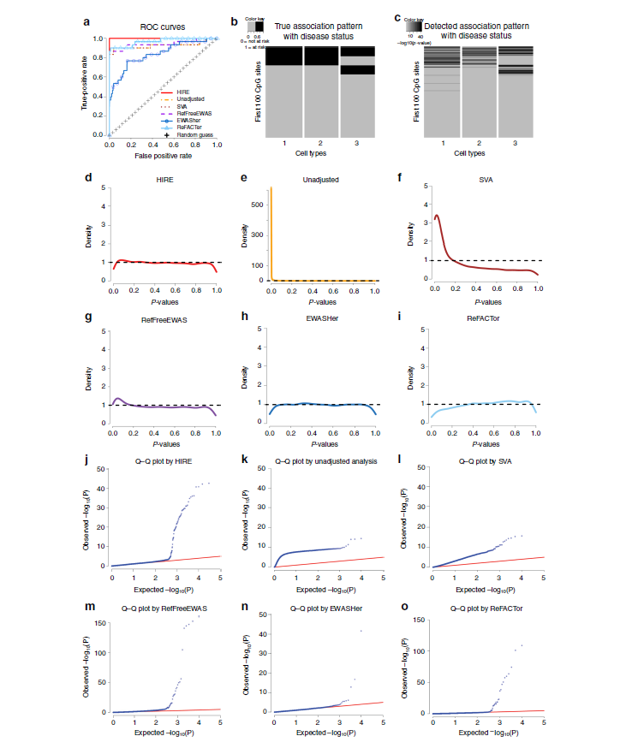
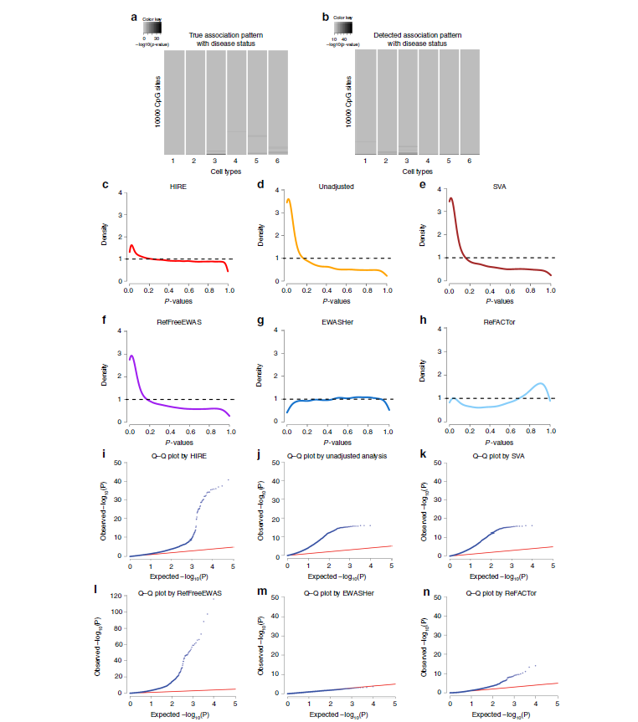
Simulated data with true associations
Rheumatoid arthritis whole blood dataset (cases vs controls)
1
1=CD4+
2,4 = Neutrophils
3 = ? (has the strongest associations)

Slide 6
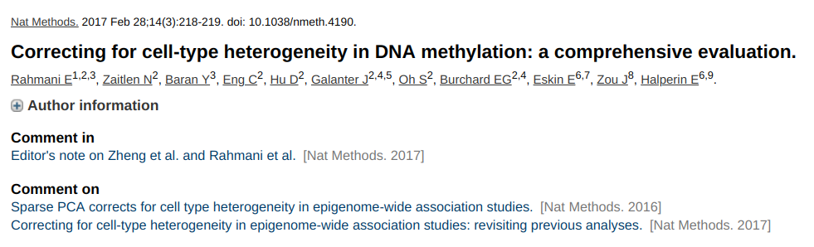
Methods
Thompson M, Chen ZJ, Rahmani E, Halperin E. CONFINED: distinguishing biological from technical sources of variation by leveraging multiple methylation datasets. Genome Biol. 2019 Jul 12;20(1):138.
"a reference-free method based on sparse canonical correlation analysis to separate the biological from technical sources of variability"
"based on the observation that the same biological sources of variation typically affect different studies that are performed under the same conditions (e.g., on the same tissue type), while technical variability is study-specific"

Slide 7
Roles for specific cell types
Watanabe et al. Genetic mapping of cell type specificity for complex traits. Nat Commun. 2019 Jul 19;10(1):3222.
For some traits, the GWAS 'hits' are linked to genes enriched among genes with expression patterns specific to a cell type. This indicates that the cell type has a critical role in the trait.
This approach has been applied in specific instances.
The authors provide tools and a reference dataset to automate these analyses.
43 publicly available scRNA-seq datasets
"3-step workflow with conditional analyses within and between datasets ... to uncover associations of traits with cell types. Applied this method to 26 traits ..."

Slide 8
eQTLs and differentation
Strober BJ, Elorbany R, Rhodes K, Krishnan N, Tayeb K, Battle A, Gilad Y. Dynamic genetic regulation of gene expression during cellular differentiation. Science. 2019 Jun 28;364(6447):1287-1290.
19 Yoruban individuals
induced pluripotent stem cells
16 time points during differentiation into cardiomyocytes

Slide 9
Somatic mutations
Park, Jun Sung et al. “Brain somatic mutations observed in Alzheimer's disease associated with aging and dysregulation of tau phosphorylation.” Nature communications vol. 10,1 3090. 12 Jul. 2019, doi:10.1038/s41467-019-11000-7
"deep whole-exome sequencing (average read depth 584×) in 111 postmortem hippocampal formation and matched blood samples from 52 patients with AD and 11 individuals not affected by AD."
The amount of genetic variation increases with age in the brain but at 4.8-fold slower rate than in blood.
There is enrichment for variation accumulating near genes "known to contribute to hyperphosphorylation of tau".

Slide 10
DNA in blood plasma
Lam et al. Methylation analysis of plasma DNA informs etiologies of Epstein-Barr virus-associated diseases. Nat Commun. 2019 Jul 22;10(1):3256.
The fractional concentration and size of EBV DNA from blood plasma can be used to identify individuals with nasopharyngeal carcinoma.
Performance can be improved by additionally considering DNA methylation patterns in EBV DNA (positive predictive value increased by 35.1%).

Slide 11
EWAS
Shiau, et al. Distinct epigenetic profiles in children with perinatally-acquired HIV on antiretroviral therapy. Sci Rep. 2019 Jul 19;9(1):10495.
Whole blood from 120 HIV-infected children on antiretroviral therapy (ART)
60 frequency age-matched HIV-uninfected children aged 4-9 years
Johannesburg, South Africa
1,309 differentially-methylated CpG sites
Hillary RF, …, McRae AF, Visscher PM, Deary IJ, Marioni RE. Genome and epigenome wide studies of neurological protein biomarkers in the Lothian Birth Cohort 1936. Nat Commun. 2019 Jul 18;10(1):3160.
GWAS and EWAS
92 neurological proteins in plasma
n = 750 healthy older adults)
41 independent genetic loci for 33 proteins
26 CpG sites for 9 proteins
causal relationships between protein levels and
gene expression (DRAXIN, MDGA1 and KYNU)
and DNA methylation profiles (MATN3, MDGA1 and NEP)

Slide 12
EWAS
Kazmi et al. Hypertensive Disorders of Pregnancy and DNA Methylation in Newborns. Hypertension. 2019 Aug;74(2):375-383.
maternal HDP (10 cohorts; n=5242 [cases=476])
preeclampsia (3 cohorts; n=2219 [cases=135])
cord blood
43 sites HDP
26 sites preeclampsi
"In longitudinal analyses conducted in 1 study (n=108 HDP cases; 550 controls), there were similar changes in DNA methylation in offspring of those with and without HDP up to adolescence."
Santos et al. Epigenome-wide DNA methylation in placentas from preterm infants: association with maternal socioeconomic status. Epigenetics. 2019 Aug;14(8):751-765.
SEP factors: less than college education, single marital status, food and nutritional service assistance, and public health insurance
426 placentas from a sample of infants born < 28 weeks of gestation from the Extremely Low Gestational Age Newborn cohort
Associations at 33 CpG sites

Slide 13
EWAS in target tissue
Guo K, Elzinga S, Eid S, Figueroa-Romero C, Hinder LM, Pacut C, Feldman EL, Hur J. Genome-wide DNA methylation profiling of human diabetic peripheral neuropathy in subjects with type 2 diabetes mellitus. Epigenetics. 2019 Aug;14(8):766-779.
human sural nerve biopsies
significant nerve regeneration (regenerators) vs significant nerve degeneration (degenerators)
reduced representation bisulfite sequencing
3,460 differentially methylated CpG dinucleotides
N=6v6
Gaiteri, et al. Gene expression and DNA methylation are extensively coordinated with MRI-based brain microstructural characteristics. Brain Imaging Behav. 2019 Aug;13(4):963-972.
postmortem neuroimaging of microstructure by MRI
gene expression and DNA methylation
222 deeply-phenotyped persons in a longitudinal aging cohort
"hundreds of genes and methylation at thousands of loci are related"

Slide 14
EWAS of hydroxymethylation
Ringh, Mikael V. et al. Tobacco smoking induces changes in true DNA methylation, hydroxymethylation and gene expression in bronchoalveolar lavage cells, EBioMedicine, 2019 Jul 11. pii: S2352-3964(19)30441-4.
"We identified 1667 total 5mC + 5hmC, 1756 5mC and 67 5hmC differentially methylated positions (DMPs) between smokers and non-smokers (FDR-adjusted P <.05, absolute Δβ >0.15)."
Most were novel for smoking differences.
Directions of 5mC and 5hmC differences indicated that smoking demethylated DNA via conversion to 5hmC.

Slide 15
Study registration
Groene SG, Todtenhaupt P, van Zwet EW, van Pel M, Berkhout RJM, Haak MC, Roest AAW, Lopriore E, van Klink JMM, Heijmans BT. TwinLIFE: The Twin Longitudinal Investigation of FEtal Discordance. Twin Res Hum Genet. 2019 Jul 25:1-6.
DNA methylation of mesenchymal stromal cells isolated from cord
follow up the MC twins for growth, cardiovascular and neurodevelopmental outcomes during childhood
100 MC twin pairs
Ek, et al. A randomized controlled trial for overweight and obesity in preschoolers: the More and Less Europe study - an intervention within the STOP project. BMC Public Health. 2019 Jul 15;19(1):945.
"A two-arm, parallel design randomized controlled trial" for obesity intervention
300 2-to 6-year-old children with overweight and obesity
Intervention: 10-weekly group sessions which focus on evidence-based parenting practices followed by "MINISTOP application for 6-months to support healthy eating and physical activity behaviors ..."
Outcomes considered after 9 months, including DNA methylation.

