Slide 1
August 5, 2019
Journal club

Slide 2
EWAS
Shiau, et al. Distinct epigenetic profiles in children with perinatally-acquired HIV on antiretroviral therapy. Sci Rep. 2019 Jul 19;9(1):10495.
Whole blood from 120 HIV-infected children on antiretroviral therapy (ART)
60 frequency age-matched HIV-uninfected children aged 4-9 years
Johannesburg, South Africa
1,309 differentially-methylated CpG sites
Hillary RF, …, McRae AF, Visscher PM, Deary IJ, Marioni RE. Genome and epigenome wide studies of neurological protein biomarkers in the Lothian Birth Cohort 1936. Nat Commun. 2019 Jul 18;10(1):3160.
GWAS and EWAS
92 neurological proteins in plasma
n = 750 healthy older adults)
41 independent genetic loci for 33 proteins
26 CpG sites for 9 proteins
causal relationships between protein levels and
gene expression (DRAXIN, MDGA1 and KYNU)
and DNA methylation profiles (MATN3, MDGA1 and NEP)

Slide 3
EWAS
Santos et al. Epigenome-wide DNA methylation in placentas from preterm infants: association with maternal socioeconomic status. Epigenetics. 2019 Aug;14(8):751-765.
SEP factors: less than college education, single marital status, food and nutritional service assistance, and public health insurance
426 placentas from a sample of infants born < 28 weeks of gestation from the Extremely Low Gestational Age Newborn cohort
Associations at 33 CpG sites
Surkan et al. Can social support during pregnancy affect maternal DNA methylation? Findings from a cohort of African-Americans. Pediatr Res. 2019 Jul 26.
n=250
blood collected after delivery
a few associations with lack of support from the baby's father and from family and friends
Massrali et al. Integrated genetic and methylomic analyses identify shared biology between autism and autistic traits. Mol Autism. 2019 Jul 17;10:31.
708 cord blood
traits at age 8
no associations observed with autism or autism traits or concordance between the two
concordance was observed with autism EWAS in brain

Slide 4
EWAS in target tissue
Gaiteri, et al. Gene expression and DNA methylation are extensively coordinated with MRI-based brain microstructural characteristics. Brain Imaging Behav. 2019 Aug;13(4):963-972.
postmortem neuroimaging of microstructure by MRI
gene expression and DNA methylation
222 deeply-phenotyped persons in a longitudinal aging cohort
"hundreds of genes and methylation at thousands of loci are related"
Mehta, et al. DNA methylation from germline cells in veterans with PTSD. J Psychiatr Res. 2019 Sep;116:42-50. doi: 10.1016/j.jpsychires.2019.06.001. Epub 2019 Jun 6.
299 trauma-exposed Vietnam veterans
In sperm 3 CpG sites associated with PTSD [19 vs 19]
In peripheral blood [48 vs 48] but none were genome-wide significant and the overlap with sperm was small (using nominal p < 0.05).

Slide 5
EWAS in target tissue
Gaine et al. Differentially methylated regions in bipolar disorder and suicide. Am J Med Genet B Neuropsychiatr Genet. 2019 Jul 27.
SureSelectXT system, Methyl-Seq
prefrontal cortex in 50 BD individuals and 31 nonpsychiatric controls
one DMR located in ARHGEF38, 23.4% less methylated in BDS
Richter et al. A combined epigenome- and transcriptome-wide association study of the oral masticatory mucosa assigns CYP1B1 a central role for epithelial health in smokers. Clin Epigenetics. 2019 Jul 22;11(1):105.
18 current smokers and 21 never smokers
EPIC and RNA-seq
9 CpGs associated with smoking status including CYP1B1, AHRR.
61 CpG sites associated with quantity of smoking including CYP1B1.
Increased expression of CYP1B1 and 13 other transcripts in smokers. Six transcripts were downregulated.
No differential expression was observed for AHRR.

Slide 6
EWAS of hydroxymethylation
Ringh, Mikael V. et al. Tobacco smoking induces changes in true DNA methylation, hydroxymethylation and gene expression in bronchoalveolar lavage cells, EBioMedicine, 2019 Jul 11. pii: S2352-3964(19)30441-4.
"We identified 1667 total 5mC + 5hmC, 1756 5mC and 67 5hmC differentially methylated positions (DMPs) between smokers and non-smokers (FDR-adjusted P <.05, absolute Δβ >0.15)."
Most were novel for smoking differences.
Directions of 5mC and 5hmC differences indicated that smoking demethylated DNA via conversion to 5hmC.

Slide 7
Study registration
Groene SG, Todtenhaupt P, van Zwet EW, van Pel M, Berkhout RJM, Haak MC, Roest AAW, Lopriore E, van Klink JMM, Heijmans BT. TwinLIFE: The Twin Longitudinal Investigation of FEtal Discordance. Twin Res Hum Genet. 2019 Jul 25:1-6.
DNA methylation of mesenchymal stromal cells isolated from cord
follow up the MC twins for growth, cardiovascular and neurodevelopmental outcomes during childhood
100 MC twin pairs
Ek, et al. A randomized controlled trial for overweight and obesity in preschoolers: the More and Less Europe study - an intervention within the STOP project. BMC Public Health. 2019 Jul 15;19(1):945.
"A two-arm, parallel design randomized controlled trial" for obesity intervention
300 2-to 6-year-old children with overweight and obesity
Intervention: 10-weekly group sessions which focus on evidence-based parenting practices followed by "MINISTOP application for 6-months to support healthy eating and physical activity behaviors ..."
Outcomes considered after 9 months, including DNA methylation.

Slide 8
Mechanism
Komljenovic, et al. Cross-species functional modules link proteostasis to human normal aging. PLoS Comput Biol. 2019 Jul 3;15(7):e1007162.
"we integrate evolutionary and functional information of normal aging across human and model organisms at three levels:
gene-level,
process-level, and
network-level."
"show proteostasis to be conserved in normal aging."
"we find that mechanisms related to protein quality control network are enriched for genes harboring genetic variants associated with 22 age-related human traits and associated to caloric restriction."

Slide 9
Methods
Levy JJ, Titus AJ, Salas LA, Christensen BC. PyMethylProcess - convenient high-throughput preprocessing workflow for DNA methylation data. Bioinformatics. 2019 Aug 1. pii: btz594. doi: 10.1093/bioinformatics/btz594.
Python program that combines multiple R packages together to allow analysis of Illumina methylation bead chips (includes for example minfi and meffil).
Purpose is to make DNA methylation datasets available for Python visualization and machine learning tools.

Slide 10
Rahmani E, Schweiger R, Rhead B, Criswell LA, Barcellos LF, Eskin E, Rosset S, Sankararaman S, Halperin E. Cell-type-specific resolution epigenetics without the need for cell sorting or single-cell biology. Nat Commun. 2019 Jul 31;10(1):3417. doi: 10.1038/s41467-019-11052-9.
Remember Luo et al. Detection of cell-type-specific risk-CpG sites in epigenome-wide association studies Nat Commun. 2019 ?
Here is another method to identify cell-type specific associations in complex tissues.
"Tensor Composition Analysis (TCA) ... emulates the scenario in which each individual in the bulk data has been profiled with a single-cell resolution and then signals were aggregated in each cell population of the individual separately."
"TCA can most naturally be described as a generalization of matrix factorization"

Slide 11
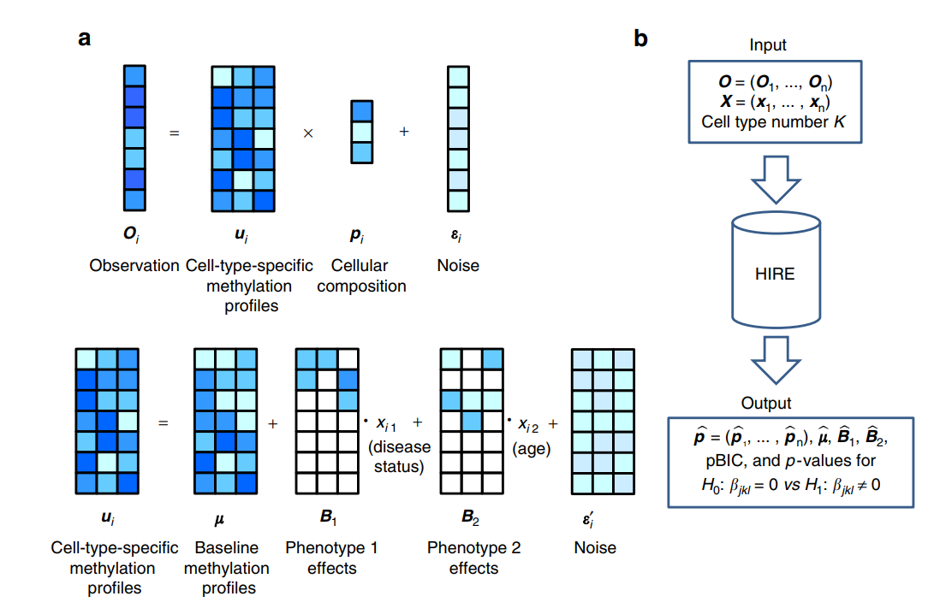
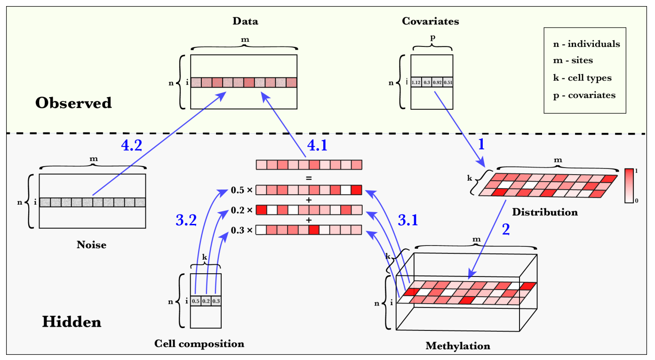
Luo et al.
Rahmani et al.
"For completeness, we verified that TCA performs substantially better than the method by Luo et al. (Supplementary Figs. 13 and 14; see 'Methods')"

Slide 12
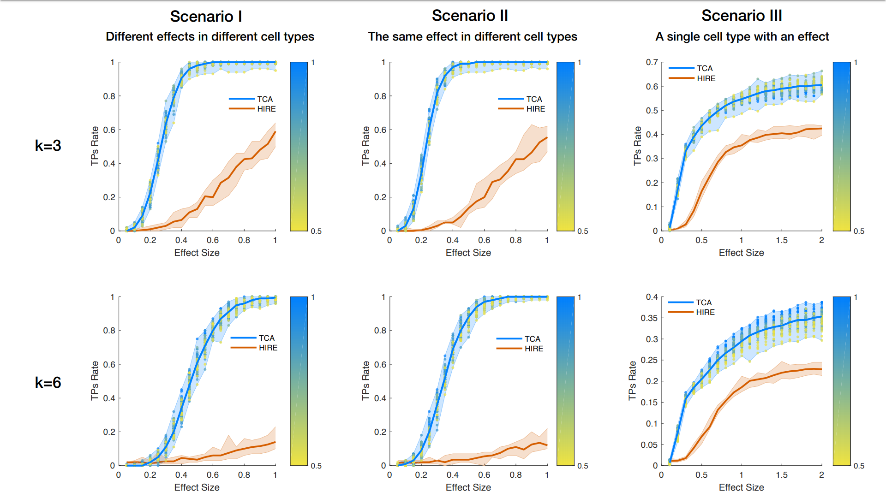
Supplementary Fig 13

Slide 13
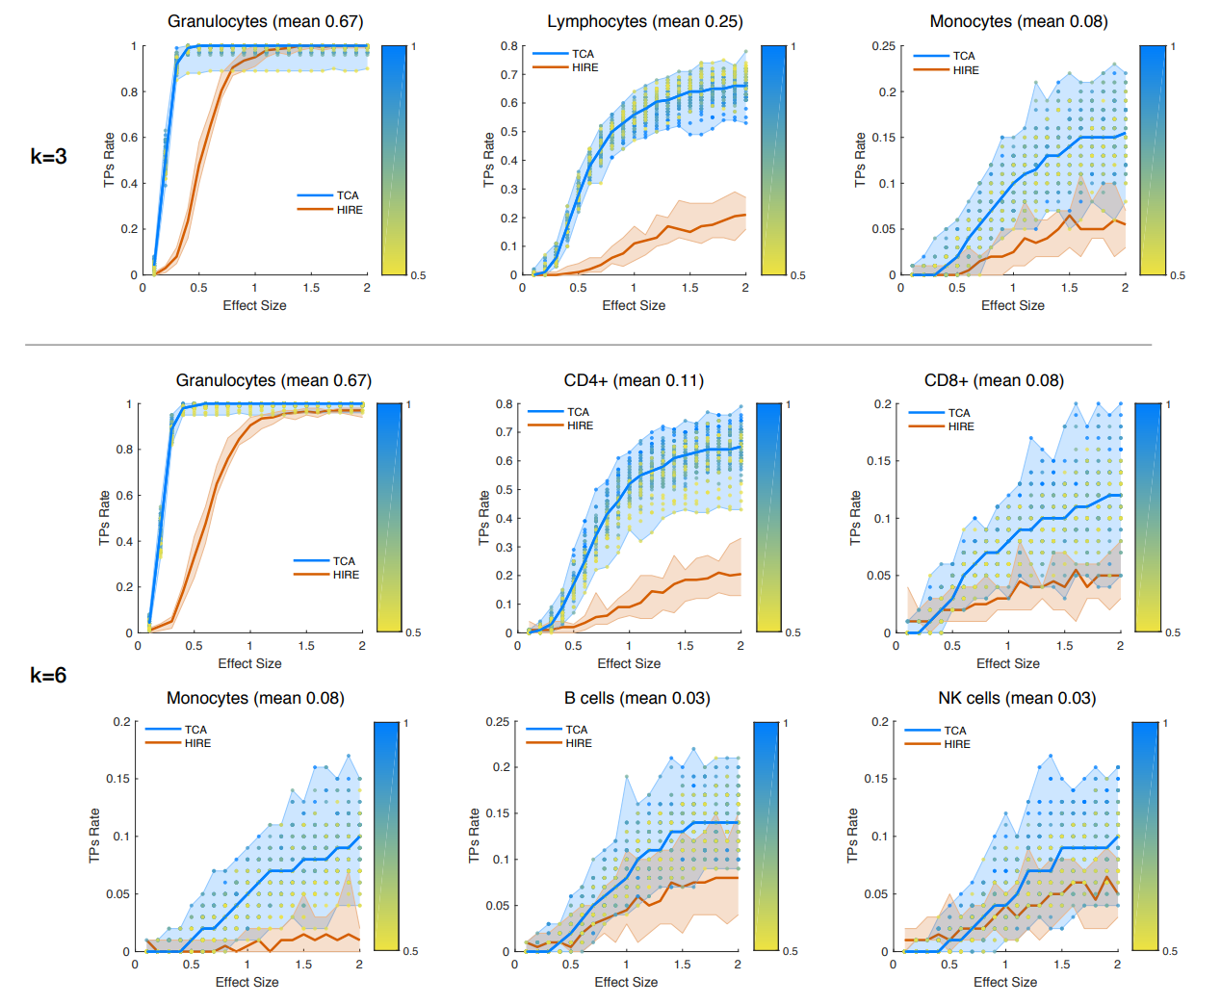
Supplementary Fig 14
"only a single effect size for a single cell type exists"

