Slide 1
Journal club August 12, 2019

Slide 2
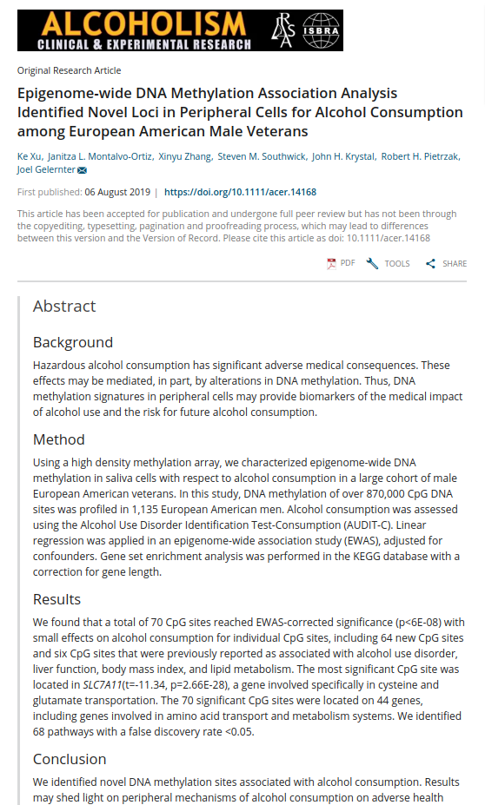
EWAS
n=1135
DNAm (EPIC array) of saliva
70 CpG site associations with AUDIT-C
6 previously reported

Slide 3
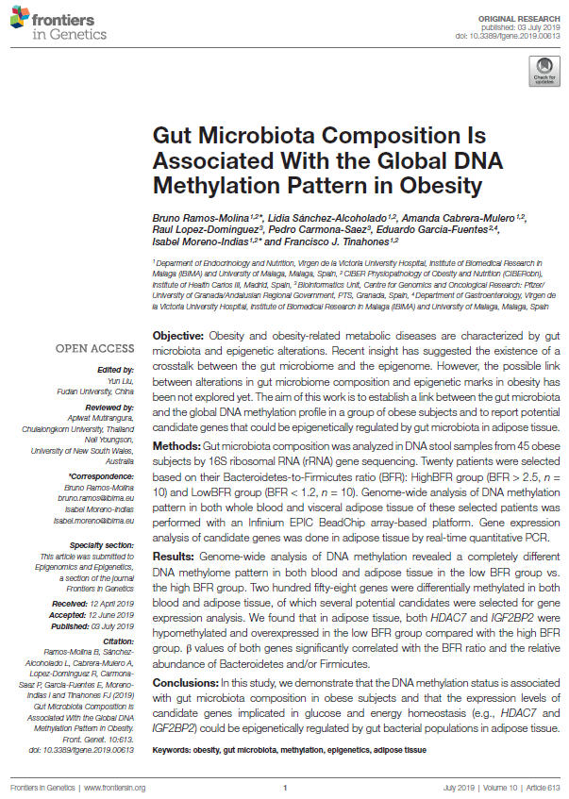
EWAS
"Twenty patients were selected based on their Bacteroidetes-to-Firmicutes ratio (BFR):
HighBFR group (BFR > 2.5, n = 10) and
LowBFR group (BFR < 1.2, n = 10).
Genome-wide analysis of DNA methylation pattern in both whole blood and visceral adipose tissue of these selected patients was performed … 258 genes differentially methylated in both."

Slide 4
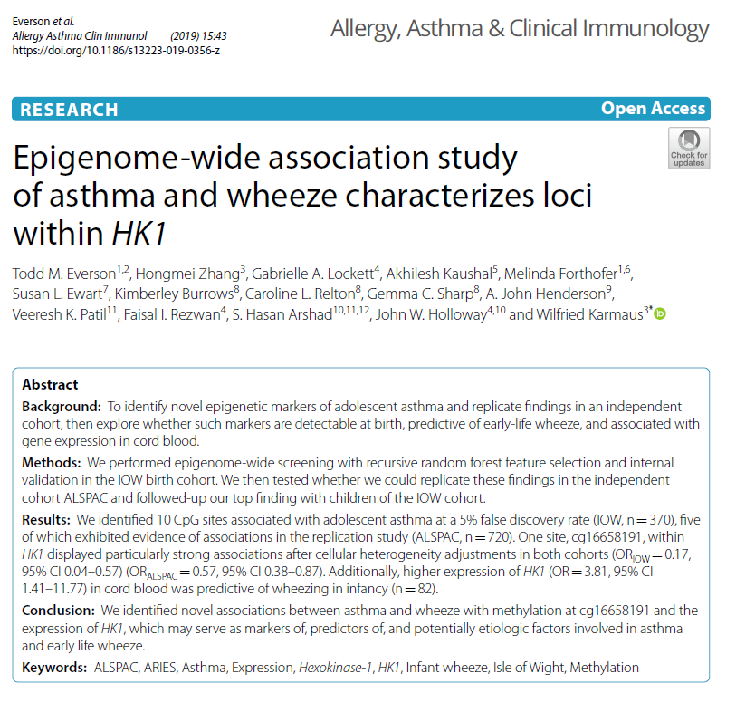
EWAS
"10 CpG sites associated with adolescent asthma"
in n=370 adolescents
of which 5 replicated in ALSPAC (age 17).
Gene expression of one linked gene (HK1) was predictive in cord blood of wheezing in infancy.

Slide 5
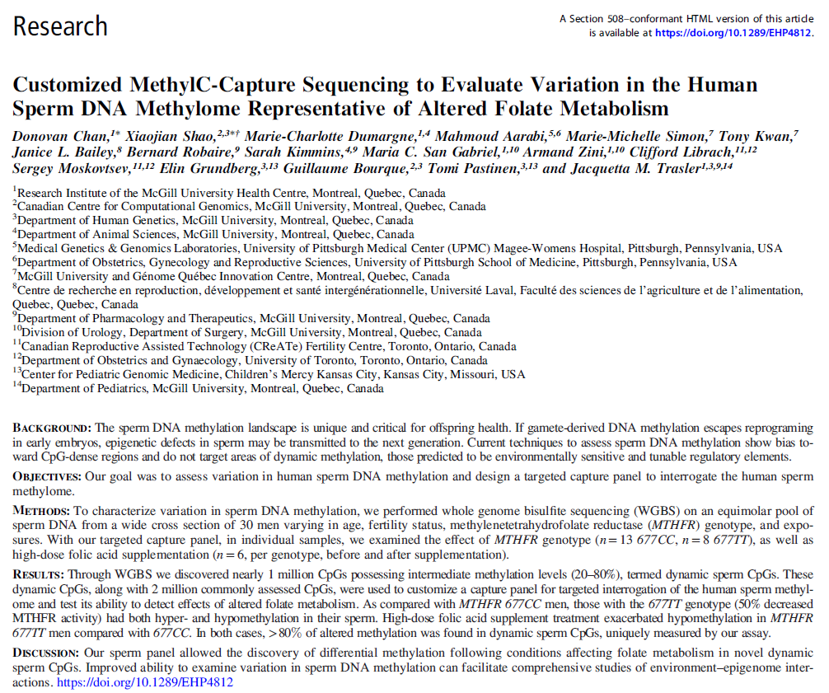
EWAS
Performed WGBS on sperm
Found 1 million CpG sites with intermediate levels of methylation ('dynamic sperm CpGs')
Investigated a panel of CpG sites (3 million) in sperm of 30 men.
Observed effects of MTHFR genotype and folate supplementation.

Slide 6
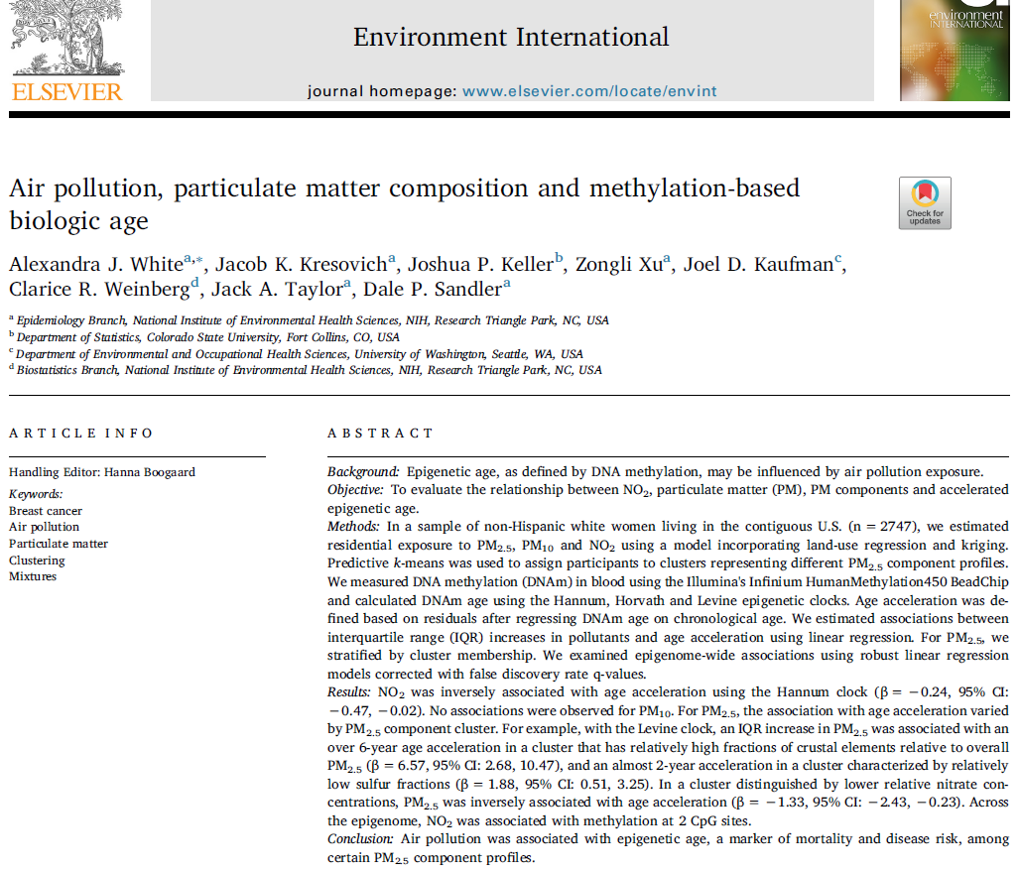
DNAm age
n = 2747 women
Estimated residential exposure to PM2.5, PM10 and NO2
Hannum, Horvath and Levine epigenetic clocks evaluated
NO2 associated with Hannum age acceleration
DNAm age accelerations varied by PM2.5 component cluster.

Slide 7
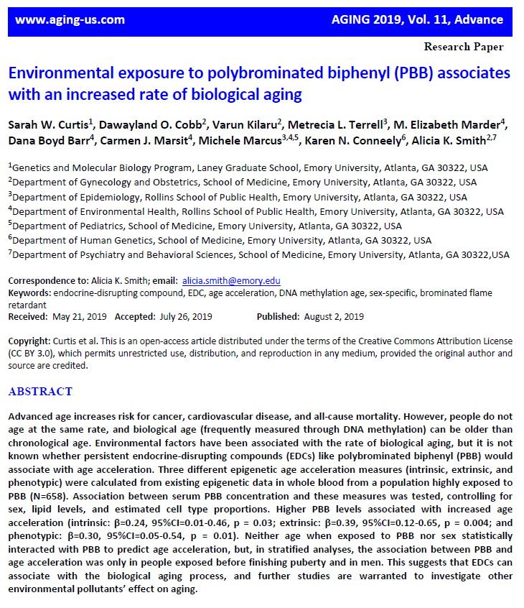
DNAm age
Population highly exposed to PBB (N=658)
"Higher PBB levels associated with increased age acceleration":
- intrinsic
- extrinsic
- phenotypic

Slide 8
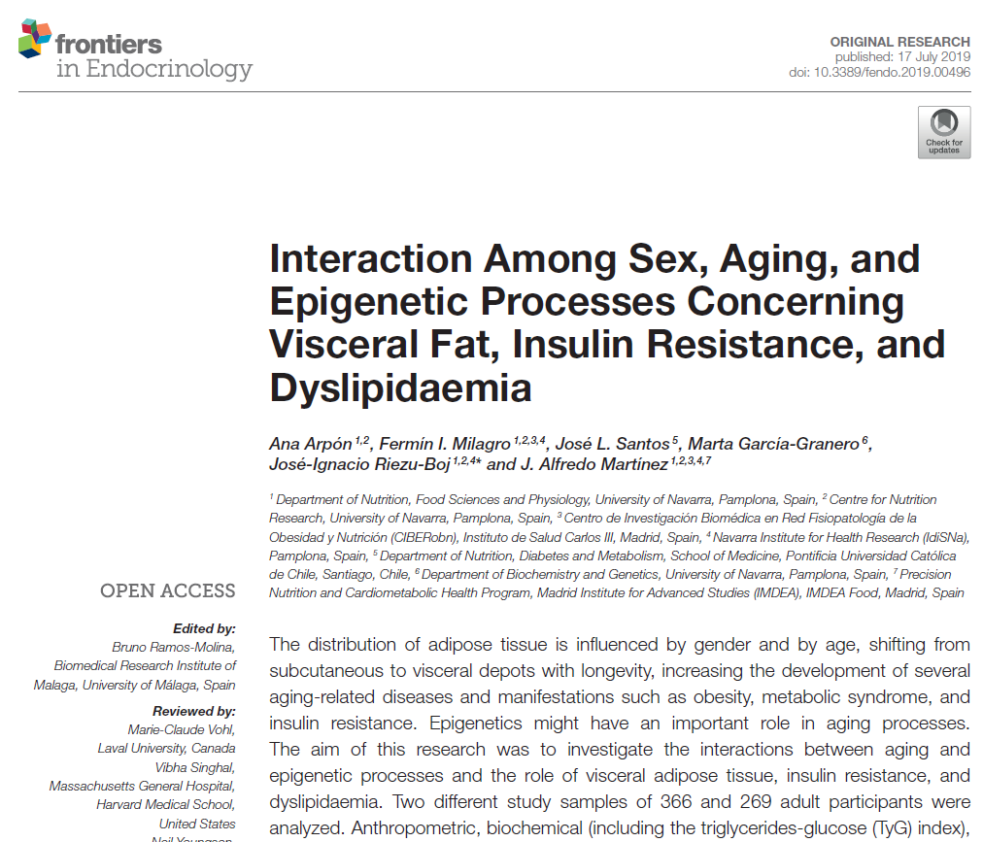
DNAm age
N=366 adults
"Anthropometric, biochemical (including the triglycerides-glucose (TyG) index), and blood pressure measurements were assessed"
N=269
"Body composition measurements by Dual-energy X-ray absorptiometry (DXA)"
DNAm of peripheral white blood cells used to generate estimates of DNAm age
Observed sex-specific associations with DNAm age acceleration.

Slide 9
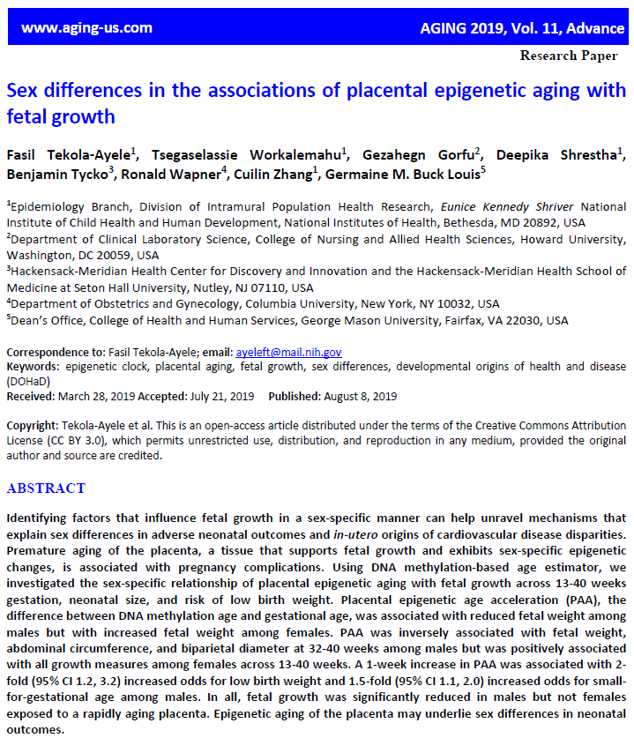
DNAm age
"PAA (placenta DNAm age acceleration) was
inversely associated with
- fetal weight,
- abdominal circumference, and
- biparietal diameter at 32-40 weeks among males (n=152)
… but was positively associated with all growth measures among females (n=149) across 13-40 weeks."

Slide 10
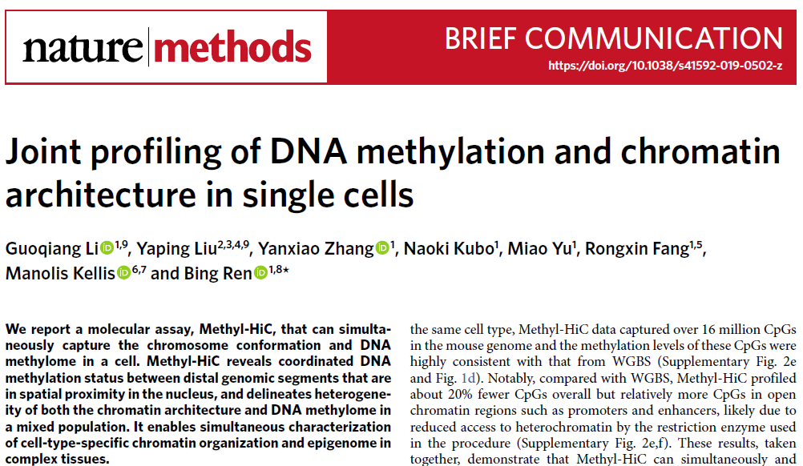
Methods

Slide 11
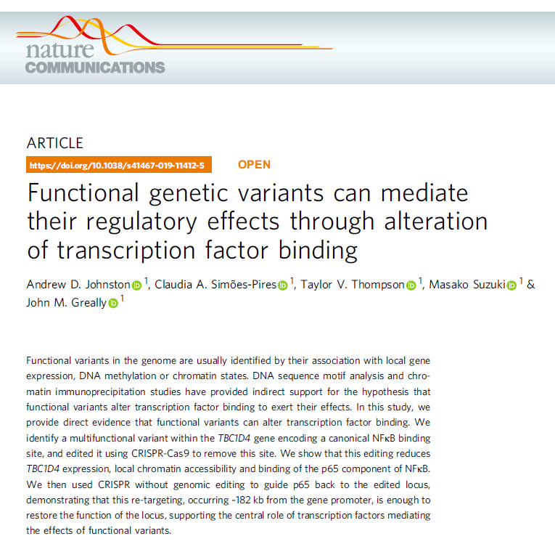
Gene regulation
Used CRISPR-Cas9 to edit a binding site and show:
- reduced TF binding and
- changes gene expression
- changes in chromatin.

Slide 12
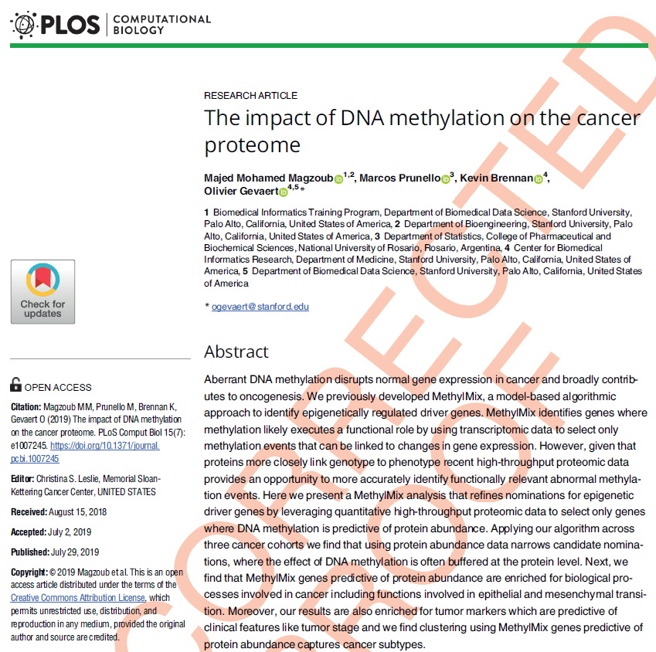
Methods
"refines nominations for epigenetic driver genes by:
leveraging quantitative high-throughput proteomic data to select only genes where DNA methylation is predictive of protein abundance."
I would be interesting to know how protein-methylation associations in cancer differ from those in blood … I would imagine quite a lot given that eQTLs are differentiate-stage-specific.

Slide 13
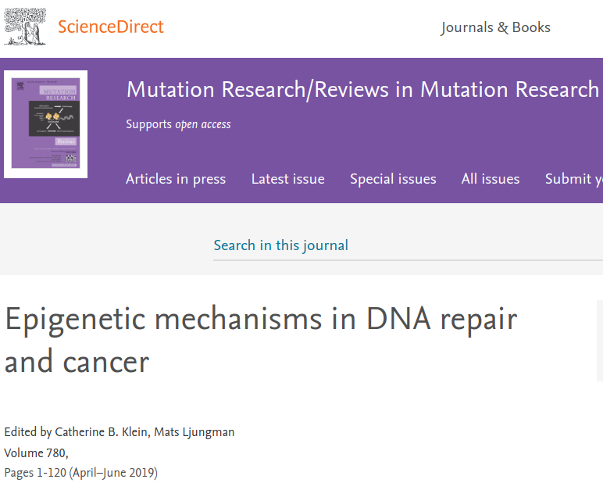
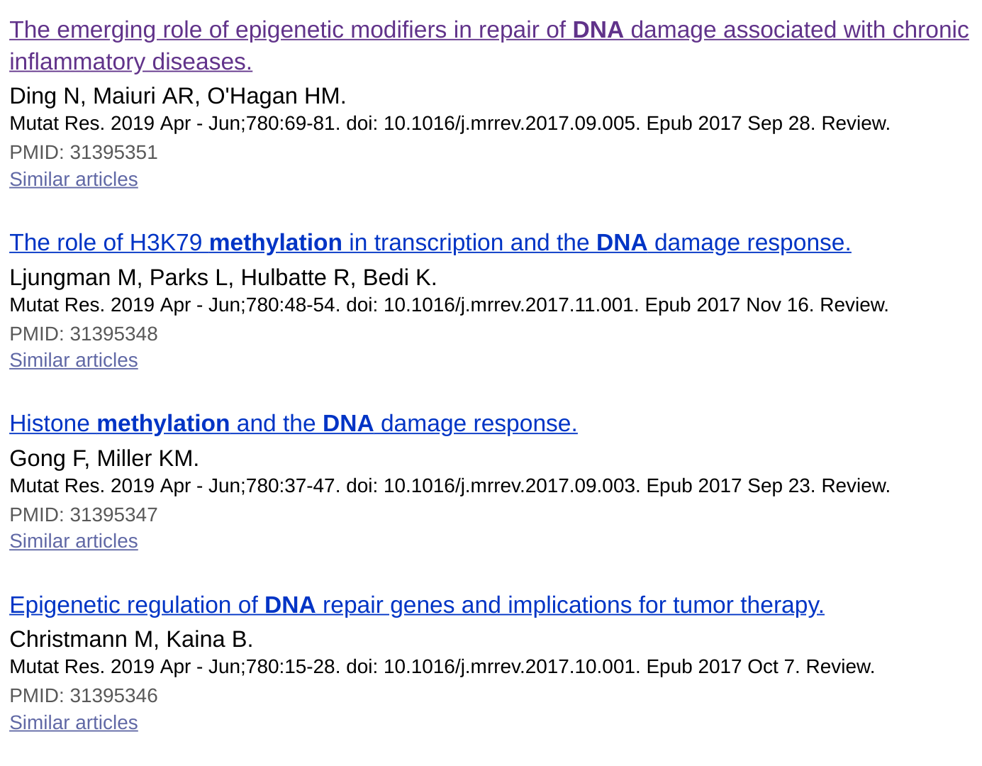
DNAm roles
Epigenetic machanisms in DNA repair and cancer

Slide 14
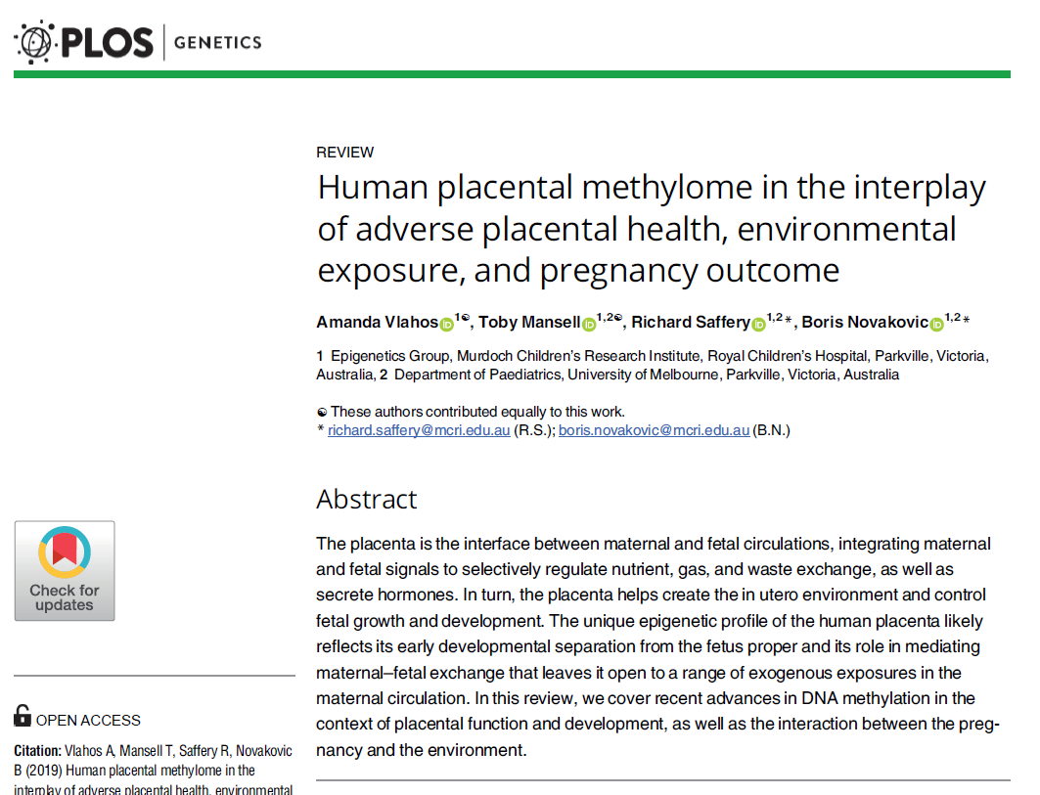
Review
"In this review, we cover recent advances in DNA methylation in the context of placental function and development, as well as the interaction between the pregnancy and the environment."

Slide 15
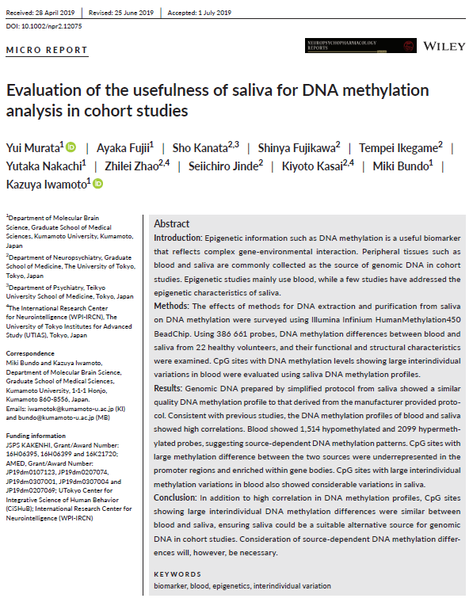
Review
Found that the number of CpG sites with population variation in saliva is similar the number in blood.
Conclude that saliva potentially as useful as blood for EWAS.

