Slide 1
Journal club Oct 14, 2019
Categories | Number
Database | 3
DNAm age | 2
DNAm score (smoking) | 1
Epigenetics | 1
EWAS | 6
Genetics | 1
meQTLs | 2
Methods | 2

Slide 2
Jung I, Schmitt A, Diao Y, Lee AJ, Liu T, Yang D, Tan C, Eom J, Chan M, Chee S, Chiang Z, Kim C, Masliah E, Barr CL, Li B, Kuan S, Kim D, Ren B. A compendium of promoter-centered long-range chromatin interactions in the human genome. Nat Genet. 2019 Oct;51(10):1442-1449. doi: 10.1038/s41588-019-0494-8. Epub 2019 Sep 9. PubMed PMID: 31501517.
Database
Hi-C of 27 human cell/tissue types
Used to
identify interactions between promoters
infer target genes of regulatory elements
Infer regulatory function of 27K noncoding sequence variants.

Slide 3
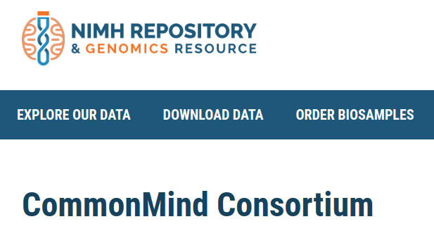
Hoffman GE, Bendl J, Voloudakis G, Montgomery KS, Sloofman L, Wang YC, Shah HR, Hauberg ME, Johnson JS, Girdhar K, Song L, Fullard JF, Kramer R, Hahn CG, Gur R, Marenco S, Lipska BK, Lewis DA, Haroutunian V, Hemby S, Sullivan P, Akbarian S, Chess A, Buxbaum JD, Crawford GE, Domenici E, Devlin B, Sieberts SK, Peters MA, Roussos P. CommonMind Consortium provides transcriptomic and epigenomic data for Schizophrenia and Bipolar Disorder. Sci Data. 2019 Sep 24;6(1):180. doi: 10.1038/s41597-019-0183-6. PubMed PMID: 31551426.
Database
https://www.nimhgenetics.org/resources/commonmind
RNA-seq and SNPs (n=980)
ATAC-seq (n=269)
dorsolateral prefrontal cortex
schizophrenic (n=353)
bipolar disorder (n=120)

Slide 4
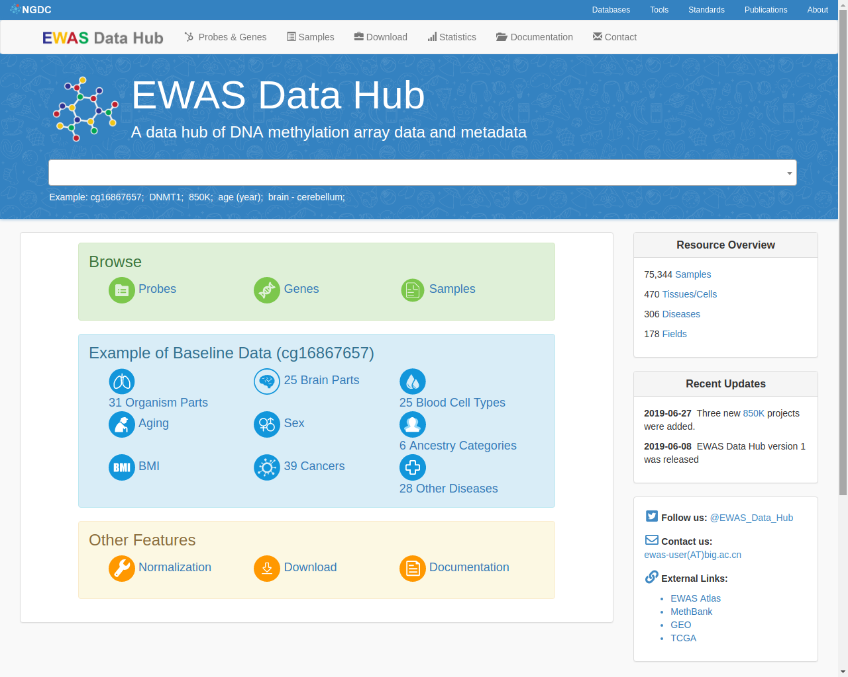
Xiong Z, Li M, Yang F, Ma Y, Sang J, Li R, Li Z, Zhang Z, Bao Y. EWAS Data Hub: a resource of DNA methylation array data and metadata. Nucleic Acids Res. 2019 Oct 4. pii: gkz840. doi: 10.1093/nar/gkz840. [Epub ahead of print] PubMed PMID: 31584095.
Database
https://bigd.big.ac.cn/ewas/datahub
75,344 publicly available DNA methylation profiles
normalized to remove batch effects
81 tissues/cell types
Same group that created EWAS Atlas (https://bigd.big.ac.cn/ewas)

Slide 5
Li C, Wang Z, Hardy T, Huang Y, Hui Q, Crusto CA, Wright ML, Taylor JY, Sun YV. Association of Obesity with DNA Methylation Age Acceleration in African American Mothers from the InterGEN Study. Int J Mol Sci. 2019 Aug 31;20(17). pii: E4273. doi: 10.3390/ijms20174273. PubMed PMID: 31480455; PubMed Central PMCID: PMC6747309.
DNAm age
n=232
saliva samples
African American women
average age 30
Result: 1 kg/m² increase in BMI associated with 0.14 years increase in DNAm age acceleration

Slide 6
Hernando-Herraez I, Evano B, Stubbs T, Commere PH, Jan Bonder M, Clark S, Andrews S, Tajbakhsh S, Reik W. Ageing affects DNA methylation drift and transcriptional cell-to-cell variability in mouse muscle stem cells. Nat Commun. 2019 Sep 25;10(1):4361. doi: 10.1038/s41467-019-12293-4. PubMed PMID: 31554804; PubMed Central PMCID: PMC6761124.
DNAm age
single-cell transcriptomes and methylomes
mouse muscle stem cells.
Result: "epigenetic drift ... in promoters is associated with the degradation of coherent transcriptional networks during stem cell aging".

Slide 7
Corley J, Cox SR, Harris SE, Hernandez MV, Maniega SM, Bastin ME, Wardlaw JM, Starr JM, Marioni RE, Deary IJ. Epigenetic signatures of smoking associate with cognitive function, brain structure, and mental and physical health outcomes in the Lothian Birth Cohort 1936. Transl Psychiatry. 2019 Oct 7;9(1):248. doi: 10.1038/s41398-019-0576-5. PubMed PMID: 31591380.
DNAm score
n=895
age 70 years (LBC1936)
blood DNAm
230-CpG site smoking score associated with:
smoking
pack years
cognitive function
structural brain integrity
physical health
psychosocial health
In many cases, associations stronger than for self-report smoking (e.g. cognitive function, dietary patterns, stroke, mortality, MRI volumetric measures).

Slide 8
Price AJ, Collado-Torres L, Ivanov NA, Xia W, Burke EE, Shin JH, Tao R, Ma L, Jia Y, Hyde TM, Kleinman JE, Weinberger DR, Jaffe AE. Divergent neuronal DNA methylation patterns across human cortical development reveal critical periods and a unique role of CpH methylation. Genome Biol. 2019 Sep 26;20(1):196. doi: 10.1186/s13059-019-1805-1. PubMed PMID: 31554518; PubMed Central PMCID: PMC6761727.
Epigenetics
neocortical DNAm across the first 20 years
most dramatic changes in the first 5 years
neighboring CpG and CpH levels are correlated
CpG and CpH levels define 6 developmental trajectories
identify gene expression effects linked only to CpH and not CpG levels.

Slide 9
Dugué PA, Jung CH, Joo JE, Wang X, Wong EM, Makalic E, Schmidt DF, Baglietto L, Severi G, Southey MC, English DR, Giles GG, Milne RL. Smoking and blood DNA methylation: an epigenome-wide association study and assessment of reversibility. Epigenetics. 2019 Sep 25:1-11. doi: 10.1080/15592294.2019.1668739. [Epub ahead of print] PubMed PMID: 31552803.
EWAS
n=5044 (Melbourne Collaborative Cohort Study)
EWAS of smoking
n=1032 have blood collected 11 years later
4496 sites associated with ever smoking
1326 of these new
368 CpG sites change upon smoking cessation
2.75 half-life for the smoking score (i.e. in 2.75 years, half of the smoking effect has disappeared)

Slide 10
Broholm C, Ribel-Madsen R, Hjort L, Olsson AH, Ahlers JMD, Hansen NS, Schrölkamp M, Gillberg L, Perfilyev A, Volkov P, Ling C, Jørgensen SW, Mortensen B, Hingst J, Wojtaszewski J, Scheele C, Brøns C, Pedersen BK, Vaag A. Epigenome- and Transcriptome-wide Changes in Muscle Stem Cells from Low Birth Weight Men. Endocr Res. 2019 Sep 30:1-14. doi: 10.1080/07435800.2019.1669160. [Epub ahead of print] PubMed PMID: 31566019.
EWAS
muscle progenitor cells
23 LBW and 15 NBW controls
56 CpG sites differentially methylated
14 genes differentially expressed, particularly FYN and HDAC7
follow-up experimental work determined that "Silencing of FYN and HDAC7 was associated with impaired myotube formation, which for HDAC7 reduced muscle glucose uptake."

Slide 11
Solomon O, Macisaac JL, Tindula G, Kobor MS, Eskenazi B, Holland N. 5-Hydroxymethylcytosine in cord blood and associations of DNA methylation with sex in newborns. Mutagenesis. 2019 Oct 6. pii: gez023. doi: 10.1093/mutage/gez023. [Epub ahead of print] PubMed PMID: 31587037.
EWAS
5mC and 5hmC
n=41 (CHAMACOS)
cord blood
low levels of 5hmC
cor(5mC, 5hmC+5mC) = 0.25
5hmC sex-discordant at 21 CpG sites

Slide 12
Ju C, Fiori LM, Belzeaux R, Theroux JF, Chen GG, Aouabed Z, Blier P, Farzan F, Frey BN, Giacobbe P, Lam RW, Leri F, MacQueen GM, Milev R, Müller DJ, Parikh SV, Rotzinger S, Soares CN, Uher R, Li Q, Foster JA, Kennedy SH, Turecki G. Integrated genome-wide methylation and expression analyses reveal functional predictors of response to antidepressants. Transl Psychiatry. 2019 Oct 8;9(1):254. doi: 10.1038/s41398-019-0589-0. PubMed PMID: 31594917.
EWAS
n=211 MDD and n=112 controls age 18-60
8-week escitalopram (SRI anti-depressant)
n=82 responders and n=95 non-responders among MDD
303 CpG sites differentially methylated
2009 differentially expressed genes
overlap = 3 genes/CpG sites
replication:
n=71 responders and n=76 non-responders
One of three overlapping sites replicated
AUC = 0.59 for predicting response

Slide 13
Liu J, Zhang Z, Xu J, Song X, Yuan W, Miao M, Liang H, Du J. Genome-wide DNA methylation changes in placenta tissues associated with small for gestational age newborns; cohort study in the Chinese population. Epigenomics. 2019 Oct 9. doi: 10.2217/epi-2019-0004. [Epub ahead of print] PubMed PMID: 31596135.
EWAS
n=1292, with 39 small for gestational age
Placenta
2012 CpG sites associated with SGA
5 CpG sites associated with folic acid supplementation (FAM198A)

Slide 14
Kresovich JK, Harmon QE, Xu Z, Nichols HB, Sandler DP, Taylor JA. Reproduction, DNA methylation and biological age. Hum Reprod. 2019 Oct 10. pii: dez149. doi: 10.1093/humrep/dez149. [Epub ahead of print] PubMed PMID: 31600381.
EWAS
n=2356 women age 35-74 (Sister Study)
whole blood
parity associated with 17 CpG sites
Hannum, Horvath and Phenoage epigenetic clocks
weak associations with parity
further weakened by adjustment for BMI
weak associations with abnormal glucose tolerance

Slide 15
Helgeland Ø, Vaudel M, Juliusson PB, Lingaas Holmen O, Juodakis J, Bacelis J, Jacobsson B, Lindekleiv H, Hveem K, Lie RT, Knudsen GP, Stoltenberg C, Magnus P, Sagen JV, Molven A, Johansson S, Njølstad PR. Genome-wide association study reveals dynamic role of genetic variation in infant and early childhood growth. Nat Commun. 2019 Oct 1;10(1):4448. doi: 10.1038/s41467-019-12308-0. PubMed PMID: 31575865.
Genetics
GWAS of BMI
12 time points from 0-8 (9286 children in MOBA)
transient effects in the leptin receptor
no effect at birth
increasing to peak at 6-12 months
little effect after age 5
transient effects in the leptin gene
peaking at 1.5 years
replicated in 5235 children

Slide 16
Huan T, Joehanes R, Song C, Peng F, Guo Y, Mendelson M, Yao C, Liu C, Ma J, Richard M, Agha G, Guan W, Almli LM, Conneely KN, Keefe J, Hwang SJ, Johnson AD, Fornage M, Liang L, Levy D. Genome-wide identification of DNA methylation QTLs in whole blood highlights pathways for cardiovascular disease. Nat Commun. 2019 Sep 19;10(1):4267. doi: 10.1038/s41467-019-12228-z. PubMed PMID: 31537805; PubMed Central PMCID: PMC6753136.
meQTLs
n=4170 blood samples
identify 4.7M cis and 630K trans meQTLs targetting 120K CpG sites
replicated in 1347 individuals from two studies
22 trans-meQTL 'hotspots' targeting > 30 CpG sites
these hotspots act in cis on expression of nearby genes
MR of cardiovascular traits identify 92 causal CpG sites

Slide 17
Houlahan KE … Boutros PC. Genome-wide germline correlates of the epigenetic landscape of prostate cancer. Nat Med. 2019 Oct 7. doi: 10.1038/s41591-019-0579-z. [Epub ahead of print] PubMed PMID: 31591588.
meQTLs
241 discovery and 348 validation patients
germline WGS
prostate tumor methylation
identified and validated 1178 loci with altered DNA methylation in tumor but not nonmalignant tissue
provide evidence that tumor meQTLs influence chromatin structure and RNA and protein abundance.

Slide 18
Barton SJ, Melton PE, Titcombe P, Murray R, Rauschert S, Lillycrop KA, Huang RC, Holbrook JD, Godfrey KM. In Epigenomic Studies, Including Cell-Type Adjustments in Regression Models Can Introduce Multicollinearity, Resulting in Apparent Reversal of Direction of Association. Front Genet. 2019 Sep 10;10:816. doi: 10.3389/fgene.2019.00816. eCollection 2019. PubMed PMID: 31552104; PubMed Central PMCID: PMC6746958.
Methods
n=812 at age 17 (Western Australian Pregnancy Cohort Study)
EWAS of BMI adjusted for age and sex
cell counts estimated using the Houseman algorithm
Problem: associations in the CDKN2A promoter reversed direction when adjusted for cell counts
Reason: correlation high between cell counts and promoter methylation

Slide 19
Liu K, Theusch E, Zhou Y, Ashuach T, Dose AC, Bickel PJ, Medina MW, Huang H. GeneFishing to reconstruct context specific portraits of biological processes. Proc Natl Acad Sci U S A. 2019 Sep 17;116(38):18943-18950. doi: 10.1073/pnas.1820340116. Epub 2019 Sep 4. PubMed PMID: 31484776; PubMed Central PMCID: PMC6754596.
Methods
Input: set of genes (bait) and omic datasets
Method: clustering, dimension reduction, … but not deep learning!
Output: a set of genes with related expression patterns (fish)
Proof of principle:
Bait: 21 genes involved in cholesterol metabolism
Fish: gene GLO1 previously unlinked to cholesterol metabolism
Experiment: knocked down in a cell line and cellular cholesterol ester levels increase

