Slide 1
Journal club 21/10/2019

Slide 2
Howe, Cox, Fore, Jungius, Kvist, Lent, Miles, Salas, Rifas-Shiman, Starling, Yousefi, Ladd-Acosta,Baccarelli, Binder, Chatzi, Czamara, Dabelea, DeMeo, Ghantous, Herceg, Kajantie, Lahti, Lawlor, Litonjua, Nawrot, Nohr, Oken, Pizzi, Plusquin, Raikkenen, Relton, Sharp, Sunyer, Vrijheid, Zhang, Hivert, Breton, Maternal Gestational Diabetes Mellitus and Newborn DNA Methylation: Findings From the Pregnancy and Childhood Epigenetics Consortium. Diabetes Care 2019 Oct 10 doi: doi.org/10.2337/dc19-0524
7 pregnancy cohorts (3,677 mother-newborn pairs (317 with GDM))
Two DMRs hypomethylated in newborns exposed to GDM
chr 1: 248100345-248100614 was located in the OR2L13 promoter
chr 10: 135341870-135342620 was located in the gene body of CYP2E1 (upregulated in type 1 and type 2 diabetes)

Slide 3
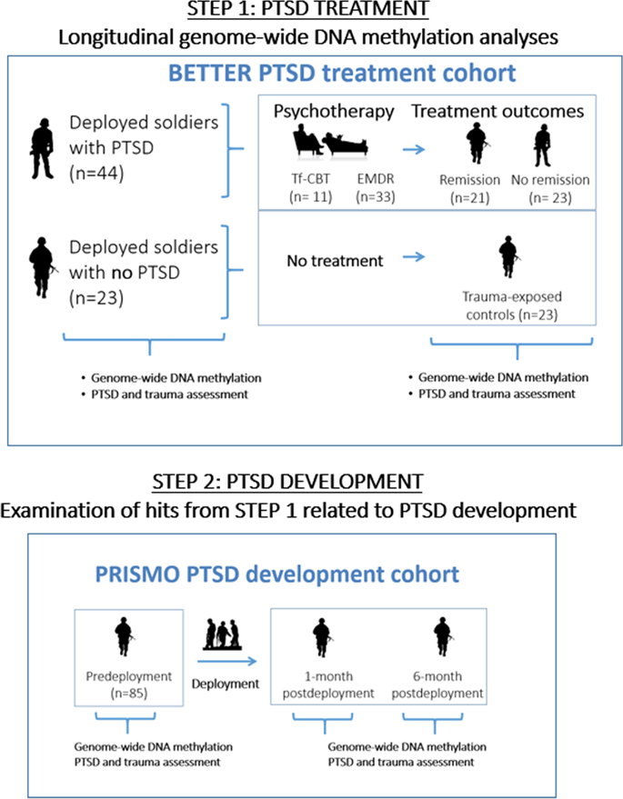
Vinkers, CH, Geuze, E, J. H. van Rooij, S, Kennis, M, Schür, R.S, Nispeling, D.M, Smith, A.K, Nievergelt, C.M, Uddin, M. Rutten, B.P.F, Vermetten, E & Boks, M.P Successful treatment of post-traumatic stress disorder reverses DNA methylation marks. Molec Psychiat 2019 Oct 23
Investigated longitudinal changes of blood-based genome-wide DNA methylation levels in relation to trauma-focused psychotherapy for
PTSD in soldiers in remission (N = 21)
non-remitted PTSD patients (N = 23)
trauma-exposed military controls (N = 23)
Independent prospective cohort, we then examined whether these DMRs were also relevant for the development of deployment-related PTSD (N = 85).
Successful treatment of PTSD was accompanied by significant changes in DNA methylation at 12 differentially methylated regions (DMRs) in the genes: APOB, MUC4, EDN2, ZFP57, GPX6, CFAP45, AFF3, TP73, UBCLP1, RPL13P, and two intergenic regions
Of the 12 DMRs related to PTSD symptom reduction, consistent prospective evidence was found for ZFP57 methylation changes related to changing PTSD symptoms
“Increasing ZFP57 methylation related to PTSD symptom reduction was present over and above the relation with symptoms, suggesting that psychological treatments exert biological effects independent of symptom reduction. Together, these data provide longitudinal evidence that ZFP57 methylation is involved in both the development and successful treatment of deployment-related PTSD.”

Slide 4
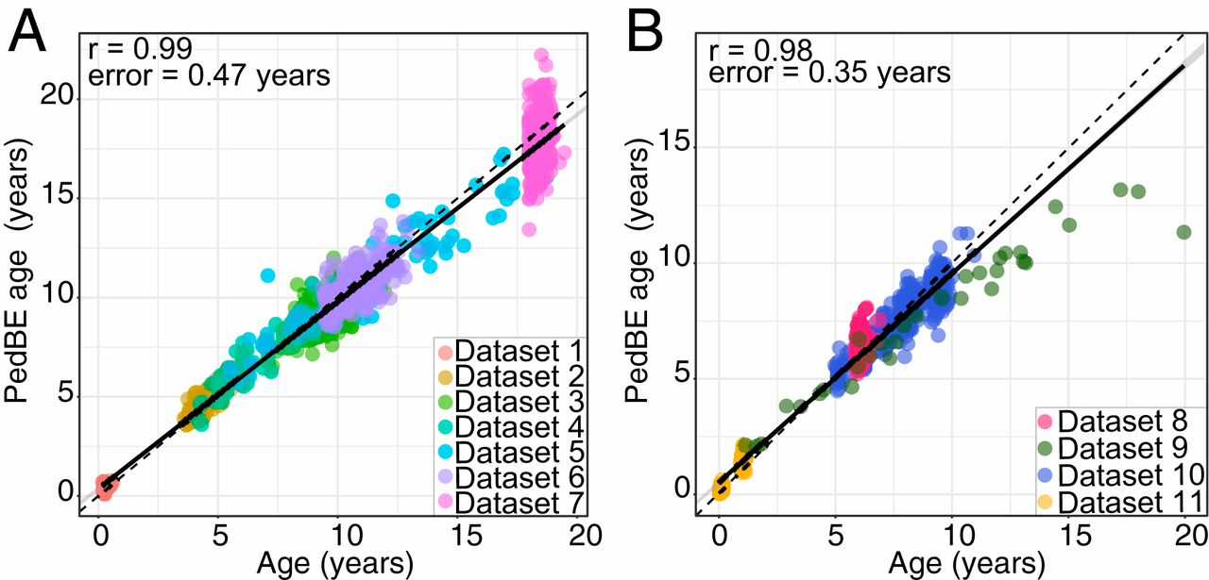
McEwen, O'Donnell, McGill, Edgar,, Jones, MacIsaac, Lin, Ramadori, Morin, Gladish, Garg, Unternaehrer, Pokhvisneva, Karnani, Kee, Klengel, Adler, Barr, Letourneau, Giesbrecht, Reynolds, Czamara, Armstrong, Essex,…Horvath, Kobor The PedBE clock accurately estimates DNA methylation age in pediatric buccal cells. Proc Natl Acad Sci U S A. 2019 Oct 14. pii: 201820843. doi: 10.1073/pnas.1820843116. [Epub ahead of print]
1,721 genome-wide epithelial buccal cell DNAm profiles 0 – 20 years
Training n=1,032/ testing n=689
Elastic net penalized regression was used to select 94 CpG sites
“DNAm at these 94 CpG sites was highly predictive of age in the test cohort…the PedBE clock was characterized in additional cohorts, showcasing the accuracy in longitudinal data, the performance in non-buccal tissues and adult age ranges, and the association with obstetric outcomes.”
Pediatric buccal DNA methylation age accurately predicted chronological age. (A) The training data (datasets 1 through 7) was used in an elastic net regression for selection of 94 age-related CpG sites. Estimated age (PedBE age) (y axis) versus chronological age (x axis). (B) The test data (datasets 8 through 11) was to independently assess the PedBE clock (r = 0.98, test error = 0.35 y). Each data point represents an individual, with the color indicating the corresponding dataset.

Slide 5
Luo, R, Song, J, Zhang, W, Lonkey, R A seven‐DNA methylation signature as a novel prognostic biomarker in breast cancer 23 October 2019 Journ Cell Biochem https://doi.org/10.1002/jcb.29461
The DNA methylation data of BC was downloaded from:
The Cancer Genome Atlas
Gene Expression Omnibus
Functional ANnoTation of The Mammalian Genome
The RNA‐Seq data and clinical information of patients were downloaded from TCGA (~1300 samples)
7 DMSs were identified - their expression levels were negatively correlated with the DNA methylation level and not affected by age, subtypes, or tumour stages.
“We proposed that these seven differentially DNA methylation sites can be used as a novel prognostic biomarker for BC - AUC = 0.74”
Probe ID | Chromosoma location | Gene symbol | Feature type | P value | Coef
cg03120091 | chr8:132052729‐132052779 | ADCY8 | HC_shore | <.001 | 1.729
cg17080504 | chr11:86383508‐86383558 | ME3 | HC_shore | <.001 | 1.740
cg04987053 | chr16:5038029‐5038079 | SEC14L5 | IC_shore | <.001 | 1.325
cg25592413 | chr5:172753646‐172753696 | STC2 | IC_shore | <.001 | 1.315
cg07972135 | chr11:105481273‐105481323 | GRIA4 | HC_shore | <.001 | 2.181
cg15603568 | chr11:105481233‐105481283 | GRIA4 | HC_shore | <.01 | −1.760
cg12424785 | chr2:154728132‐154728182 | GALNT13 | HC_shore | <.01 | 0.727

Slide 6
Abdulrahim, J.W. Kwee, L.C, Grass, E. Siegler, I.C. Williams, R., Karra, R., Kraus, W.E., Gregory, S.G., Shah, S.H Epigenome‐Wide Association Study for All‐Cause Mortality in a Cardiovascular Cohort Identifies Differential Methylation in Castor Zinc Finger 1 (CASZ123) Oct 2019 https://doi.org/10.1161/JAHA.119.013228 Journal of the American Heart Association. 2019;8:e013228
EWAS for all‐cause mortality with whole‐transcriptome data in a cardiovascular cohort
Cases - participants with mortality ≥7 days post-catheterization / controls - alive with ≥2 years of follow‐up.
In the discovery set (450k, 55 cases, 49 controls), 25,629 (6.5%) probes were differently methylated (P<0.05). In the validation set (EPIC, 108 cases, 108 controls), 3 probes were differentially methylated
6 novel differentially methylated CpG loci were found to be associated with all‐cause mortality
Differential methylation in CASZ1 may serve as a genomic regulatory element associated with increased risk of death in cardiovascular patients.
“Our findings are unique when compared with 2 previous EWAS of all‐cause mortality”

Slide 7
The clinical course of prostate cancer (PCa) is highly variable, demanding an individualized approach to therapy. Overtreatment of indolent PCa cases, which likely do not progress to aggressive stages, may be associated with severe side effects and considerable costs. These could be avoided by utilizing robust prognostic markers to guide treatment decisions. Random forest-based classification model to predict aggressive behaviour of prostate cancer. DNA methylation changes between PCa cases with good or poor prognosis (discovery cohort with n = 70) - randomly split into a training (80%) and a test set (20%) - AUC 95%. Using the ICGC cohort of early- and late-onset prostate cancer (n = 222) and the TCGA PRAD cohort (n = 477) for external validation, AUCs for sensitivity analyses were 77.1% and 68.7%, respectively.
Random forest-based modelling to detect biomarkers for prostate cancer progression Clin Epigenetics. 2019; 11: 148.
Published online 2019 Oct 22. doi: 10.1186/s13148-019-0736-8 PMCID: PMC6805338 PMID: 31640781

Slide 8
Tasaki, Gaiteri, Petyuk, Blizinsky, De Jager, Buchman, Bennett Genetic risk for Alzheimer's dementia predicts motor deficits through multi-omic systems in older adults. Transl Psychiatry. 2019; 9: 241. Oct 3. doi: 10.1038/s41398-019-0577-4 PMCID: PMC6776503 PMID: 31582723
Integrative analysis to untangle the molecular paths from genetic risk to motor impairment in n=1,885 using "brain multi-omics, including transcriptome, DNA methylation, histone acetylation (H3K9AC), and targeted proteomics, as well as diverse neuropathologies.”
DLPFC region
AD-PRS compared to several motor phenotypes
We found that the genetic risk for Alzheimer’s dementia influenced motor functions in older adults, suggesting that cognitive and motor impairment share, at least in part, an underlying genetic architecture.

Slide 9
Reilly, Tanaka, Diep, Yeerna, Tamayo, Zhang, Bejar DNA methylation identifies genetically and prognostically distinct subtypes of myelodysplastic syndromes. Blood Adv. 2019 Oct 8; 3(19): 2845–2858.2019Oct3. doi: 10.1182/bloodadvances.2019000192
Bisulfite padlock probe sequencing - 141 patients with MDS – bone marrow samples
NNMF was performed on the 3% most variably methylated CpG tiles (n = 7,382)
“…we demonstrate that using novel computational methods to agnostically classify primary MDS patients by their DNAm patterns can identify subtypes of MDS characterized by distinct patterns of genetic lesions, regulatory region methylation, and prognostic risk. Our results highlight the importance of DNAm in MDS disease biology as a convergent oncogenic phenotype and support future studies investigating DNAm profiles as clinically relevant biomarkers.”

Slide 10
Philibert, Miller, Noel, Dawes, Papworth, Black, Beach, Long, Mills, Dogan A Four Marker Digital PCR Toolkit for Detecting Heavy Alcohol Consumption and the Effectiveness of Its Treatment. J Insur Med. 2019 Oct 14. doi: 10.17849/insm-48-1-1-1.1. [Epub ahead of print]
“Building on the results of 3 genome wide methylation studies, we have previously shown in a small group of samples that methylation sensitive digital PCR assays have the potential to accurately classify individuals with respect to HAC …”
143 participants with current HAC and 200 abstinent controls.
We show that a set of 4 digital PCR assays that have a AUC 0.96 for detecting those with HAC
“After a mean of 21 days of inpatient enforced abstinence, methylation status at one of these markers, cg04987734, began to revert to baseline values.”
We conclude that clinically implementable dPCR tools can sensitively detect the presence of HAC and that they show promise for monitoring alcohol treatment results.

Slide 11
Philibert, Long, Mills, Dogan AHRR Methylation is a Significant Predictor of Mortality Risk in Framingham Heart Study. J Insur Med. 2019 Oct 16. doi: 10.17849/insm-48-1-1-11.1. [Epub ahead of print]
We analysed the relationship of methylation at cg05575921 and cg04987734 (quantitative marker of heavy alcohol consumption (HAC)) to mortality
n = 2,278 average age ~66 years
“we found that the inclusion of both cg05575921 and cg04987734 methylation to a base model consisting of age and sex only, or to a model containing 11 commonly used mortality risk factors, improved risk prediction…prediction accuracy for the base model plus methylation data was increased compared to the base model plus known predictors of mortality (CHD, COPD, or stroke).”
Cg05575921, and to a smaller extent cg04987734, are strong predictors of mortality risk in older Americans

