Slide 1
Journal club Jan 13, 2020
Categories | Number
EWAS | 5 (-4)
Small RNA | 1
meQTL | 1
Epigenetics | 1
PWAS | 1
Somatic mutations | 1

Slide 2
McCartney DL, ... Visscher PM, McRae AF, Marioni RE. An epigenome-wide association study of sex-specific chronological ageing. Genome Med. 2019 Dec 31;12(1):1.
EWAS
Dynamics of sex-discordant DNA methylation across adulthood
N=2586 age 18-87 (replication in n=4450 age 18-93)
Age associations for 250,485 autosomal and 3096 X-linked sites
Sex-by-age interactions for 52 autosomal and 597 X-linked sites
"Several [cis-SNP] associations were with sexually dimorphic traits … All of the SNPs were located on the X chromosome"
279 sites with 4582 meQTLs, 2 meQTLs "associated with male pattern baldness and prostate cancer"
Notes:
Advanced age is associated with cognitive and physical decline and is a major risk factor for a multitude of disorders. There is also a gap in life expectancy between males and females. DNA methylation differences have been shown to be associated with both age and sex. Here, we investigate age-by-sex differences in blood-based DNA methylation in an unrelated cohort of 2586 individuals between the ages of 18 and 87â€‰years, with replication in a further 4450 individuals between the ages of 18 and 93â€‰years. Linear regression models were applied, with stringent genome-wide significance thresholds (pâ€‰<â€‰3.6â€‰Ã—â€‰10<sup>-8</sup>) used in both the discovery and replication data. A second, highly conservative mixed linear model method that better controls the false-positive rate was also applied, using the same genome-wide significance thresholds. Using the linear regression method, 52 autosomal and 597 X-linked CpG sites, mapping to 251 unique genes, replicated with concordant effect size directions in the age-by-sex interaction analysis. The site with the greatest difference mapped to GAGE10, an X-linked gene. Here, DNA methylation levels remained stable across the male adult age range (DNA methylation by age râ€‰=â€‰0.02) but decreased across female adult age range (DNA methylation by age râ€‰=â€‰-â€‰0.61). One site (cg23722529) with a significant age-by-sex interaction also had a quantitative trait locus (rs17321482) that is a genome-wide significant variant for prostate cancer. The mixed linear model method identified 11 CpG sites associated with the age-by-sex interaction. The majority of differences in age-associated DNA methylation trajectories between sexes are present on the X chromosome. Several of these differences occur within genes that have been implicated in sexually dimorphic traits.

Slide 3
Kadakia R, Zheng Y, Zhang Z, Zhang W, Josefson JL, Hou L. Association of cord blood methylation with neonatal leptin: An epigenome wide association study. PLoS One. 2019 Dec 18;14(12):e0226555.
EWAS
Cord blood DNA methylation associated with leptin levels
N=114 cord blood
Cord blood leptin, birthweight, fat mass, percent body fat
247 CpG sites associated with leptin
Lack of associations with other phenotypes no surprise as sample size quite small
Notes:
Neonatal adiposity is a risk factor for childhood obesity. Investigating contributors to neonatal adiposity is important for understanding early life obesity risk. Epigenetic changes of metabolic genes in cord blood may contribute to excessive neonatal adiposity and subsequent childhood obesity. This study aims to evaluate the association of cord blood DNA methylation patterns with anthropometric measures and cord blood leptin, a biomarker of neonatal adiposity. A cross-sectional study was performed on a multiethnic cohort of 114 full term neonates born to mothers without gestational diabetes at a university hospital. Cord blood was assayed for leptin and for epigenome-wide DNA methylation profiles via the Illumina 450K platform. Neonatal body composition was measured by air displacement plethysmography. Multivariable linear regression was used to analyze associations between individual CpG sites as well as differentially methylated regions in cord blood DNA with measures of newborn adiposity including anthropometrics (birth weight, fat mass and percent body fat) and cord blood leptin. False discovery rate was estimated to account for multiple comparisons. 247 CpG sites as well as 18 differentially methylated gene regions were associated with cord blood leptin but no epigenetic changes were associated with birth weight, fat mass or percent body fat. Genes of interest identified in this study are DNAJA4, TFR2, SMAD3, PLAG1, FGF1, and HNF4A. Epigenetic changes in cord blood DNA are associated with cord blood leptin levels, a measure of neonatal adiposity.

Slide 4
Jia et al. Epigenome-wide meta-analysis of blood DNA methylation and its association with subcortical volumes: findings from the ENIGMA Epigenetics Working Group. Mol Psychiatry. 2019 Dec 6.
EWAS
DNA methylation little or no association with subcortical volumes
N=3337 (11 cohorts)
EWAS of volumes of the hippocampus, thalamus, nucleus accumbens
Two CpG sites associated with hippocampal volume
Notes:
DNA methylation, which is modulated by both genetic factors and environmental exposures, may offer a unique opportunity to discover novel biomarkers of disease-related brain phenotypes, even when measured in other tissues than brain, such as blood. A few studies of small sample sizes have revealed associations between blood DNA methylation and neuropsychopathology, however, large-scale epigenome-wide association studies (EWAS) are needed to investigate the utility of DNA methylation profiling as a peripheral marker for the brain. Here, in an analysis of eleven international cohorts, totalling 3337 individuals, we report epigenome-wide meta-analyses of blood DNA methylation with volumes of the hippocampus, thalamus and nucleus accumbens (NAcc)-three subcortical regions selected for their associations with disease and heritability and volumetric variability. Analyses of individual CpGs revealed genome-wide significant associations with hippocampal volume at two loci. No significant associations were found for analyses of thalamus and nucleus accumbens volumes. Cluster-based analyses revealed additional differentially methylated regions (DMRs) associated with hippocampal volume. DNA methylation at these loci affected expression of proximal genes involved in learning and memory, stem cell maintenance and differentiation, fatty acid metabolism and type-2 diabetes. These DNA methylation marks, their interaction with genetic variants and their impact on gene expression offer new insights into the relationship between epigenetic variation and brain structure and may provide the basis for biomarker discovery in neurodegeneration and neuropsychiatric conditions.

Slide 5
Geurtsen ML, Jaddoe VWV, Salas LA, Santos S, Felix JF. Newborn and childhood differential DNA methylation and liver fat in school-age children. Clin Epigenetics. 2019 Dec 31;12(1):3.
EWAS
DNA methylation not associated with liver fat fraction
N=785 cord blood and 344 peripheral blood at age 10
Liver fat fraction at 10 (measured by MRI)
No CpG site associations or DMRs
No candidate CpG site associations (adult non-acoholic fatty liver disease)
Notes:
Non-alcoholic fatty liver disease is the most common chronic liver disease in children in western countries. Adverse early-life exposures are associated with higher liver fat percentages in children. Differential DNA methylation may underlie these associations. We aimed to identify differential DNA methylation in newborns and children associated with liver fat accumulation in childhood. We also examined whether DNA methylation at 22 cytosine-phosphate-guanine sites (CpGs) associated with adult non-alcoholic fatty liver disease is associated with liver fat in children. Within a population-based prospective cohort study, we analyzed epigenome-wide DNA methylation data of 785 newborns and 344 10-year-old children in relation to liver fat fraction at 10 years. DNA methylation was measured using the Infinium HumanMethylation450 BeadChip (Illumina). We measured liver fat fraction by Magnetic Resonance Imaging. Associations of single CpG DNA methylation at the two-time points with liver fat accumulation were analyzed using robust linear regression models. We also analyzed differentially methylation regions using the dmrff package. We looked-up associations of 22 known adult CpGs at both ages with liver fat at 10 years. The median liver fat fraction was 2.0% (95% range 1.3, 5.1). No single CpGs and no differentially methylated regions were associated with liver fat accumulation. None of the 22 known adult CpGs were associated with liver fat in children. DNA methylation at birth and in childhood was not associated with liver fat accumulation in 10-year-old children in this study. This may be due to modest sample sizes or DNA methylation changes being a consequence rather than a determinant of liver fat.

Slide 6
Chan RF, Turecki G, Shabalin AA, Guintivano J, Zhao M, Xie LY, van Grootheest G, Kaminsky ZA, Dean B, Penninx BWJH, Aberg KA, van den Oord EJCG. Cell Type-Specific Methylome-wide Association Studies Implicate Neurotrophin and Innate Immune Signaling in Major Depressive Disorder. Biol Psychiatry. 2019 Nov 1.
EWAS
Cell-type specific associations between DNAm and MDD – an example where numbers trumps tissue!
Brain (n=206) and blood (n=1132) bisulfite sequencing
Cell-type specific EWAS meth ~ glia% + neuron% + MDD*glia% + MDD*neuron% + covs
(similar for blood)
No associations in brain (FDR > 0.1)
Monocytes (904 sites), T-cells (9 sites), whole blood (1 site) and none for B-cells and granulocytes
Enrichment for previously identified methylation differences in blood
Enrichment for genes implicated in GWAS of MDD and other psychiatric disorders
Notes:
BACKGROUND:
We sought to characterize methylation changes in brain and blood associated with major depressive disorder (MDD). As analyses of bulk tissue may obscure association signals and hamper the biological interpretation of findings, these changes were studied on a cell type-specific level.
METHODS:
In 3 collections of human postmortem brain (n = 206) and 1 collection of blood samples (N = 1132) of MDD cases and controls, we used epigenomic deconvolution to perform cell type-specific methylome-wide association studies within subpopulations of neurons/glia for the brain data and granulocytes/T cells/B cells/monocytes for the blood data. Sorted neurons/glia from a fourth postmortem brain collection (n = 58) were used for validation purposes.
RESULTS:
Cell type-specific methylome-wide association studies identified multiple findings in neurons/glia that were detected across brain collections and were reproducible in physically sorted nuclei. Cell type-specific analyses in blood samples identified methylome-wide significant associations in T cells, monocytes, and whole blood that replicated findings from a past methylation study of MDD. Pathway analyses implicated p75 neurotrophin receptor/nerve growth factor signaling and innate immune toll-like receptor signaling in MDD. Top results in neurons, glia, bulk brain, T cells, monocytes, and whole blood were enriched for genes supported by genome-wide association studies for MDD and other psychiatric disorders.
CONCLUSIONS:
We both replicated and identified novel MDD-methylation associations in human brain and blood samples at a cell type-specific level. Our results provide mechanistic insights into how the immune system may interact with the brain to affect MDD susceptibility. Importantly, our findings involved associations with MDD in human samples that implicated many closely related biological pathways. These disease-linked sites and pathways represent promising new therapeutic targets for MDD.

Slide 7
Caramaschi D, Hatcher C, Mulder RH, Felix JF, Cecil CAM, Relton CL, Walton E. Epigenome-wide association study of seizures in childhood and adolescence. Clin Epigenetics. 2020 Jan 8;12(1):8.
EWAS
Seizures may cause DNAm changes in peripheral blood.
N~800 in ALSPAC at birth (cord), 7y and 15-17y (peripheral blood)
2 CpG sites at age 7 for seizures up to age 8
3 CpG sites at age 15-17 for seizures up to age 11 (one near BDNF)
Not replicated in Generation R (peripheral blood at age 6) but similar direction of effect
MR suggests seizures might cause methylation changes
Notes:
The occurrence of seizures in childhood is often associated with neurodevelopmental impairments and school underachievement. Common genetic variants associated with epilepsy have been identified and epigenetic mechanisms have also been suggested to play a role. In this study, we analyzed the association of genome-wide blood DNA methylation with the occurrence of seizures in ~ 800 children from the Avon Longitudinal Study of Parents and Children, UK, at birth (cord blood), during childhood, and adolescence (peripheral blood). We also analyzed the association between the lifetime occurrence of any seizures before age 13 with blood DNA methylation levels. We sought replication of the findings in the Generation R Study and explored causality using Mendelian randomization, i.e., using genetic variants as proxies. The results showed five CpG sites which were associated cross-sectionally with seizures either in childhood or adolescence (1-5% absolute methylation difference at pFDR < 0.05), although the evidence of replication in an independent study was weak. One of these sites was located in the BDNF gene, which is highly expressed in the brain, and showed high correspondence with brain methylation levels. The Mendelian randomization analyses suggested that seizures might be causal for changes in methylation rather than vice-versa. In conclusion, we show a suggestive link between seizures and blood DNA methylation while at the same time exploring the limitations of conducting such study.

Slide 8
Hivert MF, Cardenas A, Allard C, Doyon M, Powe CE, Catalano PM, Perron P, Bouchard L. Interplay of Placental DNA Methylation and Maternal Insulin Sensitivity in Pregnancy. Diabetes. 2019 Dec 27. pii: db190798.
EWAS
Placenta DNAm may causally influence maternal insulin sensitivity
N~430 mother-child pairs
Maternal insulin sensitivity at 26 gestation (Matsuda index)
Placenta methylation
188 CpG site associations
Enrichment for microRNAs, histone modifications, imprinted loci (12)
MR supports causal role for 5 CpG sites
Notes:
The placenta participates in maternal insulin sensitivity changes during pregnancy, however mechanisms remain unclear. We investigated associations between maternal insulin sensitivity and placental DNA methylation markers across the genome. We analyzed data from 430 mother-offspring dyads in the Gen3G cohort. All women underwent 75g oral glucose tolerance tests at ∼26 weeks of gestation; we used glucose and insulin measures to estimate insulin sensitivity (Matsuda index). At delivery, we collected samples from placenta (fetal side) and measured DNA methylation using IlluminaEPIC arrays. Using linear regression models to quantify associations at 720,077 CpGs, adjusted for maternal age, gravidity, smoking, body mass index, child sex and gestational age at delivery, we identified 188 CpG sites where placental DNA methylation was associated with Matsuda index (P<6.94x10-8). Among genes annotated to these 188 CpGs, we found enrichment in targets for microRNAs, histone modifications, and in parent-of-origin DNA methylation including H19/MIR675 locus (paternally imprinted). We identified 12 known placenta imprinted genes, including KCNQ1 Mendelian Randomization analyses revealed 5 loci where placenta DNA methylation may causally influence maternal insulin sensitivity, including the maternally imprinted gene DLGAP2. Our results suggest that placental DNA methylation is fundamentally linked to the regulation of maternal insulin sensitivity in pregnancy.

Slide 9
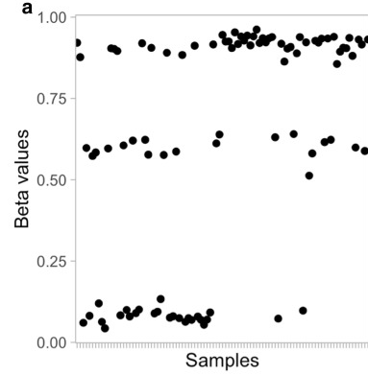
LaBarre et al. MethylToSNP: identifying SNPs in Illumina DNA methylation array data. Epigenetics Chromatin. 2019 Dec 20;12(1):79.
meQTL
Detect genotype in DNA methylation profiles
Method for detecting SNP effects in DNA methylation
There is significant disagreement between exclusion lists (e.g. Chen, Naeem, etc)
Similar to 'gap hunting' but focuses only on the '3-group' pattern
'gap hunting' used to identify 'suspicious' effects but does not attempt to assign genotype
Notes:
Current array-based methods for the measurement of DNA methylation rely on the process of sodium bisulfite conversion to differentiate between methylated and unmethylated cytosine bases in DNA. In the absence of genotype data this process can lead to ambiguity in data interpretation when a sample has polymorphisms at a methylation probe site. A common way to minimize this problem is to exclude such potentially problematic sites, with some methods removing as much as 60% of array probes from consideration before data analysis. Here, we present an algorithm implemented in an R Bioconductor package, MethylToSNP, which detects a characteristic data pattern to infer sites likely to be confounded by polymorphisms. Additionally, the tool provides a stringent reliability score to allow thresholding on SNP predictions. We calibrated parameters and thresholds used by the algorithm on simulated and real methylation data sets. We illustrate findings using methylation data from YRI (Yoruba in Ibadan, Nigeria), CEPH (European descent) and KhoeSan (southern African) populations. Our polymorphism predictions made using MethylToSNP have been validated through SNP databases and bisulfite and genomic sequencing. The benefits of this method are threefold. First, it prevents extensive data loss by considering only SNPs specific to the individuals in the study. Second, it offers the possibility to identify new polymorphisms in samples for which there is little known about the genetic landscape. Third, it identifies variants as they exist in functional regions of a genome, such as in CTCF (transcriptional repressor) sites and enhancers, that may be common alleles or personal mutations with potential to deleteriously affect genomic regulatory activities. We demonstrate that MethylToSNP is applicable to the Illumina 450K and Illumina 850K EPIC array data and is also backwards compatible to the 27K methylation arrays. Going forward, this kind of nuanced approach can increase the amount of information derived from precious data sets by considering samples of the project individually to enable more informed decisions about data cleaning.

Slide 10
García-Nieto PE, Morrison AJ, Fraser HB. The somatic mutation landscape of the human body. Genome Biol. 2019 Dec 24;20(1):298.
Somatic mutations
Somatic mutation profiles across multiple human tissues
RNA-seq from GTEx (n=7500 samples, 36 tissues)
Exome-seq of blood samples from same individuals used to estimate false positive rate
Identified 280,000 mutations
'Mutational profiles' tissue-specific
possibly due to higher mutation rates in heterochomatin
e.g. "lung samples with low expression of the mismatch-repair gene MLH1 show a mutation signature of deficient mismatch repair"
'Mutational load' associated with age, sex, ethnicity and natural selection
"Strongest strand asymmetry for C>A mutations, which preferentially occur on the transcribed strand in most tissues except for the brain"
"except for the brain" likely because almost no replication in the brain
"Cancer driver genes are enriched for mutations and under positive selection in non-disease tissues … suggesting that these mutations increase cellular proliferation well before any cancer is observed"
Notes:
BACKGROUND:
Somatic mutations in healthy tissues contribute to aging, neurodegeneration, and cancer initiation, yet they remain largely uncharacterized.
RESULTS:
To gain a better understanding of the genome-wide distribution and functional impact of somatic mutations, we leverage the genomic information contained in the transcriptome to uniformly call somatic mutations from over 7500 tissue samples, representing 36 distinct tissues. This catalog, containing over 280,000 mutations, reveals a wide diversity of tissue-specific mutation profiles associated with gene expression levels and chromatin states. For example, lung samples with low expression of the mismatch-repair gene MLH1 show a mutation signature of deficient mismatch repair. In addition, we find pervasive negative selection acting on missense and nonsense mutations, except for mutations previously observed in cancer samples, which are under positive selection and are highly enriched in many healthy tissues.
CONCLUSIONS:
These findings reveal fundamental patterns of tissue-specific somatic evolution and shed light on aging and the earliest stages of tumorigenesis.

Slide 11
Noor et al. Association of Periconception Paternal Body Mass Index With Persistent Changes in DNA Methylation of Offspring in Childhood. JAMA Netw Open. 2019 Dec 2;2(12):e1916777.
EWAS
Paternal BMI associated with offspring DNA methylation and birthweight
DNAm at birth and ages 3 and 7 (Project Viva)
429 father-mother-child triads
9 CpG sites in cord blood associated with paternal BMI (independently of maternal BMI)
Three persisted to age 3
One persisted to age 7
Stratifying by maternal body composition
No paternal BMI associations for offspring of normal weight mothers
18 associations for offspring of overweight-obese mothers (1 also in set of 9 above)
Notes:
While prenatal nutrition and maternal obesity are recognized as important contributors to epigenetic changes and childhood obesity, the role of paternal obesity in the epigenome of offspring has not been well studied. To test whether periconception paternal body mass index (BMI) is associated with DNA methylation patterns in newborns, to examine associations between maternal and paternal BMI and the epigenome of offspring, and to examine persistence of epigenetic marks at ages 3 and 7 years. Project Viva is a prebirth cohort study of mothers and children including 2128 live births that enrolled mothers from April 1999 to July 2002 and followed offspring to adolescence. This study analyzed the subset of participants with available data on paternal BMI and DNA methylation in offspring blood in the newborn period, at age 3 years, and at age 7 years. Data were analyzed from July 2017 to October 2019. The primary exposure was paternal periconception BMI; associations were adjusted for maternal prepregnancy BMI and stratified according to maternal BMI above or below 25. The primary outcome was genome-wide DNA methylation patterns in offspring blood collected at birth, age 3 years, and age 7 years. A total of 429 father-mother-infant triads were included. The mean (SD) periconception paternal BMI was 26.4 (4.0) and mean maternal prepregnancy BMI was 24.5 (5.2); 268 fathers had BMI greater than or equal to 25 (mean [SD], 28.5 [3.3]) and 161 had BMI less than 25 (mean [SD], 22.8 [1.8]). Paternal BMI greater than or equal to 25 was associated with increased offspring birth weight compared with paternal BMI less than 25 (mean [SD] z score, 0.38 [0.91] vs 0.11 [0.96]; Pâ€‰=â€‰.004). Cord blood DNA methylation at 9 CpG sites was associated with paternal BMI independent of maternal BMI (qâ€‰<â€‰.05). Methylation at cg04763273, between TFAP2C and BMP7, decreased by 5% in cord blood with every 1-unit increase in paternal BMI (Pâ€‰=â€‰3.13â€‰Ã—â€‰10-8); hypomethylation at this site persisted at ages 3 years and 7 years. Paternal BMI was associated with methylation at cg01029450 in the promoter region of the ARFGAP3 gene; methylation at this site was also associated with lower infant birth weight (Î²â€‰=â€‰-0.0003; SDâ€‰=â€‰0.0001; Pâ€‰=â€‰.03) and with higher BMI z score at age 3 years. In this study, paternal BMI was associated with DNA methylation, birth weight, and childhood BMI z score in offspring.

Slide 12
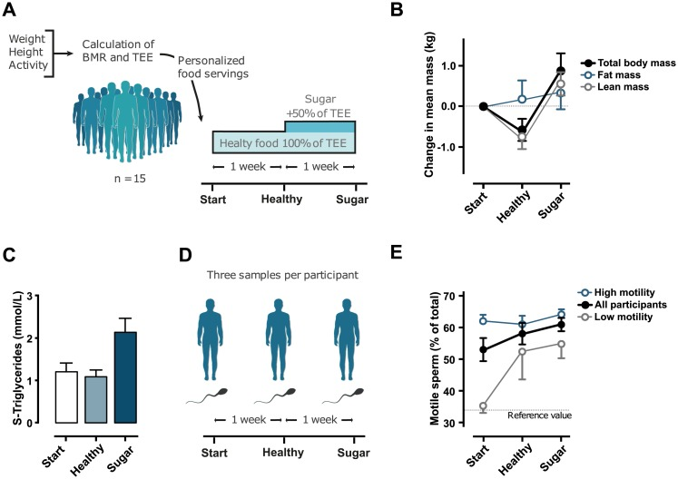
Nätt D, et al. Human sperm displays rapid responses to diet. PLoS Biol. 2019 Dec 26;17(12):e3000559.
Small RNA
'sperm displays rapid response to diet'
Background
"57% decline in sperm concentration during the past 35 years"
Obesity is a 'strong risk factor' for 'low sperm quality'
In animal models, dietary interventions in males 'create robust metabolic ripples that propogate through one or two generations'.
The most likely mechanism in mouse models appears to be tRNA-derived small RNAs (tsRNAs)
18-40bp long
Abundant in mammalian sperm
Roles in 'inhibition of translation, stress granule formation, and control of retrotransposons'
Can be found in exosomes, membrane-bound vehicles that transport lipids, proteins and RNA between cells.
TEE = total energy expenditure
BMR = basal metabolic rate
Notes:
The global rise in obesity and steady decline in sperm quality are two alarming trends that have emerged during recent decades. In parallel, evidence from model organisms shows that paternal diet can affect offspring metabolic health in a process involving sperm tRNA-derived small RNA (tsRNA). Here, we report that human sperm are acutely sensitive to nutrient flux, both in terms of sperm motility and changes in sperm tsRNA. Over the course of a 2-week diet intervention, in which we first introduced a healthy diet followed by a diet rich in sugar, sperm motility increased and stabilized at high levels. Small RNA-seq on repeatedly sampled sperm from the same individuals revealed that tsRNAs were up-regulated by eating a high-sugar diet for just 1 week. Unsupervised clustering identified two independent pathways for the biogenesis of these tsRNAs: one involving a novel class of fragments with specific cleavage in the T-loop of mature nuclear tRNAs and the other exclusively involving mitochondrial tsRNAs. Mitochondrial involvement was further supported by a similar up-regulation of mitochondrial rRNA-derived small RNA (rsRNA). Notably, the changes in sugar-sensitive tsRNA were positively associated with simultaneous changes in sperm motility and negatively associated with obesity in an independent clinical cohort. This rapid response to a dietary intervention on tsRNA in human sperm is attuned with the paternal intergenerational metabolic responses found in model organisms. More importantly, our findings suggest shared diet-sensitive mechanisms between sperm motility and the biogenesis of tsRNA, which provide novel insights about the interplay between nutrition and male reproductive health.

Slide 13
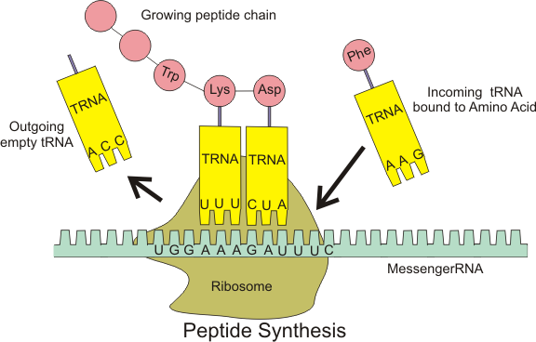
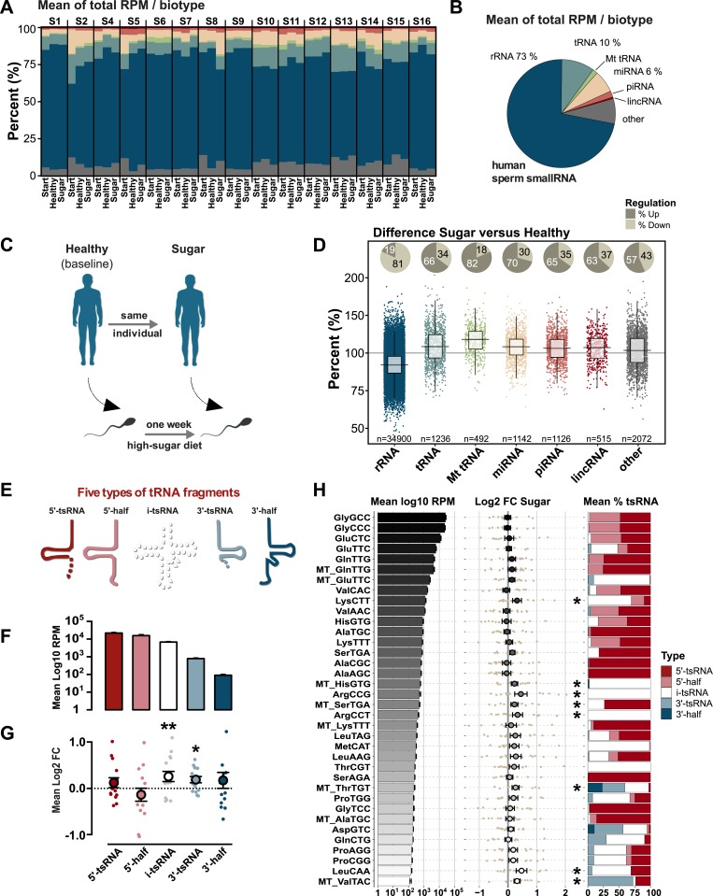
… continued Nätt D, et al. Human sperm displays rapid responses to diet. PLoS Biol. 2019 Dec 26;17(12):e3000559.
Small RNA
tRNA (transfer RNA)
Many tRNA fragments have elevated expression following sugar diet
Other stuff is different too ...
Notes:
The global rise in obesity and steady decline in sperm quality are two alarming trends that have emerged during recent decades. In parallel, evidence from model organisms shows that paternal diet can affect offspring metabolic health in a process involving sperm tRNA-derived small RNA (tsRNA). Here, we report that human sperm are acutely sensitive to nutrient flux, both in terms of sperm motility and changes in sperm tsRNA. Over the course of a 2-week diet intervention, in which we first introduced a healthy diet followed by a diet rich in sugar, sperm motility increased and stabilized at high levels. Small RNA-seq on repeatedly sampled sperm from the same individuals revealed that tsRNAs were up-regulated by eating a high-sugar diet for just 1 week. Unsupervised clustering identified two independent pathways for the biogenesis of these tsRNAs: one involving a novel class of fragments with specific cleavage in the T-loop of mature nuclear tRNAs and the other exclusively involving mitochondrial tsRNAs. Mitochondrial involvement was further supported by a similar up-regulation of mitochondrial rRNA-derived small RNA (rsRNA). Notably, the changes in sugar-sensitive tsRNA were positively associated with simultaneous changes in sperm motility and negatively associated with obesity in an independent clinical cohort. This rapid response to a dietary intervention on tsRNA in human sperm is attuned with the paternal intergenerational metabolic responses found in model organisms. More importantly, our findings suggest shared diet-sensitive mechanisms between sperm motility and the biogenesis of tsRNA, which provide novel insights about the interplay between nutrition and male reproductive health.

Slide 14
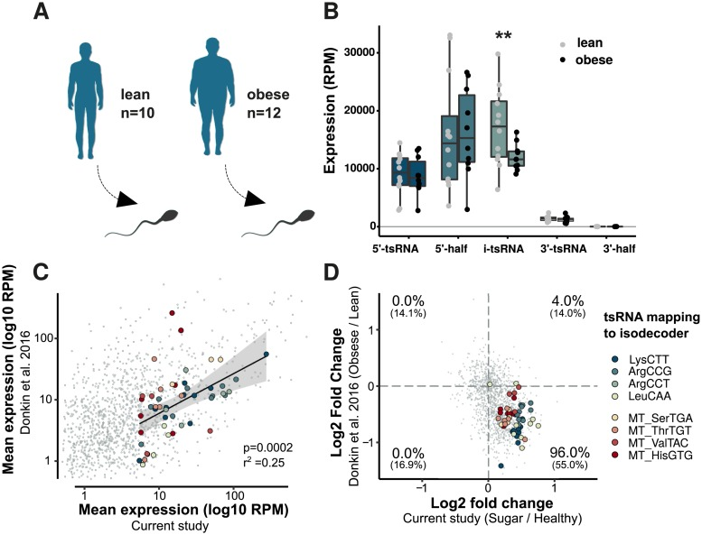
… continued Nätt D, et al. Human sperm displays rapid responses to diet. PLoS Biol. 2019 Dec 26;17(12):e3000559.
Small RNA
Comparison to a study comparing small RNA expression differences between lean and obese men
High sugar diet effects healthy young men opposite to obesity
Notes:
The global rise in obesity and steady decline in sperm quality are two alarming trends that have emerged during recent decades. In parallel, evidence from model organisms shows that paternal diet can affect offspring metabolic health in a process involving sperm tRNA-derived small RNA (tsRNA). Here, we report that human sperm are acutely sensitive to nutrient flux, both in terms of sperm motility and changes in sperm tsRNA. Over the course of a 2-week diet intervention, in which we first introduced a healthy diet followed by a diet rich in sugar, sperm motility increased and stabilized at high levels. Small RNA-seq on repeatedly sampled sperm from the same individuals revealed that tsRNAs were up-regulated by eating a high-sugar diet for just 1 week. Unsupervised clustering identified two independent pathways for the biogenesis of these tsRNAs: one involving a novel class of fragments with specific cleavage in the T-loop of mature nuclear tRNAs and the other exclusively involving mitochondrial tsRNAs. Mitochondrial involvement was further supported by a similar up-regulation of mitochondrial rRNA-derived small RNA (rsRNA). Notably, the changes in sugar-sensitive tsRNA were positively associated with simultaneous changes in sperm motility and negatively associated with obesity in an independent clinical cohort. This rapid response to a dietary intervention on tsRNA in human sperm is attuned with the paternal intergenerational metabolic responses found in model organisms. More importantly, our findings suggest shared diet-sensitive mechanisms between sperm motility and the biogenesis of tsRNA, which provide novel insights about the interplay between nutrition and male reproductive health.

Slide 15
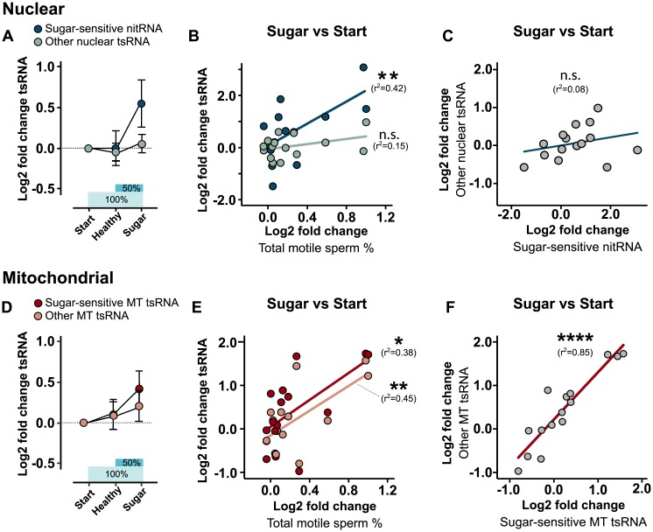
… continued Nätt D, et al. Human sperm displays rapid responses to diet. PLoS Biol. 2019 Dec 26;17(12):e3000559.
Small RNA
Sugar-sensitive tsRNA associated with sperm motility
Very specific to nuclear tsRNA
… but not specific for mitochondrial tsRNA
Notes:
The global rise in obesity and steady decline in sperm quality are two alarming trends that have emerged during recent decades. In parallel, evidence from model organisms shows that paternal diet can affect offspring metabolic health in a process involving sperm tRNA-derived small RNA (tsRNA). Here, we report that human sperm are acutely sensitive to nutrient flux, both in terms of sperm motility and changes in sperm tsRNA. Over the course of a 2-week diet intervention, in which we first introduced a healthy diet followed by a diet rich in sugar, sperm motility increased and stabilized at high levels. Small RNA-seq on repeatedly sampled sperm from the same individuals revealed that tsRNAs were up-regulated by eating a high-sugar diet for just 1 week. Unsupervised clustering identified two independent pathways for the biogenesis of these tsRNAs: one involving a novel class of fragments with specific cleavage in the T-loop of mature nuclear tRNAs and the other exclusively involving mitochondrial tsRNAs. Mitochondrial involvement was further supported by a similar up-regulation of mitochondrial rRNA-derived small RNA (rsRNA). Notably, the changes in sugar-sensitive tsRNA were positively associated with simultaneous changes in sperm motility and negatively associated with obesity in an independent clinical cohort. This rapid response to a dietary intervention on tsRNA in human sperm is attuned with the paternal intergenerational metabolic responses found in model organisms. More importantly, our findings suggest shared diet-sensitive mechanisms between sperm motility and the biogenesis of tsRNA, which provide novel insights about the interplay between nutrition and male reproductive health.

Slide 16
… continued Nätt D, et al. Human sperm displays rapid responses to diet. PLoS Biol. 2019 Dec 26;17(12):e3000559.
Small RNA
Conclusions
Sperm does appear to respond rapidly to diet
Effect on offspring?
Resemble correlates of obesity in sperm
Offspring effects in drosophila
Could certainly influence fertility
Limitations
Cannot rule out healthy diet continuing to have effects in week 2
tRNAs not the only small RNAs effected
Evidence for tRNAs playing a role in passing on metabolic programming from father to sperm to egg to offspring is largely based on mouse data
Do tRNAs come from sperm gene expression or via exosomes from somatic cells?
Notes:
The global rise in obesity and steady decline in sperm quality are two alarming trends that have emerged during recent decades. In parallel, evidence from model organisms shows that paternal diet can affect offspring metabolic health in a process involving sperm tRNA-derived small RNA (tsRNA). Here, we report that human sperm are acutely sensitive to nutrient flux, both in terms of sperm motility and changes in sperm tsRNA. Over the course of a 2-week diet intervention, in which we first introduced a healthy diet followed by a diet rich in sugar, sperm motility increased and stabilized at high levels. Small RNA-seq on repeatedly sampled sperm from the same individuals revealed that tsRNAs were up-regulated by eating a high-sugar diet for just 1 week. Unsupervised clustering identified two independent pathways for the biogenesis of these tsRNAs: one involving a novel class of fragments with specific cleavage in the T-loop of mature nuclear tRNAs and the other exclusively involving mitochondrial tsRNAs. Mitochondrial involvement was further supported by a similar up-regulation of mitochondrial rRNA-derived small RNA (rsRNA). Notably, the changes in sugar-sensitive tsRNA were positively associated with simultaneous changes in sperm motility and negatively associated with obesity in an independent clinical cohort. This rapid response to a dietary intervention on tsRNA in human sperm is attuned with the paternal intergenerational metabolic responses found in model organisms. More importantly, our findings suggest shared diet-sensitive mechanisms between sperm motility and the biogenesis of tsRNA, which provide novel insights about the interplay between nutrition and male reproductive health.

Slide 17
Zito et al. Heritability of skewed X-inactivation in female twins is tissue-specific and associated with age. Nat Commun. 2019 Nov 25;10(1):5339.
Epigenetics
X-inactivation skewing is strongly affected by environment
Background
In females, one copy of X is silenced, parent of origin seems random
However, 'skewing' to one parent has been associated with several traits
Increases with age
To what extent is skewing genetic or environmental?
N=856 from TwinsUK
Blood, adipose, skin, lymphoblastoid cell lines
Skewing is
Tissue-specific but similar between immune cell types
Increases with age in blood only
Associated with smoking and Rheumatoid Arthritis
Heritable in blood over age 55 (h2 = 0.34) but not earlier or in other tissues
Notes:
Female somatic X-chromosome inactivation (XCI) balances the X-linked transcriptional dosages between the sexes. Skewed XCI toward one parental X has been observed in several complex human traits, but the extent to which genetics and environment influence skewed XCI is largely unexplored. To address this, we quantify XCI-skew in multiple tissues and immune cell types in a twin cohort. Within an individual, XCI-skew differs between blood, fat and skin tissue, but is shared across immune cell types. XCI skew increases with age in blood, but not other tissues, and is associated with smoking. XCI-skew is increased in twins with Rheumatoid Arthritis compared to unaffected identical co-twins. XCI-skew is heritable in blood of females >55 years old (h<sup>2</sup>â€‰=â€‰0.34), but not in younger individuals or other tissues. This results in a Gene x Age interaction that shifts the functional dosage of all X-linked heterozygous loci in a tissue-restricted manner.

Slide 18
Zaghlool et al. Epigenetics meets proteomics in an epigenome-wide association study with circulating blood plasma protein traits. Nat Commun. 2020 Jan 3;11(1):15.
EWAS
EWAS
N=944 from KORA (replication in N=344)
1123 proteins
Uncorrected EWAS models: 12,606 associations involving 10,047 CpG sites and 116 proteins
EWAS corrected for cell composition, sex, age and smoking: 98 associations involving 89 CpG sites and 15 proteins
Functional analyses of CpG sites indicate processes related to chronic low-grade inflammation
Notes:
DNA methylation and blood circulating proteins have been associated with many complex disorders, but the underlying disease-causing mechanisms often remain unclear. Here, we report an epigenome-wide association study of 1123 proteins from 944 participants of the KORA population study and replication in a multi-ethnic cohort of 344 individuals. We identify 98 CpG-protein associations (pQTMs) at a stringent Bonferroni level of significance. Overlapping associations with transcriptomics, metabolomics, and clinical endpoints suggest implication of processes related to chronic low-grade inflammation, including a network involving methylation of NLRC5, a regulator of the inflammasome, and associated pQTMs implicating key proteins of the immune system, such as CD48, CD163, CXCL10, CXCL11, LAG3, FCGR3B, and B2M. Our study links DNA methylation to disease endpoints via intermediate proteomics phenotypes and identifies correlative networks that may eventually be targeted in a personalized approach of chronic low-grade inflammation.

Slide 19
Williams et al. Plasma protein patterns as comprehensive indicators of health. Nat Med. 2019 Dec;25(12):1851-1857.
PWAS
The first PWAS
N=16,894
~5000 plasma proteins measured
13 health indicators
Elastic models derived (70% of data), refined (15%) and validated (15%)
Models for 11 indicators successfully generated
So many questions, e.g. How do these performances compare to DNAm? How persistent are protein associations? Are protein levels good predictors?
Notes:
Proteins are effector molecules that mediate the functions of genes<sup>1,2</sup> and modulate comorbidities<sup>3-10</sup>, behaviors and drug treatments<sup>11</sup>. They represent an enormous potential resource for personalized, systemic and data-driven diagnosis, prevention, monitoring and treatment. However, the concept of using plasma proteins for individualized health assessment across many health conditions simultaneously has not been tested. Here, we show that plasma protein expression patterns strongly encode for multiple different health states, future disease risks and lifestyle behaviors. We developed and validated protein-phenotype models for 11â€‰different health indicators: liver fat, kidney filtration, percentage body fat, visceral fat mass, lean body mass, cardiopulmonary fitness, physical activity, alcohol consumption, cigarette smoking, diabetes risk and primary cardiovascular event risk. The analyses were prospectively planned, documented and executed at scale on archived samples and clinical data, with a total of ~85â€‰million protein measurements in 16,894â€‰participants. Our proof-of-concept study demonstrates that protein expression patterns reliably encode for many different health issues, and that large-scale protein scanning<sup>12-16</sup> coupled with machine learning is viable for the development and future simultaneous delivery of multiple measures of health. We anticipate that, with further validation and the addition of more protein-phenotype models, this approach could enable a single-source, individualized so-called liquid health check.

Slide 20
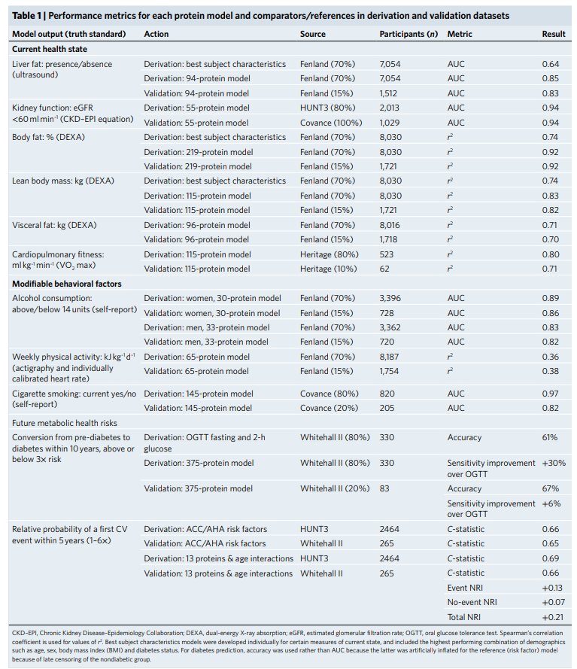

Slide 21
