Slide 1
Journal club August 3, 2020
Categories​ | Number​
EWAS​ | 8
DNAm score | 4
Methods | 1
meQTL | 1

Slide 2
Smoking changes DNAm in the brain but not like blood or saliva or fat or lung
Markunas CA, Semick SA, Quach BC, et al. Genome-wide DNA methylation differences in nucleus accumbens of smokers vs. nonsmokers. Neuropsychopharmacology. 2020;10.1038/s41386-020-0782-0. n=120 European American; n=101 African American (~25% smokers)
nicotine
smoking gwas
smoking exp
prenatal smoke
lung cancer
schizophrenia
dopamine

Slide 3
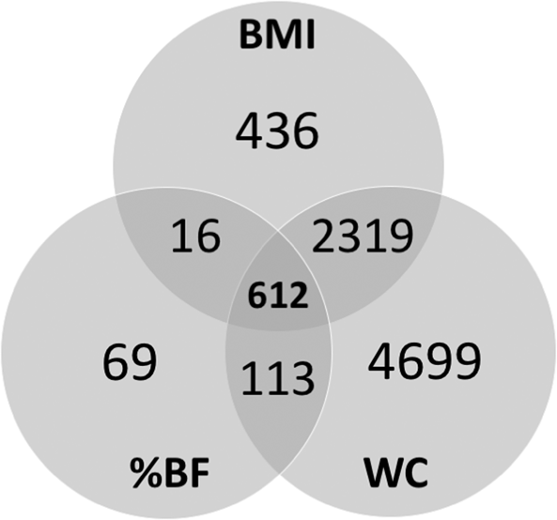
EWAS
Phenotype | Tissue | N | CpGs | Note | PMID | Journal
BMI, WC, %BF | Blood | 2325 (mostly age 50-64) | 8264 | %BF and WC biologically distinct | 32728124 | Int J Obes (Lond)
Death | Blood | 12300 (CHARGE) | 9 | MR association of 2 with CHD | 32697766 | Aging
Dementia | Blood | 73 cases vs 87 controls | 1 | Blood samples taken prior to diagnosis | 32671182 | Alzheimers Dement (Amst).
Pyrethroid pesticide | Blood | 237 | 4 |  | 32679516 | Int J Hyg Environ Health
Polychlorinated biphenyls (PCBs) | Blood | 641 | 1345 (!) | R=0.29 with CRP EWAS effects | 32660331 | Epigenetics
Maternal plasma persistent organic pollutants (POP) | Placenta | 260 | 214 with 10 POPs | 44 of these also associated with birth length, birthweight or head circumference (in this study) | 32653021 | Clin Epigenetics
Dyslipidemia | Placenta | 262 | 11 | *only access to a confusing abstract* | 32677467 | Epigenomics

Slide 4
DNAm CRP is much more than CRP
Stevenson AJ, McCartney DL, Hillary RF, et al. Characterisation of an inflammation-related epigenetic score and its association with cognitive ability. Clin Epigenetics. 2020;12(1):113. Data: Lothian Birth Cohort (n=889), Generation Scotland (n=7028)
R~0.3 between serum CRP and DNAm CRP score
 | Serum CRP | DNAm CRP score
Genetic CRP | R>0.2 | Null
Age | Decrease (p=0.003) | Increase (p < 2e-16)
BMI/ Smoking | Pos/Pos | Pos/Pos
Alcohol/Social deprivation | Null | Pos/Neg
Reliability (test-re-test) | ICC=0.72 | ICC=0.82
Cognitive ability | None (p > 0.25) | Negative (p = 0.04)

Slide 5
Colorectal cancer predictor puts reviewers to sleep
Onwuka JU, Li D, Liu Y, et al. A panel of DNA methylation signature from peripheral blood may predict colorectal cancer susceptibility. BMC Cancer. 2020;20(1):692. n=166 cases vs n=424 controls (GEO)
Methods
EWAS identified 48 differentially methylated CpG sites
Dataset split into 70% training/30% testing partitions
LASSO identifies 22-CpG site model from 48
Stepwise logistic regression identifies 19-CpG site model from 48
Final model generated by fitting logistic regression model to 16 sites in common
In 30% testing partition: AUC = 0.82
In TCGA data: AUC = 0.73 (appears that model coefficients were recalculated)

Slide 6
Circulating tumor DNA methylation can be detected
Chen X, Gole J, Gore A, et al. Non-invasive early detection of cancer four years before conventional diagnosis using a blood test. Nat Commun. 2020;11(1):3475. Small amounts of tumor DNA ends up in blood (‘circulating tumor DNA’ = ‘ctDNA’)
Strategy (PanSeer):
Identify hundreds DNAm differences between tumor and normal tissue (11,787 CpG sites across 595 regions)
Use a sensitive method to measure DNA methylation at these loci in ctDNA (semi-targeted PCR)
Train a predictive model using ‘ensemble logistic regression’
Test: apply model to participants who provided samples prior to being diagnosed with stomach, esophageal, colorectal, lung or liver cancer <= 4 years later
Results: Sensitivity > 94%, Specificity > 95%

Slide 7
GrimAge and DunedinPoAm are complementary
Hillary RF, Stevenson AJ, McCartney DL, et al. Epigenetic measures of ageing predict the prevalence and incidence of leading causes of death and disease burden. Clin Epigenetics. 2020;12(1):115. Data: Generation Scotland split into discovery (n=4450) and replication (n=2578).
Methods:
DNAm measures: GrimAge, PhenoAge, Telomere Length, DunedinPoAm, HannumAge, DNAmAge
Phenotypes: 33 including all cause mortality, 14 disease, 18 continuous
Association tests (33 x 6) in the discovery set
Basic model: Phenotype ~ Epigenetic Measure + age + sex
Fully adjusted model: Phenotype ~ Epigenetic Measure + age + sex + alcohol units consumed per week + body mass index + educational attainment + Scottish Index of Multiple Deprivation + smoking pack years
Any the survive adjustment for multiple tests are evaluated in the replication set

Slide 8
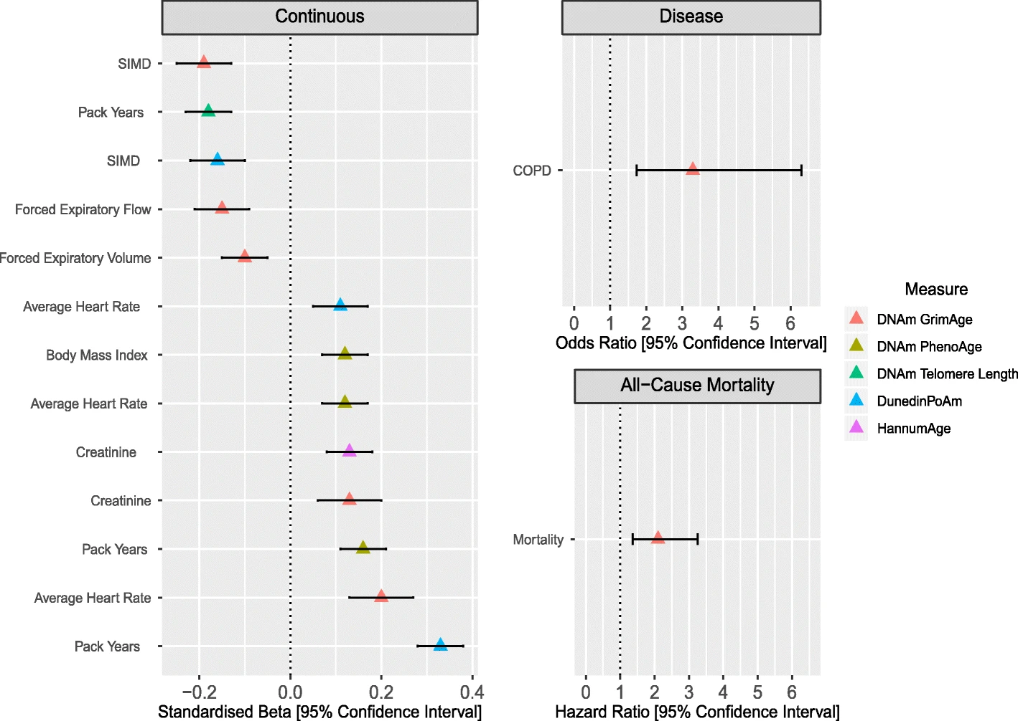
GrimAge
Telomere Length
DunedinPoAm
GrimAge
GrimAge
GrimAge
DunedinPoAm
PhenoAge
PhenoAge
HannumAge
GrimAge
GrimAge
PhenoAge
GrimAge
DunedinPoAm
SIMD = Scottish Index of Multiple Deprivation

Slide 9
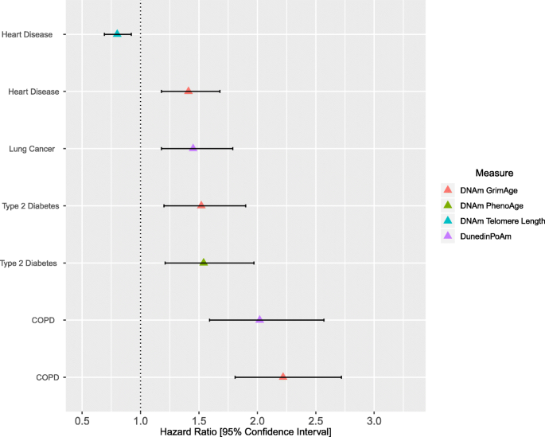
Telomere Length
GrimAge
DunedinPoAm
GrimAge
PhenoAge
DunedinPoAm
GrimAge

Slide 10
Forget about meQTLs, here DNAm modifies SNP effects
Romanowska J, Haaland ØA, Jugessur A, et al. Gene-methylation interactions: discovering region-wise DNA methylation levels that modify SNP-associated disease risk. Clin Epigenetics. 2020;12(1):109. Input: case-parent dyad/triad genotypes, DNAm profiles for cases
Method: Search for interactions –
G x Me: methylation modifies SNP effect
PoO x Me: methylation modifies parent-of-origin SNP effect (parent-of-origin effect: SNP effect depends on parent it came from)
Power is a huge issue – summarize methylation over regions (average DNAm)
Apply in cleft study as proof of principle, identify a couple of examples

Slide 11
Genotype loses to environment in old age
Reynolds CA, Tan Q, Munoz E, et al. A decade of epigenetic change in aging twins: Genetic and environmental contributions to longitudinal DNA methylation. Aging Cell. 2020;e13197. Data: 96 pairs of elderly twins, blood DNAm measured 2 times, 10 years apart
Methods: Fit “bivariate ACE and ADE Cholesky models to evaluate the degree to which additive genetic (A), dominance or non‐additive genetic (D), common environmental (C), and non‐shared factors (E) contribution DNAm variation”
Results:
Genotype explains 23.8% of DNAm variation at time 1, and 18% at time 2
Age-associated CpG sites (previous studies) were more heritable than others
5K most heritable sites enriched in immune and inflammation pathways
2K least stable sites were enriched in stress-related pathways

