Slide 1
Journal club September 14, 2020
Categories​ | Number​
EWAS​ | 3
Methods | 1
Data quality | 1
Review | 1

Slide 2
EWAS
Phenotype | Tissue | Population | Study | N | CpGs | Note | PMID | Journal
Micornutrient supp (tablet) | Blood | Indian children age 7-9 | EMPHASIS RCT | 698 | 6 | Enriched with meta-stable epialleles | 32889533 | Am J Clin Nutr
Micronutrient supp (food) |  | Gambian children age 7-9 |  | 293 | 1
Waist circumference | Blood | African-American adults | ARC study | 2684 | 11 | Replicated in WHI and FHS (n=5743) and 2 replicated in The Raine Study (adolescents; n=820). Novel associations near TXNIP, ADCY7, SREBF1 and RAP1GAP2 | 32901515 | Epigenomics
Waist to hip ratio
Waist to height ratio
Maternal atopy | Cord blood | Infants | ELMA | 96 | 83 | Unsure if children tested for atopy. | 32902349 | Epigenetics

Slide 3
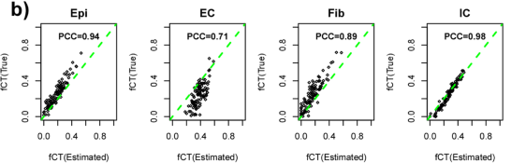
scRNA-seq -> DNAm cell type reference
Teschendorff, A.E., Zhu, T., Breeze, C.E. et al. EPISCORE: cell type deconvolution of bulk tissue DNA methylomes from single-cell RNA-Seq data. Genome Biol 21, 221 (2020).
Idea: Single-cell RNA-seq profiles are ideal for cataloguing and defining cell types. Perhaps we can use them to estimate DNA methylation tissue references (where none currently exists).
EPISCORE
Single-cell RNA-seq profiles -> mRNA expression tissue reference
Matching bulk RNA-seq and DNAm -> build model to predict DNAm from RNA-seq
mRNA expression tissue reference + model -> DNAm tissue reference
Lung Tissue Example

Slide 4
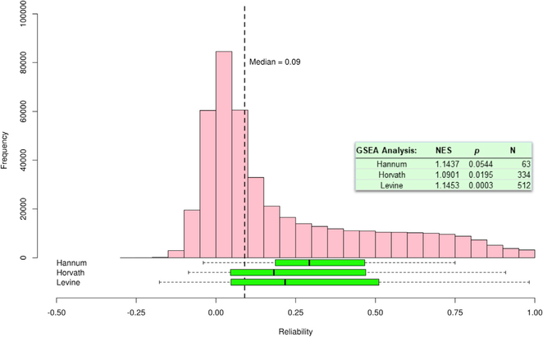
DNAm is more informative than our data indicates
Sugden K, Hannon EJ, Arseneault L, et al. Patterns of Reliability: Assessing the Reproducibility and Integrity of DNA Methylation Measurement. Patterns (N Y). 2020;1(2):100014.
Data: DNAm of 350 blood samples measure using both Illumina HumanMethylation450K and the Infinium MethylationEPIC BeadChips.
Reliability is low and highly variable (ICC range -0.28 to 1, median=0.09)
Reliable probes are more heritable and most strongly associated with environmental exposure (ACE model applied to twin DNAm)
Reliable probes are more likely to have an meQTL
Reliable probes more likely to be replicated in smoking studies
DNAm clocks have mostly unreliable probes
Reliable probes are more strongly associated with gene expression
Reliable probes are more strongly correlated between blood and brain

Slide 5
The future of genomics according to 12 leading researchers
McGuire AL, Gabriel S, Tishkoff SA, et al. The road ahead in genetics and genomics. Nat Rev Genet. 2020;1-16.
Some agreement
All: more data
All: apply or develop some cool new technology
Population-scale databases of all human populations (4-5 of 12)
Use CRISPR (3 of 12)

Slide 6
Researcher | Summary
Amy McGuire (Baylor College of Medicine) | Equity in genomics
Stacey Gabriel (Broad Institute) | Population-scale data by improving sequencing
Sarah Tishkoff (University of Pennsylvania) | Inclusion of all human populations in cell line studies
Ambroise Wonkam (University of Cape Town) | African genomic variation
Aravinda Chakravarti (New York University School of Medicine) | “Solve” a few complex traits completely
Eileen E. M. Furlong (EMBL) | Single-cell genomics with single-cell imaging
Barbara Treutlein (ETH Zurich) | ‘Spatial’ single cell multi-omics
Alexander Meissner (Max Planck Institute) | Take epigenetics from descriptive to mechanism using new technologies
Howard Y. Chang (Stanford University) | Large-scale creation and testing of synthetic lncRNAs
Núria López-Bigas (University Pompeu Fabra) | Determine what is sufficient for cancer
Eran Segal (Weizmann Institute of Science) | Go beyond correlation using iPS cell models and multi-omic profiling of cohorts
Jin-Soo Kim (Institute for Basic Science in Daejon) | Medical applications of programmable nucleases
Notes:
Amy McGuire (Baylor College of Medicine) studies ethical and policy issues related to emerging technologies. She has a TedMed talk titled “There is No Genome for the Human Spirit” (2014).
"The genomics of the future must be a genomics for all, regardless of ethnicity, geography or ability to pay."
1. "equitable representation in genomic research", i.e. study participants
2. "equitable access to the fruits of that research", i.e. health care
3. "equitable outcomes from genomic medicine", i.e. health outcomes
Stacey Gabriel is Senior Director of the Genomics Platform at the Broad Institute. She has contributed to the International HapMap Project, the 1000 Genomes Project, The Cancer Genome Atlas, the National Heart, Lung, and Blood Institute’s Exome Sequencing Project and the TOPMed programme.
"building up population-scale databases of genomic plus clinical information"
However, "The cost per megabase of sequence data has remained largely unchanged since around 2016".
Solution: innovation, scale, competition,
Sarah Tishkoff (University of Pennsylvania) works on genomic variation in Africa, human evolutionary history, the genetic basis of adaptation, phenotypic variation and susceptibility to infectious disease in Africa.
Studies should be more inclusive of all human populations and focus on causal analysis in the lab using cell lines, induced pluripotent cell lines and CRISPR. To get a better understand evolution, we need better methods for sequencing ancient DNA.
Ambroise Wonkam (University of Cape Town) investigates clinical variability in sickle cell disease, hearing impairment genetics and the return of individual findings in genetic research in Africa.
"African genomic variation represents the next frontier of genetic medicine for three major reasons: ancestry, ecology and equity."
Aravinda Chakravarti (New York University School of Medicine) has been a key participant in the Human Genome Project, the International HapMap Project and the 1000 Genomes Project. His research attempts to understand the molecular basis of multifactorial disease.
We must go beyond GWAS to identify loci that contribute the 'core biology' of a trait, especially those in non-coding regions. This can be achieved by investigating relationships between transcription factors and enhancers and between gene regulatory networks and specific cellular responses. Our goal should be "solving at least a few complex traits completely".
Eileen E. M. Furlong (EMBL) investigates the fundamental principles of how the genome is regulated and how it drives cell fate decisions during embryonic development, including how developmental enhancers are organized and function within the 3D nucleus.
"The systematic functional dissection of gene regulation and true integration of single-cell genomics with single-cell imaging will bring many exciting advances in our understanding of the programmes driving embryonic development in the coming years."
Barbara Treutlein (ETH Zurich) uses and develops single-cell genomics approaches in combination with stem cell-based 2D and 3D culture systems to study how human organs develop and regenerate and how cell fate is regulated.
Spatial multi-omics in single cells applied "to human 2D cell culture and 3D organoid biosystems".
Alexander Meissner (Max Planck Institute) uses genomic tools to study developmental and disease biology with a particular focus on epigenetic regulation.
Epigenetics has largely been descriptive and failed to explain basic questions (e.g. gene body methylation). This can change with new technologies such as CRISPR, organoids, chromosome conformation capture, etc.
Howard Y. Chang (Stanford University) works on deciphering the hidden information in the non-coding genome, investigating long non-coding RNAs in gene regulation and developing new epigenomic technologies.
We will develop "technologies for large-scale creation and testing of synthetic lncRNAs" to better understand the "information content" of RNA sequences and shapes.
Núria López-Bigas (University Pompeu Fabra) focuses on the identification of cancer driver mutations, genes and pathways across tumour types and in understanding the mutational processes that lead to the accumulation of mutations in cancer cells.
We have identified examples of oncogenes, we need to catalog all of them across different tissues. We know that cancer is the result of cellular variation and selection getting out of control. Why doesn't this happen more often? We know that 'driver mutations' are necessary for cancer. What is sufficient for cancer to occur?
Eran Segal (Weizmann Institute of Science) uses his experience in machine learning, computational biology and analysis of heterogeneous high-throughput genomic data to study the microbiome, nutrition and genetics, and their effect on health and disease.
"By continuing to focus on more and more measurements and the creation of more atlases and catalogues, we run the danger of drowning in ever-growing amounts of data and correlative findings."
"Instead, we should use genomics to tackle big unanswered questions such as what causes the variation that we see across people in phenotypes, disease susceptibility and drug responses?"
How:
- "At the cellular level, we can use iPS cells from patients to derive cellular models of multiple diseases and prioritize treatments based on measuring both their cellular and molecular response (for example, gene expression and epigenetics) to existing drugs and drug combinations."
- "we can be much more ambitious and directly profile large cohorts of human individuals using diverse ‘omics’ assays."
- there a variety of approaches for obtaining causal information from observational studies.
Jin-Soo Kim (Institute for Basic Science in Daejon) focuses on developing tools for genome editing in biomedical research.
We should tackle "questions related to medical applications of programmable nucleases concern their mode of delivery, specificity, on-target activity and immunogenicity."

Slide 7
Strongest opinion
Eran Segal
"By continuing to focus on more and more measurements and the creation of more atlases and catalogues, we run the danger of drowning in ever-growing amounts of data and correlative findings."
"Instead, we should use genomics to tackle big unanswered questions such as what causes the variation that we see across people in phenotypes, disease susceptibility and drug responses?"

