Slide 1
Epigenetic Epidemiology Update
Matthew Suderman
MRC Integrative Epidemiology Unit
June 7, 2021

Slide 2
EWAS of COVID-19
PMID | Phenotype | Tissue | Study population | Assocs
33867313¹ | COVID-19 severity | Blood | 194 mild, 213 severe | 44
34034806² | COVID-19 outcome COVID-19 severity | Blood | 102 cases, 39 ctrls 100 cases | 1505 DMRs (DMRcate) 19 DMRs
¹Create ‘EPICOVID’ score for predicting severity but use 44 CpG sites which were replicated in testing dataset.
²Reference first study in Discussion but make no effort to compare findings.

Slide 3
EWAS of risk
PMID | Disease | Tissue | Study population | Assocs
34008478* | Lung cancer risk | Blood | 208 pre-diagnostic cases, 222 ctrls | 16
33980183 | CVD risk | Blood | 83 pre-diagnostic cases, 83 matched ctrls | 8
33964519 | PTSD | Blood | 74 PTSD, 75 traumatized ctrls, 75 ctrls | ?
*Controlled for smoking using a DNA methylation smoking so no typical smoking CpG sites included in the 16.

Slide 4
EWAS of exposure
PMID | Exposure | Tissue | Study population | Assocs
34044884 | Sex | Placenta | 343 placentas | 162
33990564 | Coffee and tea intake | Blood | 15789 (15 cohorts) | 11 (coffee)
33993705 | Alcohol intake | Blood | 57 MZ twins | 1*
* Cpg site has never been linked to alcohol intake previously.

Slide 5
Single-cell epigenetics of T1D
Chiou J, et al. Interpreting type 1 diabetes risk with genetics and single-cell epigenomics. Nature. 2021 May 19.
GWAS of type 1 diabetes (n=520,850 samples)
Create ‘open chromatin’ profiles for individual blood and pancreas cells (snATAC-seq for 131,544 nulcei)
Use snATAC-seq profiles to cluster nuclei by cell-type
Test enrichment of T1D genetic variants in open chromatin by cell type - T1D variants enriched in various T cells in blood but not in pancreas immune cells! - T2D variants enriched in pancreatic endocrine, acinar, ductal cells - however, restricting to cell-type-specific open chromatin identified enrichments in pancreatic cell types like beta cells
Pursue story of CFTR locus which contains one T1D variant …

Slide 6
Single-cell epigenetics of Atherosclerosis
Örd T, et al. Single-Cell Epigenomics and Functional Fine-Mapping of Atherosclerosis GWAS Loci. Circ Res. 2021 May 24.
7,000 cells derived from human atherosclerotic lesions
5 lesional cell types identified
Coronary Artery Disease associated genetic variants enriched in endothelial and smooth muscle cell-specific open chromatin
“We present several examples where the chromatin accessibility and gene expression could be assigned to one cell type predicting the cell type of action for CAD loci.”

Slide 7
Omics analysis of hypertension and the kidney
Eales JM, et al. Uncovering genetic mechanisms of hypertension through multi-omic analysis of the kidney. Nat Genet. 2021 May;53(5):630-637.
Samples: n=430 kidneys
Data: blood pressure, genotype, gene expression, alternative splicing, DNA methylation
Previous GWAS of BP: 918 associations
Kidney drugs: 210 drugs that target 49
Methods:
cis-eQTL, sQTL and mQTL analyses
Two-Sample MR to evaluate
effect of BP genetic variation on related outcomes (e.g. CHD)
effect of renal genes/methylation on BP

Slide 8
Omics analysis of hypertension and the kidney
Eales JM, et al. Uncovering genetic mechanisms of hypertension through multi-omic analysis of the kidney. Nat Genet. 2021 May;53(5):630-637.
Results
eQTL analysis links 232/918 BP SNPs (eSNPs) to genes (eGenes)
sQTL analysis links 164/918 BP SNPs (sSNPs) to gene splicing (sGenes)
mQTL analysis links 357/918 BP SNPs (mSNPs) to CpG methylation (mSites)
Using eSNPs, sSNPs and mSNPs as MR instruments showed slightly stronger effects than other BP SNPs for outcomes CHD and stroke but not different for other outcomes.
Evidence for causal effects of 309 (e/sGenes/mSites) on BP

Slide 9
Aging
Review of biomarkers
Li X, Ploner A, Wang Y, Zhan Y, Pedersen NL, Magnusson PK, Jylhävä J, Hägg S. Clinical biomarkers and associations with healthspan and lifespan: Evidence from observational and genetic data. EBioMedicine. 2021 Apr;66:103318.
Review of sex and aging
Hägg S, Jylhävä J. Sex differences in biological aging with a focus on human studies. Elife. 2021 May 13;10:e63425.
Skeletal muscle
Sillanpää E, et al. Blood and skeletal muscle ageing determined by epigenetic clocks and their associations with physical activity and functioning. Clin Epigenetics. 2021 May 17;13(1):110.
“Based on our results, the investigated epigenetic clocks have rather low value in estimating muscle ageing with respect to the physiological adaptations that typically occur due to ageing or PA.”

Slide 10
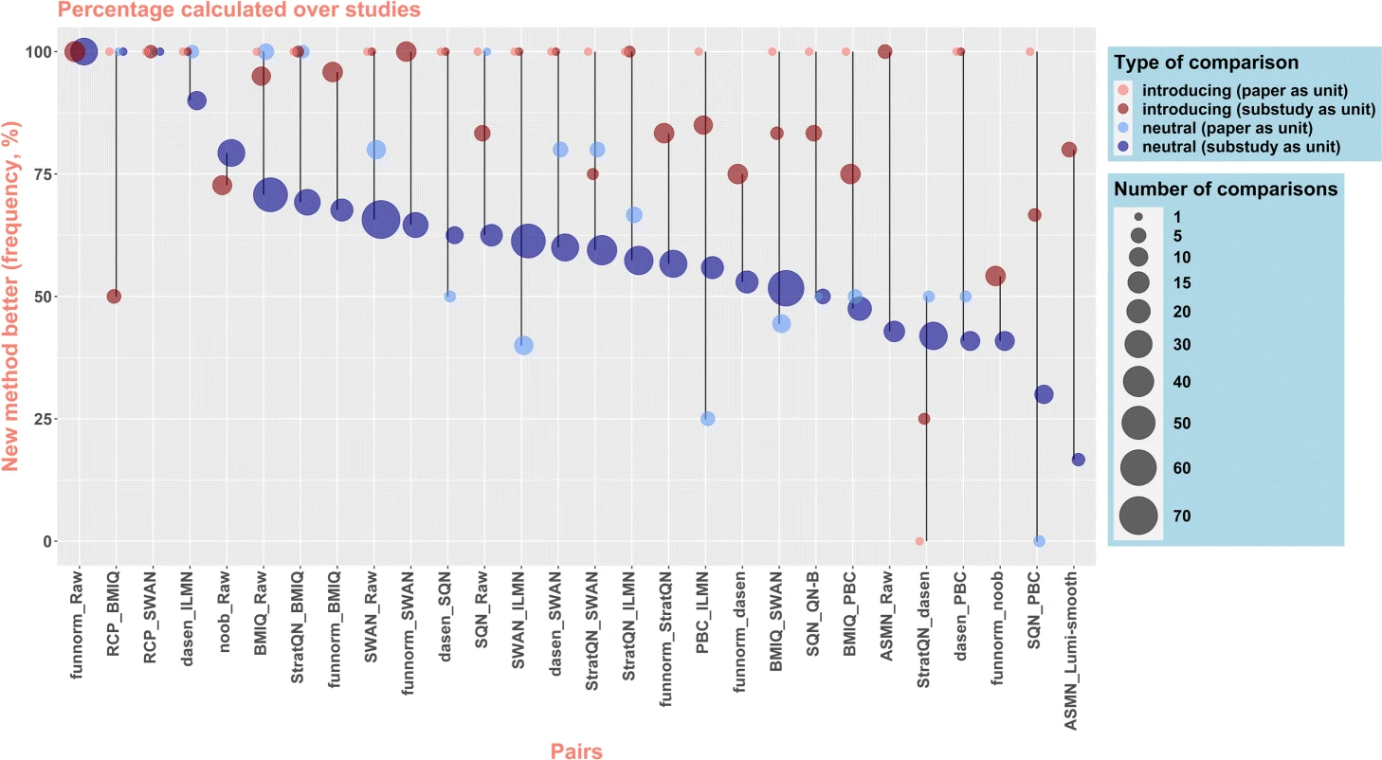
Methods
Buchka S, et al. On the optimistic performance evaluation of newly introduced bioinformatic methods. Genome Biol. 2021 May 11;22(1):152.
"For authors to feel comfortable reporting balanced results and detailing the weaknesses of their new methods, the acceptance of nuanced pictures and open statements must increase."
"the general scientific community and the journals in particular can play a positive role by acknowledging that neutral method-comparison studies are valuable research contributions"

Slide 11
Methods
Banerjee S, et al. Tejaas: reverse regression increases power for detecting trans-eQTLs. Genome Biol. 2021 May 6;22(1):142.
Identify trans-eQTLs by testing association with all genes simultaneously using penalised regression
Identify 18,851 trans eQTLs in GTEx across 49 tissues (cf only 141 identified previously)
Talukder A, Barham C, Li X, Hu H. Interpretation of deep learning in genomics and epigenomics. Brief Bioinform. 2021 May 20;22(3):bbaa177.
Describe methods for interpreting deep neural network models
Discuss how they have/can be applied in genomics and epigenomics

Slide 12
Protein-wide association studies (PWAS)
Will be worth comparing associations of these outcomes/phenotypes with DNA methylation and DNA methylation models of protein abundance.
Covid-19
Filbin MR, et al. Longitudinal proteomic analysis of severe COVID-19 reveals survival-associated signatures, tissue-specific cell death, and cell-cell interactions. Cell Rep Med. 2021 May 18;2(5):100287.
Metabolic syndrome
Elhadad MA, et al. Metabolic syndrome and the plasma proteome: from association to causation. Cardiovasc Diabetol. 2021 May 20;20(1):111.
Cardiorespiratory fitness
Robbins JM, et al. Human plasma proteomic profiles indicative of cardiorespiratory fitness. Nat Metab. 2021 May 27.

