Slide 1
Epigenetic Epidemiology Update
Matthew Suderman
MRC Integrative Epidemiology Unit
Sept 5, 2021

Slide 2
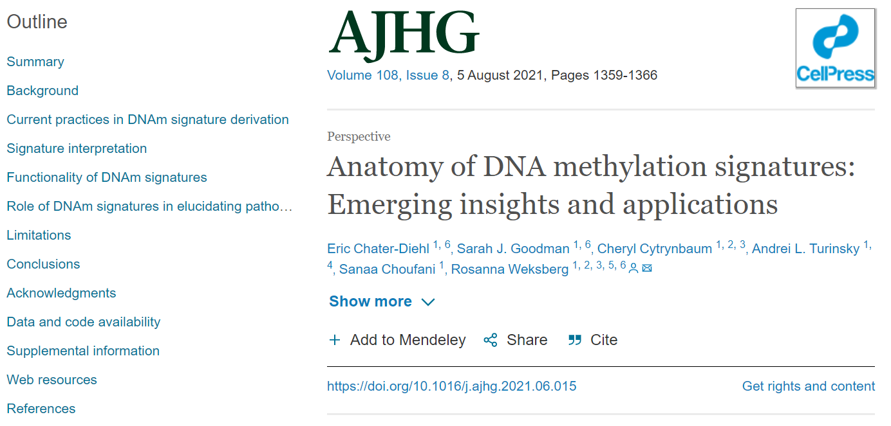

Slide 3
DNA methylation signatures
definition
“unique patterns of DNAm alterations
… defined for rare disorders
… caused by pathogenic variants
… in epigenetic regulatory genes.”
“there are >300 known epigenetic regulatory genes”
“∼100 of which are linked to neurodevelopmental disorders”
“~50 signatures have been identified”
“successful as predictive tools for classifying variants of uncertain significance as pathogenic or benign.”

Slide 4
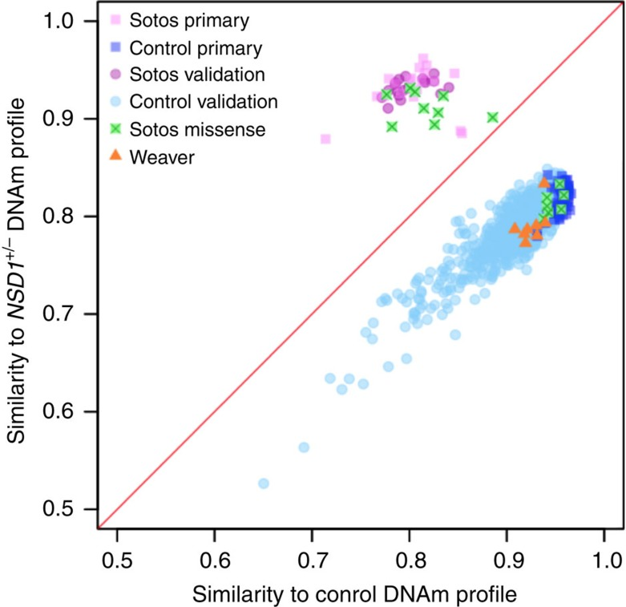
Variants of unknown significance
Some individuals have disease phenotypes but lack the genetic variation typically associated with the disease.
They may have other abnormal genetic variation ( ). Is this variation benign or pathogenic?
If the DNA methylation signature clusters them with other known cases, then we have evidence that the genetic variation may be pathogenic.
Cases
Controls
Choufani S, Cytrynbaum C, Chung BH, et al. NSD1 mutations generate a genome-wide DNA methylation signature. Nat Commun. 2015;6:10207.

Slide 5
“there are no published guidelines for signature generation”
Informal standards
Illumina Beadchip data
Cases vs controls (age and sex-matched)
Whole blood
Signature generation by EWAS
Adjustment for cell count estimates

Slide 6
Challenges
Defining cases: phenotypic uncertainty
Defining cases: non-uniform genetic variation
Sample sizes
Peripheral rather than non-target tissues
Signature size (a minimal signature may lack redundancy necessary to cover all cases)
Disorder specificity (distinct disorders may have phenotypic/genetic/epigenetic similarities)

Slide 7
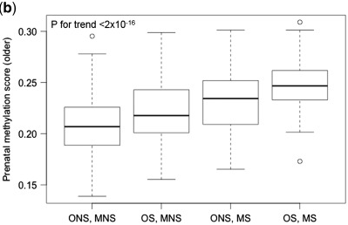
Neglected Specificity
We typically develop DNAm models by comparing
Cases vs controls
Exposed vs unexposed
Here specificity refers to correctly identifying controls/unexposed.
But what about related diseases or exposures?
Errors could lead to incorrect treatment …
Richmond RC, Suderman M, Langdon R, Relton CL, Davey Smith G. DNA methylation as a marker for prenatal smoke exposure in adults. Int J Epidemiol. 2018 Aug 1;47(4):1120-1130.

