Slide 1
Epigenetic Epidemiology Update
Matthew Suderman
MRC Integrative Epidemiology Unit
June 20, 2022

Slide 2
EWAS of disease/phenotype
PMID | Journal | Variable | Tissue | Sample | Associations
35703085 | World J Biol Psychiatry | anorexia | blood | 145 women | 205 active vs controls; 162 active vs remitted
35650177 | Transl Psychiatry | obsessive-compulsive disorder | blood | 76 cases vs controls | 9
35627945 | Healthcare (Basel) | schizophrenia with suicide ideation severity | blood | 112 | null
35595947 | Eur J Epidemiol | lung cancer | blood | 209 cases vs 826 controls (EPIC-Italy and NOWAC) | 29 (21 smoking-unrelated)
35635730 | Arthritis Rheumatol | systemic lupus erythematosus | blood 2 years apart | 101 | 256
35679866 | Am J Hum Genet | low vs high-grade osteoarthritis | cartilage; synoviocytes | 98 | 15328; 18 grade-specific mQTLs
35681244 | Clin Epigenetics | lung function (FEV1;FVC) | blood | 1677 adult Native Americans (Strong Heart Study) | elastic net
35652342 | Circulation | longitudinal cardiovascular health | blood | 1085 (CARDIA study) | 45

Slide 3
EWAS of exposure
PMID | Journal | Variable | Tissue | Sample | Associations
35700439 | Med Sci Sports Exerc | physical activity (accelerometer) | blood | 898 Japanese | 9
35692099 | Clin Transl Med | healthy lifestyle | blood | unhealthy vs healthy | 145
EWAS of mediation
PMID | Journal | Variable | Tissue | Sample | Associations
35654255 | Environ Pollut | mediation of plasma zinc on lung cancer risk | blood | 359 lung cancer cases vs 1399 controls | 7
35596190 | Clin Epigenetics | mediation of maternal sleep and offspring adiposity | cord blood | 231 (Shanghai Birth Cohort) | 13
35665255 | Front Cardiovasc Med | mediation of socioeconomic status on cardiovascular risk | monocytes | 1154 (MESA) | 410

Slide 4
EWAS at birth
PMID | Journal | Variable | Tissue | Sample | Associations
35690418 | Mutat Res Rev Mutat Res | sex differences | cord blood | 8438 infants (PACE) | 46979
35672357 | Sci Rep | sex differences | placenta | 532 | 5212

Slide 5
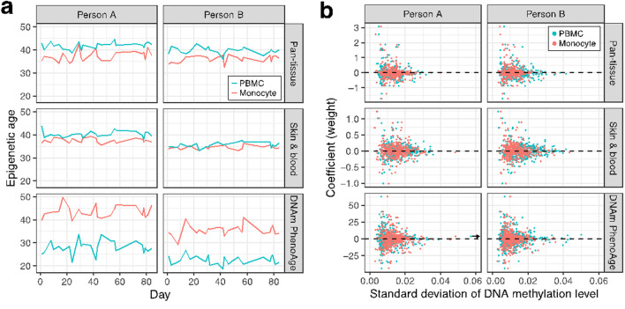
DNAm age fluctuates by up to 12 years in the same person!
Komaki, S., Ohmomo, H., Hachiya, T., Sutoh, Y., Ono, K., Furukawa, R., Umekage, S., Otsuka-Yamasaki, Y., Minabe, S., Takashima, A., Tanno, K., Sasaki, M., & Shimizu, A. (2022). Evaluation of short-term epigenetic age fluctuation. Clinical epigenetics, 14(1), 76.
DNAm age measured in two individuals 24 times over 3 months
(a) Shows fluctuations (range up to 12 years for Phenoage)
(b) Most fluctuation from sites with low weights in DNAm age models

Slide 6
Linking DNAm sites to genes
Lancaster, E. E., Vladimirov, V. I., Riley, B. P., Landry, J. W., Roberson-Nay, R., & York, T. P. (2022). Large-scale integration of DNA methylation and gene expression array platforms identifies both cis and trans relationships. Epigenetics, 1–21.
DNAm and gene expression in
N=137 Adolescent and Young Adult Twin Study (AYATS) and
N=131 Pregnancy, Race, Environment, Genes (PREG) study
Study | Significant associations | Direction | Unique CpGs | Unique tran-scripts | Mean adjR² (SD)
AYATS cis | 169 | 65% negative | 107 | 42 | 0.58 (0.11)
AYATS trans | 734 | 78% negative | 266 | 96 | 0.48 (0.10)
PREG cis | 121 | 79% negative | 87 | 31 | 0.46 (0.10)
PREG trans | 258 | 49% negative | 156 | 43 | 0.40 (0.08)

Slide 7
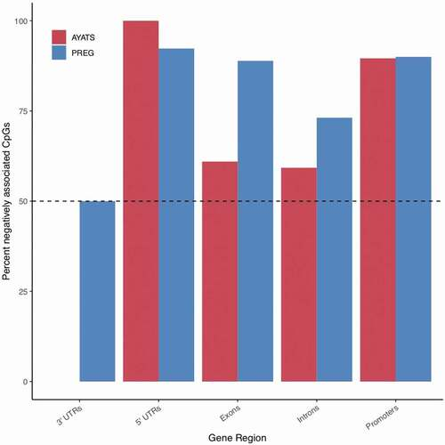
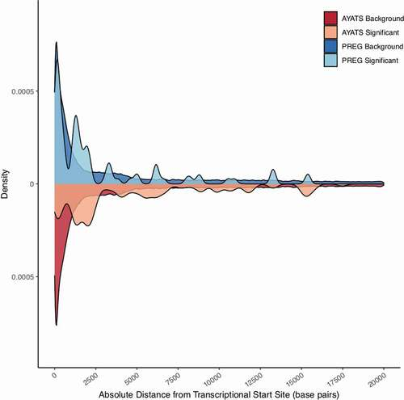
Linking DNAm sites to genes, cont.
Negative associations and gene regions
Distribution of distances (note difference between datasets!)

Slide 8
Linking DNAm sites to genes, cont.
Annotation | Cis |  |  | trans
 | Enriched | Depleted | Enriched | Depleted
PREG Chromatin States | TssA (1), ZNF/Rpts (8) | TssAFlnk (2), Tx (4) | TssAFlnk(2), TxFlnk (3), Enh (7), EnhBiv (12) | TxWk (5), Het (9), ReprPCWk (14),Quies (15)
CpG Classifiers | South Shore |  | North shore, South shore | Island
Gene Regions |  |  | Exons | Promoters, 3’-UTRs
Other | TF binding |  | Enhancers, TF binding
AYATS Chromatin States | TxFlnk (3), ZNF/Rpts (8) | Tx (4), TxWk (5), Quies (15) | TssAFlnk(2),TxFlnk (3), TxWk (5), EnhG (6), Enh (7) | TssA (1) Het (9),TssBiv (10), BivFlnk (11),ReprPC (13), ReprPCWk (14)
CpG Classifiers | South Shore | North shore, Island | South shore, Open sea | North shelf,North shore, Island
Gene Regions |  | 5’-UTRs, Promoters | Introns | 5’-UTRs, Promoters
Other | Enhancers, TF binding | lncRNAs | Enhancers | lncRNAs, Insulators
Underlined: in common Bold: Bonferroni p < 0.05

Slide 9
Linking DNAm sites to genes, cont.
(My) conclusions
Surprisingly little agreement between datasets (but likely because they were small so associations tend to be dataset-specific)
If disagreement is ‘real’, then really suggests that you need matched gene expression data to know which genes are regulated by DNAm sites – but this seems unlikely
Certainly, we should understand that trans associations lacking from gene enrichment studies

Slide 10
Predicting gene expression
Khunsriraksakul, C., McGuire, D., Sauteraud, R., Chen, F., Yang, L., Wang, L., Hughey, J., Eckert, S., Dylan Weissenkampen, J., Shenoy, G., Marx, O., Carrel, L., Jiang, B., & Liu, D. J. (2022). Integrating 3D genomic and epigenomic data to enhance target gene discovery and drug repurposing in transcriptome-wide association studies. Nature communications, 13(1), 3258.
PUMICE: A new method to predict gene expression levels from
eQTLs,
epigenomic annotation (H3K27ac, H3K4me3, DNase, and CTCF from ENCODE), and
3D genomes
Using a variation of elastic net to build predictors of gene expression from these inputs.
* Only one previous method used data other than eQTLs (EpiXcan used epigenomic reference data from Roadmap).

Slide 11
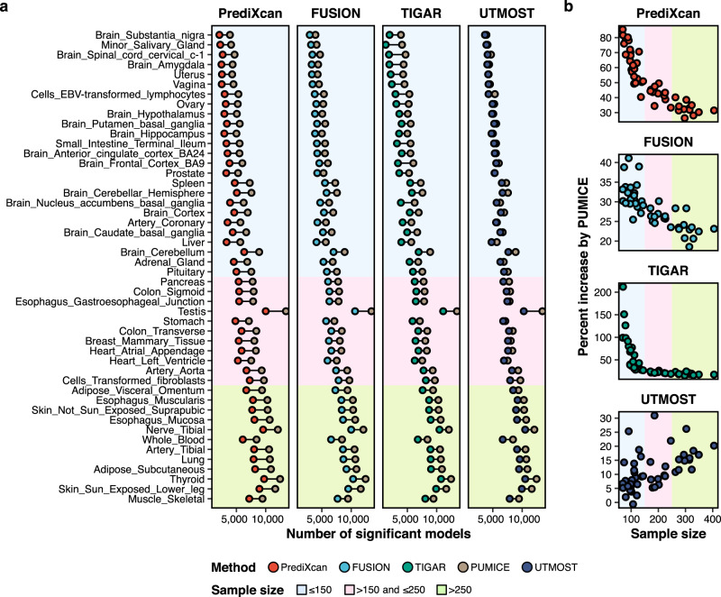
Comparison to other methods in GTEx
Outperforms previous methods in terms of number of gene predictions correlated with actual gene expression

Slide 12
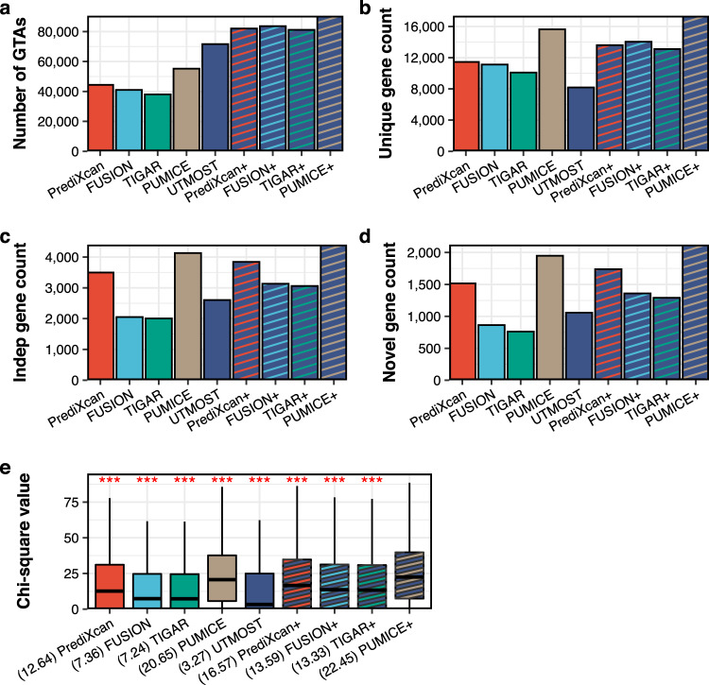
Comparison to other methods for identifying gene x trait associations
PUMICE performs well but PUMICE+ outperforms all methods.
PUMICE+
= PUMICE + eQTLs from multiple tissues
Conclusions
Epigenomic data and
Multiple tissues
provide information about gene expression beyond genotype.

Slide 13
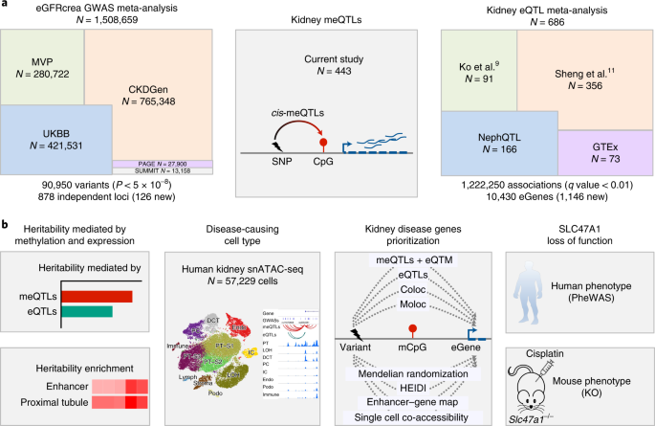
Multi-omics of kidney function from GWAS to PheWAS
Liu, H., Doke, T., Guo, D., Sheng, X., Ma, Z., Park, J., Vy, H., Nadkarni, G. N., Abedini, A., Miao, Z., Palmer, M., Voight, B. F., Li, H., Brown, C. D., Ritchie, M. D., Shu, Y., & Susztak, K. (2022). Epigenomic and transcriptomic analyses define core cell types, genes and targetable mechanisms for kidney disease. Nature genetics, 10.1038/s41588-022-01097-w.

Slide 14
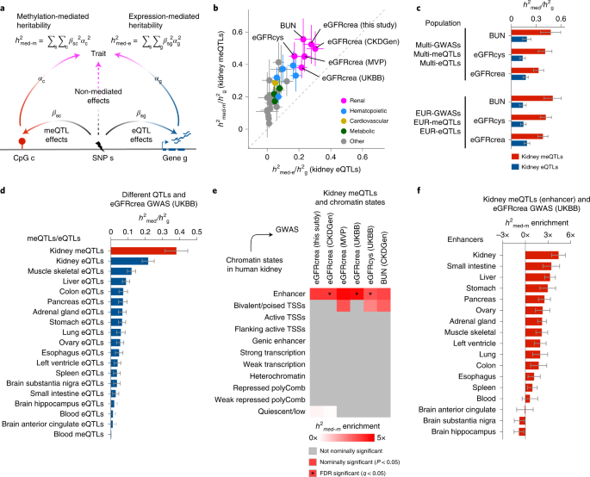
Heritability explained by DNAm and gene expression
DNAm-mediated heritability of kidney function is specifically enriched in enhancers
Heritability about 0.45 for DNAm and 0.2 for gene expression

Slide 15
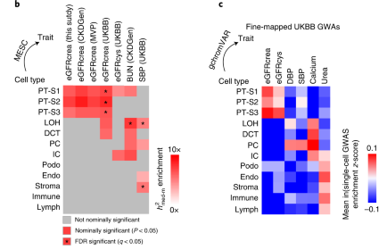
Identify causal kidney cell type – proximal tubules
DNAm-mediated heritability of kidney function is enriched in open chromatin of proximal tubules
Top GWAS loci enriched in open chromatin of proximal tubules

Slide 16
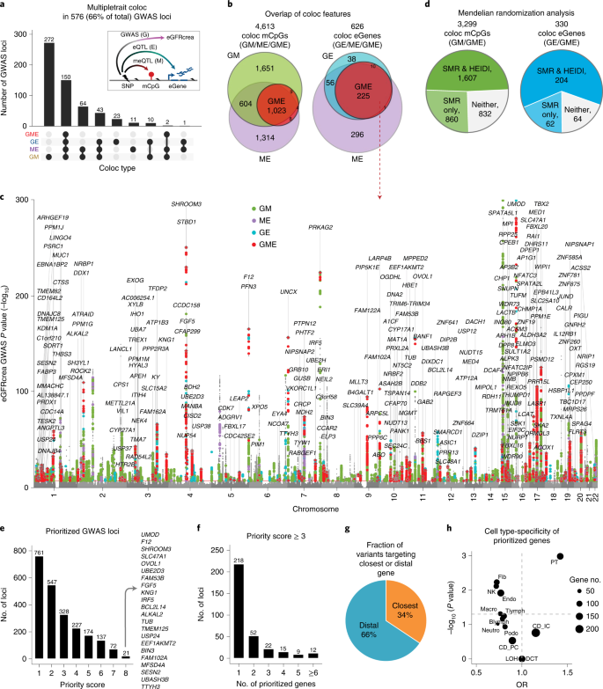
Prioritizing genes
Long process, but basically do colocalization on GWAS loci (G), eQTLs (E) and mQTLs (M) as well as summary MR …
Each test contributes to an overall ‘prioritization score’

Slide 17
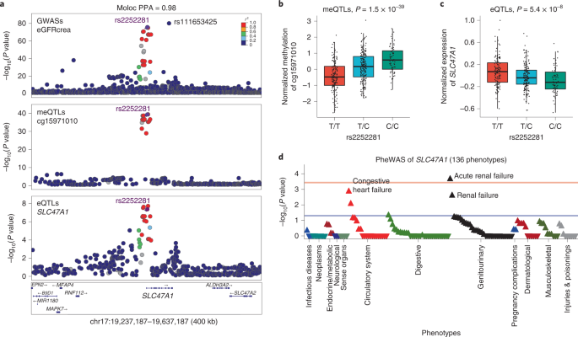
SLC47A1 appears to causal play a role in kidney function

