Slide 1



Epigenetics journal club Mar 26, 2019

Slide 2
EWAS
Fetal alcohol syndrome associated with DNAm of blood collected in childhood (after age 5)
Opiod dependence associated with DNAm in blood.
Allergic sensitisation associated with DNAm in blood in childhood.
Shift work associated with DNAm and epigenetic age in blood.
Maternal age with DNAm in blood collected in adulthood.
Orofacial cleft associated with DNAm from blood spots collected at birth (includes VTRNA2-1 gene)
Kidney function in HIV associated with DNAm in blood.
Degree of Alzheimer's disease pathology associated with DNAm and hydroxymethylation in entorhinal cortex.

Slide 3
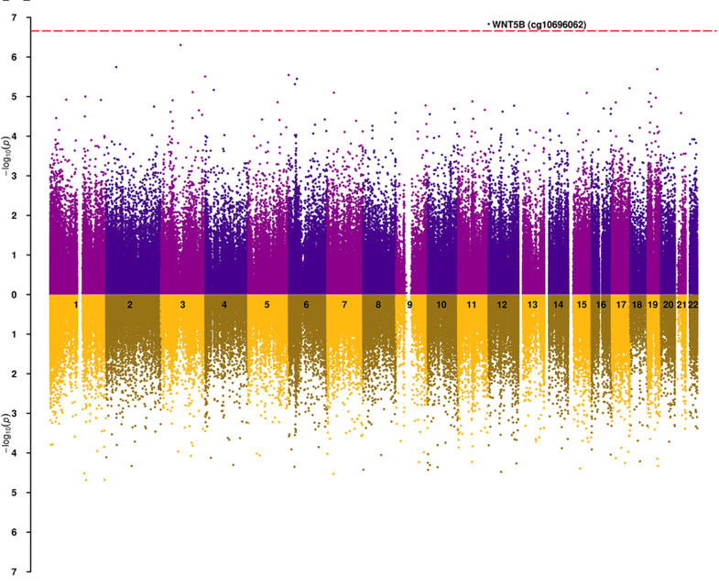
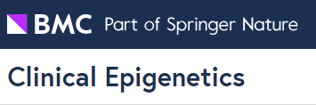
Parallel profiling of DNA methylation and hydroxymethylation highlights neuropathology-associated epigenetic variation in Alzheimer’s disease
Smith et al 2019
First EWAS of both DNA methylation and hydroxymethylation in Alzheimer’s disease
Evidence for the role of hypermethylation and hypohydroxymethylation across ANK1 in AD
Previous EWAS estimates of DNA-m in ANK1 were underestimated - implications for other EWAS and neurological traits

Slide 4
Longitudinal analyses
Longitudinal DNAm changes and associations with treatment in Parkinsons disease
Chemotherapy changes DNAm in blood.

Slide 5
EWAS comparisons
Prenatal and own smoking DNAm associations in blood enriched in lung tumour DNAm differences.
Associations of colorectal cancer and of obesity similar in the DNAm of blood.

Slide 6
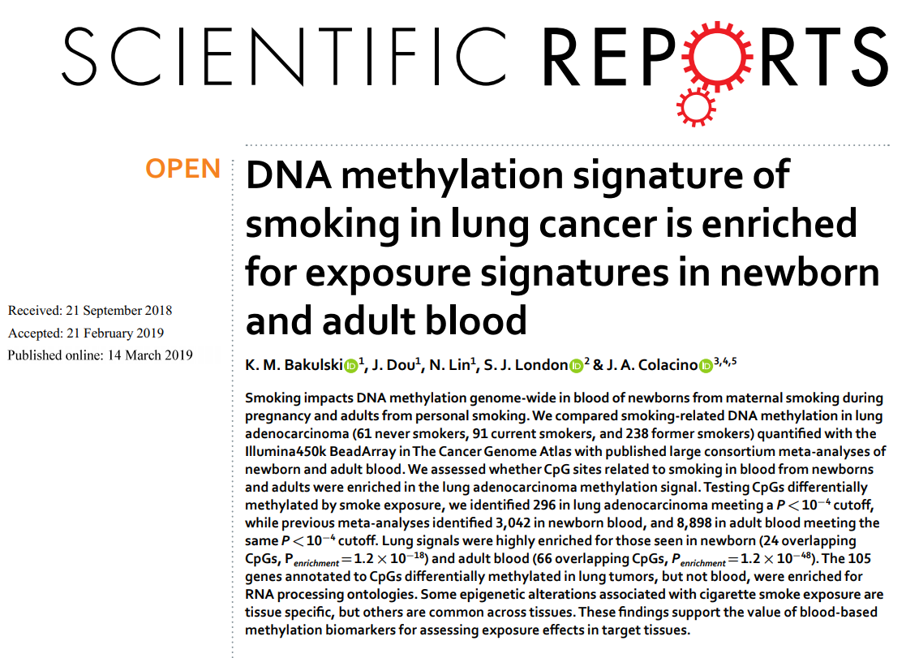

Slide 7
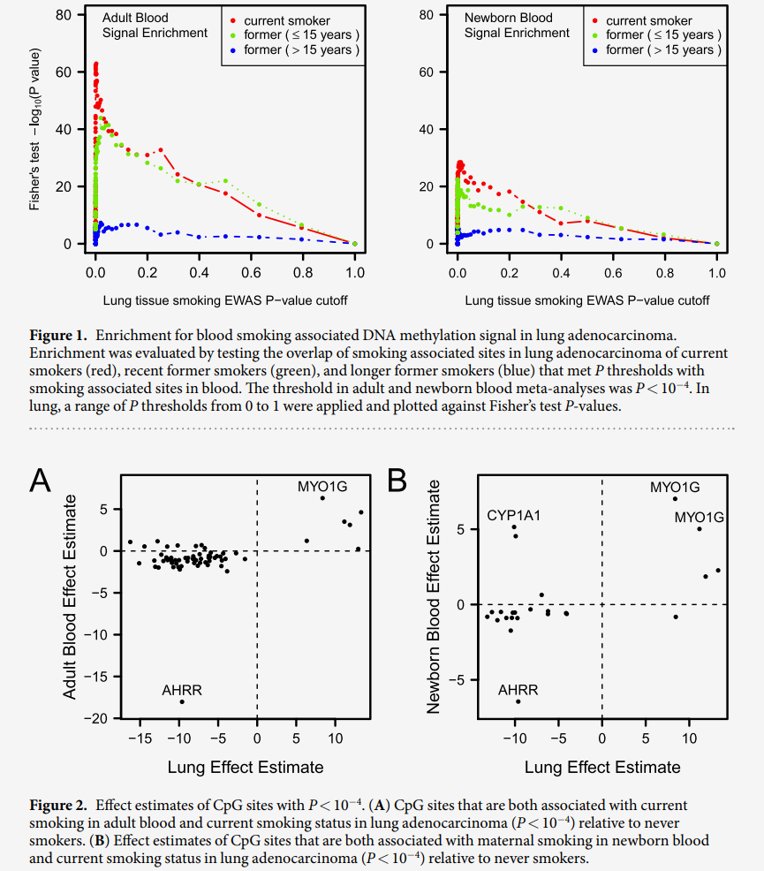
Enrichment of top associations with smoking in lung cancer among ...
Effect estimates of CpG sites with smoking association p-values < 1E-4 in both lung cancer and blood.

Slide 8
Epigenetic age
An even larger GWAS of epigenetic age acceleration (n= 13,493) identifies a few novel genetic associations.

Slide 9
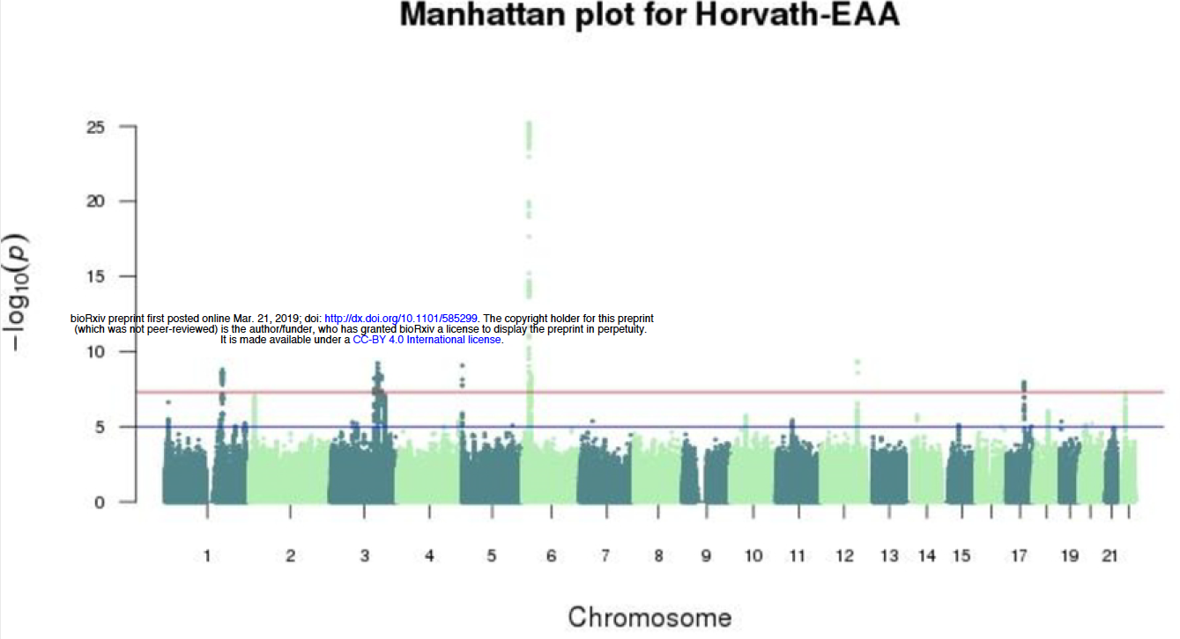

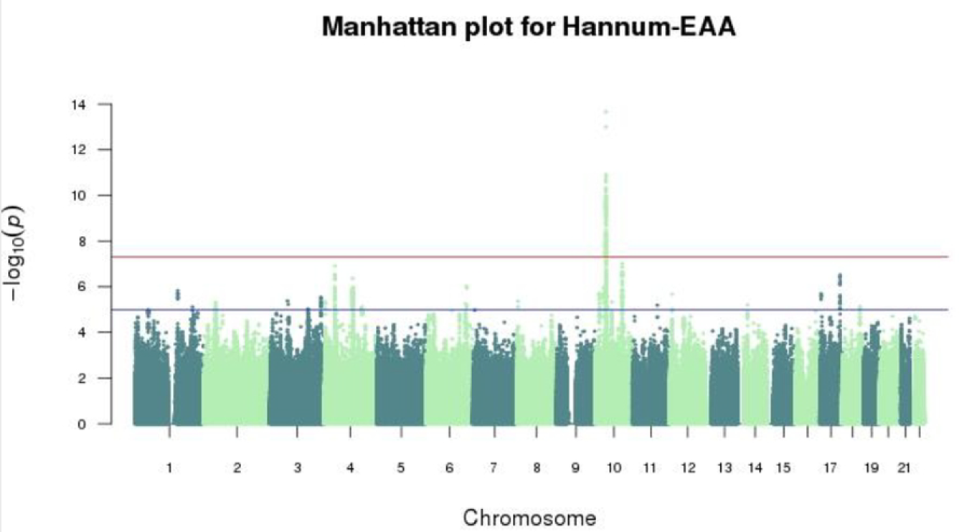
A meta-analysis of genome-wide association studies of epigenetic age acceleration
Gibson et al 2019
Hannum and Horvarth created epigenetic clocks which accurately predict human age
Epigenetic age acceleration (EAA) = chronological age < epigenetic age
Largest study of genetic determinants of EEA (n=13,493)
Meta analysed GWAS from Generation Scotland and Lu et al (2018)
Some novel findings but few overall genetic correlations with age related traits

Slide 10
Epigenetic variation
'Epivariations' in blood DNAm linked to autism and schizophrenia (these are like rare variants)

Slide 11
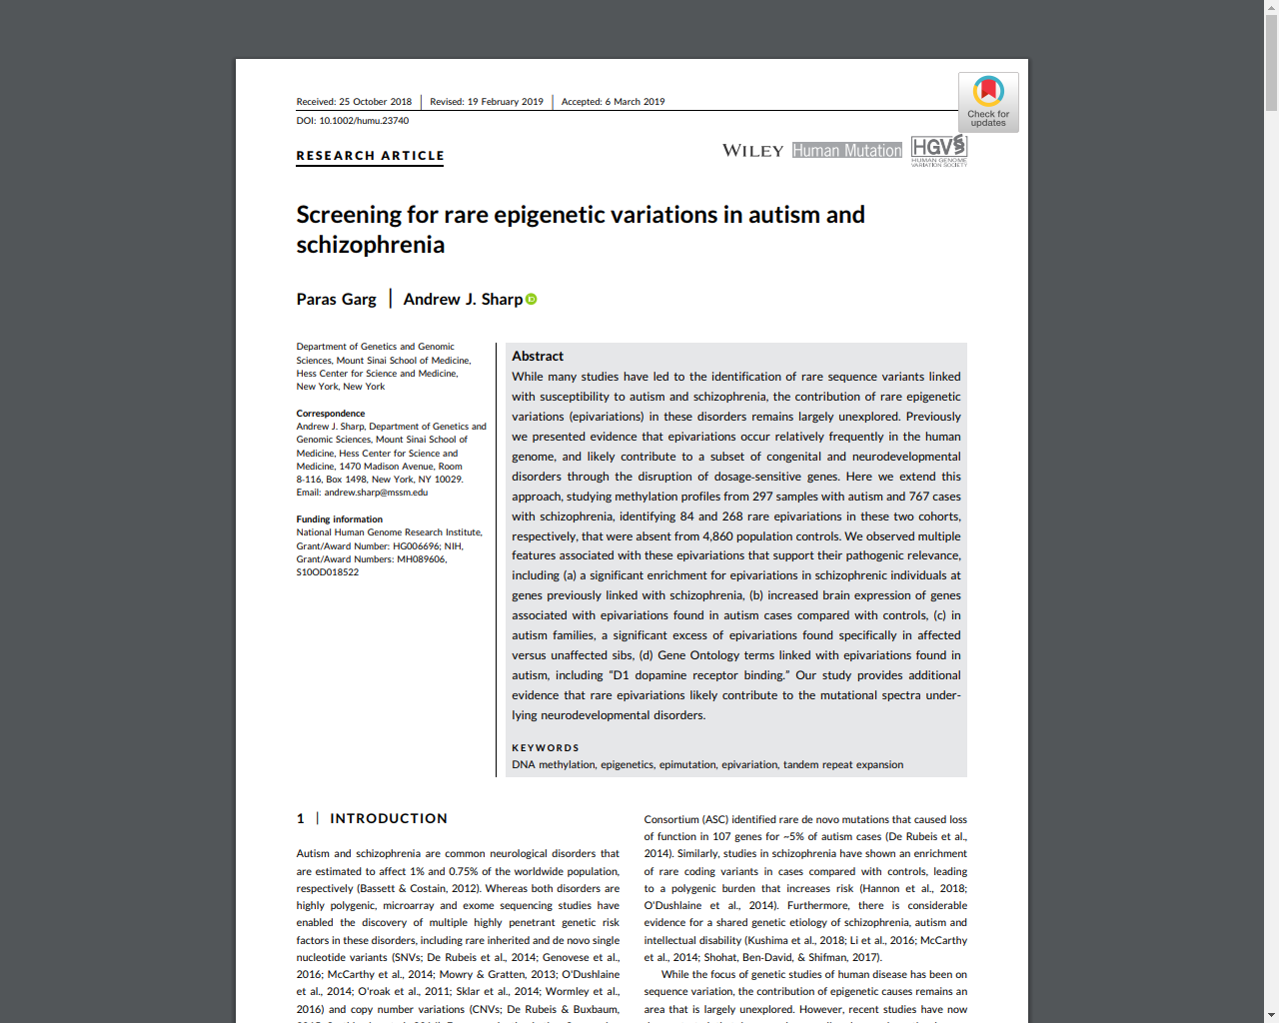
Epivariation:
"Hyper/hypo-methylated DMRs where a case presented, in a 1 kb window, at least
three probes that each had β‐values
above/below the 99.9th percentile of the control distribution for that probe and
are ≥0.15 above/below the control mean, and
at least one of these probes had a β ≥ 0.1 above/below the maximum/minimum observed in controls for that probe."

Slide 12
Cross-tissue comparisons
CpG site correlations between placenta and cord blood DNAm.

Slide 13
Mechanism
Fumaric acid esters are highly effective immunomodulators in patients with multiple sclerosis. This effect appears to be due to DNA methylation changes in brain-homing CCR6+ CD4 and CD8 T cells.
Vitamin intake and genetic variation within DNMT3L interact to influence cognitive decline.
Letter to the editor discusses our study of persistence of prenatal smoking DNAm effects in connection with a link between DRD1 and lung cancer .

Slide 14
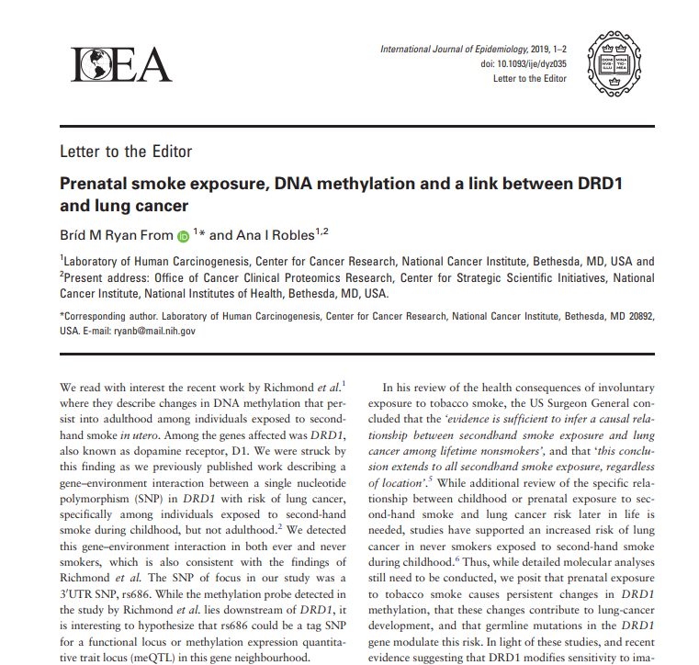

Slide 15
Methods
Bigmelon is a tool for normalizing and analysing large DNAm datasets

Slide 16
Epigenetics journal club goal
To keep up with the research community
To identify and anticipate new directions
To develop a common knowledge and vocabulary
… With minimal time and effort

