Slide 1
Epigenetics journal club goals
To keep up with the research community
To identify and anticipate new directions
To develop a common knowledge and vocabulary
… With minimal time and effort

Slide 2
Age
CpG sites associated with longevity included several associated with BMI and with age in patients with metabolic disorders, "suggesting a role of DNAm in aging-related metabolic alterations".

Slide 3
Parent of origin effects
Parent of origin effects in DNA methylation observed at 171 novel loci. A PheWAS identified "a previously unidentified imprinted locus associated with waist circumference".

Slide 4
EWAS
DNA methylation in saliva of African Americans associated with smoking, six novel sites identified and replicated.
DNA methylation in cord blood is associated with maternal antidepressant use in pregnancy.
DNA methylation in cord and peripheral blood in childhood is weakly associated with radon exposure.
The return of small EWAS?
DNA methylation in blood is different between children raised in families vs orphanages (n=58).
DNA methylation in blood is different between new and incumbent firefighters (n=86).
DNA methylation in blood at 13 years is associated with obesity but not prenatal maternal stress (n=31).

Slide 5
Other forms of DNA methylation
N-6 methylated deoxyadenosine (m6dA) was recently discovered in humans and other eukaryotes. It is somewhat rare but consistent within cell types, and it is associated with higher gene expression.

Slide 6
Non-standard EWAS
DNA methylation at 7 years is associated with childhood adversity, mainly before age 3.

Slide 7
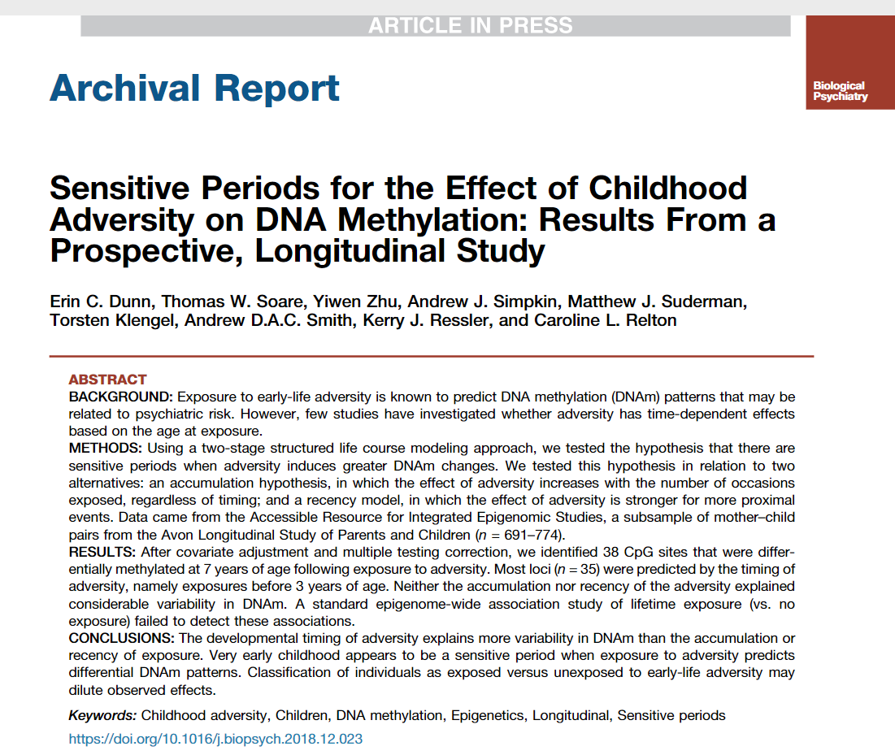
Structure life-course models
methylation at 7y ~ adversity 1-2y
+ adversity 3-5y
+ adversity 5-7y
+ covariates
Models fit using least angle regression and a covariance test.
Also considered ‘recency’ models and ‘accumulation’ models:
methylation at 7y ~ adversity + covariates
Accumulation simply sums up all events.
Recency places more weight on recent events.

Slide 8
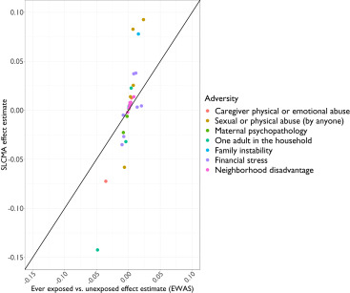
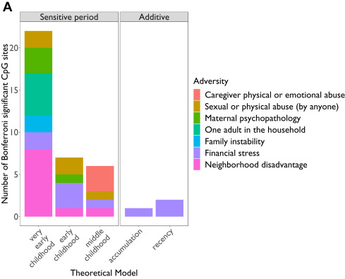
SLCMA vs EWAS
38 CpG associations with Bonferroni p < 0.05

