Slide 1
Journal club 20/05/2019

Slide 2
EWAS in children
Maternal tobacco smoke exposure and cord blood. Howe CG, et al. Environ Health Perspect. 2019 Apr;127(4):47009. WGBS in 20 individuals; 10,381 CpG site associations!
Cord Blood insulin and mitochondrial DNA content in cord blood. Reimann B, et al. Front Genet. 2019 Apr 12;10:325. 179 cord bloods; no associations survived adjustment for tests; abstract isn’t very clear
Myopia at 3 predicted by 5 CpG sites in cord blood (n=519). Seow et al. PLoS One. 2019 May 17;14(5):e0214791.
Maternal depressive symptoms and infant saliva. Wikenius E, et al. Nord J Psychiatry. 2019 May 9:1-7. Methylation in 274 samples at 6 weeks and 12 months. No associations.
Scans of neonatal amygdalae and hippocampi, genotype, cord blood DNA methylation, prenatal environment. Ong ML, et al. Genes Brain Behav. 2019 Apr 24:e12576 No associations in cord blood but ‘models incorporating methylation were better explanations than genotype, GxE or environment for amygdala variation.

Slide 3
EWAS in adults
Monozygotic twins clinically discordant for multiple sclerosis (n=45) have 7 CpG site associations, 2 validated. Souren NY, et al. Nat Commun. 2019 May 7;10(1):2094.
Four immune cell types and multiple sclerosis progression. Ewing et al. EBioMedicine. 2019 Apr 30. pii: S2352-3964(19)30281-6.
DNA methylation in CD4+ T cells (n = 31), CD8+ T cells (n = 28), CD14+ monocytes (n = 35) and CD19+ B cells (n = 27)
relapsing-remitting (RRMS), secondary progressive (SPMS) patients and healthy controls (HC)
B cells most different
Multiple autoimmune diseases and CD4+ T cell methylation. Chen et al. Front Genet. 2019 Apr 5;10:223.
116 cases vs 117 controls; 15289 differentially methylated sites!
Breast cancer, estrogen exposure and blood DNA methylation Johansson A, et al. Clin Epigenetics. 2019 Apr 30;11(1):66 Bodelon C, et al. Breast Cancer Res. 2019 May 17;21(1):62.
Meta-analysis of MCCS, EPIC-Italy, the IARC cohort of the European Prospective Investigation into Cancer and Nutrition (EPIC-IARC), and the Prostate, Lung, Colorectal, and Ovarian Cancer Screening Trial (PLCO)
Blood collected from middle age women prior to diagnosis
No CpG sites associations with risk
694 associations with lifetime estrogen; index associated with risk (Q4 vs Q1 odds ratio = 1.77 (1.07-2.93) in replication)

Slide 4
EWAS in adults
Lung function change. Imboden, et al. Eur Respir J. 2019 May 9. pii: 1900457
3 cohorts (n=2043) with DNAm and lung function measured 6-15 years apart
Replication in 7 cohorts (n=3327)
57 associations replicated but all linked to smoking
Major psychosis in prefrontal cortex neurons. Pai et al. Nat Commun. 2019 May 3;10(1):2046.
DNA methylation, gene expression and genotype in neurons
55 cases vs 27 controls
Hypomethylation observed in IGF2 enhancer of cases
Pharmacological hormonal transition model and depressive symptoms. Mehta et al. Acta Psychiatr Scand. 2019 May 17. (depressive symptoms = levels of Gonadotrophin Releasing Hormone)
Sensitivity to sex-steroid hormone fluctuations may increase risk for perinatal depression
Clinical trial comparing 30 treated with gonadotrophin release hormone agonist to 30 controls
DNAm in peripheral blood
588 differentially expressed genes and these are enriched with DNA methylation differences

Slide 5
EWAS of placenta
Socioeconomic Status in preterm infants. Santos HP Jr, et al. Epigenetics. 2019 May 7.
n=426 born < 28 weeks of gestation
33 CpG site associations
Maternal circadian disruption. Clarkson-Townsend DA, et al. PLoS One. 2019 Apr 26;14(4):e0215745.
53 night shift vs 184 no night shift
CpG site differences in seven genes.
Maternal dietary glycaemic change. Yan W, et al. Genes Nutr. 2019 May 9;14:17.
From a dietary trial to decrease glycaemic index
Compared 12 appropriate to 12 inappropriate responders
365 methylation differences (3 of 6 were replicated in n=153)

Slide 6
EWAS of protein levels
Circulating levels of inflammatory markers and DNA methylation, an analysis of repeated samples from a population based cohort. Myte R, Sundkvist A, Van Guelpen B, Harlid S. Epigenetics. 2019 Apr 29:1-11.
N=127, two blood samples 10 years apart
Levels of CRP and 160 other proteins were measured in plasma (Olink)
DNA methylation by EPIC microarray
Ominously: “Both BMI and levels of inflammatory markers generally increased over time”
Replicated 85 of 102 previously reported associations involving 95 sites and 12 proteins
Seems like power was low so they didn't appear to report any EWAS, only replications of previous findings

Slide 7
Reference data
Ghandi, et al. Next-generation characterization of the Cancer Cell Line Encyclopedia. Nature. 2019 May 8.
“genetic, RNA splicing, DNA methylation, histone H3 modification, microRNA expression and reverse-phase protein array data for 1,072 cell lines from individuals of various lineages and ethnicities”
This paper doesn’t just report about this reference data. They show a few different ways that it could be used.

Slide 8
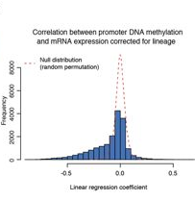
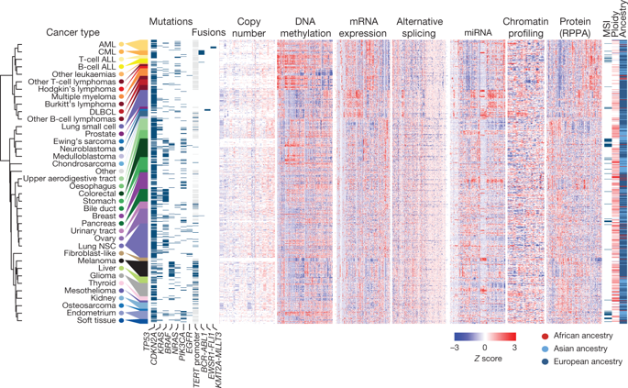
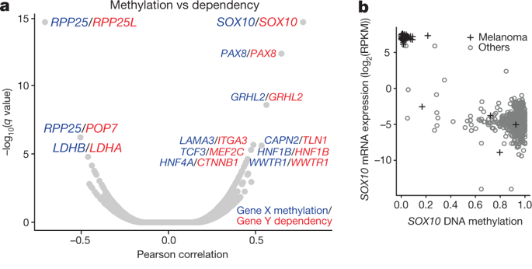
The ‘dependency’ score comes from this paper:
Tsherniak, A. et al. Defining a cancer dependency Map. Cell 170, 564–576 (2017).
SOX10 expression is mainly in melanoma due to hypomethylation.

Slide 9
Industry news...
Circulating Cell-free Genome Atlas (CCGA) Study
https://grail.com/press-releases/grail-announces-promising-new-data-with-early-detection-blood-test-to-be-presented-at-2019-american-society-of-clinical-oncology-annual-meeting/
“The CCGA study is a prospective, observational, longitudinal study that has completed enrollment of approximately 15,000 people with and without cancer across 142 sites in the United States and Canada.”
Have some kind of ‘methylation technology’ for cell-free DNA methylation analysis.
In preliminary analysis of 166 blood samples from people who had a cancer diagnosis, their approach correctly identified:
tumour’s tissue of origin in 87% of the samples;
96% breast cancer cases; (22/23)
88% lung cancer cases (29/33);
90% liver cancer cases (9/10);
100 % of pancreatic cancer cases (17/17).
“GRAIL has since selected methylation as its preferred approach …”

Slide 10
Single cell analysis
Simultaneous Profiling of mRNA Transcriptome and DNA Methylome from a Single Cell. Hu Y, An Q, Guo Y, Zhong J, Fan S, Rao P, Liu X, Liu Y, Fan G. Methods Mol Biol. 2019;1979:363-377.
Single dorsal root ganglion neuron
0.5-1 million CpG sites and mRNA level of 10,000 genes

Slide 11
Other methylation
Mongan NP, Emes RD, Archer N. Detection and analysis of RNA methylation. F1000Res. 2019 Apr 26;8. pii: F1000 Faculty Rev-559.
- mainly report a method for measuring RNA methylation
- "The number of methyl modifications to RNA is about seven times greater than those found on DNA"

Slide 12
DNA methylation age
Comparative validation of an epigenetic mortality risk score with three aging biomarkers for predicting mortality risks among older adult males. Gao X, Colicino E, Shen J, Just AC, Nwanaji-Enwerem JC, Wang C, Coull B, Lin X, Vokonas P, Zheng Y, Hou L, Schwartz J, Baccarelli AA. Int J Epidemiol. 2019 Apr 30
534 males age 55-85 years (US Normative Aging Study)
A score from 10 mortality related CpG sites predicted all-cause mortality better than ‘epigenetic age’ and telomere length.

Slide 13
Methods
Yan Q, Liu N, Forno E, Canino G, Celedón JC, Chen W. An integrative association method for omics data based on a modified Fisher's method with application to childhood asthma. PLoS Genet. 2019 May 7;15(5):e1008142.
Calculated a combined p-value of association between a trait and SNPs, DNAm and mRNA linked to a given gene.
Mansell G, Gorrie-Stone TJ, Bao Y, Kumari M, Schalkwyk LS, Mill J, Hannon E. Guidance for DNA methylation studies: statistical insights from the Illumina EPIC array. BMC Genomics. 2019 May 14;20(1):366.
Understanding Society cohort (n = 1175)
“we found no evidence that this bias [violated assumptions of linear regression] influences analyses by increasing the likelihood of affected sites to be false positives.”
“~ 1000 samples are adequately powered to detect small differences at the majority of sites”
5% family-wise error for EPIC array studies to be 9E- 8
genome-wide estimate of α=3.6E-8 by Saffari et al. 2018
Bonferroni threshold is 0.05/850000 = 5.9E-8

Slide 14
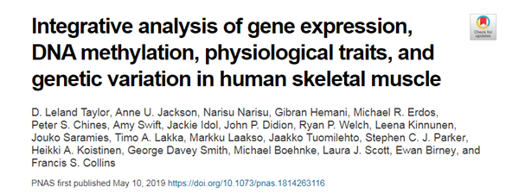
https://www.pnas.org/content/early/2019/05/09/1814263116
FUSION study
256 human skeletal muscle biopsies
expression and DNA methylation in skeletal muscle
8 physiological traits (height, waist, weight, waist–hip ratio, body mass index, fasting serum insulin, fasting plasma glucose, and type 2 diabetes)
Results
thousands of gene-CpG site associations
213 causal relationships between expression and methylation (two-thirds have methylation causing gene expression)
hundreds of genes and DNAme sites associated with fasting insulin, waist, and body mass index
FUSION mQTLs + FUSION eQTLs + GTEx eQTLs for 48 tissues + GWAS for 534 diseases/traits mix together with MR bake for 30 minutes 300 gene expression-disease/trait associations that are stronger in skeletal muscle than other tissues

