Slide 1
Journal club 10/06/19 Nancy and Matt

Slide 2
EWAS (adults)
Epigenome-Wide Association Study Indicates Hypomethylation of MTRNR2L8 in Large-Artery Atherosclerosis Stroke
12 cases vs 12 controls
MTRNR2L8 differences replicated in two cohorts
Association of dietary folate and vitamin B-12 intake with genome-wide DNA methylation in blood: a large-scale epigenome-wide association analysis in 5841 individuals
Evidence for type-specific DNA methylation patterns in epilepsy: a discordant monozygotic twin approach
Occupational exposure to gases/fumes and mineral dust affect DNA methylation levels of genes regulating expression.
903 never-smokers of the LifeLines cohort study
"14 DMRs were associated with gases/fumes and 7 with mineral dust"
"We replicated two DMRs with gases/fumes (VTRNA2-1 and GNAS) and one with mineral dust (CCDC144NL)."
Network Analysis of the Potential Role of DNA Methylation in the Relationship between Plasma Carotenoids and Lipid Profile
48 healthy subjects.
20,687 CpG sites associated with total carotenoid concentrations.
"A total of 2734 hub genes (17 unique top hub genes) were potentially related to lipid profile."
Notes:
Stroke – EWAS of large-artery atherosclerotic stroke (tiny sample size - cases:controls=12:12), and the differentially methylated loci were validated in 2 cohorts (cases:controls, 110:122 and 191:191, respectively) using a Sequenom EpiTYPER assay.
Folate - EWAS 450k (n=5841) of folate and vitamin B-12 intake in 10 cohorts. Folate and vitamin B-12 intakes were calculated from food-frequency questionnaires (FFQs). A meta-analysis was performed to identify significant DMPs and DMRs, and a pathway analysis was performed on the DMR annotated genes. We identified novel epigenetic loci that are associated with folate and vitamin B-12 intake. Interestingly, we found a negative association between folate and DNA methylation. Replication of these methylation loci is necessary in future studies.
Epilepsy – EWAS in blood and buccal samples between and within 15 monozygotic (MZ) twin pairs discordant for focal or generalized epilepsy. Found DMRs between epilepsy types associated with PM20D1 and GFPT2 genes in both tissues. Within MZ discordant twin pairs, DMRs associated with OTX1 and ARID5B genes for generalized epilepsy and TTC39C and DLX5 genes for focal epilepsy. Deepened our understanding of the neurobiology of epilepsy.
Plasma – Weighted gene correlation network analysis (WGCNA) is a systems biology method used for finding gene clusters (modules) with highly correlated methylation levels and for relating them to phenotypic traits. Hub genes = 'gene that’s regulating the network' - genes within modules can be associated with traits

Slide 3
EWAS (children)
Altered DNA methylation in children born to mothers with rheumatoid arthritis during pregnancy.
"80 blood samples from children (mean age=6.8 years) born to mothers with RA. As controls, blood samples from 354 children (mean age=6.0 years) from the population-based Generation R Study were used"
147 CpGs were differentially methylated
Prenatal Particulate Air Pollution and DNA Methylation in Newborns: An Epigenome-Wide Meta-Analysis
PM10 and PM2.5 in n > 1500
6 sites associated with PM10 and 14 with PM2.5
Replication was not convincing.

Slide 4
Genetically predicted DNAm variation
Genetically predicted levels of DNA methylation biomarkers and breast cancer risk: data from 228,951 women of European descent
Elastic net prediction
Integrated multi omics data
Found evidence that DNAm may impact breast cancer risk through regulating gene expression
Can be used for other diseases
Notes:
Models built around Framington Heart Study and Women's Health Initiative
Applied to GWAS data of ~200,000
Used 450k and genetic data to predict levels of DNAM
1 cpg – 1 model for 65K cpgs
Accuracy of pred vs measured assessed by spearman's corr
Integrative analyses of genetic, DNA methylation and gene expression data found that 38 CpGs may affect breast cancer risk through regulating expression of 21 genes. ------------------------------
Rationale: DNA methylation plays a critical role in breast cancer development. Previous studies have identified DNA methylation marks in white blood cells as promising biomarkers for breast cancer. However, these studies were limited by low statistical power and potential biases. Utilizing a new methodology, we investigated DNA methylation marks for their associations with breast cancer risk.
Methods: Statistical models were built to predict levels of DNA methylation [from white blood cells] marks using genetic data and 450k. For each CpG, we built a statistical model using allelic dosage data of cis SNPs to predict DNA methylation residuals, following the elastic net method (α=0.50) with ten-fold cross-validation. For each CpG, the predicted DNA methylation level was estimated using its prediction model and the correlation between predicted and measured DNA methylation level was evaluated using Spearman’s correlation.
In total, prediction models for 63,000 CpGs built by using FHS data were externally validated by WHI data.
Discovery - Framingham Heart Study (N=1,595). Target - The prediction models were validated using data from the Women's Health Initiative (N=883). We applied these models to GWAS data of 122,977 breast cancer cases and 105,974 controls to evaluate if the genetically predicted DNA methylation levels at CpGs are associated with breast cancer risk. All statistical tests were two-sided. Results: Of the 62,938 CpGs investigated, statistically significant associations with breast cancer risk were observed for 450 CpGs at a Bonferroni-corrected threshold of P<7.94 × 10-7, including 45 CpGs residing in 18 genomic regions which have not previously been associated with breast cancer risk. Of the remaining 405 CpGs located within 500 kilobase flaking regions of 70 GWAS-identified breast cancer risk variants, the associations for 11 CpGs were independent of GWAS-identified variants. Integrative analyses of genetic, DNA methylation and gene expression data found that 38 CpGs may affect breast cancer risk through regulating expression of 21 genes. Conclusion: Can identify novel DNA methylation biomarkers for breast cancer risk and can be applied to other diseases.

Slide 5
Genetic variation at CpG sites
Ma et al. CpG-related SNPs in the MS4A region have a dose-dependent effect on risk of late-onset Alzheimer disease. Aging Cell. 2019 May 29:e12964.
CGS = CpG-related single nucleotide polymorphisms (CGS), i.e. SNPs that create or remove a CpG site
Counted number of CGS within 1kb regions across the genome
24 European ancestry cohorts
"The total number of CGS-derived CpG dinucleotides in the window near MS4A4A was associated with AD risk (p = 2.67 × 1E-10 ), brain DNA methylation (p = 2.15 E -10 ), and gene expression in brain (p = 0.03) and blood (p = 2.53 × 10-4). "
"We confirm the importance of CGS in AD and the potential for creating a functional CpG dosage-derived genetic score to predict AD risk."

Slide 6
DNAm age
Sturm et al. Human Aging DNA Methylation Signatures are Conserved butAccelerated in Cultured Fibroblasts. Epigenetics, 2019 June 3.
"epigenetic aging is approximately 62 times faster in cultured cells than in the human body"

Slide 7
Quiz
Gunasekara et al. A genomic atlas of systemic interindividual epigenetic variation in humans. Genome Biol. 2019 Jun 3;20(1):105.
n=10
Deep whole-genome bisulfite sequencing
Tissues from three germ layer lineages: thyroid (endoderm), heart (mesoderm), and brain (ectoderm).
9926 regions with consistent interindividual variation across all three lineages
(i.e. methylation variable and correlated between individuals within lineages)
Methylation in these regions can predict expression in other tissues.
Remind anyone of anything?
What is this good for?

Slide 8
Method
Zhang F, Chen W, Zhu Z, Zhang Q, Nabais MF, Qi T, Deary IJ, Wray NR, Visscher PM, McRae AF, Yang J. OSCA: a tool for omic-data-based complex trait analysis. Genome Biol. 2019 May 28;20(1):107.
data management for which we designed a binary format to efficiently store and manage omic data;
X-WAS: linear-regression- and MLM-based methods (including the methods proposed in this study) to test for associations between omic measures and complex traits;
Methods to:
estimate the proportion of variance in a complex trait captured by all the measures of one or multiple omic profiles (e.g., all SNPs and DNAm probes) and
predict the trait phenotype in a new sample based on the joint effects of all omic measures estimated in a discovery sample; and
x-QTL analysis: an efficient implementation of the methods to identify genetic variants associated with an omic profile, e.g., DNA methylation quantitative trait loci (mQTL) analysis.

Slide 9
OSCA method MOA
"Multi-level-model-based approaches (MOA and MOMENT) that include all the (distal) probes as random effects in the model to account for the effects of the confounders on the trait and probes as well as the correlations among distal probes."
y=Cβ+Wu+e
y = phenotype
C = covariates
β is a vector of fixed effects
W = omic dataset (e.g. methylation)
u and e are random effects
y=wibi + Cβ+Wu+e
wi is the omic values of feature i (e.g. CpG site i)
W as before but with features with 50kb of feature i removed
Notes:
In this study, we proposed a reference-free method (called MOA: MLM-based omic association) that fits all probes as random effects in an MLM-based association analysis to account for the confounding effects, including the correlations among distal probes induced by the confounding.

Slide 10
OSCA method MOMENT
MOA assumes a single distribution for all CpG effects. However, if cell composition associated with the phenotype of interest, then CpG sites associated with cell composition will have a different effect distribution.
MOMENT: break up the Wu term into CpG sites associated with cell count and those not associated to allow different distributions.
Notes:
We then extended the method to stratify the probes into multiple random-effect components (called MOMENT: multi-component MLM-based omic association excluding the target) to model a scenario where some probes are much more strongly associated with the phenotype than others.

Slide 11
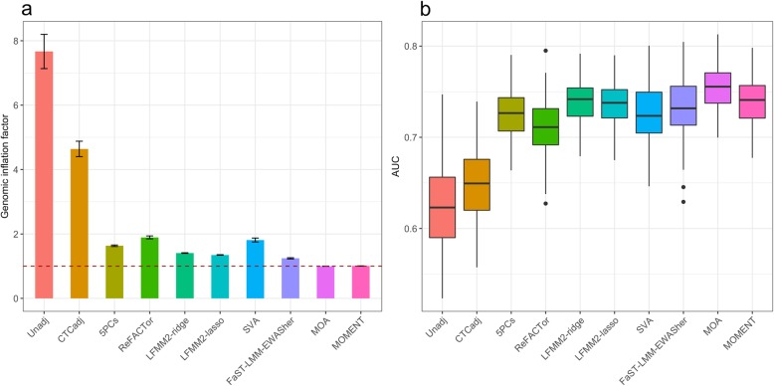
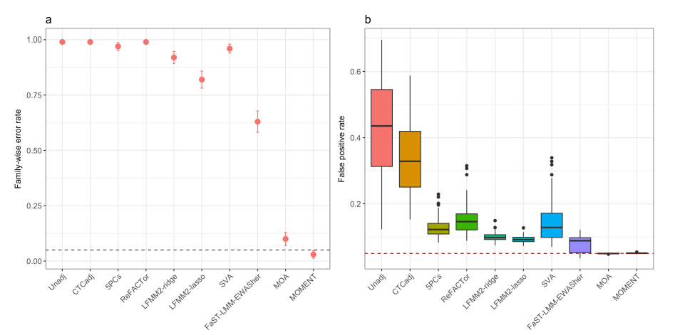
OSCA methods MOA and MOMENT for EWAS
EWAS simulations with cell type composition variation in the DNAm data.
Scenario 1: some CpG sites associated but cell type composition not associated with the phenotype

Slide 12
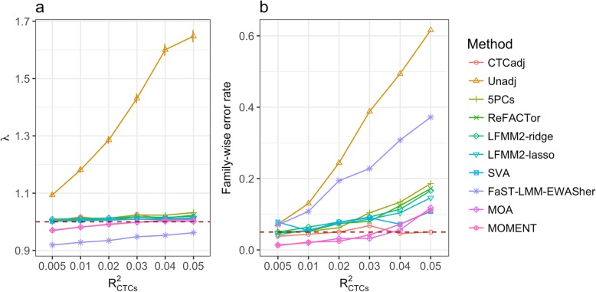
OSCA
Scenario 2: CpG sites not associated and cell type composition associated with the phenotype​

Slide 13
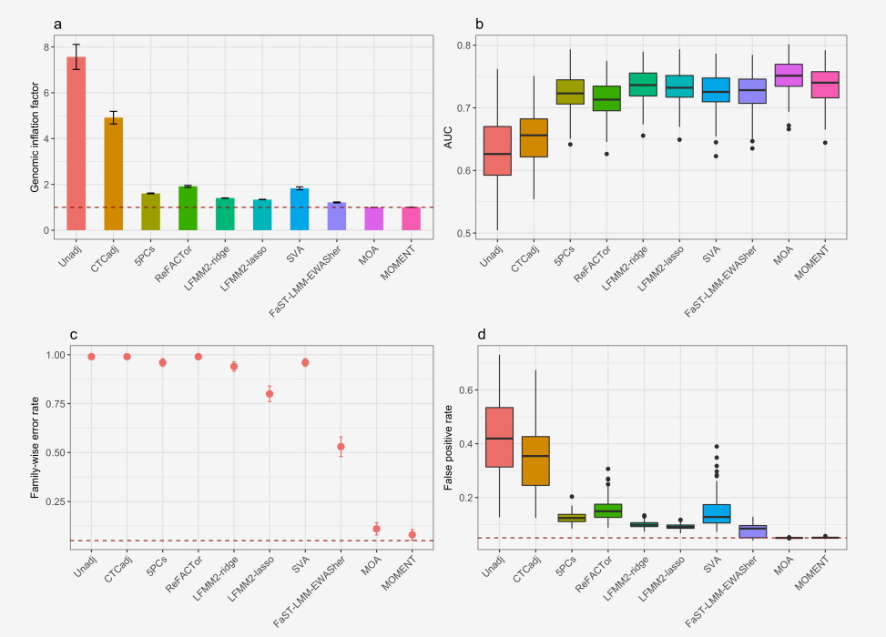
OSCA
Scenario 3: CpG sites and cell type composition associated with the phenotype​

Slide 14
However, FaST-LMM-EWASher not usually recommended ...
"FaST-LMM-EWASher resulted in the lowest type I error rate at the expense of low statistical power … ReFACTor, ISVA and SmartSVA showed the best comparable statistical power, quality of estimated methylation differences and runtime"
Brägelmann J, Lorenzo Bermejo J. Brief Bioinform. 2018 Aug 6
"FaST-LMM-EWASher gave the lowest sensitivity but highest specificity … if no such reference data are available or if the focus is not on estimating cell proportions, the SVA method is suggested"
Kaushal et al. BMC Bioinformatics. 2017 Apr 14;18(1):216.

