Slide 1
Journal club July 8, 2019

Slide 2
DNAm age predicts the future
Morrison FG, Logue MW, Guetta R, Maniates H, Stone A, Schichman SA, McGlinchey RE, Milberg WP, Miller MW, Wolf EJ. Investigation of bidirectional longitudinal associations between advanced epigenetic age and peripheral biomarkers of inflammation and metabolic syndrome. Aging (Albany NY). 2019 Jun 7;11(11):3487-3504.
n=179, mid-30s
Hannum epigenetic age acceleration associated with increased metabolic syndrome severity 2 years later
Huang RC, Lillycrop KA, Beilin LJ, Godfrey KM, Anderson D, Mori TA, Rauschert S, Craig JM, Oddy WH, Ayonrinde OT, Pennell CE, Holbrook JD, Melton PE. Epigenetic Age Acceleration in Adolescence Associates With BMI, Inflammation, and Risk Score for Middle Age Cardiovascular Disease. J Clin Endocrinol Metab. 2019 Jul 1;104(7):3012-3024.
n=995; age =17.3 ± 0.6 years;
EEAA (per 5 years) was associated with
increased body mass index (BMI) of 2.4% at 17 and 22 years,
increases of 23% in high-sensitivity C-reactive protein,
10% in interferon-γ-inducible protein of 10 kDa,
4% in soluble TNF receptor 2,
3% increase in hard endpoints of CVD by 47 years of age after adjustment for conventional risk factors.

Slide 3
DNAm age and pregnancy
Lee Y, Choufani S, Weksberg R, Wilson SL, Yuan V, Burt A, Marsit C, Lu AT, Ritz B, Bohlin J, Gjessing HK, Harris JR, Magnus P, Binder AM, Robinson WP, Jugessur A, Horvath S. Placental epigenetic clocks: estimating gestational age using placental DNA methylation levels. Aging (Albany NY). 2019 Jun 24;11(12):4238-4253.
n=1012 placental samples;
gestational predictor has r>0.95 with median error <1 week;
cord GA clocks don't perform well in placenta
Chen L, Wagner C, Dong Y, Wang X, Shary J, Huang Y, Hollis B, Zhu H. Effects of Maternal Vitamin D3 Supplementation on Offspring Epigenetic Gestational Age Acceleration at Birth: A Randomized Controlled Trial (P11-036-19). Curr Dev Nutr. 2019 Jun 13;3(Suppl 1). pii: nzz048.P11-036-19.
n=92
"Vitamin D3 supplementation decreased ∆DNAm GA by both Knight's clock (β = -0.89, P = 0.047) and Bohlin's clock (β = -0.71, P = 0.005) only in the black participants“
Shrestha D, Workalemahu T, Tekola-Ayele F. Maternal dyslipidemia during early pregnancy and epigenetic ageing of the placenta. Epigenetics. 2019 Jun 14:1-10.
n=262
"maternal dyslipidemia due to low HDLc was associated with accelerated epigenetic ageing of the placenta among mothers with normal pre-pregnancy weight and a female fetus“
dyslipidemia: ”an abnormal amount of lipids (e.g. triglycerides, cholesterol and/or fat phospholipids) in the blood”

Slide 4
DNAm age model size
Daunay A, Baudrin LG, Deleuze JF, How-Kit A. Evaluation of six blood-based age prediction models using DNA methylation analysis by pyrosequencing. Sci Rep. 2019 Jun 20;9(1):8862.
n=100 blood donors (42 women and 58 men) aged from 19–65,
<=5 CpG sites per model,
MAD~5 (similar to Horvath but not referenced)

Slide 5
EWAS in non-peripheral tissues
Gatta E, Grayson DR, Auta J, Saudagar V, Dong E, Chen Y, Krishnan HR, Drnevich J, Pandey SC, Guidotti A. Genome-wide methylation in alcohol use disorder subjects: implications for an epigenetic regulation of the cortico-limbic glucocorticoid receptors (NR3C1). Mol Psychiatry. 2019 Jun 25.
25 pairs of case-control pairs; prefrontal cortex;
5254 at p < 0.005 after testing 850K CpG sites!
Adjust for multiple tests for everything but the microarray analysis.
Wong CCY, Smith RG, Hannon E, Ramaswami G, Parikshak NN, Assary E, Troakes C, Poschmann J, Schalkwyk LC, Sun W, Prabhakar S, Geschwind DH, Mill J. Genome-wide DNA methylation profiling identifies convergent molecular signatures associated with idiopathic and syndromic autism in post-mortem human brain tissue. Hum Mol Genet. 2019 Jul 1;28(13):2201-2211.
prefrontal cortex, temporal cortex and cerebellum from 43 ASD patients and 38 controls.
"We identified widespread differences in DNA methylation associated with idiopathic ASD (iASD), with consistent signals in both cortical regions that were distinct to those observed in the CB"
Altuna M, Urdánoz-Casado A, Sánchez-Ruiz de Gordoa J, Zelaya MV, Labarga A, Lepesant JMJ, Roldán M, Blanco-Luquin I, Perdones Á, Larumbe R, Jericó I, Echavarri C, Méndez-López I, Di Stefano L, Mendioroz M. DNA methylation signature of human hippocampus in Alzheimer's disease is linked to neurogenesis. Clin Epigenetics. 2019 Jun 19;11(1):91. doi: 10.1186/s13148-019-0672-7.
n=26 cases vs n=12 controls.
188 differentially methylated CpG sites in hippocampus.
Wu J, Du Y, Song J, Dang X, Wang K, Wen Y, Zhang F, Liu R. Genome-wide DNA methylation profiling of hip articular cartilage identifies differentially methylated loci associated with osteonecrosis of the femoral head. Bone. 2019 Jun 21. pii: S8756-3282(19)30253-4.
n=15 cases (osteonecrosis of the femoral head ONFH) and n=15 controls.
DNAm measured in hip articular cartilage specimens.
2872 CpG sites differentially methylated.

Slide 6
EWAS of diet
Fasanelli F, Giraudo MT, Vineis P, Fiano V, Fiorito G, Grasso C, Polidoro S, Trevisan M, Grioni S, Krogh V, Mattiello A, Panico S, Giurdanella MC, Tumino R, De Marco L, Ricceri F, Sacerdote C. DNA methylation, colon cancer and Mediterranean diet: results from the EPIC-Italy cohort. Epigenetics. 2019 Jun 14:1-12.
161 pairs selected from the Italian EPIC cohort
'EWAS' of 995 CpG sites in 48 inflammation genes investigated for associations with CC and MD
two sites replicated
"cg20674490-RUNX3 may be a potential molecular mediator explaining the protective effect of MD on CC onset."
Leet RW, Whitsel E, Staimez L, Horvath S, Assimes T, Bhatti P, Jordahl K, Narayan KMV, Conneely K. Epigenome-wide Association Study of Diet Quality in the Women's Health Initiative (OR31-06-19). Curr Dev Nutr. 2019 Jun 13;3(Suppl 1). pii: nzz037.OR31-06-19.
n=4529; 340 CpG sites associated with diet quality
Borengasser S, Hendricks A, Jambal P, Gilley S, Palacios A, Kemp J, Westcott J, Garces A, Figueroa L, Friedman J, Jones K, Hambidge M, Krebs N. Differential DNA Methylation of Human Metastable Epialleles in Guatemalan Infants at Birth Due to Timing of a Maternal Lipid-Based Nutrition Supplement and Pre-Pregnancy BMI (P11-139-19). Curr Dev Nutr. 2019 Jun 13;3(Suppl 1). pii: nzz048.P11-139-19.
n=45 LNS -3 months to delivery, n=45 LNS 12 weeks prior to delivery, n=45 no LNS;
269 ME regions bisulfite sequenced;
a few associations with LNS and LNS timing
Miles F, Mashchak A, Fraser G. Differences in DNA Methylation Patterns Between Vegans and Non-vegetarians in the AHS-2 Cohort (FS11-06-19). Curr Dev Nutr. 2019 Jun 13;3(Suppl 1). pii: nzz037.FS11-06-19.
n=57 vegans vs n=80 controls
nearly 3000 CpG site associations at FDR < 0.05

Slide 7
EWAS of exposures
Gondalia R, Baldassari A, Holliday KM, Justice AE, Méndez-Giráldez R, Stewart JD, Liao D, Yanosky JD, Brennan KJM, Engel SM, Jordahl KM, Kennedy E, Ward-Caviness CK, Wolf K, Waldenberger M, Cyrys J, Cyrys J, Bhatti P, Horvath S, Assimes TL, Pankow JS, Demerath EW, Guan W, Fornage M, Bressler J, North KE, Conneely KN, Li Y, Hou L, Baccarelli AA, Whitsel EA. Methylome-wide association study provides evidence of particulate matter air pollution-associated DNA methylation. Environ Int. 2019 Jun 14:104723.
n = 8397, 12 cohorts,
1 CpG PM10, 2 CpGs PM2.5 and PM2.5-10
Phillips RV, Rieswijk L, Hubbard AE, Vermeulen R, Zhang J, Hu W, Li L, Bassig BA, Wong JYY, Reiss B, Huang Y, Wen C, Purdue M, Tang X, Zhang L, Smith MT, Rothman N, Lan Q. Human exposure to trichloroethylene is associated with increased variability of blood DNA methylation that is enriched in genes and pathways related to autoimmune disease and cancer. Epigenetics. 2019 Jun 26:1-13.
n=67 exposed vs n=73 controls;
25 CpG sites had higher methlation variance in exposed individuals
Wang AL, Gruzieva O, Qiu W, Merid SK, Celedón JC, Raby BA, Söderhäll C, DeMeo DL, Weiss ST, Melén E, Tantisira KG. DNA methylation is associated with inhaled corticosteroid response in persistent childhood asthmatics. Clin Exp Allergy. 2019 Jun 12.
n=394
"Differential DNA methylation of IL12B and CORT are associated with inhaled corticosteroid treatment response in persistent childhood asthmatics."
Kim GS, Smith AK, Xue F, Michopoulos V, Lori A, Armstrong DL, Aiello AE, Koenen KC, Galea S, Wildman DE, Uddin M. Methylomic profiles reveal sex-specific differences in leukocyte composition associated with post-traumatic stress disorder. Brain Behav Immun. 2019 Jun 19. pii: S0889-1591(19)30104-7.
n=483.
Higher monocytes observed in PTSD males.

Slide 8
EWAS of cardio-metabolic traits
Liu J, ..., van Duijn CM. An integrative cross-omics analysis of DNA methylation sites of glucose and insulin homeostasis. Nat Commun. 2019 Jun 13;10(1):2581.
4808 non-diabetic Europeans in the discovery phase and 11,750 individuals in the replication;
identify DNAm associations with fasting glucose and insulin;
"Our study sheds light on the biological interactions between genetic variants driving differential methylation and gene expression in the early pathogenesis of T2D"
Dye CK, Corley MJ, Li D, Khadka VS, Mitchell BI, Sultana R, Lum-Jones A, Shikuma CM, Ndhlovu LC, Maunakea AK. Comparative DNA methylomic analyses reveal potential origins of novel epigenetic biomarkers of insulin resistance in monocytes from virally suppressed HIV-infected adults. Clin Epigenetics. 2019 Jun 28;11(1):95.
identified 123 differentially methylated CpG sites in "monocytes in HIV-infected individuals (n = 37)" between high and low insulin sensitivity.
"4 CpGs (cg27655935, cg02000426, cg10184328, and cg23085143) whose methylation levels independently predicted the insulin-resistant state at a higher confidence than that of clinical risk factors typically associated with insulin resistance (i.e., fasting glucose, 120-min oral glucose tolerance test, Framingham Risk Score, and Total to HDL cholesterol ratio)"
Arpón A, Milagro FI, Ramos-Lopez O, Mansego ML, Riezu-Boj JI, Martínez JA; MENA Project. Methylome-Wide Association Study in Peripheral White Blood Cells Focusing on Central Obesity and Inflammation. Genes (Basel). 2019 Jun 11;10(6). pii: E444.
n=473,
669 associations with waist circumference
Kazmi et al. Hypertensive Disorders of Pregnancy and DNA Methylation in Newborns. Hypertension. 2019 Jun 24:HYPERTENSIONAHA11912634.
maternal HDP (10 cohorts; n=5242 [cases=476]) or preeclampsia (3 cohorts; n=2219 [cases=135]);
cord blood methylation;
HDP and preeclampsia were associated with DNA methylation at 43 and 26 CpG sites

Slide 9
Non-standard EWAS
Curtis SW, Cobb DO, Kilaru V, Terrell ML, Marder ME, Barr DB, Marsit CJ, Marcus M, Conneely KN, Smith AK. Exposure to polybrominated biphenyl and stochastic epigenetic mutations: application of a novel epigenetic approach to environmental exposure in the Michigan polybrominated biphenyl registry. Epigenetics. 2019 Jun 14:1-16.
SEM=stochastic epigenetic mutation
n=658.
Weak associations and only in individuals exposed at higher ages. Number of SEMs per individual was highly variable (119-18,309).
Czamara J. … Binder EB. Integrated analysis of environmental and genetic influences on cord blood DNA methylation in new-borns. Nat Commun. 2019 Jun 11;10(1):2548.
VMR=variably methylated regions
n=2365 (4 cohorts)
"Genetic and environmental factors in combination best explain DNAm at the majority of VMRs. The CpGs best explained by either G, G + E or GxE are functionally distinct."

Slide 10
Single-gene studies
Bergens MA, Pittman GS, Thompson IJB, Campbell MR, Wang X, Hoyo C, Bell DA. Smoking-associated AHRR demethylation in cord blood DNA: impact of CD235a+ nucleated red blood cells. Clin Epigenetics. 2019 Jun 10;11(1):87.
"Prenatal smoke exposure was highly significantly associated with AHRR methylation in cord blood, CD14+ monocytes, and CD235a+ nRBCs.”
“AHRR methylation levels in nRBCs and nRBC counts had minimal effect on cord blood methylation measurements.”
“However, regression models using estimated nRBCs or actual nRBC counts outperformed those lacking these covariates."
Li M, Wang C, Yu B, Zhang X, Shi F, Liu X. Diagnostic value of RASSF1A methylation for breast cancer: a meta-analysis. Biosci Rep. 2019 Jun 28;39(6). pii: BSR20190923.
19 papers
1849 patients and 1542 controls
Results: blood serum RASSF1A methylation best with sensitivity=0.55, diagnostic odds ratio=22.0 and AUC=0.86

Slide 11
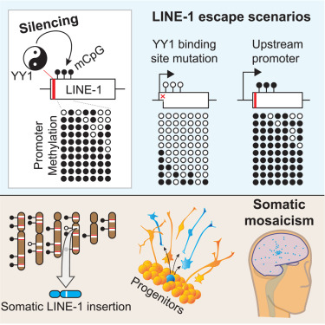
Mechanism (DNAm doesn’t just regulate genes)
Sanchez-Luque FJ, Kempen MHC, Gerdes P, Vargas-Landin DB, Richardson SR, Troskie RL, Jesuadian JS, Cheetham SW, Carreira PE, Salvador-Palomeque C, García-Cañadas M, Muñoz-Lopez M, Sanchez L, Lundberg M, Macia A, Heras SR, Brennan PM, Lister R, Garcia-Perez JL, Ewing AD, Faulkner GJ. LINE-1 Evasion of Epigenetic Repression in Humans. Mol Cell. 2019 Jun 20. pii: S1097-2765(19)30396-X.
Epigenetic silencing defends against LINE-1 (L1) retrotransposition in mammalian cells but sometimes an L1 escapes to cause somatic genome mosaicism in the brain.
Findings:
"a conserved Yin Yang 1 (YY1) transcription factor binding site mediates L1 promoter DNA methylation ...
By analyzing 24 hippocampal neurons with three distinct single-cell genomic approaches, we characterized and validated a somatic L1 insertion ...
The source (donor) L1 for this insertion ... lacked the YY1 binding site, ... was highly mobile when tested in vitro ... [and was] hypomethylated ... in brain tissue."

Slide 12
Methods
Similar conclusions to cord and peripheral blood but specifics are tissue-specific:
Solomon O, MacIsaac J, Quach H, et al. Comparison of DNA methylation measured by Illumina 450K and EPIC BeadChips in blood of newborns and 14-year-old children. Epigenetics. 2018;13:655–664.
Fernandez-Jimenez N, Allard C, Bouchard L, Perron P, Bustamante M, Bilbao JR, Hivert MF. Comparison of Illumina 450K and EPIC arrays in placental DNA methylation. Epigenetics. 2019 Jun 28:1-6.
n=108 matched 450k/EPIC profiles of placenta methylation.
"We conclude that EPIC and 450K placental data can be combined, and we provide two lists of CpGs that should be excluded to avoid misleading results."
Torkamneh D, Laroche J, Boyle B, Belzile F. DepthFinder: A Tool to Determine the Optimal Read Depth for Reduced-Representation Sequencing. Bioinformatics. 2019 Jun 7. pii: btz473.
Koch A, Jeschke J, Van Criekinge W, van Engeland M, De Meyer T. MEXPRESS update 2019. Nucleic Acids Res. 2019 Jul 2;47(W1):W561-W565.
MEXPRESS (https://mexpress.be).
“It contains the latest TCGA data, additional types of omics and clinical data and extra functionality, allowing users to explore mechanisms of gene dysregulation beyond expression and DNA methylation."
Alag A. Machine learning approach yields epigenetic biomarkers of food allergy: A novel 13-gene signature to diagnose clinical reactivity. PLoS One. 2019 Jun 19;14(6):e0218253.
An interesting introduction to machine learning using genomic data. They reduce a 96-CpG signature down to 18 CpG sites.
Torabi Moghadam B, Etemadikhah M, Rajkowska G, Stockmeier C, Grabherr M, Komorowski J, Feuk L, Carlström EL. Analyzing DNA methylation patterns in subjects diagnosed with schizophrenia using machine learning methods. J Psychiatr Res. 2019 Jul;114:41-47.
"post-mortem brain tissue from a cohort of 73 subjects diagnosed with schizophrenia and 52 control samples ... these methods did not uncover any significant signals ... suggesting that if there are methylation changes associated with schizophrenia, they are heterogeneous and complex with small effect." Quite entertaining! Uses bumphunter, discretizes CpG sites as methylated/unmethylated, ...
Korthauer K, Chakraborty S, Benjamini Y, Irizarry RA. Detection and accurate false discovery rate control of differentially methylated regions from whole genome bisulfite sequencing. Biostatistics. 2019 Jul 1;20(3):367-383.

Slide 13
Review
Bludau A, Royer M, Meister G, Neumann ID, Menon R. Epigenetic Regulation of the Social Brain. Trends Neurosci. 2019 Jul;42(7):471-484.
"the role of the epigenetic network in regulating the enduring effects of social experiences during early-life, adolescence, and adulthood. We discuss research in animal models, primarily rodents, and associations between dysregulation of epigenetic mechanisms and human psychopathologies, specifically autism spectrum disorder (ASD) and schizophrenia."

Slide 14
Single-cell analysis
Welch JD, Kozareva V, Ferreira A, Vanderburg C, Martin C, Macosko EZ. Single-Cell Multi-omic Integration Compares and Contrasts Features of Brain Cell Identity. Cell. 2019 Jun 13;177(7):1873-1887.e17.
Single-cell gene expression in mouse and human brain cells.
Single-cell DNA methylation in mouse brain cells.
Investigate cell type identity and mechanism.

Slide 15
Machine learning to discover a biomarker of food allergy
Dataset
GSE59999
PBMC methylation
11-15 month-old infants
n=71 of which 29 with FA, 29 sensitized
Testing and training
40 samples for training,
10 samples for cross-validation,
8 completely hidden samples for testing
In each, half FA and half not.
Repeat 8 times ensuring that each sample in the hidden dataset at least once.

Slide 16
Machine learning, continued
Training
Identify top 99 CpG site associations for each of the 8 training sets
Combined to yield 636 CpG sites
Apply the following to one CpG site at a time: a Decision Tree (DT), Logistic Regression Model (LR), Radial Basis Function (RBF), and a Multi-Layer Perceptron (MLP).
"The perceptron was a deep learning network with an architecture of two hidden layers with ten nodes each"
Result: 20,352 classifiers (8 independent folds x 636 features x 4 classifiers)

Slide 17
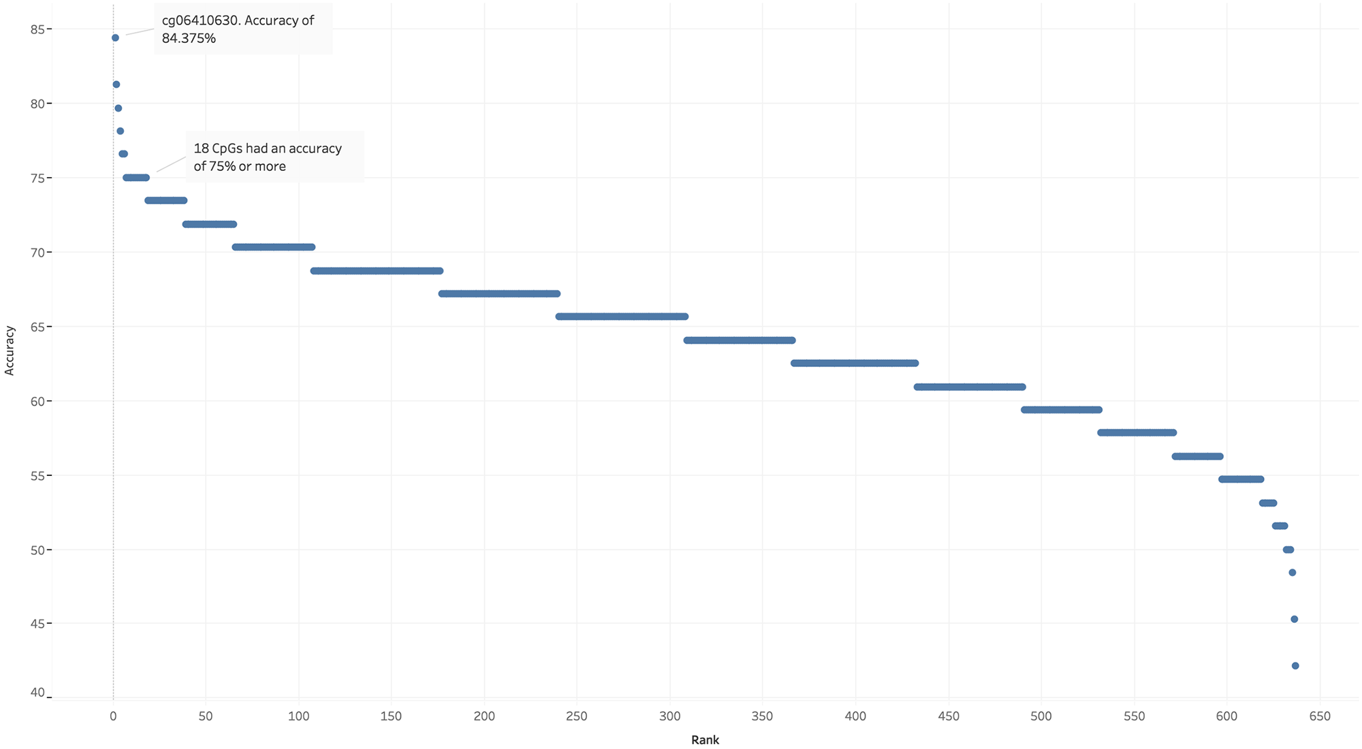
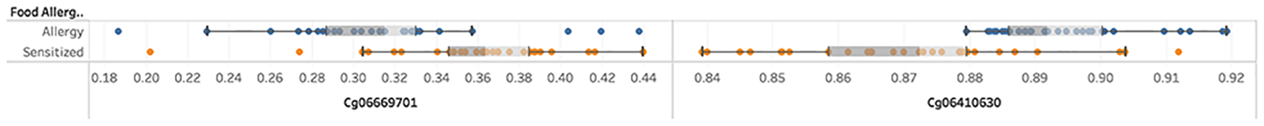
Machine learning, continued
Average accuracies of the 636 CpG sites across the 8 hidden datasets
Top 2 CpG sites

Slide 18
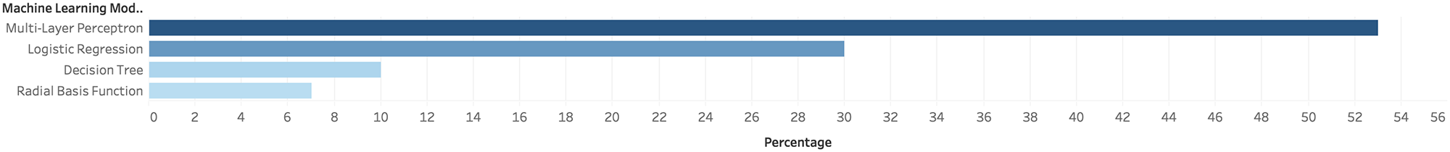
Machine learning, continued
And more training!
Identify the top 18 CpGs ranked by accuracy
Use forward selection to create combinations of 2-12 of these CpGs
(Why 12? Because perfect classification achieved)
Number of selected classifiers for each algorithm

Slide 19
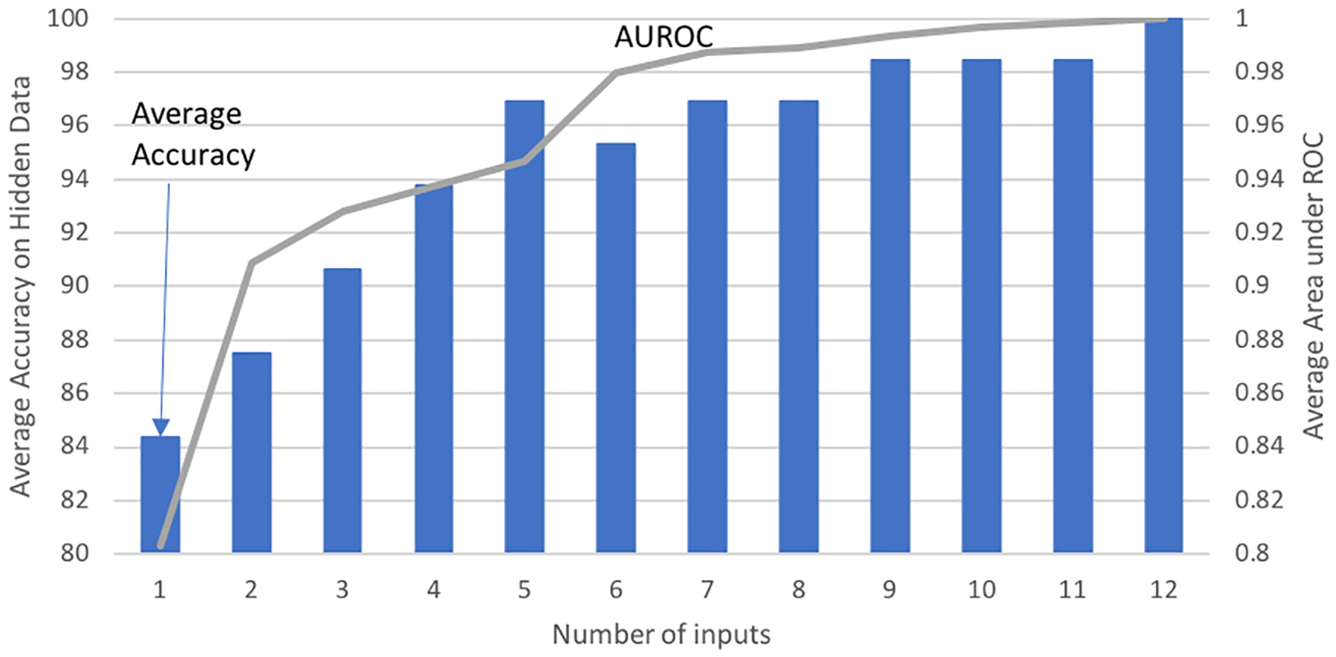
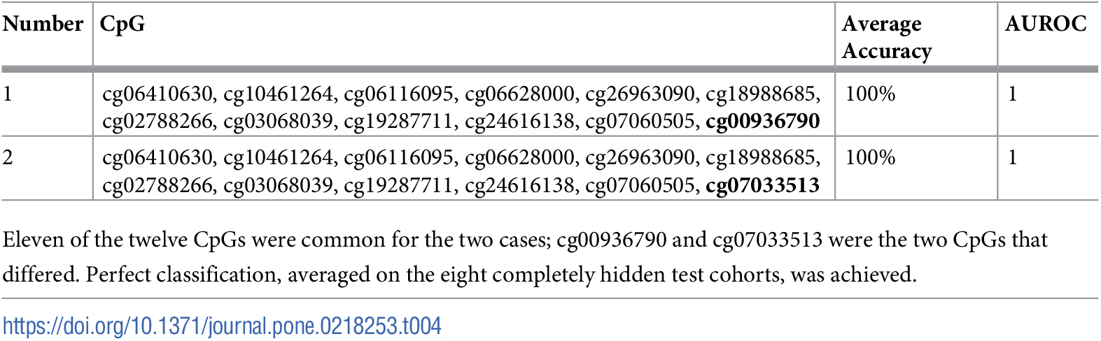
Machine learning, continued
Number of CpG sites

Slide 20
Machine learning, continued
And more training!
Apply a simple majority voting scheme (ensemble) to combine these 2-12 CpG site classifiers.

Slide 21
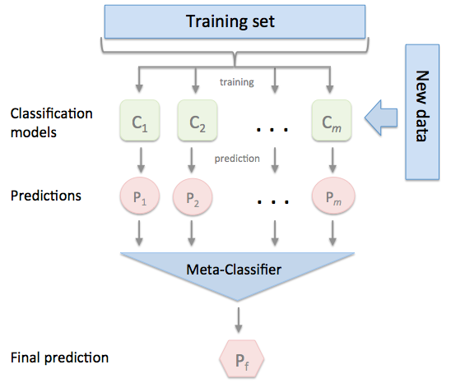
Ensemble classifiers
Why do this?
1. The number of learning samples is small compared to the number of possible classifiers. Ensembles combine different classifiers that, when several agree, are more likely to be correct. Kind of like triangulation.
2. Machine learning algorithms typically apply some heuristic to find a 'good' classifier. In their search they often get stuck in 'local minima'. Combining multiple classifiers ensures that many different searches are considered.

Slide 22
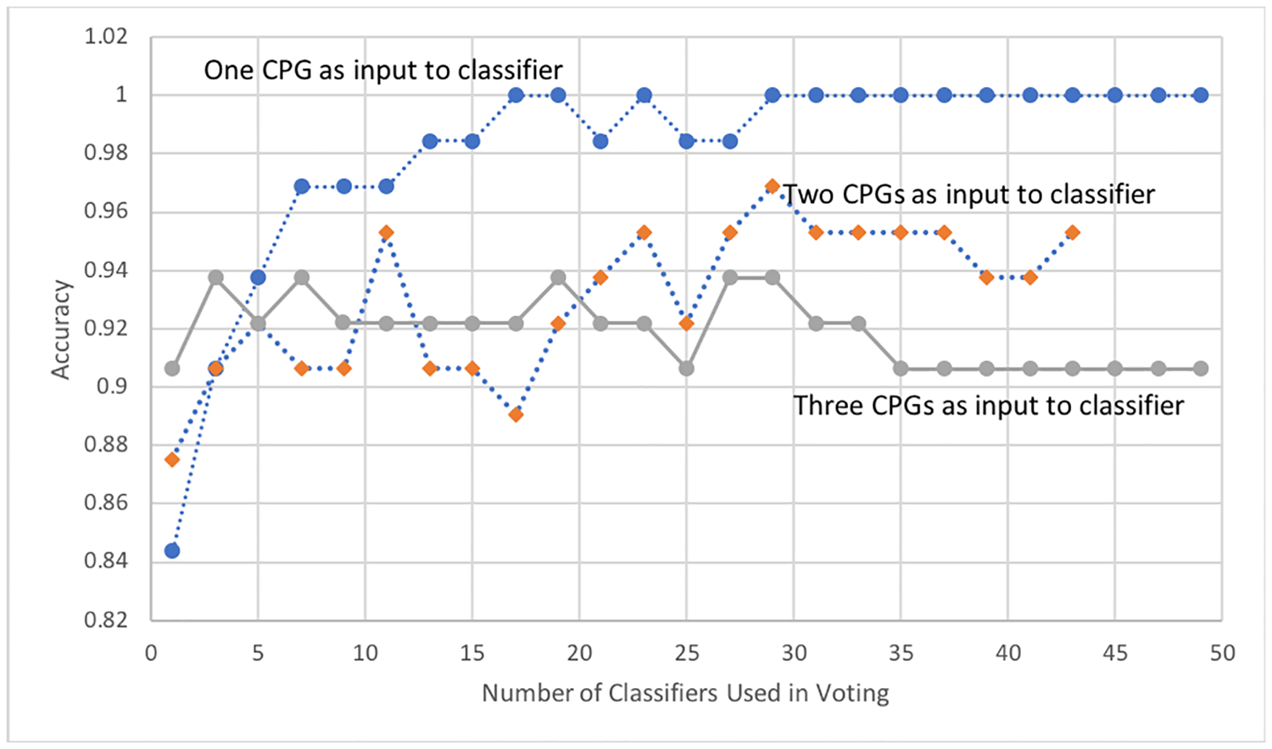
Machine learning, continued
Accuracies of ensemble classifiers (in the 8 hidden samples)

Slide 23
Machine learning, continued
Training finished?
"Taking the top 26 classifiers with 12 features each, including the two with the feature-lists enumerated in Table 4 as well as 24 additional 12-CpG classifiers that had an accuracy score of 98.4375% each, a list of 18 unique CpGs was created that mapped to 13 genes."
Testing
"To validate the diagnostic strength of the 18-CpG signature, the top 26 12-CpG classifiers were evaluated on a large number of hidden test sets, where the samples were repeatedly randomly allocated to the train-validation-test datasets."
"... the first two models achieved an average hidden-data accuracy of 95.3125% (AUROC 0.98328125) and 95.625% (AUROC 0.9853125)."
Conclusions
"This research demonstrates a generalized data-driven machine learning approach..."
"The 18-CpG signature and the 26 12-CpG signatures (subsets of the 18) consistently achieved around 94% to 96% accuracy. This high accuracy, similar to that achieved by previous work on this dataset, is better than any known clinical test today "
"Validation of the 13-gene signature in a second cohort would also be of tremendous value."

