Slide 1
July 22, 2019
Reviews | 4
Methods | 3
Imprinting | 1
eQTLs | 1
Somatic mutations | 1
EWAS | 1
DNAm age | 1

Slide 2
Reviews
Lønning, Per E et al. “Constitutional Mosaic Epimutations - a hidden cause of cancer?.” Cell stress vol. 3,4 118-135. 22 Mar. 2019.
Mosaic methylation of genes linked genetically to cancer risk may cause cancer and be useful as biomarkers.
Hawe, Johann S et al. “Inferring Interaction Networks From Multi-Omics Data.” Frontiers in genetics vol. 10 535. 12 Jun. 2019
"we review state-of-the-art techniques for inferring the topology of interaction networks from functional multi-omics data“
Young, Alexander I. “Solving the missing heritability problem.” PLoS Genetics vol. 15,6 e1008222. 24 Jun. 2019
A letter describing challenges of expanding analyses to the whole genome and suggesting solutions.

Slide 3
Reviews
Xia B, Yanai I. A periodic table of cell types. Development. 2019 Jun 27;146(12). pii: dev169854.
A framework for distinguishing between cell type and cell state in single-cell RNA-seq.
Old approach
New approach cell type = expression profile of transcription factors

Slide 4
Draft periodic table of cell types
Limitations
1. Different table for each species.
2. Over-simplifies complexity of differentiation.
Advantages
1. Systematically organizes what we know.
2. Identifies cell types that are missing.
3. Can be built from less complex to more complex organisms.

Slide 5
Methods
Liu, Xiaomeng et al. “Comprehensive DNA methylation analysis of tissue of origin of plasma cell-free DNA by methylated CpG tandem amplification and sequencing (MCTA-Seq).” Clinical Epigenetics vol. 11,1 93. 24 Jun. 2019.
Use DNA methylation patterns of circulating DNA to identify tissue-of-origin.
Anke Hüls & Darina Czamara (2019) Methodological challenges in constructing DNA methylation risk scores, Epigenetics.
Discusses differences between polygenic risk scores and DNAm scores.

Slide 6
Methods
Luo X, Yang C, Wei Y. Detection of cell-type-specific risk-CpG sites in epigenome-wide association studies. Nat Commun. 2019;10(1):3113. Published 2019 Jul 15.
A method for improving power of EWAS in complex tissues.
Reference EWAS model essentially adjusts for cell type in order to identify an ‘aggregate’ effect across all cell types. It fits the following model for each CpG site:
O_{i} = observed methylation for individual i at the CpG site
T = effects of each phenotype on methylation
x_{i} = phenotype values for individual i
M = cell-type specific methylation levels
p_{i} = cell-type proportions for individual i

Slide 7
EWAS for cell-type specific effects
Parameters estimated by a generalized expectation-maximization algorithm.
Cell-type proportions are initially estimated using Houseman’s algorithm.
Cell-type specific baseline methylation profiles are initially estimated by simple linear regression.
i = individual (n)
j = CpG site
l = phenotype
k = cell type
(pBIC used to select ‘optimal’ K)
Two-layer hierarchical model
3 cell types

Slide 8
Performance of HIRE under simulations
A few associations | No associations

Slide 9
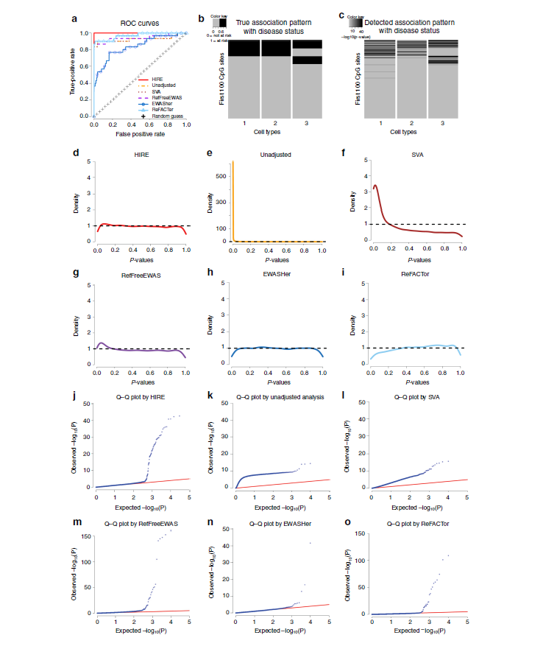
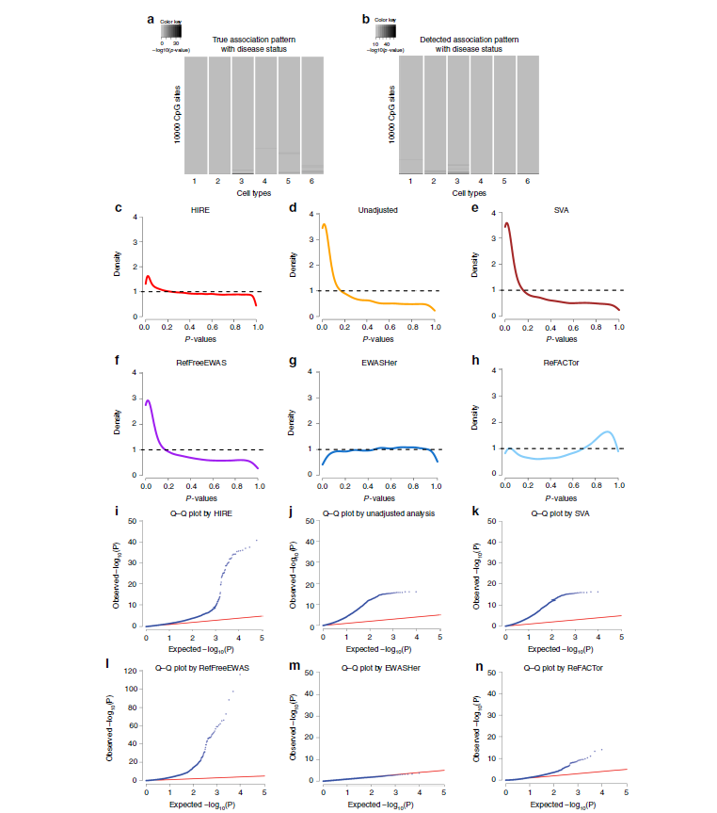
Simulated data with true associations
Rheumatoid arthritis whole blood dataset (cases vs controls)
1
1=CD4+
2,4 = Neutrophils
3 = ? (has the strongest associations)

Slide 10
Imprinting
Jadhav, Bharati et al. “RNA-Seq in 296 phased trios provides a high-resolution map of genomic imprinting.” BMC biology vol. 17,1 50. 24 Jun. 2019, doi:10.1186/s12915-019-0674-0
"7 [new] transcripts showing parental bias in gene expression"

Slide 11
eQTLs and differentation
Strober BJ, Elorbany R, Rhodes K, Krishnan N, Tayeb K, Battle A, Gilad Y. Dynamic genetic regulation of gene expression during cellular differentiation. Science. 2019 Jun 28;364(6447):1287-1290.
19 Yoruban individuals
induced pluripotent stem cells
16 time points during differentiation into cardiomyocytes

Slide 12
Somatic mutations
Park, Jun Sung et al. “Brain somatic mutations observed in Alzheimer's disease associated with aging and dysregulation of tau phosphorylation.” Nature communications vol. 10,1 3090. 12 Jul. 2019, doi:10.1038/s41467-019-11000-7
"deep whole-exome sequencing (average read depth 584×) in 111 postmortem hippocampal formation and matched blood samples from 52 patients with AD and 11 individuals not affected by AD."
The amount of genetic variation increases with age in the brain but at 4.8-fold slower rate than in blood.
There is enrichment for variation accumulating near genes "known to contribute to hyperphosphorylation of tau".

Slide 13
EWAS
Ringh, Mikael V. et al. Tobacco smoking induces changes in true DNA methylation, hydroxymethylation and gene expression in bronchoalveolar lavage cells, EBioMedicine, 2019 Jul 11. pii: S2352-3964(19)30441-4.
"We identified 1667 total 5mC + 5hmC, 1756 5mC and 67 5hmC differentially methylated positions (DMPs) between smokers and non-smokers (FDR-adjusted P <.05, absolute Δβ >0.15)."
Most were novel for smoking differences.
Directions of 5mC and 5hmC differences indicated that smoking demethylated DNA via conversion to 5hmC.

Slide 14
DNAm age
Liu, Zuyun et al. “Associations of genetics, behaviors, and life course circumstances with a novel aging and healthspan measure: Evidence from the Health and Retirement Study.” PLoS medicine vol. 16,6 e1002827. 18 Jun. 2019, doi:10.1371/journal.pmed.1002827
"Based on data from 2,339 adults (aged 51+ years, mean age 69.4 years, 56% female, and 93.9% non-Hispanic white) from the US Health and Retirement Study”
“genetic, behavioral, and socioenvironmental circumstances during childhood and adulthood account for about 30% of differences in" PhenoAge variation.
"behaviors had the largest contribution to PhenoAge".

