Slide 1
Journal club
Sept 23, 2019
EWAS | 6
Gene regulation | 1
ASE | 1
Methods | 2
Cohort | 1

Slide 2
Prenatal smoking vs own smoking
EWAS of exposure
Sikdar S, Joehanes R, Joubert BR, …, London SJ. Comparison of smoking-related DNA methylation between newborns from prenatal exposure and adults from personal smoking. Epigenomics. 2019 Sep 19.
Cord blood and sustained maternal smoking during pregnancy (9 cohorts, 5648 newborns, 897 exposed)
Adult blood methylation and personal smoking (16 cohorts, 15907 participants, 2433 current smokers)
"we identified numerous signatures specific to newborns along with many shared between newborns and adults."
"Unique smoking-associated genes in newborns were enriched in xenobiotic metabolism pathways."

Slide 3
Diet intervention
EWAS
Hibler E, Huang L, Andrade J, Spring B. Impact of a diet and activity health promotion intervention on regional patterns of DNA methylation. Clin Epigenetics. 2019 Sep 11;11(1):133.
"three 12-week interventions to
simultaneously increase exercise and fruit/vegetable intake, while decreasing sedentary leisure screen time;
sequentially increase fruit/vegetable intake and decrease leisure screen time first, then increase exercise;
increase sleep and decrease stress (control)."
Collected blood samples at baseline, 3 and 9 months
N=68 (1 simultaneous n=25; 2 sequential n=21; 3 controls n=12).
Between controls (3) and intervention (1 and 2):
0 DMRs at baseline (using DMRcate)
154 DMRs at 3 months
298 DMRs at 9 months (only 1 in common with 3 month DMRs)

Slide 4
Kidney for predicting transplantation success
EWAS of disease
Heylen L, Thienpont B, Busschaert P, Sprangers B, Kuypers D, Moisse M, Lerut E, Lambrechts D, Naesens M. Age-related changes in DNA methylation affect renal histology and post-transplant fibrosis. Kidney Int. 2019 Jul 10. pii: S0085-2538(19)30705-7.
95 renal biopsies obtained prior to kidney transplantation from donors aged 16 to 73 years.
92 778 CpGs associated with age
"age-associated changes in DNA methylation at the time of transplantation predict future injury of transplanted kidneys"

Slide 5
Bisphenol A in amniocytes
EWAS of exposure
Bansal A, Robles-Matos N, Wang PZ, Condon DE, Joshi A, Pinney SE. In utero bisphenol A exposure is linked with sex specific changes in the transcriptome and methylome of human amniocytes. J Clin Endocrinol Metab. 2019 Sep 19. pii: dgz037.
19 controls, 16 exposed
RNA-seq, RRBS for DNAm profiling, Hi-C
exposure and DNAm measured in amnyotic fluid
36 DMRs in males, 14 in females
101 DE genes in males, 1 in females
Hi-C identified interactions between 24 DE genes and DMRs in males and 12 DE genes and DMRs in females.

Slide 6
Disc degeneration in spine
EWAS of disease
Ikuno A, Akeda K, Takebayashi SI, Shimaoka M, Okumura K, Sudo A. Genome-wide analysis of DNA methylation profile identifies differentially methylated loci associated with human intervertebral disc degeneration. PLoS One. 2019 Sep 12;14(9):e0222188.
Human intervertebral disc tissue, specifically nucleus pulpous (NP)
220 CpGs different between early (n=8) and advanced stages of disc degeneration (n=8)
Enriched in cell-cell adhesion

Slide 7
Fasting in fat and muscle
EWAS
Gillberg L, Rönn T, Jørgensen SW, Perfilyev A, Hjort L, Nilsson E, Brøns C, Vaag A, Ling C. Fasting unmasks differential fat and muscle transcriptional regulation of metabolic gene sets in low versus normal birth weight men. EBioMedicine. 2019 Aug 19. pii: S2352-3964(19)30533-X.
Subcutaneous fat and skeletal muscle
Collected before and after 36h of fasting.
Genes in oxidative phosphorylation were lower in low birth weight men before fasting and higher after fasting.
DNAm changes were not observed (n=8 low birth weight; n=8 normal birth weight).

Slide 8
'Chains' of enhancers
Gene regulation
Song W, Sharan R, Ovcharenko I. The first enhancer in an enhancer chain safeguards subsequent enhancer-promoter contacts from a distance. Genome Biol. 2019 Sep 12;20(1):197.
Hi-C data in 4 human cell lines
Detect connections between promoters and active enhancers
Identify 9000 enhancer chains associated with 2600 human genes
"the primary, critical enhancer is distal, commonly located further away than other enhancers. This first, distal enhancer establishes contacts with multiple regulatory elements and safeguards a complex regulatory program of its target gene."

Slide 9
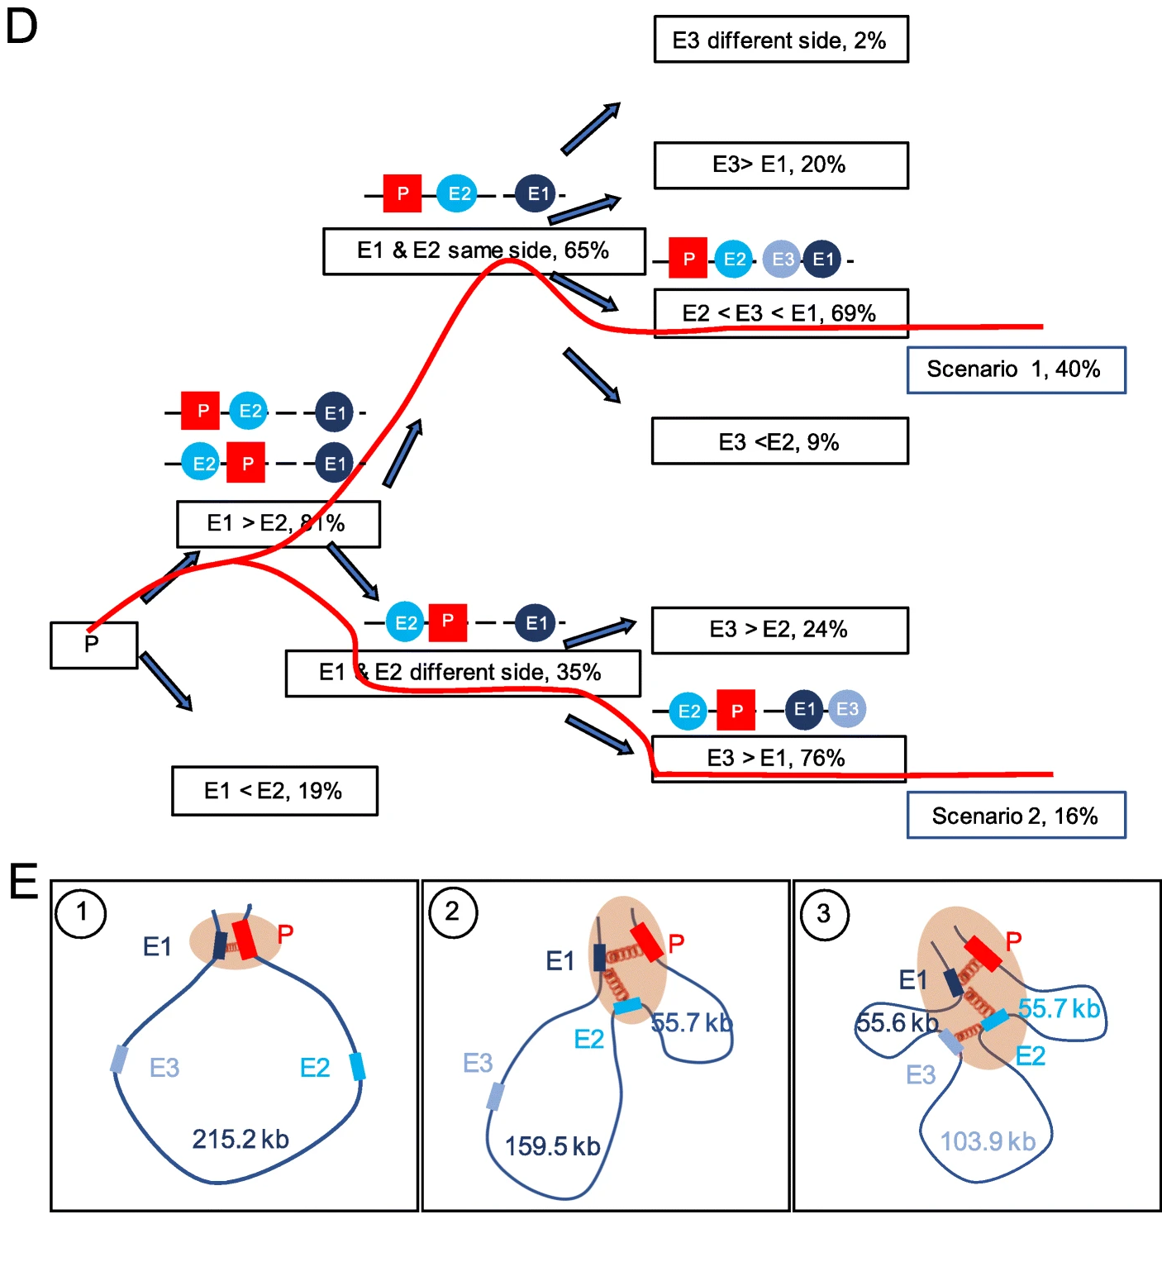

Slide 10
Allele-specific gene expression in autism
ASE
Lee C, Kang EY, Gandal MJ, Eskin E, Geschwind DH. Profiling allele-specific gene expression in brains from individuals with autism spectrum disorder reveals preferential minor allele usage. Nat Neurosci. 2019 Sep;22(9):1521-1532.
Normally, in ASE, the minor allele is less expressed.
In ASD, the minor allele is more expressed.
In ASD, genes with ASE are often downregulated in ASD postmortem brains and harbor de novo ASD mutations.

Slide 11
Simultaneous 3D DNA structure and DNAm
Methods
Lee DS, Luo C, Zhou J, Chandran S, Rivkin A, Bartlett A, Nery JR, Fitzpatrick C, O'Connor C, Dixon JR, Ecker JR. Simultaneous profiling of 3D genome structure and DNA methylation in single human cells. Nat Methods. 2019 Sep 9.
'methyl-3C' sequencing generates 3D structure and DNAm simultaneously.
Used to show differences between 14 different cortical cell types.

Slide 12
Weighted elastic net for robust models
Methods
Handl L, Jalali A, Scherer M, Eggeling R, Pfeifer N. Weighted elastic net for unsupervised domain adaptation with application to age prediction from DNA methylation data. Bioinformatics. 2019 Jul 15;35(14):i154-i163.
DNAm models derived in one dataset, often fail to perform well in other datasets due to technical or even biological differences
e.g. a model of age may be applied in a new tissue or to samples from individuals from a different age range.
Robustness can be improved by weighting the contribution of CpG sites by how well their relationships to other CpG sites agree between training and testing datasets.
Example: weighted elastic net generates improved models of age in cerebellum when cerebellum is not included in the training dataset.
Downside: whereas elastic net takes minutes using a single processor, this extension takes dozens of hours using 10 processors.

Slide 13
Assisted Reproductive Techniques Cohort
Cohort
Iliadou AN, Öberg AS, Pege J, Rodriguez-Wallberg KA, Olofsson JI, Holte J, Wramsby H, Wramsby M, Cnattingius S, Cesta CE. The Uppsala-Stockholm Assisted Reproductive Techniques (UppStART) study. BMJ Open. 2019 Aug 28;9(8):e028866.
"The cohort includes 971 participants (n= 514 women; n= 457 men), and 129 pregnancies were achieved from the first IVF cycle included in the study."
Biological samples such as blood and saliva will be collected.

Slide 14
