Slide 1

Journal club 30/09/2019
Nancy McBride and Matt Suderman’s journalclub package

Slide 2
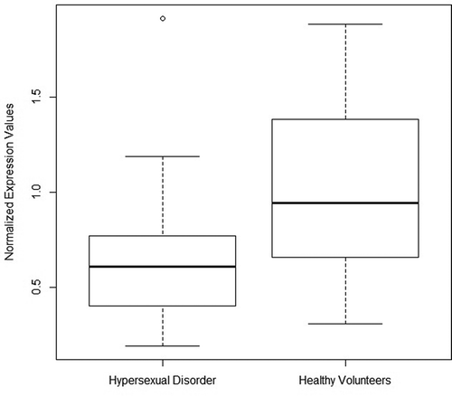
Boström AE, Chatzittofis A, Ciuculete DM…, Hypermethylation-associated downregulation of microRNA-4456 in hypersexual disorder with putative influence on oxytocin signalling: A DNA methylation analysis of miRNA genes. Epigenetics 2019 Sep 22
Whole blood (60 HD and 33 healthy volunteers)
“we perform a DNA methylation analysis of miRNA-associated CpG-sites in peripheral blood in order to examine if any DNA methylation patterns are associated with HD compared to healthy volunteers”
DNAm AND miRNA profiling
Two CpG-sites linked to MIR708 and MIR4456 are differentially methylated in subjects with HD
Validation cohort - 107 subjects (24 alcohol-dependent) explore association with addictive behaviour
MIR4456 associated CpG-site cg01299774 is hypermethylated in alcohol dependence in the validation cohort
Notes:
miRNA - small non-coding RNA molecule regulate gene expression (bind to mRNAs). Recent studies have revealed altered miRNA expression profiles in the circulation and brain of patients with psychiatric disorders. Differential expression of microRNA in peripheral blood mononuclear cells as specific biomarker for major depressive disorder patients. Drawing on this evidence, Issler et al. suggested that miRNAs targeting mRNAs expressed in brain could become novel treatment options in psychiatric disorders
Looked at CpG’s association to nearby miRNAs
in this study, we perform a DNA methylation analysis of miRNA-associated CpG-sites in peripheral blood in order to examine if any DNA methylation patterns are associated with HD compared to healthy volunteers
we measured the expressional profile of identified candidate miRNA to investigate whether they were differentially expressed in HD
we investigated whether the methylation levels of candidate CpG-sites contributes to explaining the differential expression pattern of the associated miRNAs in HD
Validation cohort – AA – excluded high BMI?
Where changes were detected, they investigated levels of gene expression at the associated miRNA
“we initially aimed to identify miRNA genes in proximity of CpG-sites, in which modifications of the epigenetic profile are associated with HD.”
These 2 survived multiple testing
Figure 1. Boxplot diagram of MIR4456 normalized expression values in HD and healthy volunteers.
MIR4456 FINDING - may be primarily associated with the addictive component observed in HD
The miRNA identified, miRNA-4456, targets genes that are normally expressed at particularly high levels in the brain and that are involved in the regulation of the hormone oxytocin.
But - mean difference in DNAm between groups was only around 2.6% - impact on physiological changes might be called into question – but we know subtle methylation changes can have wide-ranging consequences for other psychiatric conditions
In summary, our study implicates a potential contribution of MIR4456 in the pathophysiology of HD by putatively influencing oxytocin signalling.
Don’t know about expression modifications occurring in brain
This miRNA putatively targets genes preferentially expressed in brain tissue and involved in major neuronal molecular mechanisms thought to be relevant to the pathogenesis of HD. Our findings from the investigation of shifts in the epigenome contributes to further elucidating the biological mechanisms behind the pathophysiology of HD with special emphasis on MIR4456 and its role in oxytocin regulation. Further studies are needed to confirm and further elucidate the exact interplay between MIR4456 and the oxytocin signalling pathway in HD.

Slide 3
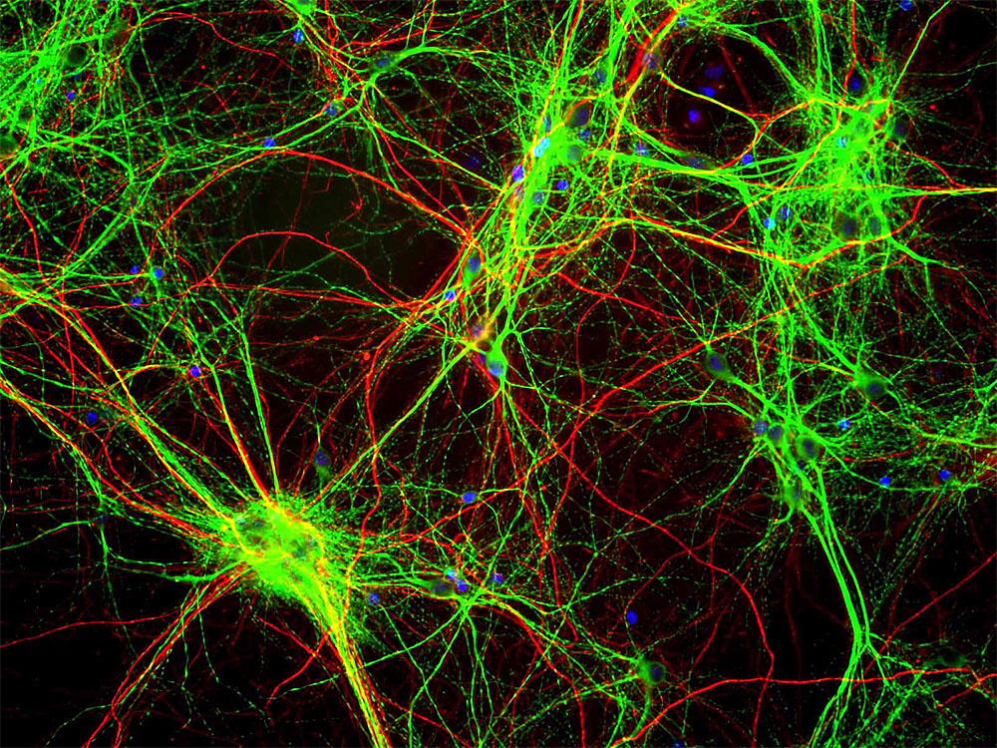
Mihoko Shimada, Taku Miyagawa, Akari Takeshima. Epigenome-wide association study of narcolepsy-affected lateral hypothalamic brain and overlapping DNA methylation profiles between narcolepsy and multiple sclerosis. Sleep. 2019 Sep 26
Lateral hypothalamic (LH) and temporal cortex (TC) brain samples – 11 narcolepsy 15 non-narcolepsy
DNAm differences between groups was found only in LH (81 DMRs)
Most differentially methylated regions located in the myelin base protein region
Overlap between DNAm profiles of narcolepsy and MS
Myelin!
Notes:
Post mortem – regions chosen because we know a loss of orexin neurons is associated with narcolepsy – known to be a neuropeptide that regulates arousal, wakefulness, and appetite
Authors previously conducted GWAS and EWAS of peripheral blood and found strong associations with immune and metabolic pathways
Here they looked at specific brain regions prev implicated. Used both Japanese and European brains. Different causes of death.
Dissected LH region and temporal cortex postmortem
No difference in cell composition / 850k / Used the CHAMP program for EWAS and bump hunter for DMRs / 4 of 81 DMRs in HLA
Of the DMRs found in LH, MBP was strongest assoc - this is a structural component of the myelin sheath essential for CNS myelin formation. Role of attention?
However, bc they focused on the LH region, the methylation diffs seen here may be a cause or effect we don’t know
Some population issues - what did ppl die of????? Did that effect DNAm??? Also most cases had diabetes. All patients male. 1 control female. But to be fair none of the 77 DMs found were assoc w sex or diabetes.
NEEDS CONFIRMATION STUDY

Slide 4
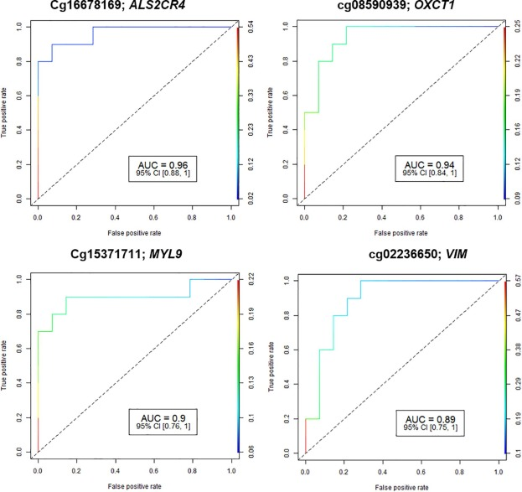
Ray O.Bahado Singh Sangeetha Vishweswaraiah Buket Ayd Artificial intelligence analysis of newborn leucocyte epigenomic markers for the prediction of autism. Brain Research 2019 Dec 01
EWAS newborn leukocyte DNA in autism (14 autism cases and 10 controls)
Differential methylation - 230 CpG sites in 249 genes
Many predictive CpG markers AUC >0.9 with >5% DNAm diff between groups
Determined accuracy of ML approaches for DNAm and autism
DL yielded an AUC (95% CI) = 1.00 (0.80–1.00) 5 CpG loci
4/5 ML AUC >0.95
“Our findings suggest significant epigenetic role in autism development and epigenetic markers appeared highly accurate for newborn prediction.”
Notes:
Recent reports suggest that epigenetic alterations may play a vital role in disease pathophysiology.
Our goal was to investigate the epigenetic basis of autism and identification of early biomarkers for disease prediction.
DL yielded an AUC (95% CI) = 1.00 (0.80–1.00) with 97.5% sensitivity and 100.0% specificity for autism detection for 5 CpG loci
Should you use deep learning on so few samples?
Standard multivariate logistic regression analysis
The combination of 3 CpG/gene markers: cg20129082 (LOC100126784; NAV2), cg08590939 (OXCT1) and cg20187719 (LOC285375) achieved an AUC 95% CI = 1.0 (1.0, 1.0). This confirms the robustness of CpG markers for autism prediction.
“Epigenetic dysregulation was identified in several important candidate genes including some previously linked to autism development e.g.: EIF4E, FYN, SHANK1, VIM, LMX1B, GABRB1, SDHAP3 and PACS2. “

Slide 5


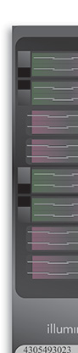

Jonathan A Heiss, Kasey J Brennan, Andrea A Baccarelli…, Battle of epigenetic proportions: comparing Illumina’s EPIC methylation microarrays and TruSeq targeted bisulfite sequencing Epigenetics 2019 Sep 05
Comparing Illumina's EPIC methylation microarrays and TruSeq targeted bisulfite sequencing
Comparison - cord blood samples - four newborns in duplicates using both the Illumina HumanMethylationEPIC BeadChip and the Illumina TruSeq Methyl Capture EPIC Kit
“We conclude that with current analytic goals microarrays still outperform bisulphite sequencing for precise quantification of DNA methylation”

