Slide 1
Journal club Nov 11 and 18, 2019
Categories | Number
EWAS | 1
DNAm score | 2
Mitochondria | 1
Epigenetics | 1
Initiative | 1
Methods | 3+bonus

Slide 2
Albao DS, Cutiongco-de la Paz EM, Mercado ME, Lirio A, Mariano M, Kim S, Yangco A, Melegrito J, Wad-Asen K, Gauran II, Francisco MA, Santos-Acuin C, David-Padilla C, Murphy EJ, Paz-Pacheco E, Seielstad M. Methylation changes in the peripheral blood of filipinos with type 2 diabetes suggest spurious transcription initiation at TXNIP. Hum Mol Genet. 2019 Nov 6.
EWAS
Functional investigation of loss of TXNIP methylation in T2D
N=218 controls and N=147 cases
177 differentially methylated CpG sites
3 sites near TXNIP replicate previous study
“The TXNIP downmethylation coincided with increased transcription at the 3’-UTR, H3K36me3 histone markings, and Sp1 binding, suggesting spurious transcription initiation at the TXNIP 3’-UTR as a functional consequence of T2D methylation changes” – uses publicly available datasets

Slide 3
Hlady RA, Zhao X, Pan X, Yang JD, Ahmed F, Antwi SO, Giama NH, Patel T, Roberts LR, Liu C, Robertson KD. Genome-wide discovery and validation of diagnostic DNA methylation-based biomarkers for hepatocellular cancer detection in circulating cell free DNA. Theranostics. 2019 Sep 25;9(24):7239-7250.
DNAm score
Blood biomarker for identifying HCC in individuals with liver cirrhosis.
“As liver cirrhosis is the principal risk state for HCC development, markers to detect early HCC within this patient population are urgently needed.”
N=22 per group, Illumina 450k for circulating cell free DNA (cfDNA)
AUC > 0.95 in validation (N=15 per group)
AUC > 0.95 when tested in liver tissue methylation data
However, predictors derived in liver tissue did not perform well in cfDNA

Slide 4
Patil V, Cuenin C, Chung F, Aguilera JRR, Fernandez-Jimenez N, Romero-Garmendia I, Bilbao JR, Cahais V, Rothwell J, Herceg Z. Human mitochondrial DNA is extensively methylated in a non-CpG context. Nucleic Acids Res. 2019 Nov 4;47(19):10072-10085.
Mitochrondia
First DNA methylation profiles of mitochrondrial DNAm
Bisulfite sequencing used to measure mitochondrial DNAm
“mitochondrial genomes are extensively methylated predominantly at non-CpG sites”
“DNMT3B knockdown cells displayed a comparatively pronounced global reduction in mtDNA methylation with concomitant increases in gene expression”

Slide 5
Locken-Castilla A, Pacheco-Pantoja EL, Rodríguez-Brito F, May-Kim S, López-Rivas V, Ceballos-Cruz A. Smoking index, lifestyle factors, and genomic instability assessed by single-cell gel electrophoresis: a cross-sectional study in subjects from Yucatan, Mexico. Clin Epigenetics. 2019 Oct 29;11(1):150.
Epigenetics
Associations of genomic instability with lifestyle (it is an epigenetic trait)
“Genomic instability was evaluated through a single-cell gel electrophoresis using peripheral blood mononuclear cells in three different conditions of oxidative stress”
Genomic instability ~ DNA damage ~ DNA breaks
N=82
Associated with:
Age
Smoking
Diet
Long sitting hours
Radiation
Notice the association with age and smoking … Smoking and DNAm age acceleration not associated.
EWAS this?
Notes:
There were consistent significant positive associations of genomic damage rates with smoking index and three PCA groups (p = 0.007, p = 0.004, p = 0.009). The smoking status and age group analysis revealed that there were significant differences for adult smokers with the same aforementioned PCA groups (p = 0.002, p = 0.001, p = 0.010). In addition, higher DNA damage rates were found in subjects with incorrect diet patterns, long sitting hours, and previous exposure to radiation. The analysis with binary logistic regression displayed two models in which lifestyles (age, diet, and/or sedentarism) did not change the significance of smoking index for DNA fragmentation risk; however, when physical activity was present in the model, the smoking index was not a significant factor for DNA damage risk.

Slide 6
Peedicayil J. Identification of Biomarkers in Neuropsychiatric Disorders Based on Systems Biology and Epigenetics. Front Genet. 2019 Oct 11;10:985.
Initiative
A systems biology biomarker is a subnetwork of features rather than a single or simply a collection of features. Predicts that they will perform better because longitudinal multi-omics + systems biology = magic.
Huge effort to understand neuropsychiatric disorders using ‘systems biology’
Willsey AJ,…, Ideker T, State MW, Krogan NJ. The Psychiatric Cell Map Initiative: A Convergent Systems Biological Approach to Illuminating Key Molecular Pathways in Neuropsychiatric Disorders. Cell. 2018 Jul 26;174(3):505-520.

Slide 7
Andersson, Lin, Liu, Levy, Mitchell, Larson, Vasan. An Integrated Multi-Omics Approach to Identify Genetic Underpinnings of Heart Failure and its Echocardiographic Precursors: The Framingham Heart Study. Circ Genom Precis Med. 2019 Nov 8.
Methods
Obtain biological insight and improve robustness by identifying genes implicated in multiple omics
Heart failure has heterogeneous causes, making GWAS likely to miss relevant loci
8372 Framingham Heart Study participants
Omics: DNA methylation, gene expression, genotypes for a subset
Phenotypes: 8 echocardiographic and 4 heart failure phenotypes
Integrative method:
Perform a GWAS, EWAS and TWAS
Produce gene orderings from each (by statistical significance)
Merge orderings into a single ordering (robust rank aggregation)
Results: several new genes identified that had been previously implicated, for example, in animal models.
Notes:
Background: Heart failure (HF) may arise from alterations in metabolic, structural, and signaling pathways, but its genetic architecture is incompletely understood. To elucidate potential genetic contributors to cardiac remodeling and HF, we integrated genome-wide single nucleotide polymorphisms (SNPs), gene expression, and DNA methylation using a transomics analytical approach.
Methods: We used robust rank aggregation (where the position of a certain gene in a rank order list [based on statistical significance level] is tested against a randomly shuffled rank order list) to derive an integrative trans-omic score for each annotated gene associated with a HF trait.
Results: We evaluated up to 8372 Framingham Heart Study participants (54% women, mean age 55±17 years). Of these, 62 (0.7%) and 35 (0.4%) had prevalent HF with reduced and preserved left ventricular (LV) ejection fraction (HFrEF and HFpEF), respectively. During a mean followup of 8.5 years (min-max 0.005-18.6 years), 223 (2.7%) and 234 (2.8%) individuals developed incident HFrEF and HFpEF, respectively. Top genes included MMP20 (matrix metalloprotease 20) and MTSS1 (promotes actin assembly at intercellular junctions) for LV systolic function; ITGA9 (receptor for VCAM1) and C5 (complement C5) for LV remodelling; NUP210 (expressed during myogenic differentiation) and ANK1 (cytoskeletal protein) for diastolic function; TSPAN16 and RAB11FIP3 (involved in regulation of actin cytoskeleton) for prevalent HFrEF; ANKRD13D and TRIM69 for incident HFrEF; HPCAL1 and PTTG1IP for prevalent HFpEF; and ZNF146 (close to the COX7A1 enzyme) and ZFP3 (close to SLC52A1, the riboflavin transporter) for incident HFpEF. We tested the HF-related top SNPs in the UK biobank, where rs77059055 in TPM1 (MAF 0.023, odds ratio 0.83, p=0.002) remained statistically significant upon Bonferroni-correction.
Conclusions: Our integrative transomics approach offers insights into potential molecular and genetic contributors to HF and its precursors. Although several of our candidate genes have been implicated in HF in animal models, independent replication is warranted

Slide 8
Turchin MC, Stephens M. Bayesian multivariate reanalysis of large genetic studies identifies many new associations. PLoS Genet. 2019 Oct 9;15(10):e1008431.
Methods
Improve power of EWAS, particularly in cohort studies?
“in simulation experiments, multivariate analyses have been shown to be more powerful at detecting associations [than univariate analysis]”
13 large studies of related traits
anthropometric traits (GIANT), plasma lipid traits (GlobalLipids), and red blood cell traits (HaemgenRBC)
many new associations (433 in total across the 13 studies)
many replicate

Slide 9
Ramisch, A., Heinrich, V., Glaser, L.V. et al. CRUP: a comprehensive framework to predict condition-specific regulatory units. Genome Biol 20, 227 (2019).
Methods
Identify enhancers and target genes most relevant to a condition
Input: H3K4me1, H3K4me3, H3K27ac and gene expression profiles across conditions.
Step 1. CRUP-EP: enhancer prediction
Step 2. CRUP-ED: enhancer dynamics (i.e. identify condition-specific enhancers)
Step 3. CRUP-ET: enhancer targets
(i.e. link dynamic enhancers to target genes)
Targets limited to same topological association domain (as determined by Hi-C) Target = gene expression is associated with enhancer activity across conditions
* condition = phenotype, exposure, state, etc.
Notes:
We present the software Condition-specific Regulatory Units Prediction (CRUP) to infer from epigenetic marks a list of regulatory units consisting of dynamically changing enhancers with their target genes. The workflow consists of a novel pre-trained enhancer predictor that can be reliably applied across cell types and species, solely based on histone modification ChIP-seq data. Enhancers are subsequently assigned to different conditions and correlated with gene expression to derive regulatory units. We thoroughly test and then apply CRUP to a rheumatoid arthritis model, identifying enhancer-gene pairs comprising known disease genes as well as new candidate genes.

Slide 10
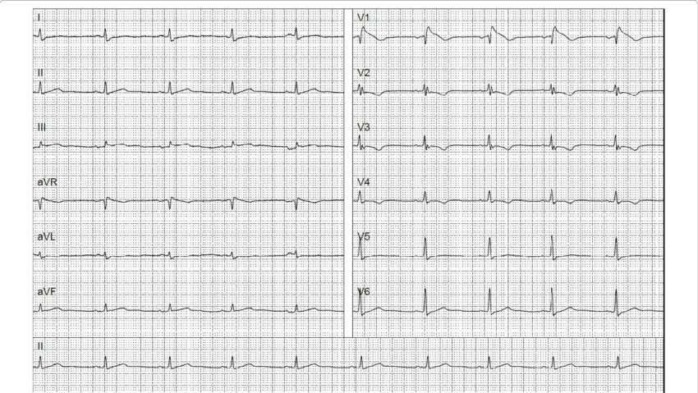
Methods
Raghunath et al. Deep neural networks can predict mortality from 12-lead electrocardiogram voltage data. arXiv:1904.07032.
Neural networks outperform clinicians in predicting mortality
N=1,775,926 12-lead resting ECGs
Goal: predict one-year all-cause mortality
Tool: 'deep neural network'
Results:
AUC = 0.85
AUC = 0.84 in N=297,548 ECGs interpreted as 'normal' by a physician

