Slide 1
Journal club Jan 27, 2020
Categories | Number
EWAS | 3
Methods | 1
DNAm age | 1
Prediction | 1

Slide 2
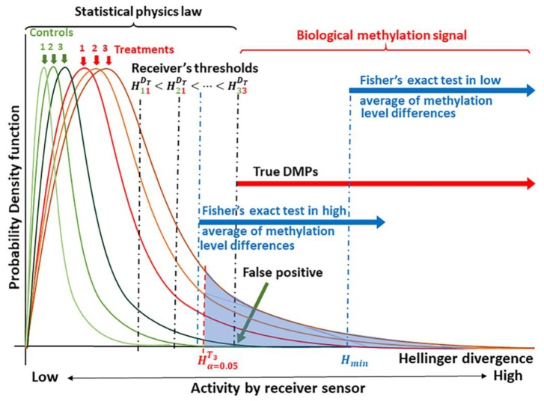
Sanchez R, Yang X, Maher T, Mackenzie SA. Discrimination of DNA Methylation Signal from Background Variation for Clinical Diagnostics. Int J Mol Sci. 2019 Oct 27;20(21).
Methods
A solution to the problem of identifying an optimal cutoff in clinical settings?
Based on "signal theory and machine learning"
Input is "whole biomarker genomic regions" rather than just the biomarker itself

Slide 3
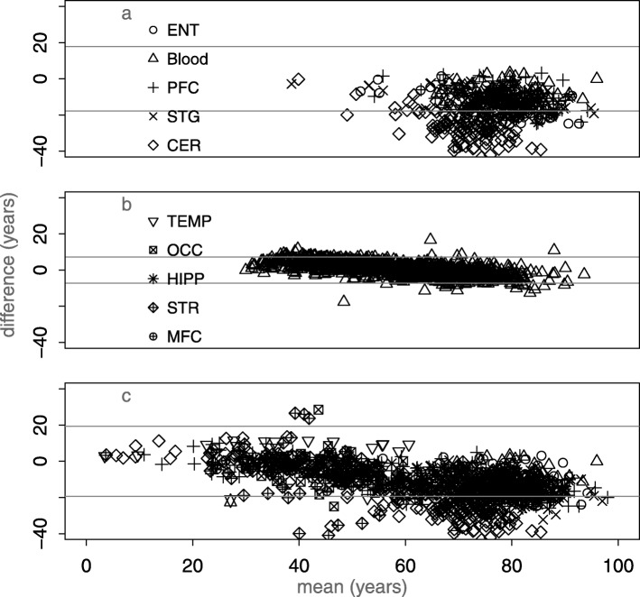
El Khoury et al. Systematic underestimation of the epigenetic clock and age acceleration in older subjects. Genome Biol. 2019 Dec 17;20(1):283.
DNAm age
DNAm age acceleration is associated with age, especially in older individuals
Recommendation: "Association tests of age acceleration should include age as a covariate."
Question: They consider Horvath and Hannum clocks, what about the others, PhenoAge and Grimage?

Slide 4
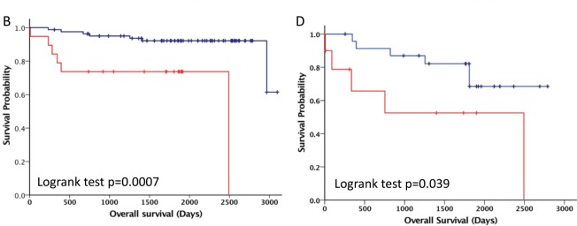
Jiang et al. DNA methylation markers in the diagnosis and prognosis of common leukemias. Signal Transduct Target Ther. 2020 Jan 10;5:3.
Prediction
Blood DNA methylation identifenties ALL and AML patients and survival
194 AML patients, 136 ALL patients, and 754 healthy individuals
Blood DNA methylation
Training (70%), testing (30%) sets
AUC > 0.99 for AML,ALL vs normal and AML vs ALL
Nearest shrunken centroids method (centroid = mean methylation of each CpG site for each class member)
Survival predictors generated as well (figure shows results in validation dataset)

Slide 5
Fraszczyk et al. The effects of bariatric surgery on clinical profile, DNA methylation, and ageing in severely obese patients.
Clin Epigenetics. 2020 Jan 20;12(1):14.
EWAS
A
40 severely obese individuals
Blood collected at bariatric surgery and 12 months later
Results
decrease over time in BMI, fasting glucose, HbA1c, HOMA-IR, insulin, total cholesterol, triglycerides, LDL and free fatty acids levels
4857 differentially methylated CpG sites 12 months
Not replicated but ...

Slide 6
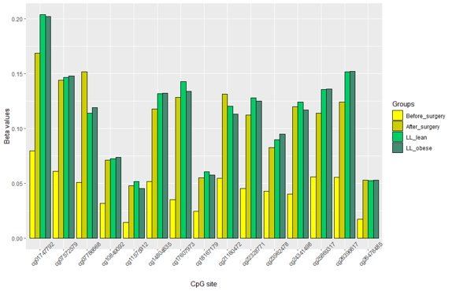
DNA methylation levels for top 15 CpG sites in severely obese patients before and after surgery and in sub-cohorts from Lifelines.
Notice how methylation after surgery matches 'normal' population ("LL_lean" and "LL_obese"). They call LL_obese 'healthy'.

Slide 7
Salas LA et al. Prediagnostic breast milk DNA methylation alterations in women who develop breast cancer. Hum Mol Genet. 2020 Jan 16.
EWAS
Breast milk methylation predicts cancer risk
breast milk from 87 women, 23 with later breast cancer diagnosis
58 DMPs
'inferred repeat element methylation' lower in cases (p = 2.9x10⁻⁴; REMP R pkg)
'epigenetic mitotic tick rate' (epiTOC) higher in cases (p = 3.2x10⁻⁴)
DNAm age higher in cases (p = 0.07)
Notes:
Prior candidate gene studies have shown tumor suppressor DNA methylation in breast milk related with history of breast biopsy, an established risk factor for breast cancer. To further establish the utility of breast milk as a tissue-specific biospecimen for investigations of breast carcinogenesis we measured genome-wide DNA methylation in breast milk from women with and without a diagnosis of breast cancer in two independent cohorts. DNA methylation was assessed using Illumina HumanMethylation450k in 87 breast milk samples. Through an Epigenome Wide Association Study we explored CpG sites associated with a breast cancer diagnosis in the prospectively collected milk samples from the breast that would develop cancer compared with women without a diagnosis of breast cancer using linear mixed effects models adjusted for history of breast biopsy, age, RefFreeCellMix cell estimates, time of delivery, array chip, and subject as random effect. We identified 58 differentially methylated CpG sites associated with a subsequent breast cancer diagnosis (q-value <â€‰0.05). Nearly all CpG sites associated with a breast cancer diagnosis were hypomethylated in cases compared with controls and were enriched for CpG islands. In addition, inferred repeat element methylation was lower in breast milk DNA from cases compared to controls, and cases exhibited increased estimated epigenetic mitotic tick rate as well as DNA methylation age compared with controls. Breast milk has utility as a biospecimen for prospective assessment of disease risk, for understanding the underlying molecular basis of breast cancer risk factors and improving primary and secondary prevention of breast cancer.

Slide 8
Lin PI, Shu H, Mersha TB.Comparing DNA methylation profiles across different tissues associated with the diagnosis of pediatric asthma. Sci Rep. 2020 Jan 13;10(1):151.
EWAS
Blood methylation not best peripheral tissue for asthma
Airway epithelial cells (74 asthma and 41 controls)
Nasal epithelial cells (15 asthma and 14 controls)
PBMCs (697 asthma, 97 controls)
Random forest classification
AUC based on 'out of bag errors'
PBMC – 31 loci AUC = 0.87
NEC - 8 loci AUC = 0.99
AEC – 4 loci AUC = 0.97

