Slide 1
Journal club Feb 10, 2020
Categories | Number
EWAS | 3
Methods | 2
DNAm age | 1
Epigenetics | 1
Mitochondria | 1

Slide 2
Barnett et al. ATAC-Me Captures Prolonged DNA Methylation of Dynamic Chromatin Accessibility Loci during Cell Fate Transitions. Mol Cell. 2020 Jan 17.
Epigenetics
DNAm loss is a final step in enhancer activation during cell fate transitions
What we knew …
DNAm critical for establishing cell identity
Cell-type DNAm is wide-spread but most pronounced in gene regulatory regions distant from genes
DNAm associated with promoter and enhancer repression
Exception In pluripotent stem cells, 'accessible' enhancers are often methylated.
Hypothesis During cell fate transitions, loss of DNAm is the final step in the activation of enhancers.
Experiment Measure DNAm and DNA accessibility simultaneously in enhancers in a monocyte-to-macrophage model (24 hours).
Observed DNA accessibility changes at thousands enhancers with matching gene expression changes but 'many' with no noticeable DNAm changes.
Notes:
DNA methylation of enhancers is dynamic, cell-type specific, and vital for cell fate progression. However, current models inadequately define its role within the hierarchy of gene regulation. Analysis of independent datasets shows an unanticipated overlap between DNA methylation and chromatin accessibility at enhancers of steady-state stem cells, suggesting that these two opposing features might exist concurrently. To define their temporal relationship, we developed ATAC-Me, which probes accessibility and methylation from single DNA library preparations. We identified waves of accessibility occurring rapidly across thousands of myeloid enhancers in a monocyte-to-macrophage cell fate model. Prolonged methylation states were observed at a majority of these sites, while transcription of nearby genes tracked closely with accessibility. ATAC-Me uncovers a significant disconnect between chromatin accessibility, DNA methylation status, and gene activity. This unexpected observation highlights the value of ATAC-Me in constructing precise molecular timelines for understanding the role of DNA methylation in gene regulation.

Slide 3
Moore JE, Pratt HE, Purcaro MJ, Weng Z. A curated benchmark of enhancer-gene interactions for evaluating enhancer-target gene prediction methods. Genome Biol. 2020 Jan 22;21(1):17.
Methods
Enhancer targeting is cell-type specific and we're not very good at it.
Problem: Predict which genes are regulated by an enhancer.
Solutions
Simple heuristic: A gene is regulated by the nearest enhancer
Data-driven: Hi-C, xQTL, xQTM, DNA sequence
Machine learning: TargetFinder, PEP
Performance?
Benchmark of candidate Enhancer-Gene Interactions (BENGI)
TargetFinder is a bit better than simple heuristic but only when trained and applied within the same cell type

Slide 4
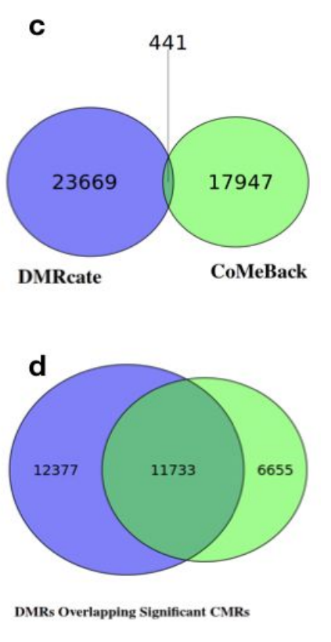
Gatev E, Gladish N, Mostafavi S, Kobor MS.CoMeBack: DNA Methylation Array Data Analysis for Co-Methylated Regions. Bioinformatics. 2020 Jan 27.
Methods
Method for combining correlated CpG sites for dimension reduction
CoMeBack
Partition genome into regions (CMR=two CpG probes in the same region if correlated, at most 2Kb apart, no sub-region with >400bp without a CpG site)
Region methylation = first principal component of all probes in the region
33K CMRs covering 100K probes
Median contained 2 probes, 80% had at most 3 probes
Exact overlap
Any overlap

Slide 5
Tian et al.Selenium-associated DNA methylation modifications in placenta and neurobehavioral development of newborns: An epigenome-wide study of two U.S. birth cohorts. Environ Int. 2020 Jan 30;137:105508.
EWAS
DNAm in placenta associated with placental selenium
N=343 New Hampshire Birth Cohort Study
N=141 Rhode Island Child Health Study
DNAm at 5 CpG sites associated with Se in placenta
Weak evidence that increased Se and increased DNAm at cg09674502 (GFI1) associated with decreased muscle tone
Notes:
BACKGROUND/AIM:
Selenium (Se) levels in pregnancy have been linked to neurobehavioral development of the offspring. DNA methylation is a potential mechanism underlying the impacts of environmental exposures on fetal development; however, very few studies have been done elucidating the role of DNA methylation linking prenatal Se and child neurobehavior. We aimed to investigate the associations between placental Se concentration and epigenome-wide DNA methylation in two U.S. cohorts, and to assess the association between Se-related DNA methylation modifications and newborns' neurobehavior.
METHODS:
We measured placental Se concentrations in 343 newborns enrolled in the New Hampshire Birth Cohort Study and in 141 newborns in the Rhode Island Child Health Study. Genome-wide placental DNA methylation was measured by HumanMethylation450 BeadChip, and newborn neurobehavioral development was assessed by the NICU Network Neurobehavioral Scales (NNNS). We meta-analyzed the associations between placental Se concentration and DNA methylation in each cohort, adjusting for covariates. We also fit multiple linear regression and ordinal logistic regression for methylation and newborn NNNS summary scores.
RESULTS:
We identified five Se-related differentially methylated CpG sites. Among them was cg09674502 (GFI1), where selenium concentration was positively associated with methylation (β-coefficient = 1.11, FDR-adjusted p-value = 0.045), and where we observed that a one percent methylation level increase was associated with a 15% reduced odds of higher muscle tone in the arms, legs and trunk of newborns, (OR [95% Confidence Interval, CI] = 0.85 [0.77, 0.95]). We also observed for each interquartile range (IQR) increase in selenium concentration in the placenta, there was 1.76 times greater odds of higher hypotonicity (OR [95% CI] = 1.76 [1.12, 2.82]).
CONCLUSIONS:
Placental selenium concentration was inversely associated with muscle tone of newborns, and hypermethylation of GFI1 could be a potential mechanism underlying this association.

Slide 6
Kazmi N, Elliott HR, Burrows K, Tillin T, Hughes AD, Chaturvedi N, Gaunt TR, Relton CL. Associations between high blood pressure and DNA methylation. PLoS One. 2020 Jan 30;15(1):e0227728.
EWAS
Ethnicity-specific associations with high blood pressure
N=364 European and 348 South Asian men (SABRE)
Peripheral blood
1 DBP DMP
7 DBP DMP in Europeans
No associations with SBP or hypertension
Very little agreement between European and South Asian EWAS
Notes:
BACKGROUND:
High blood pressure is a major risk factor for cardiovascular disease and is influenced by both environmental and genetic factors. Epigenetic processes including DNA methylation potentially mediate the relationship between genetic factors, the environment and cardiovascular disease. Despite an increased risk of hypertension and cardiovascular disease in individuals of South Asians compared to Europeans, it is not clear whether associations between blood pressure and DNA methylation differ between these groups.
METHODS:
We performed an epigenome-wide association study and differentially methylated region (DMR) analysis to identify DNA methylation sites and regions that were associated with systolic blood pressure, diastolic blood pressure and hypertension. We analyzed samples from 364 European and 348 South Asian men (first generation migrants to the UK) from the Southall And Brent REvisited cohort, measuring DNA methylation from blood using the Illumina Infinium® HumanMethylation450 BeadChip.
RESULTS:
One CpG site was found to be associated with DBP in trans-ancestry analyses (i.e. both ethnic groups combined), while in Europeans alone seven CpG sites were associated with DBP. No associations were identified between DNA methylation and either SBP or hypertension. Comparison of effect sizes between South Asian and European EWAS for DBP, SBP and hypertension revealed little concordance between analyses. DMR analysis identified several regions with known relationships with CVD and its risk factors.
CONCLUSION:
This study identified differentially methylated sites and regions associated with blood pressure and revealed ethnic differences in these associations. These findings may point to molecular pathways which may explain the elevated cardiovascular disease risk experienced by those of South Asian ancestry when compared to Europeans.

Slide 7
Morrow JD, Make B, Regan E, Han M, Hersh CP, Tal-Singer R, Quackenbush J, Choi AMK, Silverman EK, DeMeo DL. DNA Methylation is Predictive of Mortality in Current and Former Smokers. Am J Respir Crit Care Med. 2020 Jan 29.
EWAS
DNAm associated with mortality among smokers (but unrelated to smoking?)
Training: 101 deaths among N=667 current and former smokers (COPDGene study)
Replication: N=231 (ECLIPSE)
7 DMPs associated with mortality replicated
None associated with lung function decline, smoking history, current smoking. Two associated with lung function at enrollment. Two previously associated with gestational age.
Notes:
RATIONALE:
Smoking results in at least a decade lower life expectancy. Mortality among current smokers is two to three times as high as never smokers. DNA methylation is an epigenetic modification of the human genome that has been associated with both cigarette smoking and mortality.
OBJECTIVES:
We sought to identify DNA methylation marks in blood predictive of mortality in a subset of the COPDGene study, representing 101 deaths among 667 current and former smokers.
METHODS:
We assayed genome-wide DNA methylation in non-Hispanic white smokers with and without COPD using blood samples from the COPDGene enrollment visit. We tested whether DNA methylation was associated with mortality in models adjusted for COPD status, age, sex, current-smoking status, and pack-years of cigarette smoking. Replication was performed in a subset of 231 individuals from the ECLIPSE study.
RESULTS:
We identified seven CpG sites associated with mortality (FDR < 20%) that replicated in the ECLIPSE cohort (p < 0.05). None of these marks were associated with longitudinal lung function decline in survivors, smoking history or current smoking status. However, differential methylation of two replicated PIK3CD sites were associated with lung function at enrollment (p < 0.05). We also observed associations between DNA methylation and gene expression for the PIK3CD sites.
CONCLUSIONS:
This study is the first to identify variable DNA methylation associated with all-cause mortality in smokers with and without COPD. Evaluating predictive epigenomic marks of smokers in peripheral blood may allow for targeted risk stratification and aid in delivery of future tailored therapeutic interventions.

Slide 8
Gensous et al. One-year Mediterranean diet promotes epigenetic rejuvenation with country- and sex-specific effects: a pilot study from the NU-AGE project. Geroscience. 2020 Jan 24.
DNAm age
1-year Mediterranean diet reduces DNAm age
N=120 (60 Polish and 60 Italian, ~72 years old)
Measured DNAm before and after 1 year diet
EWAS null
Horvath DNAm age acceleration decreased in Polish (p=0.03, driven mostly by females p = 0.001)
Notes:
Mediterranean diet has been proposed to promote healthy aging, but its effects on aging biomarkers have been poorly investigated. We evaluated the impact of a 1-year Mediterranean-like diet in a pilot study including 120 elderly healthy subjects from the NU-AGE study (60 Italians, 60 Poles) by measuring the changes in their epigenetic age, assessed by Horvath's clock. We observed a trend towards epigenetic rejuvenation of participants after nutritional intervention. The effect was statistically significant in the group of Polish females and in subjects who were epigenetically older at baseline. A genome-wide association study of epigenetic age changes after the intervention did not return significant (adjusted p value < 0.05) loci. However, we identified small-effect alleles (nominal p value < 10-4), mapping in genes enriched in pathways related to energy metabolism, regulation of cell cycle, and of immune functions. Together, these findings suggest that Mediterranean diet can promote epigenetic rejuvenation but with country-, sex-, and individual-specific effects, thus highlighting the need for a personalized approach to nutritional interventions.

Slide 9
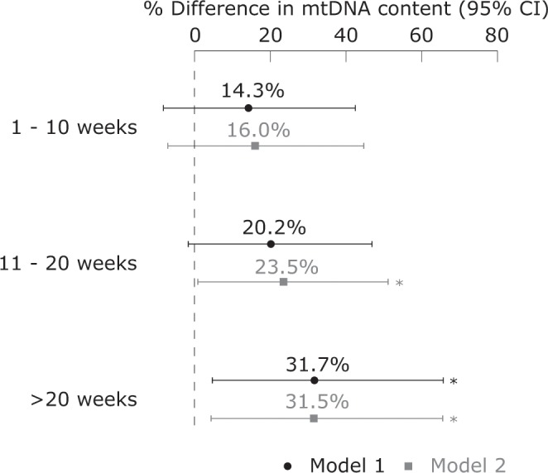
Cosemans et al. Breastfeeding predicts blood mitochondrial DNA content in adolescents.Sci Rep. 2020 Jan 15;10(1):387.
Mitochondria
Breastfeeding duration associated with mitochondrial DNA content in adolescence
Lower mtDNA: T2DM, aging, Parkinsons
Higher mtDNA: lower risk metabolic syndrome, greater endurance
N=303 age 14-15 (Flemish Environment and Health Study)
mtDNA content 23.1% higher in breastfed adolescents (95%CI:4.4-45.2)
mtDNA content increases with breastfeeding duration (see figure)
Notes:
Nutrition during early childhood is linked to metabolic programming. We hypothesized that breastfeeding has long-term consequences on the energy metabolism exemplified by mitochondrial DNA (mtDNA). As part of the third cycle of the Flemish Environment and Health Study (FLEHSIII) cohort, 303 adolescents aged 14-15 years were included. We associated breastfeeding and blood mtDNA content 14-15 years later while adjusting for confounding variables. Compared with non-breastfed adolescents, mtDNA content was 23.1% (95%CI: 4.4-45.2; p = 0.013) higher in breastfed adolescents. Being breastfed for 1-10 weeks, 11-20 weeks, and >20 weeks, was associated with a higher mtDNA content of respectively 16.0% (95%CI: -7.1-44.9; p = 0.191), 23.5% (95%CI: 0.8-51.3; p = 0.042), and 31.5% (95%CI: 4.3-65.7; p = 0.021). Our study showed a positive association between breastfeeding and mtDNA content in adolescents which gradually increased with longer periods of breastfeeding. Higher mtDNA content may be an underlying mechanism of the beneficial effects of breastfeeding on children's metabolism.
"A lower mtDNA copy number is a potential biomarker for type 2 diabetes mellitus, while an increased mtDNA copy number is linked with a lower risk of metabolic syndrome in adults25. Furthermore, mtDNA content has been positively associated with metabolic hormones such as leptin and insulin in early life26,27. In addition, a reduced mtDNA copy number has also been associated with aging28–30 and has been suggested as a biomarker for age-related neurodegenerative diseases, such as Parkinson’s disease31.

