Slide 1
Journal club April 6, 2020
Categories​ | Number​
EWAS​ | 4
DNAm score | 1
SEM | 1
Epigenetics | 3

Slide 2
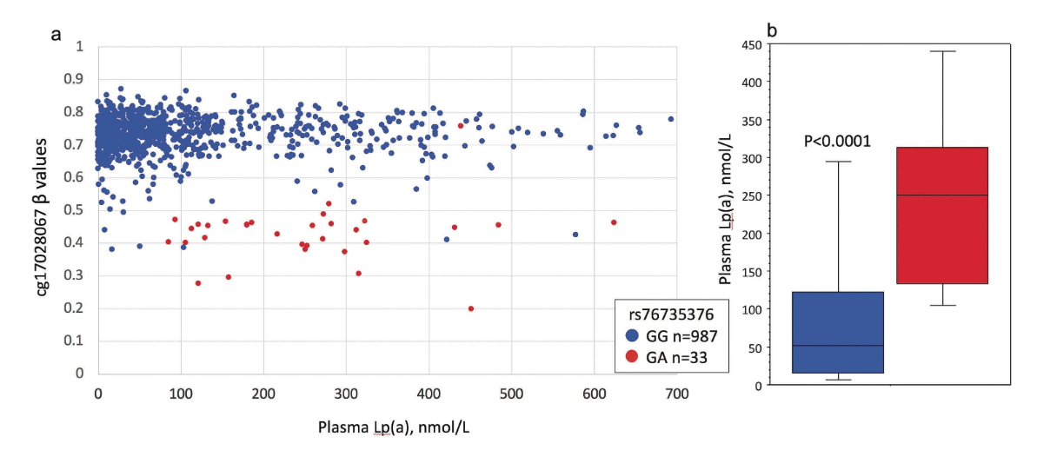
Jones GT, Marsman J, Bhat B, Phillips VL, Chatterjee A, Rodger EJ, Williams MJA, van Rij AM, McCormick SPA. DNA methylation profiling identifies a high effect genetic variant for lipoprotein(a) levels. Epigenetics. 2020 Apr 1:1-10.
EWAS
EWAS identifies novel association lipoprotein(a) … which is genetic.
Lipoprotein(a) "an independent risk factor for cardiovascular diseases"
Whole blood in n=1020 elderly participants
Validation in n=359 elderly males
1 CpG site association validated, cg17028067 in intron 1 of the Lipoprotein(a) gene
Coincides with 'uncommon' SNP rs76735376 which explains the association … however is a novel genetic variant associated with lipoprotein(a).
Notes:
1020 elderly individuals using the Illumina EPIC array and independent validation in 359 elderly males using the Illumina 450 k array. Plasma Lp(a) was measured using an apolipoprotein(a)-size-independent ELISA. Epigenome-wide rank regression analysis identified and validated a single CpG site, cg17028067 located in intron 1 of the LPA gene, that was significantly associated with plasma Lp(a) levels after correction for multiple testing. Genotyping of the site identified a relatively uncommon SNP (rs76735376, MAF <0.02) at the CpG site that largely explained the observed methylation effect. Rs76735376 is an expression quantitative trait loci for the LPA gene and could affect expression by altering enhancer activity. This EWAS for plasma Lp(a) identified a single CpG site within LPA. This association is due to an uncommon, but highly effective genetic variant, which was not in significant linkage disequilibrium with other variants known to influence Lp(a) levels or apo(a) isoform size. This study highlights the utility of CpG site methylation to identify potentially important genetic associations that would not be readily apparent in a comparable size genetic association study.

Slide 3
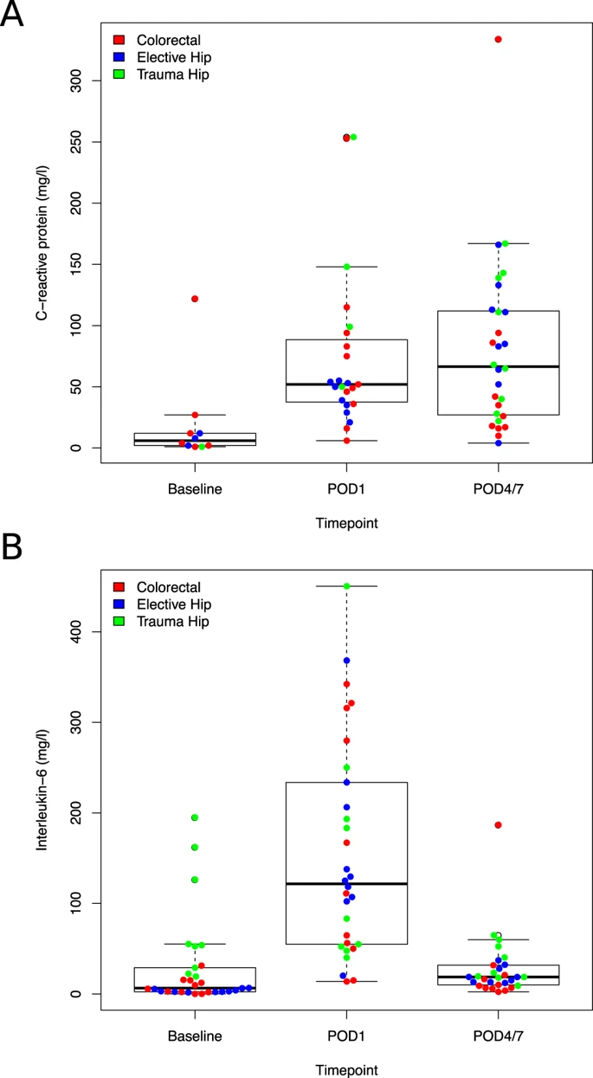
Sadahiro R, Knight B, James F, Hannon E, Charity J, Daniels IR, Burrage J, Knox O, Crawford B, Smart NJ, Mill J. Major surgery induces acute changes in measured DNA methylation associated with immune response pathways. Sci Rep. 2020 Apr 1;10(1):5743.
EWAS
Surgery induces immediate DNAm changes, including epigenetic age
DNA methylation measured PBMCs collected at 3 times:
just before surgery (baseline)
the day after surgery (POD1)
just before discharge (POD4/7)
Baseline vs POD1: 11 DMPs, immune response, Grimage +1.6y
Baseline vs POD4/7: 43 DMPs, also immune response
1 site in common, but effects of CpG sites quite similar (r > 0.74)
Grimage at POD4/7? POD1 vs POD4/7?
 | All | Colorectal | Hip Elective | Hip Fracture
N | 30 | 11 | 10 | 9
Age | 77.9 ± 6.4 | 73.6 ± 5.8 | 79.4 ± 4.6 | 81.3 ± 6.4
Notes:
Surgery is an invasive procedure evoking acute inflammatory and immune responses that can influence risk for postoperative complications including cognitive dysfunction and delirium. Although the specific mechanisms driving these responses have not been well-characterized, they are hypothesized to involve the epigenetic regulation of gene expression. We quantified genome-wide levels of DNA methylation in peripheral blood mononuclear cells (PBMCs) longitudinally collected from a cohort of elderly patients undergoing major surgery, comparing samples collected at baseline to those collected immediately post-operatively and at discharge from hospital. We identified acute changes in measured DNA methylation at sites annotated to immune system genes, paralleling changes in serum-levels of markers including C-reactive protein (CRP) and Interleukin 6 (IL-6) measured in the same individuals. Many of the observed changes in measured DNA methylation were consistent across different types of major surgery, although there was notable heterogeneity between surgery types at certain loci. The acute changes in measured DNA methylation induced by surgery are relatively stable in the post-operative period, generally persisting until discharge from hospital. Our results highlight the dramatic alterations in gene regulation induced by invasive surgery, primarily reflecting upregulation of the immune system in response to trauma, wound healing and anaesthesia.

Slide 4
Cresswell GD, Nichol D, Spiteri I, Tari H, Zapata L, Heide T, Maley CC, Magnani L, Schiavon G, Ashworth A, Barry P, Sottoriva A. Mapping the breast cancer metastatic cascade onto ctDNA using genetic and epigenetic clonal tracking. Nat Commun. 2020 Mar 27;11(1):1446.
Circulating
DNAm a solution for identifying the source of ctDNA fragments
Problems for interpretting data from circulating tumor DNA (ctDNA):
ctDNA comes from multiple distinct cells
ctDNA diluted with DNA from normal cells
ctDNA may come from multiple sites in the body
Whole-genome sequencing a solution?
Possible if reads are long enough to contain genetic differences between cells
Possible if lots of DNA sequenced
Possible if reads are long enough to contain genetic differences between cells at different sites
DNA methylation?
DNAm differences between cells, especially in cancer, are much more common than genomic differences, so reads don't have to be as long and sequencing doesn't have to be as deep

Slide 5
Soriano-Tárraga C, Lazcano U, Giralt-Steinhauer E, Avellaneda-Gómez C, Ois Á, Rodríguez-Campello A, Cuadrado-Godia E, Gomez-Gonzalez A, Fernández-Sanlés A, Elosua R, Fernández-Cadenas I, Cullell N, Montaner J, Moran S, Esteller M, Jiménez-Conde J, Roquer J. Identification of 20 novel loci associated to ischemic stroke. Epigenome-Wide Association Study. Epigenetics. 2020 Mar 23.
EWAS
Blood DNAm associated with ischemic stroke
Discovery N=218 ischemic stroke vs N=183 controls
Independent samples (N=226 and N=166)
22 CpG site differences validated
2 in ZFHX locus which contains genetic variants associated with stroke
Notes:
A two-stage case-control epigenome-wide association study was designed. The discovery sample with 401 samples included 218 ischemic stroke (IS) patients, assessed at Hospital del Mar (Barcelona, Spain) and 183 controls from the REGICOR cohort. In two independent samples (N=226 and N=166), we replicated 22 CpG sites differentially methylated in IS in 21 loci, including 2 CpGs in locus ZFHX3, which includes known genetic variants associated with stroke. The pathways associated to these loci are inflammation and angiogenesis. The meta-analysis identified 384 differentially methylated CpGs, including loci of known stroke and vascular risk genetic variants, enriched by loci involved in lipid metabolism, adipogenesis, circadian clock, and glycolysis pathways.Conclusions. We identified a set of 22 CpGs in 21 loci associated with IS. Our analysis suggests that DNA methylation changes may contribute to orchestrating gene expression that contributes to IS.

Slide 6
Reed ZE, Suderman MJ, Relton CL, Davis OSP, Hemani G. The association of DNA methylation with body mass index: distinguishing between predictors and biomarkers. Clin Epigenetics. 2020 Mar 30;12(1):50.
DNAm scores
DNAm is independently associated with extant BMI and cardiometabolic traits but does not predict future BMI
ARIES DNA methylation (all time points)
Published DNAm score of BMI
Explains 10% (middle age), 2% (pregnancy), 3% (15-17y), 2% (7y), 1% (birth) of BMI variation
DNAm score does not predict/cause future BMI
Some evidence that BMI does predict/cause future DNAm
However, DNAm scores associated with cardiometabolic traits independently of BMI and genotype
Notes:
The DNA methylation scores in adult women explained 10% of extant BMI variance. However, less extant variance was explained by scores generated in the same women during pregnancy (2% BMI variance) and in older children (15–17 years; 3% BMI variance). Similarly, little extant variance was explained in younger children (at birth and at 7 years; 1% and 2%, respectively). These associations remained following adjustment for smoking exposure and education levels. The DNA methylation score was found to be a poor predictor of future BMI using linear and cross-lagged models, suggesting that DNA methylation variation does not cause later variation in BMI. However, there was some evidence to suggest that BMI is predictive of later DNA methylation. Mendelian randomisation analyses also support this direction of effect, although evidence is weak. Finally, we find that DNA methylation scores for BMI are associated with extant cardiometabolic traits independently of BMI and genetic score.

Slide 7
Seeboth A, McCartney DL, Wang Y, Hillary RF, Stevenson AJ, Walker RM, Campbell A, Evans KL, McIntosh AM, Hägg S, Deary IJ, Marioni RE. DNA methylation outlier burden, health, and ageing in Generation Scotland and the Lothian Birth Cohorts of 1921 and 1936. Clin Epigenetics. 2020 Mar 26;12(1):49.
SEM
Outliers in DNAm increase with age
Generation Scotland (n=7010), LBC 1921 (n=430) and 1936 (n=898)
Number of DNAm outliers increase exponentially with age
In GS, number of outliers not due to
DNAm variance increasing with age
Age-related health outcomes
Genotype
In LBC, number of outliers not significantly related to survival.
Notes:
Here, we showed an association between age and log10-transformed DNA methylation outlier burden in a large cross-sectional cohort, the Generation Scotland Family Health Study (N = 7010, β = 0.0091, p < 2 × 10-16), and in two longitudinal cohort studies, the Lothian Birth Cohorts of 1921 (N = 430, β = 0.033, p = 7.9 × 10-4) and 1936 (N = 898, β = 0.0079, p = 0.074). Significant confounders of both cross-sectional and longitudinal associations between outlier burden and age included white blood cell proportions, body mass index (BMI), smoking, and batch effects. In Generation Scotland, the increase in epigenetic outlier burden with age was not purely an artefact of an increase in DNA methylation level variability with age (epigenetic drift). Log10-transformed DNA methylation outlier burden in Generation Scotland was not related to self-reported, or family history of, age-related diseases, and it was not heritable (SNP-based heritability of 4.4%, p = 0.18). Finally, DNA methylation outlier burden was not significantly related to survival in either of the Lothian Birth Cohorts individually or in the meta-analysis after correction for multiple testing (HRmeta = 1.12; 95% CImeta = [1.02; 1.21]; pmeta = 0.021).

Slide 8
Youk J, An Y, Park S, Lee JK, Ju YS. The genome-wide landscape of C:G > T:A polymorphism at the CpG contexts in the human population. BMC Genomics. 2020 Mar 30;21(1):270.
Epigenetics
C:G > T:A mutations quite common outside CpG islands and genes
Background: C:G > T:A most common substitution in evolution
Data
4300 genomes
60K exomes
26% of CpG sites have C:G > T:A substitutions
In CpG islands, this decreases to 5.6%, even lower in CpG islands near genes
Outside CpG islands, rate increases with distance from a CpG island (up to 2kb)
Inside protein-coding DNA, reduced rates for mutations that change amino acid
Notes:
Of the 28,084,558 CpG sites in the human reference genome, 26.0% show C:G > T:A substitution in the dataset. Remarkably, CpGs in CpG islands (CGIs) have a much lower frequency of such mutations (5.6%). Interestingly, the mutation frequency of CGIs is not uniform with a significantly higher C:G > T:A substitution rate for intragenic CGIs compared to other types. For non-CGI CpGs, the mutation rate was positively correlated with the distance from the nearest CGI up to 2 kb. Finally, we found the impact of negative selection for coding CpG mutations resulting in amino acid change.
Conclusions
This study provides the first unbiased rate of C:G > T:A substitution at the CpG dinucleotide contexts, using population-scale human genome sequencing data. Our findings provide insights into the dynamics of the mutation acquisition in the human genome.

Slide 9
Izzo F, Lee SC, Poran A, Chaligne R, Gaiti F, Gross B, Murali RR, Deochand SD, Ang C, Jones PW, Nam AS, Kim KT, Kothen-Hill S, Schulman RC, Ki M, Lhoumaud P, Skok JA, Viny AD, Levine RL, Kenigsberg E, Abdel-Wahab O, Landau DA. DNA methylation disruption reshapes the hematopoietic differentiation landscape. Nat Genet. 2020 Mar 23.
Epigenetics
DNAm influences hematopoietic differentation effects on transcription factor binding
To make a long story short:
The authors use single-cell sequencing to show that differences in DNA methylation in specific transcription factor binding sites affect TF binding (just like mutations) leading to differences in hematopoietic differentiation (in this example, the ratio of erythroid to myelomonocytic progenitors).
Notes:
Mutations in genes involved in DNA methylation (DNAme; for example, TET2 and DNMT3A) are frequently observed in hematological malignancies1,2,3 and clonal hematopoiesis4,5. Applying single-cell sequencing to murine hematopoietic stem and progenitor cells, we observed that these mutations disrupt hematopoietic differentiation, causing opposite shifts in the frequencies of erythroid versus myelomonocytic progenitors following Tet2 or Dnmt3a loss. Notably, these shifts trace back to transcriptional priming skews in uncommitted hematopoietic stem cells. To reconcile genome-wide DNAme changes with specific erythroid versus myelomonocytic skews, we provide evidence in support of differential sensitivity of transcription factors due to biases in CpG enrichment in their binding motif. Single-cell transcriptomes with targeted genotyping showed similar skews in transcriptional priming of DNMT3A-mutated human clonal hematopoiesis bone marrow progenitors. These data show that DNAme shapes the topography of hematopoietic differentiation, and support a model in which genome-wide methylation changes are transduced to differentiation skews through biases in CpG enrichment of the transcription factor binding motif.

Slide 10
Schrott R, Murphy SK. Cannabis use and the sperm epigenome: a budding concern? Environ Epigenet. 2020 Mar 19;6(1):dvaa002.
Epigenetics
THC exposure in rats changes sperm DNAm and offspring DNAm and behavior
"These studies have demonstrated significant changes to the sperm DNA methylome following cannabis use in humans, and THC exposure in rats. Furthermore, the use of rodent models has shown methylation and behavioral changes in rats born to fathers exposed to THC or synthetic cannabinoids, or to parents who were both exposed to THC."
This needs further study in humans …
Is there some way we can generate sperm methylomes in ALSPAC? Demonstrated effects of environment on sperm DNAm has a more immediate impact than in blood DNAm.
Notes:
The United States is swiftly moving toward increased legalization of medical and recreational cannabis. Currently considered the most commonly used illicit psychoactive drug, recreational cannabis is legal in 11 states and Washington, DC, and male use is an important and understudied concern. Questions remain, however, about the potential long-term consequences of this exposure and how cannabis might impact the epigenetic integrity of sperm in such a way that could influence the health and development of offspring. This review summarizes cannabis use and potency in the USA, provides a brief overview of DNA methylation as an epigenetic mechanism that is vulnerable in sperm to environmental exposures including cannabis, and summarizes studies that have examined the effects of parental exposure to cannabis or delta-9 tetrahydrocannabinol (THC, the main psychoactive component of cannabis) on the epigenetic profile of the gametes and behavior of offspring. These studies have demonstrated significant changes to the sperm DNA methylome following cannabis use in humans, and THC exposure in rats. Furthermore, the use of rodent models has shown methylation and behavioral changes in rats born to fathers exposed to THC or synthetic cannabinoids, or to parents who were both exposed to THC. These data substantiate an urgent need for additional studies assessing the effects of cannabis exposure on childhood health and development. This is especially true given the current growing state of cannabis use in the USA.

