Slide 1
Journal club June 1, 2020
Categories​ | Number​
EWAS​ | 2
MR | 1
Epigenetics | 1
DNAm age | 1

Slide 2
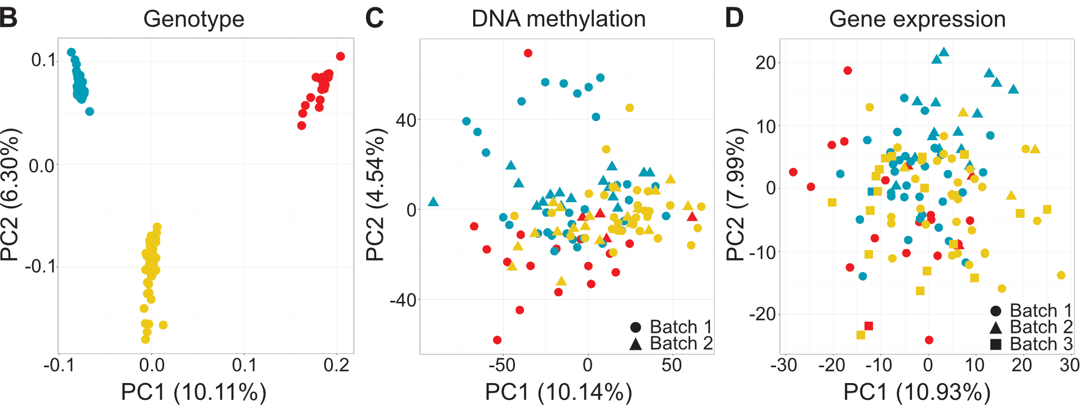
Natri et al. Genome-wide DNA methylation and gene expression patterns reflect genetic ancestry and environmental differences across the Indonesian archipelago. PLoS Genet. 2020 May 26;16(5):e1008749.
EWAS
Genotype, gene expression and DNA methylation variation across Indonesia
Data
N=100 from 3 locations representative of Indonesia
DNAm (EPIC) and gene expression (RNA-seq) profiles
Results
Differentially expressed and methylated genes enriched in pathways involved in immunity
~10% of differentially expressed genes correlated with nearby CpG site methylation
“to further refine them we intersected our lists of DMPs with published EWAS results available at the EWAS catalogue (http://ewascatalog.org; S11 Table). DMPs associated with a small number of terms are enriched in all three inter-island comparisons; these include immunity associated terms such as HIV infection, as well as lifestyle terms such as smoking behaviour and alcohol consumption, but also less straightforward terms including age.”
Notes:
Indonesia is the world's fourth most populous country, host to striking levels of human diversity, regional patterns of admixture, and varying degrees of introgression from both Neanderthals and Denisovans. However, it has been largely excluded from the human genomics sequencing boom of the last decade. To serve as a benchmark dataset of molecular phenotypes across the region, we generated genome-wide CpG methylation and gene expression measurements in over 100 individuals from three locations that capture the major genomic and geographical axes of diversity across the Indonesian archipelago. Investigating between- and within-island differences, we find up to 10.55% of tested genes are differentially expressed between the islands of Sumba and New Guinea. Variation in gene expression is closely associated with DNA methylation, with expression levels of 9.80% of genes correlating with nearby promoter CpG methylation, and many of these genes being differentially expressed between islands. Genes identified in our differential expression and methylation analyses are enriched in pathways involved in immunity, highlighting Indonesia's tropical role as a source of infectious disease diversity and the strong selective pressures these diseases have exerted on humans. Finally, we identify robust within-island variation in DNA methylation and gene expression, likely driven by fine-scale environmental differences across sampling sites. Together, these results strongly suggest complex relationships between DNA methylation, transcription, archaic hominin introgression and immunity, all jointly shaped by the environment. This has implications for the application of genomic medicine, both in critically understudied Indonesia and globally, and will allow a better understanding of the interacting roles of genomic and environmental factors shaping molecular and complex phenotypes.

Slide 3
Sherwood et al. Epigenome-Wide Association Study Reveals Duration of Breastfeeding Is Associated with Epigenetic Differences in Children. Int J Environ Res Public Health. 2020 May 20;17(10):E3569.
EWAS
Associations with breastfeeding at 10 but not at later ages
Data
DNAm from the Isle of Wight Birth Cohort at 10 (n=410), 18 (n=109) and 26 (n=302) years
Breastfeeding >3 months, >6 months, >3 months exclusive
Results
Two associations in genes SNX25 and LINC00840 with breastfeeding duration >6 months at 10 years
Associations did not persist

Slide 4
Nazarian A, Yashin AI, Kulminski AM. Summary-Based Methylome-Wide Association Analyses Suggest Potential Genetically Driven Epigenetic Heterogeneity of Alzheimer's Disease. J Clin Med. 2020 May 15;9(5):E1489.
MR
Genetically-driven DNAm associations with Alzheimer’s Disease
Data
GWAS of Alzheimer’s Disease (AD) all, males, females, hypertension, no hypertension
mQTL analyses in blood and brain
Methods: Summary-based Methylome-Wide Association Study
Results
8 (all), 31 (males), 9 (females), 6 (hypertension) and 84 (none) blood associations
2 (all), 6 (males), 4 (females), 4 (hypertension), and 27 (none) brain associations
10 genes in common: NANOS2 (males), HLA-DQB2 (females), FAM193B (hypertension), SLC6A7, BPGM, PSTK, KRTAP5-11, LECT1, ZNF598, and C16orf80 (none)
Conclusion: Some gene candidates for better understanding AD pathogenesis

Slide 5
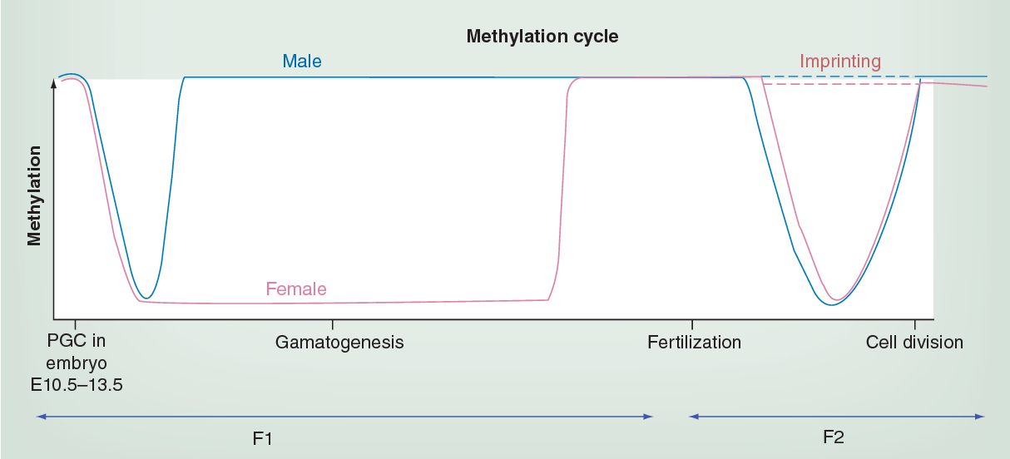
Kremsky I, Corces VG. Protection from DNA re-methylation by transcription factors in primordial germ cells and pre-implantation embryos can explain trans-generational epigenetic inheritance. Genome Biol. 2020 May 18;21(1):118.
Epigenetics
Transcription factor binding shields CpG sites from global erasure/remethylation
Background: Most DNA methylation is erased in primordial germ cells making DNA methylation an unlikely mechanism for trans-generational epigenetic inheritance
Data: previously published BS-seq, DNase-seq, ATAC-seq, and RNA-seq profiles from multiple stages of primordial germ cell and pre-implantation development
Results
After global erasure, most DNAm is restored (78% of CpG sites)
Exceptions: sites bound by transcription factors
Conclusion: “transcription factors can act as carriers of epigenetic information during germ cell and pre-implantation development by ensuring that the methylation status of CpGs is maintained”
Notes:
Figure 2. Very early embryonic development corresponds to epigenetic programing. Primordial germ cells in the embryo undergo global DNA methylation erasure, or ‘reprogramming’ from their epiblast state (red arrow). This first wave of demethylation is also denoted in the methylation cycle graph depicting both the male and female genomes devoid of DNA methylation, including imprinted genes. Gametes are then de novo methylated at different rates, with maternal methylation marks being established later (graph pink line) than paternal marks. A second round of ‘reprogramming’ occurs upon fusion of the gametes (sperm and oocyte) producing totipotent or pluripotent cell states. At this point, demethylation occurs more rapidly in the paternal genome (graph blue line), moreover, imprinted genes escape erasure (graph dotted lines) maintaining their methylation marks. Genomewide remethylation occurs in both parental genomes at implantation (green arrow). The timeline denoted in this schematic refer to event in the mouse life cycle. The timeline in humans is not yet full defined, though the events are considered to occur in a similar manner. PGC: Primordial germ cell. Adapted with permission from [11].

Slide 6

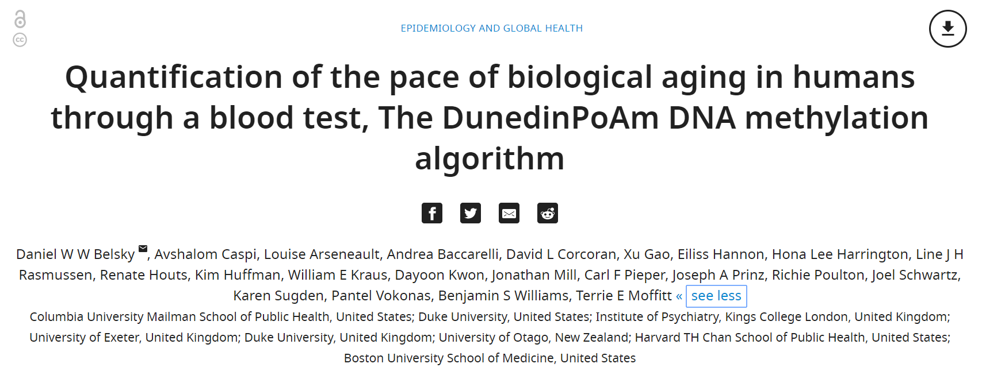
DNAm age
DunedinPoAM = Dunedin(P)ace(o)f(A)ging(m)ethylation

Slide 7
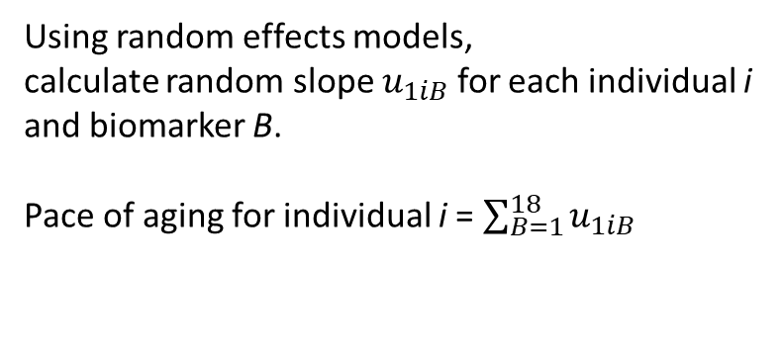
Using random effects models,
calculate random slope $u_{1iB}$ for each individual i
and biomarker B.
Pace of aging for individual i = $\sum_{B=1}^{18}{u_{1iB}}$

Slide 8
Pace of Aging associations (not exhaustive)
“faster Pace of Aging is associated with early-life factors important for aging:
- familial longevity,
- low childhood social class, and
- adverse childhood experiences”
Belsky et al. Aging Cell 2017
Belsky et al. PNAS 2015

Slide 9
N=954 samples for training
46 CpG sites
Estimates ‘rate of aging’ so no not an adjustment for chronological age.

Slide 10
Pace of Aging and DunedinPoAm
Notes:
Figure s4

Slide 11
N=954 samples for training
46 CpG sites

Slide 12
DunedinPoAm at 38 years and signs of aging at 45 years
Notes:
Figure 2 Faster age-38 DunedinPoAm is associated with poorer physical and cognitive
1115 functioning and subjective signs of aging at age 45 years, and with physical, cognitive, and
1116 subjective decline in the Dunedin Study.

Slide 13
DunedinPoAm at 38 years and changes from 38 to 45 years

Slide 14
DunedinPoAm at 38 years and changes from 38 to 45 years
Notes:
Figure s6

Slide 15
N=954 samples for training
46 CpG sites

Slide 16
DunedinPoAm associated with (biological) age

Slide 17
N=954 samples for training
46 CpG sites

Slide 18
DunedinPoAm associated with survival

Slide 19
N=954 samples for training
46 CpG sites

Slide 20
SEP and victimization in E-Risk (age 18)
Notes:
Figure 5

