Slide 1
Journal club June 15, 2020
Categories​ | Number​
EWAS​ | 8
Prediction | 1
Genetic mosaicism | 1
Single-cell RNA-seq | 1

Slide 2
EWAS
Phenotype | Tissue | N | CpGs | Note | PMID | Journal
Blood pressure | WB | 4820 age 14-69 (replication in CHARGE) | 39 at P < 10⁻⁵ 16 replicated | Twin data shows mostly shared unique env | 32520614 | Hypertension
VEGF-A (angiogenesis) | PBMC | 201 (STANISLAS Family study) | 41 |  | 32503626 | Clin Epigenetics
Polybrominated biphenyl levels | WB | 381 women, 277 men | 17 in women, 675 in men | No overlap | 32496131 | Epigenomics
Birthweight | Placenta | 301 | 15 | Overlaps with previous EWAS of preeclampsia, pre-pregnancy underweight, birthweight, type 2 diabetes | 32493484 | Clin Epigenetics
Diet | WB | 5 cohorts: 6662 Eur, 2702 Afr, 360 Hisp | 30 (only in Europeans) | 6 CpGs with CVD risk factors by MR | 32525743 | Circ Genom Precis Med
Transportation noise and air pollution | WB | 1389 at two time points (SAPALDIA Study) | DMRs by DMRcate |  | 32484729 | Environ. Health Perspect.
Cadmium and Smoking | WB | 2325 age 45-74 (Strong Heart Study) | 6 for Cd, 288 smoking, 17 former smoking | Cadmium EWAS adjusted for smoking status (not pack years …) | 32484362 | Environ. Health Perspect.
Change across puberty | Saliva | 118 at Tanner T1 and 2 years later | 2602 in all, 364 in females, 64 in males | Differences distinct from sex differences | 32493224 | BMC Genomics

Slide 3
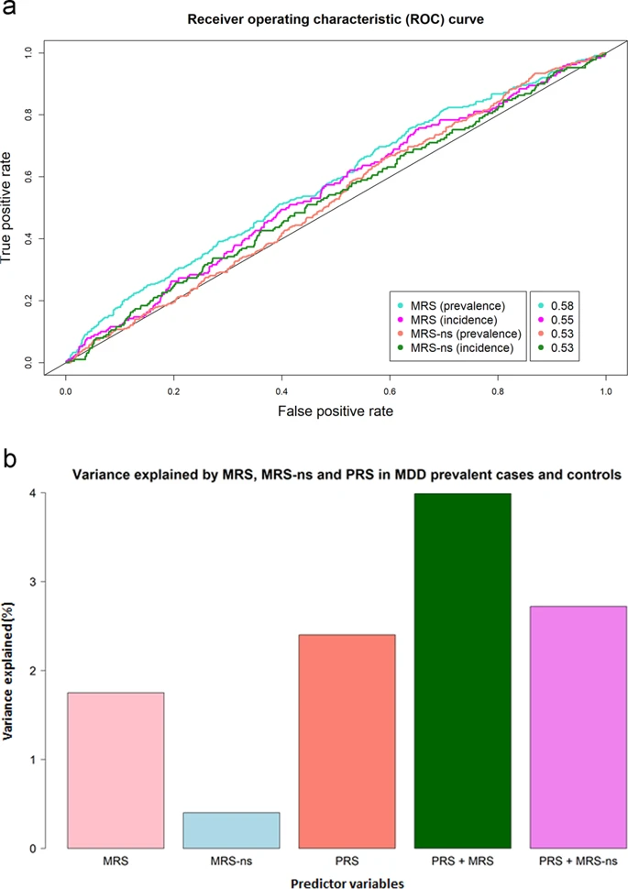
Barbu MC, Shen X, Walker RM, Howard DM, Evans KL, Whalley HC, Porteous DJ, Morris SW, Deary IJ, Zeng Y, Marioni RE, Clarke TK, McIntosh AM. Epigenetic prediction of major depressive disorder. Mol Psychiatry. 2020 Jun 10.
Prediction
DNAm detects MDD
Data
Training: 1223 MDD cases, 1824 controls
Testing: 363 cases, 1417 controls
Methods LASSO
Results (ns=non-smokers, MRS=196 CpG site methylation risk score)
MRS associated with lifestyle and socio-demographic factors (e.g. smoking and BMI)
PRS associated with psychosocial and mental health phenotypes

Slide 4
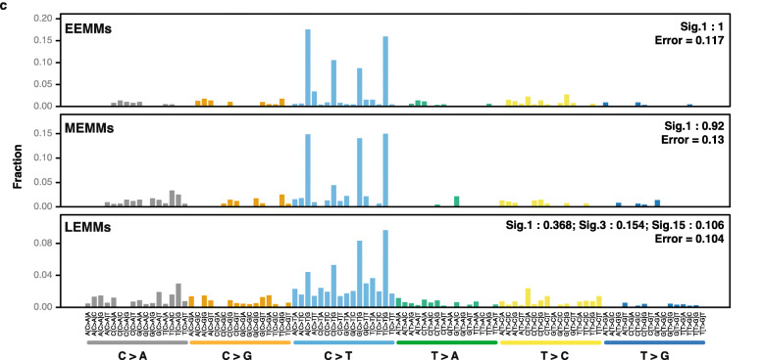
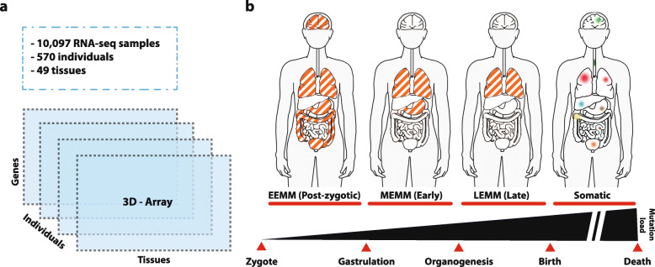
Muyas F, Zapata L, Guigó R, Ossowski S. The rate and spectrum of mosaic mutations during embryogenesis revealed by RNA sequencing of 49 tissues. Genome Med. 2020 May 27;12(1):49.
Genetic mosaicism
Coding mutations during embryogenesis tend to be spontaneous but rare
Data
10,097 RNA-seq profiles for blood samples distributed over 570 individuals and 49 tissues
Results
Estimate 0.5-1 embryonic mosaic mutation per person
Mostly methylated C > T – which implies that most were spontaneous rather than caused by environment

Slide 5
Khrameeva et al. Single-cell-resolution transcriptome map of human, chimpanzee, bonobo, and macaque brains. Genome Res. 2020 May;30(5):776-789.
Single-cell RNA-seq
Single-cell RNA-seq much more sensitive than bulk tissue RNA-seq
Data
RNA-seq profiles for 88,047 cells
from 422 brain samples
covering 33 regions
from humans, chimps, bonobos and macaques
Results
Humans most different in cerebral cortex, hypothalamus, cerebral gray and white matter
Humans more different in astrocytes and oligodendrocyte progenitors than neurons
Bulk RNA-seq did not detect 2/3s of these differences

