Slide 1
First look at phase 2 results
https://github.com/MRCIEU/godmc_phase2_analysis

Slide 2
Genetics of DNA methylation Consortium
46 cohorts with ~35,000 samples

Slide 3
GoDMC Analysis Strategy
www.godmc.org.uk
Email:
Josine Min: Josine.Min@bristol.ac.uk
Gibran Henami: g.hemani@bristol.ac.uk
Kim Burrows: Kimberley.burrows@Bristol.ac.uk
Phase 1
Genotype
Methylation
Completed
22 Cohorts: N=17,873
120 Million SNP-CpG pairs
SNP-CpG Candidate list
Fast approximation method
450K*8 M Tests
Single cohort P Value <1e-05
Phase 2
Linear model of 120 M tests
Addition of disease associated SNPs, CpGs and most variable sites in Phase 1
Meta-analysis
In Progress
>45 Cohorts: N=>33,000
Construct a MethQTL Catalogue
~ 4 Months
MethQTL Catalogue
Phase 3
In Preparation
Cohorts have joined with DNA methylation measured in additional tissues such as saliva
As well as non-European ancestries
Ideas for additional analyses welcome
Causal Analysis
Genomic Annotation
Selection
Other Ancestries and Tissues
Notes:
Take home message from this slide:
Phase 1 and 2 are for European ancestry and blood derived methylation only
Phase 1 completed and Phase 2 has started
Phase 3 will include additional analyses including exploring meQTLs in non-European ancestries and comparing Phase 2 results to other tissue types
Phase 3 can begin in preparation shortly

Slide 4
16: Maximising coverage, minimising bias
CpGs
SNPs
Phase 1
Cohort 1
Cohort 2
Cohort 3
CpGs
120 million putative associations to be tested in all cohorts
SNPs
Phase 2
All cohorts

Slide 5
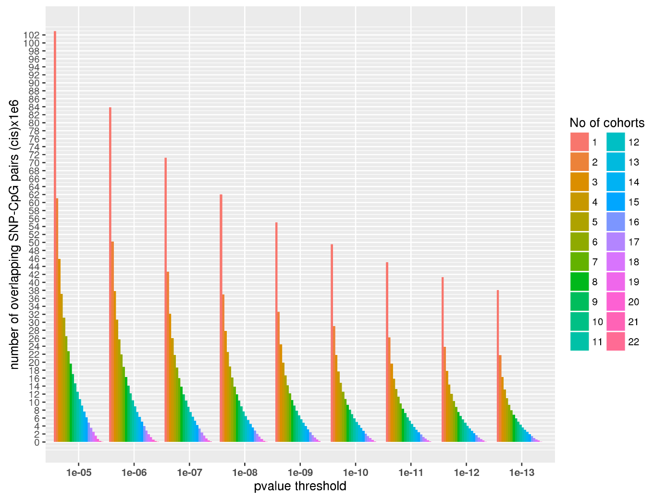
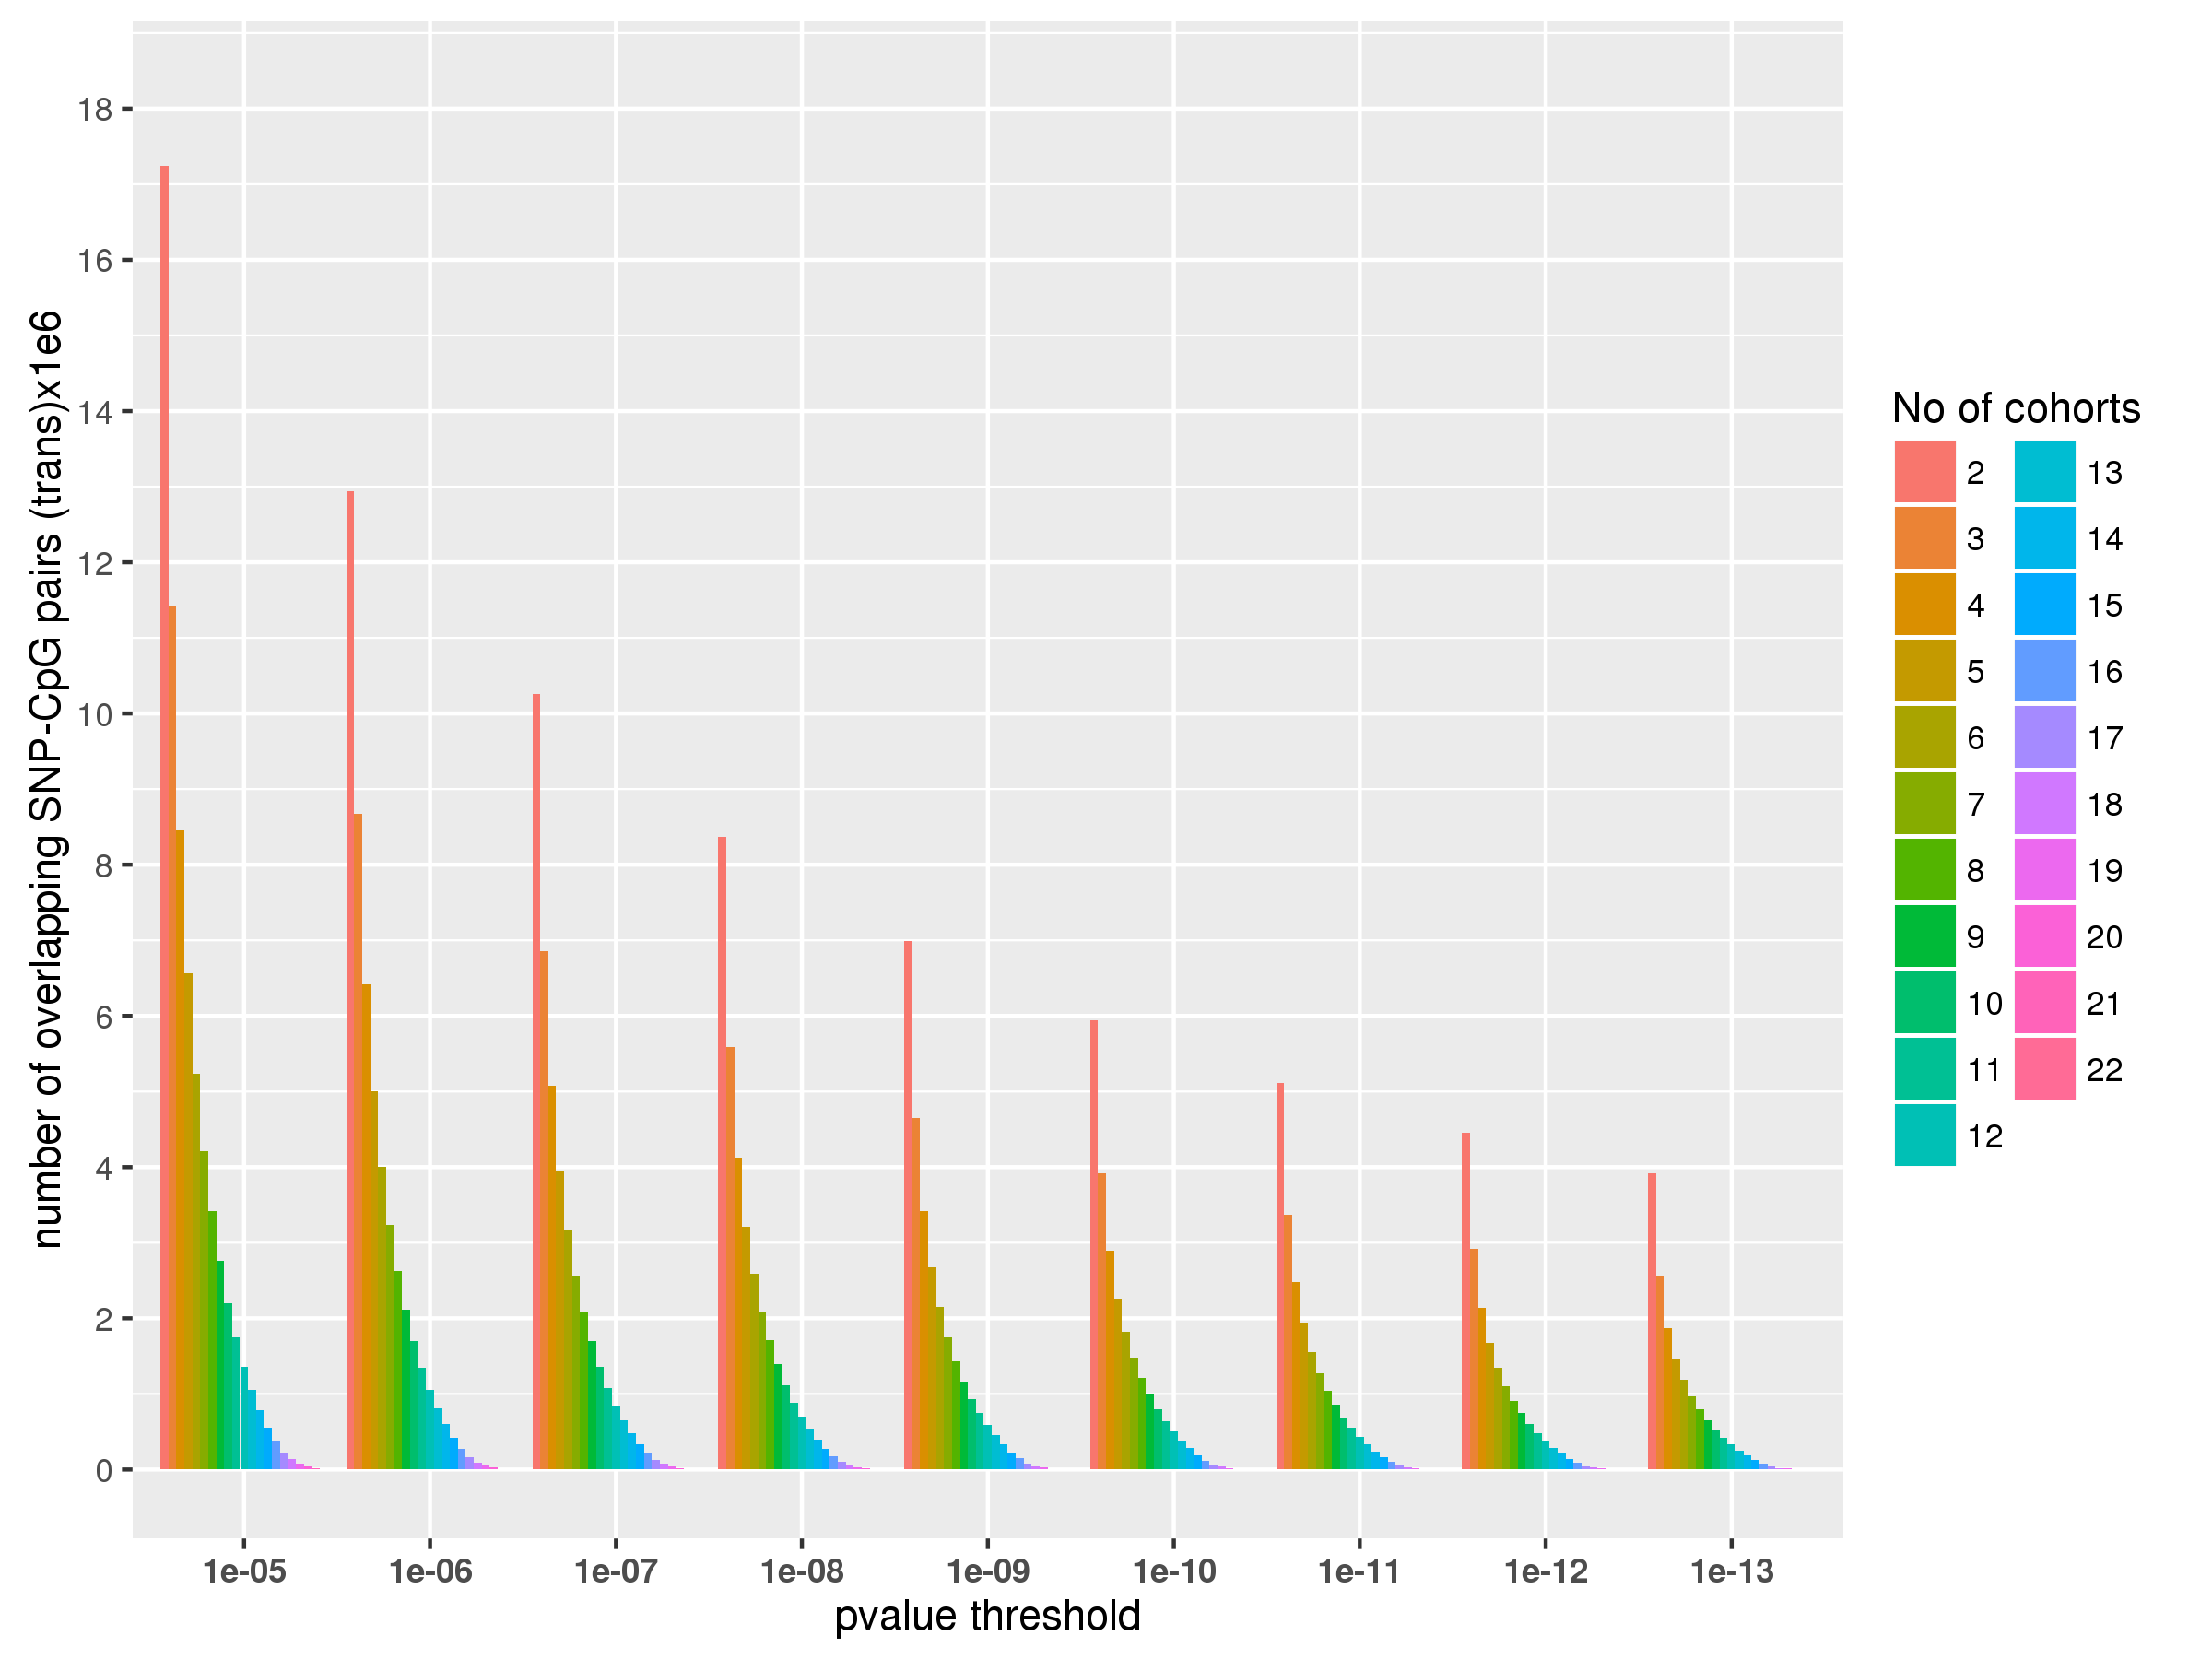
SNP-CpG pairs returned from phase 1

Slide 6
17: Additional coverage
Selected SNPs
Chromatin QTLs | 13446
GTEX QTLs | 2916
GWAS catalog | 6365
Metabolomic QTLs | 239
MR-Base QTLs | 3244
Neanderthal alleles (Simonti et al 2016) | 1328
Proteomic QTLs | 55
Trans eQTLs (Westra et al) | 349
Total unique SNPs | 26688
Selected methylation probes
250k most variable sites | 251285
Age associated CpGs (Horvath predictor) | 353
BMI associated CpGs (Wilson et al 2017) | 187
Schizophrenia (Hannon et al 2016) | 25
Schizophrenia (Montana et al 2016) | 172
Smoking associated CpGs (Joehanes et al) | 18760
Total unique CpGs | 255943
6.8 billion `hypothesis-driven’ associations tested in all cohorts

Slide 7
Meta analysis (16)
Approximately 120 million SNP-CpGs split in 962 files
Each CpG represented in only one file
Using METAL to do meta analysis
Fixed effects (IVW)
Fast and handles large files ok
Only prints to 4 significant figures

Slide 8
Clumping
2.5Mb radius
Rsq 0.001
Cis-pval 1e-4
Trans-pval 5e-8
European 1000G reference panl

Slide 9
Using 1Mb radius as cis distance

Slide 12
Independent hits from clumping
chr16:67605794:SNP associates with 402 different CpGs at p < 1e-14

Slide 13
Independent hits from conditional analysis (using cojo-slct – this may be wrong)

Slide 16
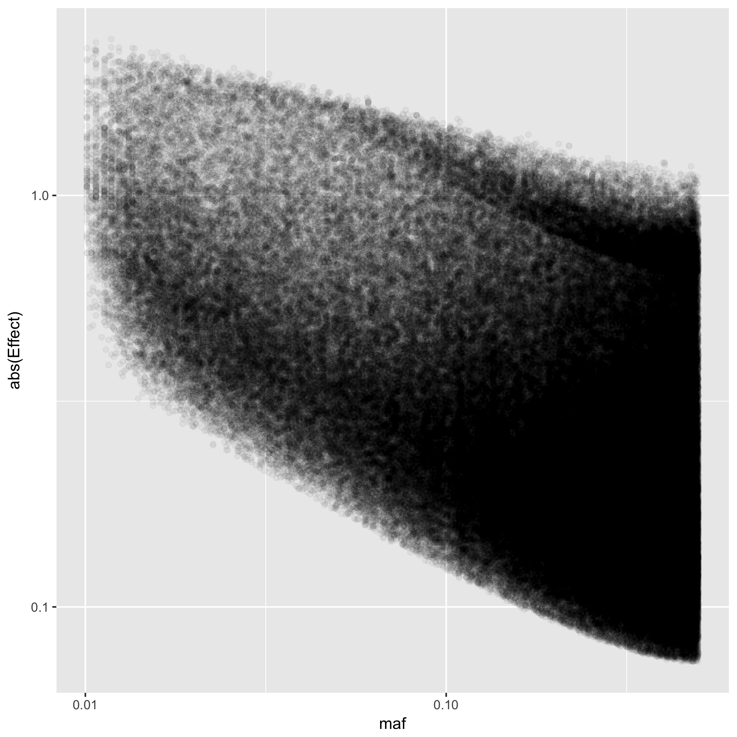

Slide 17
Variance of 450k mQTL (p < 5e-8) explained by
Cis: 3.16%
Trans: 0.25%

Slide 18
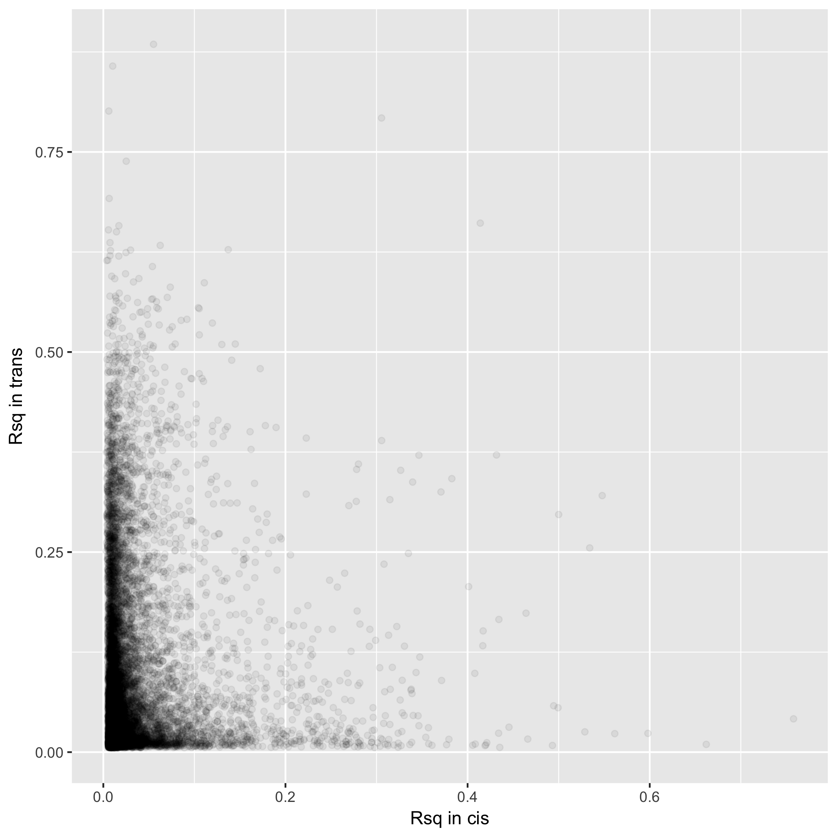
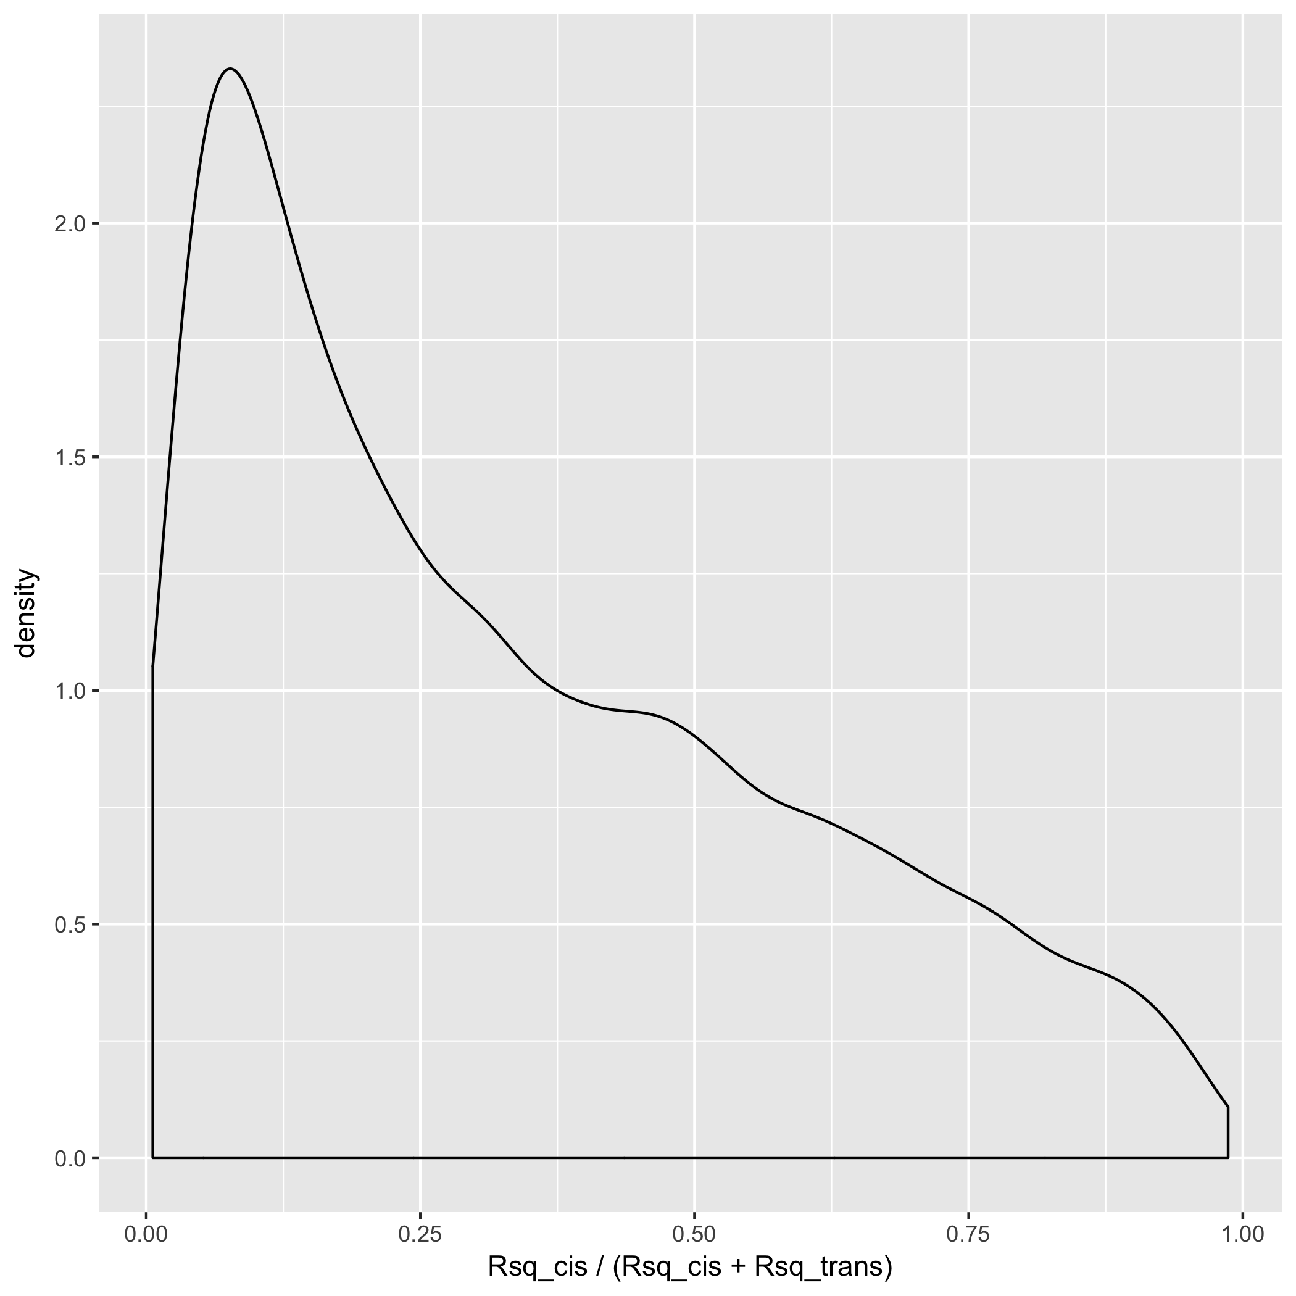
Selecting CpGs that have both cis and trans…

Slide 19
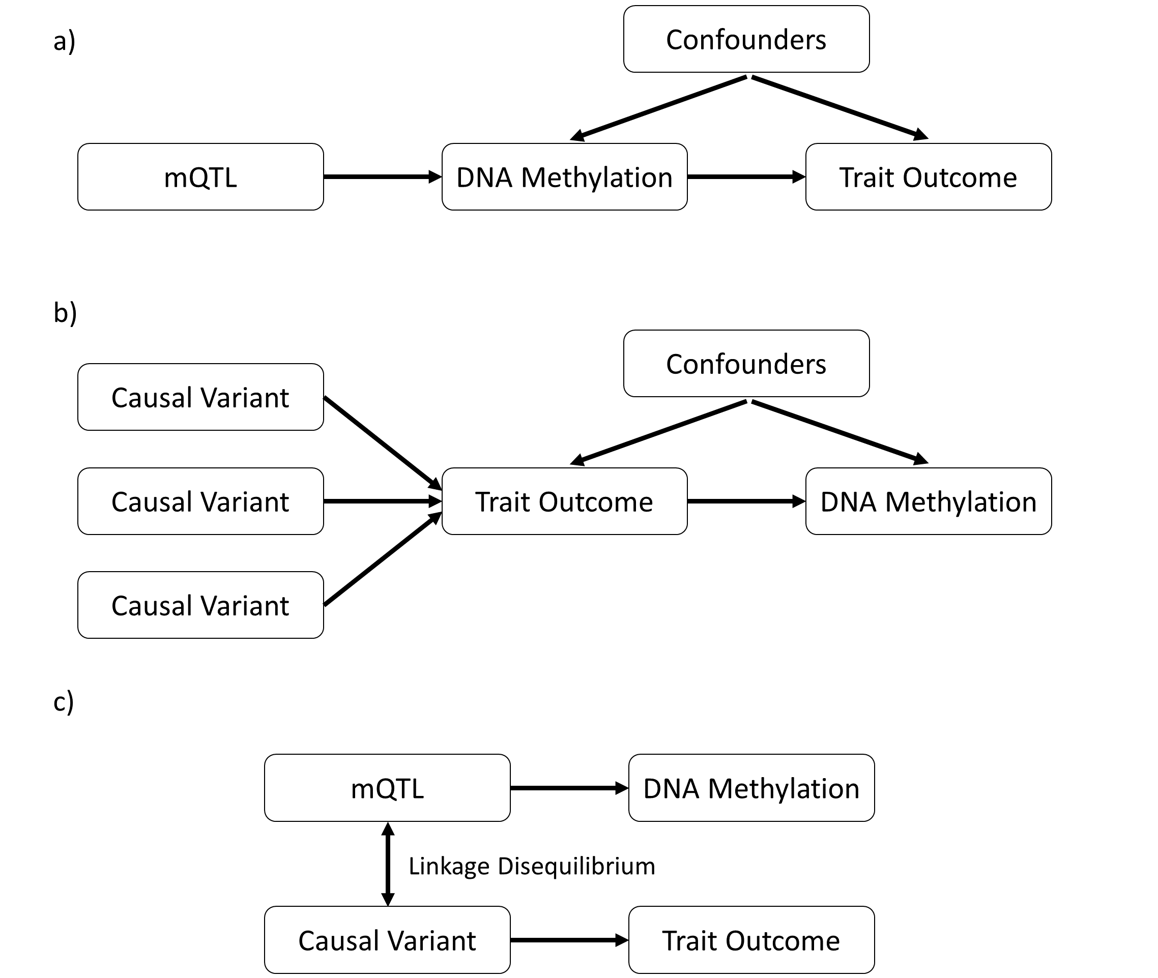
17: The causal influence of DNA methylation on complex traits
Multiple variants instrumenting a trait is valuable for orienting causal directions, and separating vertical from horizontal pleiotropy

