Slide 1
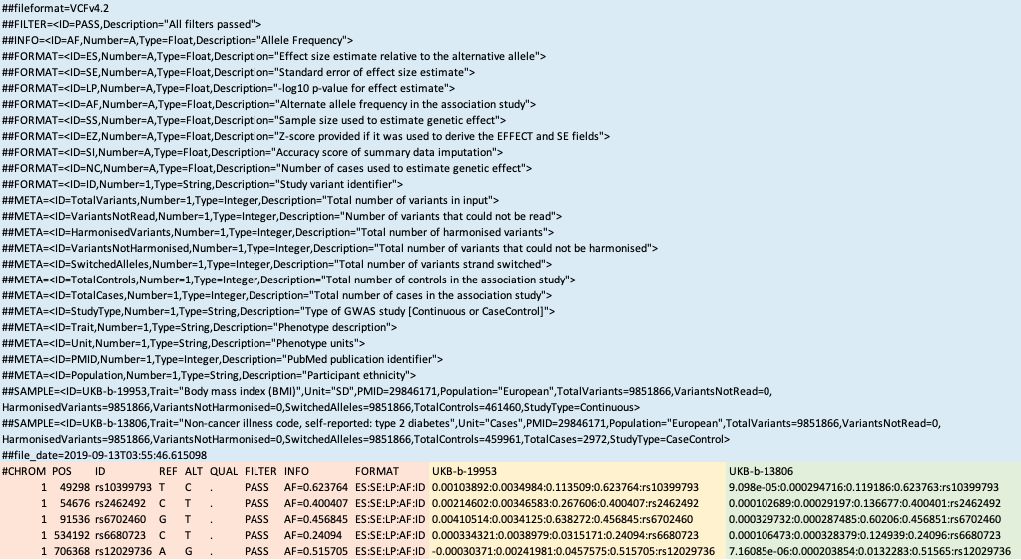
Metadata
Variants
Loci
Trait one association metrics
Trait two association metrics

