Slide 1
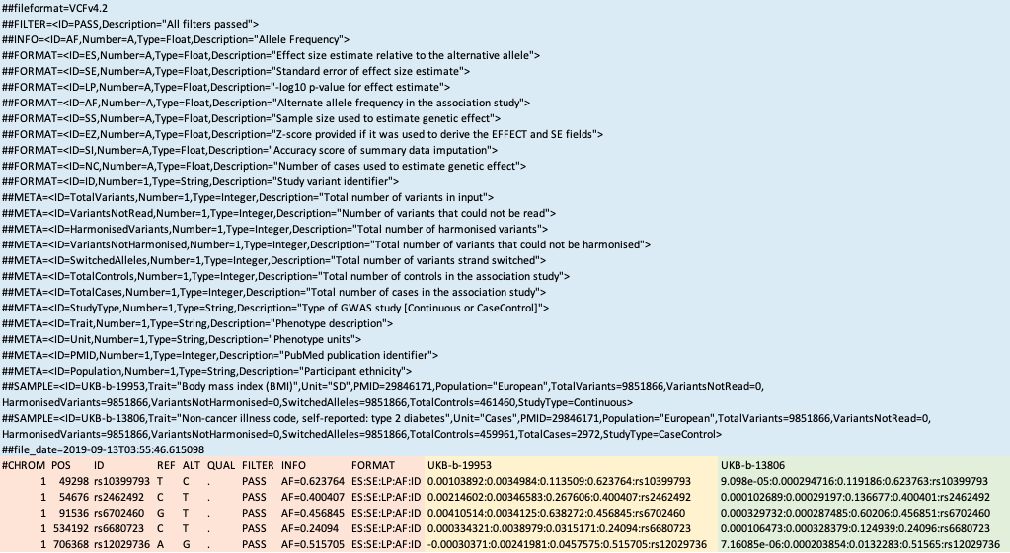
Metadata
Variant information
Trait one
Trait two

