Slide 1
Azure Resource Manager
Rob Moore
Principal Consultant, Readify
@robdmoore
Matt Davies
Lead Consultant, Readify
@mdaviesnet

Slide 2

https://dddperth.com

Slide 3
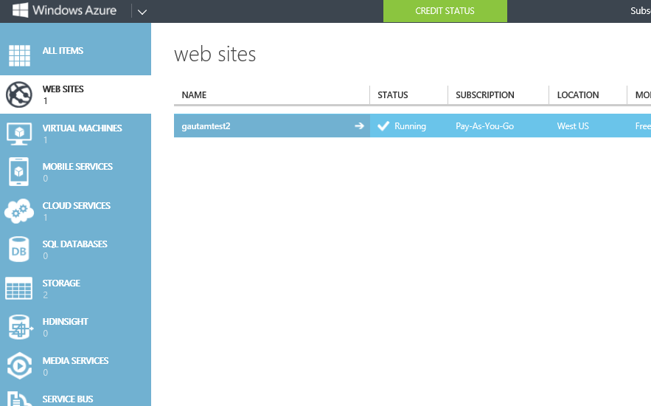
Old Portal: Component-centric Views

Slide 4
Component-centric
SQL
D
A
T
ABASE
VI
R
T
U
AL M
A
CHINE
S
T
OR
A
GE
→ Deployment and specification of application components is imperative
Seeing all the components that make up an application together is difficult
More complex management/APIs/documentation
→ Access control is global to subscription

Slide 5
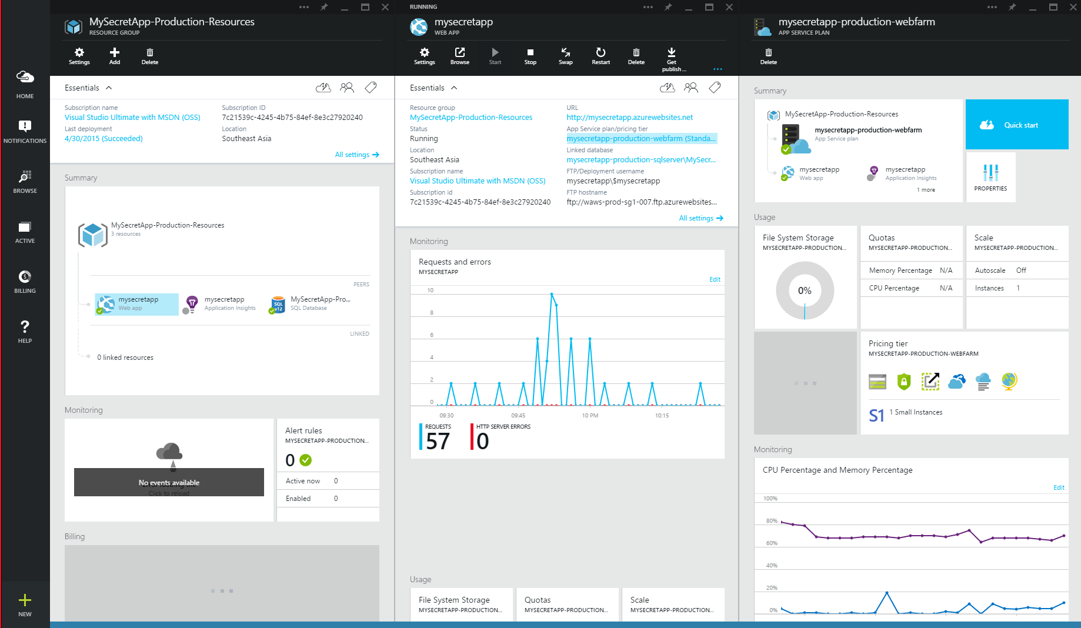
New Portal: Resource-centric Views

Slide 6
Azure Resource Manager (ARM)
Helps you…
→Visualize a group of resources in a logical view, including monitoring/billing/tags
Describe resources in a simple, consistent way
Manage permissions on a group of resources
Deploy / update multiple resources repeatedly, idempotently & declaratively

Slide 7
ARM Definitions
Resources
User-managed entities such as a database server, website, etc.
Resource groups
Provide an integrated way to manage resources
Resource providers
Services that manage specific types of resources

Slide 8
Consistent Management Layer

Slide 9
Resource Groups
Containers of multiple resources
Resources 1:1 Resource Group
Resource groups can span regions
Resource groups can contain permissions
Unit of grouping for billing
RESOU
R
CE G
R
OUP

Slide 10
Resource Groups Demo
Notes:
Click around the portal – show a resource group with stuff in it

Slide 11
Resources
108 PowerShell commandlets -> 33
Resources can be tagged -> search and billing
Resource providers define resource interactions
Namespace e.g. Microsoft.Web
Resource Type e.g. sites
Api versions e.g. 2014-04-01
Regions e.g. East US, Southeast Asia
Operations e.g. /list /config etc.

Slide 12
ARM API Demo
Notes:
ARMClient:
Show subscription
List providers
List websites
Show website
Show website config
Update config

Slide 13
Role-Based Access Control (RBAC)
Scope, e.g. subscription, resource group, specific resource
Subject, e.g. AAD users, groups, service principals
Role, e.g. Owner, Contributor, Reader, …
Permissions, which provider operations you can perform

Slide 14
RBAC
Access Inheritance
R
RG
R
R
S
RG
R
RG
R
Role Assignment
Role = ‘Owner’
Subject = AAD User
Scope = Resource
Role Assignment
Role = ‘Reader’
Subject = AAD Group
Scope = Subscription
R
Role Assignment
Role = ‘Contributor’
Subject = AAD User
Scope = Resource Group

Slide 15
RBAC Demo
Notes:
Show adding assignment in portal
ARM Client to show different role definitions

Slide 16
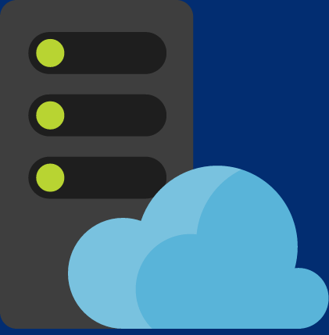
Template Deployments
deploy.json
Azure Templates can:
Ensure Idempotency
Simplify Orchestration
Simplify Roll-back
Provide Cross-Resource Configuration and Update Support
Azure Templates are:
Source file, checked-in
Specifies resources and dependencies (VMs, WebSites, DBs) and connections (config, LB sets)
Parametized input/output – multiple environments!
Hosting plan
Website
SQL
Dependency

Slide 17
Template deployment demo
Notes:
http://azure.microsoft.com/en-us/documentation/templates/

Slide 18
Workshop time!!!
Try it out yourself…
Go to http://bit.ly/azsatperth2015_arm

Slide 19
Thanks…
Rob Moore
Principal Consultant, Readify
@robdmoore
Matt Davies
Lead Consultant, Readify
@mdaviesnet

