Slide 1
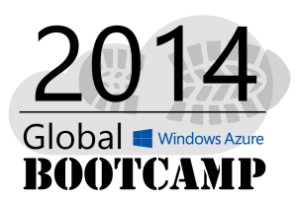
Welcome to the
Perth

Slide 2
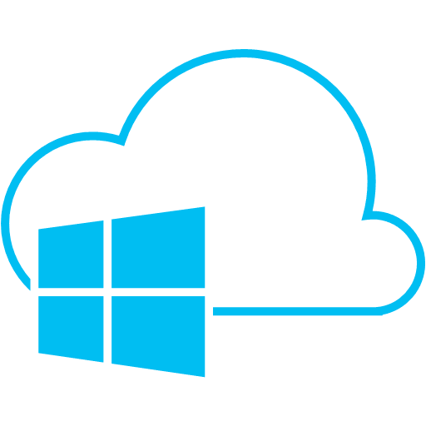















The Sponsors: These guys are doing it globally
A BIG THANK YOU

Slide 3



The Sponsors: These guys are doing it locally
Perth MS Cloud UG
A BIG THANK YOU

Slide 4
Data Storage
Rob Moore
Lead Consultant, Readify
rob.moore@readify.net
@robdmoore
Matt Davies
Senior Developer, Readify
matt.davies@readify.net
@mdaviesnet

Slide 5
Agenda
Windows Azure Storage
Blob Storage / Drives
Tables
Queues
Cache Services
Databases
Notes:
Slide Objectives:
Introduce the topics that will be covered in this session
VALUE PROP
Speaking Points:
Notes:

Slide 6
Windows Azure Storage Abstractions
Blobs
Simple named files along with metadata for the file.
Drives
Durable NTFS volumes for Windows Azure applications to use. Based on Blobs.
Tables
Structured storage. A table is a set of entities; an entity is a set of properties.
Queues
Reliable storage and delivery of messages for an application.
Notes:
Slide Objectives
Understand each of the storage types at a high level
Speaker Notes
The Windows Azure storage services provide storage for binary and text data, messages, and structured data in Windows Azure. The storage services include:
The Blob service, for storing binary and text data
The Queue service, for storing messages that may be accessed by a client
The Table service, for structured storage for non-relational data
Windows Azure drives, for mounting an NTFS volume accessible to code running in your Windows Azure service
Programmatic access to the Blob, Queue, and Table services is available via the Windows Azure Managed Library and the Windows Azure storage services REST API
Notes
http://blogs.msdn.com/b/windowsazurestorage/archive/2010/03/28/windows-azure-storage-resources.aspx

Slide 7



Windows Azure Storage Account User specified globally unique account name
Can choose geo-location to host storage account:
US
Europe
Asia
North Central US
Northern Europe
West US
Western Europe
East Asia
East US
South Central US
South East Asia
CDN, Explicit co-location or affinity groups, 512 bit shared secret keys, 100 TBs per account
Notes:
Slide Objective
Understand a Windows Azure storage account
Speaking notes
A storage account gives your applications access to Windows Azure Blob, Table, and Queue services located in a geographic region. You need a storage account to use Windows Azure storage.
The storage account represents the highest level of the namespace for accessing the storage services. A storage account can contain up to 100 TB of blob, queue, and table data. You can create up to five storage accounts for your Windows Azure subscription.
A Windows Azure subscription contains storage account
Can explicitly geo-locate to a sub region or set affinity with other services
Can enable CDN at the account level (means that public containers will be retrievable via the CDN URL)

Slide 8
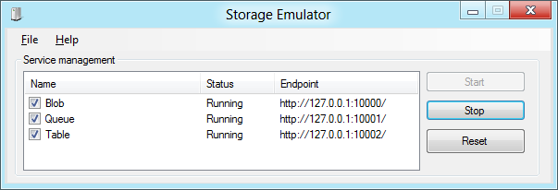
Development Storage: Emulator
Provides a local “Mock” storage
Emulates storage in cloud
Allows offline development
Requires SQL Express 2005/2008 or above
There are some differences between Cloud and Dev Storage:
http://msdn.microsoft.com/en-us/gg433135
A good approach for developers:
To test pre-deployment, push storage to the cloud first
Use Dev Fabric for compute connect to cloud hosted storage Finally, move compute to the cloud
Notes:
Slide Objective
Understand the Development Storage Service
VALUE PROP
Speaking notes
Client side simulator of storage in the cloud.
Allows completely disconnected (e.g. while travelling on a plane) development of Windows Azure apps
Can consume just like Cloud storage- from Development Fabric, from another application running locally
Is locked down so that it cannot be called from off the box
If you need this capability run a reverse proxy on the dev machine
Can use CSRun to start and stop service
More on this in Day 3
Uses a single fixed account. The account name and key are always the same
Anyone memorized the Account key yet? Eby8vd…..
Notes
http://msdn.microsoft.com/en-us/library/dd179339.aspx
The Windows® Azure™ SDK development environment includes development storage, a utility that simulates the Blob, Queue, and Table services available in the cloud. If you are building a hosted service that employs storage services or writing any external application that calls storage services, you can test locally against development storage.
The development storage utility provides a user interface to view the status of the local storage services and to start, stop, and reset them.
This topic contains the following subtopics:

Slide 9
Storage Libraries in Many Languages
C#/.NET
Python
Ruby
Perl
JavaScript (Node)
Java
PHP
Erlang
Common LISP
Objective-C
C#/VB on Windows Phone 7
Notes:
Slide Objectives:
Explain the different Storage Libraries and languages that can be used to work with Windows Azure Storage.
VALUE PROP
Programmatic access to the Blob, Queue, and Table services is available via the Windows Azure client libraries and the Windows Azure storage services REST API.
Speaking Points:
Windows Azure is an open cloud platform that enables you to quickly build, deploy and manage applications across a global network of Microsoft-managed datacenters.You can build applications using any language, tool or framework.
Notes:

Slide 10
Storage Security
Windows Azure Storage provides simple security for calls to storage service
HTTPS endpoint
Digitally sign requests for privileged operations
Two 512bit symmetric keys per storage account
Can be regenerated independently
More granular security via Shared Access Signatures
Notes:
Slide Objective
Describe security principles
Speaking notes
Simple shared secret security
Can use HTTP or HTTPS to access
Use HTTP for public content
Use HTTPS for secure content (i.e. where using es or Shared Access Signatures)
Two 512bit keys
Keys used to sign priv requests
Two keys supports rolling of keys
E.g. if one key is compromised can use the second key while first is regenerated
More on SAS’s soon
Notes
More on Security on Day 3
http://social.msdn.microsoft.com/Forums/en-US/windowsazure/thread/1e023e8d-0ff9-472e-bcc1-05400a41466c
http://blogs.msdn.com/b/usisvde/archive/2010/05/21/best-practices-for-data-storage-security-on-windows-azure.aspx

Slide 11
Blob Storage

Slide 12
Blob Storage Concepts
http://<account>.blob.core.windows.net/<container>/<blobname>
Account
Container
Blob
Pages/ Blocks
PIC01.JPG
images
Block/Page
PIC02.JPG
contoso
Block/Page
videos
VID1.AVI
Notes:
Slide Objectives
Understand the hierarchy of Blob storage
Speaker Notes
The Blob service provides storage for entities, such as binary files and text files.
The REST API for the Blob service exposes two resources:
Containers
Blobs.
A container is a set of blobs; every blob must belong to a container.
The Blob service defines two types of blobs:
Block blobs, which are optimized for streaming.
Page blobs, which are optimized for random read/write operations and which provide the ability to write to a range of bytes in a blob.
Blobs can be read by calling the Get Blob operation. A client may read the entire blob, or an arbitrary range of bytes.
Block blobs less than or equal to 64 MB in size can be uploaded by calling the Put Blob operation.
Block blobs larger than 64 MB must be uploaded as a set of blocks, each of which must be less than or equal to 4 MB in size.
Page blobs are created and initialized with a maximum size with a call to Put Blob.
To write content to a page blob, you call the Put Page operation. The maximum size currently supported for a page blob is 1 TB.
Notes
http://msdn.microsoft.com/en-us/library/dd573356.aspx
Using the REST API for the Blob service, developers can create a hierarchical namespace similar to a file system. Blob names may encode a hierarchy by using a configurable path separator. For example, the blob names MyGroup/MyBlob1 and MyGroup/MyBlob2 imply a virtual level of organization for blobs. The enumeration operation for blobs supports traversing the virtual hierarchy in a manner similar to that of a file system, so that you can return a set of blobs that are organized beneath a group. For example, you can enumerate all blobs organized under MyGroup/.

Slide 13
Windows Azure Drives
Durable NTFS volume for Windows Azure Instances
Use existing NTFS APIs to access a network attached durable drive
Use System.IO from .NET
Benefits
Move existing apps using NTFS more easily to the cloud
Durability and survival of data on instance recycle
Drives can be up to 1TB
A Windows Azure Drive is an NTFS VHD Page Blob
Mounts Page Blob over the network as an NTFS drive
Local cache on instance for read operations
All flushed and unbuffered writes to drive are made durable to the Page Blob
Notes:
Slide Objective
Understand Windows Azure Drives
VALUE PROP
A Windows Azure drive acts as a local NTFS volume that is mounted on the server’s file system and that is accessible to code running in a role.
Speaking notes
The data written to a Windows Azure drive is stored in a page blob defined within the Windows Azure Blob service, and cached on the local file system.
The data is maintained even if the role instance is recycled because data written to the drive is stored in a page blob.
Windows Azure drive can be used to run an application that must maintain state, such as a third-party database application.
The Windows Azure Managed Library provides the CloudDrive class for mounting and managing Windows Azure drives.
The CloudDrive class is part of the Microsoft.WindowsAzure.StorageClient namespace.
Notes

Slide 14
Tables

Slide 15
Table Storage Concepts
Account
Table
Entity
Not an RDBMS! Table
Name =…
Email = …
customers
Name =…
EMailAdd=
contoso
Photo ID =…
Date =…
photos
Photo ID =…
Date =…
Notes:
Slide Objectives
Understand Tables
Speaker Notes
The Table service provides structured storage in the form of tables.
The Table service supports a REST API that is compliant with the ADO.NET Data Services REST API.
Developers may also use the .NET Client Library for ADO.NET Data Services to access the Table service.
Notes
http://msdn.microsoft.com/en-us/library/dd573356.aspx

Slide 16
Entity Properties
Tables can have up to 200TB of data
Accounts can query up to 20k entities/s
Entity can have up to 255 props / 1 MB
Mandatory Properties for every entity
PartitionKey & RowKey (only indexed properties)
Timestamp
No fixed schema for other properties
Each property is stored as a <name, typed value> pair
Notes:
Slide Objectives
Understand Tables and Entities
Speaker Notes
Tables store data as entities.
An entity is a collection of named properties and their values, similar to a row- not an RDBMS though
Tables are partitioned to support load balancing across storage nodes.
Each table has as its first property a partition key that specifies the partition an entity belongs to.
The second property is a row key that identifies an entity within a given partition.
The combination of the partition key and the row key forms a primary key that identifies each entity uniquely within the table.
The Table service does not enforce any schema.
A developer may choose to implement and enforce a schema on the client side
Notes
http://msdn.microsoft.com/en-us/library/dd573356.aspx
http://msdn.microsoft.com/en-us/library/dd179338.aspx

Slide 17
Databases

Slide 18

SQL Database
SQL Server database technology as a service
Fully Managed
Enterprise-ready with automatic support for HA
Designed to scale out elastically with demand
Ideal for simple and complex applications
Notes:
Slide Objectives:
Understand the overall concepts and benefits of SQL Database
Transition:
Let’s clear up any confusion and look at the basics of what SQL Database really is and some of its benefits.
Speaking Points:
The same great SQL Server database technology that you know, love, and use on-premises provided as a service
Enterprise-ready
Automatic support for High-Availability
Designed to scale on-demand to provide the same great elasticity
Notes:
High-availability – 3 copies of the database free for the cost of the one database. Always in sync. The cost to do this on-premises isn’t cheap. This is FREE in SQL Database.
Scalability using SQL Federation (discussed later in the presentation).

Slide 19

MS SQL VM
Fully featured deployment of MS SQL in Azure
Manage it yourself
Suited to more complex situations

Slide 20

MySQL
Two options:
ClearDB (Fully managed hosted solution)
Manually deploy in a VM (Do it yourself)

Slide 21

Oracle VM
Deploy Oracle in a Virtual Machine
Pre-provided VM images that include Oracle
Licensing costs included in the VM images
Or if you have existing licenses, you can deploy Oracle yourself

Slide 22
The Sponsors: These guys are doing it globally
A BIG THANK YOU

Slide 23
The Sponsors: These guys are doing it locally
A BIG THANK YOU

Slide 24

The Social Fun
Please share our “little” event on the WWW by any means
Use the HASHTAG
#GWAB
extensively

Slide 25
The Social Fun (part deux)
Find all the online locations here
http://bit.ly/gwabflickr
http://bit.ly/gwabTwitter (capital ‘T’)
http://bit.ly/gwabfacebook

