Slide 1
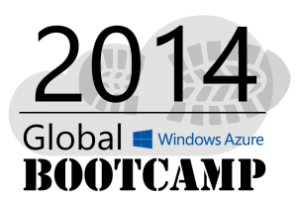
Welcome to the
Perth

Slide 2
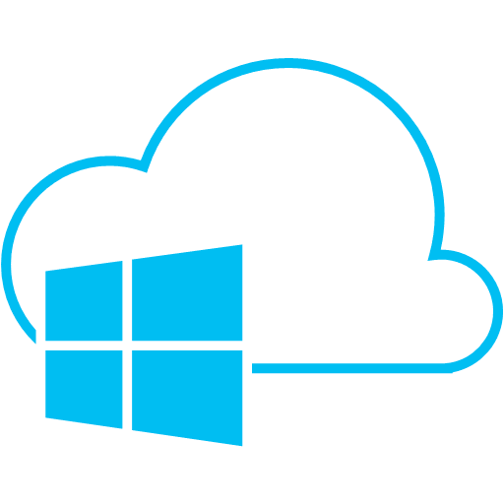















The Sponsors: These guys are doing it globally
A BIG THANK YOU

Slide 3
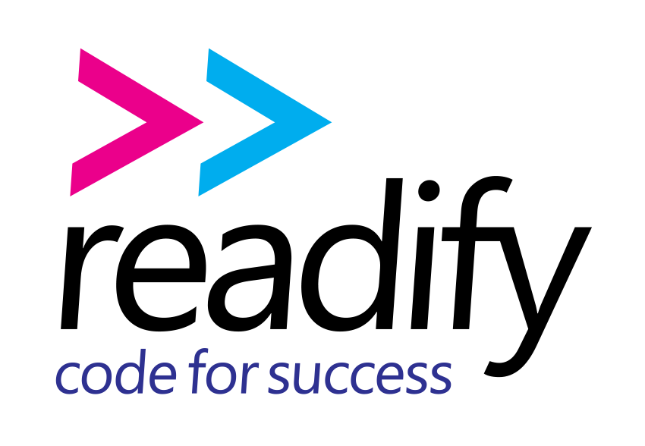
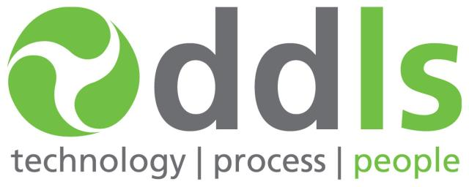

The Sponsors: These guys are doing it locally
Perth MS Cloud UG
A BIG THANK YOU

Slide 4
Authentication
Rob Moore
Lead Consultant, Readify
rob.moore@readify.net
@robdmoore
Matt Davies
Senior Developer, Readify
matt.davies@readify.net
@mdaviesnet

Slide 5

Overview
Identity As a Service
Windows Azure Access Control Service
Windows Azure AD vs On-Premises AD
Parts of Windows Azure Training Kit used (Apache 2.0 License)
for this presentation: http://windowsazure-trainingkit.github.io/

Slide 6
Identity “As a Service”

Slide 7



A Service-Oriented Approach to Identity
Windows Azure
Rely 100% on Infrastructure
Reuse Identity Capabilities
via Standard Facades
Take Care of everything
Notes:
Notes:
<click> Identity and access management in traditional applications targeting on-premises environments tends <click> to live at two extremes of a continuum.
<click> on one hand you have applications which do not include any authentication code and rely 100% on the underlying infrastructure to do that on their behalf. Examples of this are LOB apps relying on Active Directory, like the classic versions of exchange or SharePoint, or even any application which rely on the file system ACLs to enforce access rather that having dedicated code on their own. This works great and yields the best ROI, but unfortunately works without extra effort only within one own's network.
<click> on the other end of the spectrum there are applications which ignore whatever user infrastructure may be already in place, and provide their own credentials stores and verification logic, custom attributes stores, and so on. That's the approach you take when you create a new ASP.NET membership provider for every new web application. Very expensive, time-consuming, hard to maintain and hated by the users (who need to create and maintain yet another account).
<click> The shortcomings of those approaches are especially evident when managing change becomes necessary. Here we can consider what happens when the change consists in <click> moving the applications to the cloud, but the issue is by no mean relegated to cloud only scenarios.
The application that was relying on the infrastructure will no longer function, as that infrastructure is no longer available. The other application will require a duplication of the entire identity infrastructure, with all its costs and synchronization problems.
<click> as it often happens, the best solution lies in the middle. If the infrastructure is there one should not ignore it, however it should not be necessary to take a dependency on the implementation details of that infrastructure: that is what limits its reusability.
Here we can take the same approach you'd use in service orientation <click><click>. You hide the capability you want to reuse behind a service boundary, <click> and you enforce every interaction to go through a standard facade which is exposed via contract and can be engaged via open standards.
In the identity jargon, such a facade is a special type of web service, called security token service (STS) and the authentication service itself is said to play the role of the identity provider. This makes possible to reuse the authentication infrastructure beyond the intranet boundaries, without taking a hard dependency on its implementation details.

Slide 8
Identity and Windows Azure
Windows Azure Access Control Service (ACS)
Windows Azure Active Directory (WAAD)
Hosting Windows Server AD in Virtual Machines
ACS WAAD VMs
Notes:
Are there ways to make this easier on yourself and develop less custom code?
How can you authenticate your cloud applications and services?
How can you authenticate your SaaS applications and services?
How can you integrate apps and services with your on-premises AD?
How can you query users, roles, contacts, and groups?

Slide 9
Windows Azure ACS

Slide 10
Windows Azure ACS Overview
ACS is a Federation Provider in claims-based authentication.
A cloud federation service for your cloud applications and services that
demands federated authentication.
Supports multiple identity providers
Facebook, Google, Microsoft, Windows Server AD FS, Yahoo!
Supports multiple protocols
WS-Federation, WS-Trust, OAuth 2.0 (draft 13)
Supports multiple tokens
JWT, SAML 1.1/2.0, SWT
Notes:
WS-Federation – web service federation – open standard allowing for disparate security realms to broker information on identities, identity attributes and authentication.
WS-Trust is a set of standards that deal with issuing, renewing and validating security tokens, as well as establishing and assessing the presence of trust relationships between participants in a secure message exchange.
Oauth – standard for clients to access server resources on behalf of a resource owner without the resource owner having to directly share their credentials with the client.
JSON web token standard, heavily used by ACS and WAAD.
SAML – Security Assertion Markup Language – open XML format for exchanging authentication and authorization data between parties (usually between an identity provider and a service provider).
SWT – Simple web token - still a newer standard along with JWT (whereas SAML is much older and more complex).

Slide 11
Windows Azure AD

Slide 12
Using Windows Azure Active Directory
Azure Active Directory is one possible Identity Provider in claims-based authentication.
Azure AD is NOT the same as Windows AD!
Three options:
Maintain a list of identities
Integrate with SaaS providers (e.g. Salesforce, Office 365, Google Apps)
Integrate with on-premise AD

Slide 13
Password Source
You can synchronise your on-premises Active Directory – DirSync, FIM, Powershell
Use passwords synced to your existing Office 365 Azure Directory
Keep passwords on-premises using ADFS 2.0
Notes:
ADFS centres around having a STS (secure token service) on premises
If you sync the passwords up, you don’t need it – but you forfeit the entire login experience to Microsoft Online

Slide 14
Graph API
No concept of LDAP so we need an alternative
Graph API is a web service provided by Microsoft to lookup users, groups and roles from Azure Active Directory
http://graphexplorer.cloudapp.net

Slide 15
Options, options, options…
Azure Access Control Service
Azure Active Directory
Active Directory Virtual Machines
Simple Federated Authentication
Users no longer need to create and maintain a new account just to use your service – easily hook into Facebook, Twitter etc.
Free, Managed Active Directory
Very little to do yourself! Create a fully redundant, managed directory of users and roles in a matter of minutes – optionally synced with your on-premises AD!
All The Power
Let’s you do everything you can do with Windows AD, with the added advantage of cloud level scale and redundancy (if set up correctly). No need to rewrite parts of existing apps.
Delegate Authentication
No longer a need to roll your own authentication code or manage a database of usernames and passwords yourself.
Office 365 Integration
Take advantage of your existing Office 365 cloud directory – if you’re using Office 365, this is a nice freebie not everyone knows about.
Most Complex, Expensive Solution
Requires strong knowledge of Windows AD to set up, and ongoing skills and resources to maintain correctly. You also need to pay for your VM usage within Azure.
Evolution is Azure Active Directory
The future direction from Microsoft seems to be Azure Active Directory. This is still a quick and simple solution for existing apps, but it’s worth looking at Azure AD for new apps.
Limits of Authentication As Service
Moving from Windows AD to Azure AD means you do lose some functionality of traditional Active Directory.
No Simple Federated Authentication
If you’d like to offer users federated authentication with third party providers, you need to manage this yourself or work to find and integrate a library to handle it.

Slide 16
Pricing
Azure Access Control Service
Azure Active Directory
Active Directory Virtual Machines
Azure Active Dirctory
FREE
FREE (up to 500,000 objects)
MFA component costs:
$2/month per user with unlimited transactions,
or $2 per 10 authentications
1x Small VM: $68/month
1x Medium VM: $136/month
1x Large VM: $271/month
Plus any extra storage and bandwidth costs.

Slide 17
The Sponsors: These guys are doing it globally
A BIG THANK YOU

Slide 18
The Sponsors: These guys are doing it locally
A BIG THANK YOU

Slide 19

The Social Fun
Please share our “little” event on the WWW by any means
Use the HASHTAG
#GWAB
extensively

Slide 20
The Social Fun (part deux)
Find all the online locations here
http://bit.ly/gwabflickr
http://bit.ly/gwabTwitter (capital ‘T’)
http://bit.ly/gwabfacebook

