Slide 1
AIUB
Course Code: CSC5307
Course Title: Data Warehousing & Data Mining
Dept. of Computer Science
Faculty of Science and Technology
Lecturer No: |  | Week No: |  | Semester: | Summer 24-25
Instructor: | M Shamim Kaiser (m.shamimkaiser@outlook.com)

Slide 2
What Is an Attribute?
An attribute (also called a feature, field, or variable) is a property or characteristic of a data object that describes it.
A data object (also known as a record, tuple, or instance) represents an entity in the dataset — such as a person, product, or event.
Each data object is described by a set of attributes.
  Data Object: Each row (e.g., S001, S002)
  Attributes: Student_ID, Name, Gender, Age, GPA
  So, attributes describe the characteristics of data objects.
Student_ID | Name | Gender | Age | GPA
S001 | Rahim | Male | 21 | 3.60
S002 | Anika | Female | 22 | 3.90

Slide 3
Nominal Attributes
A nominal attribute is a type of categorical attribute that represents names or labels. The values have no ordering or ranking — they simply identify categories. Examples: Gender: {Male, Female, Other}
  Color: {Red, Green, Blue}; City: {Dhaka, Chattogram, Khulna}
  Nominal values are often represented using: Integers: e.g., Male = 1, Female = 2
  One-hot encoding: e.g., Red = (1,0,0), Green = (0,1,0), Blue = (0,0,1)
  Example Table:
Product_ID | Color | Category
P001 | Red | Clothing
P002 | Blue | Electronics
P003 | Green | Food

Slide 4
Binary Attributes
A binary attribute is a special case of nominal attribute with only two possible values — usually represented as 0 and 1.
Types of Binary Attributes:
Symmetric Binary Attribute: Both values are equally important (e.g., Gender: Male/Female).
Asymmetric Binary Attribute: One value is more significant (e.g., Disease: Present/Absent — only “Present” matters).
Examples: Gender: Male (0), Female (1); Loan_Approved: Yes (1), No (0). Spam_Email: Spam (1), Not Spam (0)

Slide 5
Customer_ID | Defaulted_Loan | VIP_Member
C001 | 0 (No) | 1 (Yes)
C002 | 1 (Yes) | 0 (No)
C003 | 0 (No) | 1 (Yes)

Slide 6
Ordinal Attributes
An ordinal attribute has categories with an order or ranking, but the differences between ranks are not measurable. In other words, you can say which is greater, but not by how much.
Examples: Education Level: {Primary < Secondary < College < University}; Customer Satisfaction: {Poor < Fair < Good < Excellent}; Grades: {A, B, C, D, F}
Customer_ID | Satisfaction_Level
C001 | Good
C002 | Excellent
C003 | Fair
The order Fair < Good < Excellent has meaning, but the exact difference between “Fair” and “Good” cannot be quantified.

Slide 7
Numeric Attributes
A numeric (quantitative) attribute represents measurable quantities. Mathematical operations (addition, subtraction, average) are meaningful on numeric attributes.
Numeric attributes are of two types: Interval Attributes and Ratio Attributes
Interval Attributes
  Have meaningful differences between values.
  No true zero point (zero does not mean absence).
Examples: Temperature (°C): 0°C does not mean “no temperature.”; Dates: The difference between 2000 and 2020 is 20 years, but “year 0” is arbitrary.

Slide 8
City | Temperature (°C)
Dhaka | 30
Chattogram | 25
You can compute differences (30 − 25 = 5°C), but you can’t say Dhaka is 1.2 times hotter — because zero is arbitrary.

Slide 9
Ratio Attributes
  Have meaningful differences and a true zero point.
  You can perform all arithmetic operations (including ratios).
Examples: Age (years) – 0 means “no age.” Weight (kg) – 0 means “no weight.” Income (Tk) – 0 means “no income.”
Example Table:
Person | Age | Income (Tk)
A | 25 | 30000
B | 50 | 60000

Slide 10
Discrete versus Continuous Attributes
Discrete Attributes
Take finite or countably infinite number of values.
Often integer-valued and derived from counting.
Usually represented as categorical or integer numbers.
Examples:
Number of students = 50
Number of cars sold = 10
Number of children = 3
Example Table:
Family_ID | No_of_Children
F001 | 2
F002 | 3

Slide 11
Continuous Attributes
Can take any real value within a range.
Derived from measurement rather than counting.
Often represented as floating-point numbers.
Examples:
Temperature = 36.7°C
Height = 172.5 cm
Weight = 68.3 kg
Person | Height (cm) | Weight (kg)
A | 165.5 | 60.2
B | 175.8 | 72.4

Slide 12
Attribute Type | Description | Example | Operations
Nominal | Names or categories with no order | Color = {Red, Green, Blue} | =, ≠
Binary | Two possible values (0/1) | Gender: Male/Female | =, ≠
Ordinal | Ordered categories | Rating: {Poor, Fair, Good, Excellent} | <, >
Numeric – Interval | Ordered, equal spacing, no true zero | Temperature (°C) | +, −
Numeric – Ratio | Ordered, equal spacing, true zero | Age, Income | +, −, ×, ÷
Discrete | Countable values | Number of students | Counting
Continuous | Measurable values | Height, Weight | Measurement

Slide 13
Need for Data Preprocessing
Data preprocessing is the first and most crucial step in any data analysis or machine learning workflow. Real-world data is often incomplete, inconsistent, noisy, or contains errors. Before analysis or model training, the raw data must be cleaned, integrated, transformed, and reduced to make it suitable for meaningful analysis.
Reasons for Data Preprocessing
Missing values: Some data points might be missing due to errors in data collection.
Noisy data: Data may contain outliers, errors, or random variations.
Inconsistent data: Different data sources might have different naming conventions or formats.
Irrelevant attributes: Some attributes may not contribute to the analysis.
Redundant data: Multiple sources might store duplicate or overlapping data.

Slide 14
Benefits of Data Preprocessing
Suppose we have a dataset of customers for a retail store:
Customer_ID | Name | Age | Gender | Income | Purchase
C001 | Rahim | 25 | Male | 30000 | Yes
C002 | Karim |  | Male | 40000 | No
C003 | Anika | 27 | F | N/A | Yes
C004 | Rahima | 60 | Female | 90000 | Yes
C005 | Karim | 27 | Male | 40000 | No

Slide 15
Issues here:
Missing Age (C002) → incomplete data.
Income = N/A (C003) → missing value.
Gender coded differently (“F”, “Female”) → inconsistent data.
Duplicate record (C002 & C005) → redundant data.

Slide 16
Data Preprocessing Methods
Data preprocessing generally involves four main stages:
Data Cleaning
Data Integration
Data Transformation
Data Reduction

Slide 17
Data Cleaning
Objective: To remove noise and handle missing, inconsistent, or incorrect data.
Techniques:
Handling missing values:
  Ignore record: Remove records with missing data.
  Fill with global constant: e.g., fill with “Unknown”.
  Fill with mean/median/mode: e.g., replace missing Age with average age.
  Predict missing values: Use regression or k-NN to estimate.

Slide 18
Data Cleaning
Handling noisy data:
  Binning: Group data into bins and smooth values (e.g., 1–10 = “Low”).
  Regression: Fit a regression line to reduce random variation.
  Clustering: Detect outliers as noise.
Resolving inconsistencies:
  Standardize formats (e.g., “M” and “Male” → “Male”).
  Correct spelling or data entry errors.

Slide 19
Age | Income | Gender
25 | 30000 | M
— | 40000 | Male
27 | N/A | Female
Age | Income | Gender
25 | 30000 | Male
27 | 40000 | Male
27 | 35000 | Female

Slide 20
Data Integration
Objective: Combine data from multiple sources into a consistent dataset.
Examples:
  Merging data from sales and customer databases using Customer_ID.
  Schema integration: Unify naming conventions (e.g., “Cust_ID” vs “Customer_ID”).
  Entity resolution: Identify and merge records referring to the same person or object.

Slide 21
Customer_ID | Purchase | Amount
C001 | Yes | 5000
Customer_ID | Name | Age
C001 | Rahim | 25

Slide 22
Data Transformation
Objective: Convert data into a suitable format or structure for analysis.
Techniques:
  Normalization: Scale data into a specific range (e.g., [0, 1]). Formula (Min-Max Normalization):
  Aggregation: Summarize data (e.g., monthly sales → yearly sales).
  Generalization: Replace low-level data with higher-level concepts (e.g., “Dhaka” → “Bangladesh”).
  Encoding categorical data: Convert text data into numerical form (e.g., “Male” = 1, “Female” = 0).

Slide 23
Income | Normalized (0–1)
30000 | 0.0
40000 | 0.5
50000 | 1.0

Slide 24
Data Reduction
Objective: Reduce the data volume while maintaining its integrity and analytical value.
Techniques:
  Attribute (Feature) Selection: Select the most relevant attributes.
  Dimensionality Reduction: Use PCA (Principal Component Analysis) or LDA.
  Numerosity Reduction: Replace data with smaller representations (e.g., histograms, clustering).
  Data Compression: Use coding or encoding schemes to store efficiently.
Example: If a dataset has 50 features but only 10 significantly affect predictions, feature selection or PCA can reduce dimensionality—making computation faster and improving model performance.

Slide 25
Basic Statistical Descriptions of Data
Statistical description of data involves summarizing and understanding the essential features of a dataset using numerical measures and visual representations. These descriptions help in understanding the central tendency (where the data tends to cluster) and the dispersion (how spread out the data is).
Measuring the Central Tendency: Mean, Median, and Mode: Central tendency measures describe the center or typical value of a dataset.

Slide 26
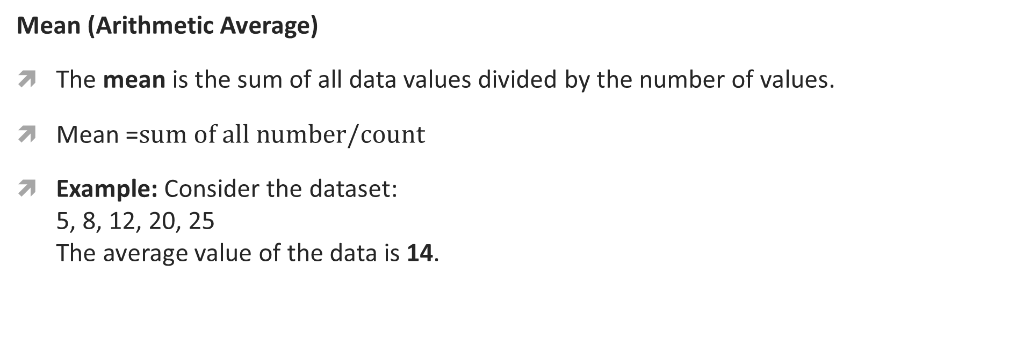
Mean (Arithmetic Average)
The mean is the sum of all data values divided by the number of values.
Mean =$sum of all number/count$
Example: Consider the dataset:
5, 8, 12, 20, 25
The average value of the data is 14.

Slide 27
Median
The median is the middle value when the data is arranged in ascending or descending order.
If the number of data values (n) is odd, the median is the middle value.
If even, the median is the average of the two middle values.
Example:
Dataset: 4, 7, 10, 12, 18
Median = 10 (middle value)
If dataset = 4, 7, 10, 12, 18, 20
Median = (10 + 12) / 2 = 11

Slide 28
Mode
The mode is the value that occurs most frequently in a dataset.
A dataset can have:
  One mode → unimodal
  Two modes → bimodal
  More than two modes → multimodal
Example:
Dataset: 2, 4, 4, 6, 7, 8, 8, 8
Mode = 8 (occurs most frequently)

Slide 29
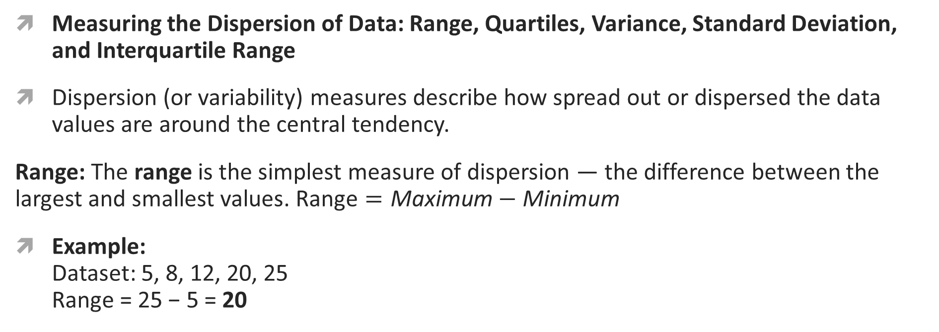
Measuring the Dispersion of Data: Range, Quartiles, Variance, Standard Deviation, and Interquartile Range
Dispersion (or variability) measures describe how spread out or dispersed the data values are around the central tendency.
Range: The range is the simplest measure of dispersion — the difference between the largest and smallest values. $\text{Range}=\text{Maximum}−\text{Minimum}$
Example:
Dataset: 5, 8, 12, 20, 25
Range = 25 − 5 = 20

Slide 30
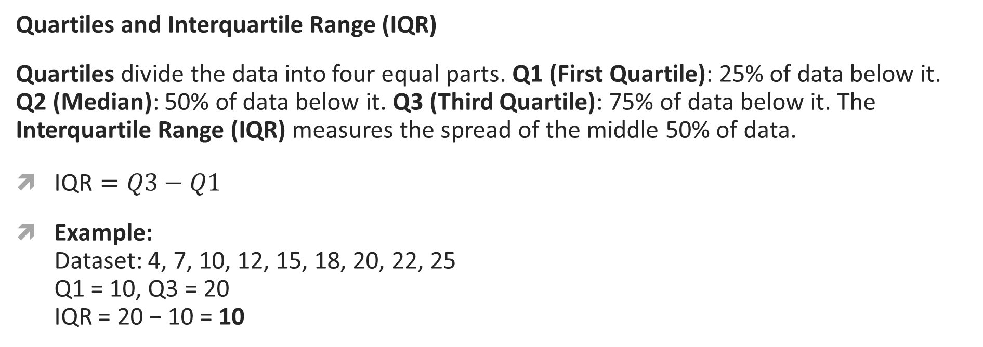
Quartiles and Interquartile Range (IQR)
Quartiles divide the data into four equal parts. Q1 (First Quartile): 25% of data below it. Q2 (Median): 50% of data below it. Q3 (Third Quartile): 75% of data below it. The Interquartile Range (IQR) measures the spread of the middle 50% of data.
$\text{IQR}=Q3−Q1$
Example:
Dataset: 4, 7, 10, 12, 15, 18, 20, 22, 25
Q1 = 10, Q3 = 20
IQR = 20 − 10 = 10

Slide 31
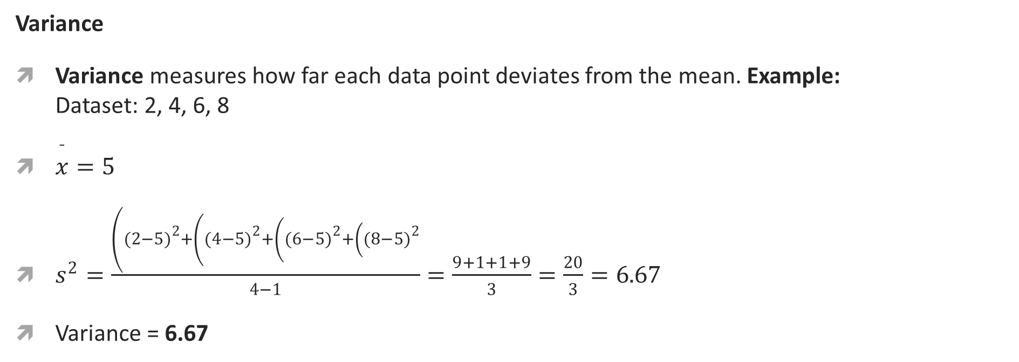
Variance
Variance measures how far each data point deviates from the mean. Example:
Dataset: 2, 4, 6, 8
$\overset{ˉ}{x}=5$
$s^{2}=\frac{\left((2−5{\left.)\right.}^{2}+\left((4−5{\left.)\right.}^{2}+\left((6−5{\left.)\right.}^{2}+\left((8−5{\left.)\right.}^{2}\right.\right.\right.\right.}{4−1}=\frac{9+1+1+9}{3}=\frac{20}{3}=6.67$
Variance = 6.67

Slide 32
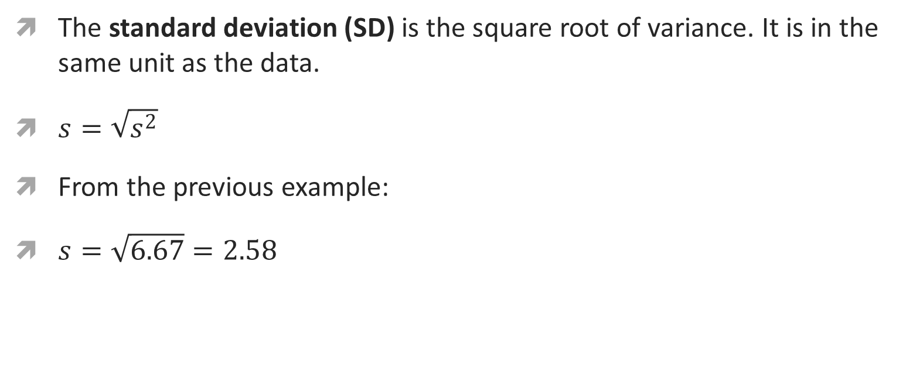
The standard deviation (SD) is the square root of variance. It is in the same unit as the data.
$s=\sqrt{s^{2}}$
From the previous example:
$s=\sqrt{6.67}=2.58$

Slide 33
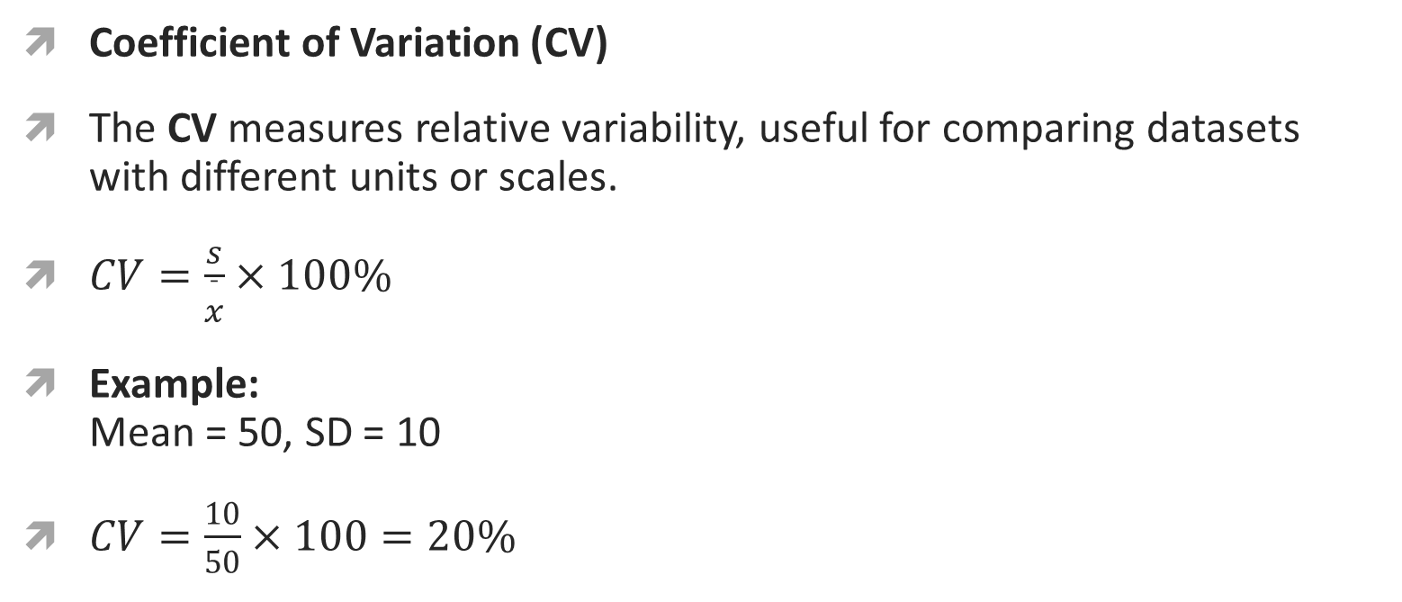
Coefficient of Variation (CV)
The CV measures relative variability, useful for comparing datasets with different units or scales.
$CV=\frac{s}{\overset{ˉ}{x}}×100\%$
Example:
Mean = 50, SD = 10
$CV=\frac{10}{50}×100=20\%$

Slide 35
Books
Data Mining Concepts and Techniques-J. Han et al. 3rd Edition

