Slide 1

Course No. CSE3118
Course Name: Microprocessor & Microcontrollers Lab
Course Teachers
Prof. Dr. Md. Shamim Akhter &
Lomat Haider Chowdhury

Slide 2
Project Name
Catch Me If You Can!
(Laser Security System)
Group Members
ANIK KUMAR SANNYASHI
ID - 20210104077
MUBASWIRA IBNAT ZIDNEY
ID - 20210104098
ANIKA ANJUM ARIN
ID - 20210104100

Slide 3

Contents:
Visualization of our project
Usage of Design tools, hardware and software
Features
Impact on social and economic development
Conflicting Issues
Estimated Budget

Slide 4
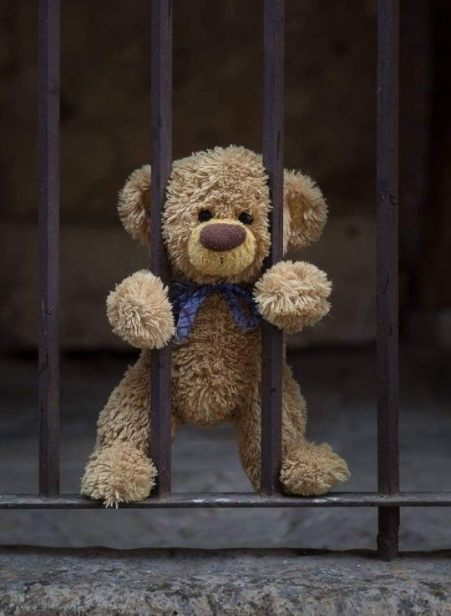
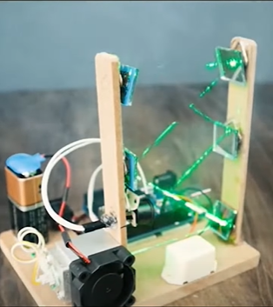
Visualization of our project

Slide 5
Usage of Design tools, hardware and software
Design Tools: Proteus
Hardware: Arduino Uno, Laser Sensor, Alarm,
Fingerprint System
Software: Arduino IDE

Slide 6
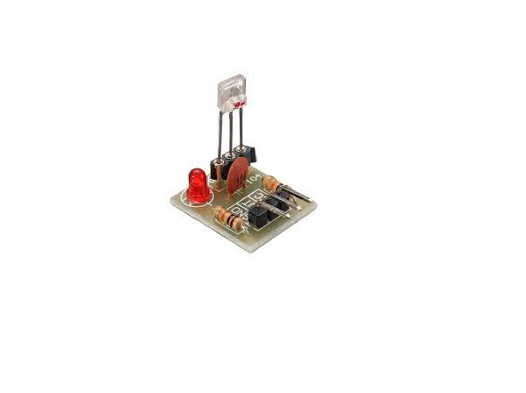
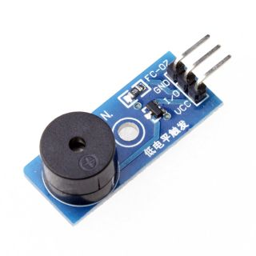
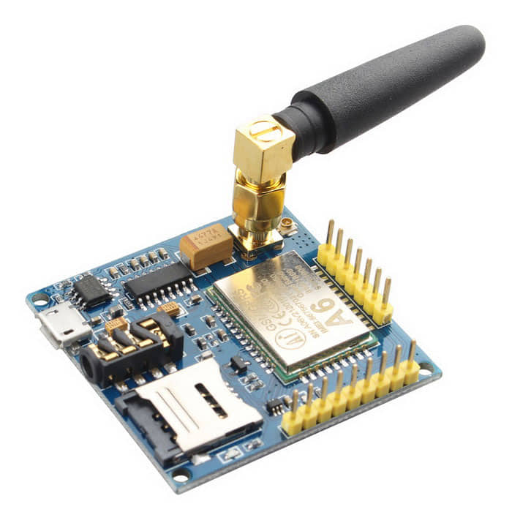
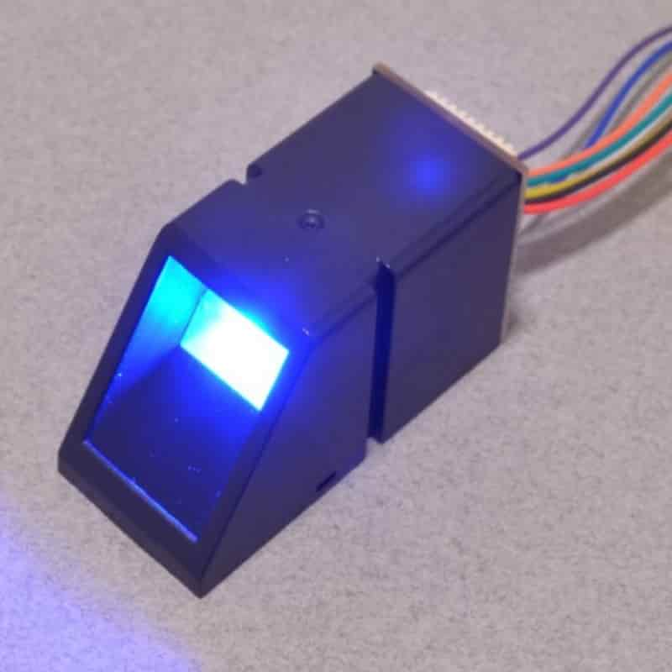
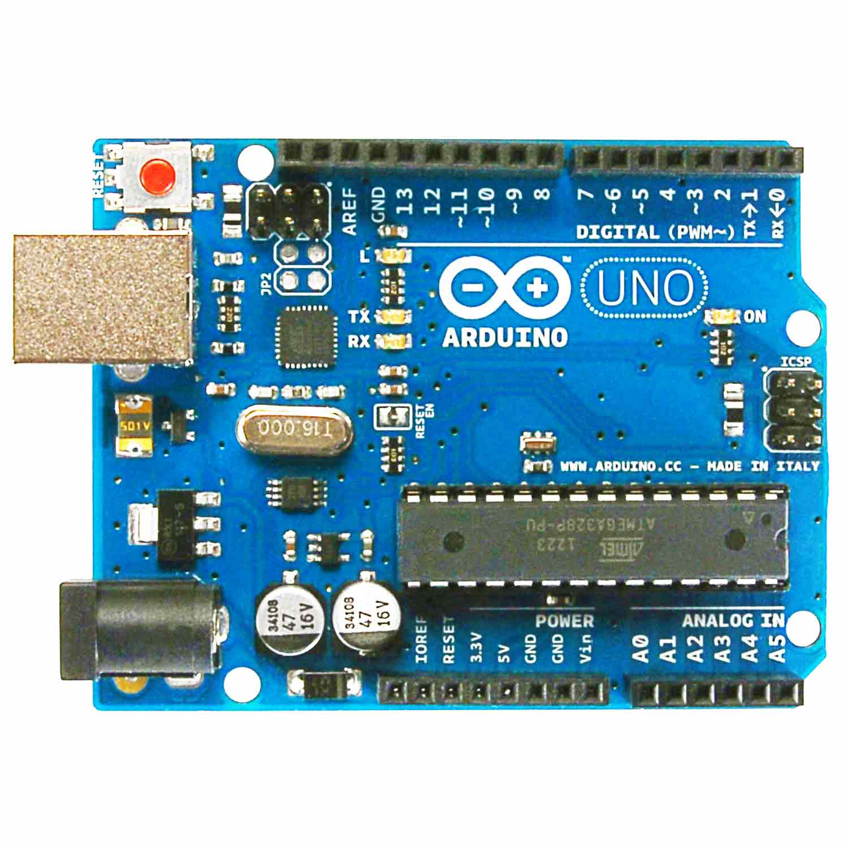
Sensors & Modules
Laser Receiving Sensor
Active Buzzer Module
GSM Module
Fingerprint Sensor
Arduino Uno

Slide 7
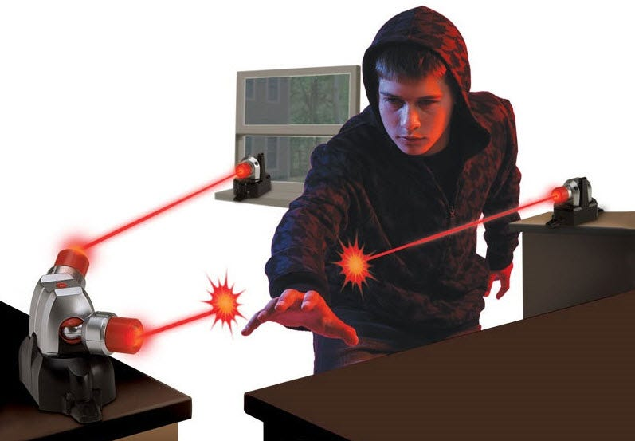


Features
Advanced Laser System
Fingerprint System
Alarm & Messaging System

Slide 8
Impact on social &
economic development
Social Impact:
Enhanced Security
Crime Deterrence
Community Confidence
Emergency Response
Economic Development:
Reduction in Losses
Insurance Premiums
Increased Productivity
Job Creation
Property Value
Technological Advancement

Slide 9
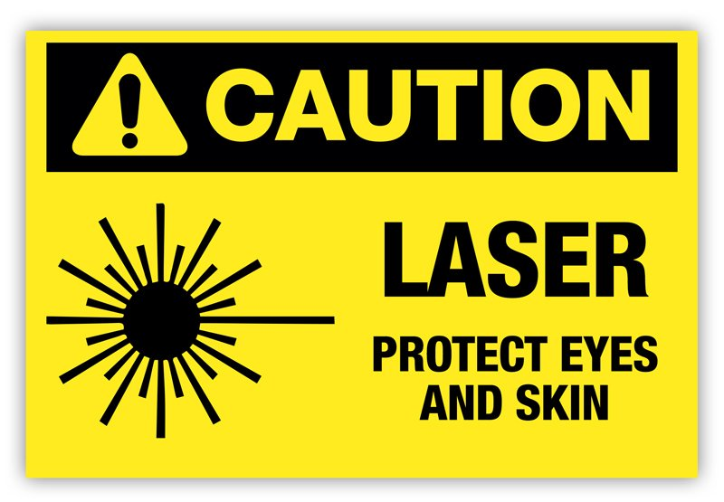



Conflicting Issues
Laser Effects
Maintenance
Cost of Implementation
False Alarm

Slide 10
Estimated Budget
Arduino Uno - 840 Taka
Laser Receiving Sensor- 120 Taka
Buzzer - 40 Taka
Fingerprint Sensor – 1990 Taka
GSM Module – 900 Taka
Total – 5000 (Approximate including other electronic materials)

Slide 11
THANK YOU!
ANY QUESTIONS?

