Slide 1
Bank Vault Management System
Course No: CSE 3118 Course Name: Microprocessor & Microcontrollers Lab
Course Teachers
Prof. Dr. Md. Shamim Akhter &
Lomat Haider Chowdhury

Slide 2



Group: 05 Team Name: Team_Delulu Group Members
Manzar Nur Rahman Eftee Sharjil Shabab Khan Md. Shaleh Abu Mayeen
ID – 20210104105 ID – 20210104108 ID - 20210104123
2

Slide 3
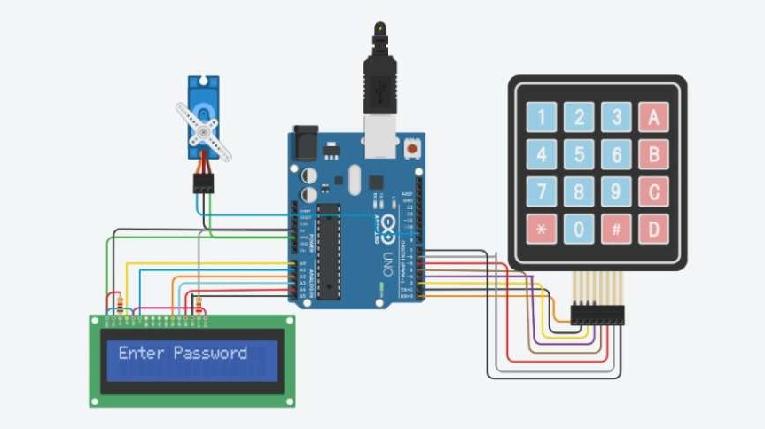
Core Concept
3

Slide 4
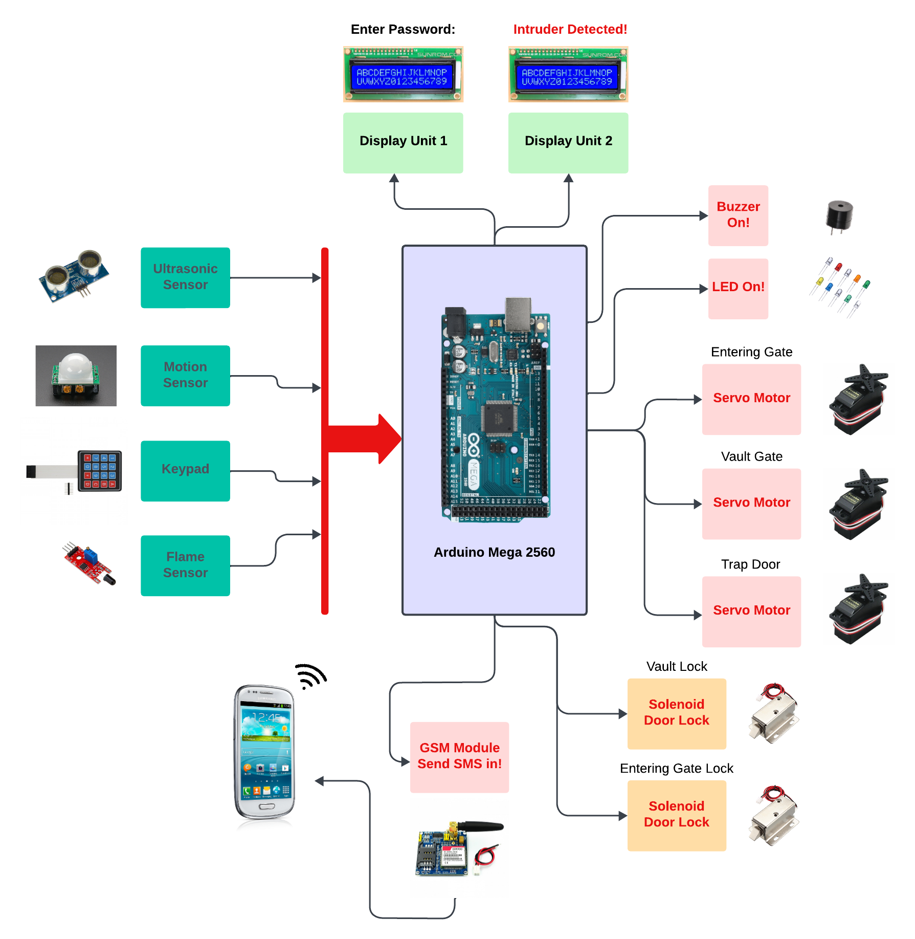
Visualization of our Project
4

Slide 5
Usage of Design tools, hardware and software
Design Tools: Proteus
Hardware: Arduino Mega, Buzzer, Servo Motor, Keypad, LED, register, Ultrasonic Sensor, GSM Module, Display, Lock
Software: Arduino IDE
5

Slide 6
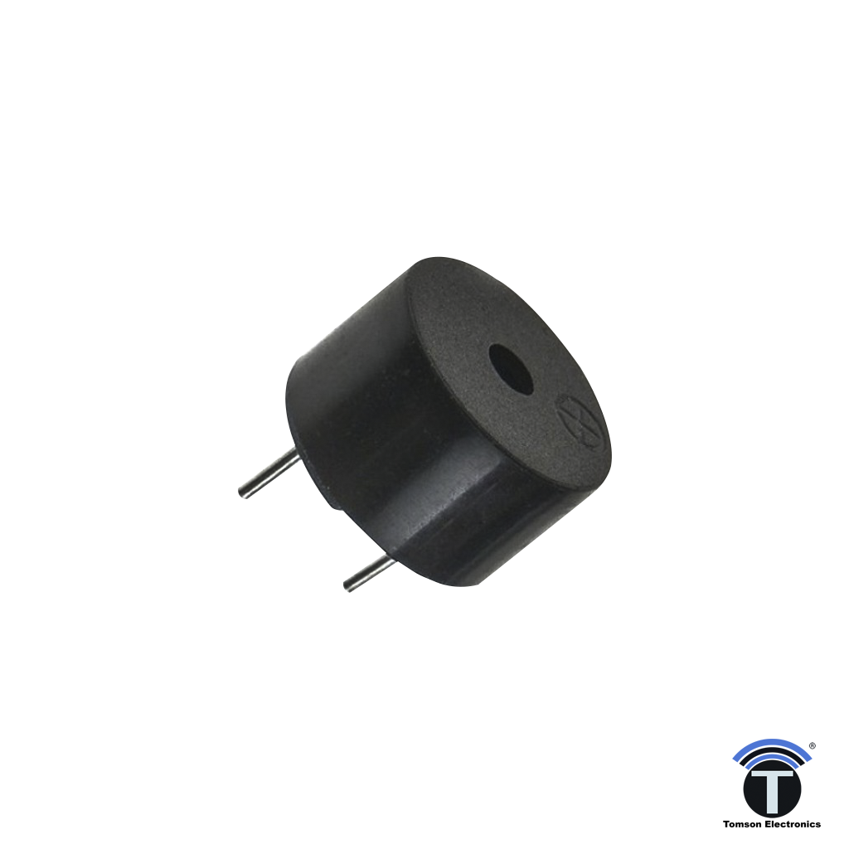
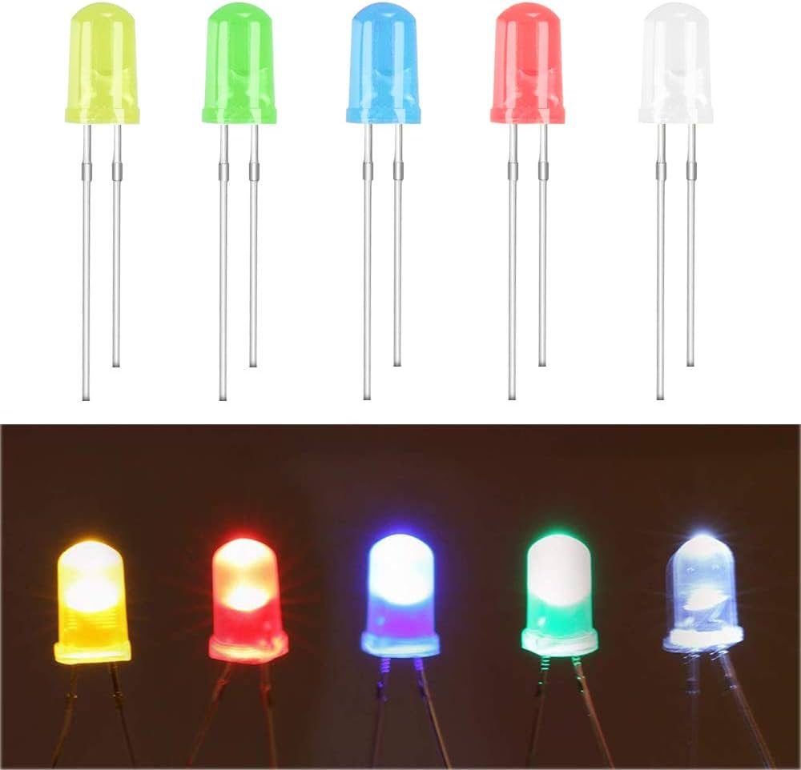
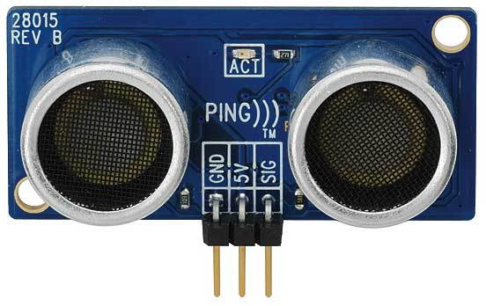
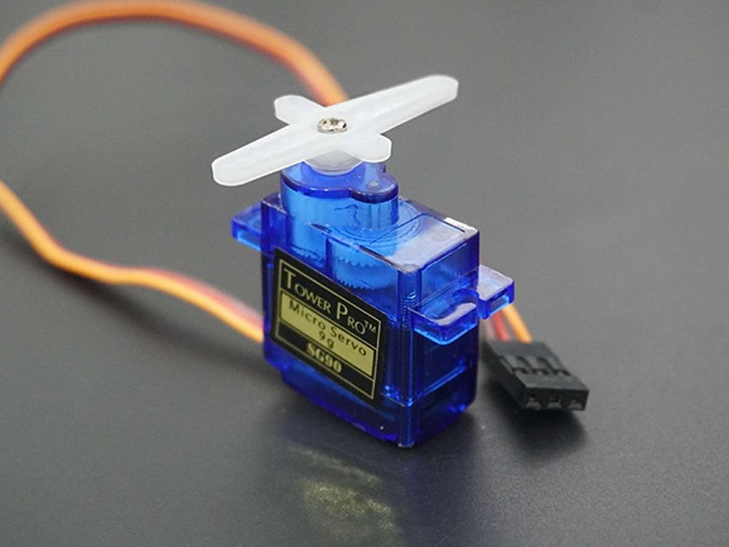
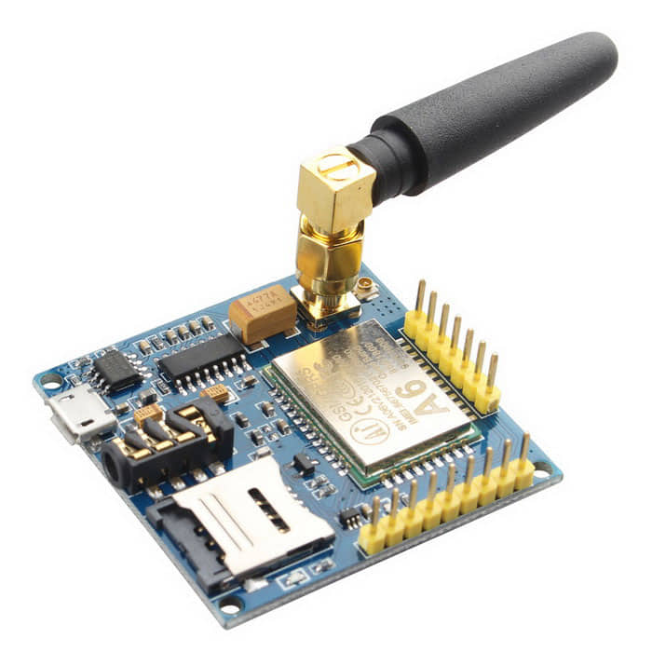
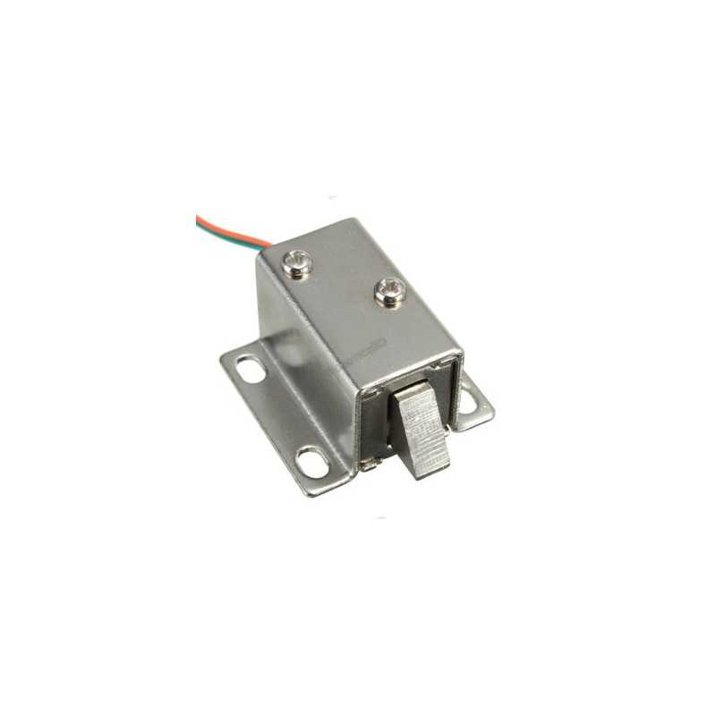
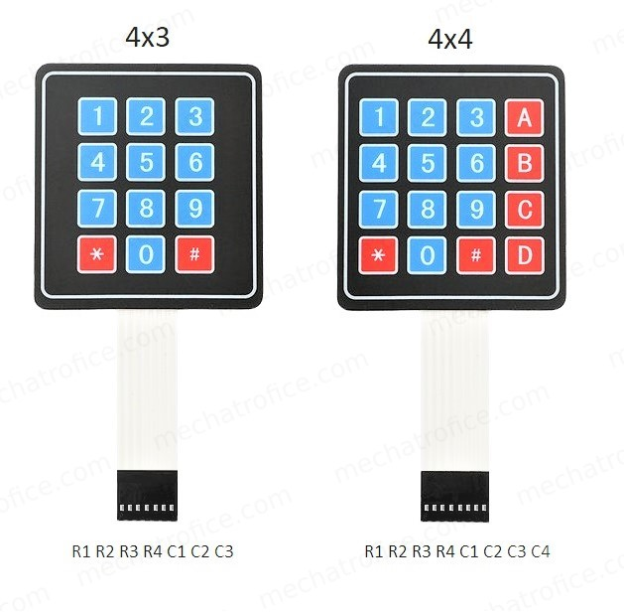
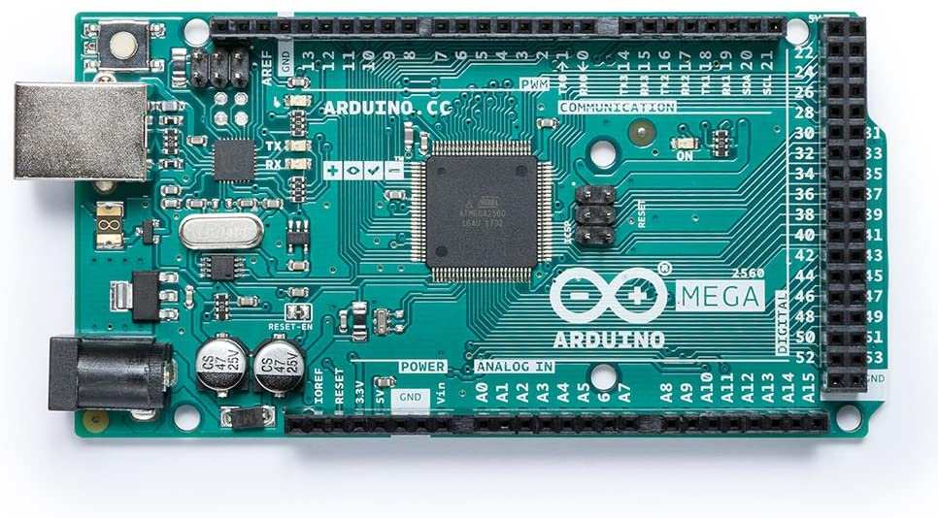
Sensor & Modules
LED
Buzzer
Ultrasonic Sensor
Servo Motor
GSM Module
Solenoid Door Lock
Keypad
Arduino Mega
6

Slide 7
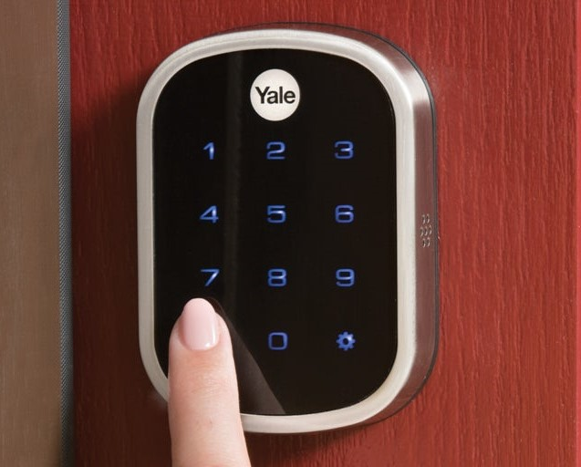


Working System
Keypad Unlocking System
Trap Door
System
Alarm & Messaging
System
7

Slide 8
Social Impact:
Impact on Social & Economic Development
Enhanced Security
Crime Deterrent
Trust & Confidence
Employment Opportunities
Customer Convenience
Technological Advancement
Emergency Preparedness
One step closer to being Digital Bangladesh!
8

Slide 9
Economic Development:
Impact on Social & Economic Development
Increased Productivity
Increased Investments
Job Creation
Increased Trust in Banking
Revenue Generation
Infrastructure Development
Tech Sector Growth
Internation Competitiveness
9

Slide 10
Estimated Budget
Arduino Mega – 1200 bdt
GSM Module – 900 bdt
Solenoid Door lock – 750 bdt
Keypad – 75 bdt
Servo Motor – 150 bdt
Buzzer – 50 bdt
Ultrasonic Sensor – 90 bdt
Total – 6000 (Approximate including other electronic materials)
10

Slide 11
Thank you!
Do you have any questions?
11

