Slide 1

Statistical Analysis
Meera Radhish
Mentor: Smriti Mehta OESON Global

Slide 2



Agenda
Introduction
Objective
Descriptive Analysis
Histograms
Comparative Analysis
Summary

Slide 3


Introduction
In this project the goal is to create a statistical report capturing live data for stock prices of major US companies like Apple, Tesla, Microsoft, to study the behavior of the company stock.
The dataset has been extracted from the website of Yahoo Finance, between the year 2018 &2023 on daily basis.
The data set also contains S&P500 values as well during the same period. The percentage change in stock values has been calculated and provided in the data set as %change variable.

Slide 4

Objective
The objective of this project is to do a comprehensive analysis of the trends of major US firm stock prices focusing on Microsoft, Apple & Tesla. Through the analysis of real time stock price data , we hope to obtain insightful knowledge on stock price trends.

Slide 5
Descriptive Analysis

Slide 6
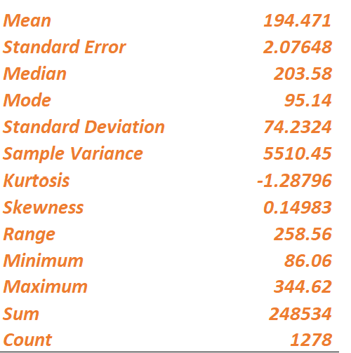
Microsoft
With an average price of $194, $203 median Microsoft indicating a relatively balanced distribution.
A modest positive skewness 0.15 implies slight rightward tail.

Slide 7
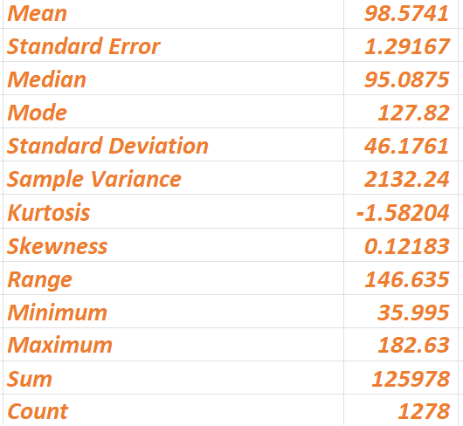
Apple
With a mean price of 98.57, close to 95 median, Apple shows a well centered distribution.
A slight positive skewness of 0.12 suggests occasional higher prices.
With low standard deviation of 46.17 Apple seems to be more stable and less volatile

Slide 8
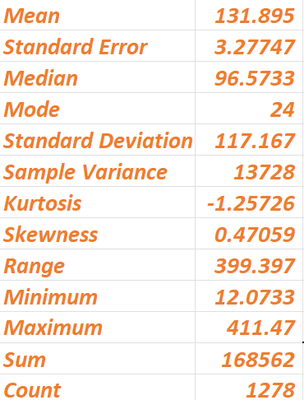
Tesla
With a mean of 132 and a median of 97 Tesla indicates more dispersed price distribution.
Also Tesla records the highest standard deviation at 117 which indicates significant price volatility.

Slide 9
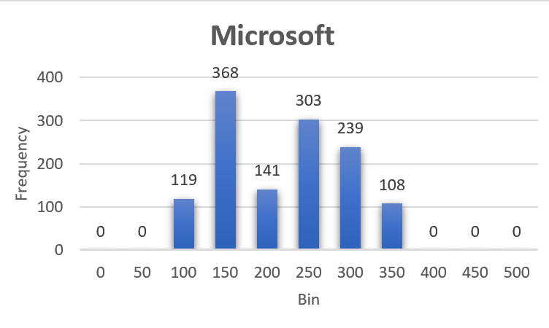
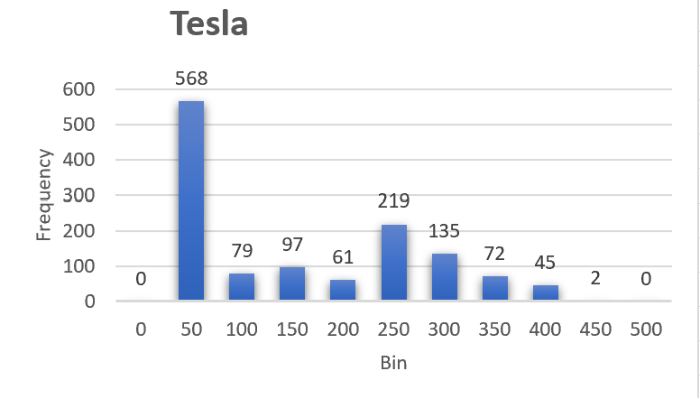
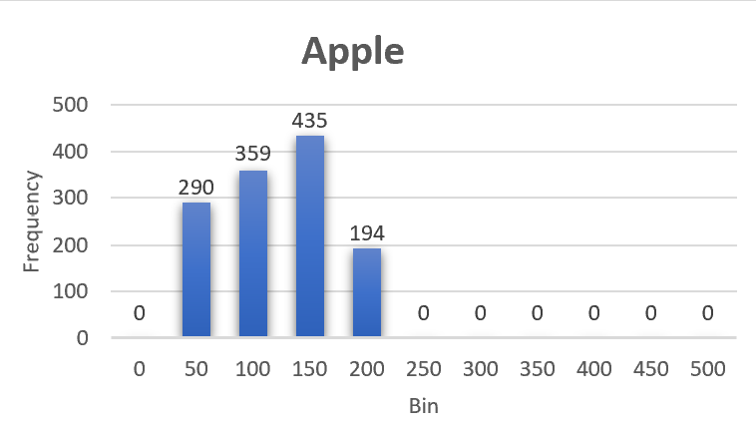
Histograms

Slide 10
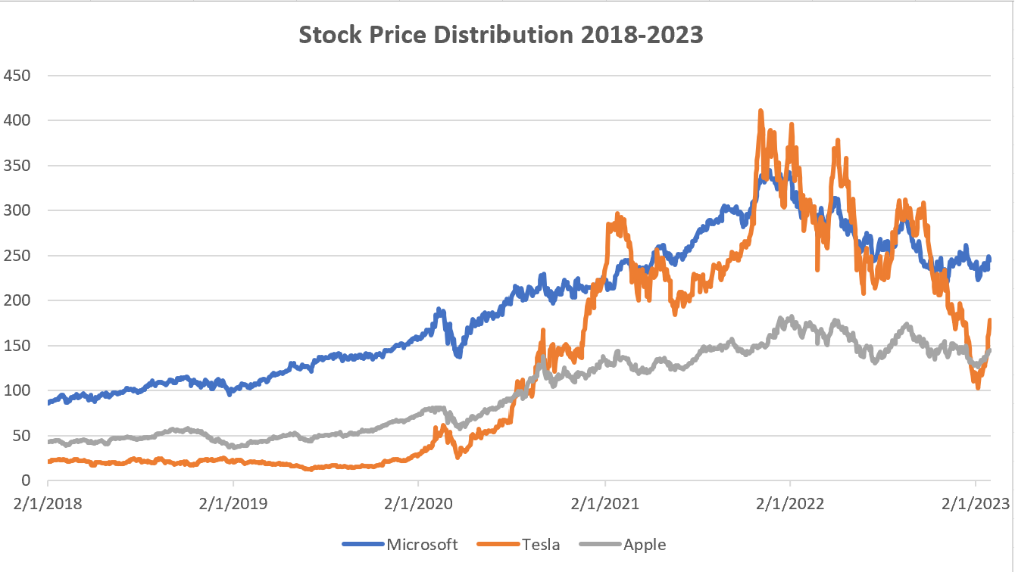
Comparative Analysis

Slide 11
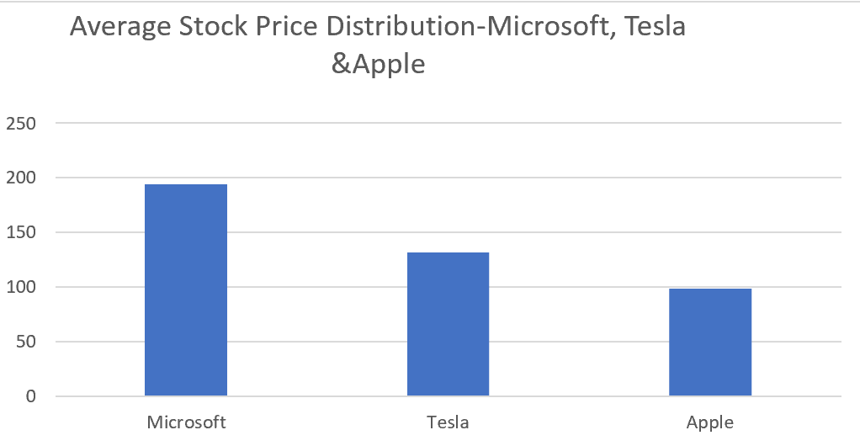
Comparative Analysis

Slide 12

Summary
Microsoft: Broader price range with frequent prices around $150 and higher standard deviation, indicating greater price volatility and associated risk. Suitable for investors with low to medium risk tolerance. Apple: Stable price range mainly around $150 and lowest standard deviation,signifying stability and lower volatility. Suitable for investors with low risk tolerance. Tesla: Widest price range with frequent prices of $50, indicating significant price volatility and highest standard deviation which signifies highest stock price volatility. Suitable for investors with high risk tolerance.

Slide 13


Thank You

