Slide 1
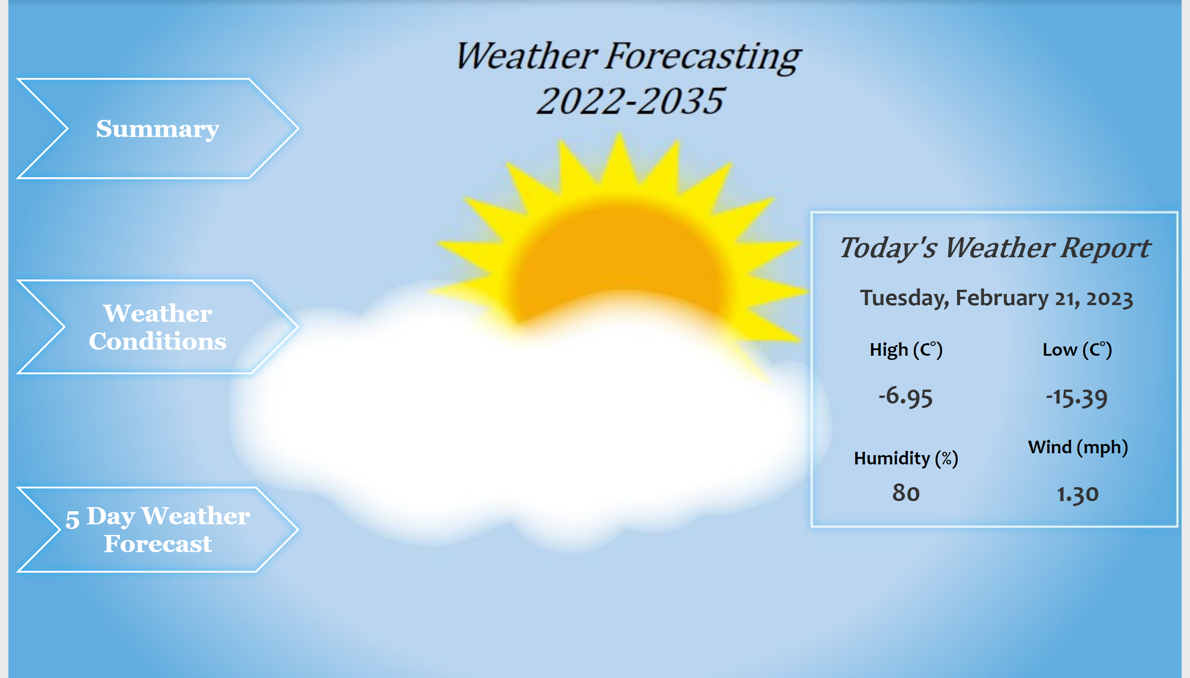
Introduction
Notes:
shape
No alt text provided
shape
No alt text provided
shape
No alt text provided
card
No alt text provided
High (C°)
No alt text provided
Low (C°)
No alt text provided
Humidity (%)
No alt text provided
Wind (mph)
No alt text provided
textbox
No alt text provided

Slide 2
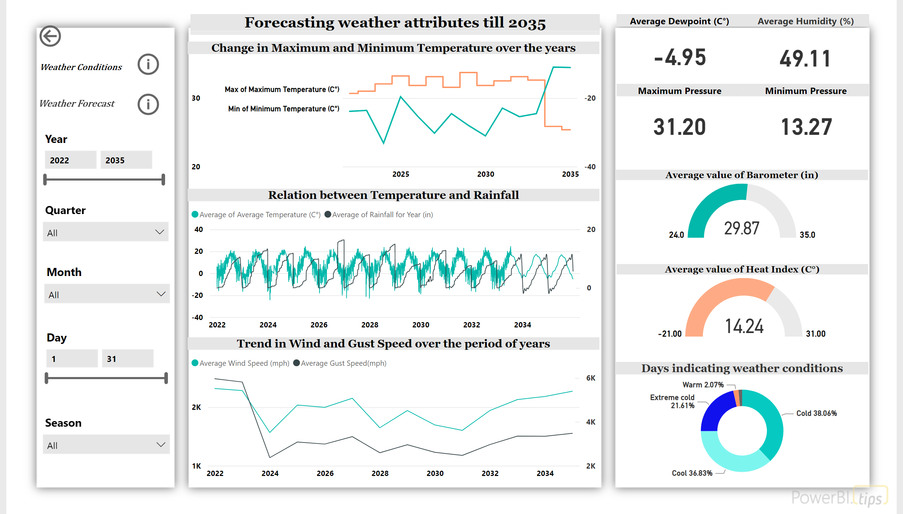
Executive Summary
Notes:
Date Slicer
No alt text provided
Slicer 1
No alt text provided
Change in Maximum and Minimum Temperature over the years
We can see how their is going to be a change in temperature over the period of years.
Forecasting weather attributes till 2035
No alt text provided
Average Dewpoint (C°)
No alt text provided
Average Humidity (%)
No alt text provided
Relation between Temperature and Rainfall
We can see how their is going to be a change in temperature over the period of years.
Maximum Pressure
No alt text provided
Minimum Pressure
No alt text provided
Slicer 4
No alt text provided
Date Slicer
No alt text provided
Trend in Wind and Gust Speed over the period of years
We can see how their is going to be a change in temperature over the period of years.
Average value of Barometer (in)
No alt text provided
Average value of Heat Index (C°)
No alt text provided
Days indicating weather conditions
No alt text provided
slicer
No alt text provided
actionButton
No alt text provided
actionButton
No alt text provided
textbox
No alt text provided
actionButton
No alt text provided
textbox
No alt text provided

Slide 3
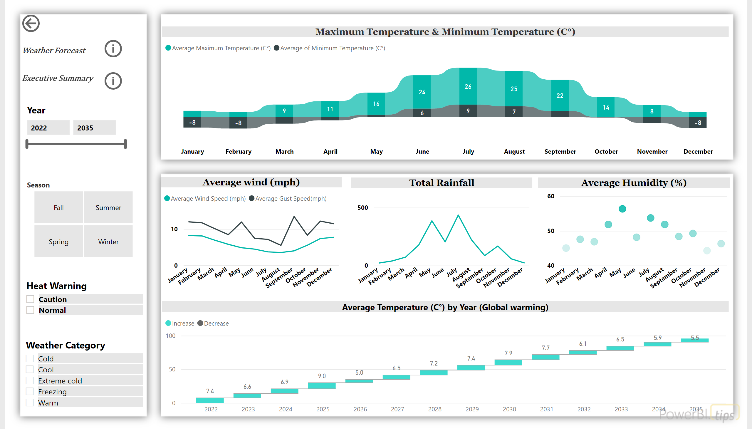
Weather Conditions
Notes:
Maximum Temperature & Minimum Temperature (C°)
No alt text provided
Average wind (mph)
No alt text provided
Total Rainfall
No alt text provided
slicer
No alt text provided
Average Temperature (C°) by Year (Global warming)
No alt text provided
slicer
No alt text provided
slicer
No alt text provided
Date Slicer
No alt text provided
Average Humidity (%)
No alt text provided
actionButton
No alt text provided
textbox
No alt text provided
actionButton
No alt text provided
textbox
No alt text provided
actionButton
No alt text provided

Slide 4
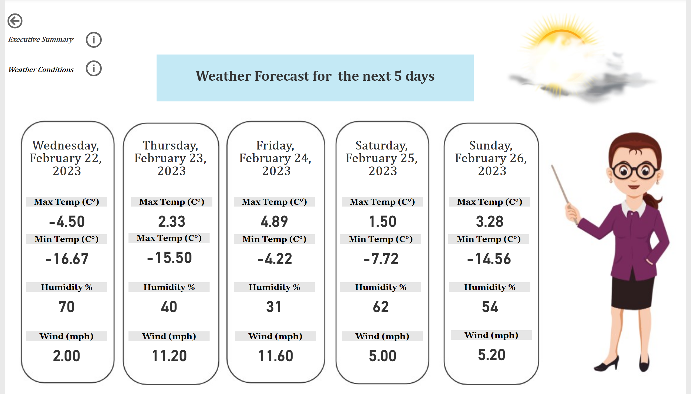
5 day weather forecast
Notes:
card
No alt text provided
card
No alt text provided
card
No alt text provided
card
No alt text provided
card
No alt text provided
Max Temp (C°)
No alt text provided
Min Temp (C°)
No alt text provided
Humidity %
No alt text provided
Wind (mph)
No alt text provided
Max Temp (C°)
No alt text provided
Max Temp (C°)
No alt text provided
Max Temp (C°)
No alt text provided
Max Temp (C°)
No alt text provided
Max Temp (C°)
No alt text provided
Min Temp (C°)
No alt text provided
Min Temp (C°)
No alt text provided
Min Temp (C°)
No alt text provided
Humidity %
No alt text provided
Humidity %
No alt text provided
Humidity %
No alt text provided
Humidity %
No alt text provided
Wind (mph)
No alt text provided
Wind (mph)
No alt text provided
Wind (mph)
No alt text provided
Wind (mph)
No alt text provided
textbox
No alt text provided
textbox
No alt text provided
image
No alt text provided
actionButton
No alt text provided
textbox
No alt text provided
actionButton
No alt text provided
textbox
No alt text provided
actionButton
No alt text provided

