Slide 1

HEALTHCARE DATA ANALYSIS
ADVANCE EXCEL PROJECT
MEERA RADHISH
SUPERVISOR: SMRITI MEHTA
OESON Global

Slide 2
INTRODUCTION
WHAT IS IT ALL ABOUT
This project aims to analyze the data of different healthcare centers of various states located in US.
The data set is sourced from hospital charges database, comprises extensive repository of more than 150000 records document of various ailments and its costs across the numerous healthcare centers in the different states/cities of United states.
Key insights includes records of 100 distinct ailments , a comprehensive list of 3000+ healthcare providers and their geographical distribution overall US, the information about the costs on various treatments.
The primary objective is to analyze and interpret the dataset , leading to the development of a detailed report which is focused on providing insights to healthcare providers catering to specific ailments within US.

Slide 3
INDEX
OVERVIEW
DATA CLEANING
ANALYSIS
INFERENCES
CONCLUSION

Slide 4

OVERVIEW
HEALTH CARE DATA- USA
Dataset source: Hospital charges database, contains 15000+ records.
Records for 100 distinct ailments
A list of more than 3000 hospitals and medical centers spreaded over United States
Geographical coverage across 50 States and 2000 cities
Cost information in detail
Each entry uniquely combines state, city, ailment,provider with area code as well as average treatment costs for each ailment.

Slide 5
DATA CLEANING
HEALTH CARE DATA- USA
The healthcare dataset, being row, presented some anomalies. To ensure the optimal results the following steps are taken.
Duplicate rows as well as empty cells are eliminated
The discharge information of the patients included decimal values as well as negative values. Negative values whichnis logically meaningless are replaced by zero.
The data related to ailments, hospital information, geographical information are fromatted using proper function to feel comfortable.
The cost information were provided as text values which is converted to numbers as well.
Some uneven values are noticed in ‚providerid‘ column and ‚providerzipcode‘column which is also normalised by applying excel functions.

Slide 6

DATA ANALYSIS
HEALTH CARE DATA- USA
Areas Explored:
States with highest number of Healthcare providers
Total discharges in each state
Top 10 hospitals withtheir covered costs
Diseases with high treatment costs
Comparison of treatment costs with covered costs and medicare payments
Top 10 hopital regions with maximum ailments facility .
Top 10 hospital regions with highest covered charges

Slide 7
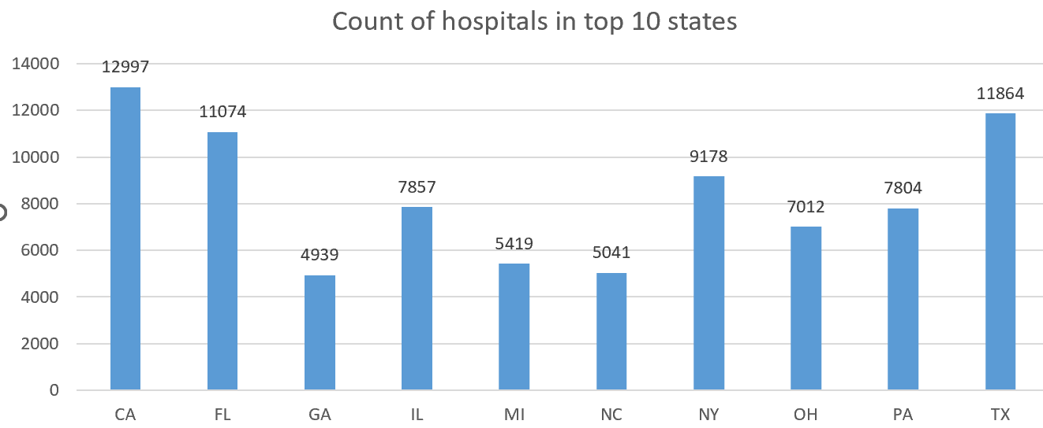
DATA ANALYSIS
HEALTH CARE DATA- USA
The clustered column chart illustrates the distribution of hospitals in the to 10 states of US.
California (CA) stands out with the highest number rof healthcare providers based on the top 10 states. This can be because of the population density,economic factors compared to other areas of United States.

Slide 8
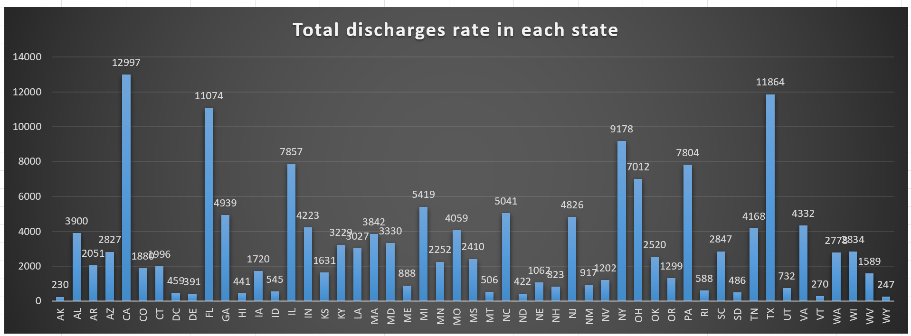
DATA ANALYSIS
HEALTH CARE DATA- USA
The chart depicts the number of discharges in all states.
CA has highest number of discharges where AK(Alaska) marks lowest number of discharges. This can be based on the population of the regions as it varies from states to states.
Top 3 states with highest number of discharges are CA,TX,FL.

Slide 9
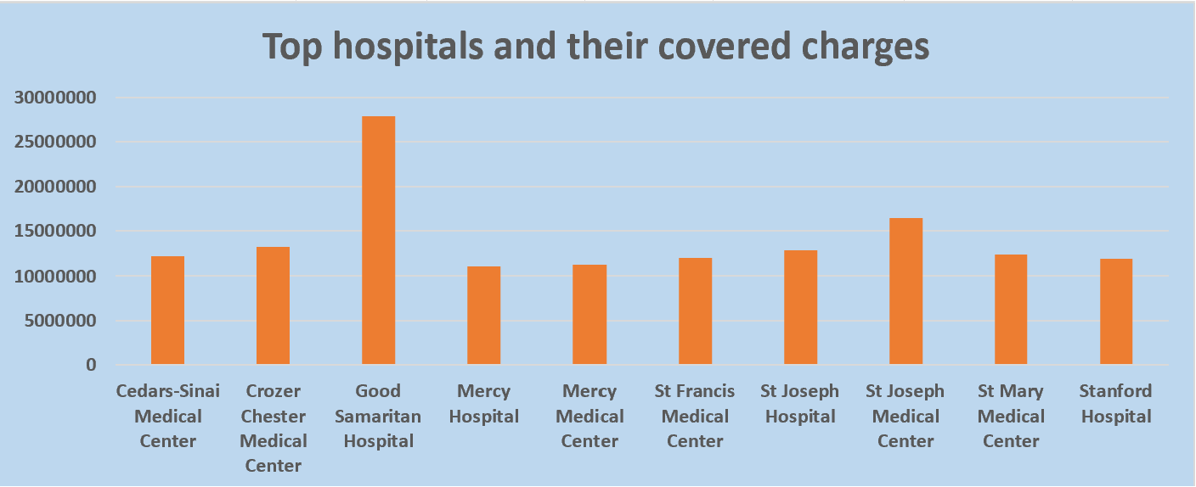
DATA ANALYSIS
HEALTH CARE DATA- USA
The chart illustrates the health providers with highest covered costs.
Considering the health providers, Good Samaritan Hospital holds highest covered costs.

Slide 10
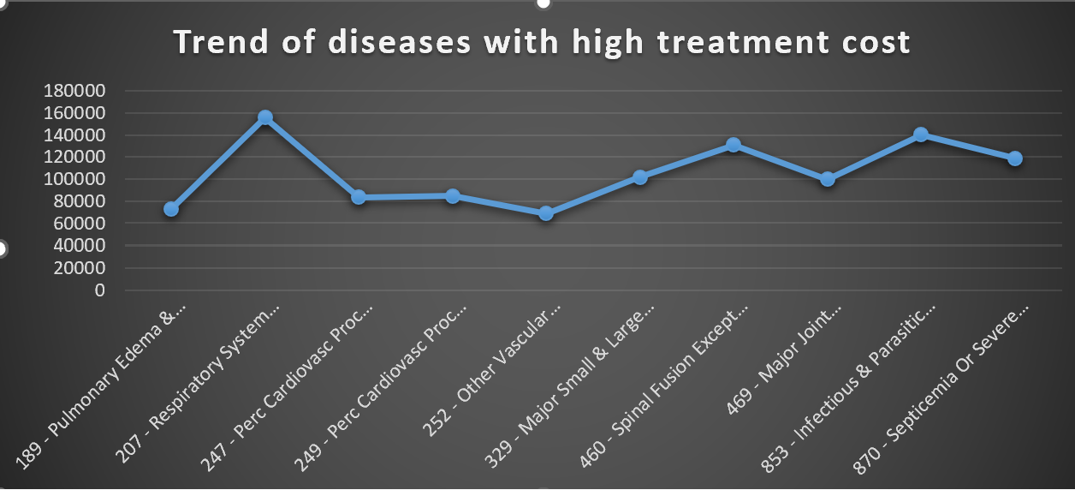
DATA ANALYSIS
HEALTH CARE DATA- USA
The line chart shows the highest treatment costs based on the ailments.
Highest treatment cost is for diagnosis of Respiratory System with ventilator support 96+hrs

Slide 11
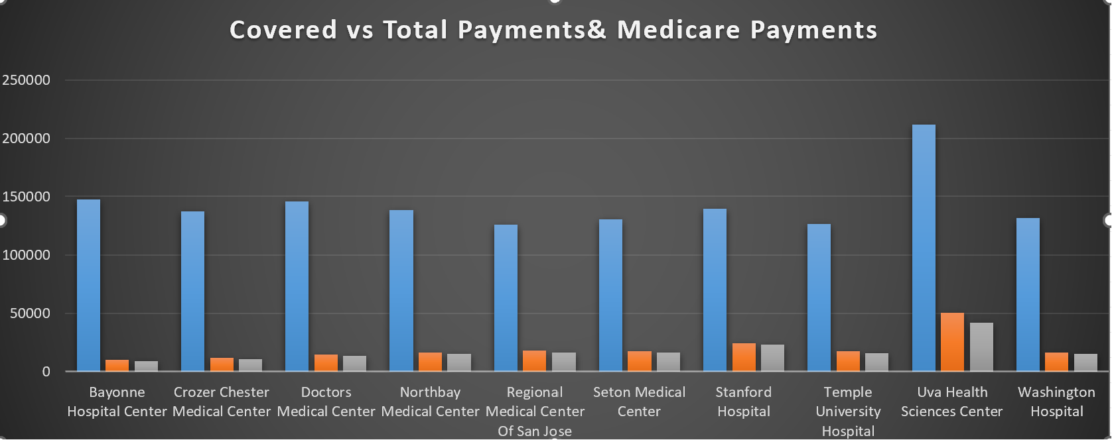
DATA ANALYSIS
HEALTH CARE DATA- USA
The chart illustrates the comparison of various treatment costs based on the top health care providers.
Uvva Health Sciences center holds maximum costs as well as covered costs and medicare payments.
The lowest covered and medicare costs comes in Bayonne Hospital center .

Slide 12
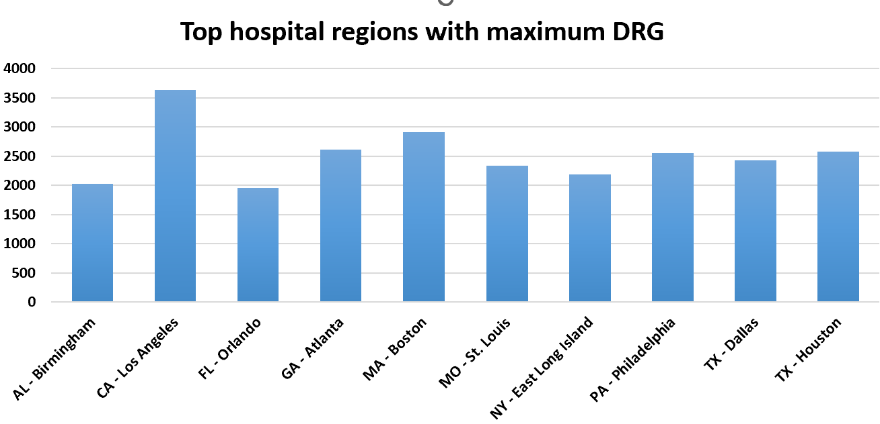
DATA ANALYSIS
HEALTH CARE DATA- USA
The chart illustrates comparison of maximum DRG support based on the top 10 regions.
CA-Los Angeles shows highest number of ailment facility.

Slide 13
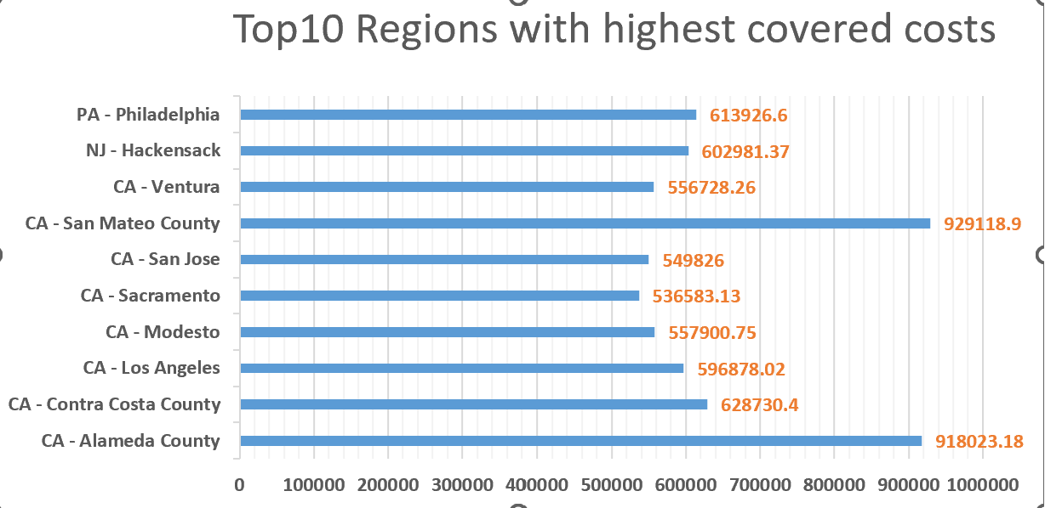
DATA ANALYSIS
HEALTH CARE DATA- USA
This chart depicts the maximum covered costs on top 10 regions.
The region,CA- Sanmateo county has highest number of covered costs.

Slide 14
INFERENCES
The state California covers maximum diagnosis facilities, covered costs as well as highest number of health care providers.
There is significant difference between treatment costs and covered costs.
There is lack of pricing transparency observed
Since there is a significant hike on treatment costs, cost-effective practices can be adapted by health providers.

Slide 15
CONCLUSION
The health care data analysis highlights crucial insights into the distribution and disparities amon healthcare providers across different states of USA. The findings underscore the need for targeted improvements in health care accessibility and resource allocation. Understanding of these patterns can contribute to informed decision making for enhancing health care services and addressing disparities within the health care system.

Slide 16
THANK YOU

