Slide 1

Computer Architecture & Microprocessors Microprocessor, Microcomputer, Microcontroller
Spring 2023 Shahid Beheshti University (SBU) Electrical Engineering Faculty
Erfan Amoozad Khalili Mohammadreza Jafari

Slide 2
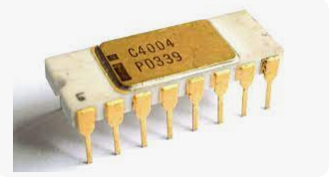
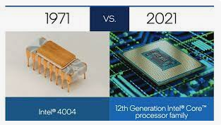
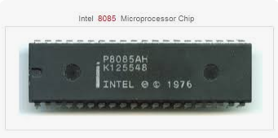
Microprocessor
A Central Processing Unit (CPU) on a single chip
Some typical components of a CPU are: Arithmetic Logic Unit (ALU) – instruction decoder – registers – bus and bus control circuit

Slide 3
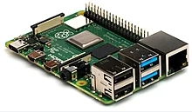
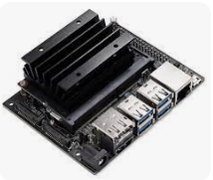
Microcomputer
Microprocessor + associated support circuitry, peripheral I/O, memory (program and data)
For example an 8085 Microprocessor + EPROM + RAM + a few I/O interface → Microcomputer
PCB not a single chip

Slide 4
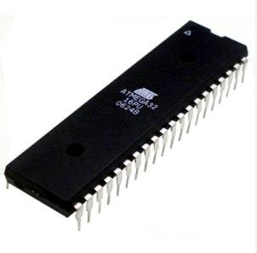
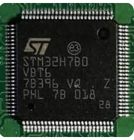
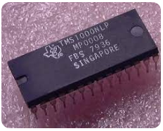
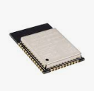
Microcontroller
A Microcomputer on a single VLSI chip of silicon
ARM, AVR, ESP, PIC, Intel 8051, TMS1000

Slide 5
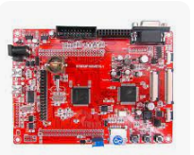
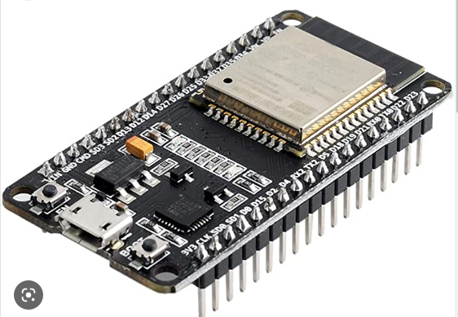
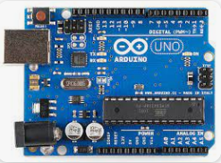
Development Board
A microcontroller development board is a printed circuit board (PCB) with circuitry and hardware designed to facilitate experimentation with certain microcontroller board features.

Slide 6
Conclusion
Microprocessors, microcomputers, and microcontrollers are defined, but it is quite common to see these terms being used loosely and interchangeably. This fuzziness in terms exists and we will have to live with it!

Slide 7
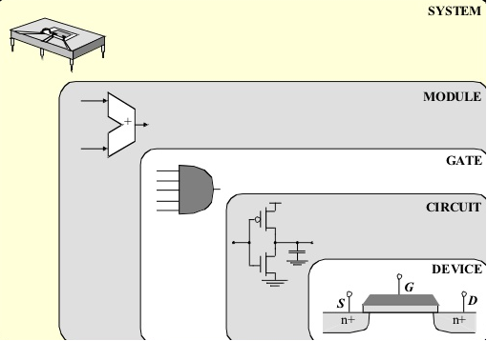
Abstraction Level

