Slide 1
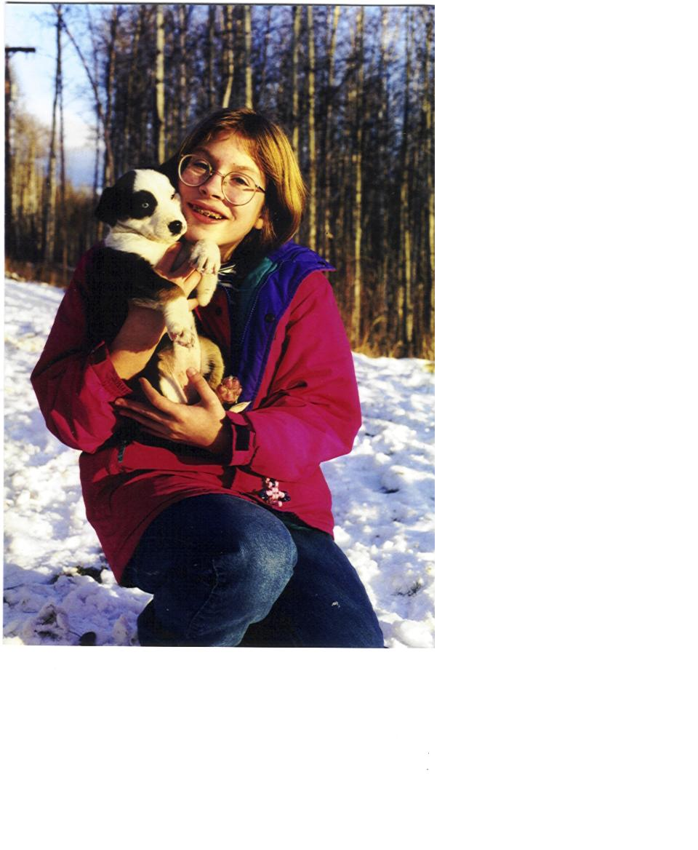
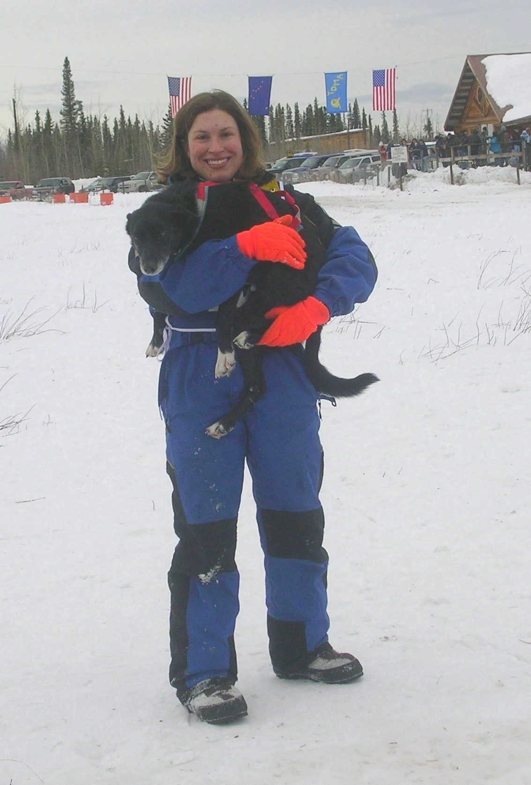
We’ve come a long way

Slide 2
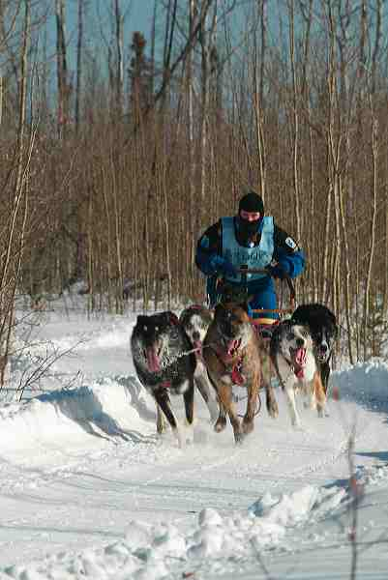
Tok, 2004

Slide 3
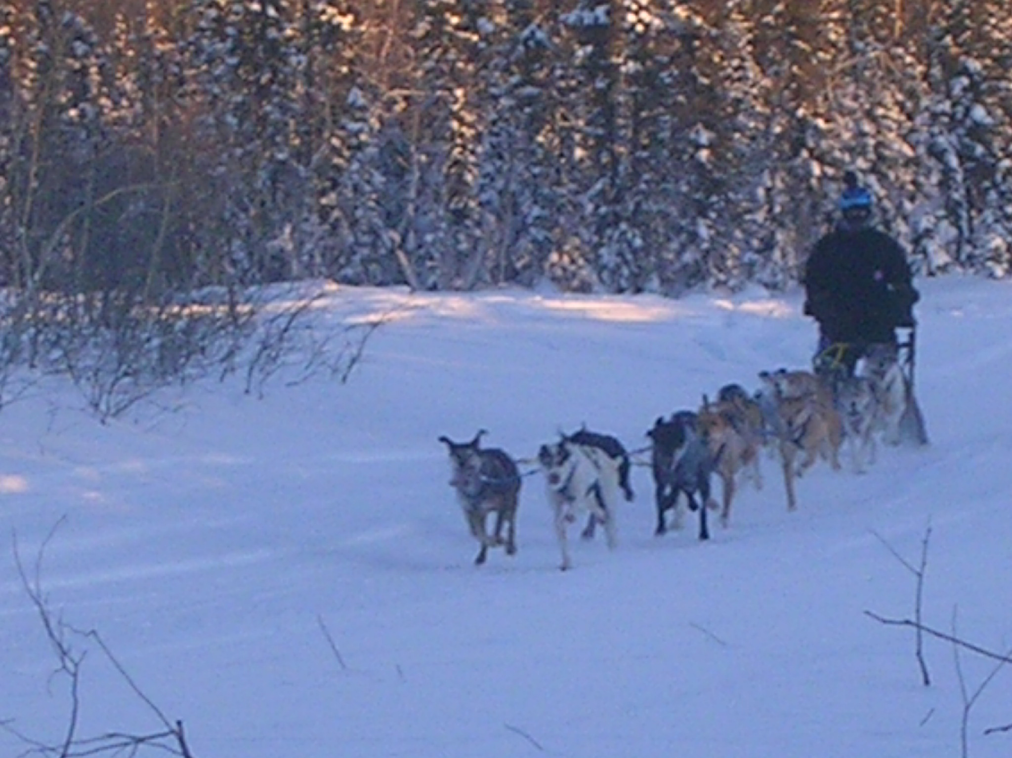
Huslia, 2011

Slide 4
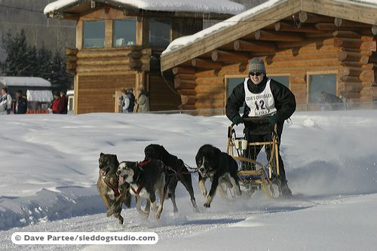

Slide 5
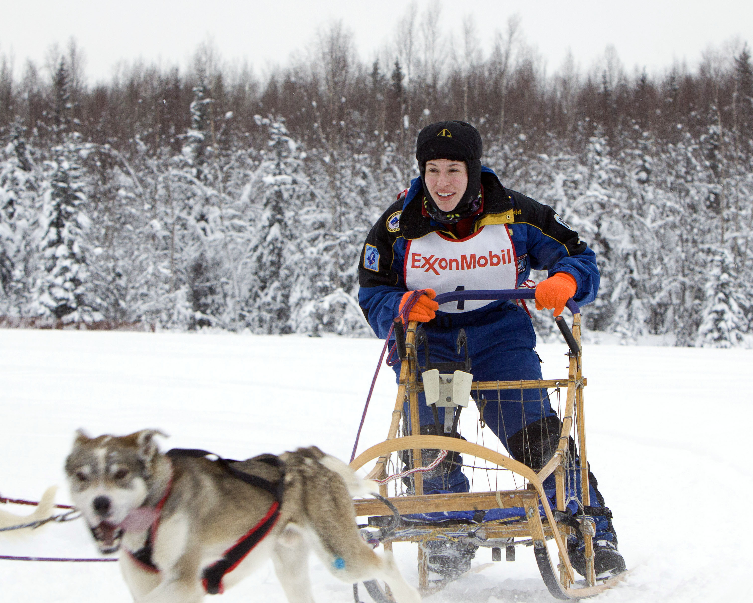

Slide 6
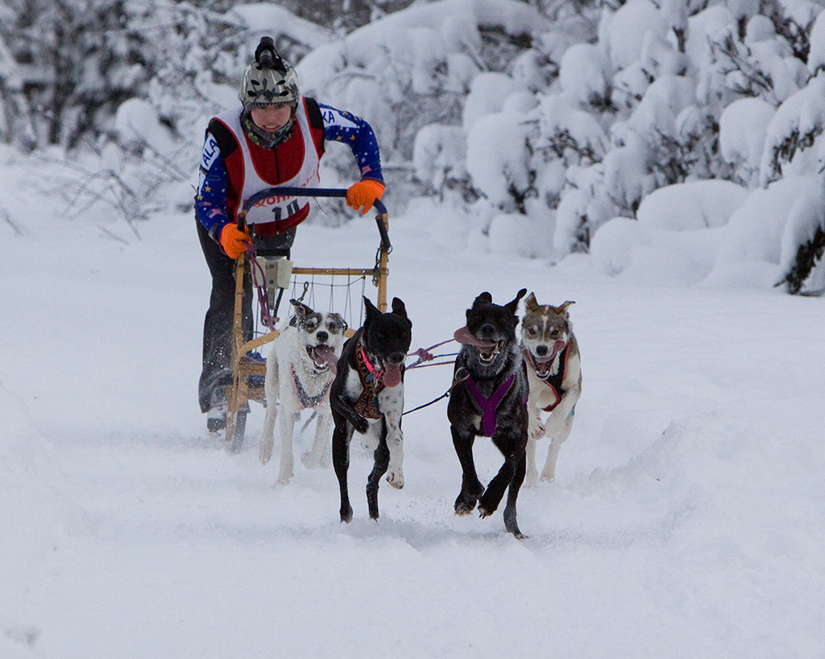

Slide 7
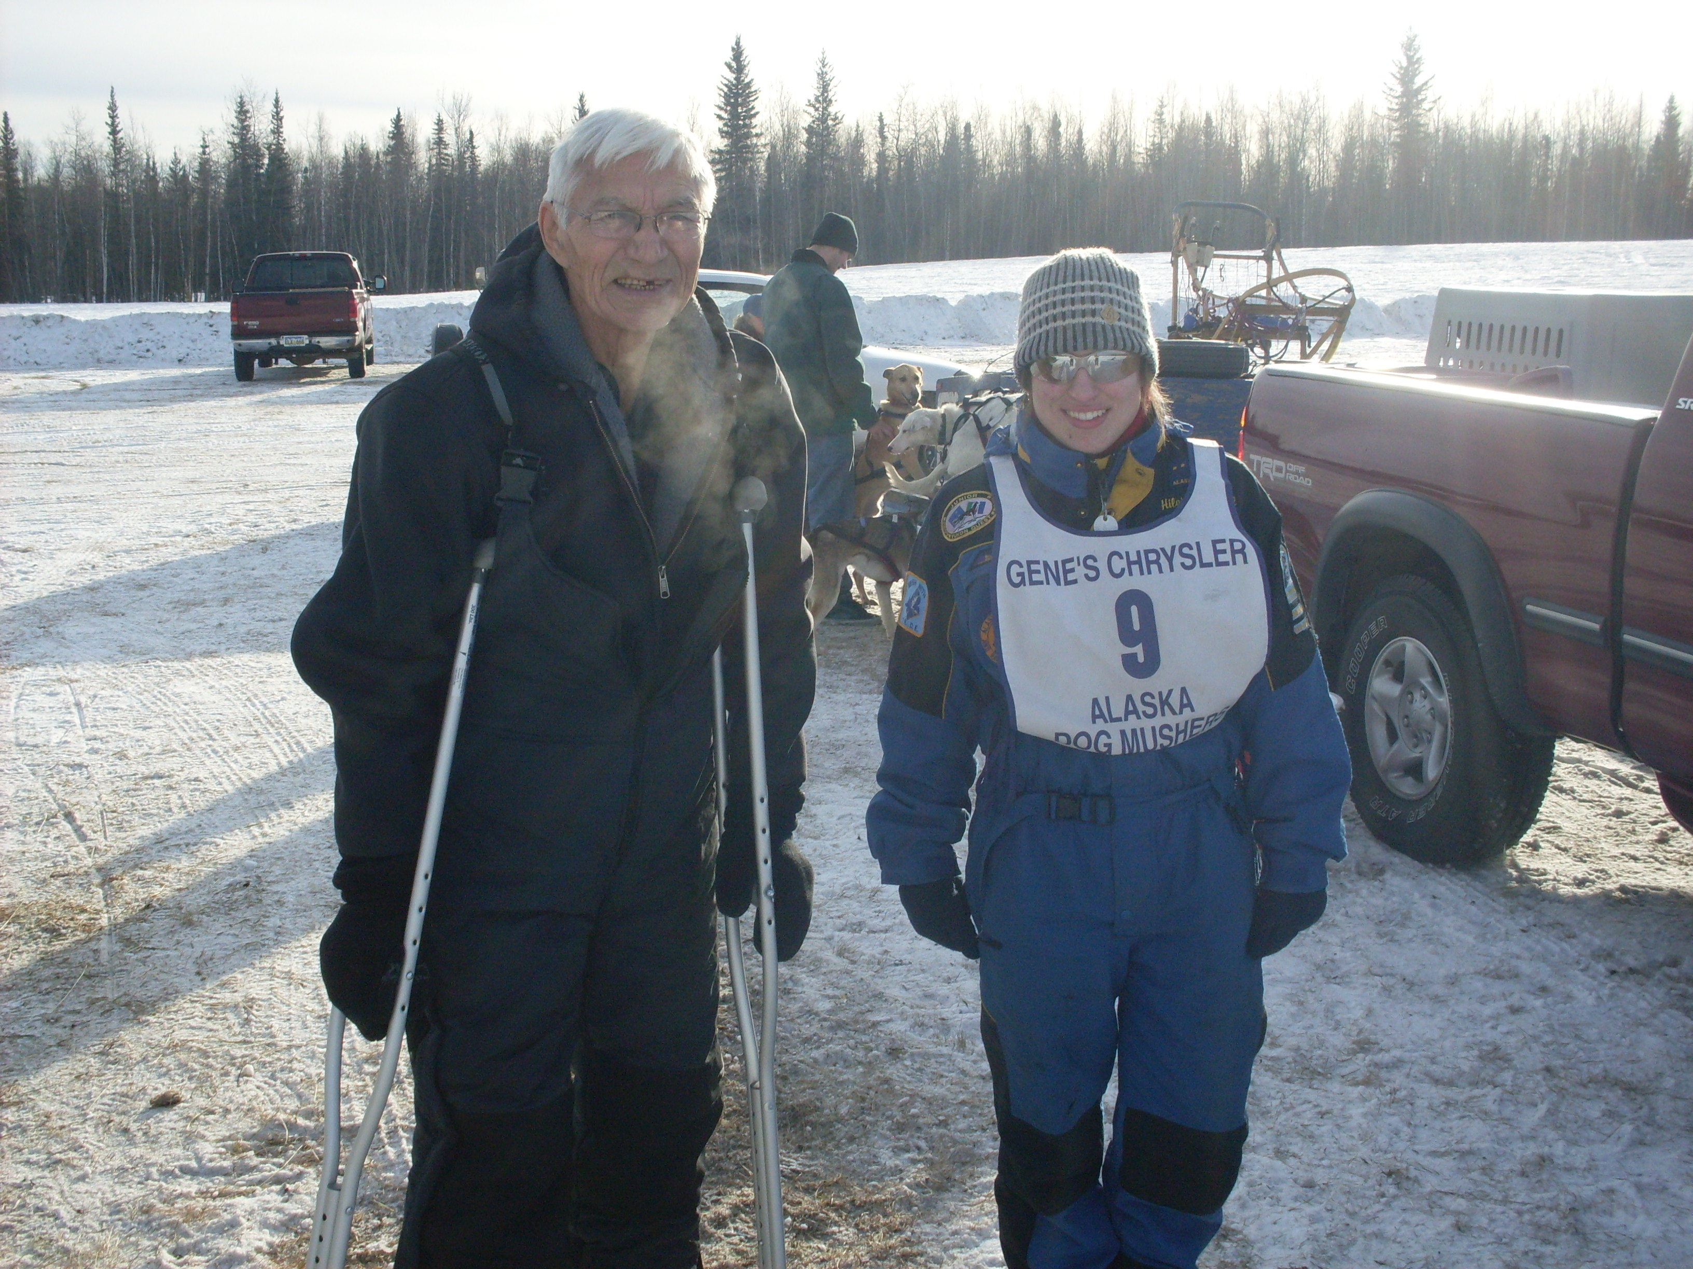
Listen to people who know more than you

Slide 8
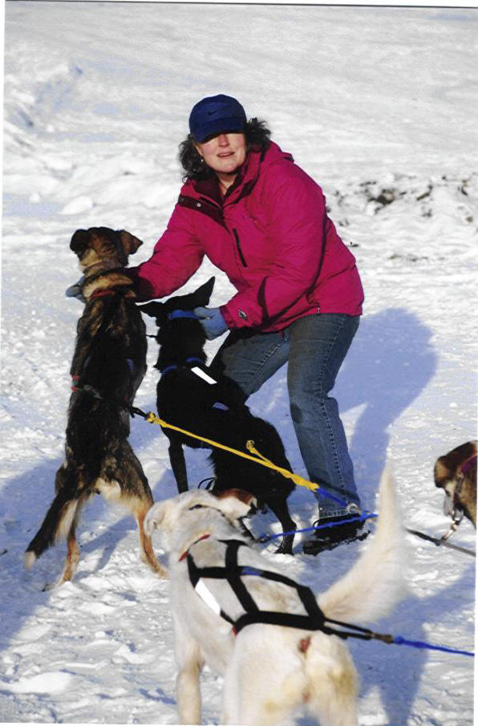
Be thankful to people who support you

Slide 9
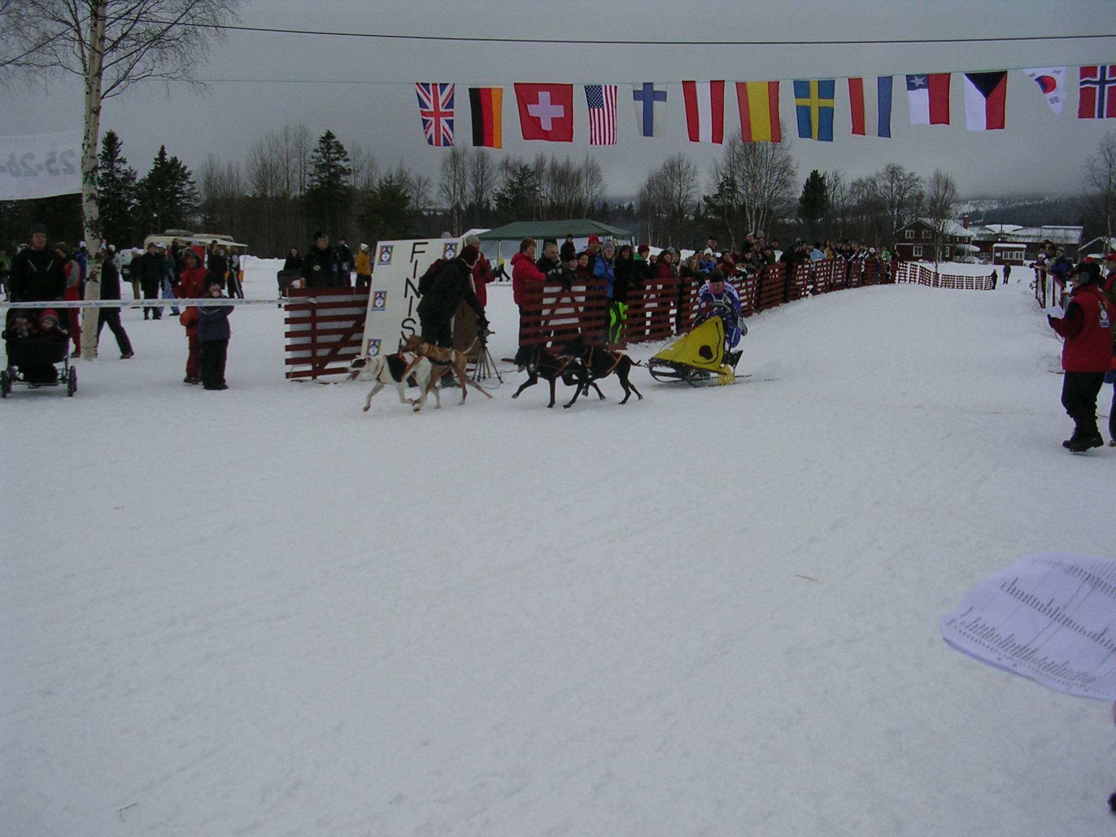
Pursue opportunities. Go with the flow.

Slide 10
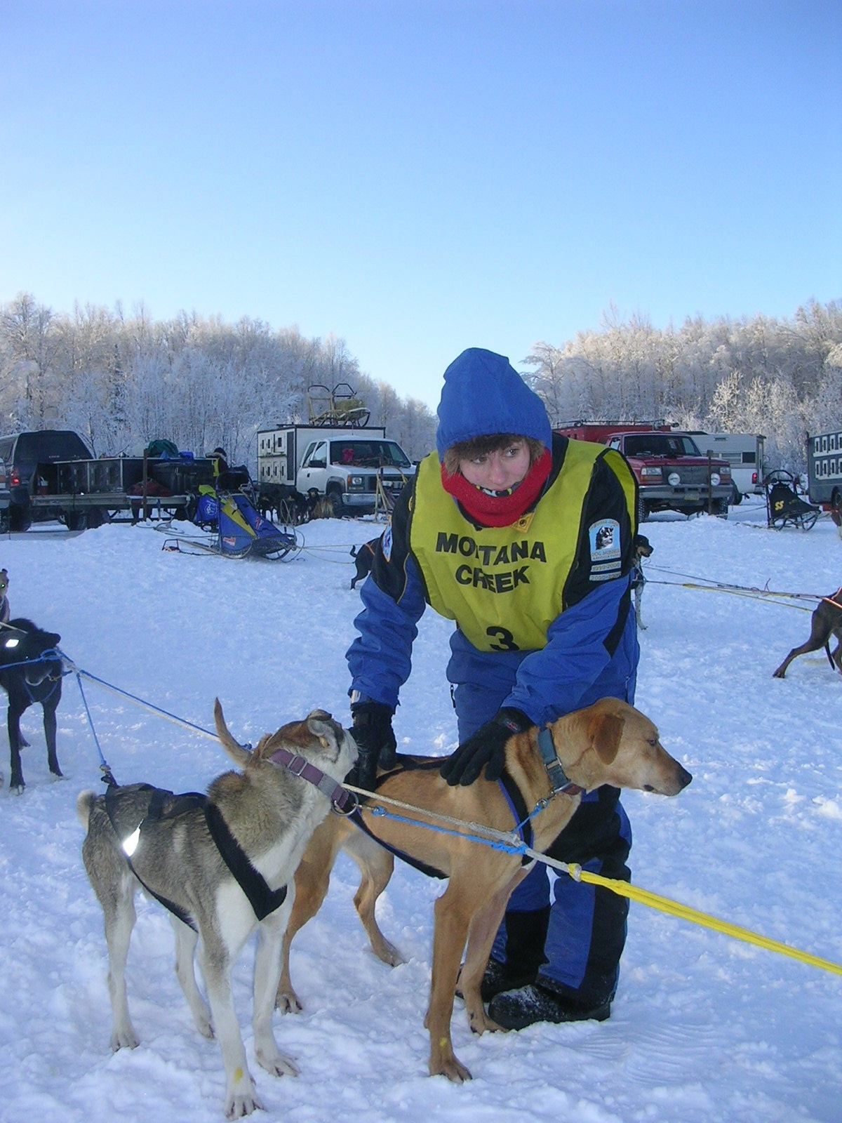
Preparation is everything.

Slide 11
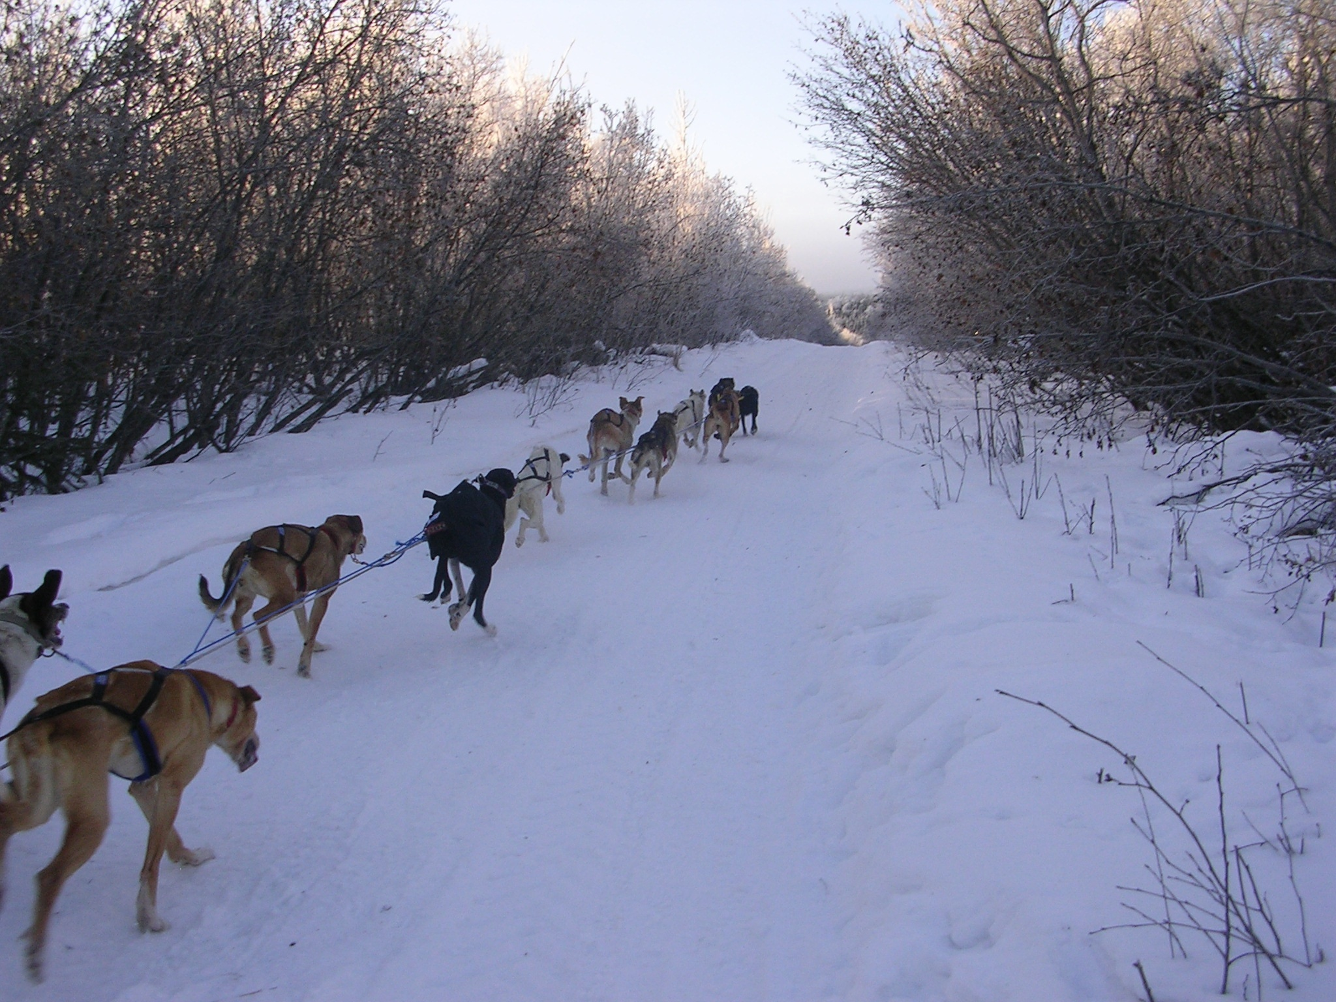
Don’t let anyone tell you what you can’t do.

Slide 12
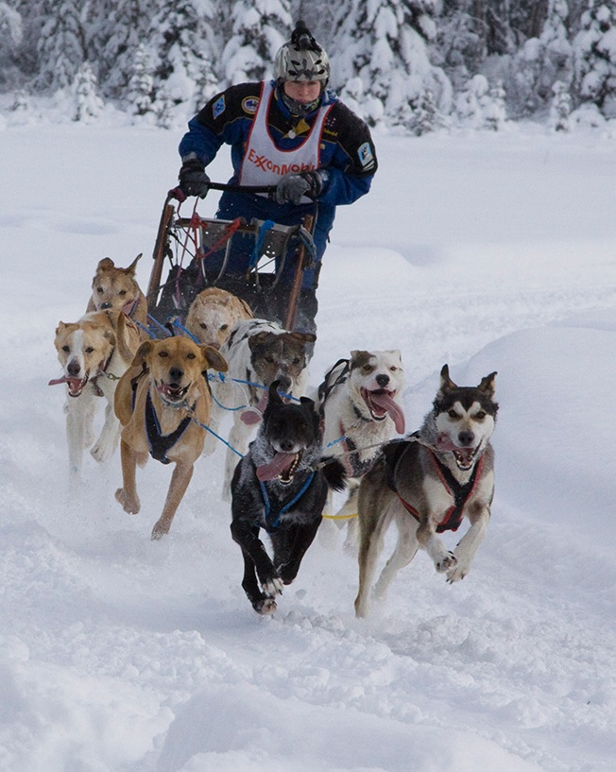
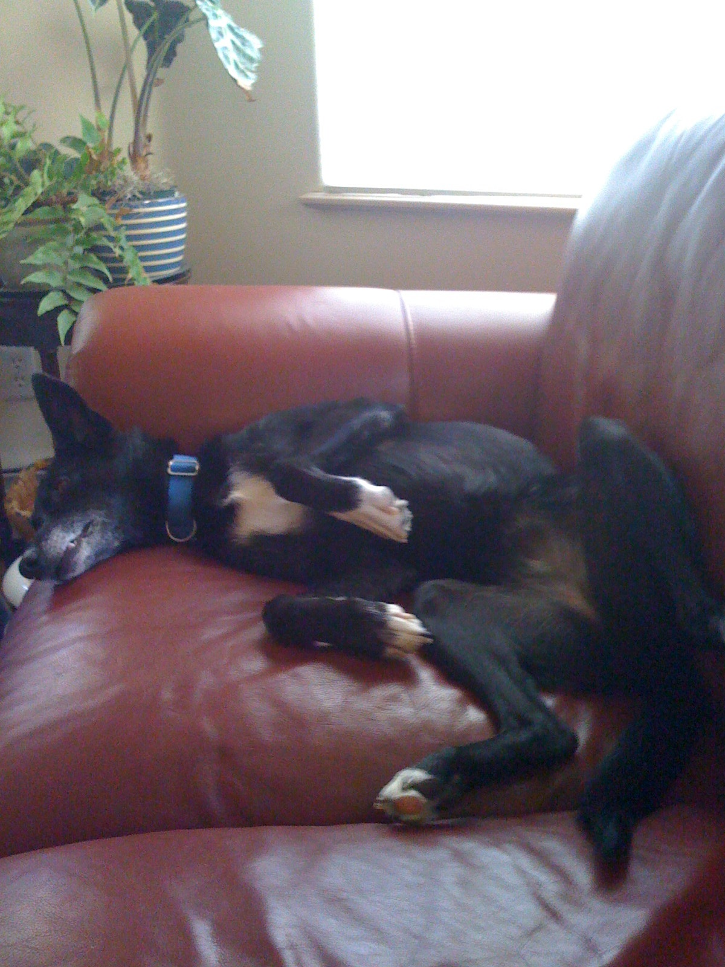
Don’t let anyone tell you what you can’t do…continued.

Slide 13
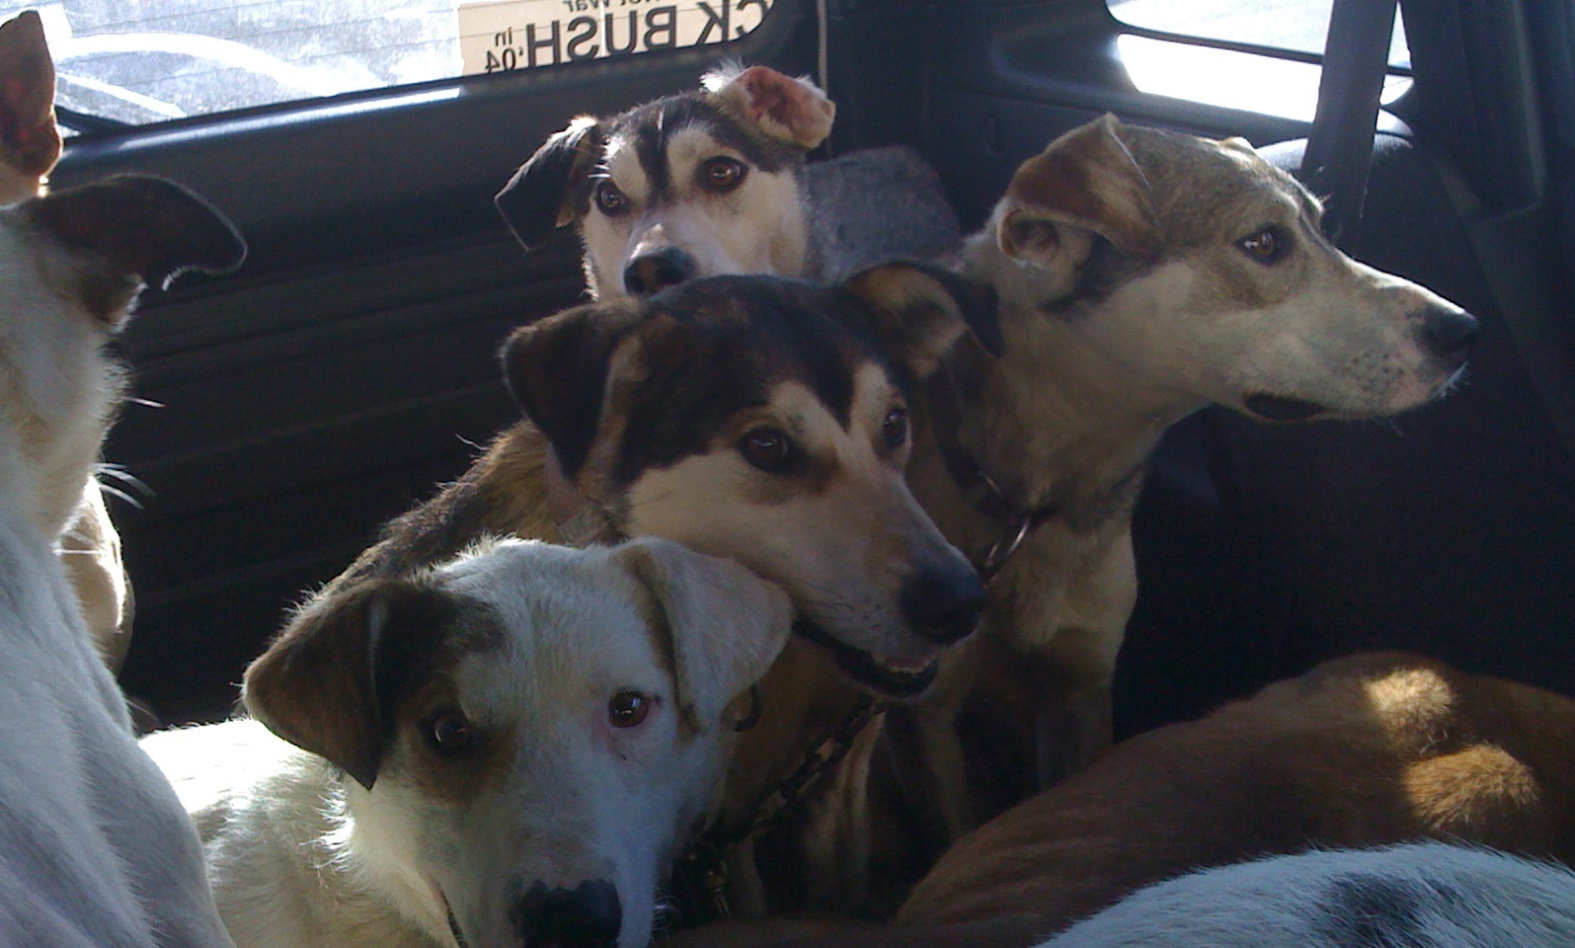
Do whatever you have to do to get where you’re going.

Slide 14

Enjoy the ride.

