Slide 1

Traffic Sign Detection and Recognition for Visually Impaired
Group members:
Sailee Kadam , Ketaki Kamble , Maithili Kharabe
Guide: Prof. Jyoti Madake
Vishwakarma Institute of Technology, Pune

Slide 2
Introduction
Literature Survey
Research Gap
Novelty
Methodology
Conclusion
Contents

Slide 3
INTRODUCTION:
2.2 Billion Visually Impaired People
As pedestrians in a big city, blind and impaired people face numerous challenges
Proposed a method for detecting and recognizing traffic signs on the road
Aims to Reduce the Walking Difficulty

Slide 4
Fused IR sensor and RGB sensors with voice guidance technology
Raspberry Pi and OCR for certain object detection in an environment
Advanced driver assistance systems (ADAS)
Smart cane with guaranteed beeps and vibrations
LITERATURE
SURVEY

Slide 5
Limited to certain range
Erroneous results in high light intensity
Research Gap
Non-portable & heavy systems
Expensive systems
Low Accuracy

Slide 6
Able to detect and recognize 3 different Traffic Sign
Real-time detection
Novelty
Cost Efficient
Portable and lightweight systems
Good Accuracy

Slide 7
METHODOLOGY

Slide 8
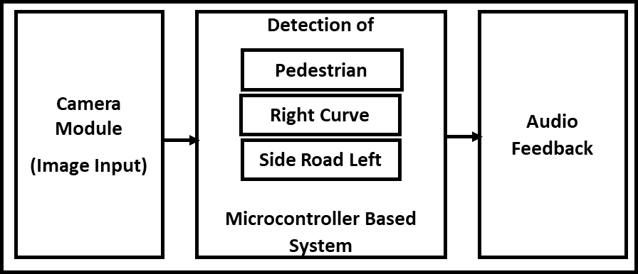
System Block Diagram

Slide 9
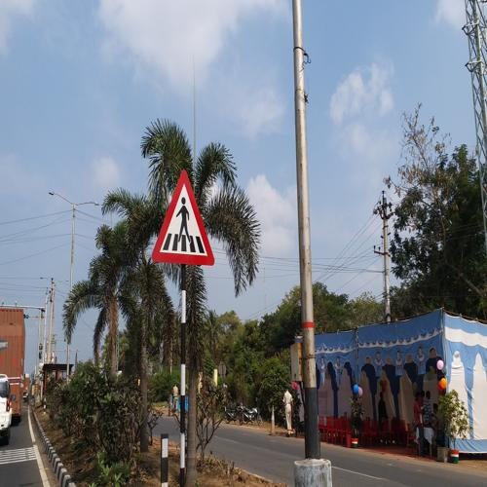
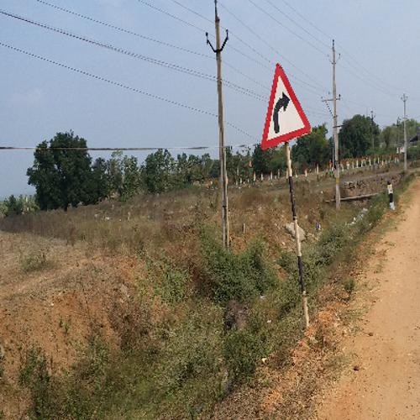
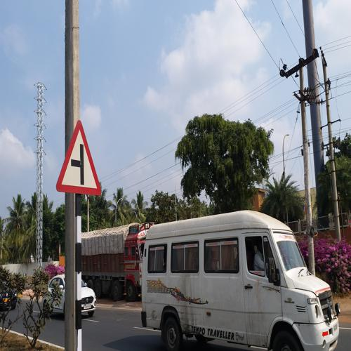
Dataset and Preprocessing:
Dataset consists of 18000 RGB images.
3000 - Side Road Left
3000 - Pedestrian
3000 - Right curve
9000 - Negative Images
Every image is resized to 180x230 pixels.
Images converted to grayscale

Slide 10
Feature extraction:
Scale Invariant Feature Transform(SIFT)
Extracts feature vector of N x 128 dimension.
Rotation and Scale Invariant
Robust to occlusion and clutter
Shape of feature vector from SIFT: 1480736x 128

Slide 11
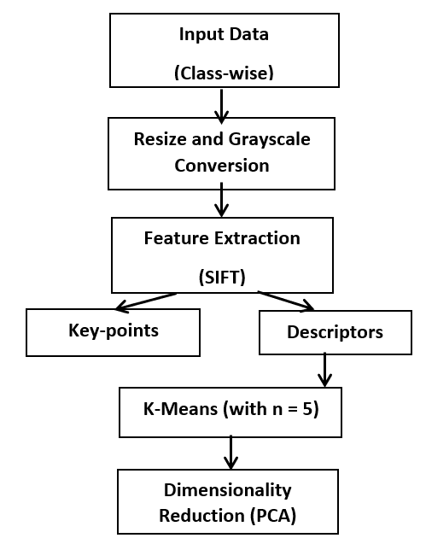
Dimensionality reduction process:
Using :
K Means
PCA

Slide 12
The algorithms are as follows:
Decision Tree
SVM
K Nearest Neighbor
Random Forest
Performance Metrics
Classification and Analysis:

Slide 13
Performance Metrics
Performance Metrics

Slide 14
Gives user understanding about the surrounding.
Can accurately classify the types of traffic signs.
System can also work efficiently at night.
Maximum accuracy: 78% to 79%
Lightweight, efficient and cost effective solution.
Conclusion

Slide 15
THANK YOU

