Slide 1

ATHAR أثر
Every camera tells a fragment. ATHAR tells the story.
Forensic multi-camera tracking & re-identification. Built in Egypt, for Egypt.
Abdelrahman Hamdi · Ali Ashraf · Mohamed Amar · Seif Tamer
Cairo University · Faculty of Engineering · Supervisor: Assoc. Prof. Ahmed Hamdi
Team CS140 · IEEE Made in Egypt · 20th Edition Finals · August 2026
Notes:
30s. Hook before the slide content: 'A suspect crosses the city. Two hundred cameras saw him. And nobody can follow him.' Then: we are ATHAR, the Arabic word for trace. We turn a city's cameras into one continuous memory. Introduce team quickly; supervisor; Cairo University.

Slide 2




THE PROBLEM
Finding one person in a city of cameras takes a week of human eyes.
Manual scrubbing, camera by camera
185 hours
One real serious-assault case burned 185 hours of officer time reviewing CCTV footage, for a single suspect.
One case, one suspect
Officer time on manual CCTV review in a documented assault investigation.
Cameras don't share identity
Every hand-off between cameras loses the target. Investigators get fragments, never the journey. Egypt's New Administrative Capital alone feeds 6,000+ cameras into one command centre.
6,000+
Slow answers cost cases
Cameras in the NAC alone
Kidnappings, thefts, hit-and-runs: the response window closes while footage is still being scrubbed.
Egypt's flagship smart city with one integrated command & control centre.
$1.2 B
Existing tools don't fit Egypt
Western analytics run $600–1,200 per camera with no Arabic and no local support; Chinese stacks raise data-sovereignty concerns for government use.
Egypt electronic-security market (2024)
Massive infrastructure spend, still reviewed by human eyes.
ATHAR · CS140
2
Notes:
90s. Make it human: one officer, one week, one suspect, and he is already gone. Key beats: 185 hours is a real documented case; identity dies at every camera boundary; Egypt is scaling cameras faster than anyone can watch them; imported tools are expensive, not Arabic, or not sovereign. Transition: 'What if the cameras could remember for us?'

Slide 3




THE SOLUTION
Upload the footage. Ask for the person. Get the journey.
1. Ingest
Why nothing else does this
Days of footage from any existing CCTV network, with zero new hardware.
People AND vehicles in one system; rivals track one or the other
Investigator confirms or rejects every match; only verified evidence enters the case
Hash-chained audit trail: every result traceable from video to model to report
Arabic-first interface, RTL from day one, built for Egyptian operations
Air-gap ready: zero cloud calls; data never leaves the premises
Weeks of scrubbing become minutes of search
2. Search
One photo or crop of a person or vehicle finds every appearance, on every camera.
3. Reconstruct
The full cross-camera journey assembled on a timeline and a map.
4. Export
A court-ready evidence report with a tamper-evident chain of custody.
ATHAR · CS140
3
Notes:
2min. Walk the four steps as a story: this is the investigator's day, compressed. Right column: differentiation. Emphasize the human-in-the-loop verification (no competitor has it) and Arabic + sovereignty. Do NOT go technical yet; the next slide proves it.

Slide 4
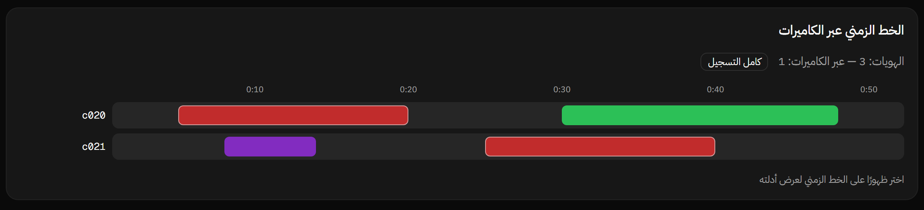
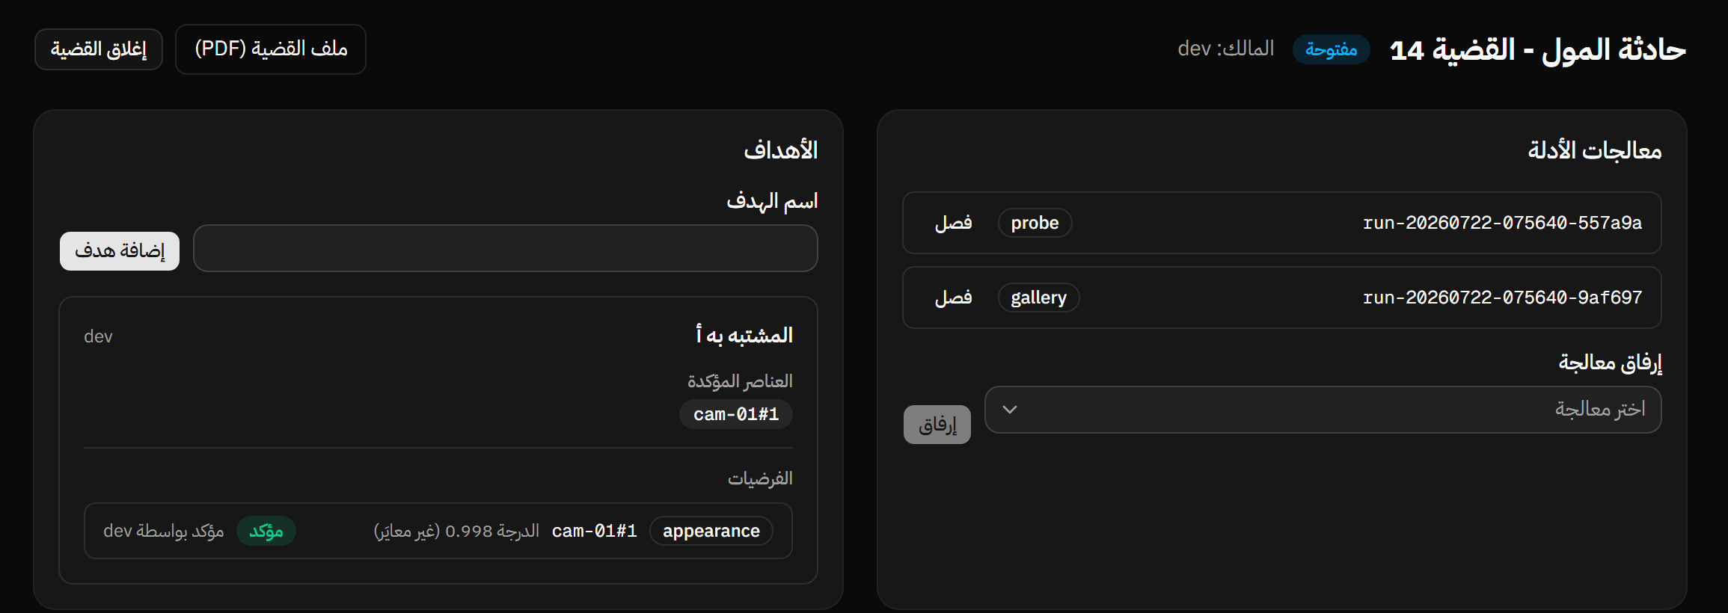


THE PRODUCT
A working product, not a paper pipeline.
The engine
Ingest & hash evidence
Detect + track per camera
Re-identify (AI ensemble)
Index & search (FAISS)
Associate across cameras
Case report & export
Chain of custody: evidence hash → frozen config → model hash → result
Air-gapped: runs fully offline on-premises; sovereign by design
Live app, Arabic RTL: cross-camera timeline (top) and the case workspace where an investigator confirms a match
YOLO26 · TransReID (ViT) + CLIP-SENet + DINOv2 ensemble · FAISS · FastAPI · Next.js
ATHAR · CS140
4
Notes:
2min. 'Everything on this slide is running today, offline, in Arabic.' Point at the timeline: identity spans across cameras. Point at the case workspace: the investigator confirming a 0.998 match. Then the engine column (six stages) and the custody chain: judges should hear 'court-ready', 'sovereign'. Tech chips at the bottom for the technical judges; expand only if asked.

Slide 5


PROOF
State of the art on world benchmarks, proven on Egyptian streets.
Vehicle re-identification · VeRi-776 (mAP %)
0.78
0.95
IDF1 · CityFlowV2
IDF1 · WILDTRACK people
City-scale vehicle tracking: within the published AI City range (0.70–0.84), offline validation protocol.
Multi-camera person tracking, MODA 0.90, near-perfect identity continuity.
Deployed on real Egyptian streets
14-camera live CCTV network in El Shorouk compound, Cairo. Ran on cameras it had never seen, with no retraining. Verified end-to-end on real footage.
And the engine keeps improving: our latest multi-domain model lifts accuracy by up to +38 points on unseen vehicle domains (+10 on city traffic). One model, every deployment.
ATHAR · CS140
5
Notes:
2min. The one-two punch: (1) we BEAT the previous best published result on VeRi-776, 93.3 vs 92.9 mAP: state of the art, (2) then we took it to a real 14-camera compound in El Shorouk and it worked on cameras it had never seen. Be precise if asked: CityFlow number is on the public validation split with offline post-processing; we say 'within the leaderboard range', never a rank. The +38/+10 gains: joint multi-domain retraining vs the single-domain baseline, evaluated deployment-mode.

Slide 6




MARKET OPPORTUNITY
Egypt is building the cameras. Nobody Egyptian is building the brain.
Egypt video-analytics software
Egypt CCTV market (USD M)
TAM · Total addressable market
$30–50M / yr by 2027
growing to $115–175M by 2033
SAM · Serviceable addressable market
$32–48M licenses
+ $6.4–9.6M/yr recurring · 80k gov & smart-city cameras by 2027
14.3% CAGR. MEA is the fastest-growing surveillance region globally ($6.7B, 12.2% CAGR)
SOM · Serviceable obtainable market
$12–25M over 5 years
60+ smart cities
6,000+ cameras
50–100k MoI cameras
Compounds & malls
10–20% share via pilots → governorates
planned under Egypt Vision 2030
NAC phase 1, one command centre
estimated installed base by 2027
private security boom nationwide
ATHAR · CS140
6
Notes:
1min. Big numbers fast, then the pivot line: 'every one of those cameras needs software, and today that software is imported.' If asked: TAM = everyone who could ever buy (all Egypt video-analytics software spend); SAM = the slice our product and channels can actually serve (government + smart-city cameras); SOM = the share we can realistically win in 5 years. Sources: Egypt CCTV market research 2024–2033, market study chapter of our published feasibility analysis.

Slide 7



COMPETITIVE LANDSCAPE
Global tools weren't built for Egypt. ATHAR was.
 | BriefCam / Milestone | Gorilla Tech | Intelion (ISID) | Hikvision / Dahua | ATHAR
Cross-camera Re-ID: people + vehicles | partial | people (body re-ID) | partial | limited | ✓ both
Investigator verification workflow | ✗ | ✗ | ✗ | ✗ | ✓ unique
Chain of custody / audit trail | ✓ | ✓ | ✓ | ✗ | ✓ hash-chained
Arabic UI + local support | ✗ | ✗ | ✗ | partial | ✓ native
Egyptian IP · data sovereignty | foreign vendor | foreign vendor | foreign vendor | ✗ gov concerns | ✓ 100% local
Est. price / camera (year 1) | $600–1,200 | quote-only | quote-only | $400–700 | $400–500
Person ↔ vehicle identity bridging
Human-in-the-loop verified evidence
Sovereign on-prem AI, Egyptian IP
No competitor combines all three, at 30–50% lower total cost of ownership.
ATHAR · CS140
7
Notes:
90s. Respect the competitors (BriefCam is excellent), then land the wedge: none were built for Egyptian operations. Three structural gaps nobody covers together: person-to-vehicle identity bridging, investigator verification, sovereign local AI. Fact base if challenged: pricing = published partner price lists and market estimates from our feasibility study; Gorilla and Intelion publish no pricing (quote-only, verified online). Intelion markets multi-camera tracking, so we grant 'partial'. Gorilla's re-ID is body (person) re-identification; no cross-entity person-to-vehicle. Rivals do offer on-prem installs; our sovereignty claim is about Egyptian IP, local support and air-gap BY DESIGN, not just an install option. Price row: we undercut Western tools 30-50% while beating Chinese stacks on sovereignty.

Slide 8







BUSINESS MODEL
License the platform. Grow with every camera.
Core platform license
Annual maintenance
Advanced analytics
Professional services
$400–500
$60–100
$80–120
15–20%
per camera, perpetual
per camera / year
per camera / year
of license revenue
Detection, tracking, cross-camera Re-ID, Arabic/English UI, evidence export.
Updates, support, model refreshes; 80% attach expected.
Video synopsis, path analysis, behaviour insights; optional subscription.
Integration, training, custom workflow configuration.
Who pays
Government & MoI
Smart-city & compound operators
Private security firms
via licensed system-integrator partners; CapEx procurement they already prefer
NUCA cities, gated communities, malls, clubs
guarding companies operating hundreds of sites
Software gross margin 50–70% · recurring layer compounds on every installed camera
ATHAR · CS140
8
Notes:
1min. One sentence per stream. The model matches how Egyptian government actually buys: perpetual license (CapEx) + maintenance. The recurring layer is the story for investors: every camera we license keeps paying. Private customers (compounds, malls, clubs, security firms) buy the same product direct.

Slide 9

GO-TO-MARKET
Private proves it. Partners scale it. Government buys it.
NOW → 6 MONTHS
6 → 18 MONTHS
18 MONTHS +
Beachhead: private, direct
Channel: government via integrators
Scale: smart cities & region
Gated compounds: El Shorouk deployment LIVE
Malls, sporting clubs, private-security firms
Short sales cycles → early revenue + references
Partner with licensed Egyptian SIs & defense contractors holding MoI / NUCA frameworks
They carry ATHAR into government tenders
ITIDA / TIEC programs de-risk certification
Smart-city integrations: New Administrative Capital, NUCA cities, New Alamein, The Spine (TMG's $27B cognitive city)
Governorate command centers via SI partners
MEA export: GCC smart-city programs
We don't knock on the Ministry's door alone. Proven integrator channels carry us in, while private sites pay the bills and battle-test the product.
ATHAR · CS140
9
Notes:
90s. The route is honest and staged: (1) private sites now; the Shorouk compound deployment already exists, and malls, clubs, guarding companies are reachable without tenders. (2) Government through the companies that already hold MoI frameworks; we are the AI inside their bids. MoI is a bridge, not the destination. (3) The destination is smart-city revenue: the NAC, NUCA's 14+ cities, New Alamein, and private cognitive cities like TMG's The Spine ($27B, Madinaty, Egypt's first cognitive city, no tender needed). Each phase funds the next.

Slide 10



IMPACT
Safer streets, faster justice, sovereign technology.
Safer cities
Faster justice
−55%
homicides in West Palm Beach after city-wide video analytics
185h → 15h
review time in a real assault case (Gorilla Tech)
−93%
cargo thefts in Tlaxcala, Mexico (multi-camera deployment)
24h → 15 min
of key evidence, Green Bay PD (BriefCam)
30–40%
crime-reduction potential (Deloitte smart-cities study)
10×
faster investigations (industry benchmark)
Economic return
Sovereign & sustainable
85%+
of video-analytics deployments reach full ROI within one year (Omdia survey, 140 organizations)
100%
local data: zero foreign dependency, Egyptian IP
$11M
community savings over 2 years in West Palm Beach
Zero
new hardware; runs on the cameras Egypt already owns
30–50%
lower monitoring staffing cost, 24/7 coverage kept
2030
aligned with Egypt Vision digital-transformation goals
Case-study figures from documented deployments of this technology class (Omdia/BriefCam, Milestone, Gorilla, Deloitte, OJP); sources on file.
ATHAR · CS140
10
Notes:
1min. Frame honestly: 'this is what happens when a city turns this class of technology on': cited third-party deployments, not our claims. The ROI stat: Omdia (independent research firm) surveyed 140 end-user organizations for BriefCam; 85%+ reached full ROI within one year, 95% in banking. Close on sovereignty: crime down, cases faster, money saved, with Egyptian technology, on Egyptian servers, running on cameras Egypt already owns.

Slide 11
FINANCIAL PROJECTIONS
Break-even inside year one. $13.6M cumulative revenue by year five.
Five-year projection (USD M)
$650k
Initial capital required
Month 9–12
Break-even point
$7.7M
5-year net profit (pre-tax)
~12×
Return on initial capital
Assumptions: $500 avg license/camera · 2,000 → 15,000 cumulative cameras by Y5 · 80% maintenance attach · 30% analytics attach by Y3 · gross margin 50–70%
ATHAR · CS140
11
Notes:
1min. Point at two things only: break-even in the first year (the first governorate-scale deployment pays back the capital), and the cumulative curve: $7.7M net over five years on $650k in. Don't read every number; the assumptions line answers questions.

Slide 12

TEAM & NEXT STEPS
The team that built it, and what happens next.
Abdelrahman Hamdi
Ali Ashraf
Mohamed Amar
Seif Tamer
Data & ingestion
Detection & tracking
Re-ID, search & indexing
Association & platform
Supervised by Assoc. Prof. Ahmed Hamdi · Cairo University, Faculty of Engineering · Team CS140
Next 12 months
The ask
1
Three paid private pilots: compound (live today), a mall, a club or security firm
Pilot introductions: smart-city & compound operators, malls, clubs, security firms
System integrators serving MoI: we power your next bid
Incubation & seed backing (ITIDA · TIEC · accelerators) to certify, harden, deploy
2
Sign 1–2 system-integrator partnerships carrying ATHAR into government tenders
3
First smart-city revenue: integrate with the New Administrative Capital, a NUCA city, or New Alamein, turning pilots into recurring per-camera income
The cameras are already watching. ATHAR makes them remember.
ATHAR · CS140
12
Notes:
45s. Team + roles in 15 seconds. Milestones: pilots, channel partners, first smart-city revenue. If asked about strategy: our goal is revenue, not government contracts for their own sake; MoI is a bridge that gets us integrated into smart cities like the NAC, NUCA cities, New Alamein, or The Spine. The ask: introductions (operators, malls, clubs, security firms, SIs serving MoI) + incubation/seed. End on the close line, pause, then: 'Thank you, we're ready for your questions.'

