Slide 1
Prescription Interface Program(PIP) 처방전 인터페이스 프로그램
KNU SCSE & JVM SW개발팀
메이하오란(Haoran Mei)

Slide 2

Background
목적: 이 처방전 인터페이스 프로그램(PIP using WPF)는 처방의료인이 전자 처방전을 말들 수 있는 서비스를 제공하는 프로그램입니다.

Slide 3
Background
Project Manager : Michael
Software Developer : Haoran Mei
User : Prescribing doctor
PC System Environment: Windows 7
Network Center: None
Development Tools: Microsoft Visual Studio 2013, Github
Development Language: C#
Framework: .net 4.5, WPF, Entity Framework 6.0

Slide 4
Outline
Local disk
Database
XML file
Tables
PIP
Prescription work
Real world
User : Prescribing doctor

Slide 5
Function Requirement
Prescribing doctor should be able to view a prescription record information.
PIP should be able to create a prescription report using WPF ReportViewer.
PIP should be able to load prescription files from local disk.
PIP should be able to connect to the database server.
PIP should be able to load data from the database.
PIP should be able to manage data in database.(insert/update/delete)
PIP should be able to show a user the prescription files list.

Slide 6
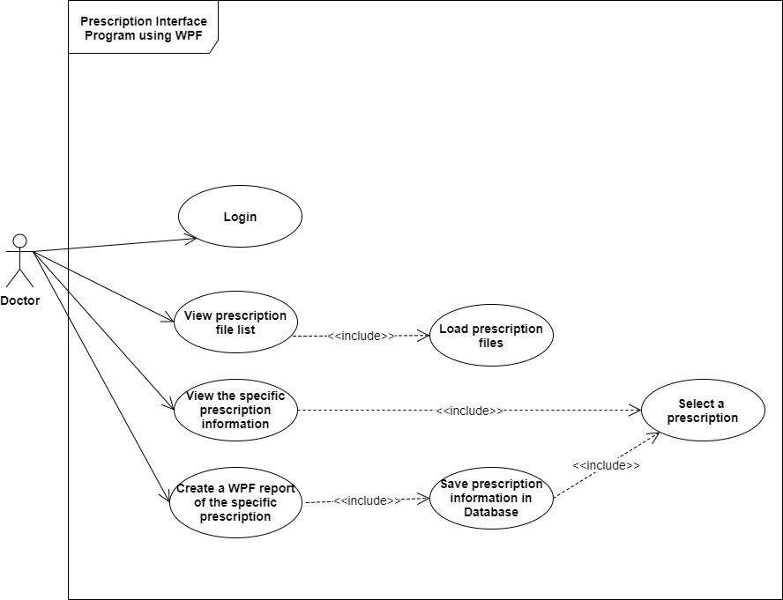
User Requirement ---- Use Case

Slide 7
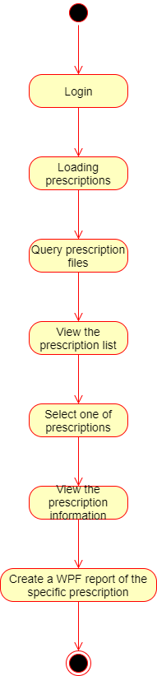
Activity Diagram

Slide 8
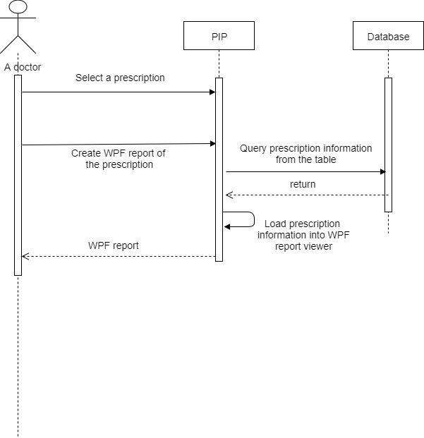
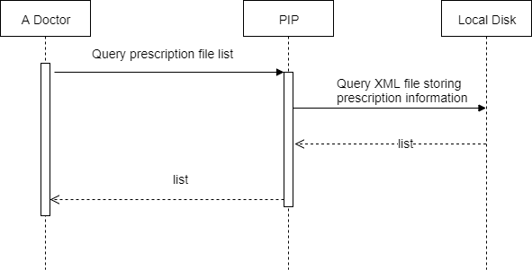
Sequence Diagram
[Create WPF report]
Load prescription files

Slide 9
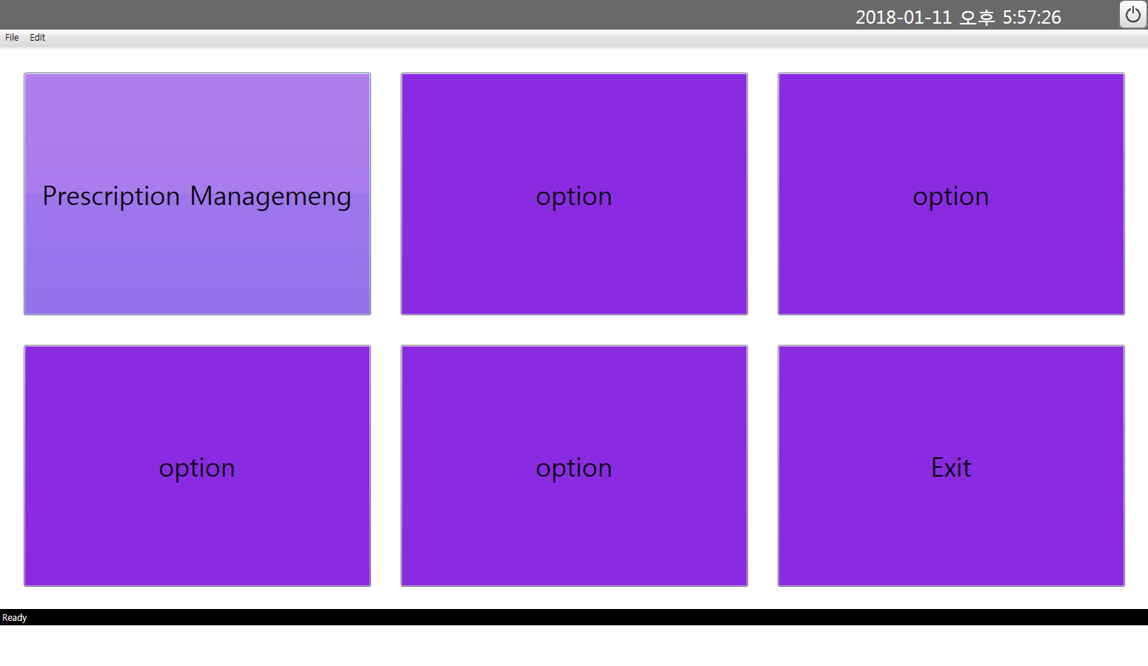
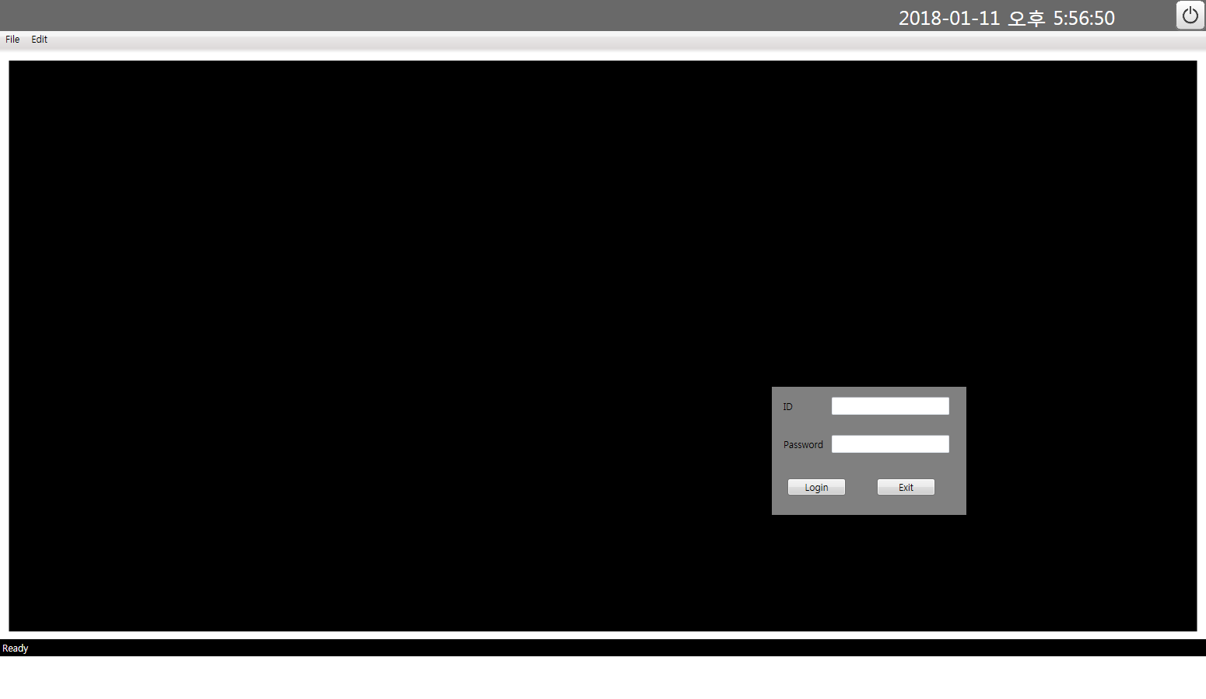

GUI[Login]

Slide 10
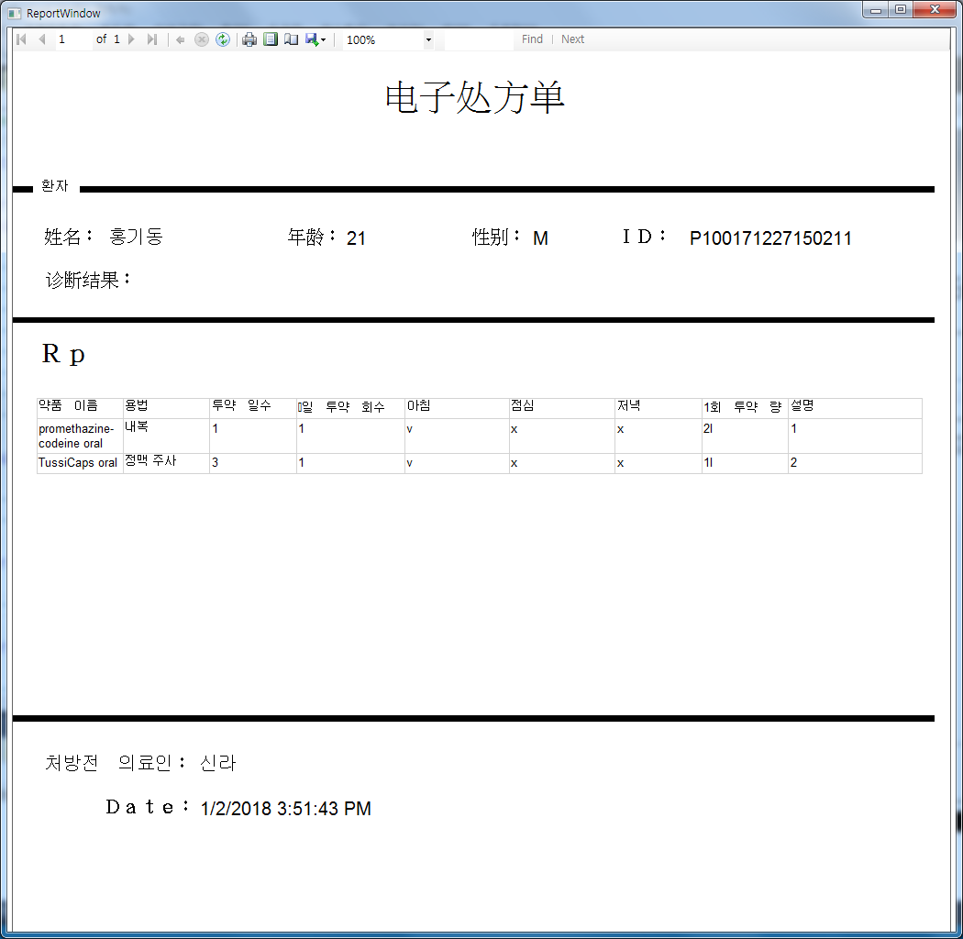
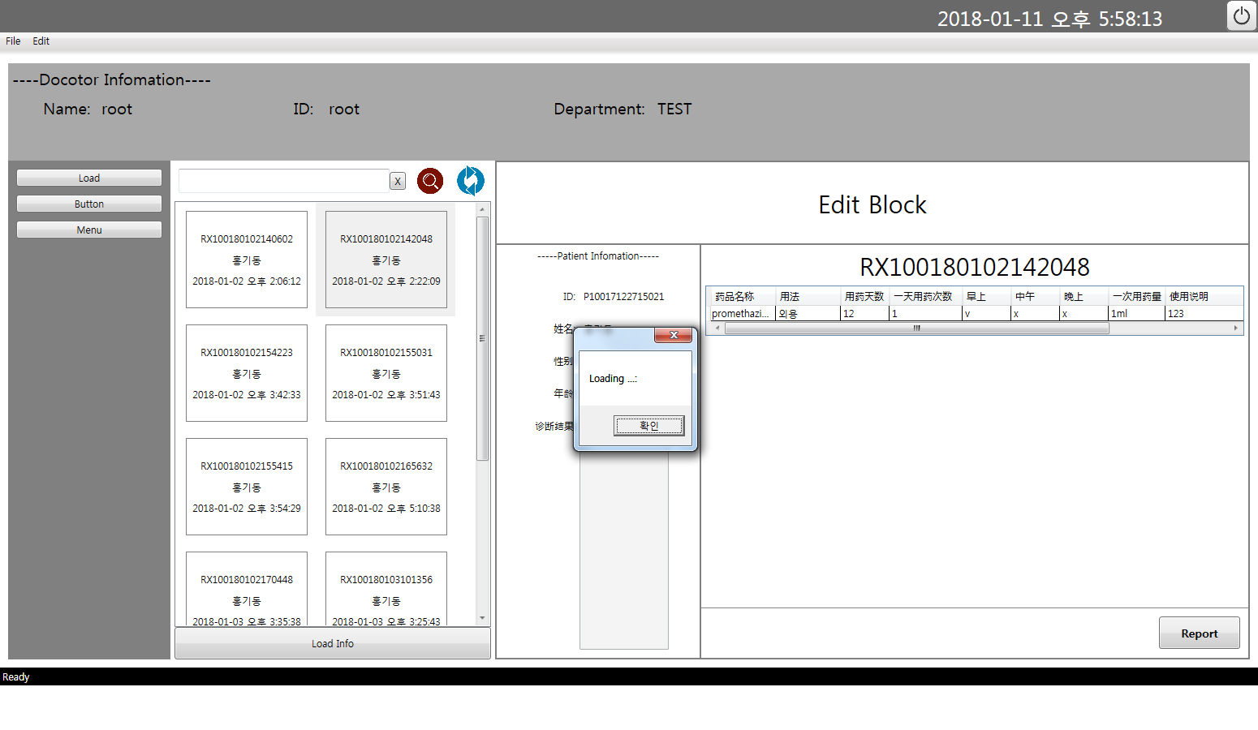
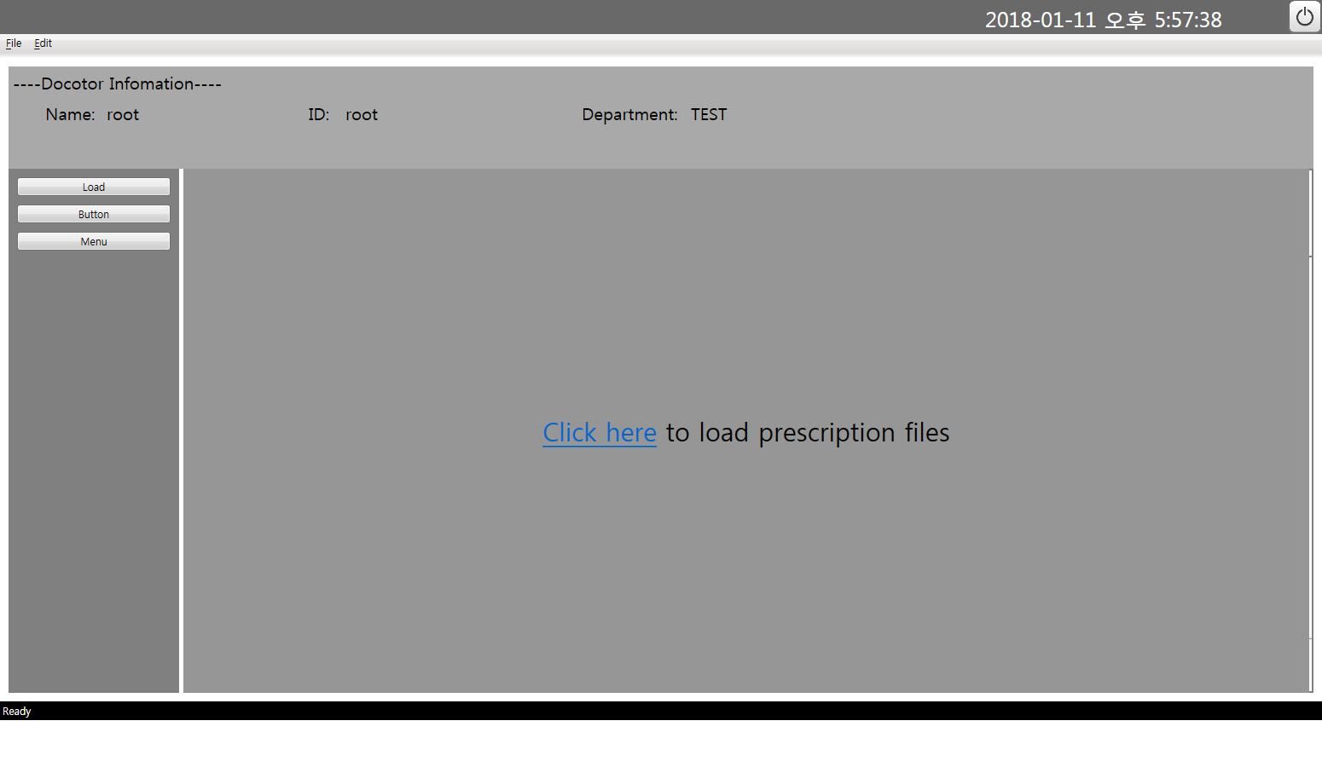
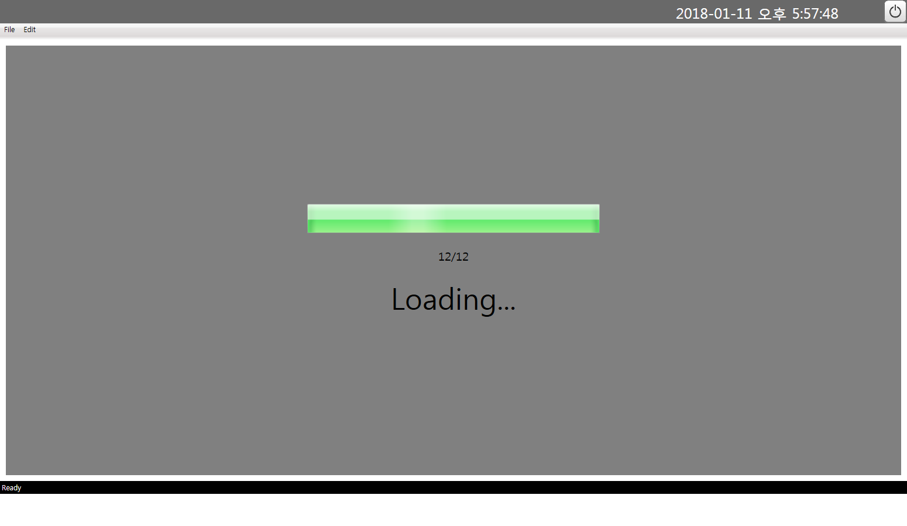
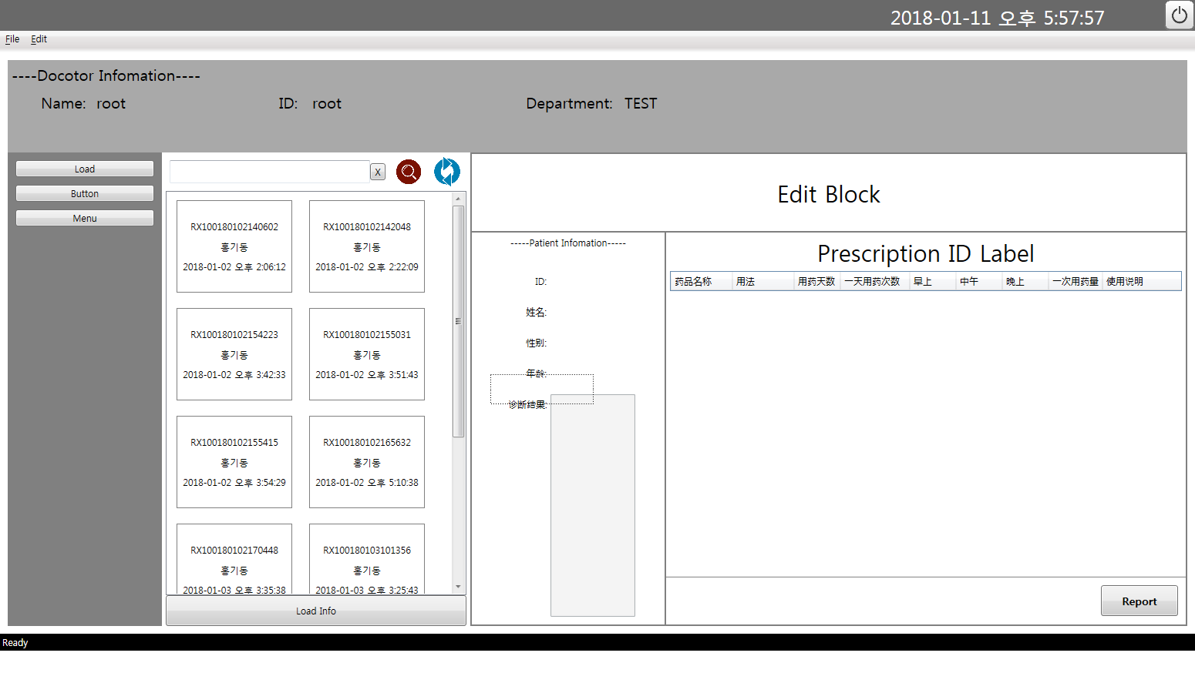
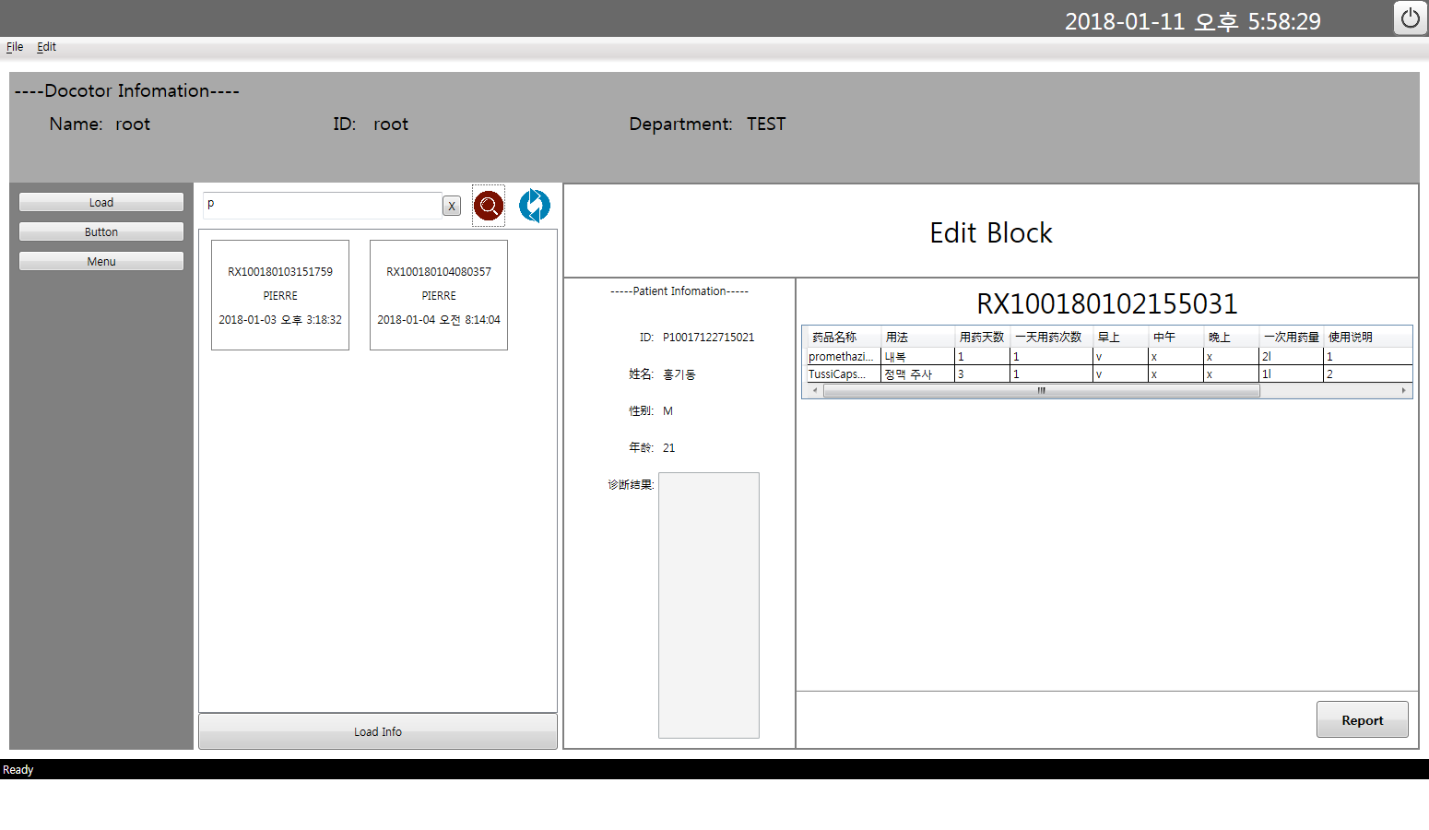
GUI[Prescription Management]

Slide 11
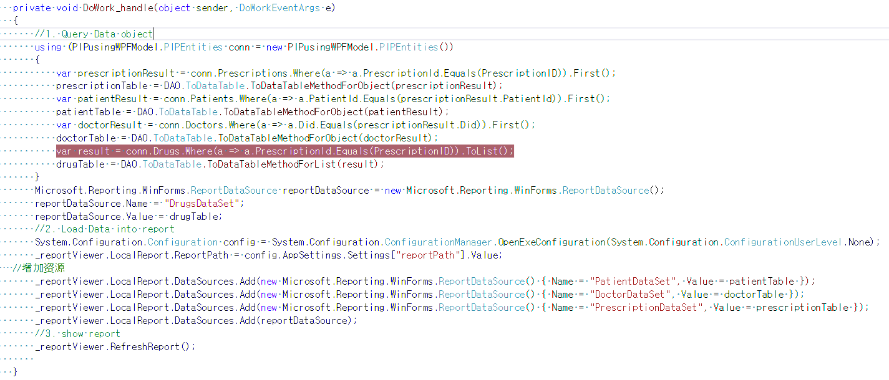
Code source[Create Report Viewer]
Set Data Source

Slide 12
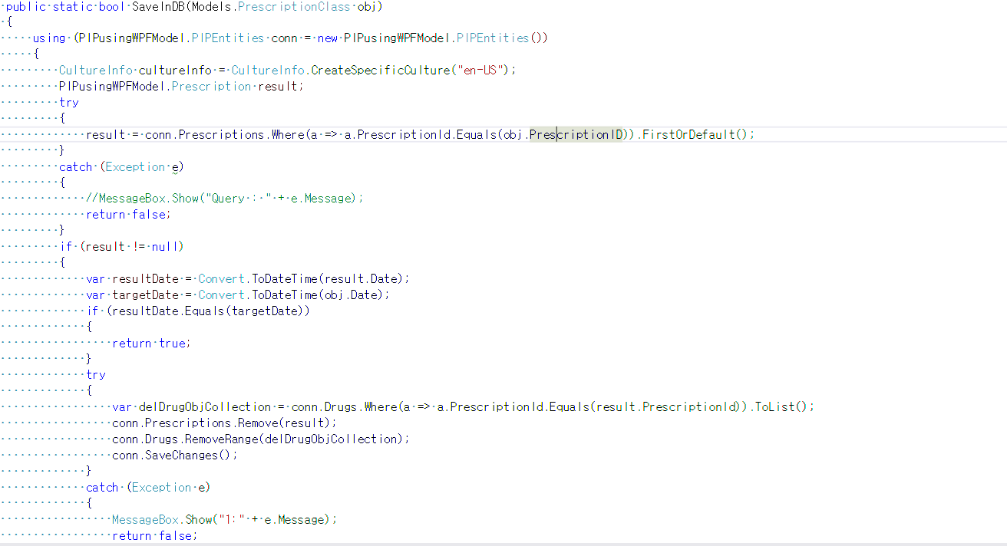
Code source[DB management]
Save

Slide 13
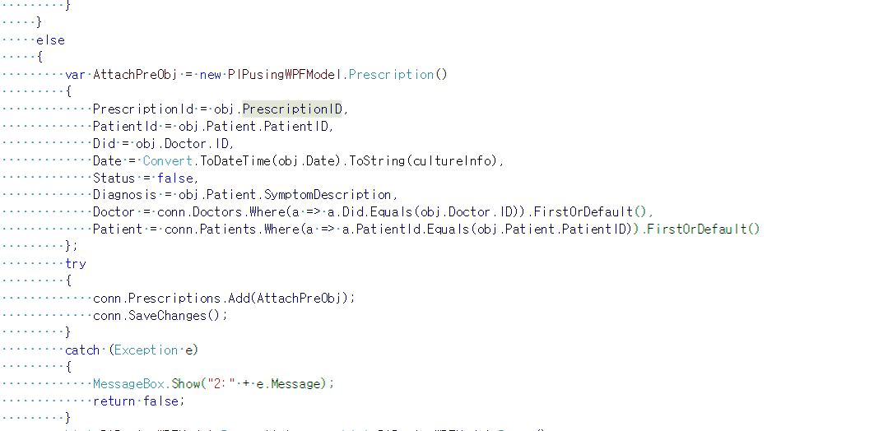
Code source[DB management]
Save

Slide 14
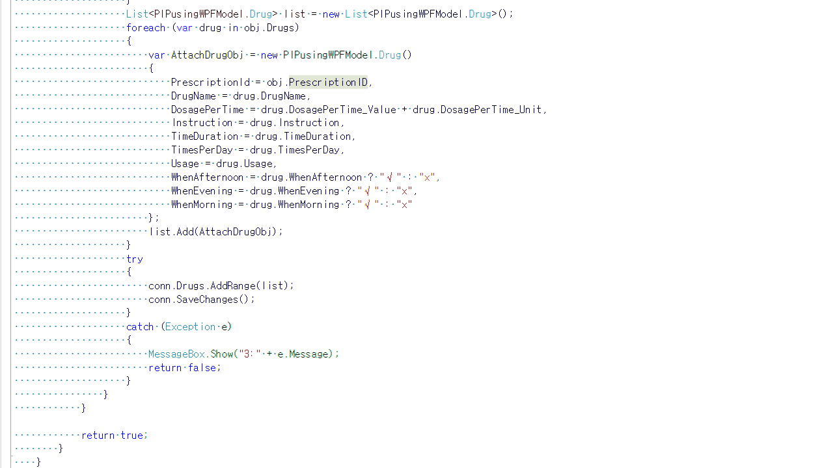
Code source[DB management]
Save

Slide 15
Test Report[Function Testing]

Slide 16
Test Report[GUI Testing]

Slide 17
Test Report[Testing]

Slide 18
The First Time
현장 실습, 한국 주식 회사
C# language ➔ Delegate, Linq + Lambda
WPF, Entity Framework ➔ WPF: 쉽게 GUI 구성할 수 있음 ; EF: 쉽게 Database를 연결할 수 있음

Slide 19
전
후
Project를 완성하기 위해서만
재이용할 수 있도록

Slide 20


Slide 21


