Slide 1
The Memory Game
Lakshmi Manohar M | FSJ0420A109

Slide 2
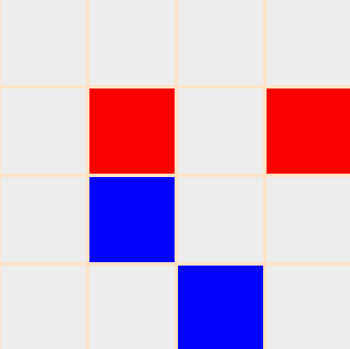
About The Project
The Memory Game is game that requires players to match similar color. As the color implies, participants need to find a match for an same color.

Slide 3
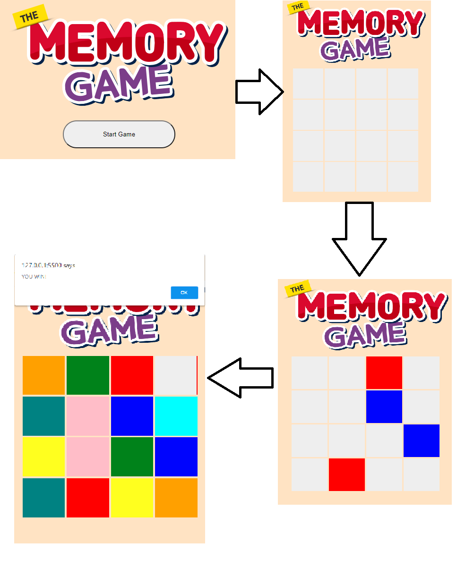
The Project

Slide 4
Concepts Used To Implement This Project
HTML DOM concept
Logical Operators
Operators in javascript
Conditional Operators
Iteration Methods

Slide 5
The Challenges Faced
01
02
03
Challenge 1
Here challenge 1 is how to hide the original colour.
Challenge 2
Here challenge 2 is comparing previous colour and present colour. If previous colour and present colour same then these two colours to be displayed. If not these two colours going to be hide.
If all colours were displayed then you will win.
Challenge 3
Here challenge 3, If you win the game then I’ve to exchange places of each colour and new game to be start.

Slide 6

Thank You

