Slide 1
All About My Project Idea
LAKSHMI MANOHAR M | FSJ0420A109

Slide 2
Lakshmi Narasimha Swami
Dying Monitoring

Slide 3
What’s The Project All About?
In Admin prospective
Creating a accounts for admin, receiving orders and generating bill for their orders.
Checking orders day to day
Managing workers
In Customers prospective
Creating account
Generating orders
Requesting bills

Slide 4
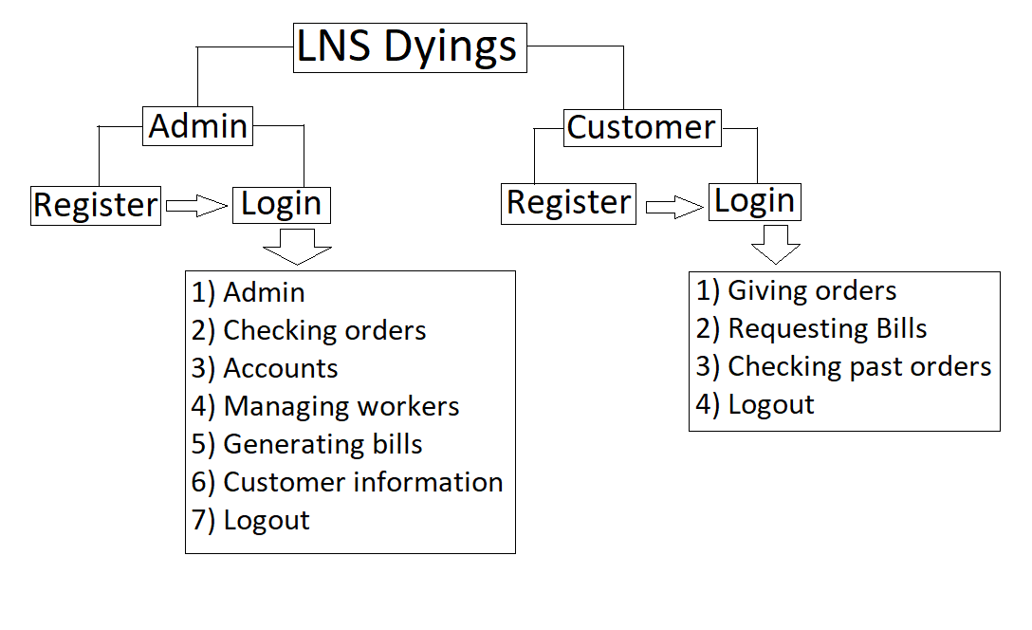

Slide 5
Implementation Modules
Module | Concept used to implement the module | Module Finish Date
Login/Sign Up | Encapsulation | Tuesday (20/07/2020) by 4:00 PM
Add & delete columns as per your requirement.

Slide 6

Thank You

