Slide 1




DATA ANALYTICS
INFO-8066-23F-SEC3
Project name: Spotify streamed song analysis

Slide 2

TEAM MEMBERS
Arunbalaji Selvamohan - 8858565
Adaobi Egwuagu - 8899054
Balaji Rangaraj - 8928828
Prince Abrokwa - 8906050
Samuel Jebasingh Dhanasingh - 8829870
Subramaniam Mahadevan - 8858816
Suyash Srivastav - 8841216

Slide 3
PROJECT ROADMAP
CRISP-DM Framework
Data preparation
Summary
This explains the project framework that helps to collect, understand, organize, manipulate, visualize, and model the Spotify data
This explains the step-by-step procedure for collecting, and cleaning the dataset for further analysis
This summarizes the project analysis and its key takeaways
2
4
6
1
3
5
Project Introduction
Business & data understanding
Data modeling
This gives brief overview of the project.
This includes the following processes
Data manipulation
Data visualization
Prescriptive Analysis
This provides the insights about the business and its relevant data which are helpful for proceeding with the data analysis and modeling

Slide 4
PROJECT
INTRODUCTION
Music is the soundtrack of our lives, and today, we're going to dive into the beats and rhythms that have dominated the global stage on Spotify.
This project helps us to analyze the top most streaming songs in the year 2023
This project illustrates the trends, patterns, and relationship between the viral songs and it’s attributes
Have you ever wondered what makes a song go viral and top on every playlists and charts in Spotify ? We’ll see it later!

Slide 5








CRISP-DM FRAMEWORK
Business
Understanding
Data
Understanding
Deployment
Data
Data
Preparation
Evaluation
Modeling

Slide 6
BUSINESS UNDERSTANDING
Knowing a business domain before analyzing its data will give a clear understanding about the its market, trends, and its Unique Selling Point.
Spotify, a music streaming platform, allows the users to access the music contents of different music artists.
This works with a freemium model, which allows users to have a limited version of its service for free and with some additional features like ad-free listening in its premium version.

Slide 7

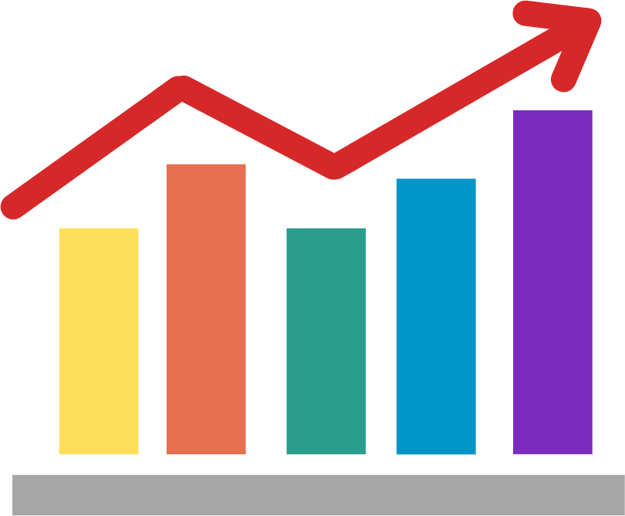

DATA UNDERSTANDING
This phase includes the understandings and explanations that can be acquired from Spotify, which includes the data collection.
The data could be related to the track name, its featuring artist, date/month/year of release, and various attributes related to the song’s musical technicalities.
This phase helps the analyst understand the type of the data, its relationship with other data, and its frequency distribution between a range.
Through this understanding, the analyst can proceed further with data manipulation like sorting, filtering, grouping, visualizing, and forecasting them to find meaningful insights

Slide 8
DATA COLLECTION
Data collection is a first step to understand the data. This includes finding the relevant information from the reliable source.
We have used KAGGLE.COM as a source for acquiring the relevant data for Spotify songs analysis.
Source URL: https://www.kaggle.com/datasets/nelgiriyewithana/top-spotify-songs-2023/data
After data collection, the Spotify data will be analyzed for data cleaning, which will be done in data preparation phase.
01 - BRANDING
02 - WEBSITE
03 - SOCIAL MEDIA

Slide 9
DATA PREPARATION
Data preparation includes cleaning, standardizing, organizing, and manipulating like sorting, filtering, grouping, and ranking the dataset, which would make it feasible to visualize, and model the data.
Cleaning the data includes identifying the errors, handling the missing data, dropping duplicates, removing unwanted information, converting the datatypes, and renaming inconsistent data.
Data standardization includes standardizing the data values. Example: instead of “Male“, ”Female”, this can be standardized to ‘M’,’F’ respectively.

Slide 10
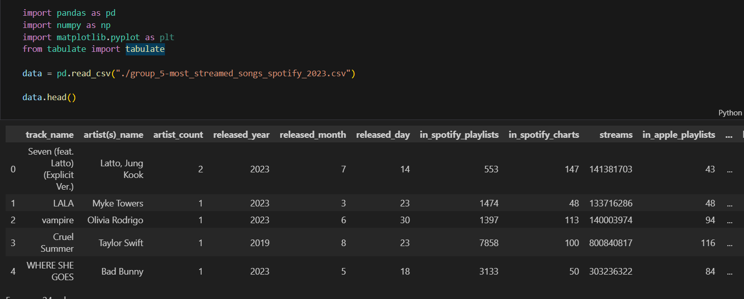
DATA CLEANING
Data cleaning is done by using Pandas and Numpy libraries from Python.
This includes the renaming the column names, handling the missing values by replacing them with its mean value, removing special characters from the column data, converting the incorrect datatype, and dropping duplicates.
Reading the file

Slide 11
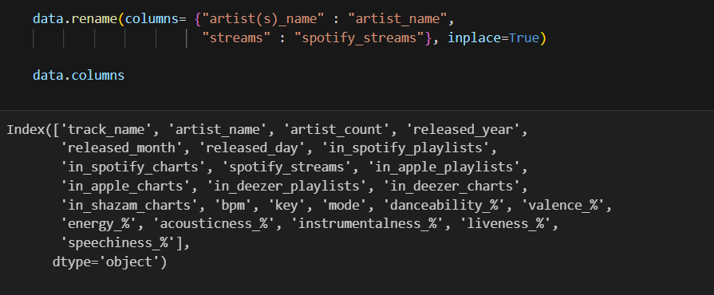
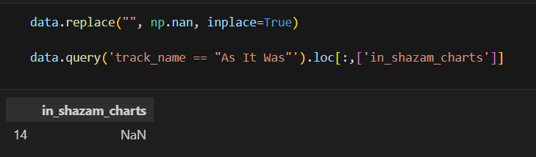
Renaming the column names
Handling the missing data

Slide 12
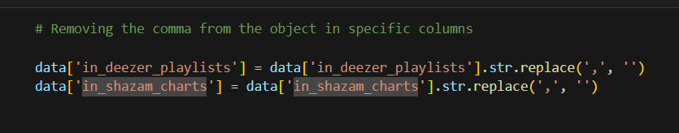
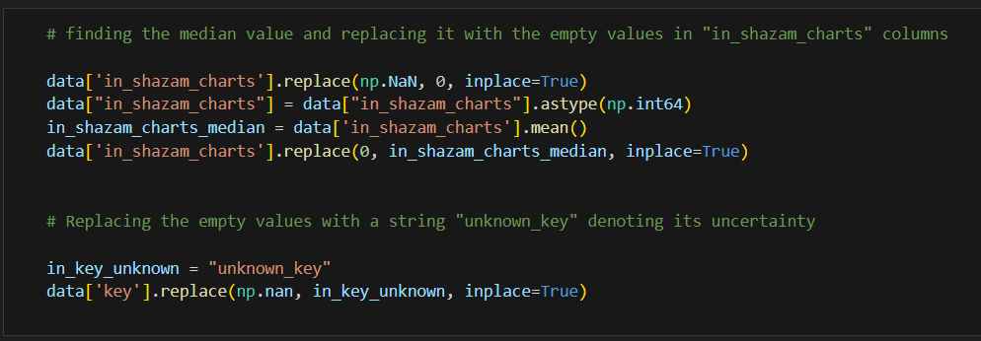
Removing the special characters

Slide 13
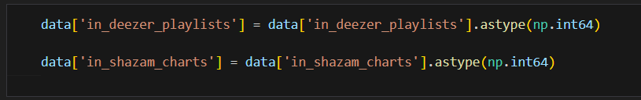

Converting the incorrect datatype
Dropping duplicates

Slide 14
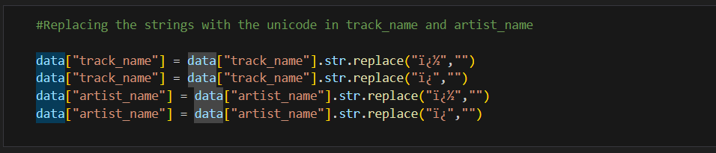
DATA STANDARDIZATION
Data standardization includes processing the data by converting its structure, removing unwanted strings, replacing shorthand expression for large data values
Removing unwanted substring

Slide 15
DATA
MODELING
Data modeling is a process of analyzing the collected data, its patterns, and relationships between other data to produce meaningful insights.
This project consists of three phases in data modeling
Data manipulation
Data visualization
Analyzing data through prescriptive analysis
By applying these techniques, analysts can find a logical findings from the data, which could lead them to forecast the business future.

Slide 16
DATA MANIPULATION
Data manipulation includes finding the descriptive statistics for the quantitative data, analyzing and finding patterns, relationship, and associations between two or more relevant column data by grouping them, measuring the data's location and variability, and analyzing it's distribution.
By manipulating data, it will produce meaningful insights.
In this Spotify data, we have taken various column values, manipulated it into a piece of meaningful information.
We found the mean, and the median value for the Spotify streams, sorted the artists by the Spotify streams, and calculated the total number of artists in this Spotify dataset

Slide 17
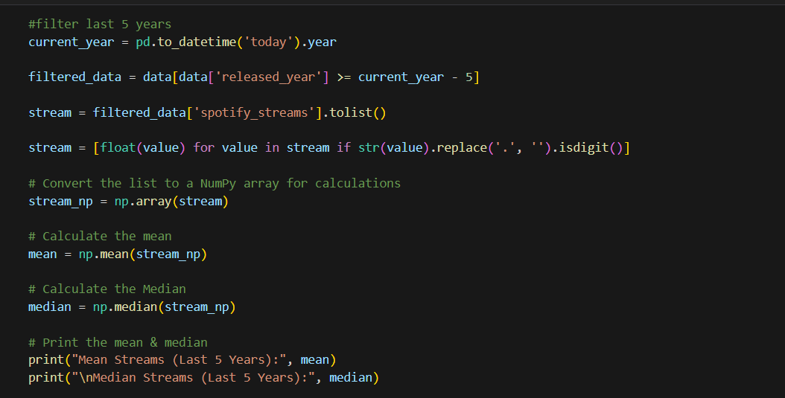
DATA MANIPULATION

Slide 18
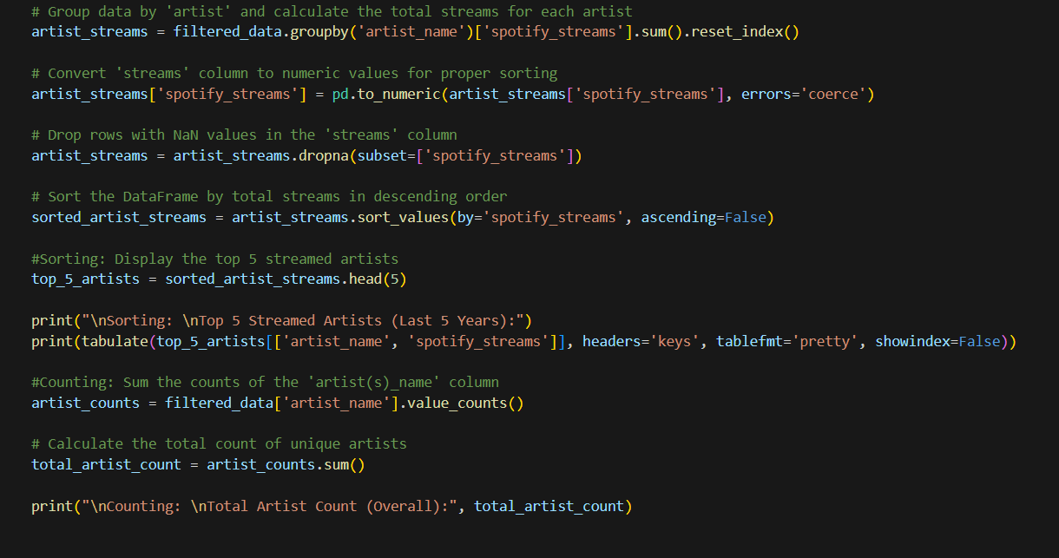
DATA MANIPULATION

Slide 19
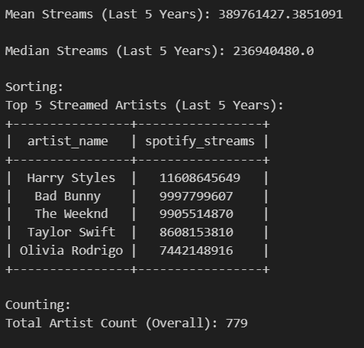
DATA MANIPULATION
The mean stream value of approximately 389,761,427 over the last five years suggests that, on average, a song or artist in the dataset has been streamed around 389 million times.
The median stream value of 236,940,480 over the last five years indicates that the middle song or artist in the dataset when arranged by stream counts, has been streamed approximately 237 million times.
The Top 5 Streamed Artists represent many streams for these top artists, emphasizing their popularity over the last five years and their contribution value to the music industry.
The Total Artist Count of 779 represents the total number of artists taken for analysis and their data.

Slide 20
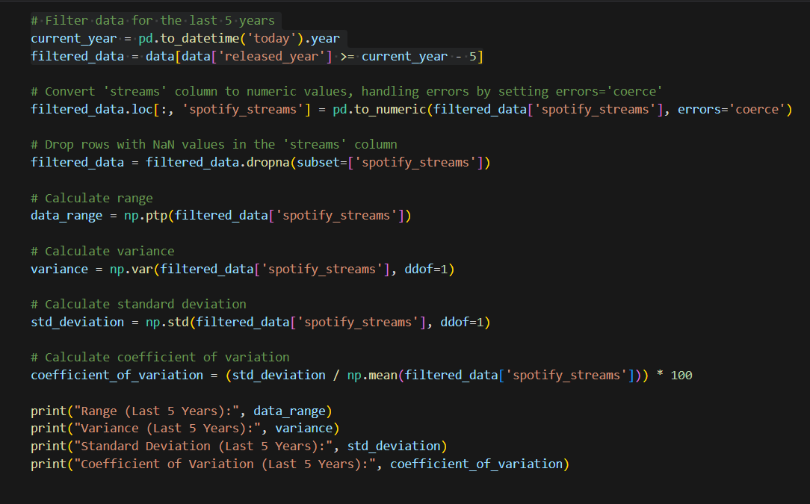
DATA MANIPULATION

Slide 21

DATA MANIPULATION
The Range of 3.7 Billion streams represents the difference between the dataset's highest and lowest stream counts. In this case, it’s 3.7 billion streams, indicating the spread or variability of stream count.
The Variance measures how spread out the stream counts are from the mean. In this case, it’s 203 trillion streams squared to provide overall variability of the stream counts.
The Amount of dispersion was 450 million streams. This case provides the typical amount by which individual streams can deviate from the mean.
COV is 115.62%, suggesting that the variability in stream counts is relatively high compared to the mean.
This enables the business to get the consolidated results for having the information in hand.
Through this manipulation of the data, we found the actionable insightful results which can be used for data visualization in the later part.

Slide 22
DATA VISUALIZATION
Data visualization represents the data in a graphical or visual formats which could help the decision makers to find the insights effectively.
This provides clarity and simplifies the data into a graphical representation.
This helps the analysts create dashboards out of charts and graphs which could empower them to find the outliers, explore the hidden insights, and identify anomalies, if any.
There are different types of visualization available., such as bar chart, line chart, scatter plot, box plot, pie charts, heatmap, etc..

Slide 23
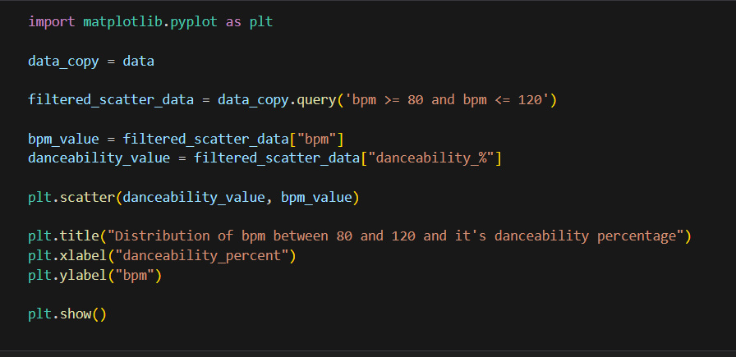
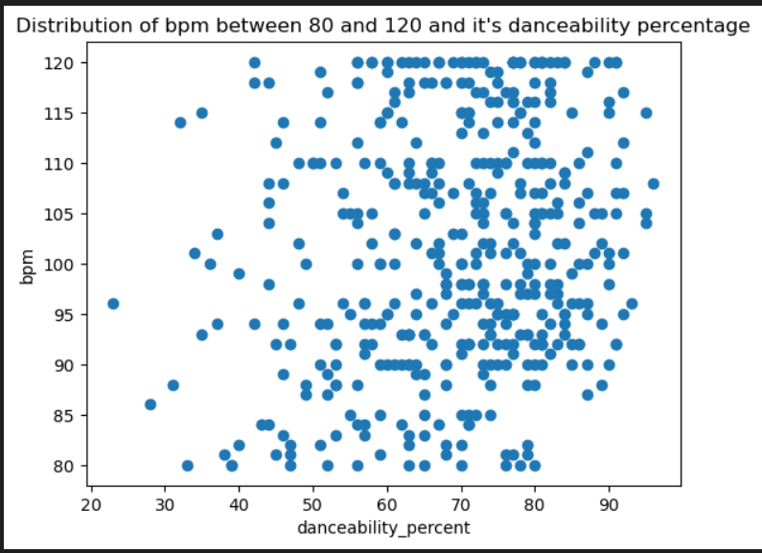
Scatter plot
Scatter plot is a two-dimensional graph that visualize the two variable data in both x axis and y axis.

Slide 24
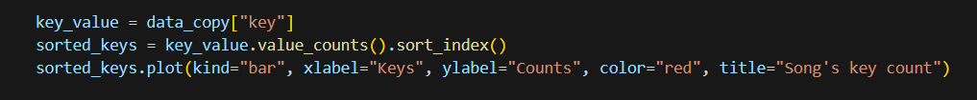
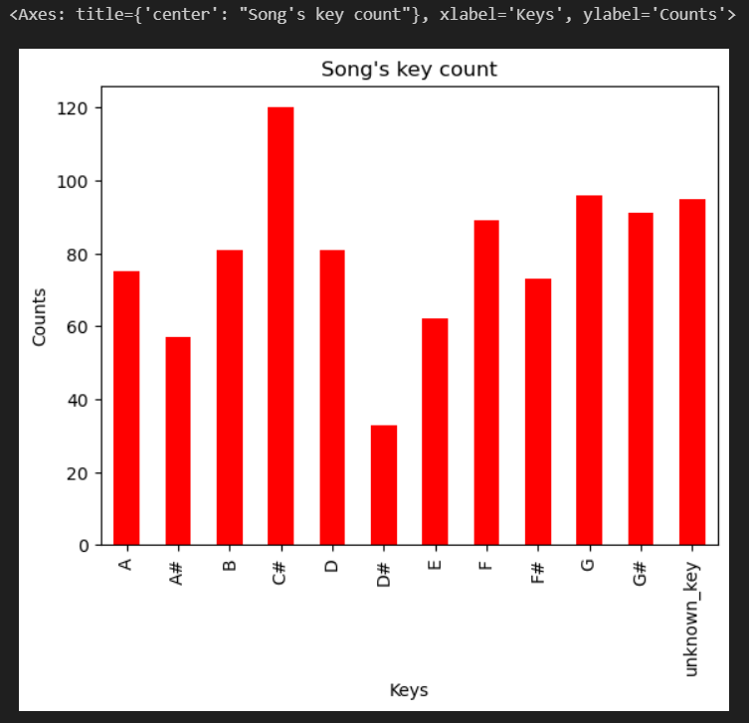
Bar chart
Bar charts are the graphical representation in which the rectangular bars illustrates the quantity of the analyzing data.

Slide 25
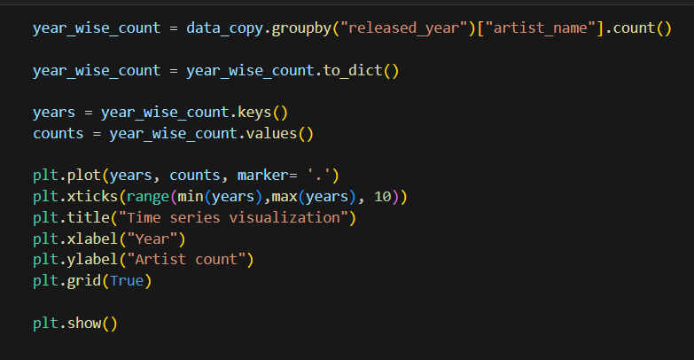
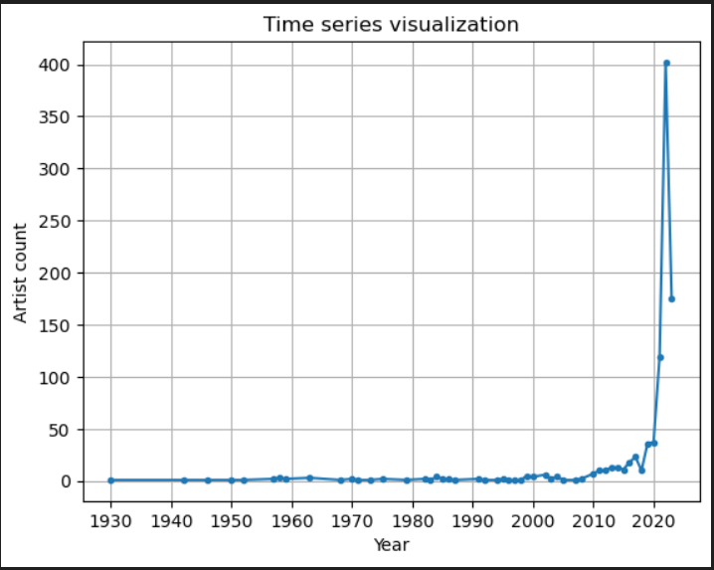
Line chart
Line charts are illustrated by connecting the datapoints in a line that helps us to find the trends of the analyzing data.

Slide 26
PRESCRIPTIVE ANALYTICS
Prescriptive analysis is the advanced level of data analysis that can be used to forecast / suggests the desirable actions to be taken for achieving a desired outcome.
What-if the analysis is a type of Excel functions that helps in the following ways.,
Creating Scenarios: What-If Planning scenarios benefits from analysis. By changing factors, users may generate scenarios, grasp possible consequences, and judge based on various circumstances.
Optimization: It finds the optimum collection of input values that result in the intended output, which helps to optimize decision variables.
Allocation of Resources: In order to optimize productivity and save expenses, organizations can utilize What-If Analysis to ascertain the best place to put personnel, assets, and money.

Slide 27
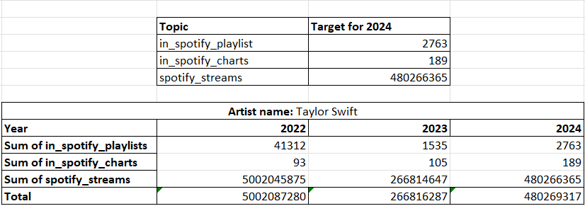
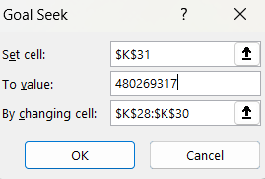
Goal Seek
Goal Seek function helps users determine the input value required to reach a certain objective or outcome. Until the intended result is achieved, the input is adjusted repeatedly.

Slide 28
Goal Seek
In this goal seek, the objective is to seek goal of 80% for the year 2024, more than the total of previous year's Spotify streams, playlists, and charts for the year 2024.
We have set up the targets, and through the Excel’s goal seek functionality, we will set the cell, add the target value in the “to Value” cell, and mention the changing cells.
This could forecast the target value by changing the values in the selected cells.

Slide 29
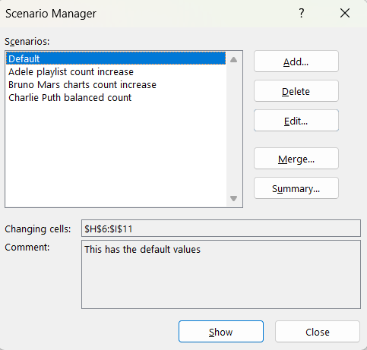
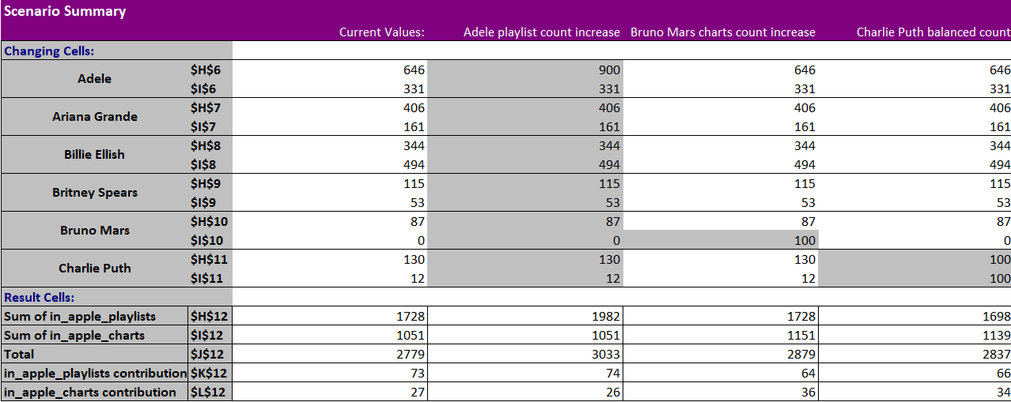
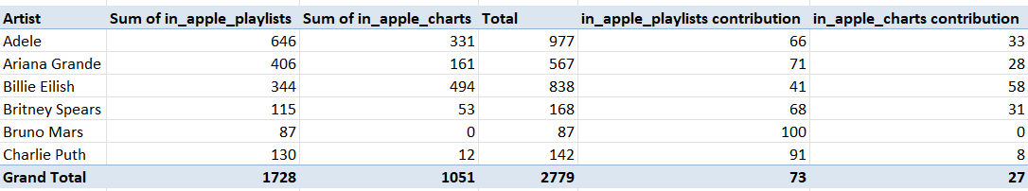
Scenario Manager
Scenario Manager function lets users generate and evaluate many scenarios by altering different input variables. It aids in determining how different input combinations affect the result in the end.

Slide 30
Scenario Manager
In this analysis, different scenarios are created by changing the values in the data.
We have taken the total sum of in-apple playlists and charts and the percentage contribution of in-apple playlists and charts.
By changing the values of sum of in-apple playlists and sum of in-apple charts, we have created different scenarios for the various top artists from the dataset

Slide 31

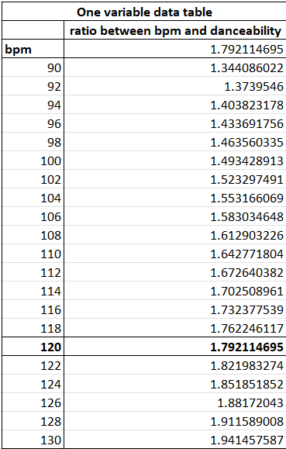
Data Table (One variable)
A data table is a grid that shows the outcomes of one or two input values by adjusting several input values. It offers a rapid method for examining various input combinations and the accompanying outputs that result from them

Slide 32
Data Table (One variable)
In this analysis, ratio between bpm and danceability is calculated by the mean of danceability and bpm value.
By calculating the one variable data table, we can find the ratio between bpm and danceability mean for various bpm counts.
This analysis will be used for defining the ratio by knowing the bpm and danceability mean, which can help the music analysts to create the playlists according to this ratio calculation.

Slide 33
SUMMARY REPORT
Spotify, a music streaming platform, allows the users to access the music contents of different music artists.
Data collection is a first step to understand the data. This includes finding the relevant information from the reliable source.
Data manipulation includes finding the descriptive statistics for the quantitative data, analyzing and finding patterns, relationship, and associations between two or more relevant column data.
Prescriptive analysis is the advanced level of data analysis that can be used to forecast / suggests the desirable actions to be taken for achieving a desired outcome.

Slide 34
THANK YOU!

