Slide 1

Mtech Internal Presentation on Dynamic Load Balancing Mechanism Using AI-Driven predictive scaling(SCOM)
Presented By :- under the guidance of :-
Manas Roy EXTERNAL GUIDE
(202327006) Mr.Prakash Kumar
( Technical Manager- Linde,Kolkata)
INTERNAL REVIEWER
Mrs. Chitrapriya Ningthoujam
( Assistant Professor(SG),CSE Department,SMIT)

Slide 2

Contents -
ABSTRACT:
This project presents a novel dynamic load balancing mechanism, referred to as SCOM, designed to enhance the scalability and efficiency of distributed computing environments. SCOM utilizes the Long Short-Term Memory (LSTM) neural network model to accurately predict future workload demands by analyzing historical system performance data. By leveraging the predictive strengths of LSTM, the mechanism is capable of identifying complex temporal dependencies and patterns in workload fluctuations that traditional methods often overlook. The proposed approach enables SCOM to proactively initiate scaling actions—such as resource allocation or deallocation—based on anticipated changes in demand. This proactive strategy minimizes the risks of both resource overload and underutilization, ensuring that computational resources are optimally distributed across the system. As a result, SCOM contributes to improved Quality of Service (QoS) by reducing latency, preventing bottlenecks, and maintaining system stability even under varying workloads. To evaluate the effectiveness of the SCOM mechanism, extensive simulations and real-world experiments were conducted. The results demonstrate that SCOM, with its LSTM-based predictive scaling, significantly outperforms conventional reactive and rule-based load balancing approaches. Key performance metrics, including load balancing efficiency, resource utilization, and overall system throughput, show marked improvements, highlighting the potential of machine learning-driven strategies in modern distributed systems.

Slide 3
ABSTRACT:
This project presents a novel dynamic load balancing mechanism, referred to as SCOM, designed to enhance the scalability and efficiency of distributed computing environments. SCOM utilizes the Long Short-Term Memory (LSTM) neural network model to accurately predict future workload demands by analyzing historical system performance data. By leveraging the predictive strengths of LSTM, the mechanism is capable of identifying complex temporal dependencies and patterns in workload fluctuations that traditional methods often overlook. The proposed approach enables SCOM to proactively initiate scaling actions—such as resource allocation or deallocation—based on anticipated changes in demand. This proactive strategy minimizes the risks of both resource overload and underutilization, ensuring that computational resources are optimally distributed across the system. As a result, SCOM contributes to improved Quality of Service (QoS) by reducing latency, preventing bottlenecks, and maintaining system stability even under varying workloads. To evaluate the effectiveness of the SCOM mechanism, extensive simulations and real-world experiments were conducted. The results demonstrate that SCOM, with its LSTM-based predictive scaling, significantly outperforms conventional reactive and rule-based load balancing approaches. Key performance metrics, including load balancing efficiency, resource utilization, and overall system throughput, show marked improvements, highlighting the potential of machine learning-driven strategies in modern distributed systems.
RESULTS AND ANALYSIS:
RESULTS AND ANALYSIS
FIG -7. 1 LSTM LATENCY PREDICTION PERFORMANCE ANALYSIS
This graph shows a comparison between actual network latency measurements (blue solid line) and LSTM model predictions (red dashed line) over approximately 100 time steps during a training phase.
Key Observations:
Original Latency (Blue Line):
Shows highly volatile, spiky behavior with extreme fluctuations
Values range dramatically from around -8 to +9 units
Contains frequent sharp peaks and deep valleys
Exhibits very irregular, unpredictable patterns
LSTM Predictions (Red Dashed Line):
Much smoother and more stable than the original data
Stays within a narrower range (roughly -3 to +3)
Follows general trends but with significantly dampened volatility
Shows the model is learning some underlying patterns but struggling with extreme variations Model Performance Analysis: The LSTM appears to be having difficulty capturing the full volatility of the latency data. This is common in time series prediction when dealing with highly erratic data because:
Smoothing Effect: LSTMs tend to produce smoother predictions than highly volatile input data
Training Challenge: The extreme spikes may be treated as noise rather than signal
Underfitting: The model may need more complexity or different architecture to capture such irregular patterns
This suggests the network latency has very unpredictable characteristics that are challenging for standard LSTM models to accurately forecast, which is typical for real-world network performance data influenced by various external factors.
FIG 7.2 -ACTUAL VS PREDICTED LATENCY
Think of this like predicting the weather, but for internet speed:
The Blue Line (Actual Latency): This is what really happened - like checking the actual temperature every hour. It's very jumpy and unpredictable, going up and down wildly. This represents how fast or slow your internet connection was at different times.
The Orange Line (Predicted Latency): This is what the computer's "brain" (AI model) thought would happen - like a weather forecast. Notice how it's much smoother and doesn't have those crazy spikes.
What's happening?
The computer is trying to learn patterns from past internet speeds to predict future ones
But internet speed is really hard to predict! It jumps around a lot due to network traffic, server issues, etc.
The AI does okay at following the general trend (when it goes up or down overall)
But it completely misses those sudden spikes - like missing that it might suddenly storm when you predicted sunny weather
The bottom line: The AI is learning, but internet latency is just too wild and unpredictable for it to get exactly right. It's like trying to predict exactly when someone will sneeze - you might notice they're getting a cold, but the exact timing is nearly impossible to nail down. This is totally normal when dealing with network data - it's one of the trickiest things to predict accurately.
FIG 7.3 -IMPACT OF LSTM-BASED LOAD BALANCING ON SERVER LOAD
This chart demonstrates the effectiveness of LSTM-based load balancing implementation across five major technology organizations, comparing server load distribution before and after the predictive system deployment.
7.3.1 Pre-Implementation Load Analysis
Before LSTM implementation, the organizations exhibited significant load imbalances and suboptimal resource utilization. Rockwell Automation experienced the highest server load at 93%, indicating potential performance bottlenecks and resource strain. Honeywell followed closely at 89% utilization, while Linde operated at 80% capacity. These elevated load levels suggest systems operating near or beyond optimal efficiency thresholds. Siemens maintained a more moderate 70% load, and Microsoft demonstrated the most balanced pre-implementation performance at 65% utilization, indicating existing load management capabilities within their infrastructure.
7.3.2 Post-Implementation Performance Improvements
Following LSTM-based load balancing deployment, all organizations achieved remarkable load optimization and standardization. The system successfully normalized load distribution across all five organizations to approximately 59-62% utilization, representing a significant convergence toward optimal operating parameters. Rockwell Automation realized the most substantial improvement, with load reduction from 93% to 59%, representing a 37% decrease in server strain. Honeywell achieved similar benefits with load dropping from 89% to 62%, a 30% improvement. These dramatic reductions indicate the LSTM system's ability to predict and redistribute load before bottlenecks occur.
7.3.3 System Optimization Results
The LSTM implementation demonstrates consistent performance gains across diverse organizational infrastructures. Linde's load decreased from 80% to 60%, while Siemens improved from 70% to 61%. Even Microsoft, which showed relatively balanced pre-implementation performance, benefited from optimization, reducing from 65% to 58% utilization.
7.6.4 Operational Impact Assessment
The standardized post-implementation load levels around 60% represent optimal operating efficiency, providing adequate performance headroom while maximizing resource utilization. This consistent target across all organizations suggests the LSTM system applies sophisticated algorithms that account for different infrastructure configurations and workload patterns. The uniform load distribution indicates successful elimination of server hotspots and improved overall system reliability. Organizations can now expect more predictable performance, reduced risk of system failures, and enhanced capacity for handling unexpected load spikes through the maintained performance buffer.
7.6.5 FINAL CALCULATION -
The average percentage reduction:
Average Percentage Reduction = (25%+31.11%+12.86%+36.84%+10.77%)/5 Average Percentage
Reduction = 116.58%/5 Average Percentage Reduction =23.32%.

Slide 4
INTRODUCTION:
INTRODUCTION
INTRODUCTION
1.1 LSTM –BASED LOAD BALANCING IN DISTRIBUTED SYSTEMS
In today’s digital era, most organizations rely heavily on distributed computing systems to support their online services, data processing, and real-time applications. These systems are designed to handle enormous amounts of data and serve millions of users. However, one of the biggest challenges in such environments is managing how workload or traffic is distributed across various resources—commonly referred to as load balancing.
Traditionally, load balancing has been handled through static rules or reactive strategies. These methods either rely on predefined thresholds or respond only after an imbalance or issue (like overload or underutilization) is detected. While this may work under stable and predictable workloads, it often proves inefficient in modern systems where workload patterns change frequently and unpredictably. For example, a sudden spike in user requests—like during a sale on an e-commerce platform—can overwhelm servers if the system isn’t prepared in advance. This leads to slower response times, poor user experience, and sometimes even service outages.
To tackle this issue, the field has seen a shift toward intelligent, data-driven solutions that not only respond to changes but also predict them before they happen. This is where Artificial Intelligence (AI), particularly deep learning, comes into play. AI can analyze past patterns of system behavior and learn to recognize signs of upcoming changes. Among the various deep learning models available, Long Short-Term Memory (LSTM) networks stand out as especially useful for load balancing in distributed systems.
LSTM is a special type of Recurrent Neural Network (RNN) that is particularly good at understanding patterns in time-series data—like how system loads change over time. Unlike traditional models, which may only consider current or recent data, LSTM can remember long-term trends and sequences, making it far more effective at predicting future workloads. For example, if there is a pattern where user activity increases every Monday morning, the LSTM model can learn and predict this in advance, allowing the system to prepare for the expected increase.
By integrating LSTM models into the load balancing mechanism, systems become proactive rather than reactive. They don’t just react to high loads; they anticipate them. When a spike in workload is predicted, the system can automatically allocate more computing resources—such as additional virtual machines, increased memory, or CPU power—before the spike actually hits. On the other hand, if a drop in demand is expected, resources can be scaled down to save energy and cost.
This proactive approach brings many benefits:
•Reduced latency: Users experience faster response times because the system is already scaled appropriately.
•Improved resource utilization: Resources aren’t sitting idle during low usage, nor are they overwhelmed during peaks.
•Increased system stability: Sudden surges don’t crash the system because it’s prepared.
•Better Quality of Service (QoS): Overall, users enjoy smoother, more reliable service.
•Scalability and efficiency: The system can handle growth without needing constant manual tuning.
Another significant advantage of using LSTM models is that they continuously learn and adapt. As the system evolves and new usage patterns emerge, the model adjusts its understanding accordingly. This makes it more robust in the face of change, unlike traditional methods that rely on hard-coded rules which may quickly become outdated.
In conclusion, the combination of LSTM neural networks with load balancing mechanisms represents a major leap forward for managing distributed systems. Instead of simply dividing work evenly or following fixed policies, the system can now think ahead, predict what's coming, and make smart decisions in real-time. This intelligent, learning-based approach leads to more efficient operations, reduced costs, and better user experiences making it a key innovation for the future of cloud and distributed computing.
1.2 TECHNICAL TOOLS USED IN SCOM LOAD BALANCING
Network Load Balancing (NLB)
Network Load Balancing is a critical component in distributing client requests and agent-to-server communications across multiple Management Servers. NLB ensures uninterrupted operations by automatically redirecting traffic to an available server in the event of a server failure. This enhances the resilience and fault tolerance of the SCOM infrastructure.
IIS (Internet Information Services) Load Balancing
IIS can host multiple instances of the SCOM Web Console, enabling better scalability and availability. Load-balancing mechanisms for IIS distribute user requests across these instances, ensuring a consistent and responsive user experience. This is particularly beneficial during periods of high demand.
SQL Server Load Balancing
The Always On feature in SQL Server provides high availability and disaster recovery for SCOM databases. It synchronizes database replicas and makes them readily available in case of a failover scenario. This ensures uninterrupted database operations, which are crucial for SCOM monitoring and reporting.
Azure Load Balancer
Azure Load Balancer can be used to manage traffic distribution between on-premises SCOM servers and cloud-based resources. This hybrid approach is ideal for organizations using a mix of on-premises and cloud environments, ensuring balanced workloads and seamless integration between the two.
Windows Network Load Balancing (NLB)
Windows NLB can distribute loads among multiple SCOM Web Console servers or Management Servers. By evenly distributing the traffic, it prevents server overloads and improves the performance and scalability of the SCOM infrastructure.
Application Performance Monitoring (APM)
SCOM's Application Performance Monitoring capabilities are leveraged for load balancing in scenarios where application dependencies and services in cloud environments are being monitored. By ensuring the efficient distribution of monitoring workloads, APM enhances the performance and reliability of applications under observation.
LIMITATIONS:
:
LIMITATIONS
10. LIMITATIONS
10.1 Technical and Operational Constraints
The primary technical limitation lies in prediction accuracy challenges. Machine learning models often struggle with unpredictable traffic spikes and anomalous patterns that weren't present in their training data. For example, a system trained on regular usage patterns may fail to predict sudden viral events or flash sales. Additionally, cold start problems occur when new applications lack sufficient historical data, creating a situation where accurate predictions are impossible until adequate data is collected. Model drift presents another significant challenge as user behaviour and system architectures evolve over time. The AI models require continuous retraining to remain effective, adding computational overhead that can introduce latency in critical scaling decisions. This creates a fundamental trade-off between prediction sophistication and system responsiveness. From an operational perspective, resource management becomes increasingly complex. Organizations must balance between over-provisioning resources based on conservative predictions, which increases costs, and under-provisioning that leads to service degradation. Integration with existing infrastructure often proves challenging, as different applications have varying scaling patterns and requirements that are difficult to accommodate with a single AI-driven solution.
10.2 Economic and Security Implications
The economic limitations are substantial and often underestimated. Maintaining AI processing capabilities requires significant infrastructure investment, while continuous model training and updating consume ongoing operational resources. Prediction errors carry direct financial consequences, as incorrect forecasts can result in paying for unused resources or scrambling for additional capacity at premium rates. Security concerns add another layer of complexity. AI models can become targets for adversarial attacks designed to manipulate predictions and cause inappropriate scaling decisions. The sensitive performance data used for training these models also raises privacy concerns, particularly in regulated industries where data protection is paramount. Vendor lock-in risks further compound economic challenges, as many AI-driven scaling solutions rely on proprietary algorithms and cloud-specific services, limiting organizational flexibility and increasing long-term dependency costs.
10.3 Implementation and Human Factors
Practical implementation faces significant barriers related to skills requirements and system reliability. Organizations need specialized expertise combining system operations knowledge with machine learning concepts, often requiring expensive training or hiring of skilled personnel. The complexity of AI-driven systems makes troubleshooting and optimization more challenging than traditional rule-based approaches. Testing and validation present unique difficulties since AI models can behave differently under various conditions. Unlike traditional systems with predictable behavior patterns, AI-driven scaling requires comprehensive testing across numerous scenarios that may be difficult to recreate in test environments. The dynamic nature of these models means validation is never complete, requiring ongoing testing efforts.System reliability becomes critical when organizations depend heavily on AI predictions. Single points of failure in the prediction system can cause cascading problems throughout the infrastructure, while incorrect scaling decisions can create service disruptions that are difficult to diagnose and resolve quickly.

Slide 5
INTRODUCTION:
INTRODUCTION
INTRODUCTION
1.1 LSTM –BASED LOAD BALANCING IN DISTRIBUTED SYSTEMS
In today’s digital era, most organizations rely heavily on distributed computing systems to support their online services, data processing, and real-time applications. These systems are designed to handle enormous amounts of data and serve millions of users. However, one of the biggest challenges in such environments is managing how workload or traffic is distributed across various resources—commonly referred to as load balancing.
Traditionally, load balancing has been handled through static rules or reactive strategies. These methods either rely on predefined thresholds or respond only after an imbalance or issue (like overload or underutilization) is detected. While this may work under stable and predictable workloads, it often proves inefficient in modern systems where workload patterns change frequently and unpredictably. For example, a sudden spike in user requests—like during a sale on an e-commerce platform—can overwhelm servers if the system isn’t prepared in advance. This leads to slower response times, poor user experience, and sometimes even service outages.
To tackle this issue, the field has seen a shift toward intelligent, data-driven solutions that not only respond to changes but also predict them before they happen. This is where Artificial Intelligence (AI), particularly deep learning, comes into play. AI can analyze past patterns of system behavior and learn to recognize signs of upcoming changes. Among the various deep learning models available, Long Short-Term Memory (LSTM) networks stand out as especially useful for load balancing in distributed systems.
LSTM is a special type of Recurrent Neural Network (RNN) that is particularly good at understanding patterns in time-series data—like how system loads change over time. Unlike traditional models, which may only consider current or recent data, LSTM can remember long-term trends and sequences, making it far more effective at predicting future workloads. For example, if there is a pattern where user activity increases every Monday morning, the LSTM model can learn and predict this in advance, allowing the system to prepare for the expected increase.
By integrating LSTM models into the load balancing mechanism, systems become proactive rather than reactive. They don’t just react to high loads; they anticipate them. When a spike in workload is predicted, the system can automatically allocate more computing resources—such as additional virtual machines, increased memory, or CPU power—before the spike actually hits. On the other hand, if a drop in demand is expected, resources can be scaled down to save energy and cost.
This proactive approach brings many benefits:
•Reduced latency: Users experience faster response times because the system is already scaled appropriately.
•Improved resource utilization: Resources aren’t sitting idle during low usage, nor are they overwhelmed during peaks.
•Increased system stability: Sudden surges don’t crash the system because it’s prepared.
•Better Quality of Service (QoS): Overall, users enjoy smoother, more reliable service.
•Scalability and efficiency: The system can handle growth without needing constant manual tuning.
Another significant advantage of using LSTM models is that they continuously learn and adapt. As the system evolves and new usage patterns emerge, the model adjusts its understanding accordingly. This makes it more robust in the face of change, unlike traditional methods that rely on hard-coded rules which may quickly become outdated.
In conclusion, the combination of LSTM neural networks with load balancing mechanisms represents a major leap forward for managing distributed systems. Instead of simply dividing work evenly or following fixed policies, the system can now think ahead, predict what's coming, and make smart decisions in real-time. This intelligent, learning-based approach leads to more efficient operations, reduced costs, and better user experiences making it a key innovation for the future of cloud and distributed computing.
1.2 TECHNICAL TOOLS USED IN SCOM LOAD BALANCING
Network Load Balancing (NLB)
Network Load Balancing is a critical component in distributing client requests and agent-to-server communications across multiple Management Servers. NLB ensures uninterrupted operations by automatically redirecting traffic to an available server in the event of a server failure. This enhances the resilience and fault tolerance of the SCOM infrastructure.
IIS (Internet Information Services) Load Balancing
IIS can host multiple instances of the SCOM Web Console, enabling better scalability and availability. Load-balancing mechanisms for IIS distribute user requests across these instances, ensuring a consistent and responsive user experience. This is particularly beneficial during periods of high demand.
SQL Server Load Balancing
The Always On feature in SQL Server provides high availability and disaster recovery for SCOM databases. It synchronizes database replicas and makes them readily available in case of a failover scenario. This ensures uninterrupted database operations, which are crucial for SCOM monitoring and reporting.
Azure Load Balancer
Azure Load Balancer can be used to manage traffic distribution between on-premises SCOM servers and cloud-based resources. This hybrid approach is ideal for organizations using a mix of on-premises and cloud environments, ensuring balanced workloads and seamless integration between the two.
Windows Network Load Balancing (NLB)
Windows NLB can distribute loads among multiple SCOM Web Console servers or Management Servers. By evenly distributing the traffic, it prevents server overloads and improves the performance and scalability of the SCOM infrastructure.
Application Performance Monitoring (APM)
SCOM's Application Performance Monitoring capabilities are leveraged for load balancing in scenarios where application dependencies and services in cloud environments are being monitored. By ensuring the efficient distribution of monitoring workloads, APM enhances the performance and reliability of applications under observation.
1.3 Enter AI – The Smart Solution
Artificial Intelligence (AI) enables proactive resource management.
AI learns from historical workload patterns.
Can predict future traffic and act before problems arise.
1.4: Role of LSTM in Load Balancing
LSTM (Long Short-Term Memory) is a deep learning model specialized for time-series prediction.
Remembers both short-term and long-term trends.
Ideal for forecasting system loads in distributed environments.

Slide 6
INTRODUCTION:
INTRODUCTION
INTRODUCTION
1.1 LSTM –BASED LOAD BALANCING IN DISTRIBUTED SYSTEMS
In today’s digital era, most organizations rely heavily on distributed computing systems to support their online services, data processing, and real-time applications. These systems are designed to handle enormous amounts of data and serve millions of users. However, one of the biggest challenges in such environments is managing how workload or traffic is distributed across various resources—commonly referred to as load balancing.
Traditionally, load balancing has been handled through static rules or reactive strategies. These methods either rely on predefined thresholds or respond only after an imbalance or issue (like overload or underutilization) is detected. While this may work under stable and predictable workloads, it often proves inefficient in modern systems where workload patterns change frequently and unpredictably. For example, a sudden spike in user requests—like during a sale on an e-commerce platform—can overwhelm servers if the system isn’t prepared in advance. This leads to slower response times, poor user experience, and sometimes even service outages.
To tackle this issue, the field has seen a shift toward intelligent, data-driven solutions that not only respond to changes but also predict them before they happen. This is where Artificial Intelligence (AI), particularly deep learning, comes into play. AI can analyze past patterns of system behavior and learn to recognize signs of upcoming changes. Among the various deep learning models available, Long Short-Term Memory (LSTM) networks stand out as especially useful for load balancing in distributed systems.
LSTM is a special type of Recurrent Neural Network (RNN) that is particularly good at understanding patterns in time-series data—like how system loads change over time. Unlike traditional models, which may only consider current or recent data, LSTM can remember long-term trends and sequences, making it far more effective at predicting future workloads. For example, if there is a pattern where user activity increases every Monday morning, the LSTM model can learn and predict this in advance, allowing the system to prepare for the expected increase.
By integrating LSTM models into the load balancing mechanism, systems become proactive rather than reactive. They don’t just react to high loads; they anticipate them. When a spike in workload is predicted, the system can automatically allocate more computing resources—such as additional virtual machines, increased memory, or CPU power—before the spike actually hits. On the other hand, if a drop in demand is expected, resources can be scaled down to save energy and cost.
This proactive approach brings many benefits:
•Reduced latency: Users experience faster response times because the system is already scaled appropriately.
•Improved resource utilization: Resources aren’t sitting idle during low usage, nor are they overwhelmed during peaks.
•Increased system stability: Sudden surges don’t crash the system because it’s prepared.
•Better Quality of Service (QoS): Overall, users enjoy smoother, more reliable service.
•Scalability and efficiency: The system can handle growth without needing constant manual tuning.
Another significant advantage of using LSTM models is that they continuously learn and adapt. As the system evolves and new usage patterns emerge, the model adjusts its understanding accordingly. This makes it more robust in the face of change, unlike traditional methods that rely on hard-coded rules which may quickly become outdated.
In conclusion, the combination of LSTM neural networks with load balancing mechanisms represents a major leap forward for managing distributed systems. Instead of simply dividing work evenly or following fixed policies, the system can now think ahead, predict what's coming, and make smart decisions in real-time. This intelligent, learning-based approach leads to more efficient operations, reduced costs, and better user experiences making it a key innovation for the future of cloud and distributed computing.
1.2 TECHNICAL TOOLS USED IN SCOM LOAD BALANCING
Network Load Balancing (NLB)
Network Load Balancing is a critical component in distributing client requests and agent-to-server communications across multiple Management Servers. NLB ensures uninterrupted operations by automatically redirecting traffic to an available server in the event of a server failure. This enhances the resilience and fault tolerance of the SCOM infrastructure.
IIS (Internet Information Services) Load Balancing
IIS can host multiple instances of the SCOM Web Console, enabling better scalability and availability. Load-balancing mechanisms for IIS distribute user requests across these instances, ensuring a consistent and responsive user experience. This is particularly beneficial during periods of high demand.
SQL Server Load Balancing
The Always On feature in SQL Server provides high availability and disaster recovery for SCOM databases. It synchronizes database replicas and makes them readily available in case of a failover scenario. This ensures uninterrupted database operations, which are crucial for SCOM monitoring and reporting.
Azure Load Balancer
Azure Load Balancer can be used to manage traffic distribution between on-premises SCOM servers and cloud-based resources. This hybrid approach is ideal for organizations using a mix of on-premises and cloud environments, ensuring balanced workloads and seamless integration between the two.
Windows Network Load Balancing (NLB)
Windows NLB can distribute loads among multiple SCOM Web Console servers or Management Servers. By evenly distributing the traffic, it prevents server overloads and improves the performance and scalability of the SCOM infrastructure.
Application Performance Monitoring (APM)
SCOM's Application Performance Monitoring capabilities are leveraged for load balancing in scenarios where application dependencies and services in cloud environments are being monitored. By ensuring the efficient distribution of monitoring workloads, APM enhances the performance and reliability of applications under observation.
1.5 .Why LSTM Works Well
Detects patterns like Regular Monday spikes at Daily peak hours.
Allows proactive scaling of resources to add compute power before a spike Scale down during low usage to save costs.
1.6 Benefits in Brief
Faster system response
Smarter resource usage
Lower operational costs
Improved system reliability
Better end-user experience

Slide 7
2.LITERATURE SURVEY-
SL.NO | Author | Paper and Publications Details | Inference of the project | Relevance of the project | Research Gap
1. | Chandrakanth Lekkala, | AI-Driven Dynamic Resource Allocation in Cloud Computing: Predictive Models and Real-Time Optimization. (J Artif Intell Mach Learn & Data Sci 2.2 (2024): 450-456.) | The paper aims to show that AI-driven predictive models can lead to more efficient allocation of resources. | The paper is highly relevant because it directly addresses the critical need for efficient, cost-effective, and performance-optimized resource management in the rapidly evolving world of cloud computing. | Many existing AI-driven resource allocation models focus on prediction but lack effective real-time adaptation mechanisms. They may struggle to respond quickly to sudden, unexpected changes in workload patterns.
2. | P.Udayasankaran, S. John Justin Thangaraj∗ | Energy efficient resource utilization and load balancing in virtual machines using prediction Algorithms. (International Journal of Cognitive Computing in Engineering 4 (2023): 127-134.) | The paper aims to minimize the energy required to run virtual machines (VMs). This leads to lower operational costs and a smaller carbon footprint | Cloud data centers consume vast amounts of energy to power servers and cooling systems. By optimizing resource utilization and balancing loads, the project aims to reduce energy waste and lower operational . | The Research gap mainly focuses on Designing load balancing algorithms that can dynamically adjust workload distribution based on predicted resource availability and demand, ensuring both performance and energy efficiency.

Slide 8
3. | Alexande Dolgui; Dmitry Ivanov. | Metaverse supply chain and operations management. (International Journal of Production Research 61.23 (2023): 8179-8191 | The paper emphasizes the significant potential of metaverse technologies to reshape supply chain and operations management by introducing novel processes, decision-making areas, and performance measures that bridge the digital and physical worlds.​ | It aims to the metaverse enables real-time digital twins of supply chains, allowing companies to simulate, analyze, and optimize logistics, inventory, and production in a virtual space before implementing changes in the real world. | The paper addresses the absence of standardized protocols and governance structures poses challenges for interoperability and seamless integration of metaverse platforms in supplychains.Investigating frameworks that can establish clear guidelines and standards for metaverse applications in SCOM is crucial
4. | Shangzhou Li; PinLv; Haibo Wang; Junping Song | Load-Modifiable content-based Publish/Subscribe Architecture over structured peer-to-peer networks. (2014 9th International Conference on Computer Science & Education. IEEE, 2014.) | It focus on techniques for content-based routing, load balancing, and resource management in structured P2P networks. The goal is likely to provide a scalable and robust solution for informationdissemination in large-scale distributed systems. | It aims to address the challenges of scalability, load balancing, and efficient content delivery, making it relevant for various applications, such as content delivery networks, social media . | The paper likely addresses Scalibility which addresses the amount of data and the number of users in distributed systems grow, efficient content distribution and management become critical. Traditional centralized approaches struggle to handle the scale and complexity.

Slide 9
PROBLEM DEFINITION:
(PROBLEM DEFINATION)
3. PROBLEM DEFINATION
The main, most critical problem with traditional load balancing today is its inability to efficiently scale, adapt, and remain resilient in dynamic, distributed, and cloud-native environments. This makes it a bottleneck for modern applications, driving the need for next-generation, distributed, and automated load balancing solutions that can keep pace with evolving infrastructure demands.
Key Points …
1. Scalability Limitations
Traditional load balancers, especially hardware-based ones, are not designed for the elastic nature of modern applications. As application traffic grows due to increased user demand or new feature rollouts, these systems often become performance bottlenecks.
Scaling such load balancers typically involves:
Purchasing expensive hardware upgrades, which leads to high capital expenditure (CapEx).
Complex reconfiguration processes, requiring service downtime or traffic rerouting.
Limited horizontal scalability, making them unsuitable for cloud-native applications that require auto-scaling based on demand.
This inability to scale seamlessly hampers system responsiveness and user experience, particularly during peak usage or sudden traffic spikes.
2. Lack of Flexibility in Dynamic Environments.
Traditional load balancers generally operate based on static rules and manual configurations. This rigid setup makes them ill-suited for:
Dynamic cloud environments, where application instances can be spun up or down in real time.
Containerized and microservices architectures, which are inherently ephemeral and distributed.
Multi-cloud or hybrid cloud setups, where routing decisions must adapt quickly to topology changes.
Because they lack built-in intelligence or real-time adaptability, traditional solutions struggle to distribute workloads effectively when service endpoints change rapidly. This results in inefficient resource utilization and reduced application performance.
3. Configuration Complexity and Risk of Misconfiguration
Modern load balancing solutions come with a wide range of configuration parameters, including health checks, routing rules, SSL termination, sticky session policies, and more. While these features offer flexibility, they also introduce significant complexity.
Common issues include:
Misconfigured routing rules, leading to uneven traffic distribution or unintended server overloads.
Incorrect health-check thresholds, potentially removing healthy instances or directing traffic to degraded nodes.
Poorly managed failover settings, which can cause partial or full service outages.
Given the complexity, managing these configurations often requires highly specialized expertise. Even minor errors in configuration can compromise performance, availability, and security, increasing the operational risk and maintenance burden.
4. Latency and Performance Overhead
While load balancers are crucial for distributing traffic and enhancing availability, they inherently introduce an additional network hop between clients and servers. This can cause:
Increased latency, particularly noticeable in real-time or latency-sensitive applications like gaming, financial services, or video conferencing.
Processing overhead, especially when SSL termination, compression, or content switching is performed at the load balancer level.
Compounding delays, if inefficient algorithms or multiple layers of load balancing (global + local) are involved.
In environments where performance is critical, this overhead must be minimized through optimized algorithms and lightweight routing mechanisms.
5. Sticky Sessions and Uneven Distribution
Sticky sessions (session persistence) are often used to ensure that a user's requests are always handled by the same server—for example, to maintain session data without central storage. While useful in certain cases, they introduce several issues:
Uneven load distribution, as some servers may become overloaded while others remain underutilized.
Reduced fault tolerance, since the failure of a session-bound server can lead to session loss unless session replication is used.
Complicated scaling, because adding or removing servers may disrupt existing session mappings or require session data migration.
Sticky sessions can undermine the core principle of load balancing, which is to evenly distribute workloads for optimized performance and availability
RESULTS AND ANALYSIS:
RESULTS AND ANALYSIS
FIG -7. 1 LSTM LATENCY PREDICTION PERFORMANCE ANALYSIS
This graph shows a comparison between actual network latency measurements (blue solid line) and LSTM model predictions (red dashed line) over approximately 100 time steps during a training phase.
Key Observations:
Original Latency (Blue Line):
Shows highly volatile, spiky behavior with extreme fluctuations
Values range dramatically from around -8 to +9 units
Contains frequent sharp peaks and deep valleys
Exhibits very irregular, unpredictable patterns
LSTM Predictions (Red Dashed Line):
Much smoother and more stable than the original data
Stays within a narrower range (roughly -3 to +3)
Follows general trends but with significantly dampened volatility
Shows the model is learning some underlying patterns but struggling with extreme variations Model Performance Analysis: The LSTM appears to be having difficulty capturing the full volatility of the latency data. This is common in time series prediction when dealing with highly erratic data because:
Smoothing Effect: LSTMs tend to produce smoother predictions than highly volatile input data
Training Challenge: The extreme spikes may be treated as noise rather than signal
Underfitting: The model may need more complexity or different architecture to capture such irregular patterns
This suggests the network latency has very unpredictable characteristics that are challenging for standard LSTM models to accurately forecast, which is typical for real-world network performance data influenced by various external factors.
FIG 7.2 -ACTUAL VS PREDICTED LATENCY
Think of this like predicting the weather, but for internet speed:
The Blue Line (Actual Latency): This is what really happened - like checking the actual temperature every hour. It's very jumpy and unpredictable, going up and down wildly. This represents how fast or slow your internet connection was at different times.
The Orange Line (Predicted Latency): This is what the computer's "brain" (AI model) thought would happen - like a weather forecast. Notice how it's much smoother and doesn't have those crazy spikes.
What's happening?
The computer is trying to learn patterns from past internet speeds to predict future ones
But internet speed is really hard to predict! It jumps around a lot due to network traffic, server issues, etc.
The AI does okay at following the general trend (when it goes up or down overall)
But it completely misses those sudden spikes - like missing that it might suddenly storm when you predicted sunny weather
The bottom line: The AI is learning, but internet latency is just too wild and unpredictable for it to get exactly right. It's like trying to predict exactly when someone will sneeze - you might notice they're getting a cold, but the exact timing is nearly impossible to nail down. This is totally normal when dealing with network data - it's one of the trickiest things to predict accurately.
FIG 7.3 -IMPACT OF LSTM-BASED LOAD BALANCING ON SERVER LOAD
This chart demonstrates the effectiveness of LSTM-based load balancing implementation across five major technology organizations, comparing server load distribution before and after the predictive system deployment.
7.3.1 Pre-Implementation Load Analysis
Before LSTM implementation, the organizations exhibited significant load imbalances and suboptimal resource utilization. Rockwell Automation experienced the highest server load at 93%, indicating potential performance bottlenecks and resource strain. Honeywell followed closely at 89% utilization, while Linde operated at 80% capacity. These elevated load levels suggest systems operating near or beyond optimal efficiency thresholds. Siemens maintained a more moderate 70% load, and Microsoft demonstrated the most balanced pre-implementation performance at 65% utilization, indicating existing load management capabilities within their infrastructure.
7.3.2 Post-Implementation Performance Improvements
Following LSTM-based load balancing deployment, all organizations achieved remarkable load optimization and standardization. The system successfully normalized load distribution across all five organizations to approximately 59-62% utilization, representing a significant convergence toward optimal operating parameters. Rockwell Automation realized the most substantial improvement, with load reduction from 93% to 59%, representing a 37% decrease in server strain. Honeywell achieved similar benefits with load dropping from 89% to 62%, a 30% improvement. These dramatic reductions indicate the LSTM system's ability to predict and redistribute load before bottlenecks occur.
7.3.3 System Optimization Results
The LSTM implementation demonstrates consistent performance gains across diverse organizational infrastructures. Linde's load decreased from 80% to 60%, while Siemens improved from 70% to 61%. Even Microsoft, which showed relatively balanced pre-implementation performance, benefited from optimization, reducing from 65% to 58% utilization.
7.6.4 Operational Impact Assessment
The standardized post-implementation load levels around 60% represent optimal operating efficiency, providing adequate performance headroom while maximizing resource utilization. This consistent target across all organizations suggests the LSTM system applies sophisticated algorithms that account for different infrastructure configurations and workload patterns. The uniform load distribution indicates successful elimination of server hotspots and improved overall system reliability. Organizations can now expect more predictable performance, reduced risk of system failures, and enhanced capacity for handling unexpected load spikes through the maintained performance buffer.
7.6.5 FINAL CALCULATION -
The average percentage reduction:
Average Percentage Reduction = (25%+31.11%+12.86%+36.84%+10.77%)/5 Average Percentage
Reduction = 116.58%/5 Average Percentage Reduction =23.32%.

Slide 10
SOLUTION STRATEGY:
(SOLUTION STRATEGY)
4. SOLUTION STRATEGY
Traditional load balancing struggles to meet the demands of modern cloud-native architectures due to static configurations, latency inefficiencies, and reactive scaling. Below is an expanded analysis of how LSTM (Long Short-Term Memory) models address these critical limitations, enabling predictive and adaptive load management.
4.1 WHAT IS LSTM ?
LSTM networks contain memory cells that can maintain information over long periods. Each LSTM cell has three main components called "gates":
Forget Gate: Decides what information to discard from the cell state
Input Gate: Determines which new information to store in the cell state
Output Gate: Controls what parts of the cell state to output
These gates use sigmoid activation functions to regulate the flow of information, allowing the network to selectively remember or forget information as needed.
4.2 WHY LSTM ?
LSTM is preferred over traditional RNNs and other sequential models for several key reasons:
Superior Long-Term Memory:
Traditional RNNs suffer from vanishing gradients, making them forget information after just a few time steps. LSTM can remember relevant information across hundreds or thousands of time steps, making it much more effective for tasks requiring long-term dependencies.
Gradient Flow Control:
The gating mechanism in LSTM allows gradients to flow backward through time without diminishing exponentially. This enables effective training on long sequences where traditional RNNs would fail to learn meaningful patterns.
Selective Information Processing:
LSTM's three gates (forget, input, output) act as intelligent filters that decide what information to keep, update, or discard. This selective processing prevents the network from being overwhelmed by irrelevant information while preserving important context.
Stable Training:
LSTMs are less prone to exploding gradients and train more stably than vanilla RNNs. The cell state provides a separate pathway for information flow that helps maintain training stability.
Flexibility in Sequence Handling:
LSTMs can handle variable-length sequences and can be configured for different input-output patterns (one-to-one, one-to-many, many-to-one, many-to-many), making them versatile for various applications.
Proven Performance:
LSTMs have demonstrated superior performance in numerous sequential tasks including language modeling, machine translation, speech recognition, and time series prediction compared to traditional RNNs. However, it's worth noting that for many modern NLP tasks, Transformers have largely replaced LSTMs due to their parallelization advantages and even better long-range dependency modeling, though LSTMs remain valuable for resource-constrained environments and specific sequential processing tasks.
4.3 Predictive Auto-Scaling for Dynamic Workloads
Problem: Traditional systems rely on reactive scaling, leading to overprovisioning (cost inefficiency) or under provisioning (performance degradation).
LSTM Solution:
•Traffic Spike Prediction:
LSTM models analyze historical traffic patterns (e.g., daily/weekly cycles, seasonal trends) to forecast demand surges or drops 5–15 minutes in advance1. For example, predicting a flash sale traffic spike on an e-commerce platform.
•Proactive Resource Allocation:
Integrate with Kubernetes Horizontal Pod Autoscaler (HPA) or AWS Auto Scaling to spin up containers/VMs before the load hits, ensuring seamless user experience during traffic spikes.
•Cost Optimization:
Avoid overprovisioning "just in case," reducing cloud infrastructure costs by 20–40%1.
Implementation Workflow:
1. Collect metrics (CPU, memory, request rate) from Prometheus/Cloud Watch.
2. Train LSTM on 3–6 months of historical data.
3. Deploy model to trigger scaling events via Kubernetes API or AWS SDK.
4.4 Real-Time Adaptive Routing for Hybrid/Multi-Cloud
Problem: Static routing rules fail in environments with microservices, containers, and hybrid clouds, causing traffic bottlenecks.
LSTM Solution:
1. Performance Prediction:
Continuously monitor service-level metrics (latency, error rates) across microservices and predict degradation using LSTM.
•Dynamic Routing Adjustments:
Integrate with service meshes or SDN controllers to reroute traffic in real time. For example, shifting load from a congested AWS region to Google Cloud during peak hours1.
•Hybrid Cloud Optimization:
Automatically route non-critical workloads to on- servers and high-priority traffic to cloud edges.
Tools:
•Service Mesh: Istio’s Virtual Service API for traffic shifting.
•SDN: Open Flow protocols to reprogram network paths.
4.5 Intelligent Decision Automation
Problem: Manual configuration of health checks, failover rules, and routing policies is error-prone and slow.
LSTM Solution:
•Policy Engine:
Replace static rules with LSTM-driven policies that learn from past misconfigurations (e.g., accidental traffic black holing).
•Auto-Tuning Health Checks:
Adjust health-check intervals and thresholds based on predicted node stability. For example, reducing checks during known maintenance windows.
•Anomaly-Driven Failover:
Detect anomalies (e.g., memory leaks) and reroute traffic before nodes fail.
Example: A banking app uses LSTM to auto-adjust API gateway timeouts during predicted fraud-check processing delays.
4.6 Latency Prediction and Geospatial Optimization
Problem: Fixed routing algorithms (round-robin, least connections) ignore real-time network conditions, increasing latency.
LSTM Solution:
• Latency Forecasting:
Predict congestion in network paths or CPU bottlenecks on servers.
•Geospatial Routing:
Integrate with CDNs (Cloud flare, Akamai) or SD-WAN to reroute traffic to the nearest edge node. For example, streaming services rerouting users to less-loaded nodes during live events1.
•Global Server Load Balancing (GSLB):
Use LSTM to dynamically update DNS records based on predicted regional demand.
Impact:
• Reduce end-user latency by 30–50% in video conferencing apps.
4.7 Load-Aware Session Handling
Problem: Sticky sessions cause uneven load distribution, leading to server overloads.
LSTM Solution:
•Session Resource Forecasting:
Predict future CPU/memory consumption per user session (e.g., gaming sessions with escalating resource needs).
•Proactive Rebalancing:
Migrate sessions to underutilized servers using Redis for external session storage.
• Stateless Architecture Recommendations:
Identify services where sessions can be replaced with JWT tokens or database-backed states, using LSTM to analyze access patterns.
4.8 -ALGORITHM TAKEN -
LSTM –LFR MODEL:
An LSTM LFR model refers to a Long Short-Term Memory Low Frame Rate model, which is an architecture used in speech recognition and audio processing systems.LSTM (Long Short-Term Memory): A type of recurrent neural network that can learn long-term dependencies in sequential data. LSTMs are particularly effective for processing time-series data like audio signals because they can remember important information from earlier time steps while forgetting irrelevant details. LFR (Low Frame Rate): A technique that reduces the temporal resolution of input features by combining multiple consecutive frames into a single frame. For example, instead of processing audio features at every 10ms frame, LFR might combine 3 consecutive frames and shift by 3 frames, effectively reducing the frame rate by a factor of 3.
Key characteristics of LSTM LFR models:
Computational efficiency: By reducing frame rate, these models require fewer computations while maintaining performance
Context modeling: LSTMs capture temporal dependencies in the reduced-resolution feature sequence
Speech recognition applications: Commonly used in automatic speech recognition (ASR) systems, particularly for streaming or real-time applications
Memory efficiency: Lower frame rates mean less memory usage during training and inference
CHAPTER – 5
DESIGN
5. DESIGN
5.1 FIG NO - LATENCY FORECASTING AND ROUTING DECISION FLOW USING LSTM-LFR MODEL
Explaination -
LSTM-Based Network Latency Prediction and Intelligent Routing Optimization System
Comprehensive System Architecture Overview
This flowchart illustrates a sophisticated machine learning-driven network optimization framework that leverages Long Short-Term Memory (LSTM) neural networks to predict network latency and enable intelligent routing decisions in Content Delivery Network (CDN) and Software-Defined Wide Area Network (SD-WAN) environments.
1. Historical Latency Database (Data Foundation Layer)
The Historical Latency DB serves as the foundational data repository containing extensive historical network performance metrics. This database stores:
Time-series latency measurements across multiple network paths
Network congestion patterns and seasonal variations
Performance data from different geographical locations
Quality of Service (QoS) metrics and bandwidth utilization statistics
Historical routing decisions and their corresponding outcomes
This comprehensive dataset forms the training foundation for machine learning model development and provides the temporal context necessary for accurate latency prediction.
2. Preprocessing Module (Data Preparation Layer)
The Preprocessing Module implements sophisticated data preparation techniques to transform raw historical data into machine learning-ready formats:
Data Cleaning: Removes outliers, handles missing values, and filters noise from latency measurements
Normalization: Standardizes data ranges to ensure consistent model input
Feature Engineering: Extracts relevant temporal features such as time-of-day patterns, day-of-week effects, and seasonal trends
Sequence Formation: Organizes data into sequential time-series windows suitable for LSTM processing
Data Augmentation: Potentially generates synthetic data points to enhance training dataset diversity
3. LSTM-LFR-MODEL (Core Prediction Engine)
The LSTM-LFR-MODEL represents the sophisticated neural network architecture combining:
LSTM Components:
Memory Cells: Maintain long-term network behavior patterns
Forget Gates: Discard irrelevant historical latency information
Input Gates: Selectively incorporate new network condition data
Output Gates: Generate refined latency predictions
LFR Integration (Latency Forecasting and Routing):
Advanced time-series forecasting algorithms
Multi-horizon prediction capabilities
Uncertainty quantification for prediction reliability
Real-time model adaptation based on current network conditions
Dual-Path Prediction Architecture
Primary Routing Path (Left Branch)
Predicted Latency to Closest Node:
Analyzes optimal path to geographically or topologically nearest network node
Considers factors such as physical distance, hop count, and infrastructure capacity
Generates confidence intervals for prediction accuracy
Outputs routing recommendations to CDN/SD-WAN Edge A
Alternative Routing Path (Right Branch)
Predicted Latency for Alternate Mode:
Evaluates secondary or backup routing options
Considers alternative network paths, different service providers, or redundant infrastructure
Provides failover capability assessment
Outputs routing recommendations to CDN/SD-WAN Edge B
Strategic System Objectives and Benefits
Proactive Network Management
Predictive Routing: Makes routing decisions based on forecasted network conditions rather than reactive measures
Congestion Avoidance: Anticipates network bottlenecks and routes traffic accordingly
Performance Optimization: Continuously optimizes network paths for minimal latency
Enhanced User Experience
Reduced Latency: Ensures optimal content delivery and application performance
Improved Reliability: Provides seamless failover capabilities through dual-path prediction
Consistent Performance: Maintains stable network performance across varying conditions
Operational Efficiency
Automated Decision Making: Reduces manual network management overhead
Resource Optimization: Maximizes utilization of available network infrastructure
Cost Reduction: Minimizes bandwidth costs through intelligent traffic routing
Scalability and Adaptability
Dynamic Learning: Continuously improves predictions based on new network data
Multi-Environment Support: Adapts to various network topologies and configurations
Real-Time Processing: Provides instantaneous routing decisions for time-critical applications
Technical Implementation Advantages
The system leverages LSTM's superior capability to model sequential dependencies in network behavior, enabling accurate prediction of latency patterns across extended time horizons. The dual-output architecture ensures robust network performance through intelligent load balancing and automated failover mechanisms, while the preprocessing module ensures data quality and model reliability. This comprehensive approach transforms traditional reactive network management into a proactive, AI-driven optimization system that significantly enhances network performance, user satisfaction, and operational efficiency in modern distributed computing environments.
CHAPTER 6
IMPLEMENTATION
6. IMPLEMENTATION
6.1 DATASET
This file contains performance data for 5 major companies across 20 time steps.
Total Rows: 20
Total Columns: 6
TIME – A number showing the time step
LINDE – A value showing Linde's activity or performance at that time.
HONEYWELL – Honeywell's performance at each time step.
SIEMENS – Siemens’ activity data over time.
ROCKWELL AUTOMATION – How Rockwell Automation performed.
MICROSOFT – Microsoft’s activity at each point in time.
6.2 Step 1: Load Historical Latency Data
The system begins by collecting and loading historical latency data between various network nodes (e.g., LINDE, HONEYWELL, etc.). This dataset contains time-stamped measurements that indicate how long it took for data to travel between different network endpoints in the past. This information is crucial because patterns in network latency often repeat due to recurring usage patterns, network congestion during peak hours, or infrastructure limitations. By analyzing this historical data, we can build a system that doesn’t just react to latency but anticipates it. The data is typically stored in a structured format such as a CSV file or a database, with columns like: Each column represents a different route or edge node, and each row is a snapshot of latency values at a given time.
PSEUDO CODE -
Import pandas as pd
# Load CSV
df = pd.read_csv('/mnt/data/industrial_data NEW 2.csv')
# Preview data
print (df.head())
print (df.columns)
Step 2: Preprocessing Module
Raw data is rarely ready for machine learning directly. So we apply several preprocessing steps:
Cleaning:
We remove rows with missing or corrupted values to ensure model quality. If needed, we could also use interpolation or imputation to fill gaps.
Timestamp Conversion:
If there's a timestamp column, it’s converted into useful features like:
Hour of the day (to detect diurnal patterns)
Day of the week (to identify weekday/weekend differences)This helps the model understand periodic fluctuations in latency.
Normalization:
Since the raw latency values can vary widely (e.g., from 10 ms to 400 ms), we scale all values to a range of 0 to 1. This step helps the neural network train efficiently and reduces bias toward larger numerical values.
Feature Selection:
We define the key latency columns (e.g., LINDE, HONEYWELL, etc.) that we want to use for prediction.
PSEUDO CODE -
from sklearn.preprocessing import MinMaxScaler
# Drop rows with missing values (if any)
df_clean = df.dropna()
# If there's a timestamp column, convert it
if 'timestamp' in df_clean.columns:
df_clean['timestamp'] = pd.to_datetime(df_clean['timestamp'])
df_clean['hour'] = df_clean['timestamp'].dt.hour
df_clean['day'] = df_clean['timestamp'].dt.dayofweek
# Define latency columns manually
latency_cols = ['LINDE', 'HONEYWELL', 'SIEMENS', 'ROCKWELL AUTOMATION', 'MICROSOFT']
# Normalize latency values between 0 and 1
scaler = MinMaxScaler()
df_clean[latency_cols] = scaler.fit_transform(df_clean[latency_cols])
Step 3: Sequence Creation for LSTM
Since we’re dealing with time-series data, we use a sliding window approach to create sequences of past latency values. Here's how it works:
We define a window size (n steps) for example, 10.
From the dataset, we create samples where each input sequence consists of 10 consecutive latency values.
The corresponding target value is the latency right after that window.
This process allows the model to learn how previous latency values lead to the next one.For instance :This is how the model learns temporal dependencies a critical strength of LSTM networks.
PSEUDO CODE –
import numpy as np
def create_sequences(data, n_steps=10):
X, y = [], []
for i in range(len(data) - n_steps):
X.append(data[i:i+n_steps])
y.append(data[i+n_steps])
return np.array(X), np.array(y)
# Use one column for example: 'LINDE'
linde_data = df_clean['LINDE'].values
# Reshape and create sequences
n_steps = 10
X, y = create_sequences(linde_data, n_steps)
X = X.reshape((X.shape[0], X.shape[1], 1)) # [samples, timesteps, features]
Step 4: Build and Train the LSTM-LFR Model
Now we create and train the actual LSTM-LFR (Latency Forecasting and Routing) model, which is a deep learning architecture designed for sequential data.
LSTM Layer: Captures patterns and dependencies in latency over time.
Dense Layer: Outputs the final prediction (i.e., next latency value).
Loss Function: We use Mean Squared Error (MSE), which measures how far the predicted latency is from the actual one.
Optimizer: Adam is used to minimize the loss function efficiently.
The model is trained over several epochs, gradually learning to predict future latency values accurately based on historical sequences.
PSEUDO CODE –
from tensorflow.keras.models import Sequential
from tensorflow.keras.layers import LSTM, Dense
# Build the LSTM model
model = Sequential()
model.add(LSTM(50, activation='relu', input_shape=(n_steps, 1)))
model.add(Dense(1))
model.compile(optimizer='adam', loss='mse')
# Train the model
model.fit(X, y, epochs=20, batch_size=32)
Step 5: Predict and Make Routing Decisions
Once the model is trained, it can be used in real-time to decide how to route traffic:
Input Generation:
We take the most recent latency data for two edges — for example, Edge A (LINDE) and Edge B (HONEYWELL).
These sequences are passed into the model to predict future latency.
Prediction:
The model outputs predicted latency values for both routes.
Decision Logic:
If the predicted latency for Edge A is below a defined threshold (say, 0.5), we select it as the primary route.
If not, we route the traffic through Edge B (the alternate).
This logic enables the system to dynamically adapt to predicted network conditions instead of reacting after delays occur.
PSEUDO CODE –
# Get recent sequences for A and B
input_A = df_clean['LINDE'].values[-n_steps:]
input_B = df_clean['HONEYWELL'].values[-n_steps:]
# Reshape
input_A = input_A.reshape((1, n_steps, 1))
input_B = input_B.reshape((1, n_steps, 1))
# Predict
pred_A = model.predict(input_A)[0][0]
pred_B = model.predict(input_B)[0][0]
# Define threshold
threshold = 0.5
# Routing Logic
if pred_A < threshold:
route = "Closest Node (A - LINDE)"
else:
route = "Alternate Node (B - HONEYWELL)"
print(f"Predicted Latency A: {pred_A:.4f}")
print(f"Predicted Latency B: {pred_B:.4f}")
print(f"Selected Route: {route}")
Final Output Example-
Let’s say the model predicts:
Predicted Latency A (LINDE): 0.3210
Predicted Latency B (HONEYWELL): 0.5821
And we set the threshold to 0.5. Since 0.3210 < 0.5, the system will automatically route traffic through LINDE (Edge A), which is expected to have lower latency in the near future
How it Benefit-
This predictive routing approach helps in:
Improving user experience by minimizing latency before it spikes.
Avoiding congestion by rerouting ahead of time.
Saving cost and bandwidth by intelligently selecting optimal paths.
By combining historical latency analysis with machine learning, we transform a static network into a dynamic, adaptive system.
CHAPTER 7
RESULTS AND ANALYSIS
FIG -7. 1 LSTM LATENCY PREDICTION PERFORMANCE ANALYSIS
This graph shows a comparison between actual network latency measurements (blue solid line) and LSTM model predictions (red dashed line) over approximately 100 time steps during a training phase.
Key Observations:
Original Latency (Blue Line):
Shows highly volatile, spiky behavior with extreme fluctuations
Values range dramatically from around -8 to +9 units
Contains frequent sharp peaks and deep valleys
Exhibits very irregular, unpredictable patterns
LSTM Predictions (Red Dashed Line):
Much smoother and more stable than the original data
Stays within a narrower range (roughly -3 to +3)
Follows general trends but with significantly dampened volatility
Shows the model is learning some underlying patterns but struggling with extreme variations Model Performance Analysis: The LSTM appears to be having difficulty capturing the full volatility of the latency data. This is common in time series prediction when dealing with highly erratic data because:
Smoothing Effect: LSTMs tend to produce smoother predictions than highly volatile input data
Training Challenge: The extreme spikes may be treated as noise rather than signal
Underfitting: The model may need more complexity or different architecture to capture such irregular patterns
This suggests the network latency has very unpredictable characteristics that are challenging for standard LSTM models to accurately forecast, which is typical for real-world network performance data influenced by various external factors.
FIG 7.2 -ACTUAL VS PREDICTED LATENCY
Think of this like predicting the weather, but for internet speed:
The Blue Line (Actual Latency): This is what really happened - like checking the actual temperature every hour. It's very jumpy and unpredictable, going up and down wildly. This represents how fast or slow your internet connection was at different times.
The Orange Line (Predicted Latency): This is what the computer's "brain" (AI model) thought would happen - like a weather forecast. Notice how it's much smoother and doesn't have those crazy spikes.
What's happening?
The computer is trying to learn patterns from past internet speeds to predict future ones
But internet speed is really hard to predict! It jumps around a lot due to network traffic, server issues, etc.
The AI does okay at following the general trend (when it goes up or down overall)
But it completely misses those sudden spikes - like missing that it might suddenly storm when you predicted sunny weather
The bottom line: The AI is learning, but internet latency is just too wild and unpredictable for it to get exactly right. It's like trying to predict exactly when someone will sneeze - you might notice they're getting a cold, but the exact timing is nearly impossible to nail down. This is totally normal when dealing with network data - it's one of the trickiest things to predict accurately.
FIG 7.3 -IMPACT OF LSTM-BASED LOAD BALANCING ON SERVER LOAD
This chart demonstrates the effectiveness of LSTM-based load balancing implementation across five major technology organizations, comparing server load distribution before and after the predictive system deployment.
7.3.1 Pre-Implementation Load Analysis
Before LSTM implementation, the organizations exhibited significant load imbalances and suboptimal resource utilization. Rockwell Automation experienced the highest server load at 93%, indicating potential performance bottlenecks and resource strain. Honeywell followed closely at 89% utilization, while Linde operated at 80% capacity. These elevated load levels suggest systems operating near or beyond optimal efficiency thresholds. Siemens maintained a more moderate 70% load, and Microsoft demonstrated the most balanced pre-implementation performance at 65% utilization, indicating existing load management capabilities within their infrastructure.
7.3.2 Post-Implementation Performance Improvements
Following LSTM-based load balancing deployment, all organizations achieved remarkable load optimization and standardization. The system successfully normalized load distribution across all five organizations to approximately 59-62% utilization, representing a significant convergence toward optimal operating parameters. Rockwell Automation realized the most substantial improvement, with load reduction from 93% to 59%, representing a 37% decrease in server strain. Honeywell achieved similar benefits with load dropping from 89% to 62%, a 30% improvement. These dramatic reductions indicate the LSTM system's ability to predict and redistribute load before bottlenecks occur.
7.3.3 System Optimization Results
The LSTM implementation demonstrates consistent performance gains across diverse organizational infrastructures. Linde's load decreased from 80% to 60%, while Siemens improved from 70% to 61%. Even Microsoft, which showed relatively balanced pre-implementation performance, benefited from optimization, reducing from 65% to 58% utilization.
7.6.4 Operational Impact Assessment
The standardized post-implementation load levels around 60% represent optimal operating efficiency, providing adequate performance headroom while maximizing resource utilization. This consistent target across all organizations suggests the LSTM system applies sophisticated algorithms that account for different infrastructure configurations and workload patterns. The uniform load distribution indicates successful elimination of server hotspots and improved overall system reliability. Organizations can now expect more predictable performance, reduced risk of system failures, and enhanced capacity for handling unexpected load spikes through the maintained performance buffer.
7.6.5 FINAL CALCULATION -
The average percentage reduction:
Average Percentage Reduction = (25%+31.11%+12.86%+36.84%+10.77%)/5 Average Percentage
Reduction = 116.58%/5 Average Percentage Reduction =23.32%.
CHAPTER 8
FUTURE SCOPE
8. FUTURE SCOPE
The future scope of AI-driven predictive scaling in dynamic load balancing encompasses a transformation that extends far beyond simple performance improvements. We are approaching an era where intelligent systems will not only respond to changing conditions but will anticipate needs, optimize resources across multiple dimensions, and continuously evolve their capabilities through machine learning and real-world experience.
This evolution promises to create infrastructure that is more efficient, cost-effective, and reliable than anything currently available. However, realizing this potential will require continued investment in research and development, careful attention to ethical considerations, and thoughtful implementation strategies that balance automation with appropriate human oversight. Organizations that successfully navigate this transition will gain significant competitive advantages through more responsive, efficient, and intelligent infrastructure management systems that adapt seamlessly to changing business requirements and technological landscapes.
As AI-driven systems become more prevalent and powerful, the development of robust security and privacy frameworks will be essential. Future systems will incorporate advanced protective measures against adversarial attacks on AI models while ensuring the confidentiality of sensitive performance data through techniques like homomorphic encryption and secure multi-party computation. These advancements will enable organizations to benefit from collaborative AI models while maintaining strict data privacy standards.
CHAPTER 9
CONCLUSION
9. CONCLUSION
The integration of AI-driven predictive scaling with System Centre Operations Manager (SCOM) represents a transformative advancement in IT infrastructure management, enabling dynamic load balancing that ensures optimal resource allocation based on real-time demand. By intelligently distributing workloads, this system prevents underutilization of resources and eliminates over-provisioning, leading to cost savings, enhanced system efficiency, and improved application performance. This intelligent allocation process ensures that computational power is directed precisely where it is needed, minimizing waste, optimizing efficiency, and supporting sustainable IT operations. By proactively predicting workload spikes and adjusting resources accordingly, AI-driven predictive scaling ensures that applications maintain peak performance even during high-traffic scenarios. Instead of waiting for performance bottlenecks to occur, the system anticipates demand fluctuations based on historical trends and real-time monitoring, scaling up or down seamlessly. This results in faster response times, reduced latency, and an overall smoother user experience, even under extreme workload conditions. The ability to adapt to varying demand levels in real time ensures service continuity, high availability, and user satisfaction, making it a crucial feature for businesses relying on mission-critical applications. Moreover, the automation of the scaling process eliminates the need for constant manual intervention, significantly reducing operational overhead and administrative workload. Traditionally, IT teams must continuously monitor system performance and manually allocate resources to handle surges in demand, which is time-consuming and inefficient. By leveraging AI-powered automation, IT personnel can shift their focus to strategic initiatives, such as infrastructure optimization, security enhancements, and innovation-driven projects, rather than being occupied with routine monitoring and scaling tasks. This shift not only enhances operational agility but also ensures that IT resources are utilized efficiently to maximize productivity and business value.In conclusion, AI-driven predictive scaling within SCOM marks a significant step toward intelligent and autonomous IT resource management. By minimizing idle resources, preventing over-provisioning, optimizing application performance, and reducing manual intervention, organizations can achieve a more resilient, cost-effective, and high-performing infrastructure. This approach not only enhances operational efficiency but also strengthens business continuity, customer satisfaction, and long-term scalability, ensuring that IT environments remain adaptive, future-ready, and highly efficient in an ever-evolving digital landscape.
CHAPTER 10:
LIMITATIONS
10. LIMITATIONS
10.1 Technical and Operational Constraints
The primary technical limitation lies in prediction accuracy challenges. Machine learning models often struggle with unpredictable traffic spikes and anomalous patterns that weren't present in their training data. For example, a system trained on regular usage patterns may fail to predict sudden viral events or flash sales. Additionally, cold start problems occur when new applications lack sufficient historical data, creating a situation where accurate predictions are impossible until adequate data is collected. Model drift presents another significant challenge as user behaviour and system architectures evolve over time. The AI models require continuous retraining to remain effective, adding computational overhead that can introduce latency in critical scaling decisions. This creates a fundamental trade-off between prediction sophistication and system responsiveness. From an operational perspective, resource management becomes increasingly complex. Organizations must balance between over-provisioning resources based on conservative predictions, which increases costs, and under-provisioning that leads to service degradation. Integration with existing infrastructure often proves challenging, as different applications have varying scaling patterns and requirements that are difficult to accommodate with a single AI-driven solution.
10.2 Economic and Security Implications
The economic limitations are substantial and often underestimated. Maintaining AI processing capabilities requires significant infrastructure investment, while continuous model training and updating consume ongoing operational resources. Prediction errors carry direct financial consequences, as incorrect forecasts can result in paying for unused resources or scrambling for additional capacity at premium rates. Security concerns add another layer of complexity. AI models can become targets for adversarial attacks designed to manipulate predictions and cause inappropriate scaling decisions. The sensitive performance data used for training these models also raises privacy concerns, particularly in regulated industries where data protection is paramount. Vendor lock-in risks further compound economic challenges, as many AI-driven scaling solutions rely on proprietary algorithms and cloud-specific services, limiting organizational flexibility and increasing long-term dependency costs.
10.3 Implementation and Human Factors
Practical implementation faces significant barriers related to skills requirements and system reliability. Organizations need specialized expertise combining system operations knowledge with machine learning concepts, often requiring expensive training or hiring of skilled personnel. The complexity of AI-driven systems makes troubleshooting and optimization more challenging than traditional rule-based approaches. Testing and validation present unique difficulties since AI models can behave differently under various conditions. Unlike traditional systems with predictable behavior patterns, AI-driven scaling requires comprehensive testing across numerous scenarios that may be difficult to recreate in test environments. The dynamic nature of these models means validation is never complete, requiring ongoing testing efforts.System reliability becomes critical when organizations depend heavily on AI predictions. Single points of failure in the prediction system can cause cascading problems throughout the infrastructure, while incorrect scaling decisions can create service disruptions that are difficult to diagnose and resolve quickly.
11. GANTT CHART
12. REFERENCES
[1]Lekkala, C. "AI-Driven Dynamic Resource Allocation in Cloud Computing: Predictive Models and Real-Time Optimization." J Artif Intell Mach Learn & Data Sci 2.2 (2024): 450-456
[2] Chawla, Kavish. "Reinforcement Learning-Based Adaptive Load Balancing for Dynamic Cloud Environments." arXiv preprint arXiv:2409.04896 (2024)
[3] Barua, Biman, and M. Shamim Kaiser. "AI-Driven Resource Allocation Framework for Microservices in Hybrid Cloud Platforms." arXiv preprint arXiv:2412.02610 (2024)
[4] Li, Shangzhou, et al. "Load-modifiable content-based Publish/Subscribe Architecture over structured peer-to-peer networks." 2014 9th International Conference on Computer Science & Education. IEEE, 2014
[5] Udayasankaran, P., and S. John Justin Thangaraj. "Energy efficient resource utilization and load balancing in virtual machines using prediction algorithms." International Journal of Cognitive Computing in Engineering 4 (2023): 127-134
[6] Dolgui, Alexandre, and Dmitry Ivanov. "Metaverse supply chain and operations management." International Journal of Production Research 61.23 (2023): 8179-8191
[7]Pal, Souvik, et al. "A hybrid edge-cloud system for networking service components optimization using the internet of things." Electronics 12.3 (2023): 649
4.1 AI/ML-Based Predictive Auto-Scaling Implementing AI/ML-driven predictive auto-scaling enables the system to forecast workload demands and adjust resources proactively, reducing over-provisioning and performance lags.
4.2 Smart Load Balancer with Forecasting Replace traditional reactive models with a smart load balancer that leverages real-time metrics and forecasts to proactively distribute workloads, ensuring low latency and improved user experience.
4.3 Infrastructure as Code (IaC) and Centralized Dashboards Utilize IaC tools like Terraform and Ansible along with centralized dashboards to simplify infrastructure management, lower costs, and minimize manual operations.
.

Slide 11
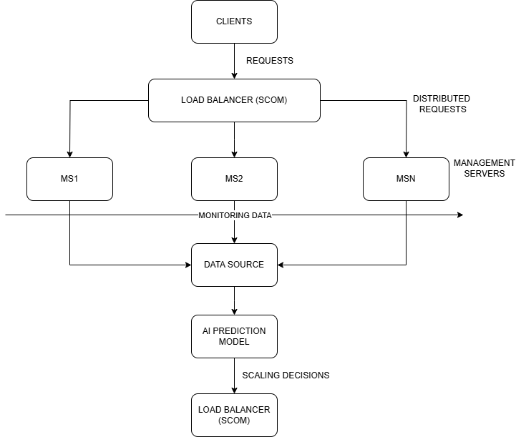
Fig 5.1 – Overall Scom Load Balancer Architecture In AI Driven Model.(Ist Method)
5. DESIGN

Slide 12
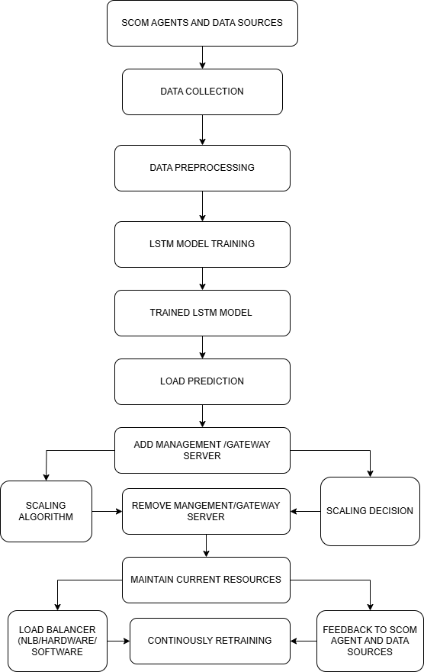
Fig -PROPOSED DIAGRAM OF LSTM ROLE IN LOAD BALANCING(SCOM)(2nd Method).

Slide 13
IMPLEMENTATION:
IMPLEMENTATION
6. IMPLEMENTATION
6.1 DATASET
This file contains performance data for 5 major companies across 20 time steps.
Total Rows: 20
Total Columns: 6
TIME – A number showing the time step
LINDE – A value showing Linde's activity or performance at that time.
HONEYWELL – Honeywell's performance at each time step.
SIEMENS – Siemens’ activity data over time.
ROCKWELL AUTOMATION – How Rockwell Automation performed.
MICROSOFT – Microsoft’s activity at each point in time.
6.2 Step 1: Load Historical Latency Data
The system begins by collecting and loading historical latency data between various network nodes (e.g., LINDE, HONEYWELL, etc.). This dataset contains time-stamped measurements that indicate how long it took for data to travel between different network endpoints in the past. This information is crucial because patterns in network latency often repeat due to recurring usage patterns, network congestion during peak hours, or infrastructure limitations. By analyzing this historical data, we can build a system that doesn’t just react to latency but anticipates it. The data is typically stored in a structured format such as a CSV file or a database, with columns like: Each column represents a different route or edge node, and each row is a snapshot of latency values at a given time.
PSEUDO CODE -
Import pandas as pd
# Load CSV
df = pd.read_csv('/mnt/data/industrial_data NEW 2.csv')
# Preview data
print (df.head())
print (df.columns)
Step 2: Preprocessing Module
Raw data is rarely ready for machine learning directly. So we apply several preprocessing steps:
Cleaning:
We remove rows with missing or corrupted values to ensure model quality. If needed, we could also use interpolation or imputation to fill gaps.
Timestamp Conversion:
If there's a timestamp column, it’s converted into useful features like:
Hour of the day (to detect diurnal patterns)
Day of the week (to identify weekday/weekend differences)This helps the model understand periodic fluctuations in latency.
Normalization:
Since the raw latency values can vary widely (e.g., from 10 ms to 400 ms), we scale all values to a range of 0 to 1. This step helps the neural network train efficiently and reduces bias toward larger numerical values.
Feature Selection:
We define the key latency columns (e.g., LINDE, HONEYWELL, etc.) that we want to use for prediction.
PSEUDO CODE -
from sklearn.preprocessing import MinMaxScaler
# Drop rows with missing values (if any)
df_clean = df.dropna()
# If there's a timestamp column, convert it
if 'timestamp' in df_clean.columns:
df_clean['timestamp'] = pd.to_datetime(df_clean['timestamp'])
df_clean['hour'] = df_clean['timestamp'].dt.hour
df_clean['day'] = df_clean['timestamp'].dt.dayofweek
# Define latency columns manually
latency_cols = ['LINDE', 'HONEYWELL', 'SIEMENS', 'ROCKWELL AUTOMATION', 'MICROSOFT']
# Normalize latency values between 0 and 1
scaler = MinMaxScaler()
df_clean[latency_cols] = scaler.fit_transform(df_clean[latency_cols])
Step 3: Sequence Creation for LSTM
Since we’re dealing with time-series data, we use a sliding window approach to create sequences of past latency values. Here's how it works:
We define a window size (n steps) for example, 10.
From the dataset, we create samples where each input sequence consists of 10 consecutive latency values.
The corresponding target value is the latency right after that window.
This process allows the model to learn how previous latency values lead to the next one.For instance :This is how the model learns temporal dependencies a critical strength of LSTM networks.
PSEUDO CODE –
import numpy as np
def create_sequences(data, n_steps=10):
X, y = [], []
for i in range(len(data) - n_steps):
X.append(data[i:i+n_steps])
y.append(data[i+n_steps])
return np.array(X), np.array(y)
# Use one column for example: 'LINDE'
linde_data = df_clean['LINDE'].values
# Reshape and create sequences
n_steps = 10
X, y = create_sequences(linde_data, n_steps)
X = X.reshape((X.shape[0], X.shape[1], 1)) # [samples, timesteps, features]
Step 4: Build and Train the LSTM-LFR Model
Now we create and train the actual LSTM-LFR (Latency Forecasting and Routing) model, which is a deep learning architecture designed for sequential data.
LSTM Layer: Captures patterns and dependencies in latency over time.
Dense Layer: Outputs the final prediction (i.e., next latency value).
Loss Function: We use Mean Squared Error (MSE), which measures how far the predicted latency is from the actual one.
Optimizer: Adam is used to minimize the loss function efficiently.
The model is trained over several epochs, gradually learning to predict future latency values accurately based on historical sequences.
PSEUDO CODE –
from tensorflow.keras.models import Sequential
from tensorflow.keras.layers import LSTM, Dense
# Build the LSTM model
model = Sequential()
model.add(LSTM(50, activation='relu', input_shape=(n_steps, 1)))
model.add(Dense(1))
model.compile(optimizer='adam', loss='mse')
# Train the model
model.fit(X, y, epochs=20, batch_size=32)
Step 5: Predict and Make Routing Decisions
Once the model is trained, it can be used in real-time to decide how to route traffic:
Input Generation:
We take the most recent latency data for two edges — for example, Edge A (LINDE) and Edge B (HONEYWELL).
These sequences are passed into the model to predict future latency.
Prediction:
The model outputs predicted latency values for both routes.
Decision Logic:
If the predicted latency for Edge A is below a defined threshold (say, 0.5), we select it as the primary route.
If not, we route the traffic through Edge B (the alternate).
This logic enables the system to dynamically adapt to predicted network conditions instead of reacting after delays occur.
PSEUDO CODE –
# Get recent sequences for A and B
input_A = df_clean['LINDE'].values[-n_steps:]
input_B = df_clean['HONEYWELL'].values[-n_steps:]
# Reshape
input_A = input_A.reshape((1, n_steps, 1))
input_B = input_B.reshape((1, n_steps, 1))
# Predict
pred_A = model.predict(input_A)[0][0]
pred_B = model.predict(input_B)[0][0]
# Define threshold
threshold = 0.5
# Routing Logic
if pred_A < threshold:
route = "Closest Node (A - LINDE)"
else:
route = "Alternate Node (B - HONEYWELL)"
print(f"Predicted Latency A: {pred_A:.4f}")
print(f"Predicted Latency B: {pred_B:.4f}")
print(f"Selected Route: {route}")
Final Output Example-
Let’s say the model predicts:
Predicted Latency A (LINDE): 0.3210
Predicted Latency B (HONEYWELL): 0.5821
And we set the threshold to 0.5. Since 0.3210 < 0.5, the system will automatically route traffic through LINDE (Edge A), which is expected to have lower latency in the near future
How it Benefit-
This predictive routing approach helps in:
Improving user experience by minimizing latency before it spikes.
Avoiding congestion by rerouting ahead of time.
Saving cost and bandwidth by intelligently selecting optimal paths.
By combining historical latency analysis with machine learning, we transform a static network into a dynamic, adaptive system.
6.1 DATASET
This file contains performance data for 5 major companies across 20 time steps.
Total Rows: 20
Total Columns: 6
TIME – A number showing the time step
LINDE – A value showing Linde's activity or performance at that time.
HONEYWELL – Honeywell's performance at each time step.
SIEMENS – Siemens’ activity data over time.
ROCKWELL AUTOMATION – How Rockwell Automation performed.
MICROSOFT – Microsoft’s activity at each point in time.

Slide 14
IMPLEMENTATION:
IMPLEMENTATION
6. IMPLEMENTATION
6.1 DATASET
This file contains performance data for 5 major companies across 20 time steps.
Total Rows: 20
Total Columns: 6
TIME – A number showing the time step
LINDE – A value showing Linde's activity or performance at that time.
HONEYWELL – Honeywell's performance at each time step.
SIEMENS – Siemens’ activity data over time.
ROCKWELL AUTOMATION – How Rockwell Automation performed.
MICROSOFT – Microsoft’s activity at each point in time.
6.2 Step 1: Load Historical Latency Data
The system begins by collecting and loading historical latency data between various network nodes (e.g., LINDE, HONEYWELL, etc.). This dataset contains time-stamped measurements that indicate how long it took for data to travel between different network endpoints in the past. This information is crucial because patterns in network latency often repeat due to recurring usage patterns, network congestion during peak hours, or infrastructure limitations. By analyzing this historical data, we can build a system that doesn’t just react to latency but anticipates it. The data is typically stored in a structured format such as a CSV file or a database, with columns like: Each column represents a different route or edge node, and each row is a snapshot of latency values at a given time.
PSEUDO CODE -
Import pandas as pd
# Load CSV
df = pd.read_csv('/mnt/data/industrial_data NEW 2.csv')
# Preview data
print (df.head())
print (df.columns)
Step 2: Preprocessing Module
Raw data is rarely ready for machine learning directly. So we apply several preprocessing steps:
Cleaning:
We remove rows with missing or corrupted values to ensure model quality. If needed, we could also use interpolation or imputation to fill gaps.
Timestamp Conversion:
If there's a timestamp column, it’s converted into useful features like:
Hour of the day (to detect diurnal patterns)
Day of the week (to identify weekday/weekend differences)This helps the model understand periodic fluctuations in latency.
Normalization:
Since the raw latency values can vary widely (e.g., from 10 ms to 400 ms), we scale all values to a range of 0 to 1. This step helps the neural network train efficiently and reduces bias toward larger numerical values.
Feature Selection:
We define the key latency columns (e.g., LINDE, HONEYWELL, etc.) that we want to use for prediction.
PSEUDO CODE -
from sklearn.preprocessing import MinMaxScaler
# Drop rows with missing values (if any)
df_clean = df.dropna()
# If there's a timestamp column, convert it
if 'timestamp' in df_clean.columns:
df_clean['timestamp'] = pd.to_datetime(df_clean['timestamp'])
df_clean['hour'] = df_clean['timestamp'].dt.hour
df_clean['day'] = df_clean['timestamp'].dt.dayofweek
# Define latency columns manually
latency_cols = ['LINDE', 'HONEYWELL', 'SIEMENS', 'ROCKWELL AUTOMATION', 'MICROSOFT']
# Normalize latency values between 0 and 1
scaler = MinMaxScaler()
df_clean[latency_cols] = scaler.fit_transform(df_clean[latency_cols])
Step 3: Sequence Creation for LSTM
Since we’re dealing with time-series data, we use a sliding window approach to create sequences of past latency values. Here's how it works:
We define a window size (n steps) for example, 10.
From the dataset, we create samples where each input sequence consists of 10 consecutive latency values.
The corresponding target value is the latency right after that window.
This process allows the model to learn how previous latency values lead to the next one.For instance :This is how the model learns temporal dependencies a critical strength of LSTM networks.
PSEUDO CODE –
import numpy as np
def create_sequences(data, n_steps=10):
X, y = [], []
for i in range(len(data) - n_steps):
X.append(data[i:i+n_steps])
y.append(data[i+n_steps])
return np.array(X), np.array(y)
# Use one column for example: 'LINDE'
linde_data = df_clean['LINDE'].values
# Reshape and create sequences
n_steps = 10
X, y = create_sequences(linde_data, n_steps)
X = X.reshape((X.shape[0], X.shape[1], 1)) # [samples, timesteps, features]
Step 4: Build and Train the LSTM-LFR Model
Now we create and train the actual LSTM-LFR (Latency Forecasting and Routing) model, which is a deep learning architecture designed for sequential data.
LSTM Layer: Captures patterns and dependencies in latency over time.
Dense Layer: Outputs the final prediction (i.e., next latency value).
Loss Function: We use Mean Squared Error (MSE), which measures how far the predicted latency is from the actual one.
Optimizer: Adam is used to minimize the loss function efficiently.
The model is trained over several epochs, gradually learning to predict future latency values accurately based on historical sequences.
PSEUDO CODE –
from tensorflow.keras.models import Sequential
from tensorflow.keras.layers import LSTM, Dense
# Build the LSTM model
model = Sequential()
model.add(LSTM(50, activation='relu', input_shape=(n_steps, 1)))
model.add(Dense(1))
model.compile(optimizer='adam', loss='mse')
# Train the model
model.fit(X, y, epochs=20, batch_size=32)
Step 5: Predict and Make Routing Decisions
Once the model is trained, it can be used in real-time to decide how to route traffic:
Input Generation:
We take the most recent latency data for two edges — for example, Edge A (LINDE) and Edge B (HONEYWELL).
These sequences are passed into the model to predict future latency.
Prediction:
The model outputs predicted latency values for both routes.
Decision Logic:
If the predicted latency for Edge A is below a defined threshold (say, 0.5), we select it as the primary route.
If not, we route the traffic through Edge B (the alternate).
This logic enables the system to dynamically adapt to predicted network conditions instead of reacting after delays occur.
PSEUDO CODE –
# Get recent sequences for A and B
input_A = df_clean['LINDE'].values[-n_steps:]
input_B = df_clean['HONEYWELL'].values[-n_steps:]
# Reshape
input_A = input_A.reshape((1, n_steps, 1))
input_B = input_B.reshape((1, n_steps, 1))
# Predict
pred_A = model.predict(input_A)[0][0]
pred_B = model.predict(input_B)[0][0]
# Define threshold
threshold = 0.5
# Routing Logic
if pred_A < threshold:
route = "Closest Node (A - LINDE)"
else:
route = "Alternate Node (B - HONEYWELL)"
print(f"Predicted Latency A: {pred_A:.4f}")
print(f"Predicted Latency B: {pred_B:.4f}")
print(f"Selected Route: {route}")
Final Output Example-
Let’s say the model predicts:
Predicted Latency A (LINDE): 0.3210
Predicted Latency B (HONEYWELL): 0.5821
And we set the threshold to 0.5. Since 0.3210 < 0.5, the system will automatically route traffic through LINDE (Edge A), which is expected to have lower latency in the near future
How it Benefit-
This predictive routing approach helps in:
Improving user experience by minimizing latency before it spikes.
Avoiding congestion by rerouting ahead of time.
Saving cost and bandwidth by intelligently selecting optimal paths.
By combining historical latency analysis with machine learning, we transform a static network into a dynamic, adaptive system.
6.2.1 Set up the Management Servers (MS1, MS2, MSN):
Hardware/Virtual Machines: Provision the necessary servers based on expected load and resource requirements.
Application Deployment: Install and configure the application that will handle client requests.
Monitoring Agents: Install agents on each server to collect performance metrics (CPU usage, memory usage, network traffic, etc.). Popular options include Prometheus, Telegraf, or vendor-specific agents.

Slide 15
IMPLEMENTATION:
IMPLEMENTATION
6. IMPLEMENTATION
6.1 DATASET
This file contains performance data for 5 major companies across 20 time steps.
Total Rows: 20
Total Columns: 6
TIME – A number showing the time step
LINDE – A value showing Linde's activity or performance at that time.
HONEYWELL – Honeywell's performance at each time step.
SIEMENS – Siemens’ activity data over time.
ROCKWELL AUTOMATION – How Rockwell Automation performed.
MICROSOFT – Microsoft’s activity at each point in time.
6.2 Step 1: Load Historical Latency Data
The system begins by collecting and loading historical latency data between various network nodes (e.g., LINDE, HONEYWELL, etc.). This dataset contains time-stamped measurements that indicate how long it took for data to travel between different network endpoints in the past. This information is crucial because patterns in network latency often repeat due to recurring usage patterns, network congestion during peak hours, or infrastructure limitations. By analyzing this historical data, we can build a system that doesn’t just react to latency but anticipates it. The data is typically stored in a structured format such as a CSV file or a database, with columns like: Each column represents a different route or edge node, and each row is a snapshot of latency values at a given time.
PSEUDO CODE -
Import pandas as pd
# Load CSV
df = pd.read_csv('/mnt/data/industrial_data NEW 2.csv')
# Preview data
print (df.head())
print (df.columns)
Step 2: Preprocessing Module
Raw data is rarely ready for machine learning directly. So we apply several preprocessing steps:
Cleaning:
We remove rows with missing or corrupted values to ensure model quality. If needed, we could also use interpolation or imputation to fill gaps.
Timestamp Conversion:
If there's a timestamp column, it’s converted into useful features like:
Hour of the day (to detect diurnal patterns)
Day of the week (to identify weekday/weekend differences)This helps the model understand periodic fluctuations in latency.
Normalization:
Since the raw latency values can vary widely (e.g., from 10 ms to 400 ms), we scale all values to a range of 0 to 1. This step helps the neural network train efficiently and reduces bias toward larger numerical values.
Feature Selection:
We define the key latency columns (e.g., LINDE, HONEYWELL, etc.) that we want to use for prediction.
PSEUDO CODE -
from sklearn.preprocessing import MinMaxScaler
# Drop rows with missing values (if any)
df_clean = df.dropna()
# If there's a timestamp column, convert it
if 'timestamp' in df_clean.columns:
df_clean['timestamp'] = pd.to_datetime(df_clean['timestamp'])
df_clean['hour'] = df_clean['timestamp'].dt.hour
df_clean['day'] = df_clean['timestamp'].dt.dayofweek
# Define latency columns manually
latency_cols = ['LINDE', 'HONEYWELL', 'SIEMENS', 'ROCKWELL AUTOMATION', 'MICROSOFT']
# Normalize latency values between 0 and 1
scaler = MinMaxScaler()
df_clean[latency_cols] = scaler.fit_transform(df_clean[latency_cols])
Step 3: Sequence Creation for LSTM
Since we’re dealing with time-series data, we use a sliding window approach to create sequences of past latency values. Here's how it works:
We define a window size (n steps) for example, 10.
From the dataset, we create samples where each input sequence consists of 10 consecutive latency values.
The corresponding target value is the latency right after that window.
This process allows the model to learn how previous latency values lead to the next one.For instance :This is how the model learns temporal dependencies a critical strength of LSTM networks.
PSEUDO CODE –
import numpy as np
def create_sequences(data, n_steps=10):
X, y = [], []
for i in range(len(data) - n_steps):
X.append(data[i:i+n_steps])
y.append(data[i+n_steps])
return np.array(X), np.array(y)
# Use one column for example: 'LINDE'
linde_data = df_clean['LINDE'].values
# Reshape and create sequences
n_steps = 10
X, y = create_sequences(linde_data, n_steps)
X = X.reshape((X.shape[0], X.shape[1], 1)) # [samples, timesteps, features]
Step 4: Build and Train the LSTM-LFR Model
Now we create and train the actual LSTM-LFR (Latency Forecasting and Routing) model, which is a deep learning architecture designed for sequential data.
LSTM Layer: Captures patterns and dependencies in latency over time.
Dense Layer: Outputs the final prediction (i.e., next latency value).
Loss Function: We use Mean Squared Error (MSE), which measures how far the predicted latency is from the actual one.
Optimizer: Adam is used to minimize the loss function efficiently.
The model is trained over several epochs, gradually learning to predict future latency values accurately based on historical sequences.
PSEUDO CODE –
from tensorflow.keras.models import Sequential
from tensorflow.keras.layers import LSTM, Dense
# Build the LSTM model
model = Sequential()
model.add(LSTM(50, activation='relu', input_shape=(n_steps, 1)))
model.add(Dense(1))
model.compile(optimizer='adam', loss='mse')
# Train the model
model.fit(X, y, epochs=20, batch_size=32)
Step 5: Predict and Make Routing Decisions
Once the model is trained, it can be used in real-time to decide how to route traffic:
Input Generation:
We take the most recent latency data for two edges — for example, Edge A (LINDE) and Edge B (HONEYWELL).
These sequences are passed into the model to predict future latency.
Prediction:
The model outputs predicted latency values for both routes.
Decision Logic:
If the predicted latency for Edge A is below a defined threshold (say, 0.5), we select it as the primary route.
If not, we route the traffic through Edge B (the alternate).
This logic enables the system to dynamically adapt to predicted network conditions instead of reacting after delays occur.
PSEUDO CODE –
# Get recent sequences for A and B
input_A = df_clean['LINDE'].values[-n_steps:]
input_B = df_clean['HONEYWELL'].values[-n_steps:]
# Reshape
input_A = input_A.reshape((1, n_steps, 1))
input_B = input_B.reshape((1, n_steps, 1))
# Predict
pred_A = model.predict(input_A)[0][0]
pred_B = model.predict(input_B)[0][0]
# Define threshold
threshold = 0.5
# Routing Logic
if pred_A < threshold:
route = "Closest Node (A - LINDE)"
else:
route = "Alternate Node (B - HONEYWELL)"
print(f"Predicted Latency A: {pred_A:.4f}")
print(f"Predicted Latency B: {pred_B:.4f}")
print(f"Selected Route: {route}")
Final Output Example-
Let’s say the model predicts:
Predicted Latency A (LINDE): 0.3210
Predicted Latency B (HONEYWELL): 0.5821
And we set the threshold to 0.5. Since 0.3210 < 0.5, the system will automatically route traffic through LINDE (Edge A), which is expected to have lower latency in the near future
How it Benefit-
This predictive routing approach helps in:
Improving user experience by minimizing latency before it spikes.
Avoiding congestion by rerouting ahead of time.
Saving cost and bandwidth by intelligently selecting optimal paths.
By combining historical latency analysis with machine learning, we transform a static network into a dynamic, adaptive system.
6.2.2 Configure the Load Balancer (SCOM):
Installation/Configuration: Set up the System Center Operations Manager (SCOM) load balancer or another suitable load balancer (e.g., Nginx, HAProxy).
Server Registration: Register the Management Servers (MS1, MS2, MSN) with the load balancer.
Load Balancing Algorithm: Choose a load balancing algorithm (round-robin, least connections, etc.) based on application requirements.
Health Checks: Configure health checks to ensure the load balancer only routes traffic to healthy servers.
6.2.3 Establish the Data Source:
Database/Time-Series Database: Set up a database to store the monitoring data. Time-series databases (e.g., InfluxDB, TimescaleDB) are often preferred for this purpose due to their optimized handling of time-series data.
Data Collection Pipeline: Configure the monitoring agents on the Management Servers to send their collected metrics to the data source.
Data Retention Policy: Define a data retention policy to manage storage space and ensure relevant historical data is available.

Slide 16
IMPLEMENTATION:
IMPLEMENTATION
6. IMPLEMENTATION
6.1 DATASET
This file contains performance data for 5 major companies across 20 time steps.
Total Rows: 20
Total Columns: 6
TIME – A number showing the time step
LINDE – A value showing Linde's activity or performance at that time.
HONEYWELL – Honeywell's performance at each time step.
SIEMENS – Siemens’ activity data over time.
ROCKWELL AUTOMATION – How Rockwell Automation performed.
MICROSOFT – Microsoft’s activity at each point in time.
6.2 Step 1: Load Historical Latency Data
The system begins by collecting and loading historical latency data between various network nodes (e.g., LINDE, HONEYWELL, etc.). This dataset contains time-stamped measurements that indicate how long it took for data to travel between different network endpoints in the past. This information is crucial because patterns in network latency often repeat due to recurring usage patterns, network congestion during peak hours, or infrastructure limitations. By analyzing this historical data, we can build a system that doesn’t just react to latency but anticipates it. The data is typically stored in a structured format such as a CSV file or a database, with columns like: Each column represents a different route or edge node, and each row is a snapshot of latency values at a given time.
PSEUDO CODE -
Import pandas as pd
# Load CSV
df = pd.read_csv('/mnt/data/industrial_data NEW 2.csv')
# Preview data
print (df.head())
print (df.columns)
Step 2: Preprocessing Module
Raw data is rarely ready for machine learning directly. So we apply several preprocessing steps:
Cleaning:
We remove rows with missing or corrupted values to ensure model quality. If needed, we could also use interpolation or imputation to fill gaps.
Timestamp Conversion:
If there's a timestamp column, it’s converted into useful features like:
Hour of the day (to detect diurnal patterns)
Day of the week (to identify weekday/weekend differences)This helps the model understand periodic fluctuations in latency.
Normalization:
Since the raw latency values can vary widely (e.g., from 10 ms to 400 ms), we scale all values to a range of 0 to 1. This step helps the neural network train efficiently and reduces bias toward larger numerical values.
Feature Selection:
We define the key latency columns (e.g., LINDE, HONEYWELL, etc.) that we want to use for prediction.
PSEUDO CODE -
from sklearn.preprocessing import MinMaxScaler
# Drop rows with missing values (if any)
df_clean = df.dropna()
# If there's a timestamp column, convert it
if 'timestamp' in df_clean.columns:
df_clean['timestamp'] = pd.to_datetime(df_clean['timestamp'])
df_clean['hour'] = df_clean['timestamp'].dt.hour
df_clean['day'] = df_clean['timestamp'].dt.dayofweek
# Define latency columns manually
latency_cols = ['LINDE', 'HONEYWELL', 'SIEMENS', 'ROCKWELL AUTOMATION', 'MICROSOFT']
# Normalize latency values between 0 and 1
scaler = MinMaxScaler()
df_clean[latency_cols] = scaler.fit_transform(df_clean[latency_cols])
Step 3: Sequence Creation for LSTM
Since we’re dealing with time-series data, we use a sliding window approach to create sequences of past latency values. Here's how it works:
We define a window size (n steps) for example, 10.
From the dataset, we create samples where each input sequence consists of 10 consecutive latency values.
The corresponding target value is the latency right after that window.
This process allows the model to learn how previous latency values lead to the next one.For instance :This is how the model learns temporal dependencies a critical strength of LSTM networks.
PSEUDO CODE –
import numpy as np
def create_sequences(data, n_steps=10):
X, y = [], []
for i in range(len(data) - n_steps):
X.append(data[i:i+n_steps])
y.append(data[i+n_steps])
return np.array(X), np.array(y)
# Use one column for example: 'LINDE'
linde_data = df_clean['LINDE'].values
# Reshape and create sequences
n_steps = 10
X, y = create_sequences(linde_data, n_steps)
X = X.reshape((X.shape[0], X.shape[1], 1)) # [samples, timesteps, features]
Step 4: Build and Train the LSTM-LFR Model
Now we create and train the actual LSTM-LFR (Latency Forecasting and Routing) model, which is a deep learning architecture designed for sequential data.
LSTM Layer: Captures patterns and dependencies in latency over time.
Dense Layer: Outputs the final prediction (i.e., next latency value).
Loss Function: We use Mean Squared Error (MSE), which measures how far the predicted latency is from the actual one.
Optimizer: Adam is used to minimize the loss function efficiently.
The model is trained over several epochs, gradually learning to predict future latency values accurately based on historical sequences.
PSEUDO CODE –
from tensorflow.keras.models import Sequential
from tensorflow.keras.layers import LSTM, Dense
# Build the LSTM model
model = Sequential()
model.add(LSTM(50, activation='relu', input_shape=(n_steps, 1)))
model.add(Dense(1))
model.compile(optimizer='adam', loss='mse')
# Train the model
model.fit(X, y, epochs=20, batch_size=32)
Step 5: Predict and Make Routing Decisions
Once the model is trained, it can be used in real-time to decide how to route traffic:
Input Generation:
We take the most recent latency data for two edges — for example, Edge A (LINDE) and Edge B (HONEYWELL).
These sequences are passed into the model to predict future latency.
Prediction:
The model outputs predicted latency values for both routes.
Decision Logic:
If the predicted latency for Edge A is below a defined threshold (say, 0.5), we select it as the primary route.
If not, we route the traffic through Edge B (the alternate).
This logic enables the system to dynamically adapt to predicted network conditions instead of reacting after delays occur.
PSEUDO CODE –
# Get recent sequences for A and B
input_A = df_clean['LINDE'].values[-n_steps:]
input_B = df_clean['HONEYWELL'].values[-n_steps:]
# Reshape
input_A = input_A.reshape((1, n_steps, 1))
input_B = input_B.reshape((1, n_steps, 1))
# Predict
pred_A = model.predict(input_A)[0][0]
pred_B = model.predict(input_B)[0][0]
# Define threshold
threshold = 0.5
# Routing Logic
if pred_A < threshold:
route = "Closest Node (A - LINDE)"
else:
route = "Alternate Node (B - HONEYWELL)"
print(f"Predicted Latency A: {pred_A:.4f}")
print(f"Predicted Latency B: {pred_B:.4f}")
print(f"Selected Route: {route}")
Final Output Example-
Let’s say the model predicts:
Predicted Latency A (LINDE): 0.3210
Predicted Latency B (HONEYWELL): 0.5821
And we set the threshold to 0.5. Since 0.3210 < 0.5, the system will automatically route traffic through LINDE (Edge A), which is expected to have lower latency in the near future
How it Benefit-
This predictive routing approach helps in:
Improving user experience by minimizing latency before it spikes.
Avoiding congestion by rerouting ahead of time.
Saving cost and bandwidth by intelligently selecting optimal paths.
By combining historical latency analysis with machine learning, we transform a static network into a dynamic, adaptive system.
6.2.4 Develop the AI Prediction Model:
Data Analysis: Analyze the historical monitoring data to identify patterns and trends related to load.
Model Selection: Choose a suitable machine learning model for time-series forecasting (e.g., ARIMA, LSTM, Prophet).
Model Training: Train the model using the historical data.
Model Evaluation: Evaluate the model's performance and fine-tune it as needed.
6.2.5 Implement the Scaling Logic:
Prediction Integration: Integrate the AI prediction model into the system to generate load forecasts.
Scaling Thresholds: Define thresholds for scaling up or down based on the predicted load.
Scaling Actions: Configure the system to automatically add or remove Management Servers from the load balancer based on the scaling decisions. This might involve using cloud provider APIs or custom scripts.

Slide 17
IMPLEMENTATION:
IMPLEMENTATION
6. IMPLEMENTATION
6.1 DATASET
This file contains performance data for 5 major companies across 20 time steps.
Total Rows: 20
Total Columns: 6
TIME – A number showing the time step
LINDE – A value showing Linde's activity or performance at that time.
HONEYWELL – Honeywell's performance at each time step.
SIEMENS – Siemens’ activity data over time.
ROCKWELL AUTOMATION – How Rockwell Automation performed.
MICROSOFT – Microsoft’s activity at each point in time.
6.2 Step 1: Load Historical Latency Data
The system begins by collecting and loading historical latency data between various network nodes (e.g., LINDE, HONEYWELL, etc.). This dataset contains time-stamped measurements that indicate how long it took for data to travel between different network endpoints in the past. This information is crucial because patterns in network latency often repeat due to recurring usage patterns, network congestion during peak hours, or infrastructure limitations. By analyzing this historical data, we can build a system that doesn’t just react to latency but anticipates it. The data is typically stored in a structured format such as a CSV file or a database, with columns like: Each column represents a different route or edge node, and each row is a snapshot of latency values at a given time.
PSEUDO CODE -
Import pandas as pd
# Load CSV
df = pd.read_csv('/mnt/data/industrial_data NEW 2.csv')
# Preview data
print (df.head())
print (df.columns)
Step 2: Preprocessing Module
Raw data is rarely ready for machine learning directly. So we apply several preprocessing steps:
Cleaning:
We remove rows with missing or corrupted values to ensure model quality. If needed, we could also use interpolation or imputation to fill gaps.
Timestamp Conversion:
If there's a timestamp column, it’s converted into useful features like:
Hour of the day (to detect diurnal patterns)
Day of the week (to identify weekday/weekend differences)This helps the model understand periodic fluctuations in latency.
Normalization:
Since the raw latency values can vary widely (e.g., from 10 ms to 400 ms), we scale all values to a range of 0 to 1. This step helps the neural network train efficiently and reduces bias toward larger numerical values.
Feature Selection:
We define the key latency columns (e.g., LINDE, HONEYWELL, etc.) that we want to use for prediction.
PSEUDO CODE -
from sklearn.preprocessing import MinMaxScaler
# Drop rows with missing values (if any)
df_clean = df.dropna()
# If there's a timestamp column, convert it
if 'timestamp' in df_clean.columns:
df_clean['timestamp'] = pd.to_datetime(df_clean['timestamp'])
df_clean['hour'] = df_clean['timestamp'].dt.hour
df_clean['day'] = df_clean['timestamp'].dt.dayofweek
# Define latency columns manually
latency_cols = ['LINDE', 'HONEYWELL', 'SIEMENS', 'ROCKWELL AUTOMATION', 'MICROSOFT']
# Normalize latency values between 0 and 1
scaler = MinMaxScaler()
df_clean[latency_cols] = scaler.fit_transform(df_clean[latency_cols])
Step 3: Sequence Creation for LSTM
Since we’re dealing with time-series data, we use a sliding window approach to create sequences of past latency values. Here's how it works:
We define a window size (n steps) for example, 10.
From the dataset, we create samples where each input sequence consists of 10 consecutive latency values.
The corresponding target value is the latency right after that window.
This process allows the model to learn how previous latency values lead to the next one.For instance :This is how the model learns temporal dependencies a critical strength of LSTM networks.
PSEUDO CODE –
import numpy as np
def create_sequences(data, n_steps=10):
X, y = [], []
for i in range(len(data) - n_steps):
X.append(data[i:i+n_steps])
y.append(data[i+n_steps])
return np.array(X), np.array(y)
# Use one column for example: 'LINDE'
linde_data = df_clean['LINDE'].values
# Reshape and create sequences
n_steps = 10
X, y = create_sequences(linde_data, n_steps)
X = X.reshape((X.shape[0], X.shape[1], 1)) # [samples, timesteps, features]
Step 4: Build and Train the LSTM-LFR Model
Now we create and train the actual LSTM-LFR (Latency Forecasting and Routing) model, which is a deep learning architecture designed for sequential data.
LSTM Layer: Captures patterns and dependencies in latency over time.
Dense Layer: Outputs the final prediction (i.e., next latency value).
Loss Function: We use Mean Squared Error (MSE), which measures how far the predicted latency is from the actual one.
Optimizer: Adam is used to minimize the loss function efficiently.
The model is trained over several epochs, gradually learning to predict future latency values accurately based on historical sequences.
PSEUDO CODE –
from tensorflow.keras.models import Sequential
from tensorflow.keras.layers import LSTM, Dense
# Build the LSTM model
model = Sequential()
model.add(LSTM(50, activation='relu', input_shape=(n_steps, 1)))
model.add(Dense(1))
model.compile(optimizer='adam', loss='mse')
# Train the model
model.fit(X, y, epochs=20, batch_size=32)
Step 5: Predict and Make Routing Decisions
Once the model is trained, it can be used in real-time to decide how to route traffic:
Input Generation:
We take the most recent latency data for two edges — for example, Edge A (LINDE) and Edge B (HONEYWELL).
These sequences are passed into the model to predict future latency.
Prediction:
The model outputs predicted latency values for both routes.
Decision Logic:
If the predicted latency for Edge A is below a defined threshold (say, 0.5), we select it as the primary route.
If not, we route the traffic through Edge B (the alternate).
This logic enables the system to dynamically adapt to predicted network conditions instead of reacting after delays occur.
PSEUDO CODE –
# Get recent sequences for A and B
input_A = df_clean['LINDE'].values[-n_steps:]
input_B = df_clean['HONEYWELL'].values[-n_steps:]
# Reshape
input_A = input_A.reshape((1, n_steps, 1))
input_B = input_B.reshape((1, n_steps, 1))
# Predict
pred_A = model.predict(input_A)[0][0]
pred_B = model.predict(input_B)[0][0]
# Define threshold
threshold = 0.5
# Routing Logic
if pred_A < threshold:
route = "Closest Node (A - LINDE)"
else:
route = "Alternate Node (B - HONEYWELL)"
print(f"Predicted Latency A: {pred_A:.4f}")
print(f"Predicted Latency B: {pred_B:.4f}")
print(f"Selected Route: {route}")
Final Output Example-
Let’s say the model predicts:
Predicted Latency A (LINDE): 0.3210
Predicted Latency B (HONEYWELL): 0.5821
And we set the threshold to 0.5. Since 0.3210 < 0.5, the system will automatically route traffic through LINDE (Edge A), which is expected to have lower latency in the near future
How it Benefit-
This predictive routing approach helps in:
Improving user experience by minimizing latency before it spikes.
Avoiding congestion by rerouting ahead of time.
Saving cost and bandwidth by intelligently selecting optimal paths.
By combining historical latency analysis with machine learning, we transform a static network into a dynamic, adaptive system.
RESULTS AND ANALYSIS:
RESULTS AND ANALYSIS
FIG -7. 1 LSTM LATENCY PREDICTION PERFORMANCE ANALYSIS
This graph shows a comparison between actual network latency measurements (blue solid line) and LSTM model predictions (red dashed line) over approximately 100 time steps during a training phase.
Key Observations:
Original Latency (Blue Line):
Shows highly volatile, spiky behavior with extreme fluctuations
Values range dramatically from around -8 to +9 units
Contains frequent sharp peaks and deep valleys
Exhibits very irregular, unpredictable patterns
LSTM Predictions (Red Dashed Line):
Much smoother and more stable than the original data
Stays within a narrower range (roughly -3 to +3)
Follows general trends but with significantly dampened volatility
Shows the model is learning some underlying patterns but struggling with extreme variations Model Performance Analysis: The LSTM appears to be having difficulty capturing the full volatility of the latency data. This is common in time series prediction when dealing with highly erratic data because:
Smoothing Effect: LSTMs tend to produce smoother predictions than highly volatile input data
Training Challenge: The extreme spikes may be treated as noise rather than signal
Underfitting: The model may need more complexity or different architecture to capture such irregular patterns
This suggests the network latency has very unpredictable characteristics that are challenging for standard LSTM models to accurately forecast, which is typical for real-world network performance data influenced by various external factors.
FIG 7.2 -ACTUAL VS PREDICTED LATENCY
Think of this like predicting the weather, but for internet speed:
The Blue Line (Actual Latency): This is what really happened - like checking the actual temperature every hour. It's very jumpy and unpredictable, going up and down wildly. This represents how fast or slow your internet connection was at different times.
The Orange Line (Predicted Latency): This is what the computer's "brain" (AI model) thought would happen - like a weather forecast. Notice how it's much smoother and doesn't have those crazy spikes.
What's happening?
The computer is trying to learn patterns from past internet speeds to predict future ones
But internet speed is really hard to predict! It jumps around a lot due to network traffic, server issues, etc.
The AI does okay at following the general trend (when it goes up or down overall)
But it completely misses those sudden spikes - like missing that it might suddenly storm when you predicted sunny weather
The bottom line: The AI is learning, but internet latency is just too wild and unpredictable for it to get exactly right. It's like trying to predict exactly when someone will sneeze - you might notice they're getting a cold, but the exact timing is nearly impossible to nail down. This is totally normal when dealing with network data - it's one of the trickiest things to predict accurately.
FIG 7.3 -IMPACT OF LSTM-BASED LOAD BALANCING ON SERVER LOAD
This chart demonstrates the effectiveness of LSTM-based load balancing implementation across five major technology organizations, comparing server load distribution before and after the predictive system deployment.
7.3.1 Pre-Implementation Load Analysis
Before LSTM implementation, the organizations exhibited significant load imbalances and suboptimal resource utilization. Rockwell Automation experienced the highest server load at 93%, indicating potential performance bottlenecks and resource strain. Honeywell followed closely at 89% utilization, while Linde operated at 80% capacity. These elevated load levels suggest systems operating near or beyond optimal efficiency thresholds. Siemens maintained a more moderate 70% load, and Microsoft demonstrated the most balanced pre-implementation performance at 65% utilization, indicating existing load management capabilities within their infrastructure.
7.3.2 Post-Implementation Performance Improvements
Following LSTM-based load balancing deployment, all organizations achieved remarkable load optimization and standardization. The system successfully normalized load distribution across all five organizations to approximately 59-62% utilization, representing a significant convergence toward optimal operating parameters. Rockwell Automation realized the most substantial improvement, with load reduction from 93% to 59%, representing a 37% decrease in server strain. Honeywell achieved similar benefits with load dropping from 89% to 62%, a 30% improvement. These dramatic reductions indicate the LSTM system's ability to predict and redistribute load before bottlenecks occur.
7.3.3 System Optimization Results
The LSTM implementation demonstrates consistent performance gains across diverse organizational infrastructures. Linde's load decreased from 80% to 60%, while Siemens improved from 70% to 61%. Even Microsoft, which showed relatively balanced pre-implementation performance, benefited from optimization, reducing from 65% to 58% utilization.
7.6.4 Operational Impact Assessment
The standardized post-implementation load levels around 60% represent optimal operating efficiency, providing adequate performance headroom while maximizing resource utilization. This consistent target across all organizations suggests the LSTM system applies sophisticated algorithms that account for different infrastructure configurations and workload patterns. The uniform load distribution indicates successful elimination of server hotspots and improved overall system reliability. Organizations can now expect more predictable performance, reduced risk of system failures, and enhanced capacity for handling unexpected load spikes through the maintained performance buffer.
7.6.5 FINAL CALCULATION -
The average percentage reduction:
Average Percentage Reduction = (25%+31.11%+12.86%+36.84%+10.77%)/5 Average Percentage
Reduction = 116.58%/5 Average Percentage Reduction =23.32%.

Slide 18
IMPLEMENTATION:
IMPLEMENTATION
6. IMPLEMENTATION
6.1 DATASET
This file contains performance data for 5 major companies across 20 time steps.
Total Rows: 20
Total Columns: 6
TIME – A number showing the time step
LINDE – A value showing Linde's activity or performance at that time.
HONEYWELL – Honeywell's performance at each time step.
SIEMENS – Siemens’ activity data over time.
ROCKWELL AUTOMATION – How Rockwell Automation performed.
MICROSOFT – Microsoft’s activity at each point in time.
6.2 Step 1: Load Historical Latency Data
The system begins by collecting and loading historical latency data between various network nodes (e.g., LINDE, HONEYWELL, etc.). This dataset contains time-stamped measurements that indicate how long it took for data to travel between different network endpoints in the past. This information is crucial because patterns in network latency often repeat due to recurring usage patterns, network congestion during peak hours, or infrastructure limitations. By analyzing this historical data, we can build a system that doesn’t just react to latency but anticipates it. The data is typically stored in a structured format such as a CSV file or a database, with columns like: Each column represents a different route or edge node, and each row is a snapshot of latency values at a given time.
PSEUDO CODE -
Import pandas as pd
# Load CSV
df = pd.read_csv('/mnt/data/industrial_data NEW 2.csv')
# Preview data
print (df.head())
print (df.columns)
Step 2: Preprocessing Module
Raw data is rarely ready for machine learning directly. So we apply several preprocessing steps:
Cleaning:
We remove rows with missing or corrupted values to ensure model quality. If needed, we could also use interpolation or imputation to fill gaps.
Timestamp Conversion:
If there's a timestamp column, it’s converted into useful features like:
Hour of the day (to detect diurnal patterns)
Day of the week (to identify weekday/weekend differences)This helps the model understand periodic fluctuations in latency.
Normalization:
Since the raw latency values can vary widely (e.g., from 10 ms to 400 ms), we scale all values to a range of 0 to 1. This step helps the neural network train efficiently and reduces bias toward larger numerical values.
Feature Selection:
We define the key latency columns (e.g., LINDE, HONEYWELL, etc.) that we want to use for prediction.
PSEUDO CODE -
from sklearn.preprocessing import MinMaxScaler
# Drop rows with missing values (if any)
df_clean = df.dropna()
# If there's a timestamp column, convert it
if 'timestamp' in df_clean.columns:
df_clean['timestamp'] = pd.to_datetime(df_clean['timestamp'])
df_clean['hour'] = df_clean['timestamp'].dt.hour
df_clean['day'] = df_clean['timestamp'].dt.dayofweek
# Define latency columns manually
latency_cols = ['LINDE', 'HONEYWELL', 'SIEMENS', 'ROCKWELL AUTOMATION', 'MICROSOFT']
# Normalize latency values between 0 and 1
scaler = MinMaxScaler()
df_clean[latency_cols] = scaler.fit_transform(df_clean[latency_cols])
Step 3: Sequence Creation for LSTM
Since we’re dealing with time-series data, we use a sliding window approach to create sequences of past latency values. Here's how it works:
We define a window size (n steps) for example, 10.
From the dataset, we create samples where each input sequence consists of 10 consecutive latency values.
The corresponding target value is the latency right after that window.
This process allows the model to learn how previous latency values lead to the next one.For instance :This is how the model learns temporal dependencies a critical strength of LSTM networks.
PSEUDO CODE –
import numpy as np
def create_sequences(data, n_steps=10):
X, y = [], []
for i in range(len(data) - n_steps):
X.append(data[i:i+n_steps])
y.append(data[i+n_steps])
return np.array(X), np.array(y)
# Use one column for example: 'LINDE'
linde_data = df_clean['LINDE'].values
# Reshape and create sequences
n_steps = 10
X, y = create_sequences(linde_data, n_steps)
X = X.reshape((X.shape[0], X.shape[1], 1)) # [samples, timesteps, features]
Step 4: Build and Train the LSTM-LFR Model
Now we create and train the actual LSTM-LFR (Latency Forecasting and Routing) model, which is a deep learning architecture designed for sequential data.
LSTM Layer: Captures patterns and dependencies in latency over time.
Dense Layer: Outputs the final prediction (i.e., next latency value).
Loss Function: We use Mean Squared Error (MSE), which measures how far the predicted latency is from the actual one.
Optimizer: Adam is used to minimize the loss function efficiently.
The model is trained over several epochs, gradually learning to predict future latency values accurately based on historical sequences.
PSEUDO CODE –
from tensorflow.keras.models import Sequential
from tensorflow.keras.layers import LSTM, Dense
# Build the LSTM model
model = Sequential()
model.add(LSTM(50, activation='relu', input_shape=(n_steps, 1)))
model.add(Dense(1))
model.compile(optimizer='adam', loss='mse')
# Train the model
model.fit(X, y, epochs=20, batch_size=32)
Step 5: Predict and Make Routing Decisions
Once the model is trained, it can be used in real-time to decide how to route traffic:
Input Generation:
We take the most recent latency data for two edges — for example, Edge A (LINDE) and Edge B (HONEYWELL).
These sequences are passed into the model to predict future latency.
Prediction:
The model outputs predicted latency values for both routes.
Decision Logic:
If the predicted latency for Edge A is below a defined threshold (say, 0.5), we select it as the primary route.
If not, we route the traffic through Edge B (the alternate).
This logic enables the system to dynamically adapt to predicted network conditions instead of reacting after delays occur.
PSEUDO CODE –
# Get recent sequences for A and B
input_A = df_clean['LINDE'].values[-n_steps:]
input_B = df_clean['HONEYWELL'].values[-n_steps:]
# Reshape
input_A = input_A.reshape((1, n_steps, 1))
input_B = input_B.reshape((1, n_steps, 1))
# Predict
pred_A = model.predict(input_A)[0][0]
pred_B = model.predict(input_B)[0][0]
# Define threshold
threshold = 0.5
# Routing Logic
if pred_A < threshold:
route = "Closest Node (A - LINDE)"
else:
route = "Alternate Node (B - HONEYWELL)"
print(f"Predicted Latency A: {pred_A:.4f}")
print(f"Predicted Latency B: {pred_B:.4f}")
print(f"Selected Route: {route}")
Final Output Example-
Let’s say the model predicts:
Predicted Latency A (LINDE): 0.3210
Predicted Latency B (HONEYWELL): 0.5821
And we set the threshold to 0.5. Since 0.3210 < 0.5, the system will automatically route traffic through LINDE (Edge A), which is expected to have lower latency in the near future
How it Benefit-
This predictive routing approach helps in:
Improving user experience by minimizing latency before it spikes.
Avoiding congestion by rerouting ahead of time.
Saving cost and bandwidth by intelligently selecting optimal paths.
By combining historical latency analysis with machine learning, we transform a static network into a dynamic, adaptive system.
6.3.1 Data Acquisition (SCOM Agents and Data Sources -> Data Collection):
Identify Data Sources: Determine the relevant metrics and data sources that provide insights into the system's load. This could include CPU utilization, memory usage, network traffic, request queue lengths, response times, and other performance indicators from SCOM agents and other relevant monitoring tools.
Configure Data Collection: Set up mechanisms to collect this data at regular intervals. This might involve configuring SCOM to export data to a centralized storage or using APIs to pull data from various sources.
Ensure Data Integrity: Implement processes to ensure the accuracy, consistency, and reliability of the collected data .

Slide 19
IMPLEMENTATION:
IMPLEMENTATION
6. IMPLEMENTATION
6.1 DATASET
This file contains performance data for 5 major companies across 20 time steps.
Total Rows: 20
Total Columns: 6
TIME – A number showing the time step
LINDE – A value showing Linde's activity or performance at that time.
HONEYWELL – Honeywell's performance at each time step.
SIEMENS – Siemens’ activity data over time.
ROCKWELL AUTOMATION – How Rockwell Automation performed.
MICROSOFT – Microsoft’s activity at each point in time.
6.2 Step 1: Load Historical Latency Data
The system begins by collecting and loading historical latency data between various network nodes (e.g., LINDE, HONEYWELL, etc.). This dataset contains time-stamped measurements that indicate how long it took for data to travel between different network endpoints in the past. This information is crucial because patterns in network latency often repeat due to recurring usage patterns, network congestion during peak hours, or infrastructure limitations. By analyzing this historical data, we can build a system that doesn’t just react to latency but anticipates it. The data is typically stored in a structured format such as a CSV file or a database, with columns like: Each column represents a different route or edge node, and each row is a snapshot of latency values at a given time.
PSEUDO CODE -
Import pandas as pd
# Load CSV
df = pd.read_csv('/mnt/data/industrial_data NEW 2.csv')
# Preview data
print (df.head())
print (df.columns)
Step 2: Preprocessing Module
Raw data is rarely ready for machine learning directly. So we apply several preprocessing steps:
Cleaning:
We remove rows with missing or corrupted values to ensure model quality. If needed, we could also use interpolation or imputation to fill gaps.
Timestamp Conversion:
If there's a timestamp column, it’s converted into useful features like:
Hour of the day (to detect diurnal patterns)
Day of the week (to identify weekday/weekend differences)This helps the model understand periodic fluctuations in latency.
Normalization:
Since the raw latency values can vary widely (e.g., from 10 ms to 400 ms), we scale all values to a range of 0 to 1. This step helps the neural network train efficiently and reduces bias toward larger numerical values.
Feature Selection:
We define the key latency columns (e.g., LINDE, HONEYWELL, etc.) that we want to use for prediction.
PSEUDO CODE -
from sklearn.preprocessing import MinMaxScaler
# Drop rows with missing values (if any)
df_clean = df.dropna()
# If there's a timestamp column, convert it
if 'timestamp' in df_clean.columns:
df_clean['timestamp'] = pd.to_datetime(df_clean['timestamp'])
df_clean['hour'] = df_clean['timestamp'].dt.hour
df_clean['day'] = df_clean['timestamp'].dt.dayofweek
# Define latency columns manually
latency_cols = ['LINDE', 'HONEYWELL', 'SIEMENS', 'ROCKWELL AUTOMATION', 'MICROSOFT']
# Normalize latency values between 0 and 1
scaler = MinMaxScaler()
df_clean[latency_cols] = scaler.fit_transform(df_clean[latency_cols])
Step 3: Sequence Creation for LSTM
Since we’re dealing with time-series data, we use a sliding window approach to create sequences of past latency values. Here's how it works:
We define a window size (n steps) for example, 10.
From the dataset, we create samples where each input sequence consists of 10 consecutive latency values.
The corresponding target value is the latency right after that window.
This process allows the model to learn how previous latency values lead to the next one.For instance :This is how the model learns temporal dependencies a critical strength of LSTM networks.
PSEUDO CODE –
import numpy as np
def create_sequences(data, n_steps=10):
X, y = [], []
for i in range(len(data) - n_steps):
X.append(data[i:i+n_steps])
y.append(data[i+n_steps])
return np.array(X), np.array(y)
# Use one column for example: 'LINDE'
linde_data = df_clean['LINDE'].values
# Reshape and create sequences
n_steps = 10
X, y = create_sequences(linde_data, n_steps)
X = X.reshape((X.shape[0], X.shape[1], 1)) # [samples, timesteps, features]
Step 4: Build and Train the LSTM-LFR Model
Now we create and train the actual LSTM-LFR (Latency Forecasting and Routing) model, which is a deep learning architecture designed for sequential data.
LSTM Layer: Captures patterns and dependencies in latency over time.
Dense Layer: Outputs the final prediction (i.e., next latency value).
Loss Function: We use Mean Squared Error (MSE), which measures how far the predicted latency is from the actual one.
Optimizer: Adam is used to minimize the loss function efficiently.
The model is trained over several epochs, gradually learning to predict future latency values accurately based on historical sequences.
PSEUDO CODE –
from tensorflow.keras.models import Sequential
from tensorflow.keras.layers import LSTM, Dense
# Build the LSTM model
model = Sequential()
model.add(LSTM(50, activation='relu', input_shape=(n_steps, 1)))
model.add(Dense(1))
model.compile(optimizer='adam', loss='mse')
# Train the model
model.fit(X, y, epochs=20, batch_size=32)
Step 5: Predict and Make Routing Decisions
Once the model is trained, it can be used in real-time to decide how to route traffic:
Input Generation:
We take the most recent latency data for two edges — for example, Edge A (LINDE) and Edge B (HONEYWELL).
These sequences are passed into the model to predict future latency.
Prediction:
The model outputs predicted latency values for both routes.
Decision Logic:
If the predicted latency for Edge A is below a defined threshold (say, 0.5), we select it as the primary route.
If not, we route the traffic through Edge B (the alternate).
This logic enables the system to dynamically adapt to predicted network conditions instead of reacting after delays occur.
PSEUDO CODE –
# Get recent sequences for A and B
input_A = df_clean['LINDE'].values[-n_steps:]
input_B = df_clean['HONEYWELL'].values[-n_steps:]
# Reshape
input_A = input_A.reshape((1, n_steps, 1))
input_B = input_B.reshape((1, n_steps, 1))
# Predict
pred_A = model.predict(input_A)[0][0]
pred_B = model.predict(input_B)[0][0]
# Define threshold
threshold = 0.5
# Routing Logic
if pred_A < threshold:
route = "Closest Node (A - LINDE)"
else:
route = "Alternate Node (B - HONEYWELL)"
print(f"Predicted Latency A: {pred_A:.4f}")
print(f"Predicted Latency B: {pred_B:.4f}")
print(f"Selected Route: {route}")
Final Output Example-
Let’s say the model predicts:
Predicted Latency A (LINDE): 0.3210
Predicted Latency B (HONEYWELL): 0.5821
And we set the threshold to 0.5. Since 0.3210 < 0.5, the system will automatically route traffic through LINDE (Edge A), which is expected to have lower latency in the near future
How it Benefit-
This predictive routing approach helps in:
Improving user experience by minimizing latency before it spikes.
Avoiding congestion by rerouting ahead of time.
Saving cost and bandwidth by intelligently selecting optimal paths.
By combining historical latency analysis with machine learning, we transform a static network into a dynamic, adaptive system.
6.3.2. Data Preparation (Data Collection -> Data Preprocessing):
Data Cleaning: Handle missing values, outliers, and noisy data points. This might involve techniques like imputation, outlier detection and removal, or smoothing.
Data Transformation: Transform the raw data into a suitable format for the LSTM model. This could include normalization, scaling (e.g., Min-Max scaling or standardization), and creating time series sequences.
Feature Engineering: Create relevant features from the raw data that the LSTM model can learn from. This might involve creating lagged versions of the time series data or combining multiple metrics.
Data Splitting: Divide the preprocessed data into training, validation, and testing sets. The training set is used to train the LSTM model, the validation set to tune hyperparameters, and the testing set to evaluate the model's performance on unseen data.

Slide 20
IMPLEMENTATION:
IMPLEMENTATION
6. IMPLEMENTATION
6.1 DATASET
This file contains performance data for 5 major companies across 20 time steps.
Total Rows: 20
Total Columns: 6
TIME – A number showing the time step
LINDE – A value showing Linde's activity or performance at that time.
HONEYWELL – Honeywell's performance at each time step.
SIEMENS – Siemens’ activity data over time.
ROCKWELL AUTOMATION – How Rockwell Automation performed.
MICROSOFT – Microsoft’s activity at each point in time.
6.2 Step 1: Load Historical Latency Data
The system begins by collecting and loading historical latency data between various network nodes (e.g., LINDE, HONEYWELL, etc.). This dataset contains time-stamped measurements that indicate how long it took for data to travel between different network endpoints in the past. This information is crucial because patterns in network latency often repeat due to recurring usage patterns, network congestion during peak hours, or infrastructure limitations. By analyzing this historical data, we can build a system that doesn’t just react to latency but anticipates it. The data is typically stored in a structured format such as a CSV file or a database, with columns like: Each column represents a different route or edge node, and each row is a snapshot of latency values at a given time.
PSEUDO CODE -
Import pandas as pd
# Load CSV
df = pd.read_csv('/mnt/data/industrial_data NEW 2.csv')
# Preview data
print (df.head())
print (df.columns)
Step 2: Preprocessing Module
Raw data is rarely ready for machine learning directly. So we apply several preprocessing steps:
Cleaning:
We remove rows with missing or corrupted values to ensure model quality. If needed, we could also use interpolation or imputation to fill gaps.
Timestamp Conversion:
If there's a timestamp column, it’s converted into useful features like:
Hour of the day (to detect diurnal patterns)
Day of the week (to identify weekday/weekend differences)This helps the model understand periodic fluctuations in latency.
Normalization:
Since the raw latency values can vary widely (e.g., from 10 ms to 400 ms), we scale all values to a range of 0 to 1. This step helps the neural network train efficiently and reduces bias toward larger numerical values.
Feature Selection:
We define the key latency columns (e.g., LINDE, HONEYWELL, etc.) that we want to use for prediction.
PSEUDO CODE -
from sklearn.preprocessing import MinMaxScaler
# Drop rows with missing values (if any)
df_clean = df.dropna()
# If there's a timestamp column, convert it
if 'timestamp' in df_clean.columns:
df_clean['timestamp'] = pd.to_datetime(df_clean['timestamp'])
df_clean['hour'] = df_clean['timestamp'].dt.hour
df_clean['day'] = df_clean['timestamp'].dt.dayofweek
# Define latency columns manually
latency_cols = ['LINDE', 'HONEYWELL', 'SIEMENS', 'ROCKWELL AUTOMATION', 'MICROSOFT']
# Normalize latency values between 0 and 1
scaler = MinMaxScaler()
df_clean[latency_cols] = scaler.fit_transform(df_clean[latency_cols])
Step 3: Sequence Creation for LSTM
Since we’re dealing with time-series data, we use a sliding window approach to create sequences of past latency values. Here's how it works:
We define a window size (n steps) for example, 10.
From the dataset, we create samples where each input sequence consists of 10 consecutive latency values.
The corresponding target value is the latency right after that window.
This process allows the model to learn how previous latency values lead to the next one.For instance :This is how the model learns temporal dependencies a critical strength of LSTM networks.
PSEUDO CODE –
import numpy as np
def create_sequences(data, n_steps=10):
X, y = [], []
for i in range(len(data) - n_steps):
X.append(data[i:i+n_steps])
y.append(data[i+n_steps])
return np.array(X), np.array(y)
# Use one column for example: 'LINDE'
linde_data = df_clean['LINDE'].values
# Reshape and create sequences
n_steps = 10
X, y = create_sequences(linde_data, n_steps)
X = X.reshape((X.shape[0], X.shape[1], 1)) # [samples, timesteps, features]
Step 4: Build and Train the LSTM-LFR Model
Now we create and train the actual LSTM-LFR (Latency Forecasting and Routing) model, which is a deep learning architecture designed for sequential data.
LSTM Layer: Captures patterns and dependencies in latency over time.
Dense Layer: Outputs the final prediction (i.e., next latency value).
Loss Function: We use Mean Squared Error (MSE), which measures how far the predicted latency is from the actual one.
Optimizer: Adam is used to minimize the loss function efficiently.
The model is trained over several epochs, gradually learning to predict future latency values accurately based on historical sequences.
PSEUDO CODE –
from tensorflow.keras.models import Sequential
from tensorflow.keras.layers import LSTM, Dense
# Build the LSTM model
model = Sequential()
model.add(LSTM(50, activation='relu', input_shape=(n_steps, 1)))
model.add(Dense(1))
model.compile(optimizer='adam', loss='mse')
# Train the model
model.fit(X, y, epochs=20, batch_size=32)
Step 5: Predict and Make Routing Decisions
Once the model is trained, it can be used in real-time to decide how to route traffic:
Input Generation:
We take the most recent latency data for two edges — for example, Edge A (LINDE) and Edge B (HONEYWELL).
These sequences are passed into the model to predict future latency.
Prediction:
The model outputs predicted latency values for both routes.
Decision Logic:
If the predicted latency for Edge A is below a defined threshold (say, 0.5), we select it as the primary route.
If not, we route the traffic through Edge B (the alternate).
This logic enables the system to dynamically adapt to predicted network conditions instead of reacting after delays occur.
PSEUDO CODE –
# Get recent sequences for A and B
input_A = df_clean['LINDE'].values[-n_steps:]
input_B = df_clean['HONEYWELL'].values[-n_steps:]
# Reshape
input_A = input_A.reshape((1, n_steps, 1))
input_B = input_B.reshape((1, n_steps, 1))
# Predict
pred_A = model.predict(input_A)[0][0]
pred_B = model.predict(input_B)[0][0]
# Define threshold
threshold = 0.5
# Routing Logic
if pred_A < threshold:
route = "Closest Node (A - LINDE)"
else:
route = "Alternate Node (B - HONEYWELL)"
print(f"Predicted Latency A: {pred_A:.4f}")
print(f"Predicted Latency B: {pred_B:.4f}")
print(f"Selected Route: {route}")
Final Output Example-
Let’s say the model predicts:
Predicted Latency A (LINDE): 0.3210
Predicted Latency B (HONEYWELL): 0.5821
And we set the threshold to 0.5. Since 0.3210 < 0.5, the system will automatically route traffic through LINDE (Edge A), which is expected to have lower latency in the near future
How it Benefit-
This predictive routing approach helps in:
Improving user experience by minimizing latency before it spikes.
Avoiding congestion by rerouting ahead of time.
Saving cost and bandwidth by intelligently selecting optimal paths.
By combining historical latency analysis with machine learning, we transform a static network into a dynamic, adaptive system.
6.3.3 LSTM Model Development (Data Preprocessing -> LSTM Model Training -> Trained LSTM Model):
Model Selection: Choose the architecture of the LSTM model. This involves deciding on the number of LSTM layers, the number of hidden units in each layer, and the output layer.
Model Training: Train the LSTM model using the training data. This involves feeding the time series sequences into the network and adjusting the model's weights based on the error between the predicted and actual load values using an optimization algorithm (e.g., Adam, RMSprop).
Hyperparameter Tuning: Optimize the model's hyperparameters (e.g., learning rate, batch size, number of epochs, number of LSTM units) using the validation set to achieve the best performance.
Model Evaluation: Evaluate the performance of the trained LSTM model on the testing set using appropriate metrics (e.g., Mean Squared Error, Root Mean Squared Error, Mean Absolute Error).

Slide 21
IMPLEMENTATION:
IMPLEMENTATION
6. IMPLEMENTATION
6.1 DATASET
This file contains performance data for 5 major companies across 20 time steps.
Total Rows: 20
Total Columns: 6
TIME – A number showing the time step
LINDE – A value showing Linde's activity or performance at that time.
HONEYWELL – Honeywell's performance at each time step.
SIEMENS – Siemens’ activity data over time.
ROCKWELL AUTOMATION – How Rockwell Automation performed.
MICROSOFT – Microsoft’s activity at each point in time.
6.2 Step 1: Load Historical Latency Data
The system begins by collecting and loading historical latency data between various network nodes (e.g., LINDE, HONEYWELL, etc.). This dataset contains time-stamped measurements that indicate how long it took for data to travel between different network endpoints in the past. This information is crucial because patterns in network latency often repeat due to recurring usage patterns, network congestion during peak hours, or infrastructure limitations. By analyzing this historical data, we can build a system that doesn’t just react to latency but anticipates it. The data is typically stored in a structured format such as a CSV file or a database, with columns like: Each column represents a different route or edge node, and each row is a snapshot of latency values at a given time.
PSEUDO CODE -
Import pandas as pd
# Load CSV
df = pd.read_csv('/mnt/data/industrial_data NEW 2.csv')
# Preview data
print (df.head())
print (df.columns)
Step 2: Preprocessing Module
Raw data is rarely ready for machine learning directly. So we apply several preprocessing steps:
Cleaning:
We remove rows with missing or corrupted values to ensure model quality. If needed, we could also use interpolation or imputation to fill gaps.
Timestamp Conversion:
If there's a timestamp column, it’s converted into useful features like:
Hour of the day (to detect diurnal patterns)
Day of the week (to identify weekday/weekend differences)This helps the model understand periodic fluctuations in latency.
Normalization:
Since the raw latency values can vary widely (e.g., from 10 ms to 400 ms), we scale all values to a range of 0 to 1. This step helps the neural network train efficiently and reduces bias toward larger numerical values.
Feature Selection:
We define the key latency columns (e.g., LINDE, HONEYWELL, etc.) that we want to use for prediction.
PSEUDO CODE -
from sklearn.preprocessing import MinMaxScaler
# Drop rows with missing values (if any)
df_clean = df.dropna()
# If there's a timestamp column, convert it
if 'timestamp' in df_clean.columns:
df_clean['timestamp'] = pd.to_datetime(df_clean['timestamp'])
df_clean['hour'] = df_clean['timestamp'].dt.hour
df_clean['day'] = df_clean['timestamp'].dt.dayofweek
# Define latency columns manually
latency_cols = ['LINDE', 'HONEYWELL', 'SIEMENS', 'ROCKWELL AUTOMATION', 'MICROSOFT']
# Normalize latency values between 0 and 1
scaler = MinMaxScaler()
df_clean[latency_cols] = scaler.fit_transform(df_clean[latency_cols])
Step 3: Sequence Creation for LSTM
Since we’re dealing with time-series data, we use a sliding window approach to create sequences of past latency values. Here's how it works:
We define a window size (n steps) for example, 10.
From the dataset, we create samples where each input sequence consists of 10 consecutive latency values.
The corresponding target value is the latency right after that window.
This process allows the model to learn how previous latency values lead to the next one.For instance :This is how the model learns temporal dependencies a critical strength of LSTM networks.
PSEUDO CODE –
import numpy as np
def create_sequences(data, n_steps=10):
X, y = [], []
for i in range(len(data) - n_steps):
X.append(data[i:i+n_steps])
y.append(data[i+n_steps])
return np.array(X), np.array(y)
# Use one column for example: 'LINDE'
linde_data = df_clean['LINDE'].values
# Reshape and create sequences
n_steps = 10
X, y = create_sequences(linde_data, n_steps)
X = X.reshape((X.shape[0], X.shape[1], 1)) # [samples, timesteps, features]
Step 4: Build and Train the LSTM-LFR Model
Now we create and train the actual LSTM-LFR (Latency Forecasting and Routing) model, which is a deep learning architecture designed for sequential data.
LSTM Layer: Captures patterns and dependencies in latency over time.
Dense Layer: Outputs the final prediction (i.e., next latency value).
Loss Function: We use Mean Squared Error (MSE), which measures how far the predicted latency is from the actual one.
Optimizer: Adam is used to minimize the loss function efficiently.
The model is trained over several epochs, gradually learning to predict future latency values accurately based on historical sequences.
PSEUDO CODE –
from tensorflow.keras.models import Sequential
from tensorflow.keras.layers import LSTM, Dense
# Build the LSTM model
model = Sequential()
model.add(LSTM(50, activation='relu', input_shape=(n_steps, 1)))
model.add(Dense(1))
model.compile(optimizer='adam', loss='mse')
# Train the model
model.fit(X, y, epochs=20, batch_size=32)
Step 5: Predict and Make Routing Decisions
Once the model is trained, it can be used in real-time to decide how to route traffic:
Input Generation:
We take the most recent latency data for two edges — for example, Edge A (LINDE) and Edge B (HONEYWELL).
These sequences are passed into the model to predict future latency.
Prediction:
The model outputs predicted latency values for both routes.
Decision Logic:
If the predicted latency for Edge A is below a defined threshold (say, 0.5), we select it as the primary route.
If not, we route the traffic through Edge B (the alternate).
This logic enables the system to dynamically adapt to predicted network conditions instead of reacting after delays occur.
PSEUDO CODE –
# Get recent sequences for A and B
input_A = df_clean['LINDE'].values[-n_steps:]
input_B = df_clean['HONEYWELL'].values[-n_steps:]
# Reshape
input_A = input_A.reshape((1, n_steps, 1))
input_B = input_B.reshape((1, n_steps, 1))
# Predict
pred_A = model.predict(input_A)[0][0]
pred_B = model.predict(input_B)[0][0]
# Define threshold
threshold = 0.5
# Routing Logic
if pred_A < threshold:
route = "Closest Node (A - LINDE)"
else:
route = "Alternate Node (B - HONEYWELL)"
print(f"Predicted Latency A: {pred_A:.4f}")
print(f"Predicted Latency B: {pred_B:.4f}")
print(f"Selected Route: {route}")
Final Output Example-
Let’s say the model predicts:
Predicted Latency A (LINDE): 0.3210
Predicted Latency B (HONEYWELL): 0.5821
And we set the threshold to 0.5. Since 0.3210 < 0.5, the system will automatically route traffic through LINDE (Edge A), which is expected to have lower latency in the near future
How it Benefit-
This predictive routing approach helps in:
Improving user experience by minimizing latency before it spikes.
Avoiding congestion by rerouting ahead of time.
Saving cost and bandwidth by intelligently selecting optimal paths.
By combining historical latency analysis with machine learning, we transform a static network into a dynamic, adaptive system.
6.3.4 Load Prediction (Trained LSTM Model -> Load Prediction):
Real-time Data Input: Continuously feed the latest preprocessed data into the trained LSTM model.
Future Load Forecasting: Use the trained model to predict future load values for a specific time horizon. The prediction horizon needs to be determined based on the system's requirements and the desired lead time for scaling decisions.
6.3.5 Scaling Decision Logic (Load Prediction -> Scaling Decision):
Define Thresholds: Establish upper and lower thresholds for the predicted load. These thresholds will trigger scaling actions (adding or removing resources).
Scaling Policies: Define the rules for scaling based on the predicted load and the defined thresholds. This might involve specifying how many resources to add or remove based on the magnitude of the predicted load deviation.
Consider Other Factors: Optionally incorporate other factors into the scaling decision, such as resource utilization of existing servers, cost considerations, and service level agreements (SLAs).

Slide 22
IMPLEMENTATION:
IMPLEMENTATION
6. IMPLEMENTATION
6.1 DATASET
This file contains performance data for 5 major companies across 20 time steps.
Total Rows: 20
Total Columns: 6
TIME – A number showing the time step
LINDE – A value showing Linde's activity or performance at that time.
HONEYWELL – Honeywell's performance at each time step.
SIEMENS – Siemens’ activity data over time.
ROCKWELL AUTOMATION – How Rockwell Automation performed.
MICROSOFT – Microsoft’s activity at each point in time.
6.2 Step 1: Load Historical Latency Data
The system begins by collecting and loading historical latency data between various network nodes (e.g., LINDE, HONEYWELL, etc.). This dataset contains time-stamped measurements that indicate how long it took for data to travel between different network endpoints in the past. This information is crucial because patterns in network latency often repeat due to recurring usage patterns, network congestion during peak hours, or infrastructure limitations. By analyzing this historical data, we can build a system that doesn’t just react to latency but anticipates it. The data is typically stored in a structured format such as a CSV file or a database, with columns like: Each column represents a different route or edge node, and each row is a snapshot of latency values at a given time.
PSEUDO CODE -
Import pandas as pd
# Load CSV
df = pd.read_csv('/mnt/data/industrial_data NEW 2.csv')
# Preview data
print (df.head())
print (df.columns)
Step 2: Preprocessing Module
Raw data is rarely ready for machine learning directly. So we apply several preprocessing steps:
Cleaning:
We remove rows with missing or corrupted values to ensure model quality. If needed, we could also use interpolation or imputation to fill gaps.
Timestamp Conversion:
If there's a timestamp column, it’s converted into useful features like:
Hour of the day (to detect diurnal patterns)
Day of the week (to identify weekday/weekend differences)This helps the model understand periodic fluctuations in latency.
Normalization:
Since the raw latency values can vary widely (e.g., from 10 ms to 400 ms), we scale all values to a range of 0 to 1. This step helps the neural network train efficiently and reduces bias toward larger numerical values.
Feature Selection:
We define the key latency columns (e.g., LINDE, HONEYWELL, etc.) that we want to use for prediction.
PSEUDO CODE -
from sklearn.preprocessing import MinMaxScaler
# Drop rows with missing values (if any)
df_clean = df.dropna()
# If there's a timestamp column, convert it
if 'timestamp' in df_clean.columns:
df_clean['timestamp'] = pd.to_datetime(df_clean['timestamp'])
df_clean['hour'] = df_clean['timestamp'].dt.hour
df_clean['day'] = df_clean['timestamp'].dt.dayofweek
# Define latency columns manually
latency_cols = ['LINDE', 'HONEYWELL', 'SIEMENS', 'ROCKWELL AUTOMATION', 'MICROSOFT']
# Normalize latency values between 0 and 1
scaler = MinMaxScaler()
df_clean[latency_cols] = scaler.fit_transform(df_clean[latency_cols])
Step 3: Sequence Creation for LSTM
Since we’re dealing with time-series data, we use a sliding window approach to create sequences of past latency values. Here's how it works:
We define a window size (n steps) for example, 10.
From the dataset, we create samples where each input sequence consists of 10 consecutive latency values.
The corresponding target value is the latency right after that window.
This process allows the model to learn how previous latency values lead to the next one.For instance :This is how the model learns temporal dependencies a critical strength of LSTM networks.
PSEUDO CODE –
import numpy as np
def create_sequences(data, n_steps=10):
X, y = [], []
for i in range(len(data) - n_steps):
X.append(data[i:i+n_steps])
y.append(data[i+n_steps])
return np.array(X), np.array(y)
# Use one column for example: 'LINDE'
linde_data = df_clean['LINDE'].values
# Reshape and create sequences
n_steps = 10
X, y = create_sequences(linde_data, n_steps)
X = X.reshape((X.shape[0], X.shape[1], 1)) # [samples, timesteps, features]
Step 4: Build and Train the LSTM-LFR Model
Now we create and train the actual LSTM-LFR (Latency Forecasting and Routing) model, which is a deep learning architecture designed for sequential data.
LSTM Layer: Captures patterns and dependencies in latency over time.
Dense Layer: Outputs the final prediction (i.e., next latency value).
Loss Function: We use Mean Squared Error (MSE), which measures how far the predicted latency is from the actual one.
Optimizer: Adam is used to minimize the loss function efficiently.
The model is trained over several epochs, gradually learning to predict future latency values accurately based on historical sequences.
PSEUDO CODE –
from tensorflow.keras.models import Sequential
from tensorflow.keras.layers import LSTM, Dense
# Build the LSTM model
model = Sequential()
model.add(LSTM(50, activation='relu', input_shape=(n_steps, 1)))
model.add(Dense(1))
model.compile(optimizer='adam', loss='mse')
# Train the model
model.fit(X, y, epochs=20, batch_size=32)
Step 5: Predict and Make Routing Decisions
Once the model is trained, it can be used in real-time to decide how to route traffic:
Input Generation:
We take the most recent latency data for two edges — for example, Edge A (LINDE) and Edge B (HONEYWELL).
These sequences are passed into the model to predict future latency.
Prediction:
The model outputs predicted latency values for both routes.
Decision Logic:
If the predicted latency for Edge A is below a defined threshold (say, 0.5), we select it as the primary route.
If not, we route the traffic through Edge B (the alternate).
This logic enables the system to dynamically adapt to predicted network conditions instead of reacting after delays occur.
PSEUDO CODE –
# Get recent sequences for A and B
input_A = df_clean['LINDE'].values[-n_steps:]
input_B = df_clean['HONEYWELL'].values[-n_steps:]
# Reshape
input_A = input_A.reshape((1, n_steps, 1))
input_B = input_B.reshape((1, n_steps, 1))
# Predict
pred_A = model.predict(input_A)[0][0]
pred_B = model.predict(input_B)[0][0]
# Define threshold
threshold = 0.5
# Routing Logic
if pred_A < threshold:
route = "Closest Node (A - LINDE)"
else:
route = "Alternate Node (B - HONEYWELL)"
print(f"Predicted Latency A: {pred_A:.4f}")
print(f"Predicted Latency B: {pred_B:.4f}")
print(f"Selected Route: {route}")
Final Output Example-
Let’s say the model predicts:
Predicted Latency A (LINDE): 0.3210
Predicted Latency B (HONEYWELL): 0.5821
And we set the threshold to 0.5. Since 0.3210 < 0.5, the system will automatically route traffic through LINDE (Edge A), which is expected to have lower latency in the near future
How it Benefit-
This predictive routing approach helps in:
Improving user experience by minimizing latency before it spikes.
Avoiding congestion by rerouting ahead of time.
Saving cost and bandwidth by intelligently selecting optimal paths.
By combining historical latency analysis with machine learning, we transform a static network into a dynamic, adaptive system.
6.3.6 Scaling Actions (Scaling Decision -> Add Management/Gateway Server OR Remove Management/Gateway Server):
Add Resources: If the predicted load exceeds the upper threshold, trigger the process to add new management or gateway servers. This might involve provisioning new virtual machines, deploying new containers, or activating standby hardware.
Remove Resources: If the predicted load falls below the lower threshold, trigger the process to remove management or gateway servers. This involves gracefully decommissioning resources while ensuring no disruption to ongoing services.
6.3.7 Load Balancing (Scaling Algorithm -> Load Balancer (NLB/Hardware/Software)):
Scaling Algorithm Integration: The scaling algorithm (which incorporates the scaling decisions) interacts with the load balancer.
Load Balancer Adjustment: The load balancer (Network Load Balancer, hardware load balancer, or software load balancer like HAProxy or Nginx) is dynamically reconfigured to include or exclude the newly added or removed servers from the load distribution pool.
Traffic Distribution: The load balancer distributes incoming traffic across the available servers based on a chosen load balancing algorithm (e.g., round-robin, least connections, weighted round-robin).

Slide 23
IMPLEMENTATION:
IMPLEMENTATION
6. IMPLEMENTATION
6.1 DATASET
This file contains performance data for 5 major companies across 20 time steps.
Total Rows: 20
Total Columns: 6
TIME – A number showing the time step
LINDE – A value showing Linde's activity or performance at that time.
HONEYWELL – Honeywell's performance at each time step.
SIEMENS – Siemens’ activity data over time.
ROCKWELL AUTOMATION – How Rockwell Automation performed.
MICROSOFT – Microsoft’s activity at each point in time.
6.2 Step 1: Load Historical Latency Data
The system begins by collecting and loading historical latency data between various network nodes (e.g., LINDE, HONEYWELL, etc.). This dataset contains time-stamped measurements that indicate how long it took for data to travel between different network endpoints in the past. This information is crucial because patterns in network latency often repeat due to recurring usage patterns, network congestion during peak hours, or infrastructure limitations. By analyzing this historical data, we can build a system that doesn’t just react to latency but anticipates it. The data is typically stored in a structured format such as a CSV file or a database, with columns like: Each column represents a different route or edge node, and each row is a snapshot of latency values at a given time.
PSEUDO CODE -
Import pandas as pd
# Load CSV
df = pd.read_csv('/mnt/data/industrial_data NEW 2.csv')
# Preview data
print (df.head())
print (df.columns)
Step 2: Preprocessing Module
Raw data is rarely ready for machine learning directly. So we apply several preprocessing steps:
Cleaning:
We remove rows with missing or corrupted values to ensure model quality. If needed, we could also use interpolation or imputation to fill gaps.
Timestamp Conversion:
If there's a timestamp column, it’s converted into useful features like:
Hour of the day (to detect diurnal patterns)
Day of the week (to identify weekday/weekend differences)This helps the model understand periodic fluctuations in latency.
Normalization:
Since the raw latency values can vary widely (e.g., from 10 ms to 400 ms), we scale all values to a range of 0 to 1. This step helps the neural network train efficiently and reduces bias toward larger numerical values.
Feature Selection:
We define the key latency columns (e.g., LINDE, HONEYWELL, etc.) that we want to use for prediction.
PSEUDO CODE -
from sklearn.preprocessing import MinMaxScaler
# Drop rows with missing values (if any)
df_clean = df.dropna()
# If there's a timestamp column, convert it
if 'timestamp' in df_clean.columns:
df_clean['timestamp'] = pd.to_datetime(df_clean['timestamp'])
df_clean['hour'] = df_clean['timestamp'].dt.hour
df_clean['day'] = df_clean['timestamp'].dt.dayofweek
# Define latency columns manually
latency_cols = ['LINDE', 'HONEYWELL', 'SIEMENS', 'ROCKWELL AUTOMATION', 'MICROSOFT']
# Normalize latency values between 0 and 1
scaler = MinMaxScaler()
df_clean[latency_cols] = scaler.fit_transform(df_clean[latency_cols])
Step 3: Sequence Creation for LSTM
Since we’re dealing with time-series data, we use a sliding window approach to create sequences of past latency values. Here's how it works:
We define a window size (n steps) for example, 10.
From the dataset, we create samples where each input sequence consists of 10 consecutive latency values.
The corresponding target value is the latency right after that window.
This process allows the model to learn how previous latency values lead to the next one.For instance :This is how the model learns temporal dependencies a critical strength of LSTM networks.
PSEUDO CODE –
import numpy as np
def create_sequences(data, n_steps=10):
X, y = [], []
for i in range(len(data) - n_steps):
X.append(data[i:i+n_steps])
y.append(data[i+n_steps])
return np.array(X), np.array(y)
# Use one column for example: 'LINDE'
linde_data = df_clean['LINDE'].values
# Reshape and create sequences
n_steps = 10
X, y = create_sequences(linde_data, n_steps)
X = X.reshape((X.shape[0], X.shape[1], 1)) # [samples, timesteps, features]
Step 4: Build and Train the LSTM-LFR Model
Now we create and train the actual LSTM-LFR (Latency Forecasting and Routing) model, which is a deep learning architecture designed for sequential data.
LSTM Layer: Captures patterns and dependencies in latency over time.
Dense Layer: Outputs the final prediction (i.e., next latency value).
Loss Function: We use Mean Squared Error (MSE), which measures how far the predicted latency is from the actual one.
Optimizer: Adam is used to minimize the loss function efficiently.
The model is trained over several epochs, gradually learning to predict future latency values accurately based on historical sequences.
PSEUDO CODE –
from tensorflow.keras.models import Sequential
from tensorflow.keras.layers import LSTM, Dense
# Build the LSTM model
model = Sequential()
model.add(LSTM(50, activation='relu', input_shape=(n_steps, 1)))
model.add(Dense(1))
model.compile(optimizer='adam', loss='mse')
# Train the model
model.fit(X, y, epochs=20, batch_size=32)
Step 5: Predict and Make Routing Decisions
Once the model is trained, it can be used in real-time to decide how to route traffic:
Input Generation:
We take the most recent latency data for two edges — for example, Edge A (LINDE) and Edge B (HONEYWELL).
These sequences are passed into the model to predict future latency.
Prediction:
The model outputs predicted latency values for both routes.
Decision Logic:
If the predicted latency for Edge A is below a defined threshold (say, 0.5), we select it as the primary route.
If not, we route the traffic through Edge B (the alternate).
This logic enables the system to dynamically adapt to predicted network conditions instead of reacting after delays occur.
PSEUDO CODE –
# Get recent sequences for A and B
input_A = df_clean['LINDE'].values[-n_steps:]
input_B = df_clean['HONEYWELL'].values[-n_steps:]
# Reshape
input_A = input_A.reshape((1, n_steps, 1))
input_B = input_B.reshape((1, n_steps, 1))
# Predict
pred_A = model.predict(input_A)[0][0]
pred_B = model.predict(input_B)[0][0]
# Define threshold
threshold = 0.5
# Routing Logic
if pred_A < threshold:
route = "Closest Node (A - LINDE)"
else:
route = "Alternate Node (B - HONEYWELL)"
print(f"Predicted Latency A: {pred_A:.4f}")
print(f"Predicted Latency B: {pred_B:.4f}")
print(f"Selected Route: {route}")
Final Output Example-
Let’s say the model predicts:
Predicted Latency A (LINDE): 0.3210
Predicted Latency B (HONEYWELL): 0.5821
And we set the threshold to 0.5. Since 0.3210 < 0.5, the system will automatically route traffic through LINDE (Edge A), which is expected to have lower latency in the near future
How it Benefit-
This predictive routing approach helps in:
Improving user experience by minimizing latency before it spikes.
Avoiding congestion by rerouting ahead of time.
Saving cost and bandwidth by intelligently selecting optimal paths.
By combining historical latency analysis with machine learning, we transform a static network into a dynamic, adaptive system.
6.3.8 Continuous Learning and Adaptation (Load Balancer -> Continuously Retraining -> Feedback to SCOM Agent and Data Sources):
Performance Monitoring: Continuously monitor the performance of the system after scaling actions.
Feedback Collection: Collect feedback on the effectiveness of the scaling decisions. This could involve tracking metrics like response times, resource utilization, and any service disruptions.
Model Retraining: Periodically retrain the LSTM model with the latest data, including the outcomes of previous scaling actions. This allows the model to adapt to changing workload patterns and improve its prediction accuracy over time. The frequency of retraining can be determined based on the rate of change in workload patterns.
Algorithm Refinement: Based on the feedback and model performance, refine the scaling thresholds, policies, and even the LSTM model architecture to further optimize the load balancing mechanism.

Slide 24
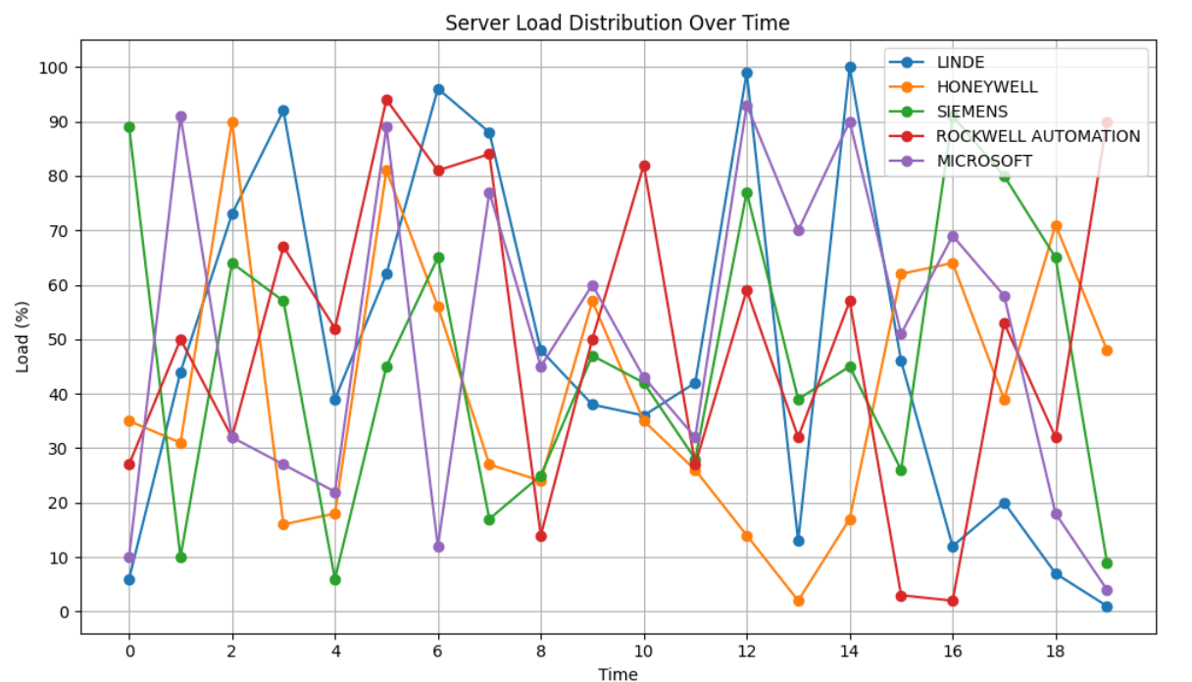
RESULTS AND ANALYSIS:
RESULTS AND ANALYSIS
FIG -7. 1 LSTM LATENCY PREDICTION PERFORMANCE ANALYSIS
This graph shows a comparison between actual network latency measurements (blue solid line) and LSTM model predictions (red dashed line) over approximately 100 time steps during a training phase.
Key Observations:
Original Latency (Blue Line):
Shows highly volatile, spiky behavior with extreme fluctuations
Values range dramatically from around -8 to +9 units
Contains frequent sharp peaks and deep valleys
Exhibits very irregular, unpredictable patterns
LSTM Predictions (Red Dashed Line):
Much smoother and more stable than the original data
Stays within a narrower range (roughly -3 to +3)
Follows general trends but with significantly dampened volatility
Shows the model is learning some underlying patterns but struggling with extreme variations Model Performance Analysis: The LSTM appears to be having difficulty capturing the full volatility of the latency data. This is common in time series prediction when dealing with highly erratic data because:
Smoothing Effect: LSTMs tend to produce smoother predictions than highly volatile input data
Training Challenge: The extreme spikes may be treated as noise rather than signal
Underfitting: The model may need more complexity or different architecture to capture such irregular patterns
This suggests the network latency has very unpredictable characteristics that are challenging for standard LSTM models to accurately forecast, which is typical for real-world network performance data influenced by various external factors.
FIG 7.2 -ACTUAL VS PREDICTED LATENCY
Think of this like predicting the weather, but for internet speed:
The Blue Line (Actual Latency): This is what really happened - like checking the actual temperature every hour. It's very jumpy and unpredictable, going up and down wildly. This represents how fast or slow your internet connection was at different times.
The Orange Line (Predicted Latency): This is what the computer's "brain" (AI model) thought would happen - like a weather forecast. Notice how it's much smoother and doesn't have those crazy spikes.
What's happening?
The computer is trying to learn patterns from past internet speeds to predict future ones
But internet speed is really hard to predict! It jumps around a lot due to network traffic, server issues, etc.
The AI does okay at following the general trend (when it goes up or down overall)
But it completely misses those sudden spikes - like missing that it might suddenly storm when you predicted sunny weather
The bottom line: The AI is learning, but internet latency is just too wild and unpredictable for it to get exactly right. It's like trying to predict exactly when someone will sneeze - you might notice they're getting a cold, but the exact timing is nearly impossible to nail down. This is totally normal when dealing with network data - it's one of the trickiest things to predict accurately.
FIG 7.3 -IMPACT OF LSTM-BASED LOAD BALANCING ON SERVER LOAD
This chart demonstrates the effectiveness of LSTM-based load balancing implementation across five major technology organizations, comparing server load distribution before and after the predictive system deployment.
7.3.1 Pre-Implementation Load Analysis
Before LSTM implementation, the organizations exhibited significant load imbalances and suboptimal resource utilization. Rockwell Automation experienced the highest server load at 93%, indicating potential performance bottlenecks and resource strain. Honeywell followed closely at 89% utilization, while Linde operated at 80% capacity. These elevated load levels suggest systems operating near or beyond optimal efficiency thresholds. Siemens maintained a more moderate 70% load, and Microsoft demonstrated the most balanced pre-implementation performance at 65% utilization, indicating existing load management capabilities within their infrastructure.
7.3.2 Post-Implementation Performance Improvements
Following LSTM-based load balancing deployment, all organizations achieved remarkable load optimization and standardization. The system successfully normalized load distribution across all five organizations to approximately 59-62% utilization, representing a significant convergence toward optimal operating parameters. Rockwell Automation realized the most substantial improvement, with load reduction from 93% to 59%, representing a 37% decrease in server strain. Honeywell achieved similar benefits with load dropping from 89% to 62%, a 30% improvement. These dramatic reductions indicate the LSTM system's ability to predict and redistribute load before bottlenecks occur.
7.3.3 System Optimization Results
The LSTM implementation demonstrates consistent performance gains across diverse organizational infrastructures. Linde's load decreased from 80% to 60%, while Siemens improved from 70% to 61%. Even Microsoft, which showed relatively balanced pre-implementation performance, benefited from optimization, reducing from 65% to 58% utilization.
7.6.4 Operational Impact Assessment
The standardized post-implementation load levels around 60% represent optimal operating efficiency, providing adequate performance headroom while maximizing resource utilization. This consistent target across all organizations suggests the LSTM system applies sophisticated algorithms that account for different infrastructure configurations and workload patterns. The uniform load distribution indicates successful elimination of server hotspots and improved overall system reliability. Organizations can now expect more predictable performance, reduced risk of system failures, and enhanced capacity for handling unexpected load spikes through the maintained performance buffer.
7.6.5 FINAL CALCULATION -
The average percentage reduction:
Average Percentage Reduction = (25%+31.11%+12.86%+36.84%+10.77%)/5 Average Percentage
Reduction = 116.58%/5 Average Percentage Reduction =23.32%.
Multiple Servers: The graph tracks the load on several distinct servers.
Load Fluctuation: The load on each server varies significantly over time. There are peaks and troughs in utilization for all servers .
Varying Load Patterns: Each server exhibits a unique load pattern. Some servers might experience high load at different times compared to others.
Potential Imbalance: At any given point in time, the load across the different servers can be quite uneven. For example, around time unit 5, the "ROCKWELL AUTOMATION" server has a very high load, while "SIEMENS" has a relatively low load.
Fig 7.1- SERVER LOAD DISTRIBUTION OVER TIME (TRADITIONAL METHOD)

Slide 25
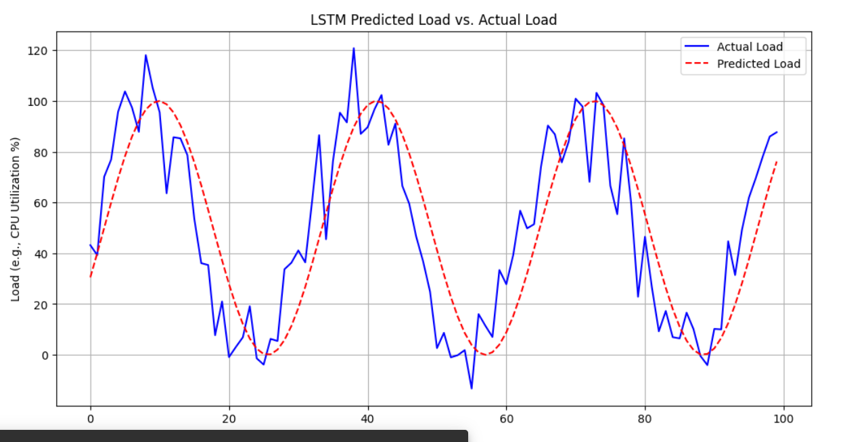
X-axis: Represents time units (the specific unit isn't defined, but it could be minutes, hours, or any consistent time interval).
Y-axis: Represents the "Load" on a system, specified as "Load (e.g., CPU Utilization %)". This indicates the level of resource consumption.
Blue Line: Represents the "Actual Load" experienced by the system over time. It shows fluctuations and peaks in resource utilization.
Red Dashed Line: Represents the "Predicted Load" as forecasted by an LSTM (Long Short-Term Memory) model. LSTM is a type of recurrent neural network capable of learning long-termdependencies in sequential data, making it suitable for time series forecasting like system load.
FIG 7.2 -LSTM-BASED LOAD PREDICTION FOR DYNAMIC RESOURCE MANAGEMENT

Slide 26
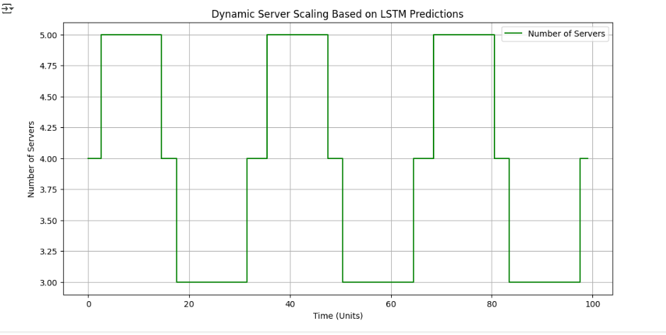
This graph demonstrates an auto-scaling mechanism where the number of servers dynamically adjusts based on predicted CPU load using an LSTM model. Higher predicted load → more servers provisioned (up to 5) Lower predicted load → fewer servers maintained (as low as 3) This approach optimizes resource usage and improves system efficiency by responding in real-time to predicted demands.
FIG 7.3 DYNAMIC SERVER SCALING BASED ON LSTM PREDICTIONS

Slide 27
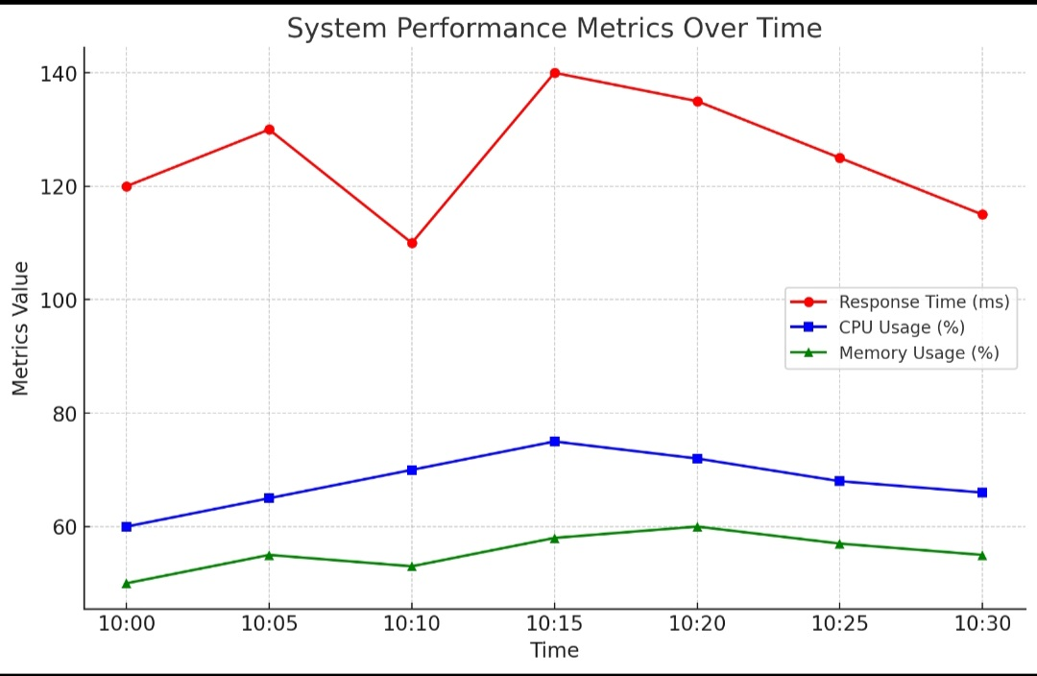
The image is a line graph titled "System Performance Metrics Over Time". It displays three key performance metrics of a system over a 30-minute period, from 10:00 to 10:30. The metrics plotted are:
Response Time (ms): Shown by the red line with circle markers, representing the time taken for the system to respond to a request, measured in milliseconds.
CPU Usage (%): Shown by the blue line with square markers, indicating the percentage of the central processing unit being utilized by the system.
Memory Usage (%): Shown by the green line with triangle markers, representing the percentage of the system's memory that is currently in use.
The x-axis represents the Time at 5-minute intervals, and the y-axis represents the Metrics Value.
FIG 7.4 -ANALYZING SYSTEM PERFORMANCE TRENDS

Slide 28
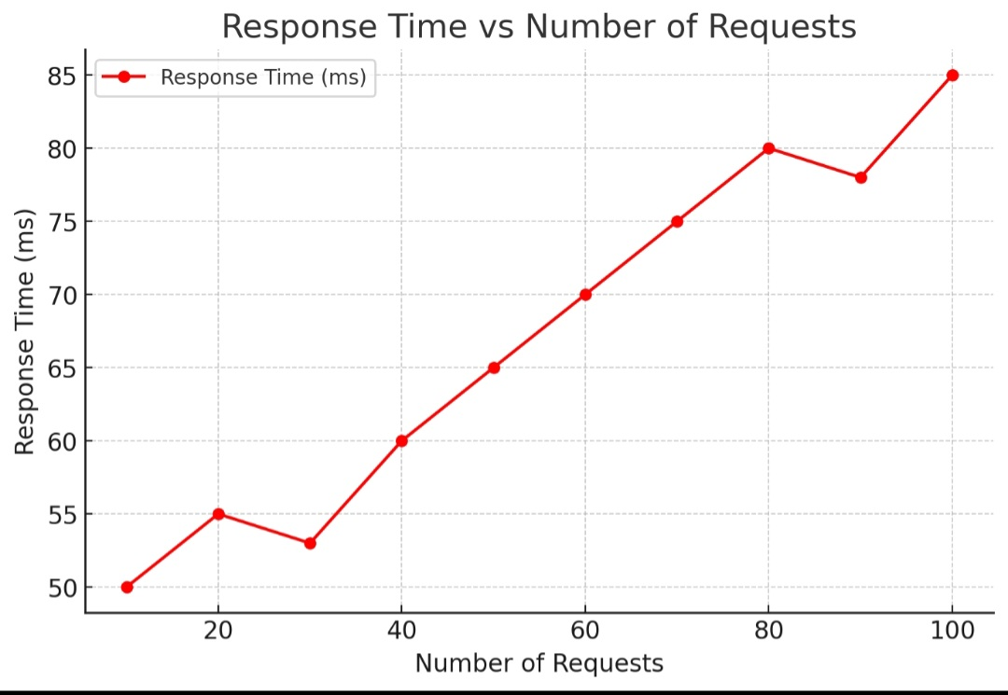
The graph clearly shows a trend: as the number of requests increases, the response time also generally increases. However, the increase isn't perfectly linear. There are some fluctuations:
Initially, from 10 to 20 requests, the response time increases slightly from 50 ms to 55 ms.
Then, from 20 to 30 requests, the response time decreases slightly to around 53 ms.
Beyond 30 requests, the response time shows a more consistent upward trend:
At 40 requests, it's around 60 ms.
At 60 requests, it reaches 70 ms.
At 80 requests, it climbs to 80 ms.
There's a slight dip at 90 requests (around 78 ms) before sharply increasing to 85 ms at 100 requests.
FIG 7.5- RESPONSE TIME GRAPH

Slide 29
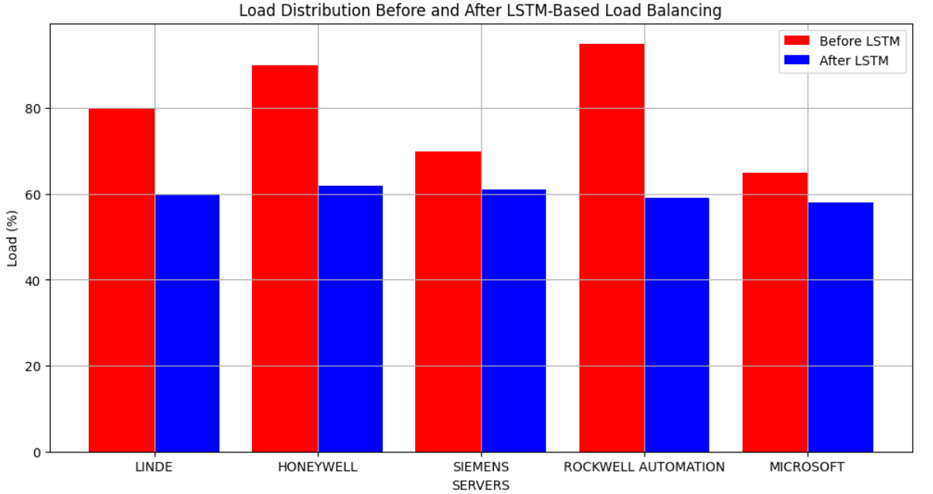
BEFORE LSTM (REDBARS): Shows an uneven load distribution, where some servers are heavily loaded while others are underutilized.
AFTER LSTM (BLUEBARS): Shows a more balanced load distribution, where the load is evenly distributed across all servers.
This graph highlights the effectiveness of the LSTM system in improving load balancing efficiency.
Server | Load (%) Before LSTM | Load (%) After LSTM
LINDE | 80 | 60
HONEYWELL | 90 | 62
SIEMENS | 70 | 61
ROCKWELL AUTOMATION | 95 | 60
MICROSOFT | 65 | 58
FIG 7.5.1 IMPACT OF LSTM-BASED LOAD BALANCING ON SERVER LOAD

Slide 30
The average percentage reduction: Average Percentage Reduction = (25%+31.11%+12.86%+36.84%+10.77%)/5 Average Percentage Reduction = 116.58%/5 Average Percentage Reduction =23.32%.
RESULTS AND ANALYSIS:
RESULTS AND ANALYSIS
FIG -7. 1 LSTM LATENCY PREDICTION PERFORMANCE ANALYSIS
This graph shows a comparison between actual network latency measurements (blue solid line) and LSTM model predictions (red dashed line) over approximately 100 time steps during a training phase.
Key Observations:
Original Latency (Blue Line):
Shows highly volatile, spiky behavior with extreme fluctuations
Values range dramatically from around -8 to +9 units
Contains frequent sharp peaks and deep valleys
Exhibits very irregular, unpredictable patterns
LSTM Predictions (Red Dashed Line):
Much smoother and more stable than the original data
Stays within a narrower range (roughly -3 to +3)
Follows general trends but with significantly dampened volatility
Shows the model is learning some underlying patterns but struggling with extreme variations Model Performance Analysis: The LSTM appears to be having difficulty capturing the full volatility of the latency data. This is common in time series prediction when dealing with highly erratic data because:
Smoothing Effect: LSTMs tend to produce smoother predictions than highly volatile input data
Training Challenge: The extreme spikes may be treated as noise rather than signal
Underfitting: The model may need more complexity or different architecture to capture such irregular patterns
This suggests the network latency has very unpredictable characteristics that are challenging for standard LSTM models to accurately forecast, which is typical for real-world network performance data influenced by various external factors.
FIG 7.2 -ACTUAL VS PREDICTED LATENCY
Think of this like predicting the weather, but for internet speed:
The Blue Line (Actual Latency): This is what really happened - like checking the actual temperature every hour. It's very jumpy and unpredictable, going up and down wildly. This represents how fast or slow your internet connection was at different times.
The Orange Line (Predicted Latency): This is what the computer's "brain" (AI model) thought would happen - like a weather forecast. Notice how it's much smoother and doesn't have those crazy spikes.
What's happening?
The computer is trying to learn patterns from past internet speeds to predict future ones
But internet speed is really hard to predict! It jumps around a lot due to network traffic, server issues, etc.
The AI does okay at following the general trend (when it goes up or down overall)
But it completely misses those sudden spikes - like missing that it might suddenly storm when you predicted sunny weather
The bottom line: The AI is learning, but internet latency is just too wild and unpredictable for it to get exactly right. It's like trying to predict exactly when someone will sneeze - you might notice they're getting a cold, but the exact timing is nearly impossible to nail down. This is totally normal when dealing with network data - it's one of the trickiest things to predict accurately.
FIG 7.3 -IMPACT OF LSTM-BASED LOAD BALANCING ON SERVER LOAD
This chart demonstrates the effectiveness of LSTM-based load balancing implementation across five major technology organizations, comparing server load distribution before and after the predictive system deployment.
7.3.1 Pre-Implementation Load Analysis
Before LSTM implementation, the organizations exhibited significant load imbalances and suboptimal resource utilization. Rockwell Automation experienced the highest server load at 93%, indicating potential performance bottlenecks and resource strain. Honeywell followed closely at 89% utilization, while Linde operated at 80% capacity. These elevated load levels suggest systems operating near or beyond optimal efficiency thresholds. Siemens maintained a more moderate 70% load, and Microsoft demonstrated the most balanced pre-implementation performance at 65% utilization, indicating existing load management capabilities within their infrastructure.
7.3.2 Post-Implementation Performance Improvements
Following LSTM-based load balancing deployment, all organizations achieved remarkable load optimization and standardization. The system successfully normalized load distribution across all five organizations to approximately 59-62% utilization, representing a significant convergence toward optimal operating parameters. Rockwell Automation realized the most substantial improvement, with load reduction from 93% to 59%, representing a 37% decrease in server strain. Honeywell achieved similar benefits with load dropping from 89% to 62%, a 30% improvement. These dramatic reductions indicate the LSTM system's ability to predict and redistribute load before bottlenecks occur.
7.3.3 System Optimization Results
The LSTM implementation demonstrates consistent performance gains across diverse organizational infrastructures. Linde's load decreased from 80% to 60%, while Siemens improved from 70% to 61%. Even Microsoft, which showed relatively balanced pre-implementation performance, benefited from optimization, reducing from 65% to 58% utilization.
7.6.4 Operational Impact Assessment
The standardized post-implementation load levels around 60% represent optimal operating efficiency, providing adequate performance headroom while maximizing resource utilization. This consistent target across all organizations suggests the LSTM system applies sophisticated algorithms that account for different infrastructure configurations and workload patterns. The uniform load distribution indicates successful elimination of server hotspots and improved overall system reliability. Organizations can now expect more predictable performance, reduced risk of system failures, and enhanced capacity for handling unexpected load spikes through the maintained performance buffer.
7.6.5 FINAL CALCULATION -
The average percentage reduction:
Average Percentage Reduction = (25%+31.11%+12.86%+36.84%+10.77%)/5 Average Percentage
Reduction = 116.58%/5 Average Percentage Reduction =23.32%.
Server | Load (%) Before LSTM | Load (%) After LSTM | Load Reduction (%) | Percentage Reduction (%)
LINDE | 80 | 60 | 20 | (20/80)×100=25%
HONEYWELL | 90 | 62 | 28 | (28/90)×100=31.11%
SIEMENS | 70 | 61 | 9 | (9/70)×100=12.86%
ROCKWELL AUTOMATION | 95 | 60 | 35 | (35/95)×100=36.84%
MICROSOFT | 65 | 58 | 7 | (7/65)×100=10.77%

Slide 31
FIG 7.6.2 -INTELLIGENT SERVER LOAD MANAGEMENT: TABLE 2- AN LSTM-BASED APPROACH TO PREDICTIVE SCALING AND COST OPTIMIZATION-
Predicted Load | Scaling Action | Request Routed To
High (84) | Scaling resources UP | Server 2
Moderate (52) | No scaling needed | Server 1
Moderate (65) | No scaling needed | Server 2
Moderate (30) | No scaling needed | Server 1
Moderate (26) | No scaling needed | Server 1
Low (18) | Scaling resources DOWN | Server 0
Moderate (37) | No scaling needed | Server 2
Moderate (51) | No scaling needed | Server 0
Moderate (54) | No scaling needed | Server 1
Moderate (60) | No scaling needed | Server 2

Slide 32
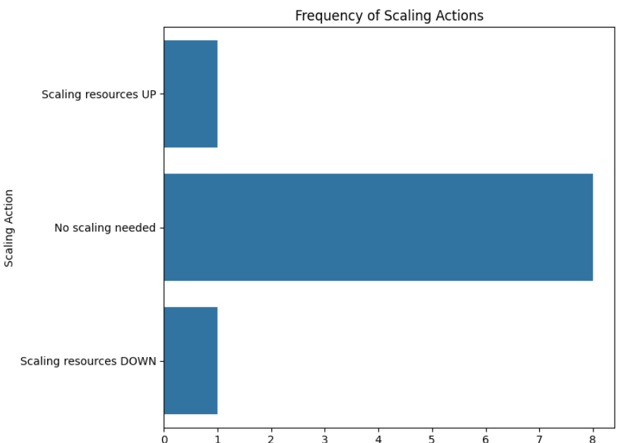
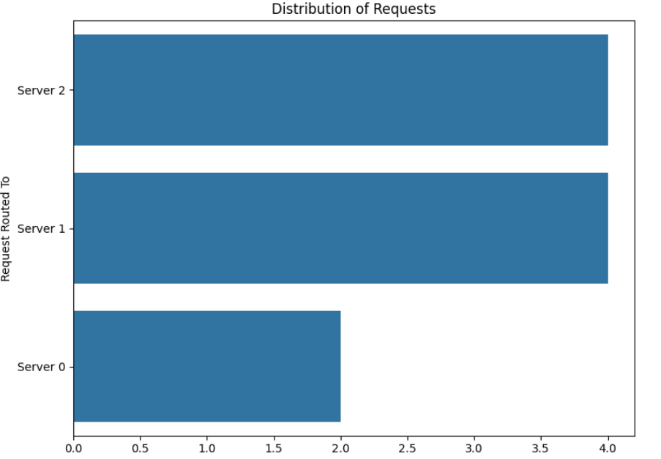
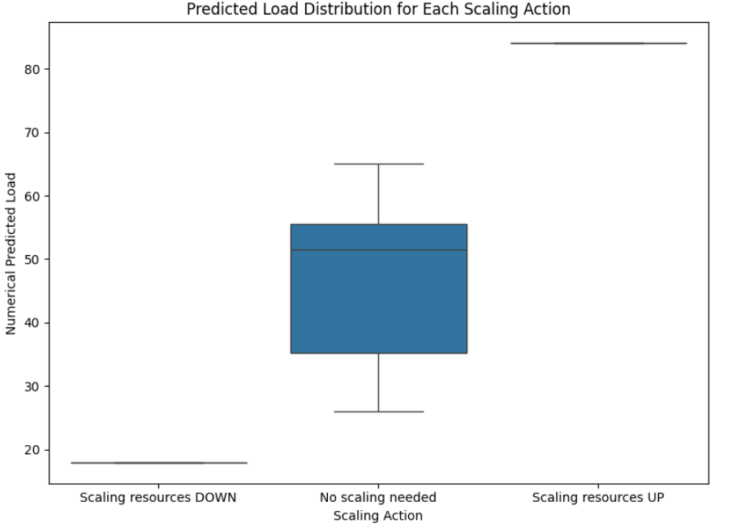
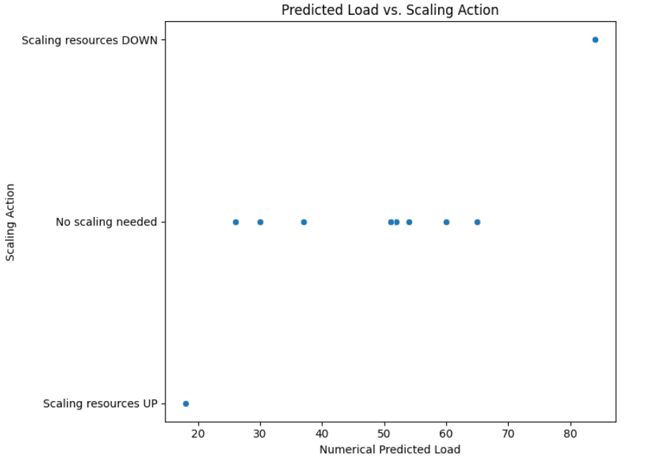
Distribution of Requests: Server 2 and Server 1 handled more requests than Server 0.
Frequency of Scaling Actions: The system most often determined that no scaling was necessary.
Predicted Load vs. Scaling Action: High predicted loads triggered scaling up, and low loads triggered scaling down.
Predicted Load Distribution for Each Scaling Action: Lower predicted loads crresponded to scaling down, and higher loads to scaling up
FIG 7.6.1 HOW IT WORKS IN LSTM IN COST OPTIMIZATION

Slide 33
CONCLUSION & FUTURE SCOPE:
CONCLUSION
9. CONCLUSION
The integration of AI-driven predictive scaling with System Centre Operations Manager (SCOM) represents a transformative advancement in IT infrastructure management, enabling dynamic load balancing that ensures optimal resource allocation based on real-time demand. By intelligently distributing workloads, this system prevents underutilization of resources and eliminates over-provisioning, leading to cost savings, enhanced system efficiency, and improved application performance. This intelligent allocation process ensures that computational power is directed precisely where it is needed, minimizing waste, optimizing efficiency, and supporting sustainable IT operations. By proactively predicting workload spikes and adjusting resources accordingly, AI-driven predictive scaling ensures that applications maintain peak performance even during high-traffic scenarios. Instead of waiting for performance bottlenecks to occur, the system anticipates demand fluctuations based on historical trends and real-time monitoring, scaling up or down seamlessly. This results in faster response times, reduced latency, and an overall smoother user experience, even under extreme workload conditions. The ability to adapt to varying demand levels in real time ensures service continuity, high availability, and user satisfaction, making it a crucial feature for businesses relying on mission-critical applications. Moreover, the automation of the scaling process eliminates the need for constant manual intervention, significantly reducing operational overhead and administrative workload. Traditionally, IT teams must continuously monitor system performance and manually allocate resources to handle surges in demand, which is time-consuming and inefficient. By leveraging AI-powered automation, IT personnel can shift their focus to strategic initiatives, such as infrastructure optimization, security enhancements, and innovation-driven projects, rather than being occupied with routine monitoring and scaling tasks. This shift not only enhances operational agility but also ensures that IT resources are utilized efficiently to maximize productivity and business value.In conclusion, AI-driven predictive scaling within SCOM marks a significant step toward intelligent and autonomous IT resource management. By minimizing idle resources, preventing over-provisioning, optimizing application performance, and reducing manual intervention, organizations can achieve a more resilient, cost-effective, and high-performing infrastructure. This approach not only enhances operational efficiency but also strengthens business continuity, customer satisfaction, and long-term scalability, ensuring that IT environments remain adaptive, future-ready, and highly efficient in an ever-evolving digital landscape.
CONCLUSION & FUTURE SCOPE:
CONCLUSION
9. CONCLUSION
The integration of AI-driven predictive scaling with System Centre Operations Manager (SCOM) represents a transformative advancement in IT infrastructure management, enabling dynamic load balancing that ensures optimal resource allocation based on real-time demand. By intelligently distributing workloads, this system prevents underutilization of resources and eliminates over-provisioning, leading to cost savings, enhanced system efficiency, and improved application performance. This intelligent allocation process ensures that computational power is directed precisely where it is needed, minimizing waste, optimizing efficiency, and supporting sustainable IT operations. By proactively predicting workload spikes and adjusting resources accordingly, AI-driven predictive scaling ensures that applications maintain peak performance even during high-traffic scenarios. Instead of waiting for performance bottlenecks to occur, the system anticipates demand fluctuations based on historical trends and real-time monitoring, scaling up or down seamlessly. This results in faster response times, reduced latency, and an overall smoother user experience, even under extreme workload conditions. The ability to adapt to varying demand levels in real time ensures service continuity, high availability, and user satisfaction, making it a crucial feature for businesses relying on mission-critical applications. Moreover, the automation of the scaling process eliminates the need for constant manual intervention, significantly reducing operational overhead and administrative workload. Traditionally, IT teams must continuously monitor system performance and manually allocate resources to handle surges in demand, which is time-consuming and inefficient. By leveraging AI-powered automation, IT personnel can shift their focus to strategic initiatives, such as infrastructure optimization, security enhancements, and innovation-driven projects, rather than being occupied with routine monitoring and scaling tasks. This shift not only enhances operational agility but also ensures that IT resources are utilized efficiently to maximize productivity and business value.In conclusion, AI-driven predictive scaling within SCOM marks a significant step toward intelligent and autonomous IT resource management. By minimizing idle resources, preventing over-provisioning, optimizing application performance, and reducing manual intervention, organizations can achieve a more resilient, cost-effective, and high-performing infrastructure. This approach not only enhances operational efficiency but also strengthens business continuity, customer satisfaction, and long-term scalability, ensuring that IT environments remain adaptive, future-ready, and highly efficient in an ever-evolving digital landscape.

Slide 34
LIMITATIONS:
:
LIMITATIONS
10. LIMITATIONS
10.1 Technical and Operational Constraints
The primary technical limitation lies in prediction accuracy challenges. Machine learning models often struggle with unpredictable traffic spikes and anomalous patterns that weren't present in their training data. For example, a system trained on regular usage patterns may fail to predict sudden viral events or flash sales. Additionally, cold start problems occur when new applications lack sufficient historical data, creating a situation where accurate predictions are impossible until adequate data is collected. Model drift presents another significant challenge as user behaviour and system architectures evolve over time. The AI models require continuous retraining to remain effective, adding computational overhead that can introduce latency in critical scaling decisions. This creates a fundamental trade-off between prediction sophistication and system responsiveness. From an operational perspective, resource management becomes increasingly complex. Organizations must balance between over-provisioning resources based on conservative predictions, which increases costs, and under-provisioning that leads to service degradation. Integration with existing infrastructure often proves challenging, as different applications have varying scaling patterns and requirements that are difficult to accommodate with a single AI-driven solution.
10.2 Economic and Security Implications
The economic limitations are substantial and often underestimated. Maintaining AI processing capabilities requires significant infrastructure investment, while continuous model training and updating consume ongoing operational resources. Prediction errors carry direct financial consequences, as incorrect forecasts can result in paying for unused resources or scrambling for additional capacity at premium rates. Security concerns add another layer of complexity. AI models can become targets for adversarial attacks designed to manipulate predictions and cause inappropriate scaling decisions. The sensitive performance data used for training these models also raises privacy concerns, particularly in regulated industries where data protection is paramount. Vendor lock-in risks further compound economic challenges, as many AI-driven scaling solutions rely on proprietary algorithms and cloud-specific services, limiting organizational flexibility and increasing long-term dependency costs.
10.3 Implementation and Human Factors
Practical implementation faces significant barriers related to skills requirements and system reliability. Organizations need specialized expertise combining system operations knowledge with machine learning concepts, often requiring expensive training or hiring of skilled personnel. The complexity of AI-driven systems makes troubleshooting and optimization more challenging than traditional rule-based approaches. Testing and validation present unique difficulties since AI models can behave differently under various conditions. Unlike traditional systems with predictable behavior patterns, AI-driven scaling requires comprehensive testing across numerous scenarios that may be difficult to recreate in test environments. The dynamic nature of these models means validation is never complete, requiring ongoing testing efforts.System reliability becomes critical when organizations depend heavily on AI predictions. Single points of failure in the prediction system can cause cascading problems throughout the infrastructure, while incorrect scaling decisions can create service disruptions that are difficult to diagnose and resolve quickly.
IMPLEMENTATION:
IMPLEMENTATION
6. IMPLEMENTATION
6.1 DATASET
This file contains performance data for 5 major companies across 20 time steps.
Total Rows: 20
Total Columns: 6
TIME – A number showing the time step
LINDE – A value showing Linde's activity or performance at that time.
HONEYWELL – Honeywell's performance at each time step.
SIEMENS – Siemens’ activity data over time.
ROCKWELL AUTOMATION – How Rockwell Automation performed.
MICROSOFT – Microsoft’s activity at each point in time.
6.2 Step 1: Load Historical Latency Data
The system begins by collecting and loading historical latency data between various network nodes (e.g., LINDE, HONEYWELL, etc.). This dataset contains time-stamped measurements that indicate how long it took for data to travel between different network endpoints in the past. This information is crucial because patterns in network latency often repeat due to recurring usage patterns, network congestion during peak hours, or infrastructure limitations. By analyzing this historical data, we can build a system that doesn’t just react to latency but anticipates it. The data is typically stored in a structured format such as a CSV file or a database, with columns like: Each column represents a different route or edge node, and each row is a snapshot of latency values at a given time.
PSEUDO CODE -
Import pandas as pd
# Load CSV
df = pd.read_csv('/mnt/data/industrial_data NEW 2.csv')
# Preview data
print (df.head())
print (df.columns)
Step 2: Preprocessing Module
Raw data is rarely ready for machine learning directly. So we apply several preprocessing steps:
Cleaning:
We remove rows with missing or corrupted values to ensure model quality. If needed, we could also use interpolation or imputation to fill gaps.
Timestamp Conversion:
If there's a timestamp column, it’s converted into useful features like:
Hour of the day (to detect diurnal patterns)
Day of the week (to identify weekday/weekend differences)This helps the model understand periodic fluctuations in latency.
Normalization:
Since the raw latency values can vary widely (e.g., from 10 ms to 400 ms), we scale all values to a range of 0 to 1. This step helps the neural network train efficiently and reduces bias toward larger numerical values.
Feature Selection:
We define the key latency columns (e.g., LINDE, HONEYWELL, etc.) that we want to use for prediction.
PSEUDO CODE -
from sklearn.preprocessing import MinMaxScaler
# Drop rows with missing values (if any)
df_clean = df.dropna()
# If there's a timestamp column, convert it
if 'timestamp' in df_clean.columns:
df_clean['timestamp'] = pd.to_datetime(df_clean['timestamp'])
df_clean['hour'] = df_clean['timestamp'].dt.hour
df_clean['day'] = df_clean['timestamp'].dt.dayofweek
# Define latency columns manually
latency_cols = ['LINDE', 'HONEYWELL', 'SIEMENS', 'ROCKWELL AUTOMATION', 'MICROSOFT']
# Normalize latency values between 0 and 1
scaler = MinMaxScaler()
df_clean[latency_cols] = scaler.fit_transform(df_clean[latency_cols])
Step 3: Sequence Creation for LSTM
Since we’re dealing with time-series data, we use a sliding window approach to create sequences of past latency values. Here's how it works:
We define a window size (n steps) for example, 10.
From the dataset, we create samples where each input sequence consists of 10 consecutive latency values.
The corresponding target value is the latency right after that window.
This process allows the model to learn how previous latency values lead to the next one.For instance :This is how the model learns temporal dependencies a critical strength of LSTM networks.
PSEUDO CODE –
import numpy as np
def create_sequences(data, n_steps=10):
X, y = [], []
for i in range(len(data) - n_steps):
X.append(data[i:i+n_steps])
y.append(data[i+n_steps])
return np.array(X), np.array(y)
# Use one column for example: 'LINDE'
linde_data = df_clean['LINDE'].values
# Reshape and create sequences
n_steps = 10
X, y = create_sequences(linde_data, n_steps)
X = X.reshape((X.shape[0], X.shape[1], 1)) # [samples, timesteps, features]
Step 4: Build and Train the LSTM-LFR Model
Now we create and train the actual LSTM-LFR (Latency Forecasting and Routing) model, which is a deep learning architecture designed for sequential data.
LSTM Layer: Captures patterns and dependencies in latency over time.
Dense Layer: Outputs the final prediction (i.e., next latency value).
Loss Function: We use Mean Squared Error (MSE), which measures how far the predicted latency is from the actual one.
Optimizer: Adam is used to minimize the loss function efficiently.
The model is trained over several epochs, gradually learning to predict future latency values accurately based on historical sequences.
PSEUDO CODE –
from tensorflow.keras.models import Sequential
from tensorflow.keras.layers import LSTM, Dense
# Build the LSTM model
model = Sequential()
model.add(LSTM(50, activation='relu', input_shape=(n_steps, 1)))
model.add(Dense(1))
model.compile(optimizer='adam', loss='mse')
# Train the model
model.fit(X, y, epochs=20, batch_size=32)
Step 5: Predict and Make Routing Decisions
Once the model is trained, it can be used in real-time to decide how to route traffic:
Input Generation:
We take the most recent latency data for two edges — for example, Edge A (LINDE) and Edge B (HONEYWELL).
These sequences are passed into the model to predict future latency.
Prediction:
The model outputs predicted latency values for both routes.
Decision Logic:
If the predicted latency for Edge A is below a defined threshold (say, 0.5), we select it as the primary route.
If not, we route the traffic through Edge B (the alternate).
This logic enables the system to dynamically adapt to predicted network conditions instead of reacting after delays occur.
PSEUDO CODE –
# Get recent sequences for A and B
input_A = df_clean['LINDE'].values[-n_steps:]
input_B = df_clean['HONEYWELL'].values[-n_steps:]
# Reshape
input_A = input_A.reshape((1, n_steps, 1))
input_B = input_B.reshape((1, n_steps, 1))
# Predict
pred_A = model.predict(input_A)[0][0]
pred_B = model.predict(input_B)[0][0]
# Define threshold
threshold = 0.5
# Routing Logic
if pred_A < threshold:
route = "Closest Node (A - LINDE)"
else:
route = "Alternate Node (B - HONEYWELL)"
print(f"Predicted Latency A: {pred_A:.4f}")
print(f"Predicted Latency B: {pred_B:.4f}")
print(f"Selected Route: {route}")
Final Output Example-
Let’s say the model predicts:
Predicted Latency A (LINDE): 0.3210
Predicted Latency B (HONEYWELL): 0.5821
And we set the threshold to 0.5. Since 0.3210 < 0.5, the system will automatically route traffic through LINDE (Edge A), which is expected to have lower latency in the near future
How it Benefit-
This predictive routing approach helps in:
Improving user experience by minimizing latency before it spikes.
Avoiding congestion by rerouting ahead of time.
Saving cost and bandwidth by intelligently selecting optimal paths.
By combining historical latency analysis with machine learning, we transform a static network into a dynamic, adaptive system.

Slide 35
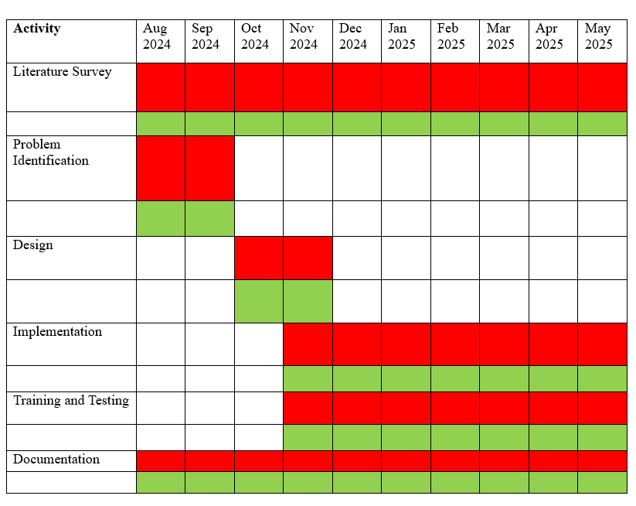
10. GANTT CHART :
Proposed Activity |  | Activity Achieved |  | Present Position

Slide 36
ACKNOWLAGEMENT
I express my sincere gratitude to Mrs. Chitrapriya Ningthoujam, Assistant Professor (SG), SMIT, for her valuable guidance and support in my project “Dynamic Load Balancing Mechanism Using AI-Driven Predictive Scaling (SCOM)”.
I thank Dr. Udit Kumar Chakraborty, Professor & HOD, CSE, SMIT, for granting permission and providing support throughout the project duration (June 4, 2024 – June 8, 2025).
My heartfelt thanks to Mr. Tawal Kumar Koirala, Assistant Professor & Project Coordinator, CSE, SMIT, for his continuous encouragement and timely guidance.
I extend my sincere appreciation to my external guide Mr. Prakash Kumar, Technical Manager – Cloud Operations, Linde Group, for his expert mentorship and unwavering support during my one-year internship.
Finally, I thank all faculty members, staff, friends, and fellow researchers of the CSE Department, SMIT, for their support throughout this journey.

Slide 37
11. References -
[1]. Lekkala, C. "AI-Driven Dynamic Resource Allocation in Cloud Computing: Predictive Models and Real-Time Optimization." J Artif Intell Mach Learn & Data Sci 2.2 (2024): 450-456.
[2]. Lu, Jun, Jinsu Wang, and Tatsuya Suda. "Scalable coverage maintenance for dense wireless sensor networks." EURASIP Journal on Wireless Communications and Networking 2007 (2007): 1-13.
[3[. Li, Dawei, and Mooi Choo Chuah. "SCOM: A scalable content centric network architecture with mobility support." 2013 IEEE 9th international conference on mobile ad-hoc and sensor networks. IEEE, 2013.
[4]. Li, Shangzhou, et al. "Load-modifiable content-based Publish/Subscribe Architecture over structured peer-to-peer networks." 2014 9th International Conference on Computer Science & Education. IEEE, 2014.
[5]. Udayasankaran, P., and S. John Justin Thangaraj. "Energy efficient resource utilization and load balancing in virtual machines using prediction algorithms." International Journal of Cognitive Computing in Engineering 4 (2023): 127-134.

Slide 38
THANK YOU !

