Slide 3
Mini whiteboards
Calculate the area of the following five shapes

Slide 4
5cm
60cm²
12cm

Slide 5
6cm
84cm²
14cm

Slide 6
16cm
40cm²
5cm

Slide 7
9cm
8cm
80cm²
11cm

Slide 8
14cm
100cm²
5cm
10cm
8cm

Slide 9
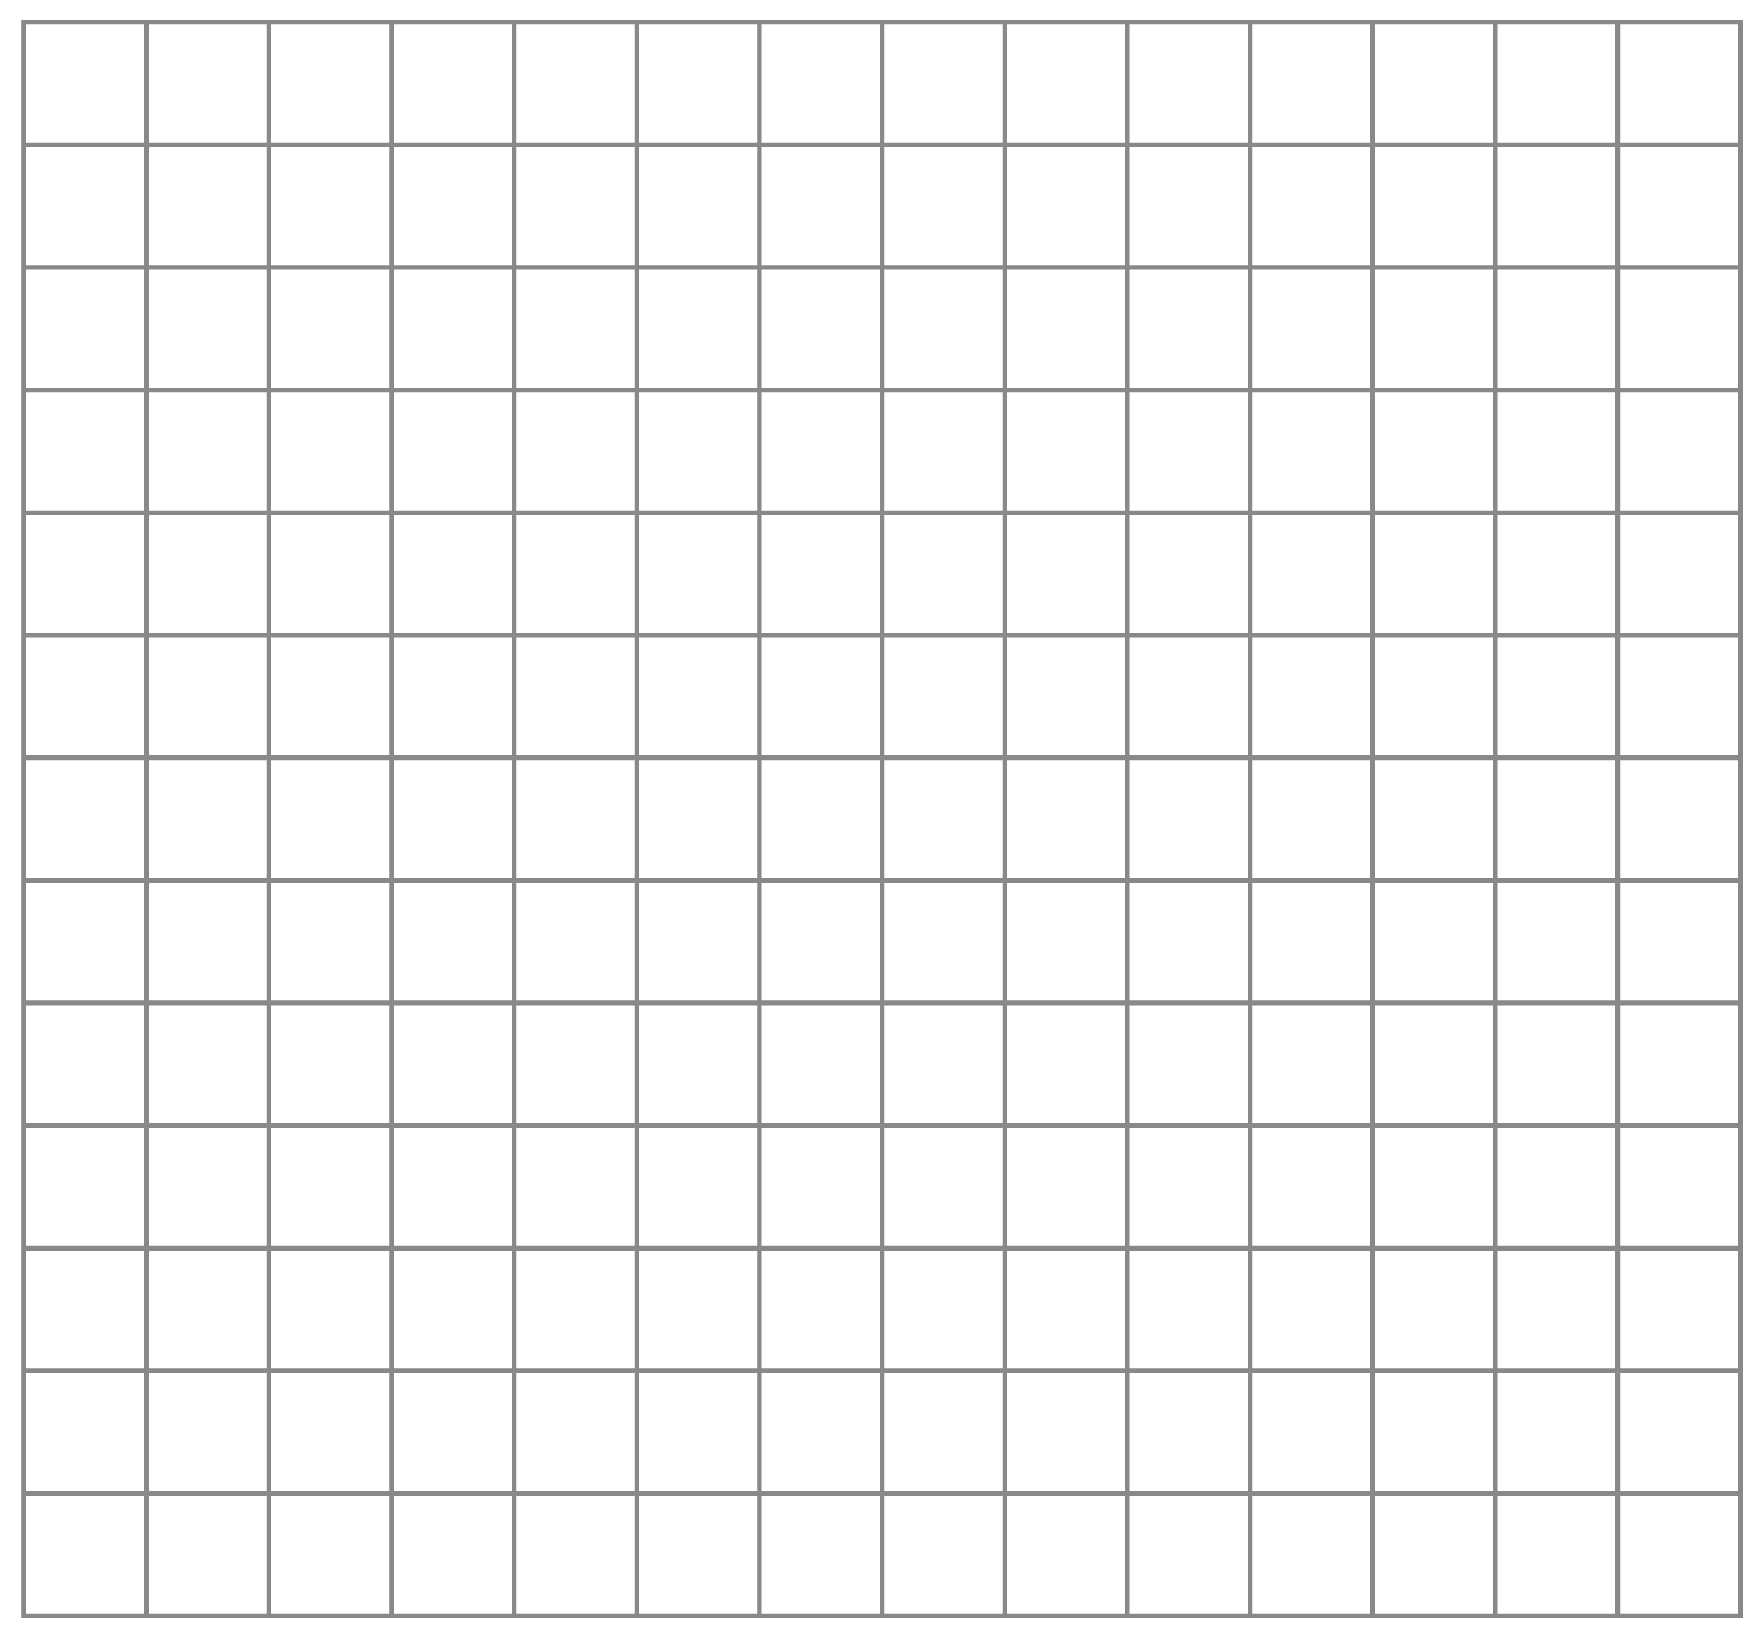
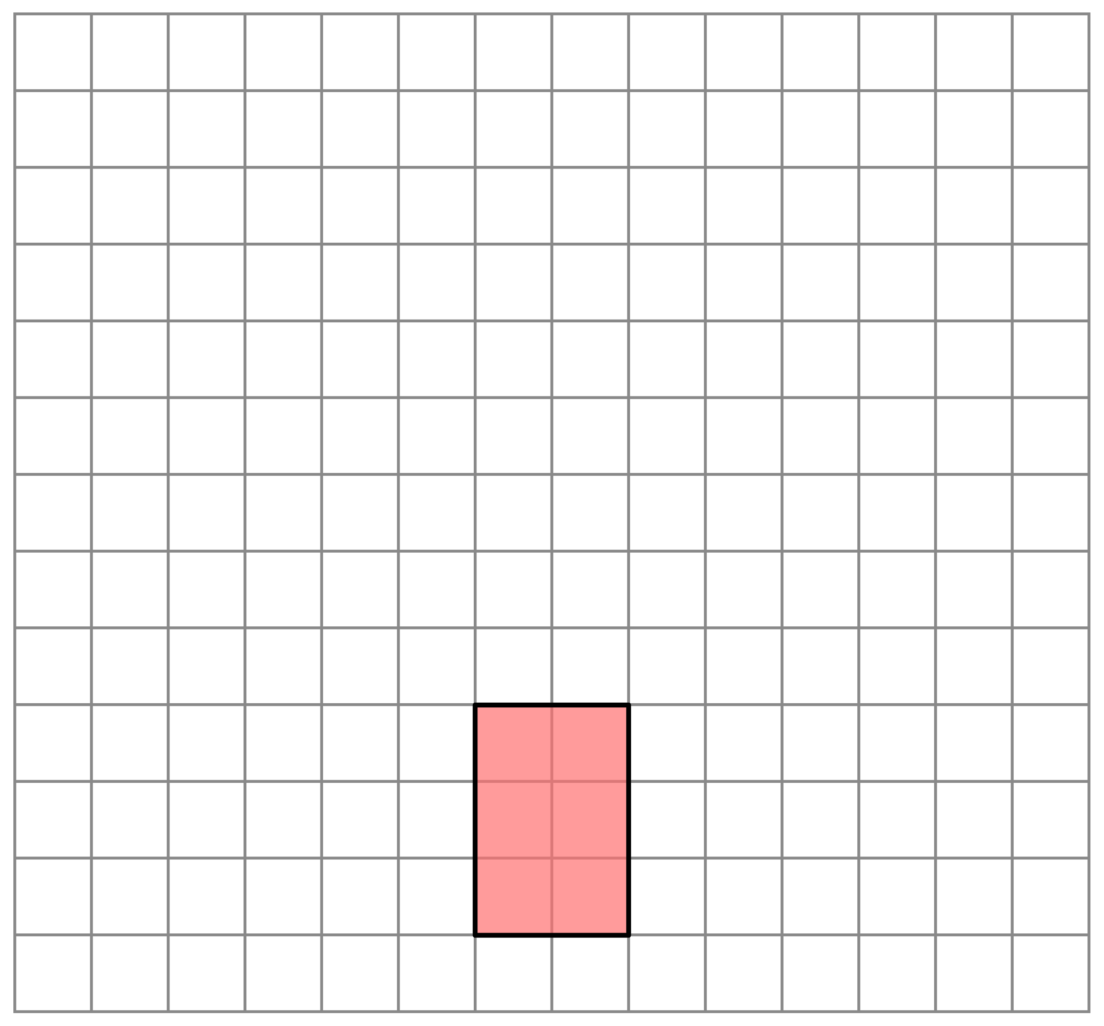
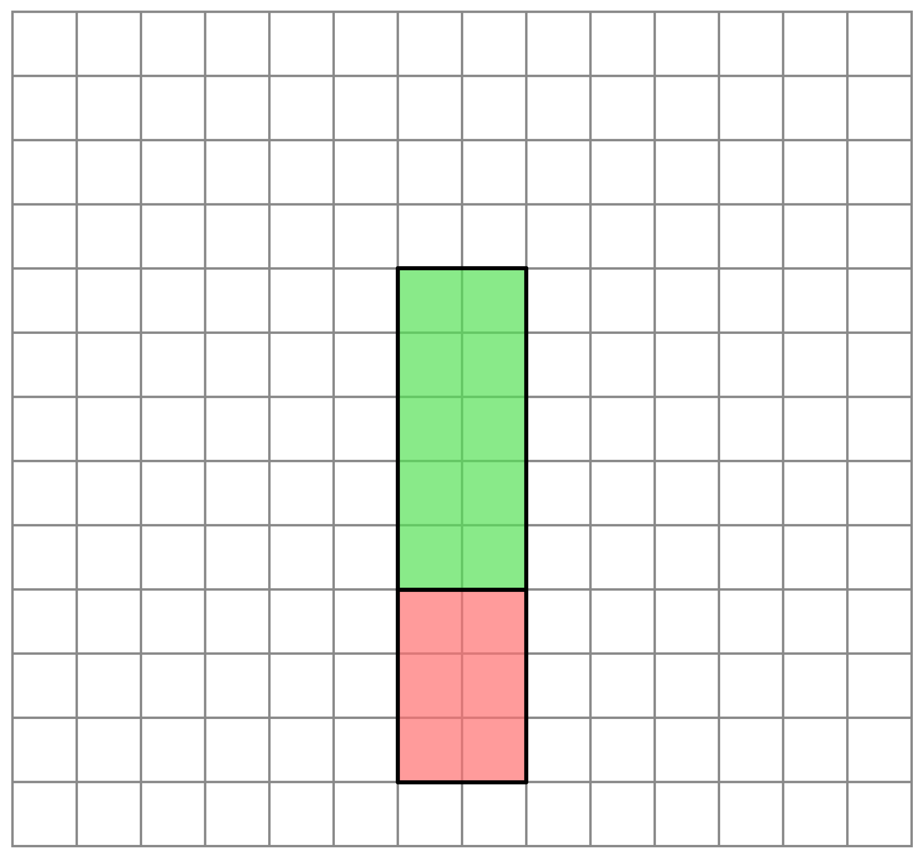
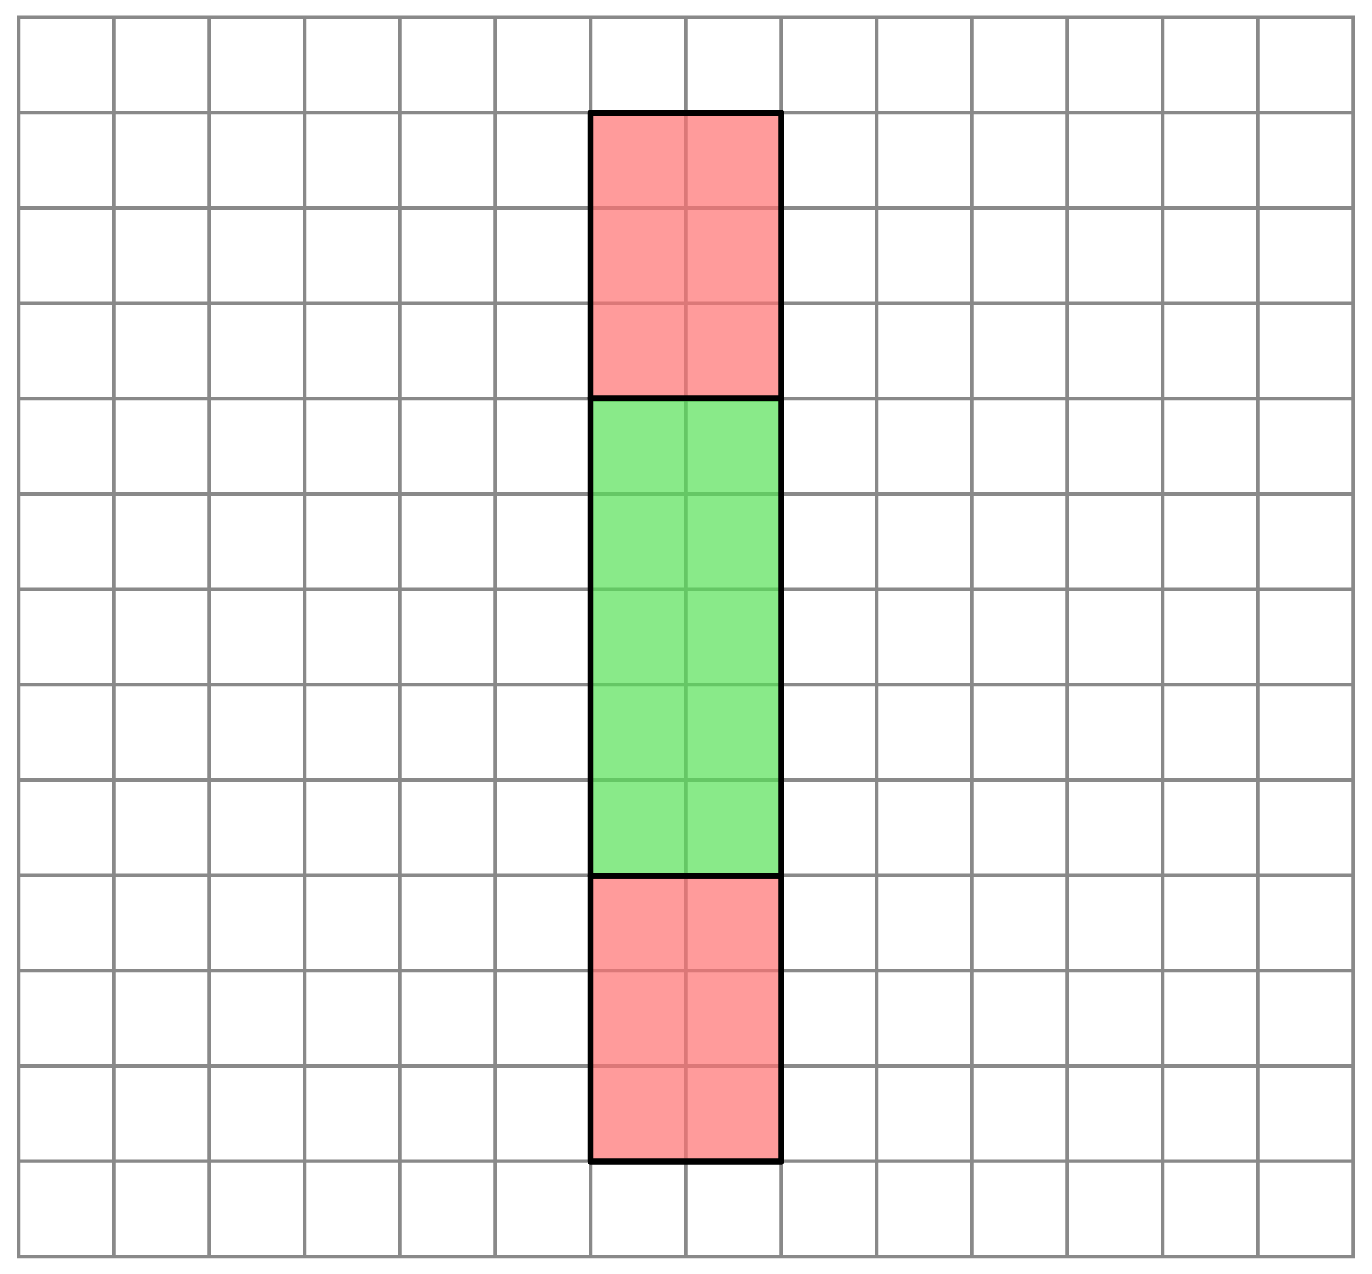
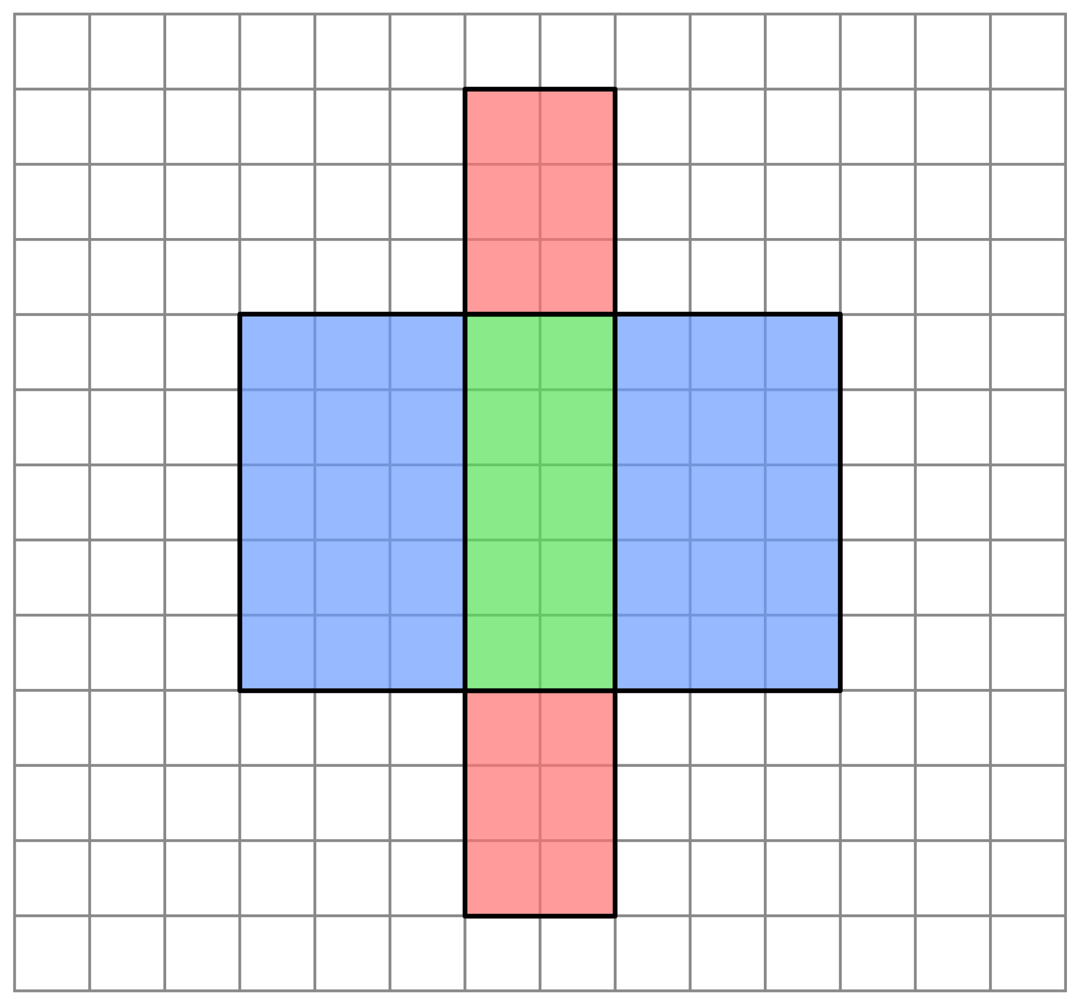
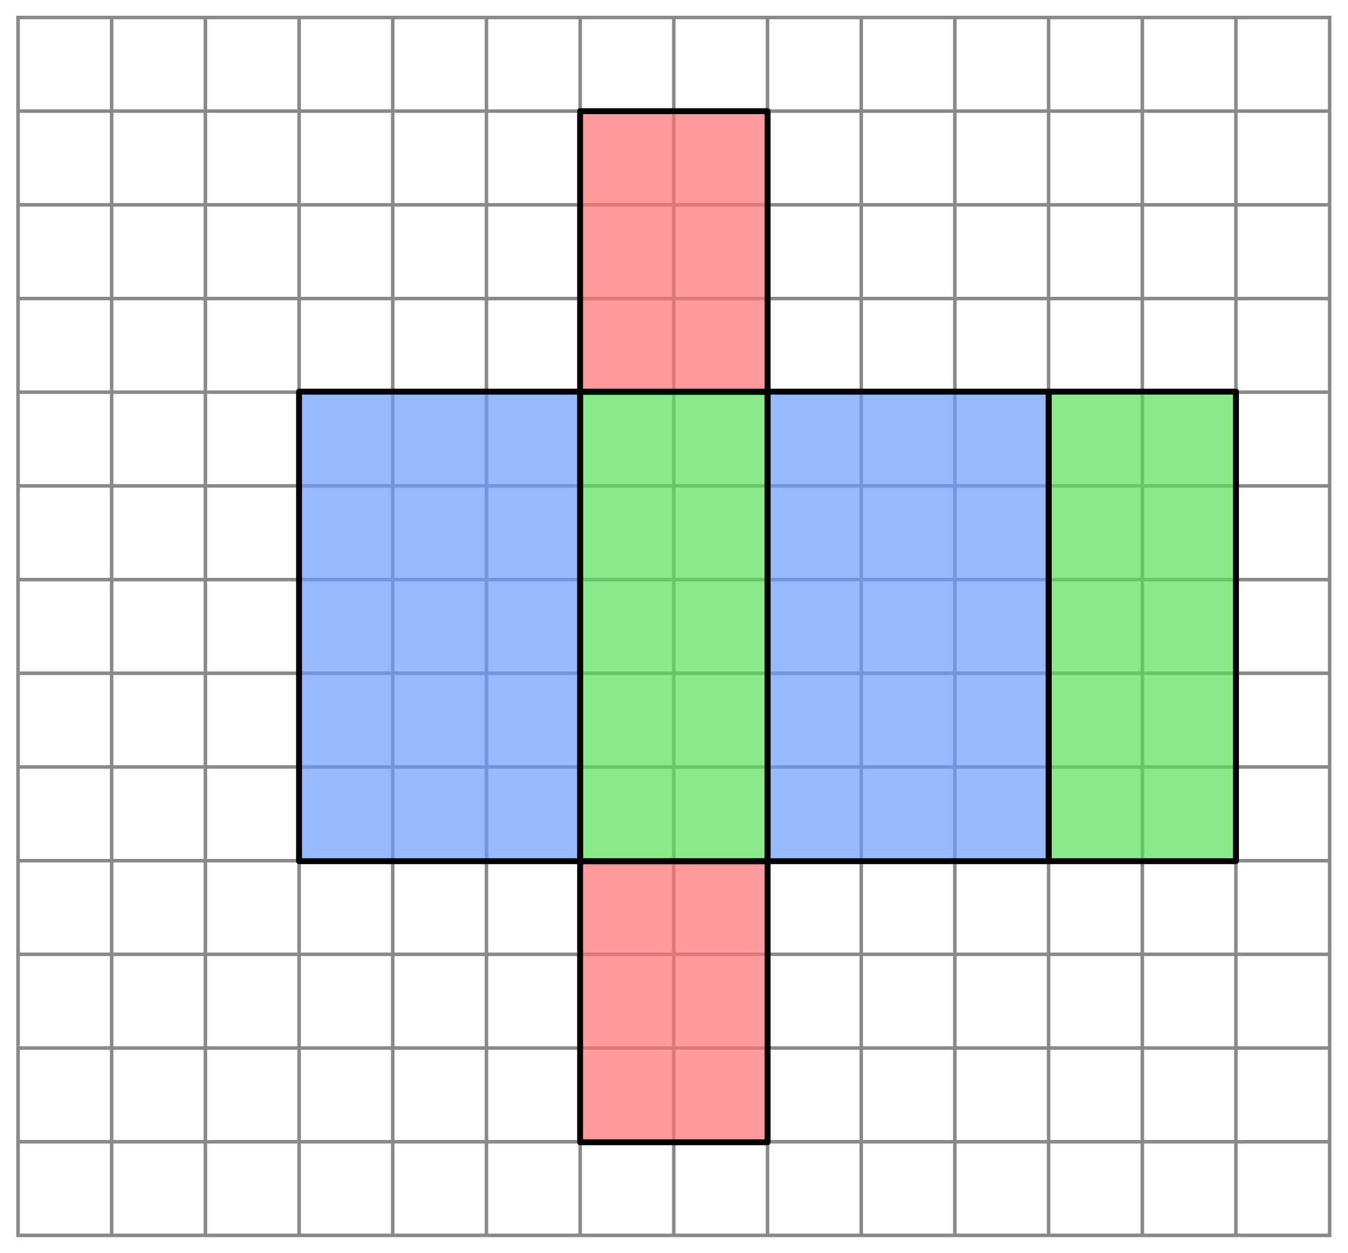
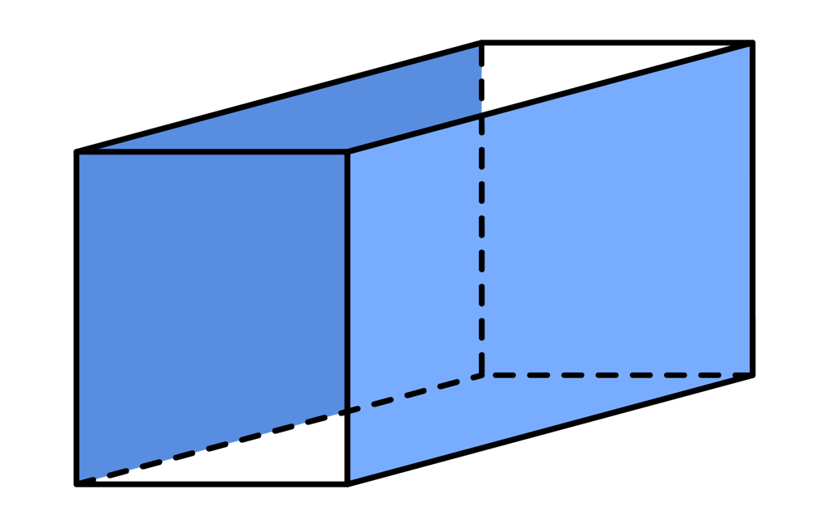
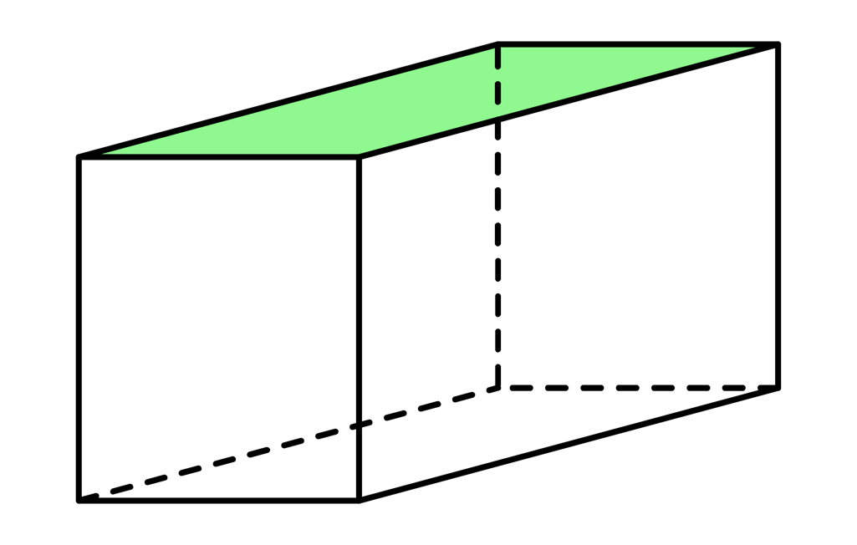
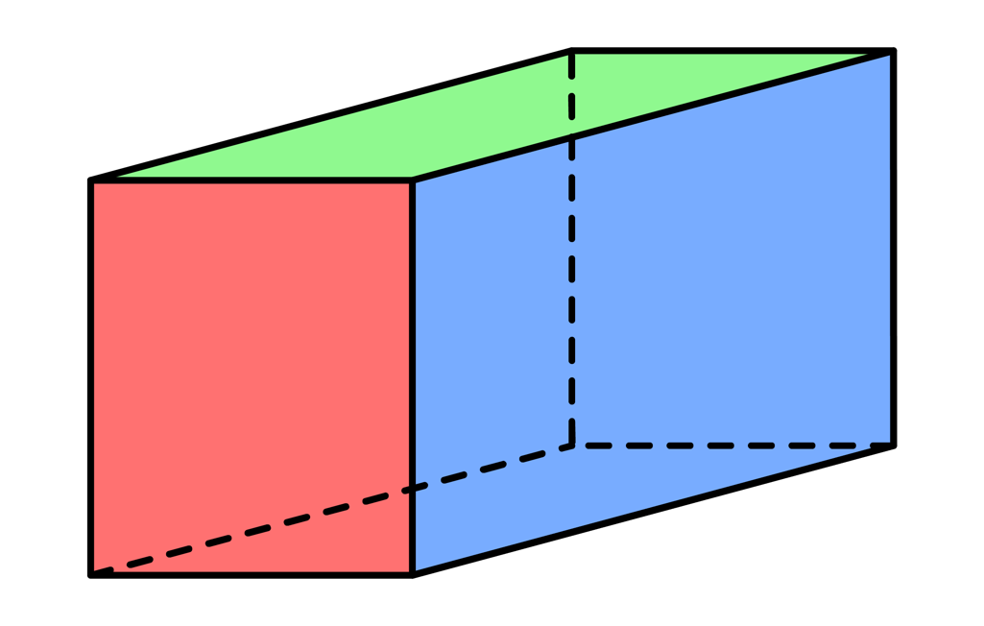
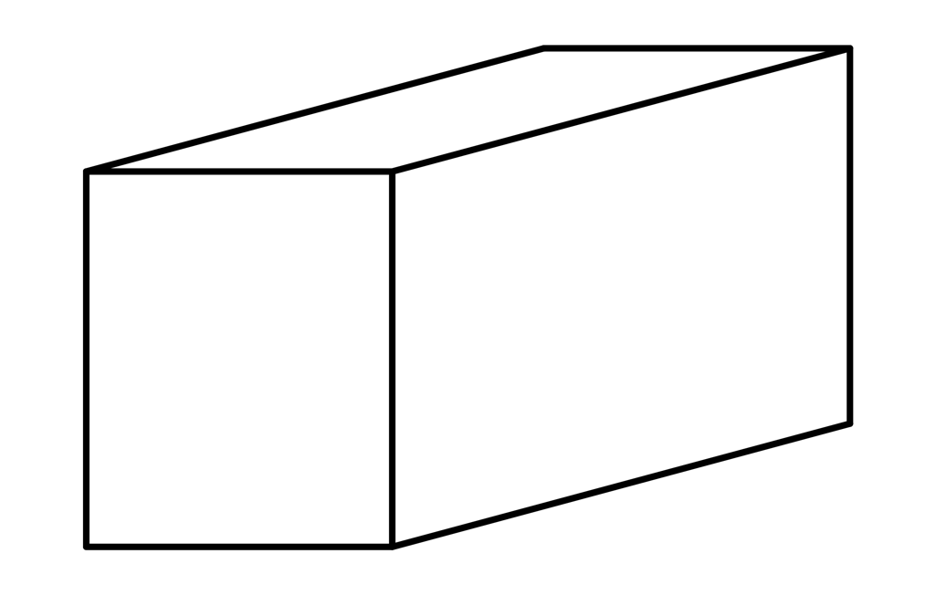
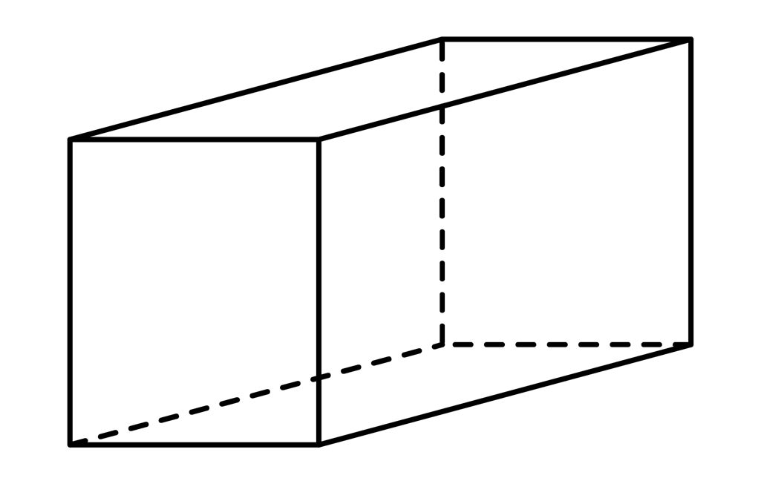
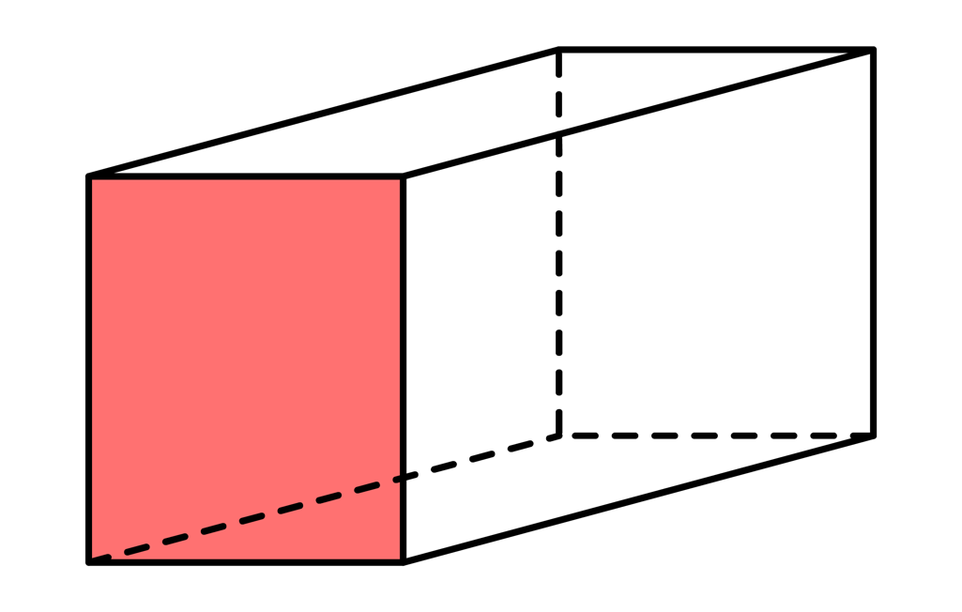
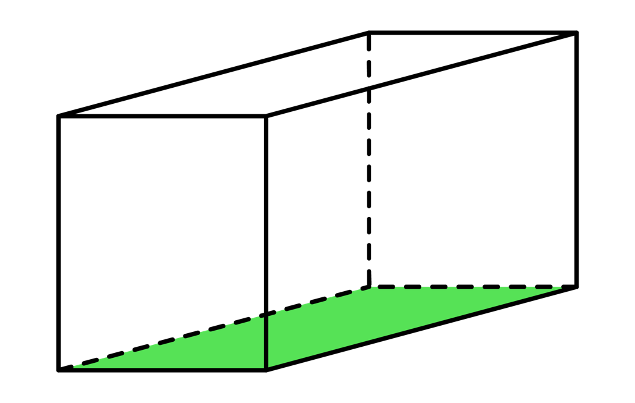
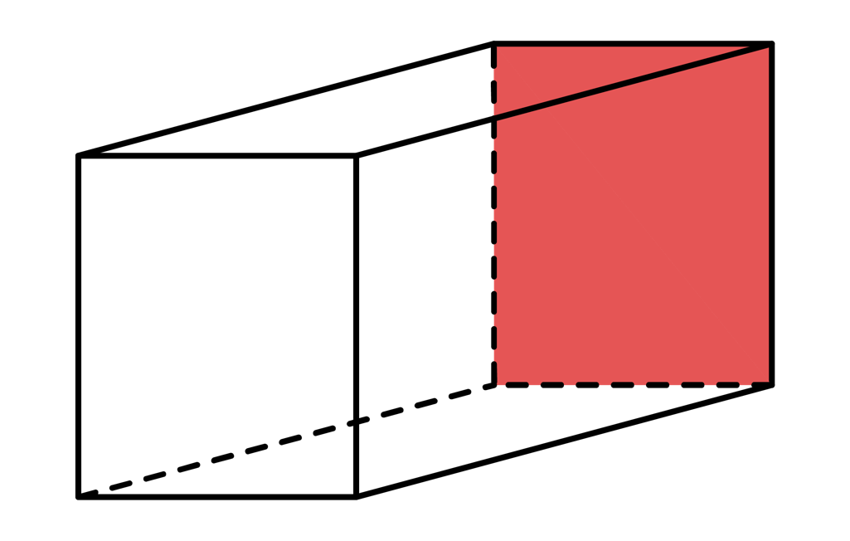
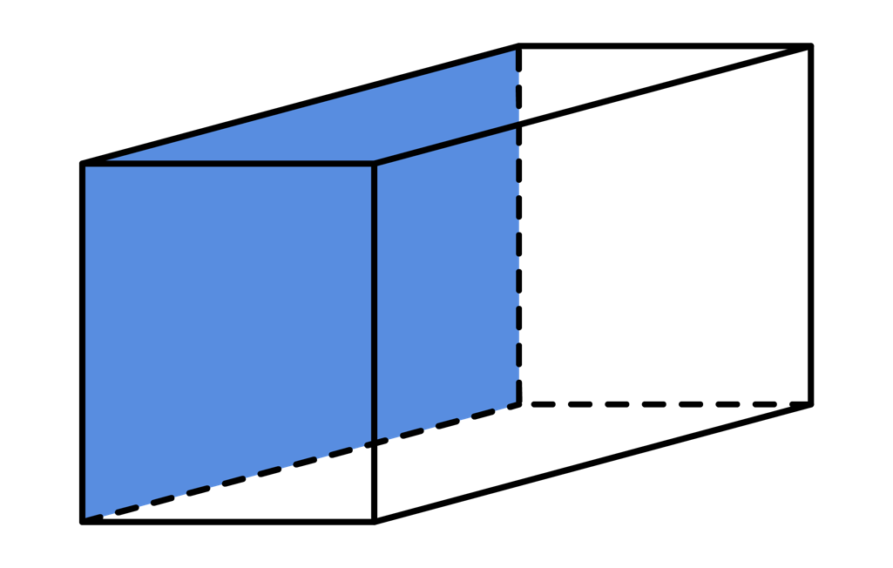
Ex1
Here is a cuboid. Draw the net of the cuboid on the grid below and, hence, calculate the surface area of the cuboid.
Solution
F $=$ 2 $×$ 3 $=$ 6
B
B $=$ 2 $×$ 3 $=$ 6
Bt $=$ 2 $×$ 5 $=$ 10
3cm
T $=$ 2 $×$ 5 $=$ 10
L
Bt
R
T
L $=$ 3 $×$ 5 $=$ 15
5cm
2cm
R $=$ 3 $×$ 5 $=$ 15
Total $=$ 62cm²
F
What is the relationship between the highlighted sides?

Slide 10
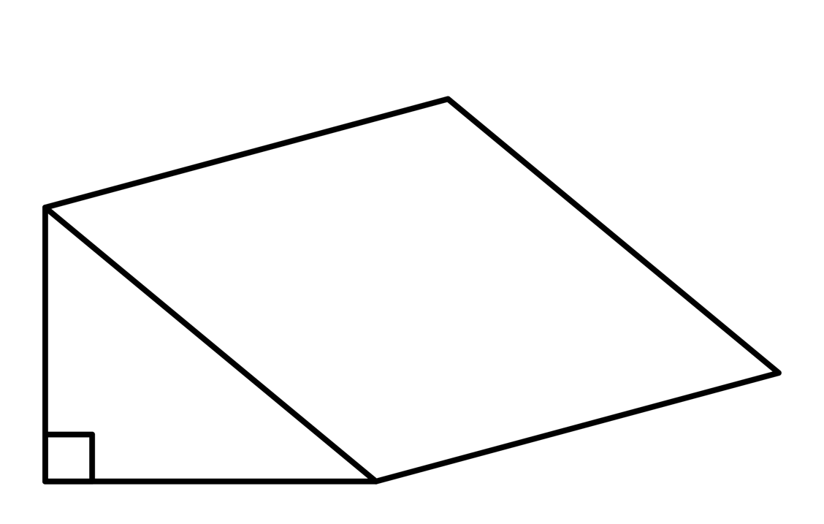
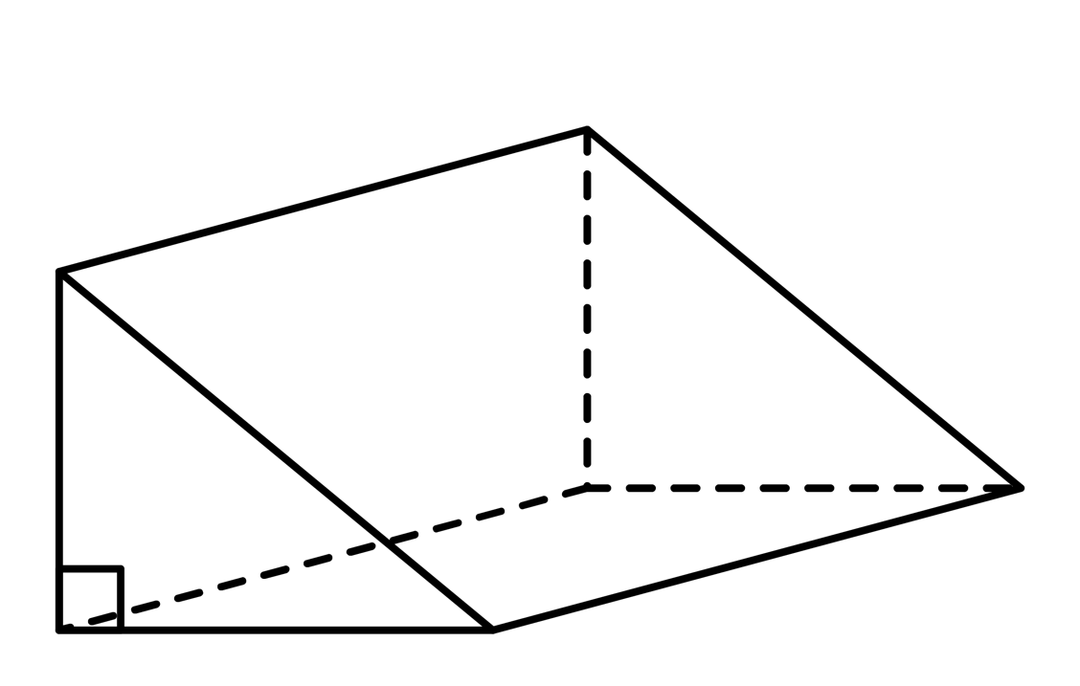
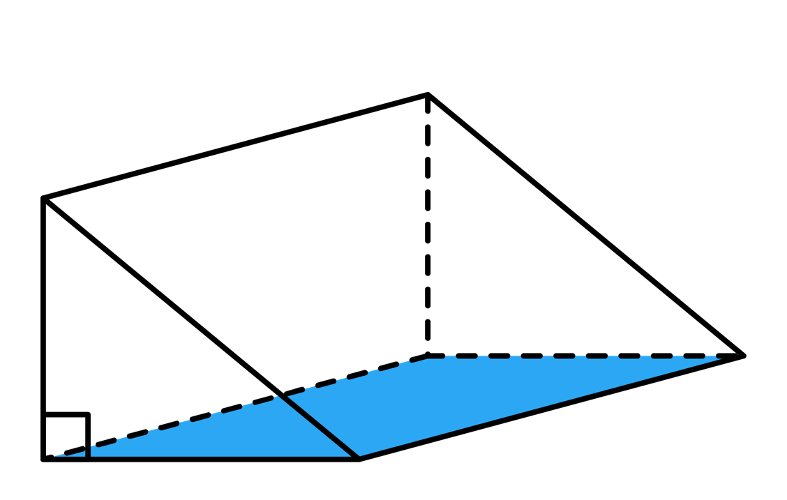
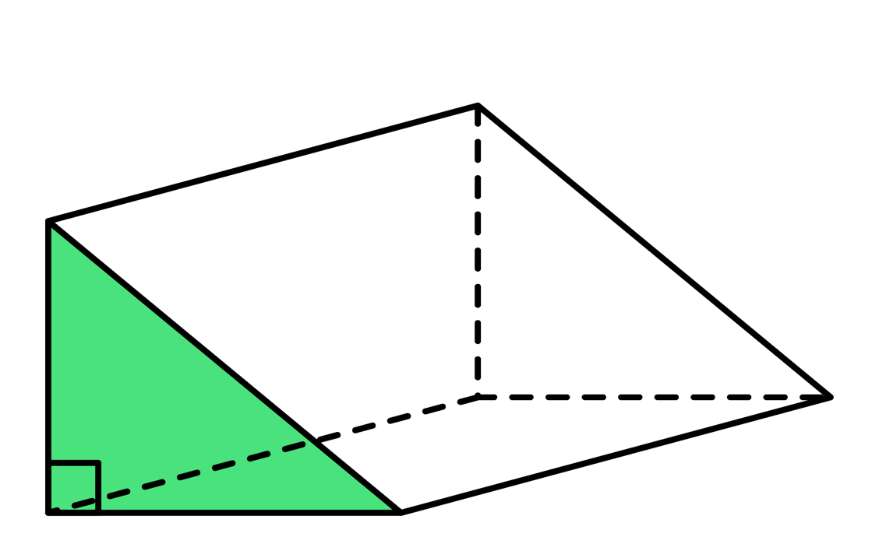
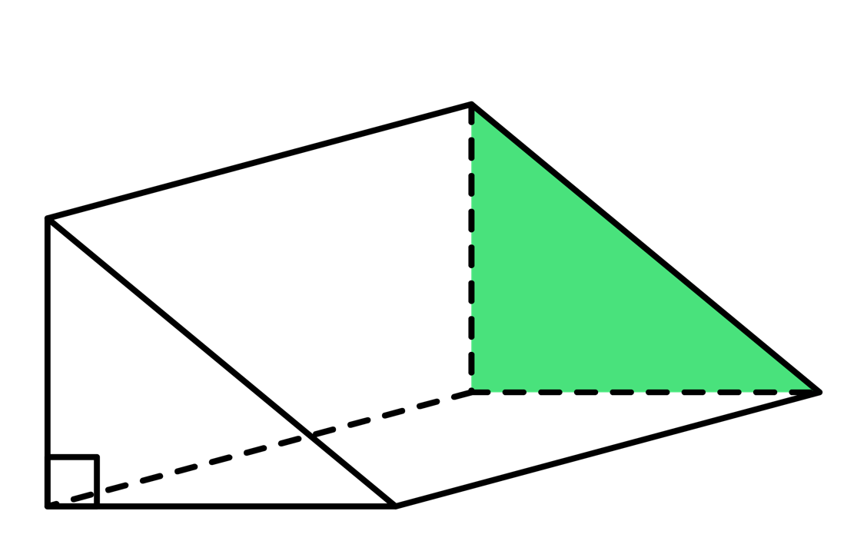
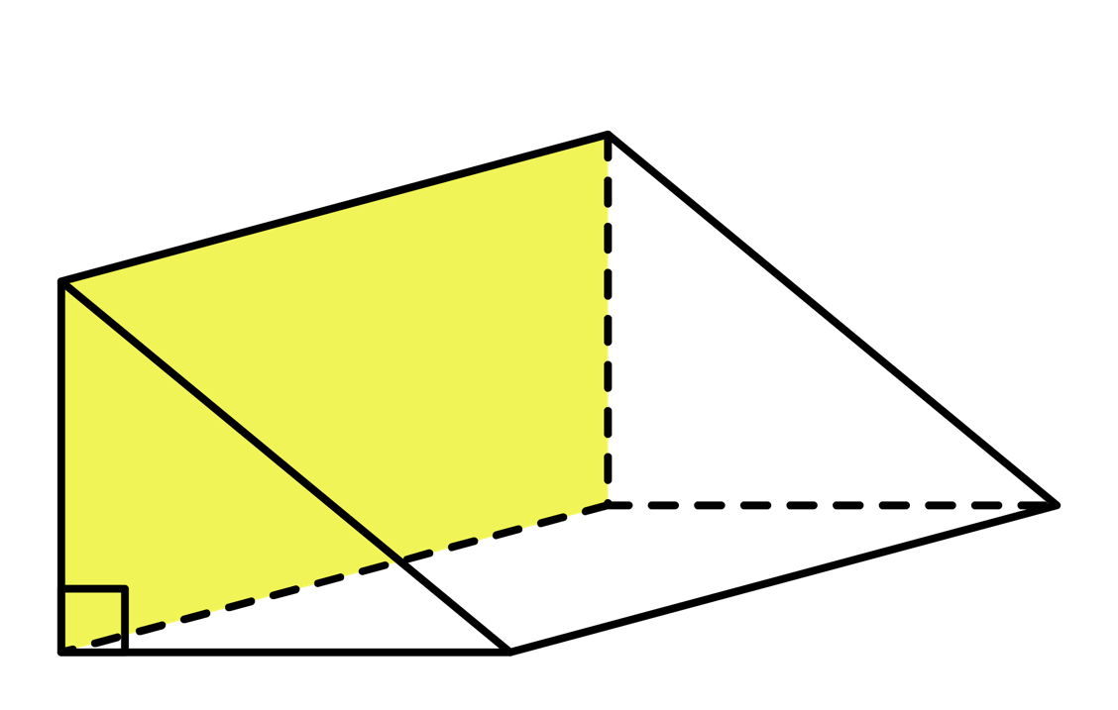
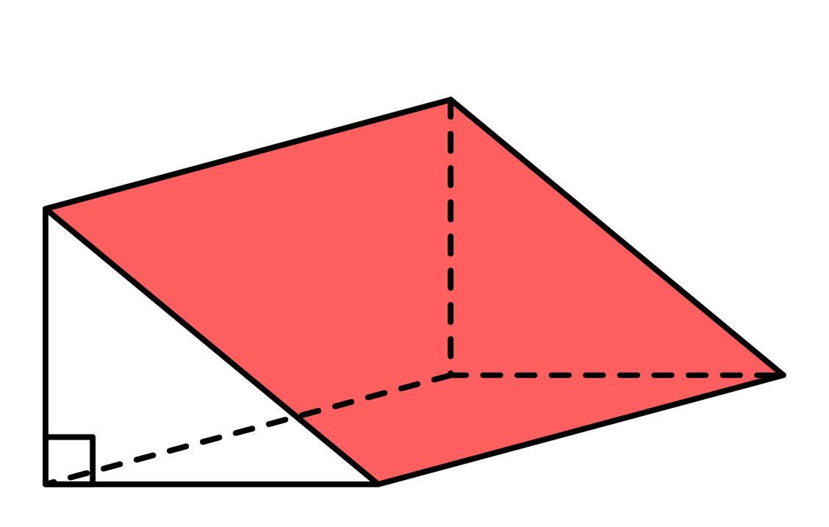
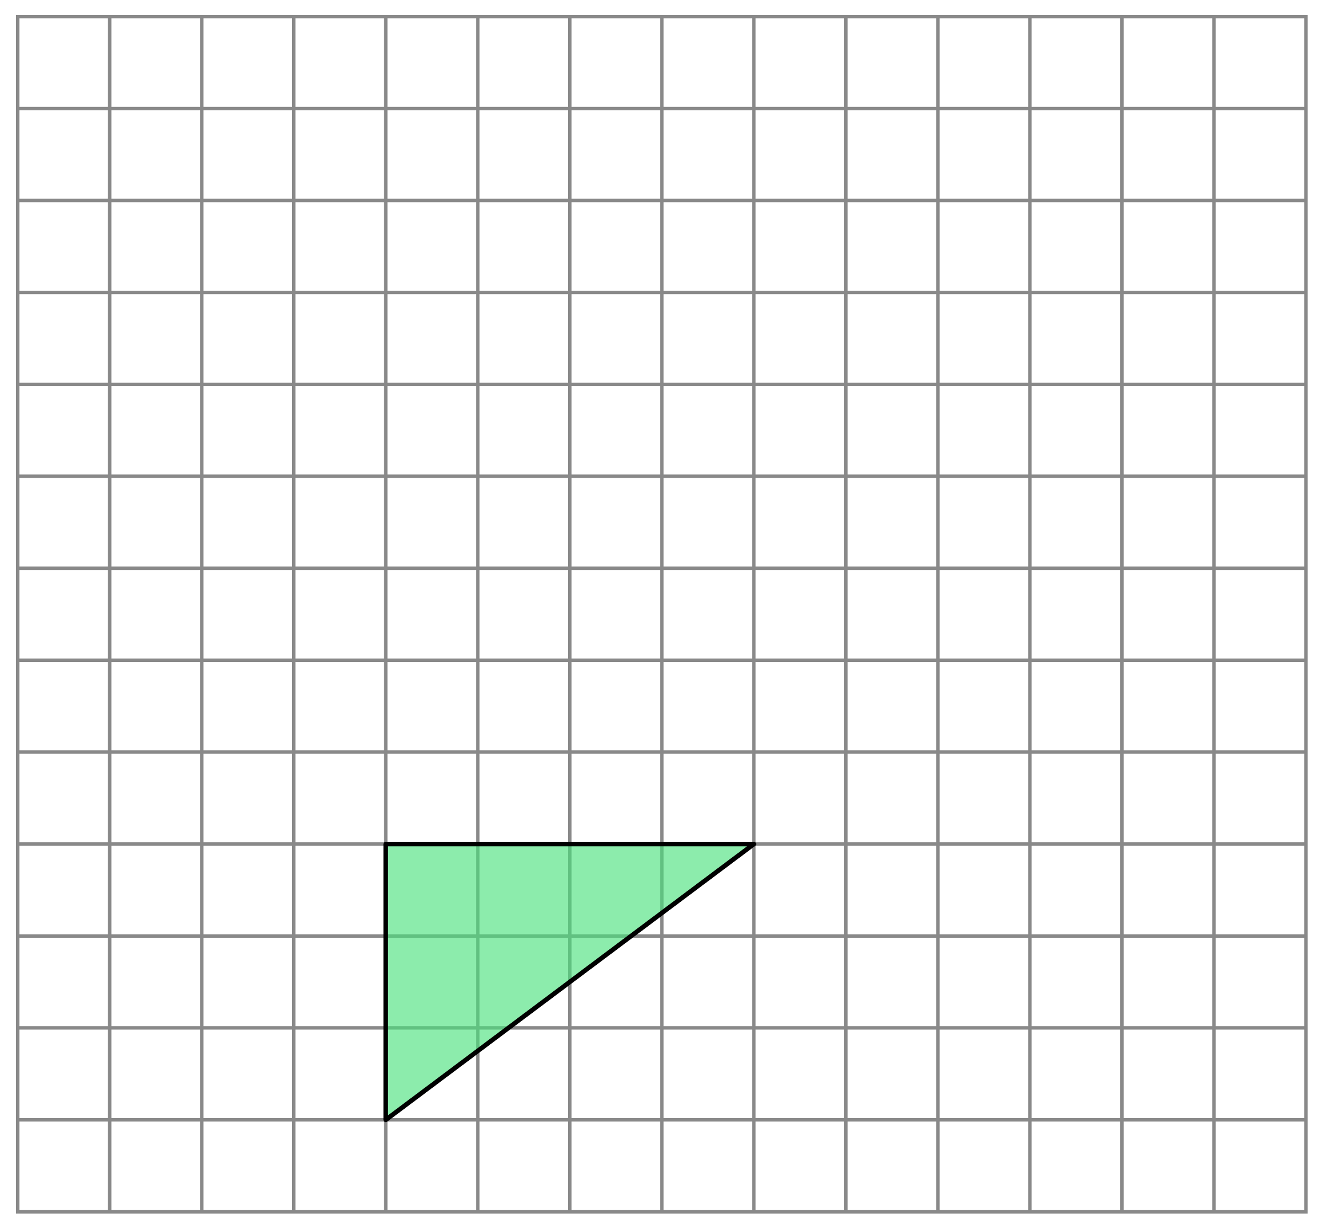
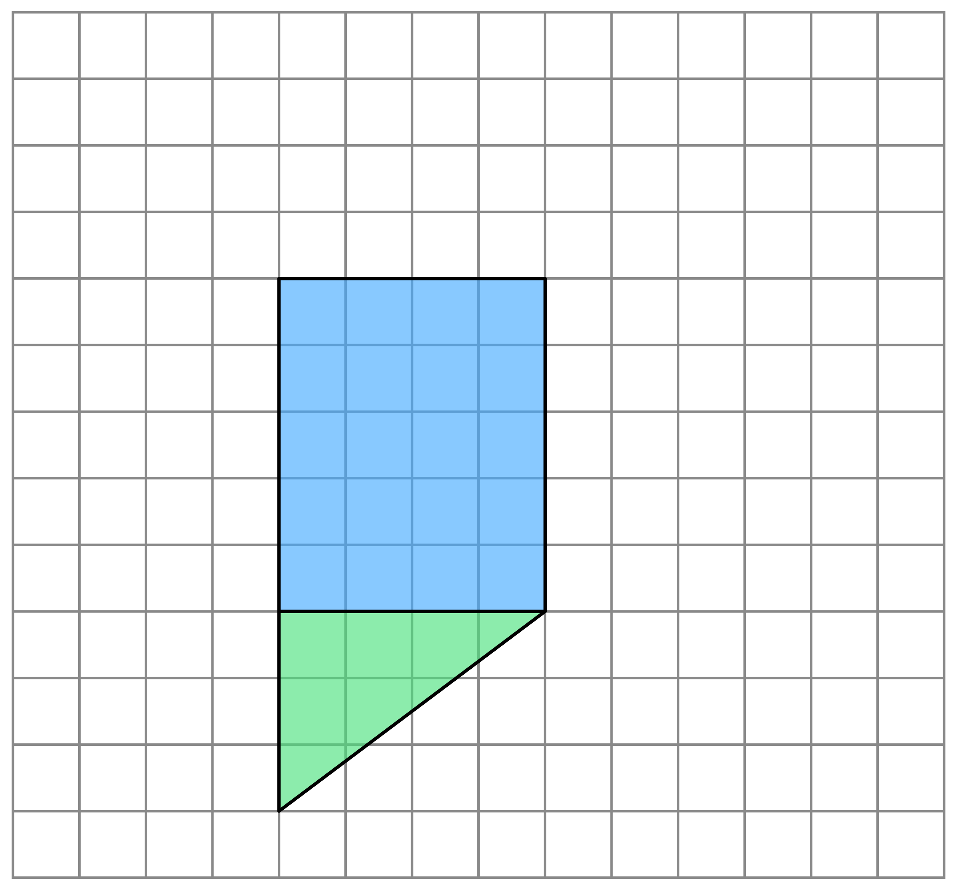
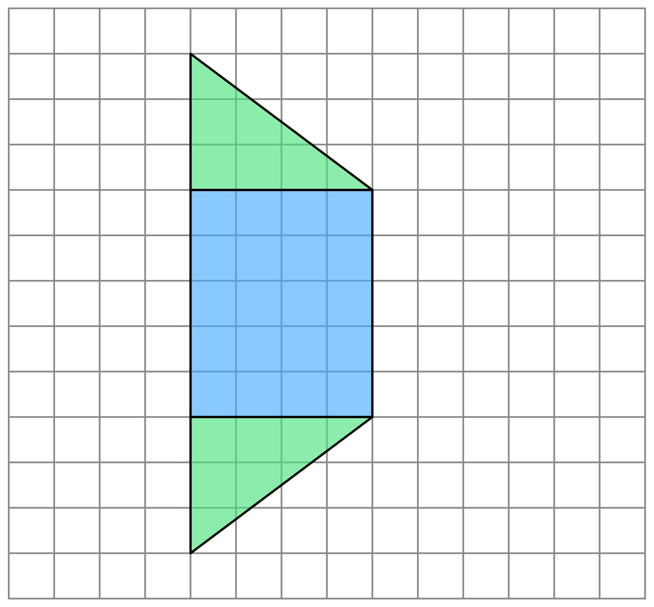
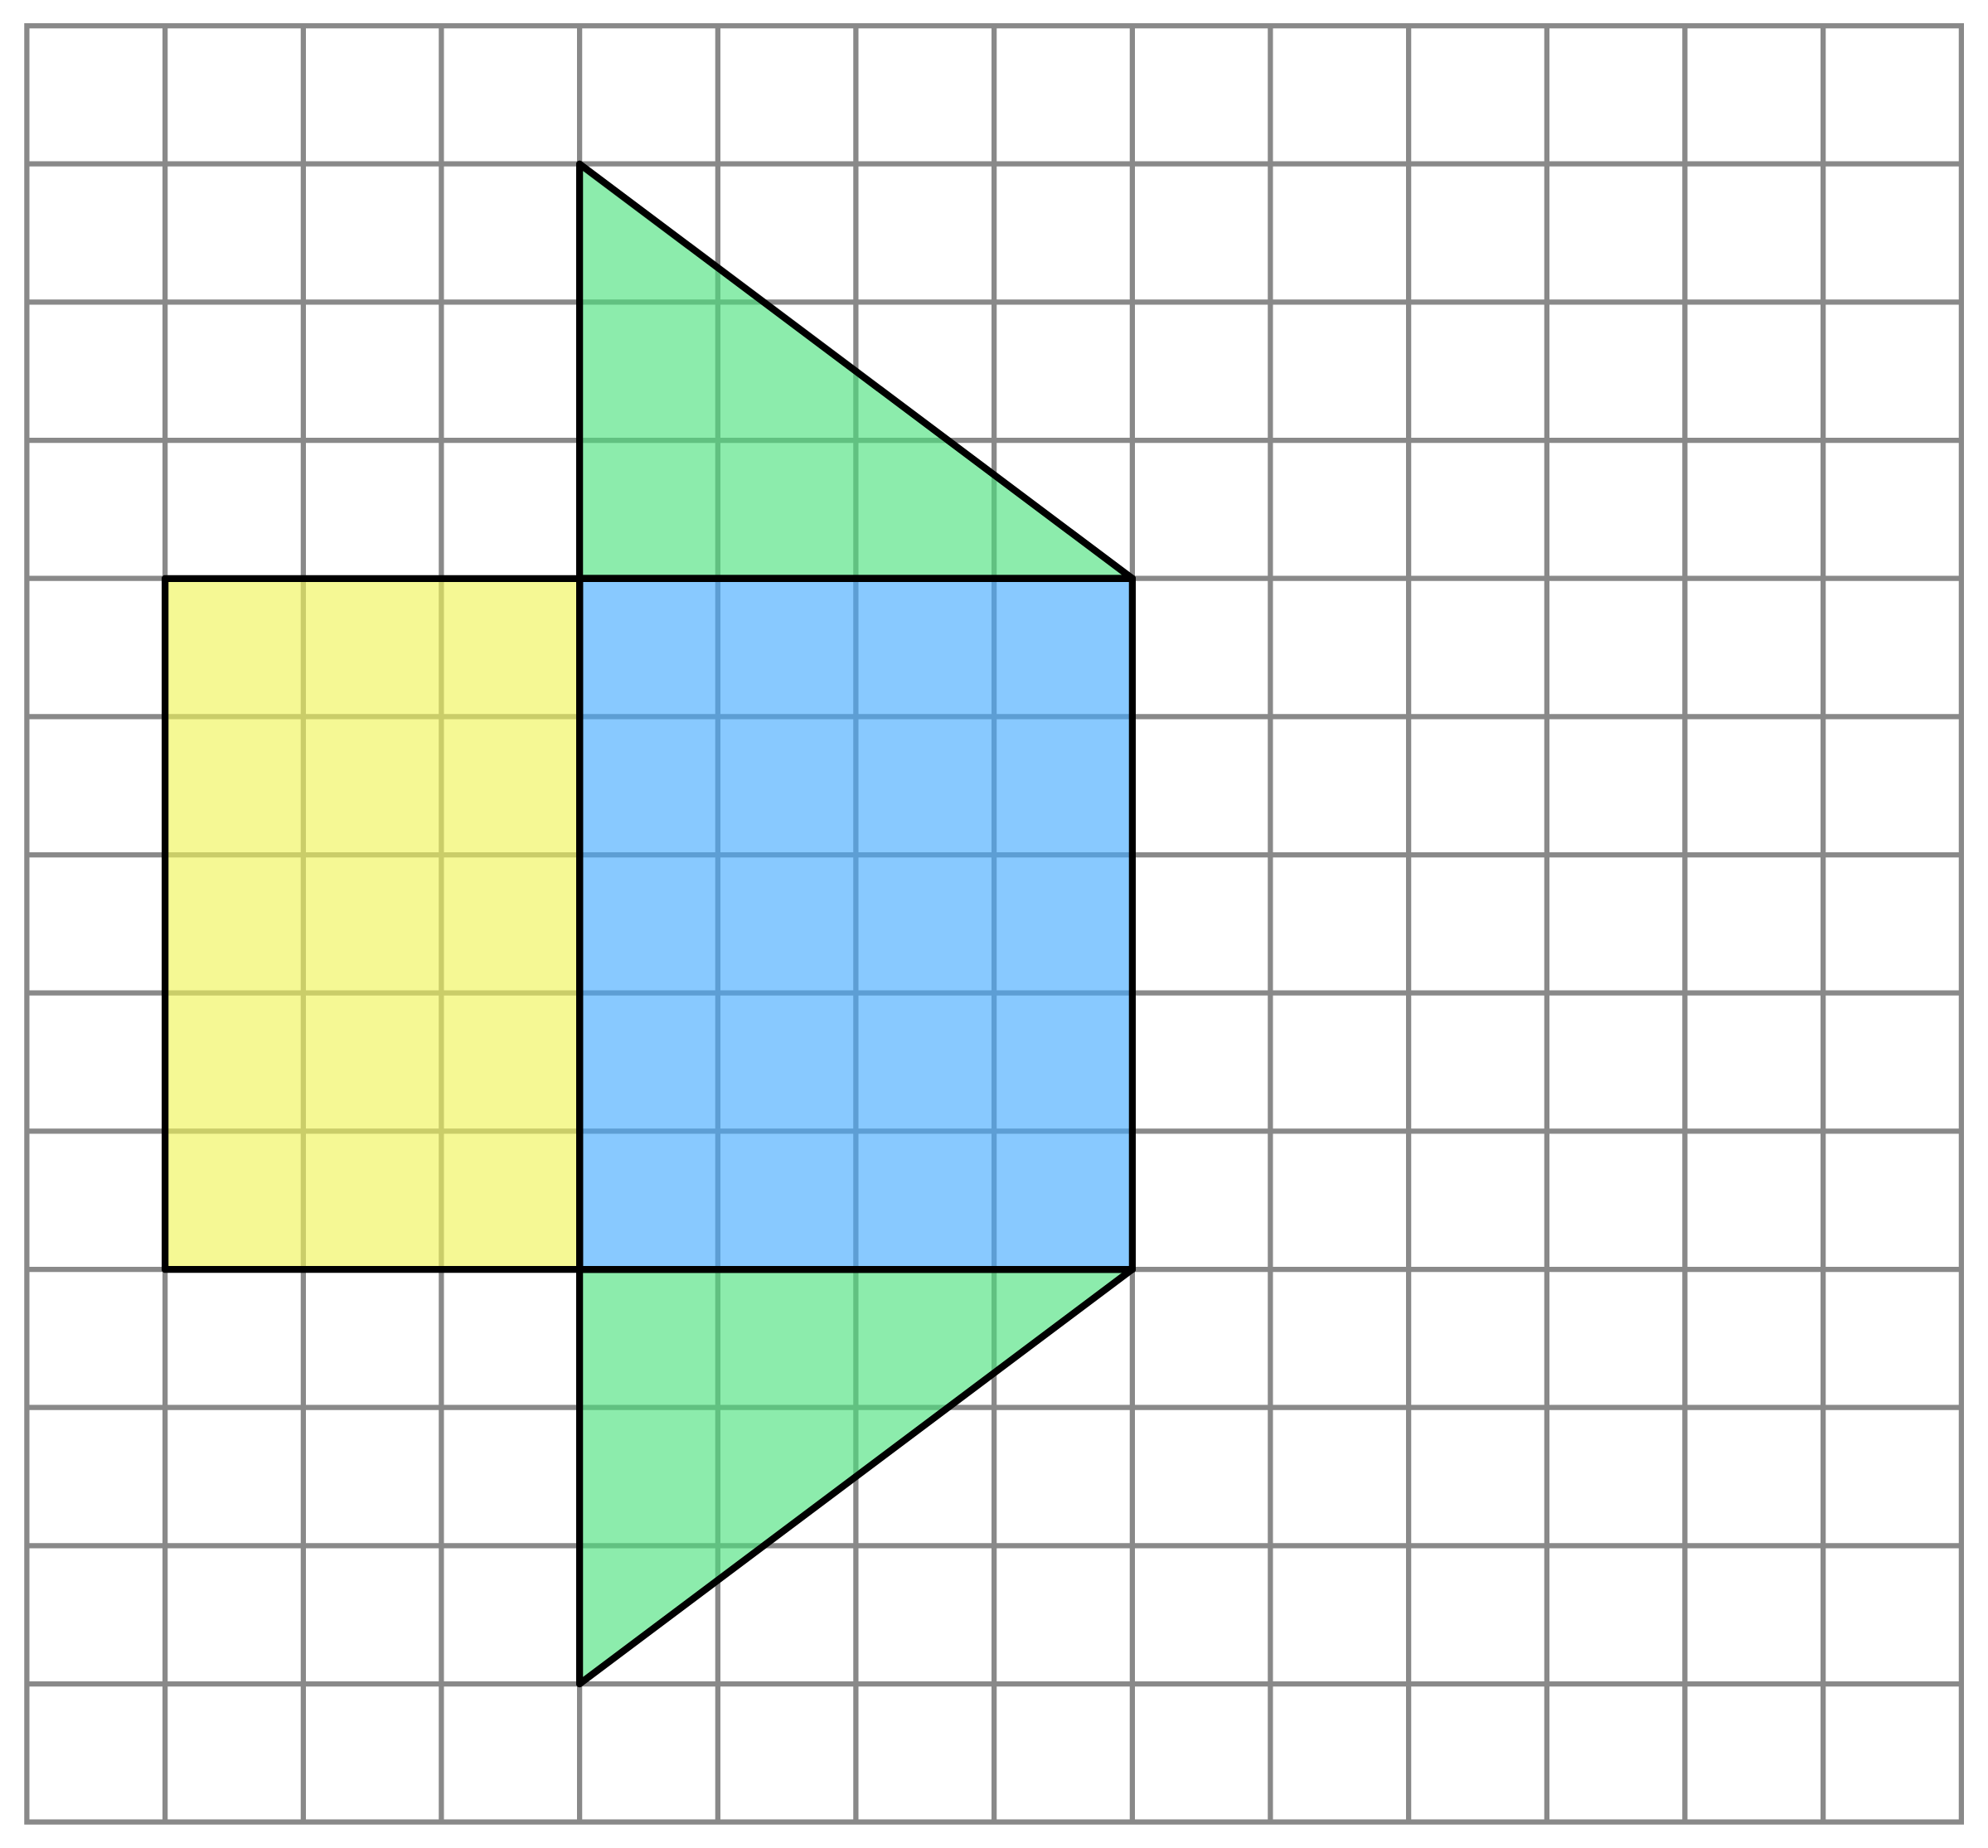
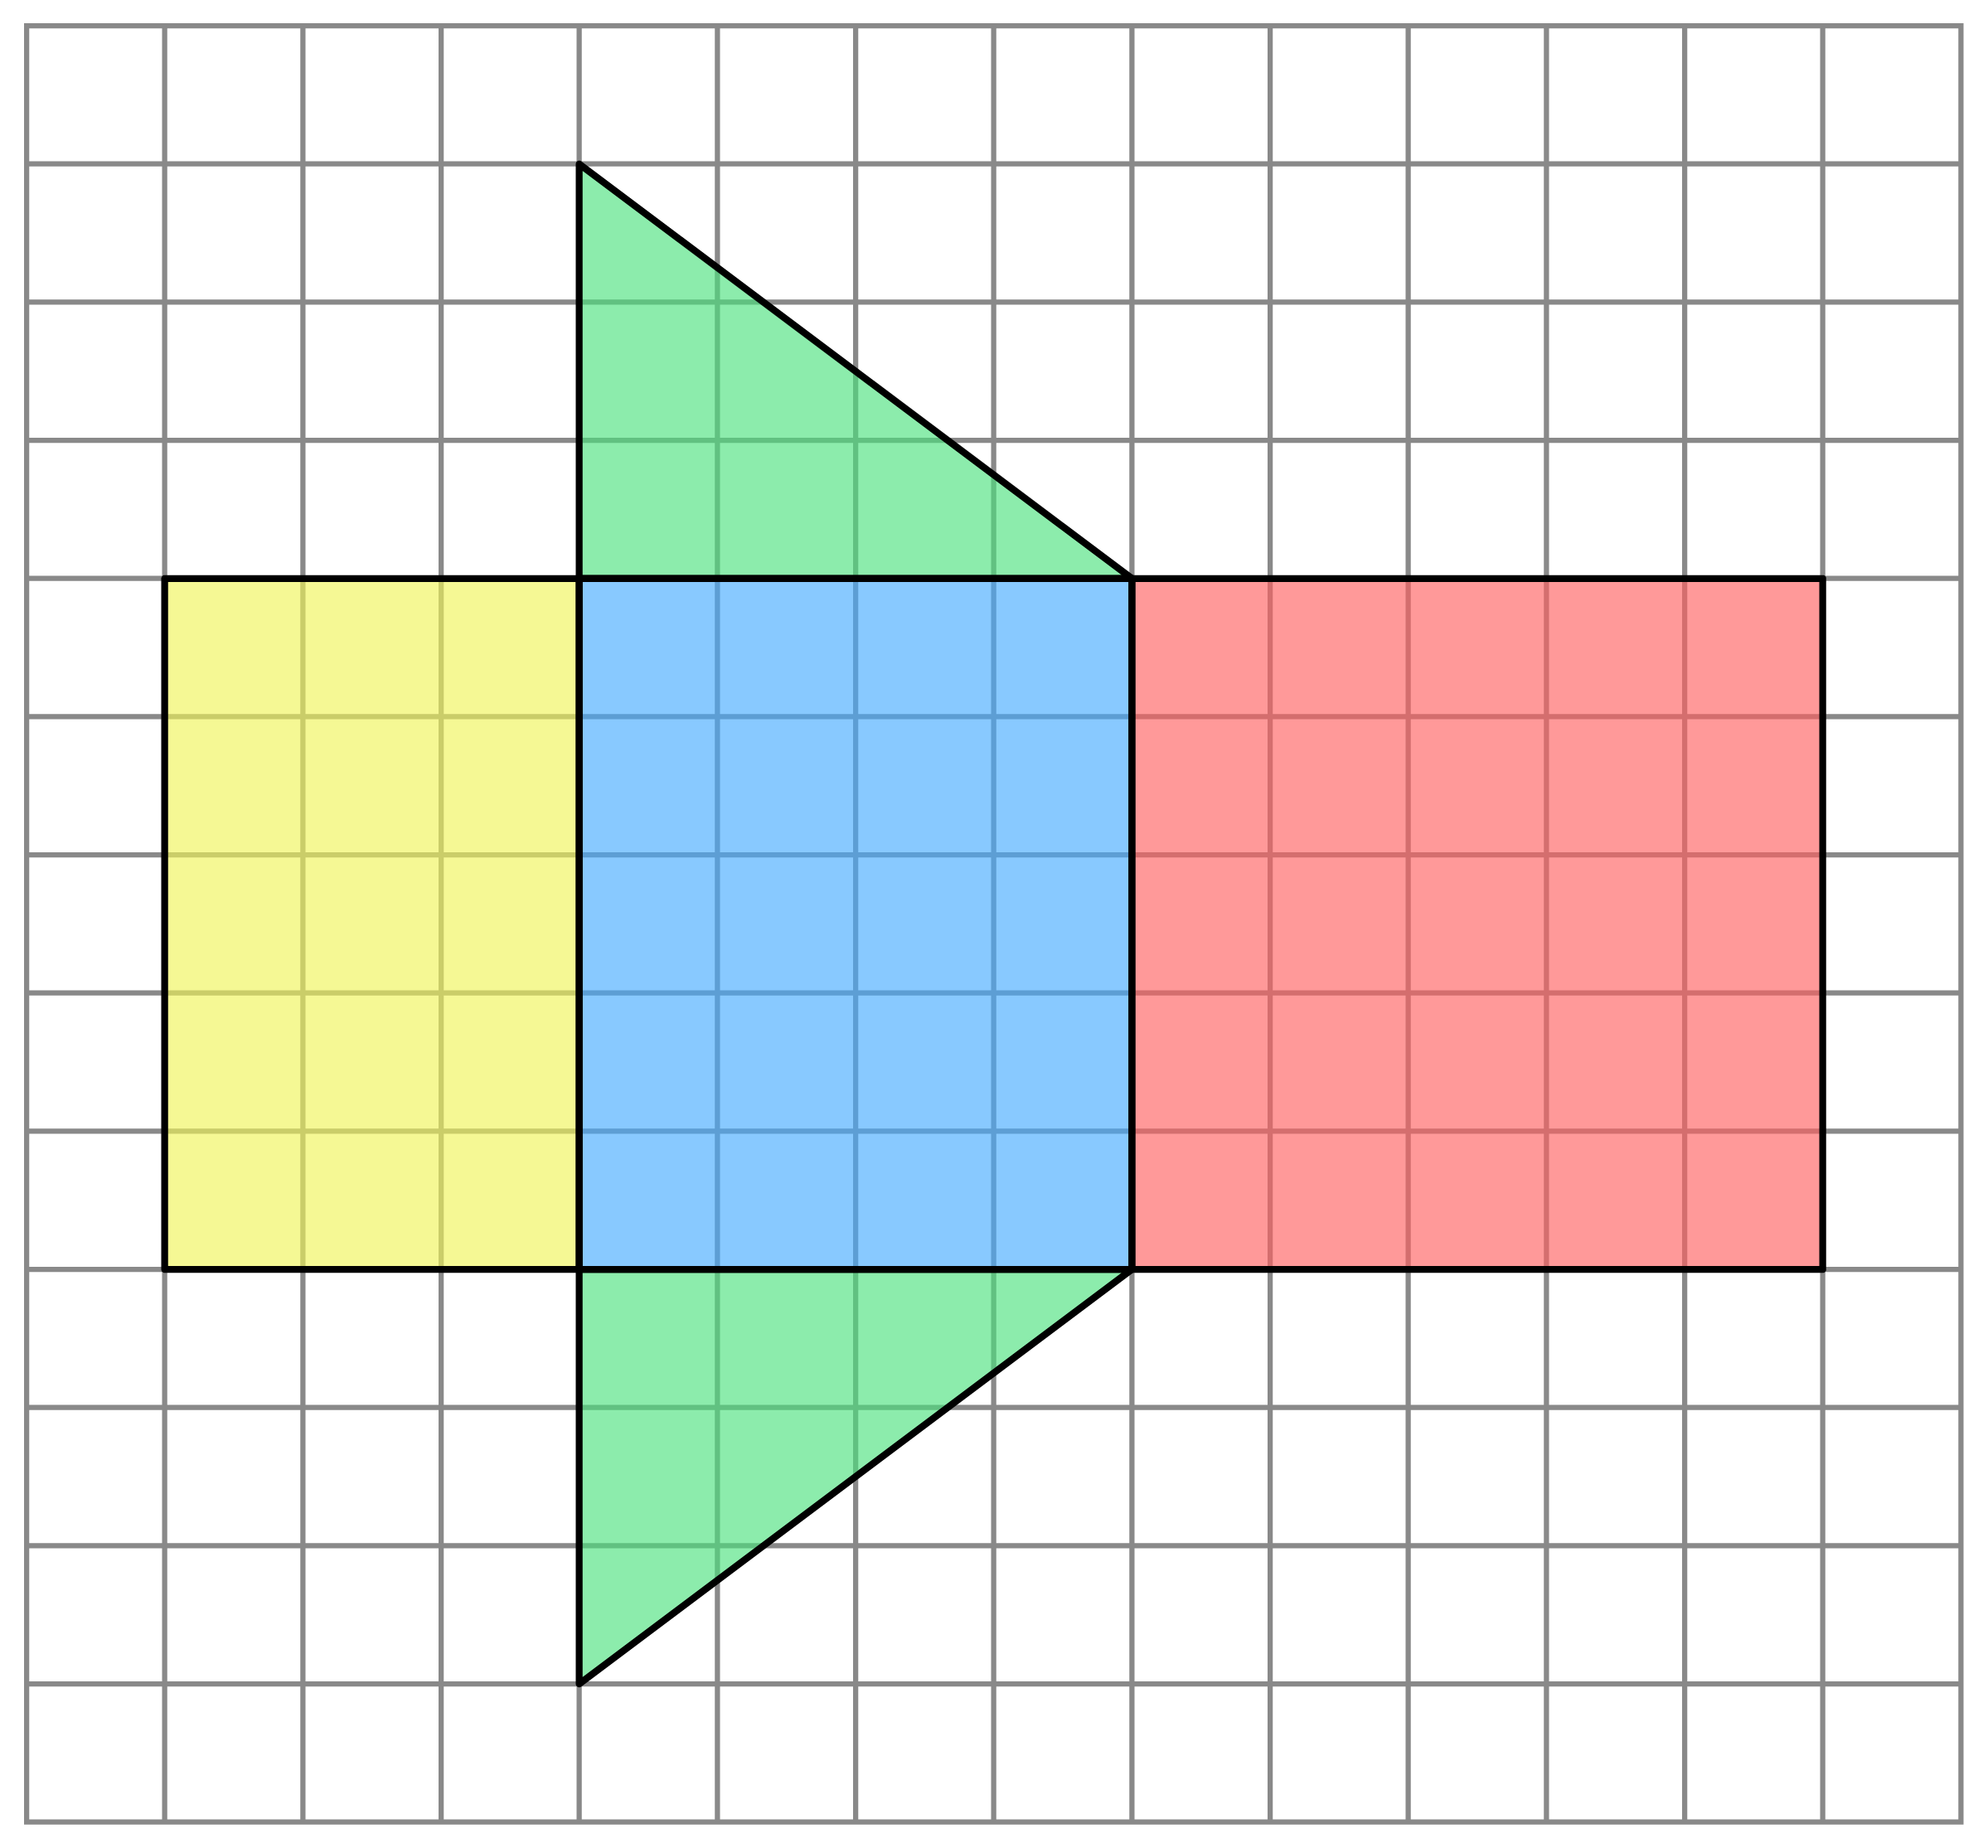
Ex2
Here is a triangular prism. Draw the net of the prism on the grid below and, hence, calculate the surface area of the prism.
Solution
F $=$ 3 $×$ 4 $=$ 6
The perimeter of the cross-section is equal to the length of the rectangle made by the ‘middle faces’.
2
B
B $=$ 3 $×$ 4 $=$ 6
3cm
5cm
2
Bt $=$ 4 $×$ 5 $=$ 20
L
Bt
R
5cm
4cm
L $=$ 3 $×$ 5 $=$ 15
R $=$ 5 $×$ 5 $=$ 25
F
Total $=$ 72cm²
What is the relationship between the highlighted sides?

Slide 11
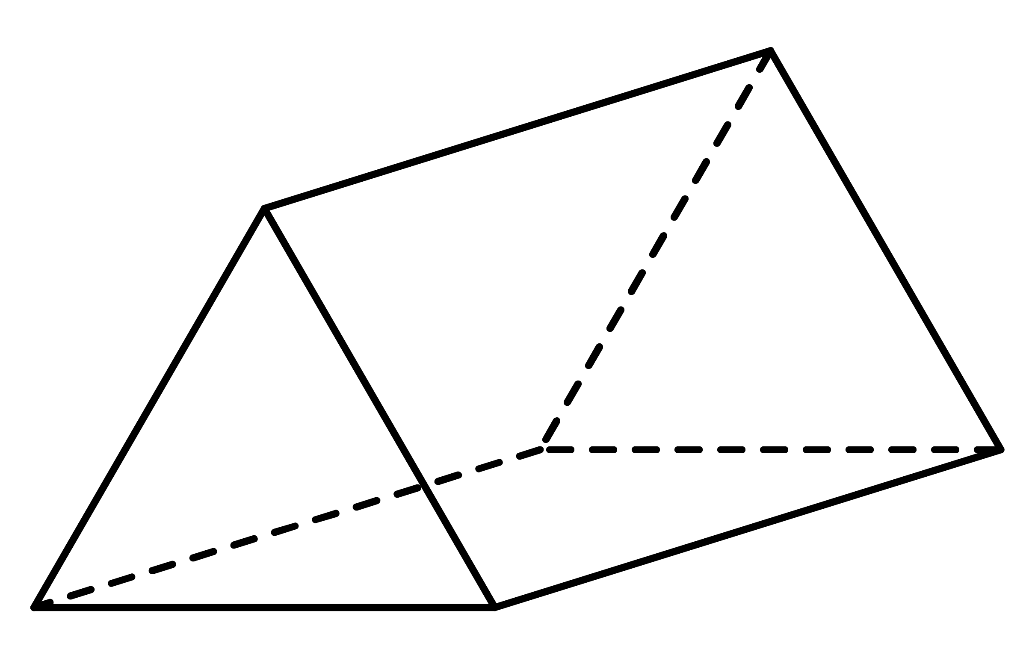
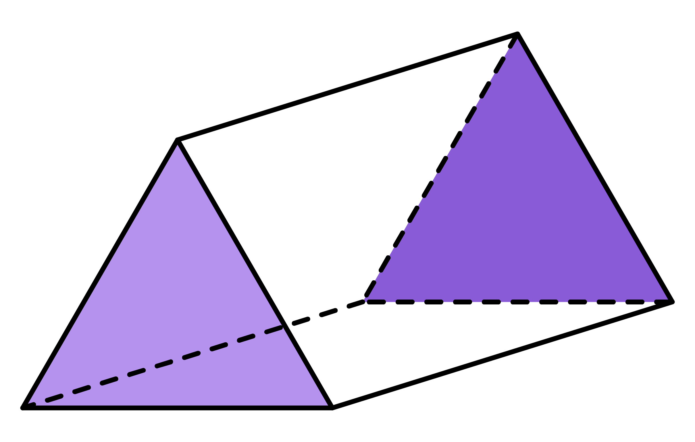
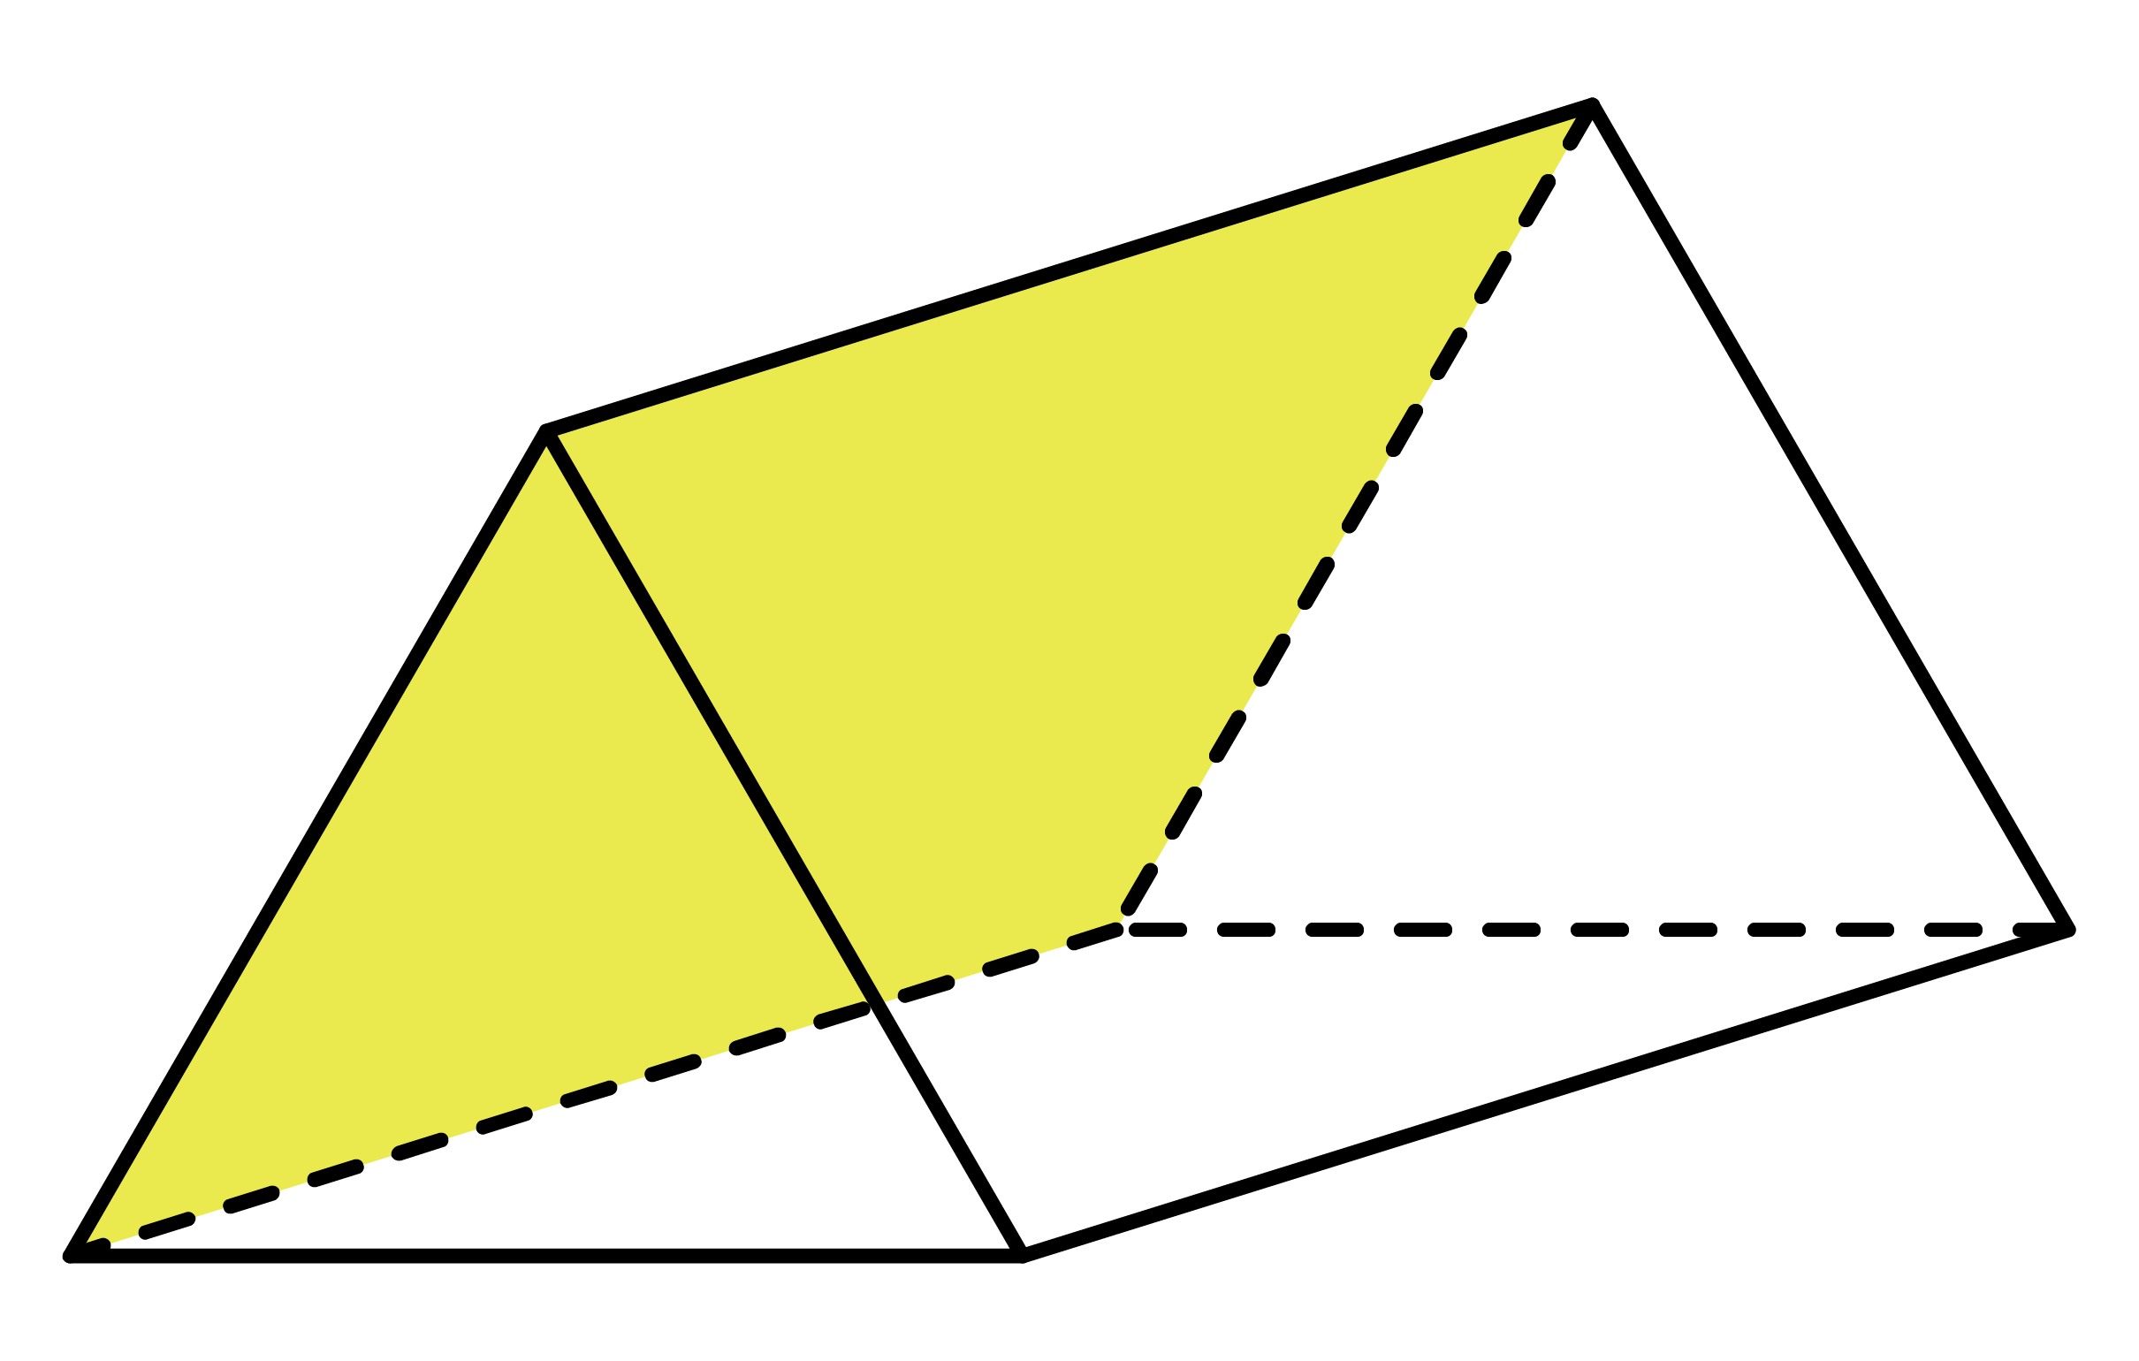
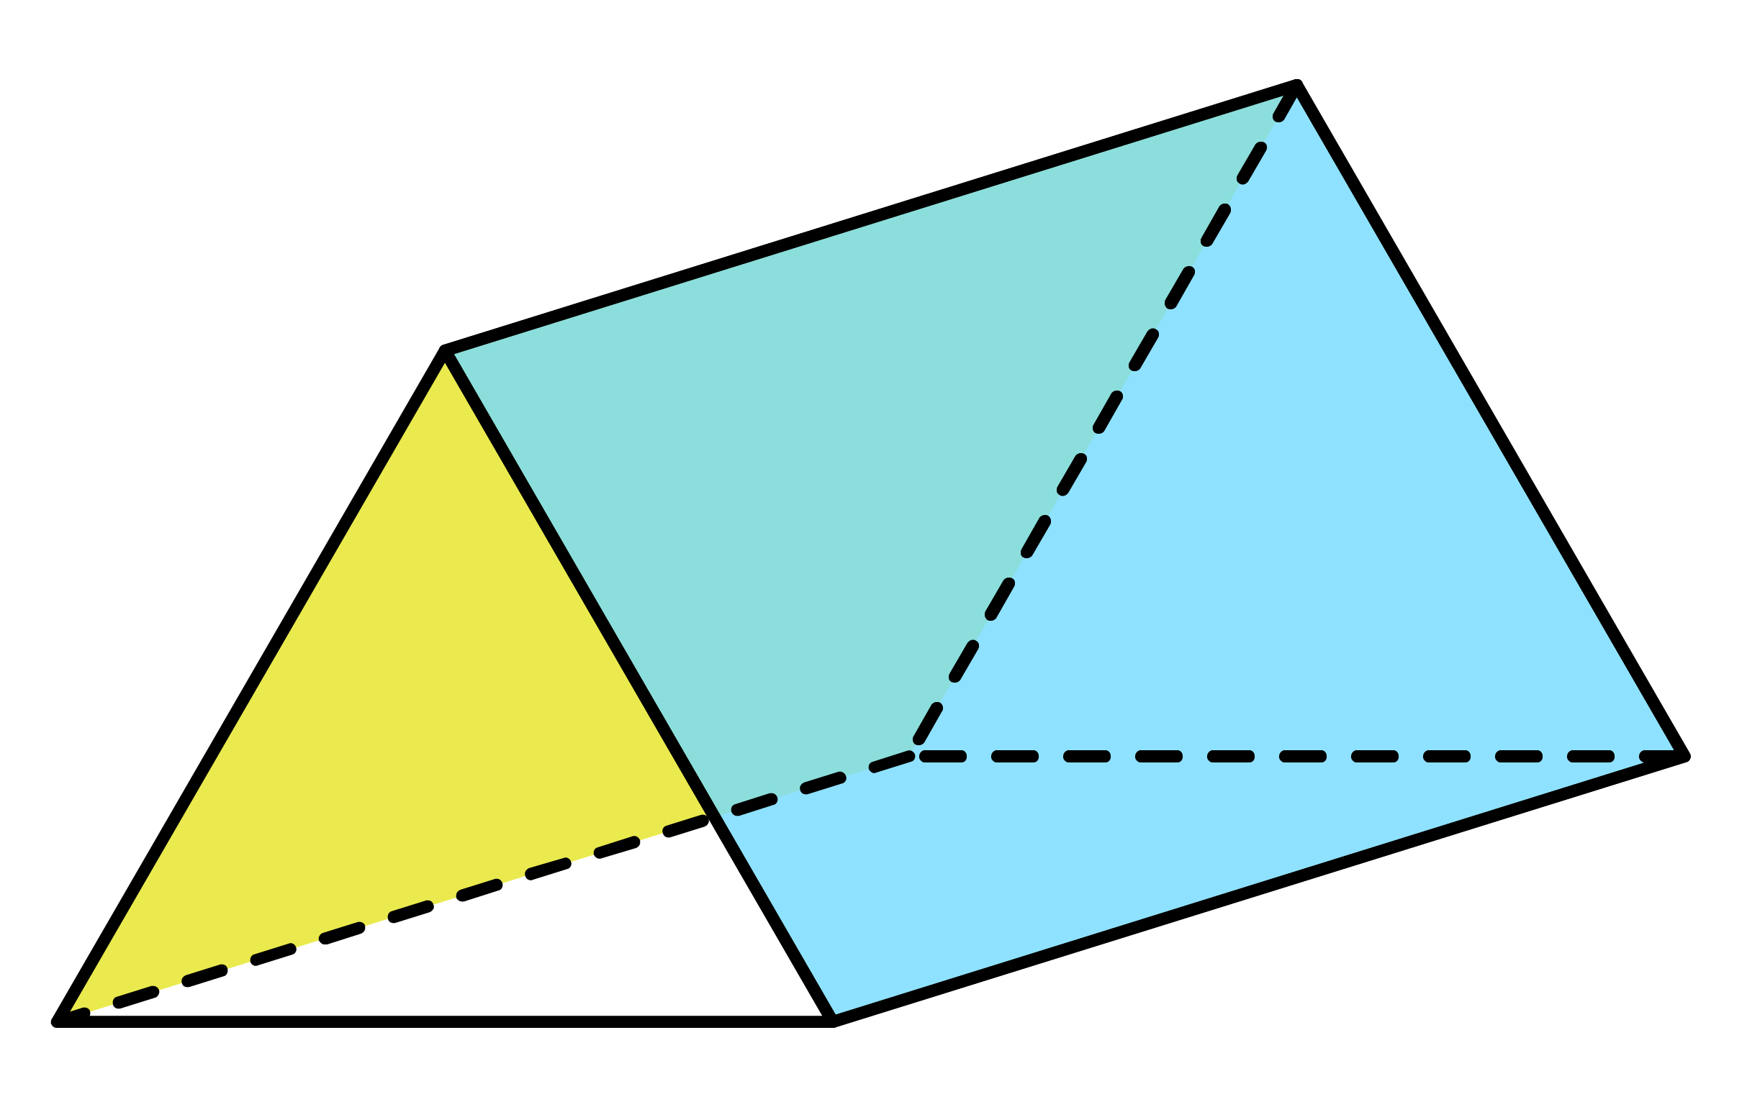
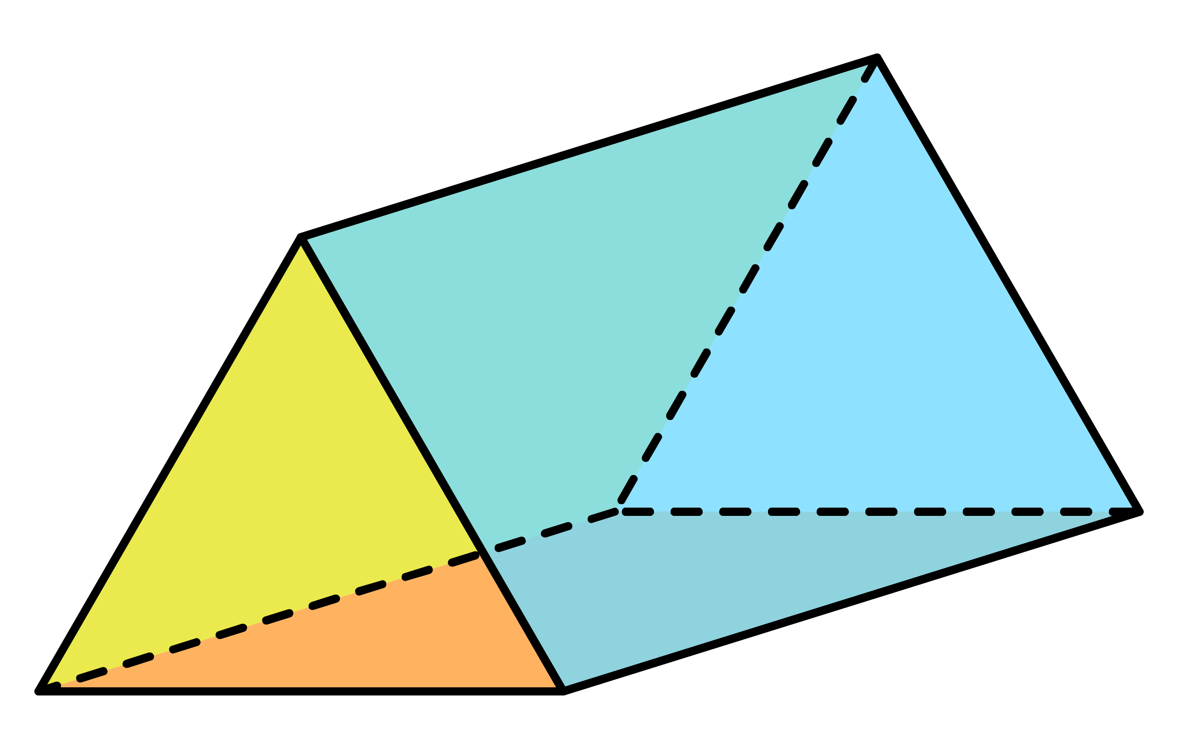







Ex3
Calculate the surface area of the following triangular prism.
Solution
Front
$=$ 6 $×$ 8
$=$ 24
2
7.2cm
Back
$=$ 6 $×$ 8
$=$ 24
2
6cm
7.2
7.2
8
Middle faces
10cm
10
22.4 $×$ 10
$=$ 224
8cm
22.4
Total surface area
24 $+$ 24 $+$ 224
$=$ 272cm²

Slide 12
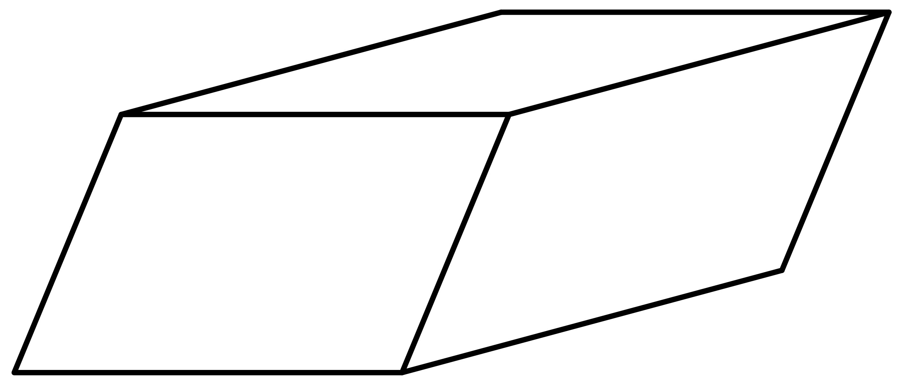
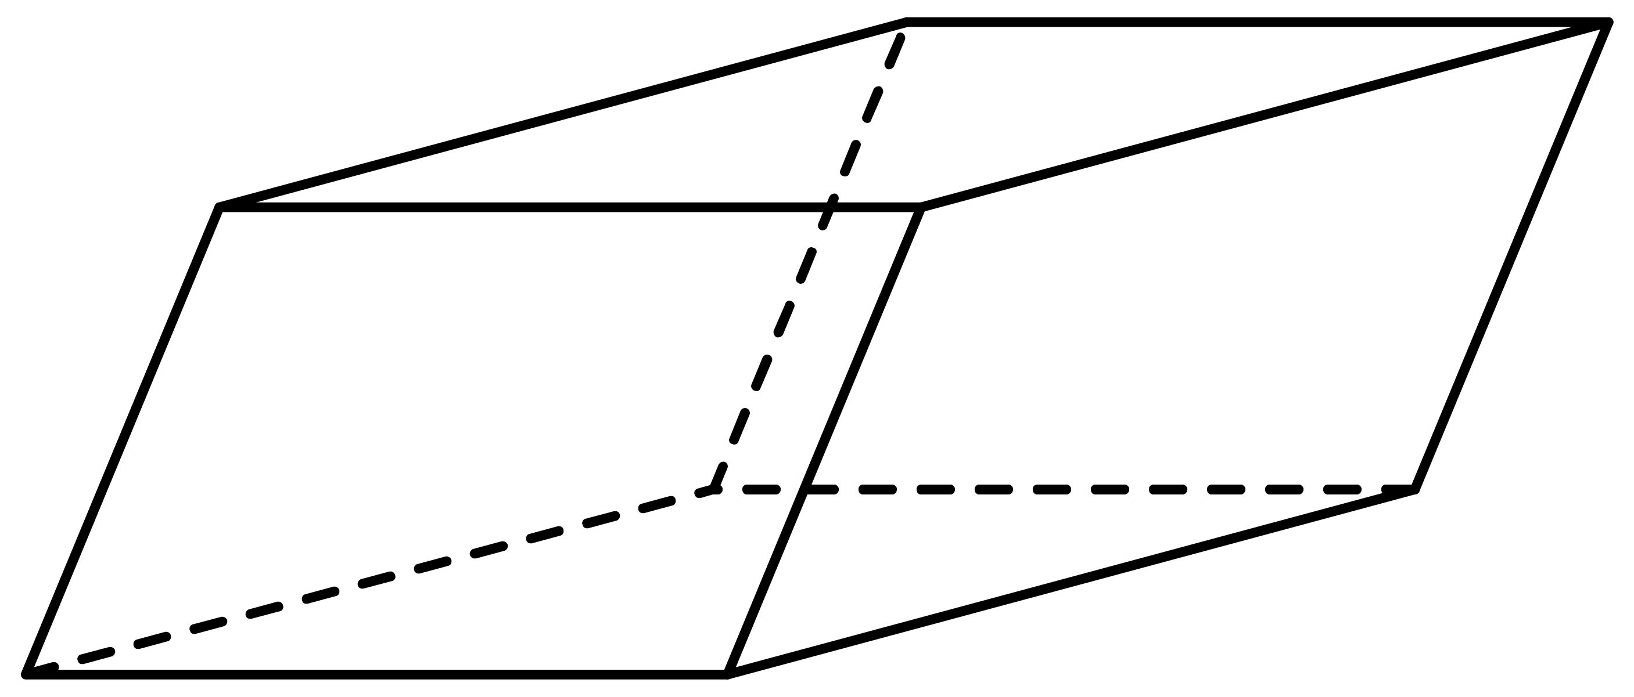
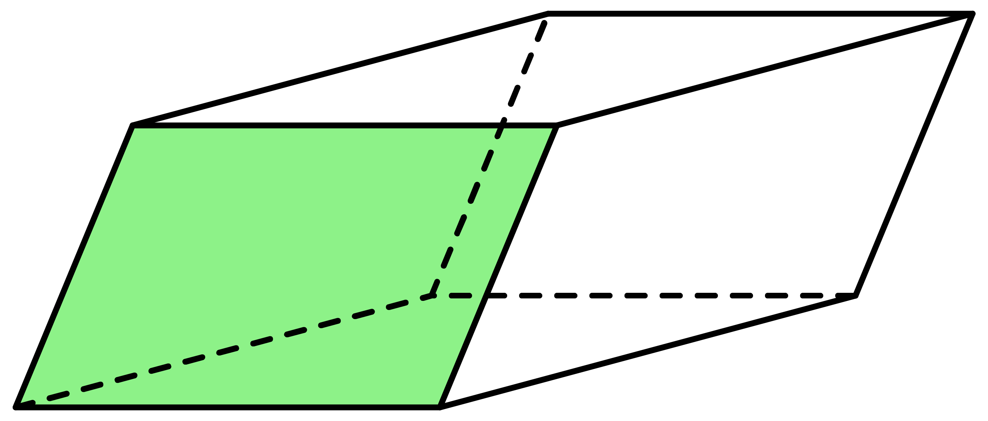
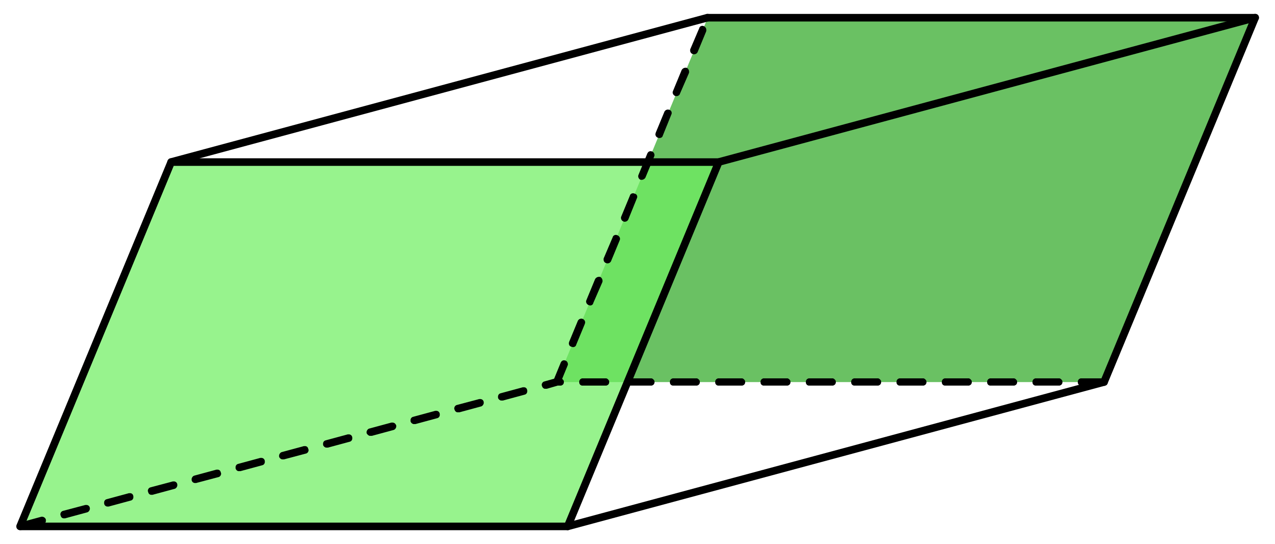
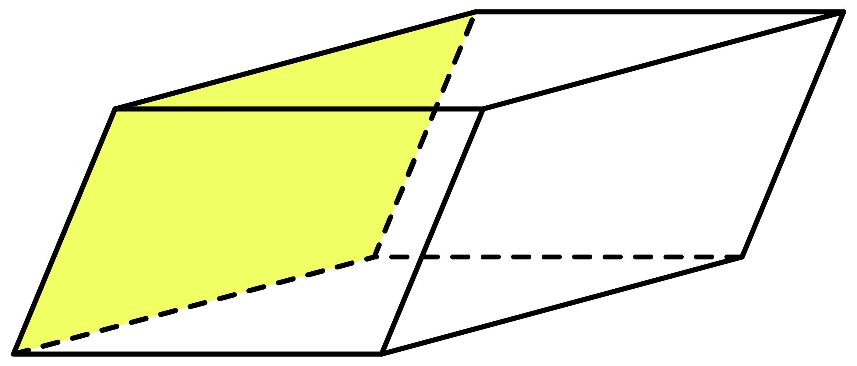
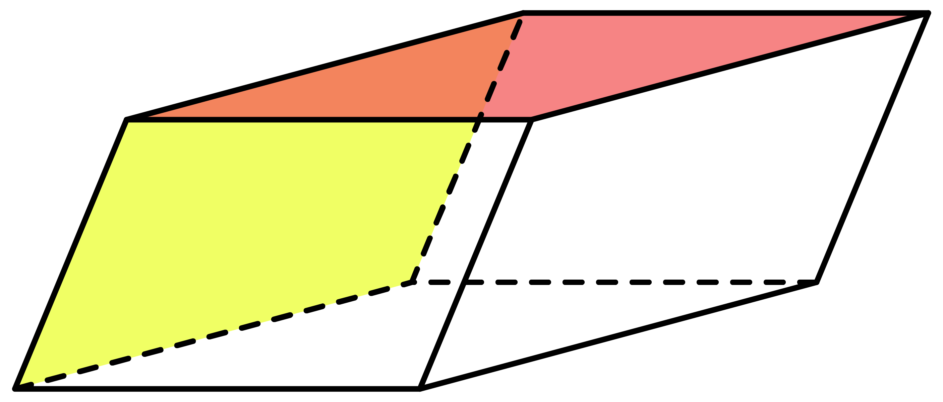
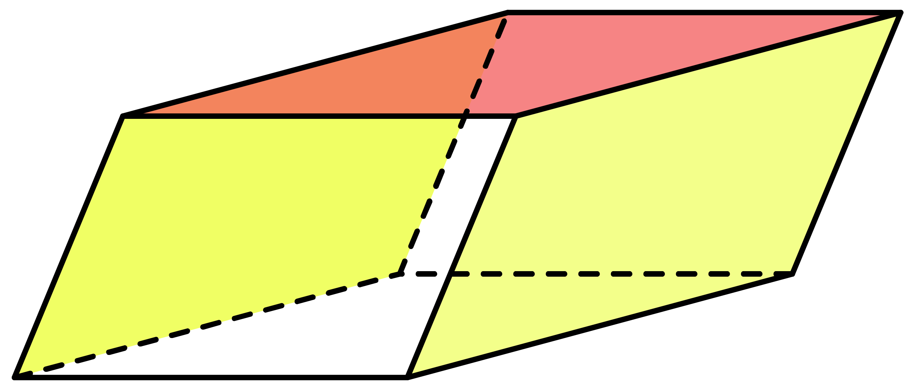
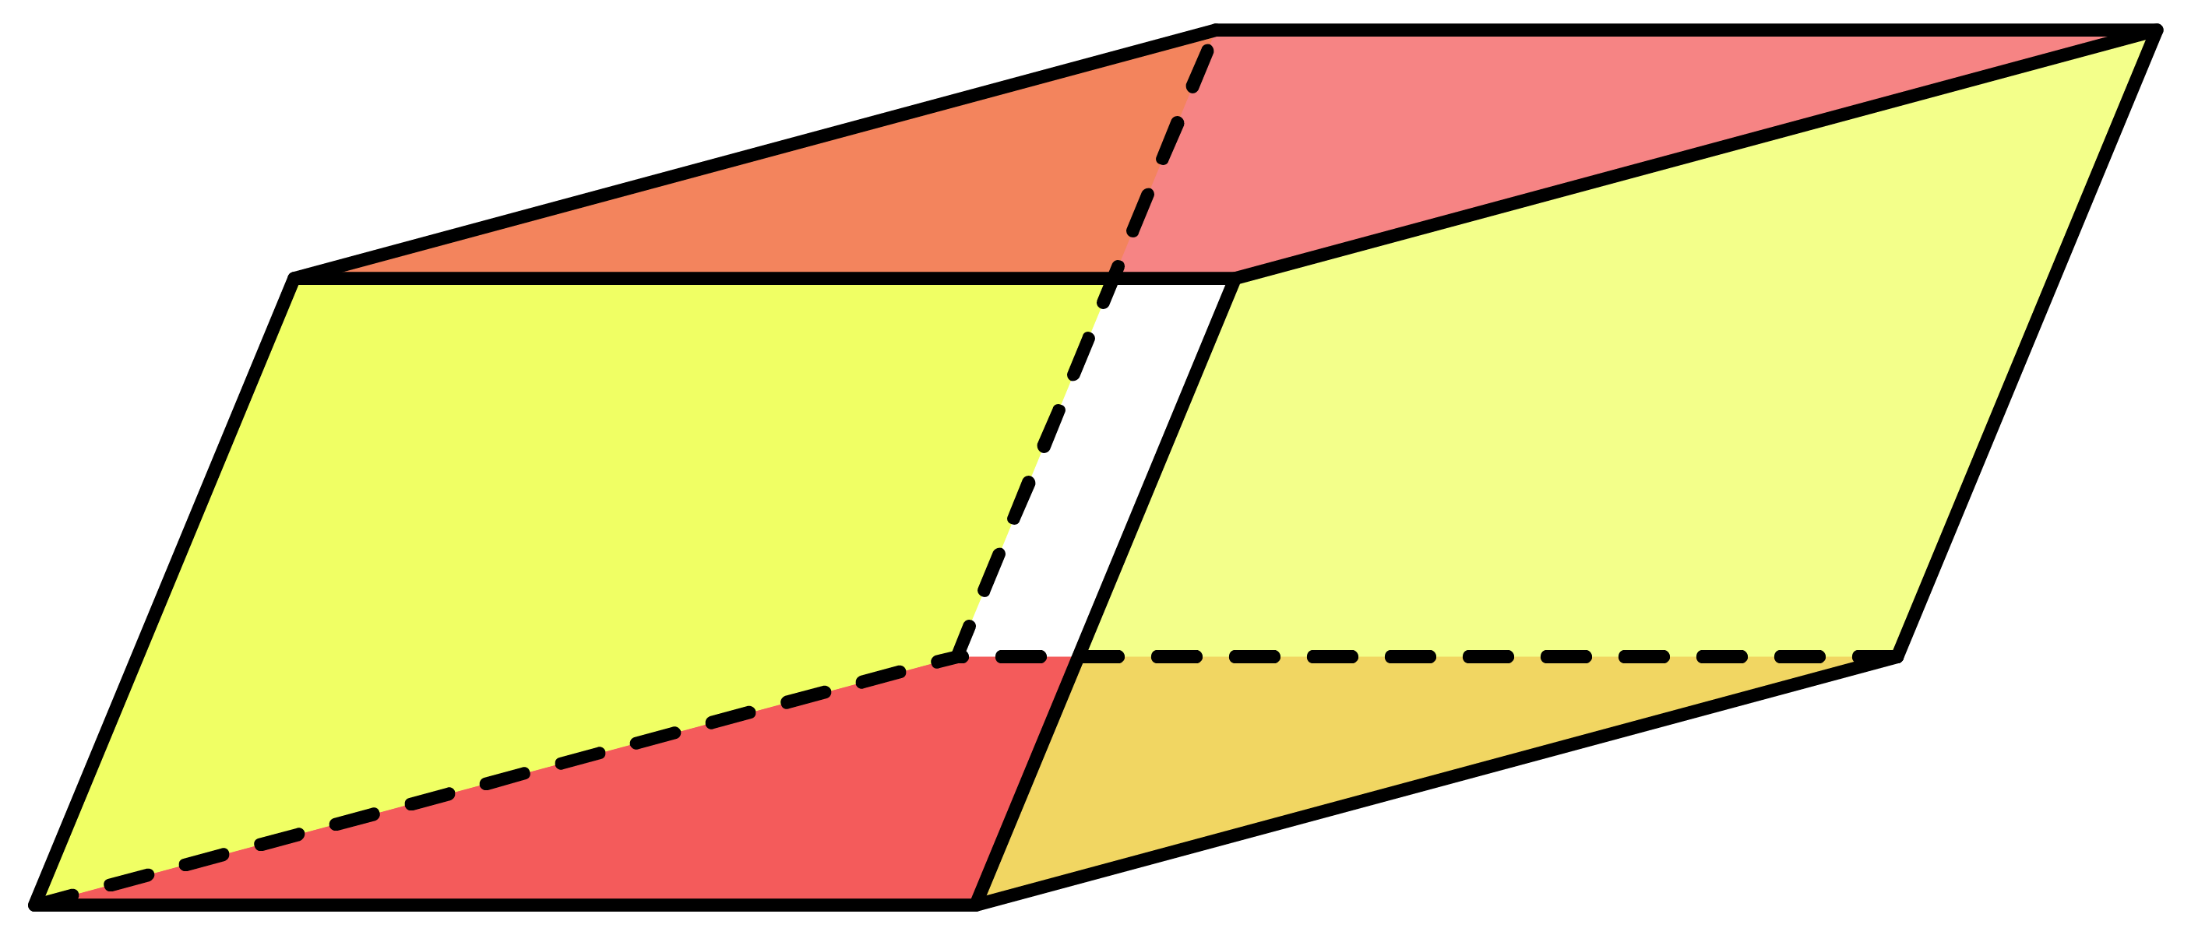








Ex4
Calculate the surface area of the following parallelepiped.
Solution
Front
$=$ 9 $×$ 6
$=$ 54
Back
$=$ 9 $×$ 6
$=$ 54
7cm
7
9
7
9
6cm
Middle faces
12cm
12
32 $×$ 12
$=$ 384
9cm
32
Total surface area
54 $+$ 54 $+$ 384
$=$ 492cm²

Slide 13
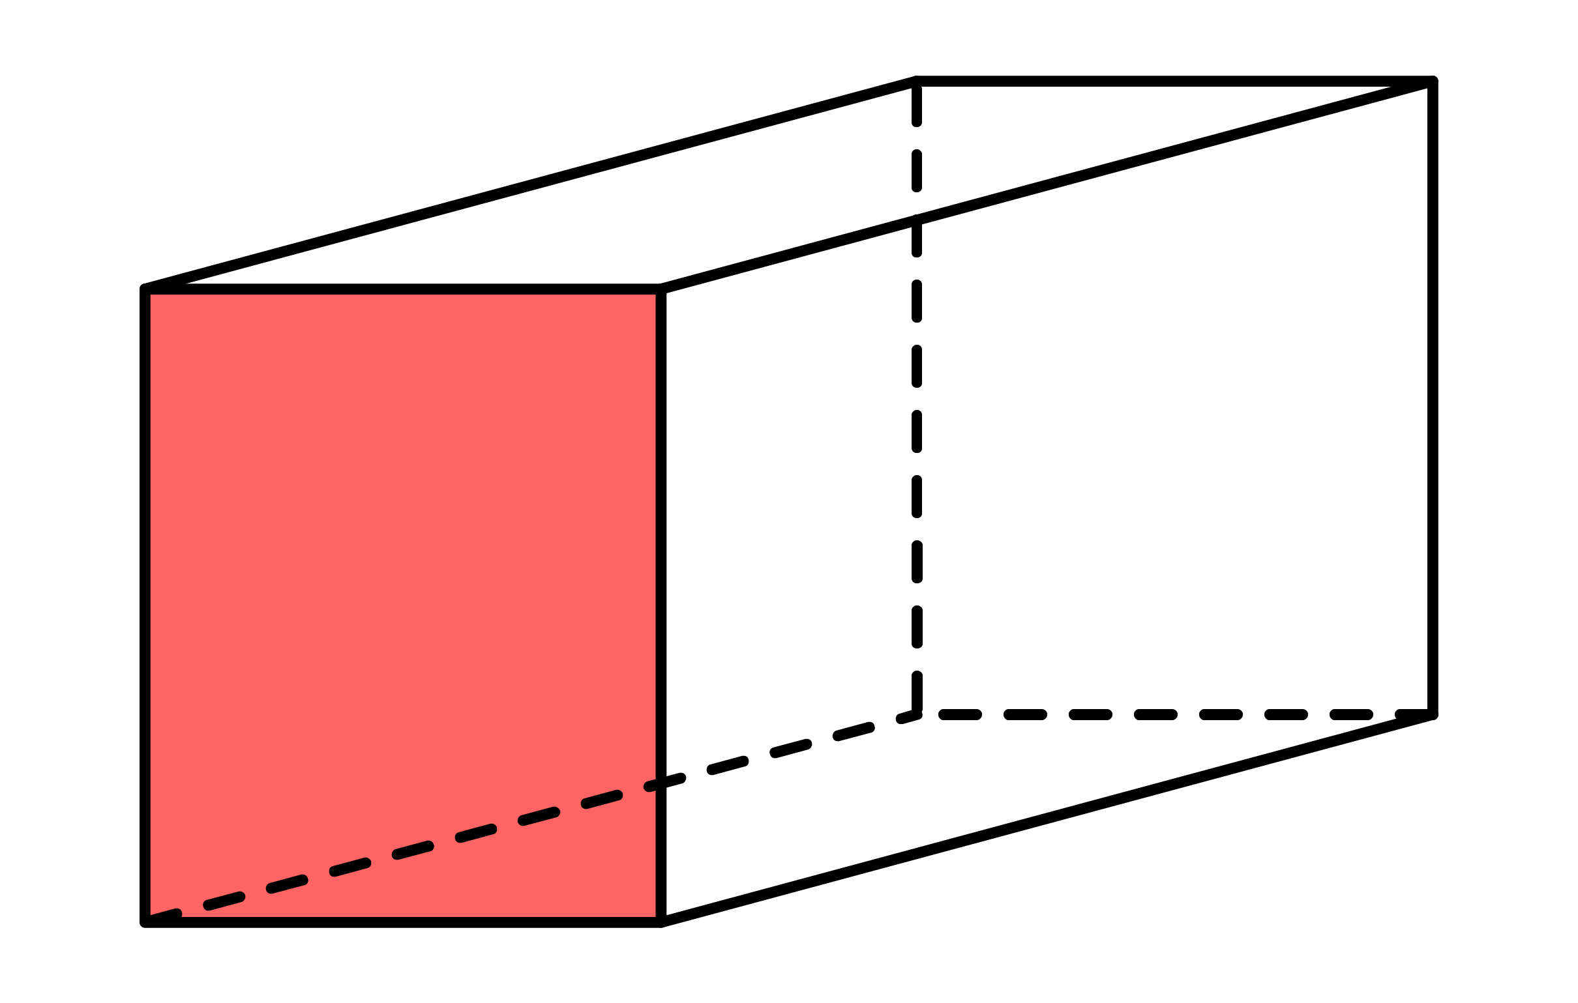
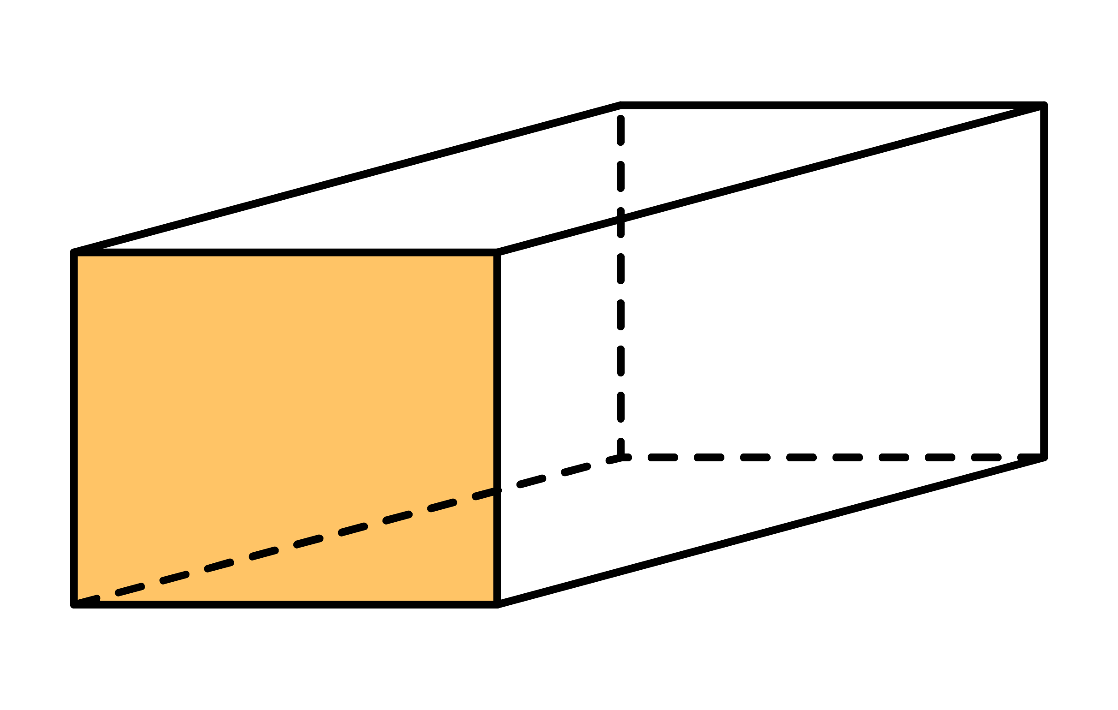
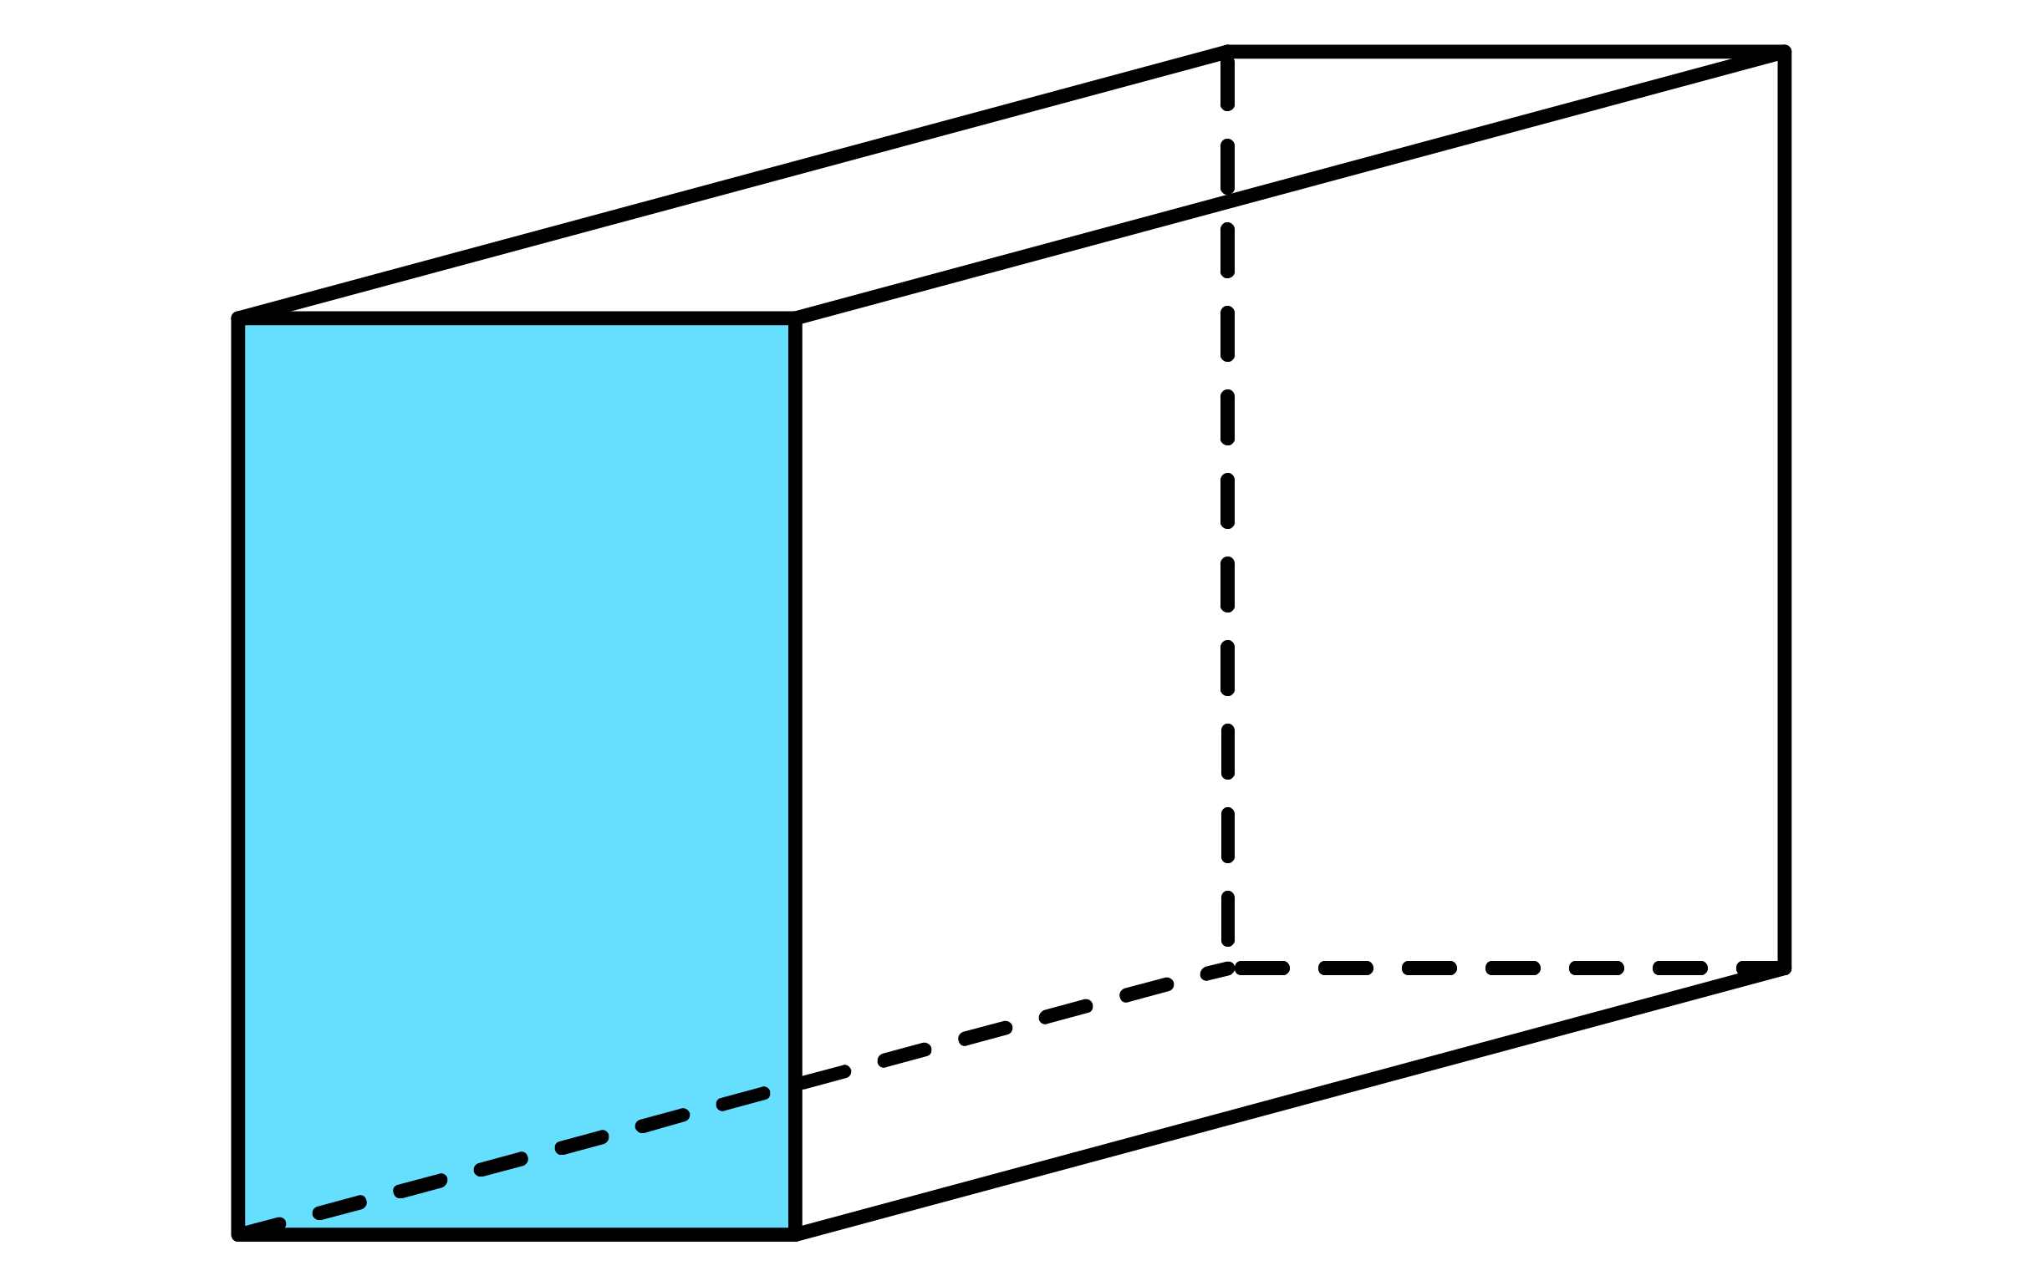
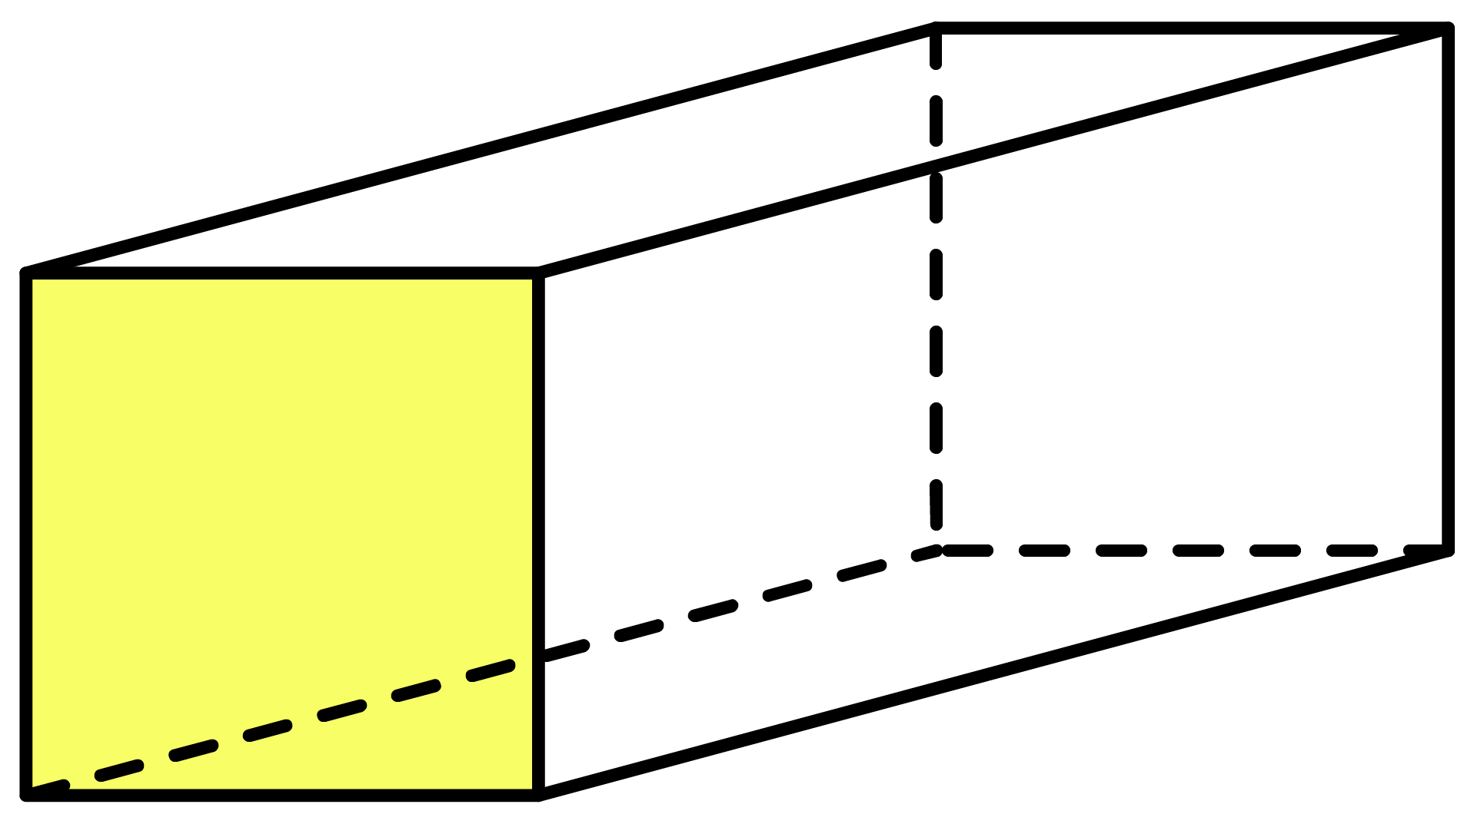
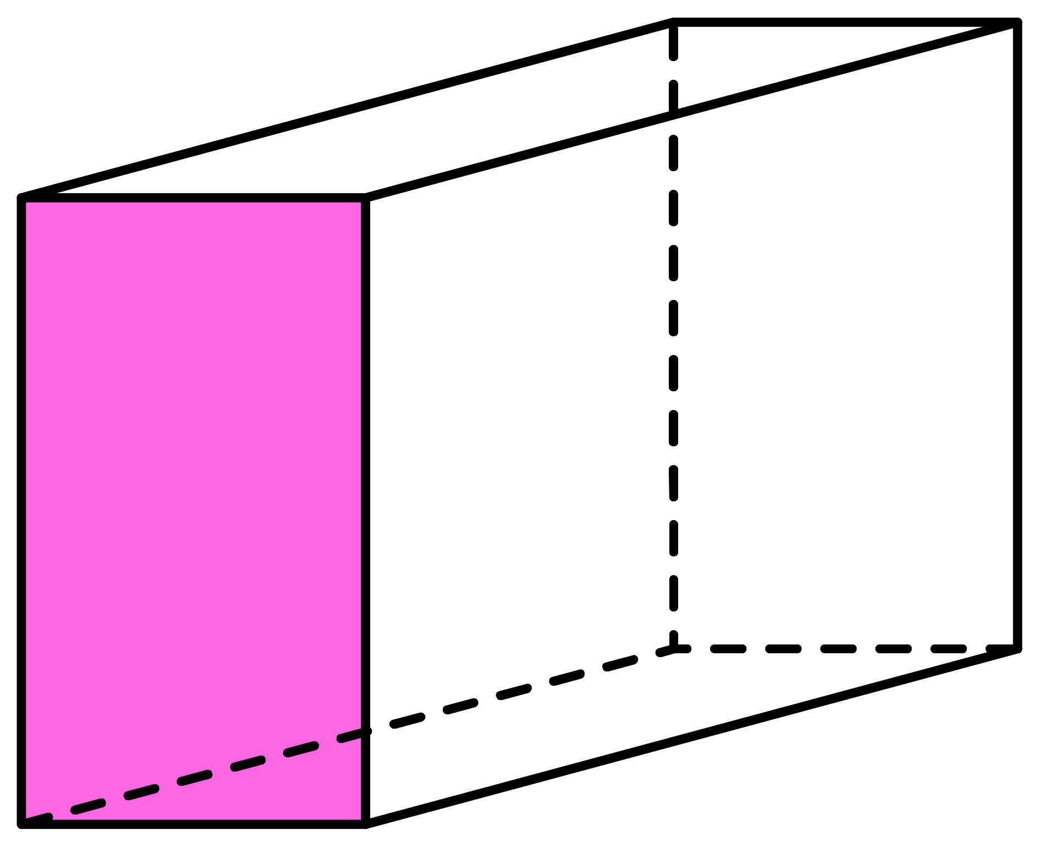
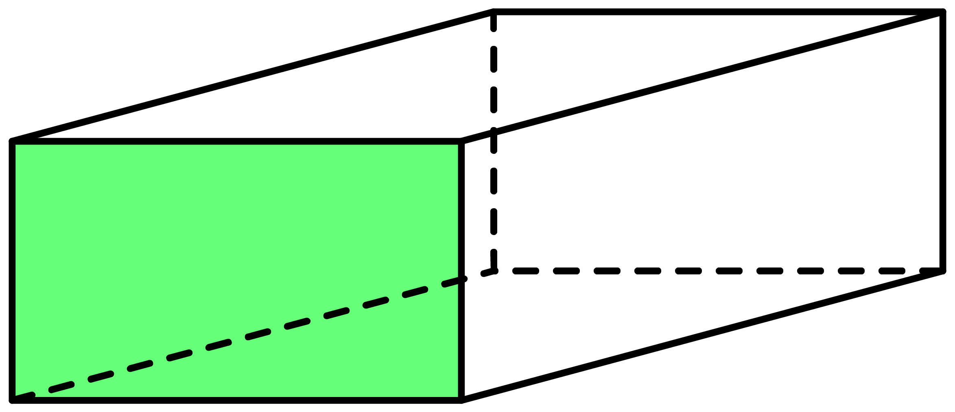
Q1
Calculate the surface area of the following cuboids.
[a]
404cm²
[b]
184m²
[c]
352ft²
8cm
4m
8ft
11cm
8m
12ft
6cm
5m
4ft
[d]
408yd³
[e]
1090mm²
[f]
630in³
7mm
12in
6yd
20mm
14yd
15mm
15in
6yd
5in

Slide 14
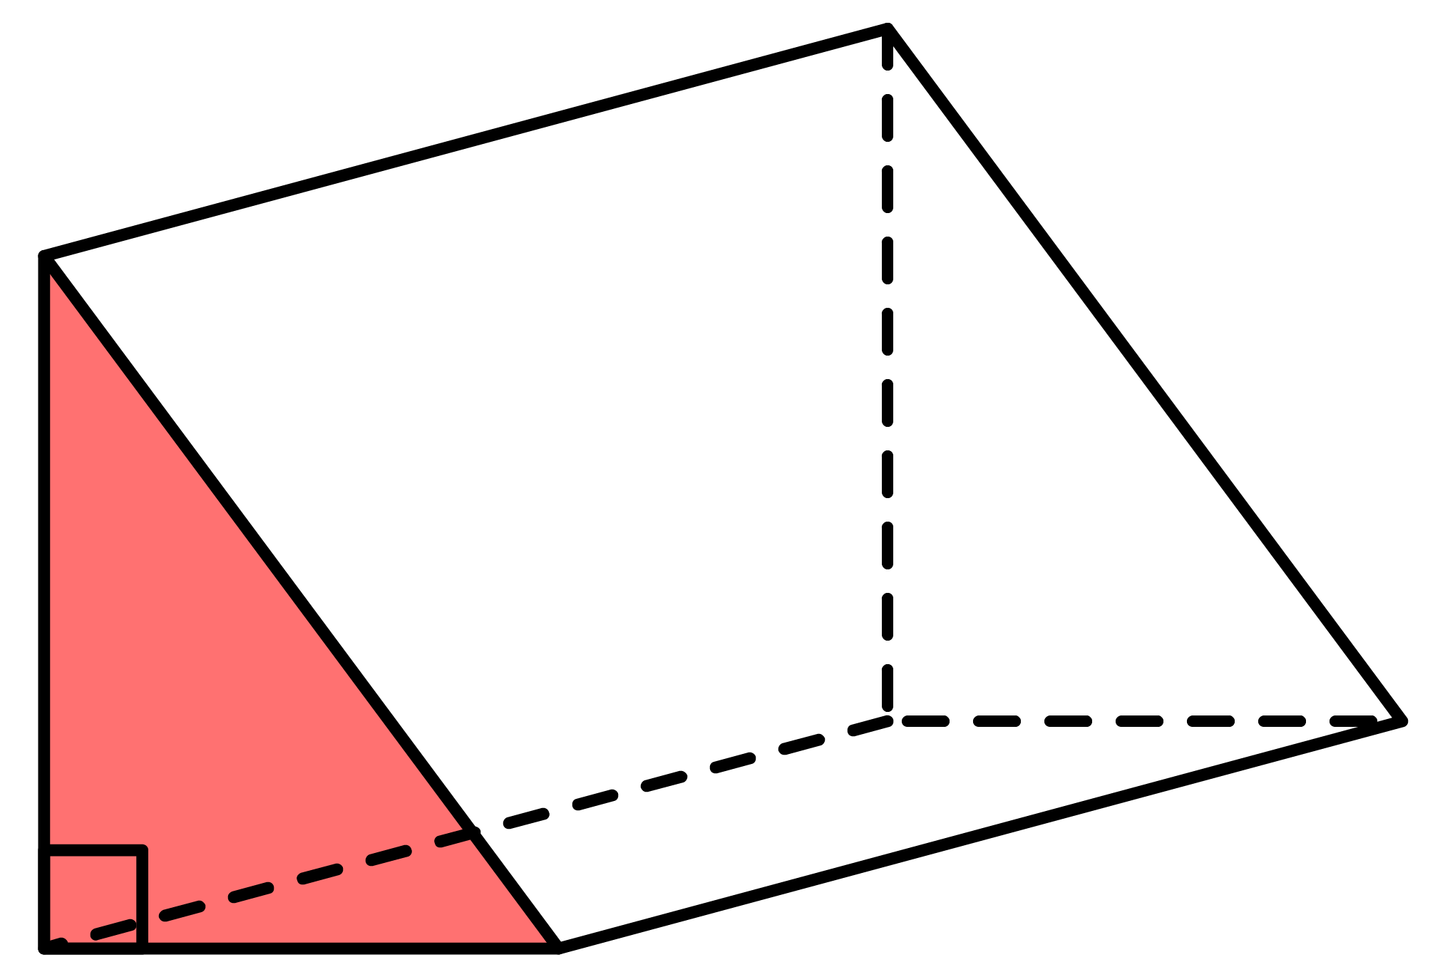
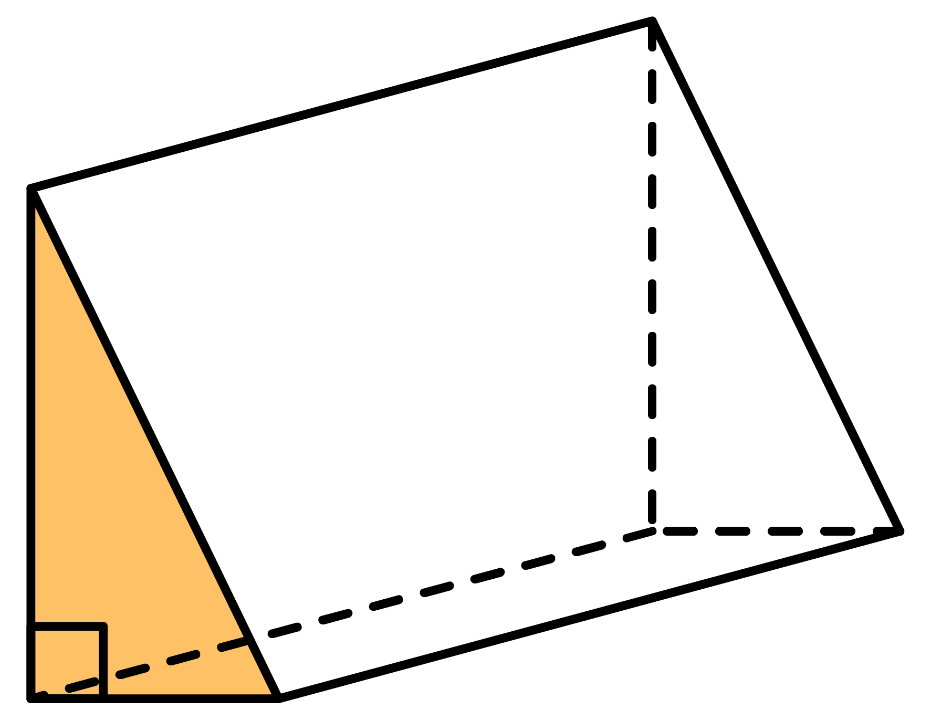
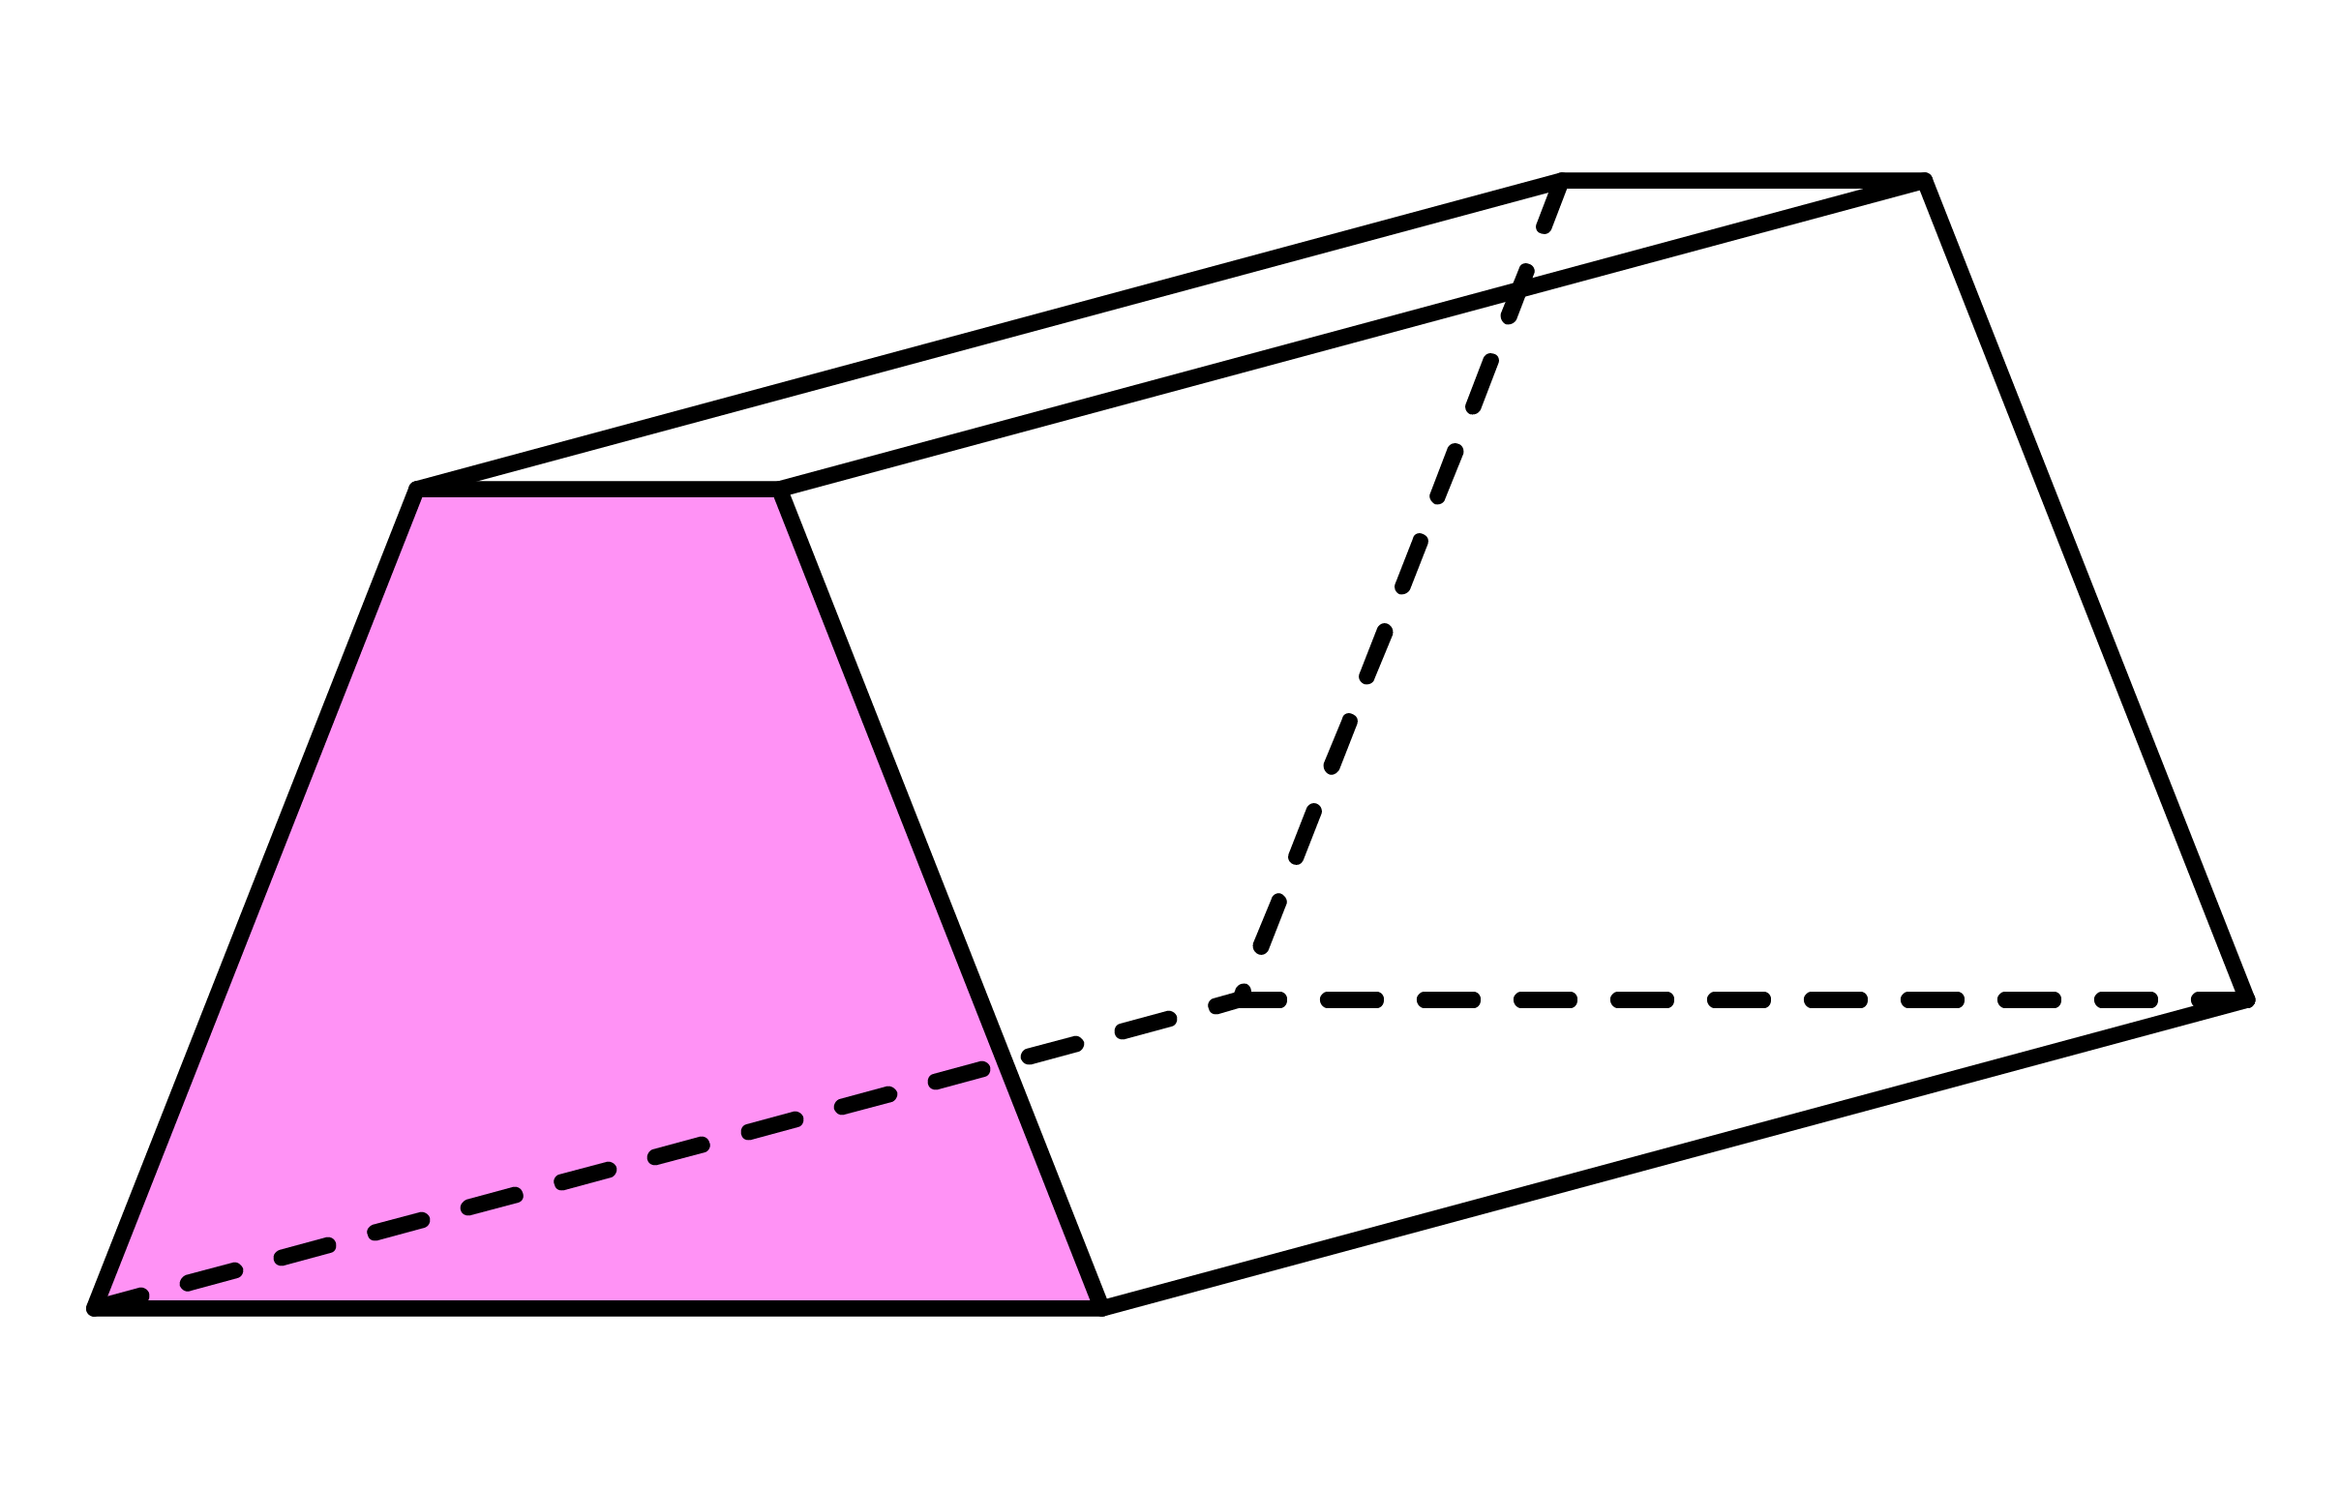
Q2
Calculate the surface area of the following prisms.
[a]
312cm²
[b]
660m²
[c]
496ft²
13m
9ft
8cm
12m
8ft
11cm
20m
12ft
6cm
5m
7ft
[d]
612yd²
[e]
360mm²
2mm
[f]
1160in²
5in
9yd
10mm
13in
6yd
8mm
12in
14yd
10mm
20in
9yd
8mm
15in

Slide 15
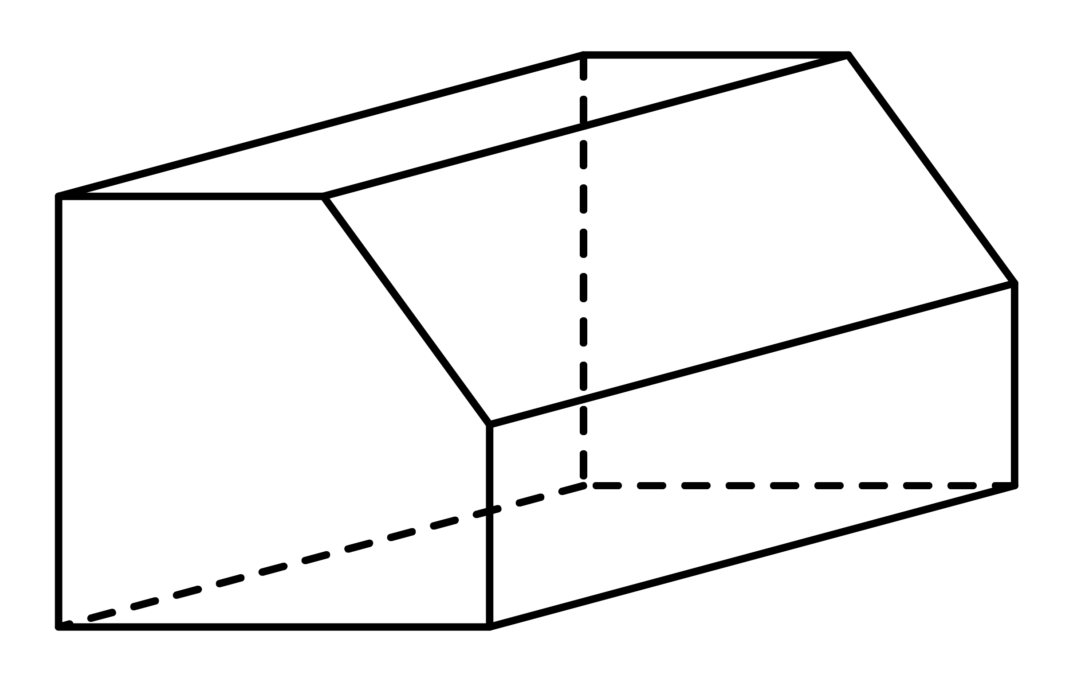










Ex5
Calculate the surface area of the following prism.
5cm
5cm
Front
Solution
Area of
A
$=$ 4 $×$ 8 $=$ 32cm²
5cm
B
Area of
B
$=$ (5 $+$ 8) $×$ 4 $=$ 26cm²
8cm
2
A
4cm
8cm
4cm
Total Area
$=$ 32 $+$ 26 $=$ 58cm²
8cm
Back
$=$ 58cm²
15cm
8cm
8
8
5
5
4
Middle faces
15
30 $×$ 15
$=$ 450
Total surface area
30
58 $+$ 58 $+$ 450
$=$ 566cm²

Slide 16








Ex6
Calculate the surface area of the following L-shape prism.
6cm
6cm
Front
Solution
Area of
A
$=$ 6 $×$ 12 $=$ 72cm²
Area of
B
$=$ 6 $×$ 6 $=$ 36cm²
12cm
A
B
6cm
Total Area
$=$ 72 $+$ 36 $=$ 108cm²
12cm
6cm
Back
$=$ 108cm²
12cm
15cm
12cm
12
12
6
6
6
6
Middle faces
15
48 $×$ 15
$=$ 720
Total surface area
48
108 $+$ 108 $+$ 720
$=$ 936cm²

Slide 17
Q3
Calculate the surface area of the following L-shape prisms.
[a]
730cm²
[b]
464in²
[c]
952m²
3cm
6in
5cm
4in
10m
10m
10cm
4in
2m
14cm
12in
18m
10cm
8in
12m
[d]
922ft²
9ft
[e]
908yd²
[f]
1494mm²
11mm
9yd
8ft
8yd
11mm
12ft
10yd
14mm
15ft
16yd
20mm
11ft
12yd
14mm

Slide 18
Q4
Calculate the surface area of the following prisms.
[a]
2520m²
20m
[b]
1570in²
12in
6m
5in
20m
7m
15in
11in
25m
20in
8m
[c]
2880ft²
[d]
868cm²
10ft
10cm
21ft
26ft
15cm
12ft
12cm

Slide 19

Q5
A company is designing a new box to hold cereal. They have two designs, cuboids A and B, with the same volume.
The company wants to choose the smallest surface area.
Which cuboid should they choose?
Q6
A cube has a surface area of 96cm².
Find the side length of the cube.
Solution
Solution
4cm
Q7
A cube has a surface area of 294cm².
Find the side length, $x$, of the cube.
Solution
7cm
Cuboid A
Cuboid B
Q8
A cube has a surface area of 150cm².
Find the volume of the cube.
8cm
4cm
4cm
Solution
125cm³
4cm
10 cm
5cm

Slide 20
Q9
Each of the four shapes shown below is made from 6 unit cubes. Which has the smallest surface area?
Q10
It takes 15 litres of paint to cover the surface are of the cube on the left.
How much paint would it take to cover the surface area of the shape on the right?
Solution
Solution
15 litres, as the surface area is the same.
Notes:
Q9 inspired by UKMT Intermediate Mathematical Challenge 2019 Q2.

Slide 21






Q11
Given that the surface area of the triangular prism below is 96cm², find $x$.
Q12
Given that the surface area of the following prisms are equal, find $y$.
Solution
Solution
5cm
7cm
4cm
$y$ cm
12cm
5cm
$x$ cm
$x=$ 7cm
3cm
$x=$ 8.2cm
6cm
11cm
7cm

