Slide 1

Measuring Tree Height
with Trigonometry
Applied Mathematics Field Investigation
Group: Euler

Slide 2
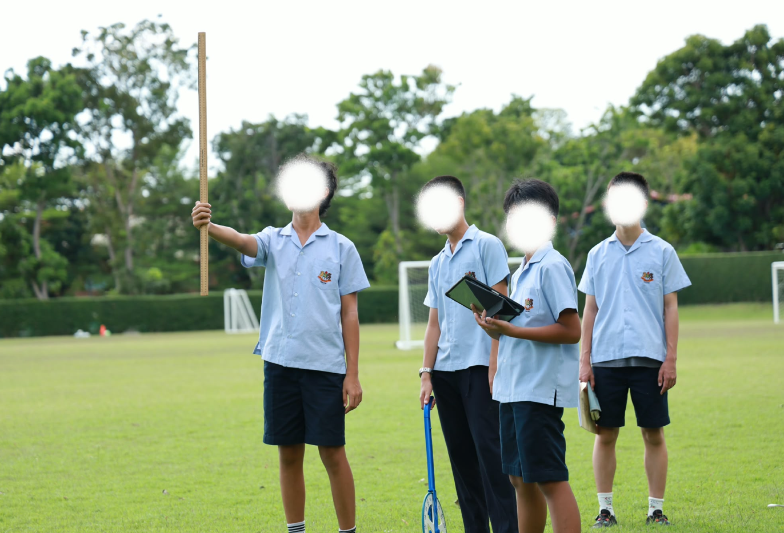
1. Our investigation
How can trigonometry help us measure something we cannot measure directly?
Our aim
To estimate the height of a tree using angle measurement, distance and trigonometry.
Our prediction
We thought the tree would be around 10 metres tall. We wanted to see how close our calculation would be.
Why this works
The tree, the ground and our line of sight can be modelled as a right-angled triangle.
2

Slide 3
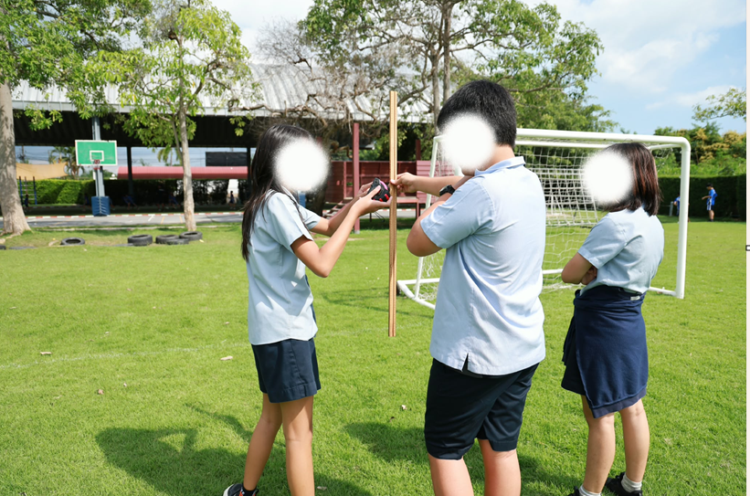
2. Method and teamwork
Each person had a clear job
Student 1 — Distance
Measured 12.0 m from the base of the tree to our observation point.
Student 2 — Angle
Measured an angle of elevation of 37° to the top of the tree.
Student 3 — Record & check
Recorded the readings, measured eye height and checked the calculation.
Equipment
Tape measure • metre stick • angle-measuring device • calculator
3

Slide 4
3. Our measured values
These are the readings we used in our calculation
Distance from tree
d
12.0 m
Angle of elevation
θ
37°
Observer's eye height
1.50 m
Important
We measured from the tree to the observation point along the ground.
4

Slide 5
4. Turning the situation into a triangle
We used the tangent ratio because we knew the opposite and adjacent sides
Eye height
1.50 m
Angle: θ = 37°
Opposite: h
Formula
height above eye level
tan θ = h ÷ d
Rearrange
h = d × tan θ
Adjacent: d = 12.0 m
5

Slide 6
5. Our calculation
We calculated the height above eye level first
1
Use tangent
tan 37° = h ÷ 12
Estimated tree height
2
Rearrange
10.54 m
h = 12 × tan 37°
3
Calculate
≈ 10.5 m
h = 12 × 0.7536 = 9.04 m
4
Add eye height
Check
9.04 + 1.50 = 10.54 m
This is close to our original prediction.
6

Slide 7
6. How accurate is our estimate?
Our answer is an estimate, not an exact measurement
• A small error in the 37° angle would change the calculated height.
• The ground may not be perfectly level.
• It can be difficult to aim at the exact top of the tree.
• Our eye-height measurement may have a small error.
• We could improve reliability by taking three readings and finding the average.
7

Slide 8
7. What we learned
• Trigonometry can be used to solve a real measurement problem.
• Good measurements are important because they affect the final answer.
• We had to communicate and check each other’s work.
• Our final estimate was 10.54 m.
• If we did it again, we would repeat the measurements and compare the results.
Thank you — any questions?

