Slide 1
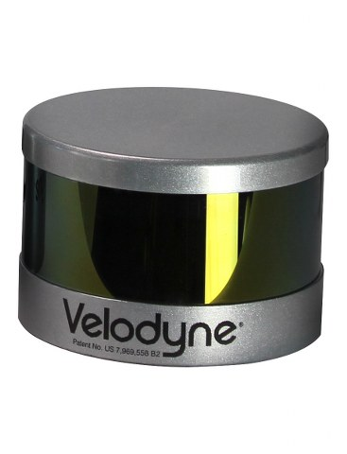
z
z
x
y
y
x
Manufacturer axes
convention
MRPT axes
convention

