Slide 1
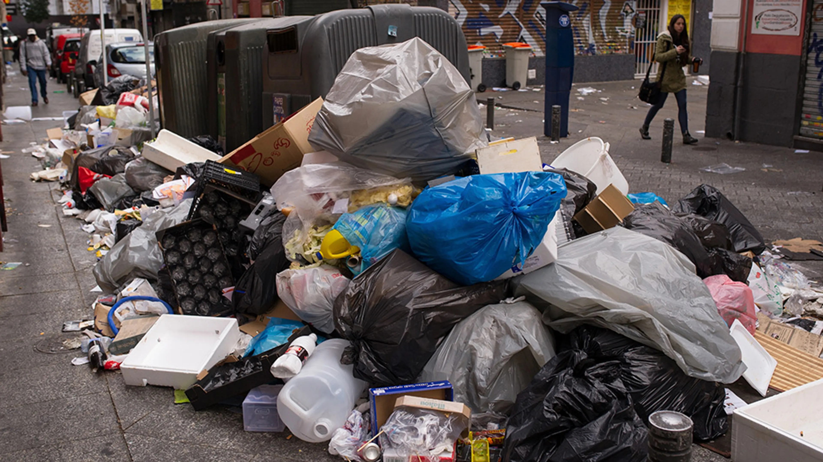
Garbage
MRRP Lab - Waste Stream Processing
October 10th, 2025
Taiming YuenJames

Slide 2
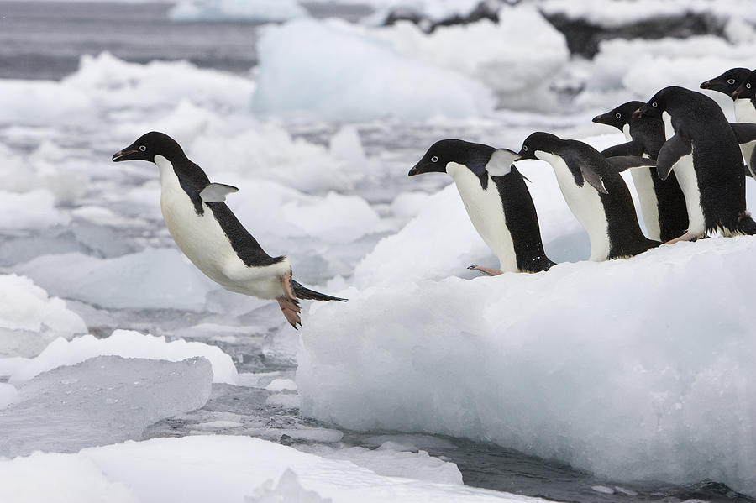

Slide 3

Timeline
Fall 2025: finalize research questions, literature & market review, safety approvals, hardware ordered, start system integration
  Deliverable: one-page proposal and pilot plan.
Winter 2026: system integration, dataset specification, baseline perception & single-arm grasping, start experiments.
  Deliverable: functioning testbed and baseline implementation.
Spring 2026: develop core methods (perception, manipulation, system control), run controlled experiments, iterate hardware/software, expand dataset, university pilot
  Deliverable: experimental protocols + interim results.

Slide 4
Timeline
Fall 2026: finalize experiments & analysis, papers written, thesis preparation, submit to conferences & journals.
  Deliverable: submitted senior paper and master’s thesis draft.
Winter 2027: papers published, travel to conference presentations, deployment demos for university stakeholders, further work with Western or City of Bellingham.
  Deliverable: presentations, outreach, and archived data/code.
Spring 2027: initial project complete, continue future research in related areas.

Slide 5

Research Topic Examples
Optimizing per-item classification accuracy under heavy contamination (ex. via RGB-D + NIR)
Real-time grasp planning for mixed deformable/rigid waste with UR3e reachability constraints
Coordinating two UR3e arms and conveyors to maximize items/minute (throughput)
Low-cost retrofit vision systems for campus-wide smart-sorting bins (edge/cloud compute)
HITL hybrid sorting: improving recall by combining humans and robots at critical points
Robust vacuum vs. gripper performance trade-offs on wet/soiled items
Active learning pipeline for waste labels collected inline to reduce manual annotation time
Behavioral nudges vs. automated sorting: measuring on-campus sorting improvement
General economics – making this tech accessible to anyone for cheap

Slide 6

Market
Bulk Handling Systems — bulkhandlingsystems.com
Waste Robotics — wasterobotics.com
Glacier — glacier.ai
Ganiga — ganiga.ai
Bin-e — bine.world
Oscarsort —oscarsort.com
TrashBot — cleanrobotics.com
Startup Overview

Slide 7
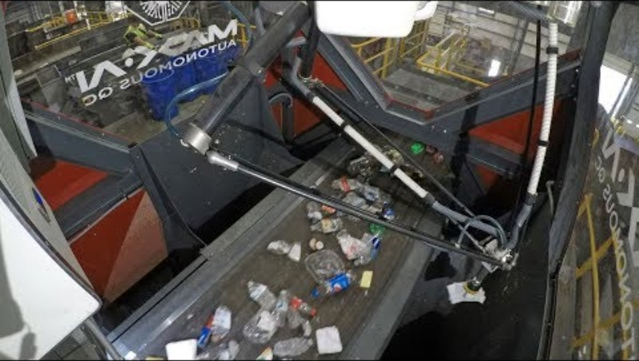
Bulk Handling Systems

Slide 8
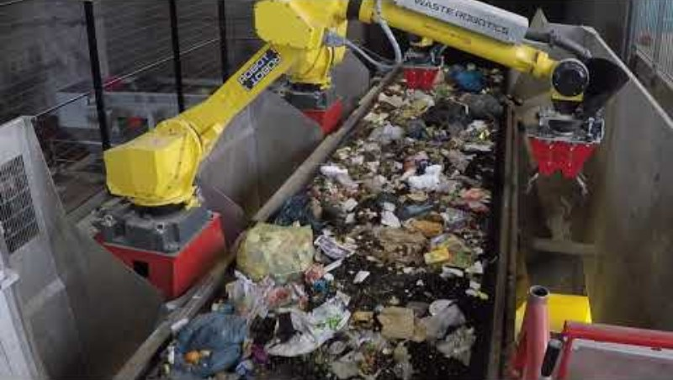
Waste Robotics

Slide 9
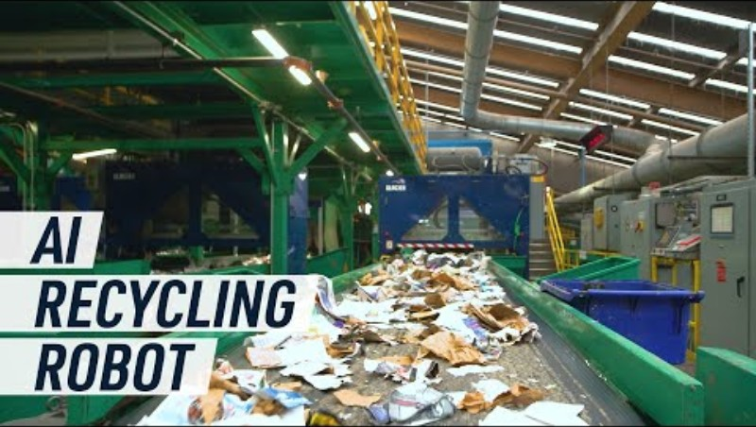
Glacier

Slide 10
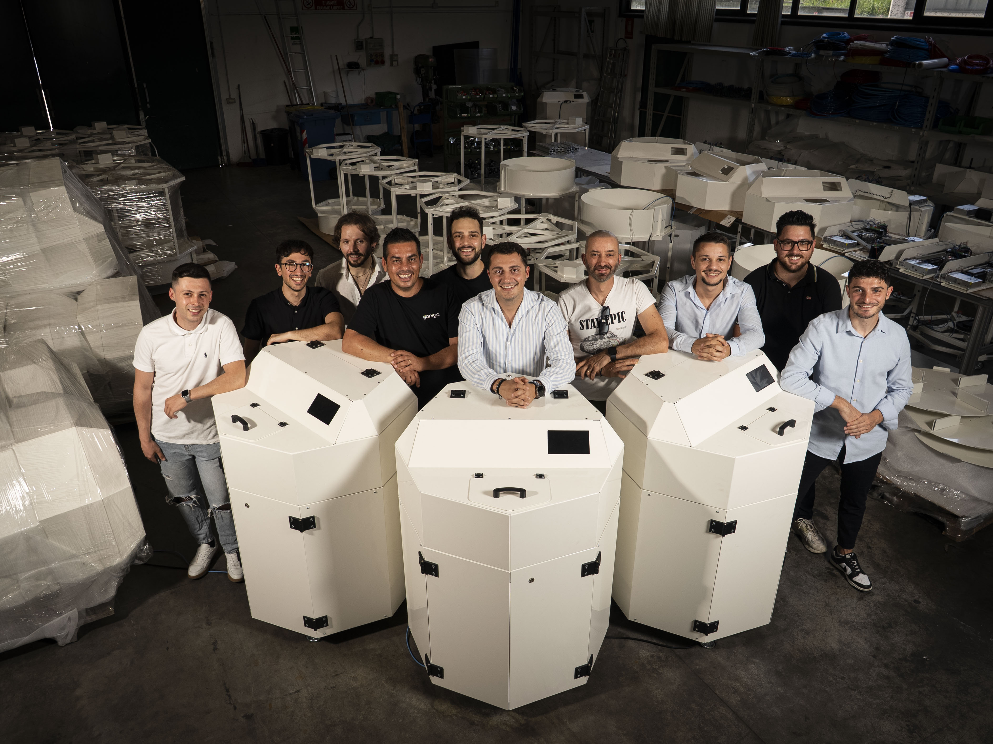
Ganiga

Slide 11
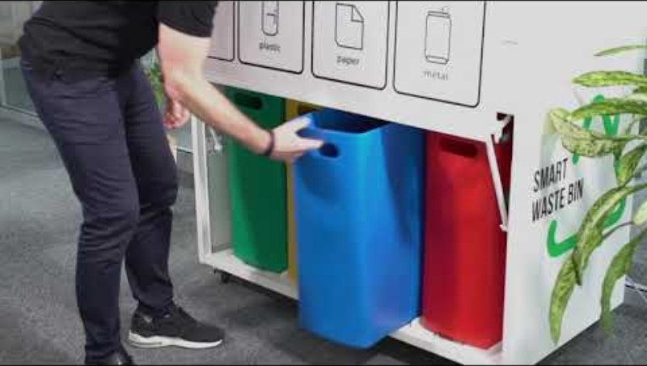
Bin-e

Slide 12
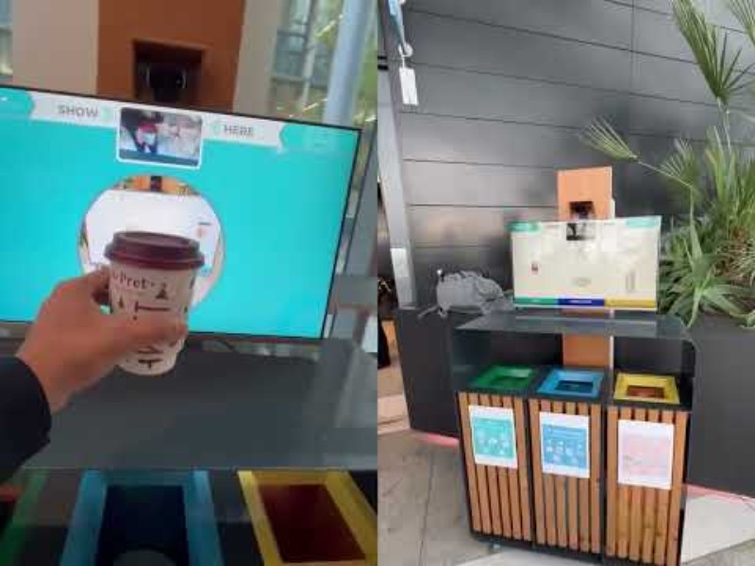
OscarSort

Slide 13
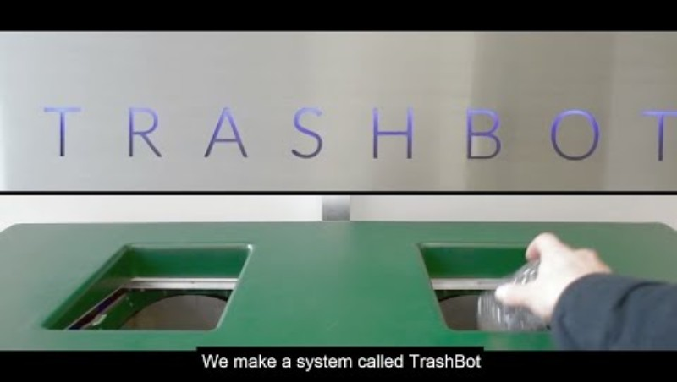
TrashBot

Slide 14

Source Sorting vs Post-Collection
Retrofit low-cost sensors + feedback displays on campus bins vs centralized robotic sorting in lab.
Measure diversion improvement by comparing contamination rate and quantity of recovered recyclables pre/post deployment.
Research question: quantify diversion gain from networked smart bins with real-time feedback versus centralized robotic sorting.
Key metrics: contamination rate, mass/volume of recovered recyclables, user compliance change, and cost per kg recovered

Slide 15

University Partnership
Diverting waste stream: negotiate with facilities to route a subset of campus waste or recycling to our lab for controlled experiments and labeled ground truth.
Funding options: internal undergraduate research grants, department instrumentation funds, sustainability office, industry sponsorship (equipment partners), campus innovation challenges.
Permissions/logistics: safety sign-off, insurance, waste handling compliance, cleaning/ventilation plans, staff training.
Data access: collaborate with facilities for historical waste audits to establish baseline metrics.

Slide 16

Roles
Perception & dataset collection
Manipulation & end-effector design
Systems & control (multi-arm + conveyor coordination)
User studies & campus deployment (smart bins)
Data analysis & writing/publishing
Etc.

Slide 17

Resources
Hardware needed:
  mounting fixtures
  end-effectors (vacuum + soft gripper prototypes)
  hardware sorting system if not arms
  NIR sensor or low-cost multispectral add-on
  edge compute device(s) for smart bins
Budget estimate: prototypes + sensors ≈ $5k–$15k, travel/publication ≈ $2k.

Slide 18

Publications
IROS (IEEE/RSJ International Conference on Intelligent Robots and Systems) — strong for robotics systems and applied demos.
ICRA (IEEE International Conference on Robotics and Automation) — top robotics conference (workshop or short paper possible).
RSS Workshop or Demo sessions (Robotics: Science and Systems) — high-quality, selective; workshops can be more accessible.
IEEE Robotics and Automation Letters (RA-L) + ICRA/ IROS conference combo (fast route to publication).
Resources, Conservation & Recycling (journal) or Waste Management (journal) — strong for applied waste-sorting and sustainability studies.

Slide 19

Datasets
SpectralWaste (Multimodal waste dataset, RGB + hyperspectral) —sites.google.com/unizar.es/spectralwaste (multimodal, recent).
TACO (Trash Annotations in Context) — github.com/pedropro/TACO (segmentation/labels for litter in context; useful for detection/segmentation).
TrashNet — github.com/garythung/trashnet (small classification dataset of 6 waste categories; good for quick prototypes).
RDD2020 / Recycle Dataset variants on Kaggle (mixed recycling datasets; search “recycling dataset” on Kaggle) — practical labeled examples for classification.
MJU-Waste (or similar academic datasets like “MJU-Waste Dataset”) — university-collected waste images with labels (search “MJU-Waste dataset download”); good for research on mixed waste.

Slide 20
Appendix A
Safety plan
  What it is: documented hazards, required PPE, emergency procedures, lockout/tagout, and who is authorized to operate equipment.
  Example: list of risks (arm collision, pinch points, electrical), required PPE (safety glasses, gloves), an emergency stop wiring diagram for UR3e + conveyors, contact list, and weekly safety checks signed by PI.
System integration
  What it is: connecting hardware, software, and controls so the whole system works together.
  Example: mounting UR3e to a frame over the conveyor, wiring conveyor encoder and E-stop to a PLC/ROS driver, configuring URScript/ROS nodes so camera detections command pick-and-place motions, and syncing timestamps across devices.
Pilot / general experiments
  What it is: small-scale trials to validate feasibility, find parameters, and detect failure modes before full experiments.
  Example: run 50 mixed-item runs through one conveyor with one UR3e using a single gripper to measure baseline pick success and sensor errors.
Testbed
  What it is: the repeatable lab setup used to run controlled experiments.
  Example: a framed station with one conveyor, overhead RGB-D camera, UR3e with interchangeable grippers, standardized item set, and a logging PC that records video, robot state, and sensor data.
A/B tests
  What it is: controlled comparison between two variants to measure impact.
  Example: run 200 trials alternating between Gripper A and Gripper B (A first half, B second half or randomized) to compare pick success rate and cycle time; analyze statistically significant differences.

Slide 21
Appendix B
RGB-D camera: a camera that captures regular color images (RGB) plus depth (distance) for each pixel—helps tell how far objects are.
NIR / hyperspectral: sensors that see beyond visible light (near-infrared or many narrow wavelength bands) to identify material properties not visible to our eyes.
End-effector: the tool on the robot arm that interacts with objects (gripper, vacuum cup, soft finger).
Grasp planner: software that decides where and how the robot should place its gripper to pick an object.
Vacuum gripper: uses suction to pick items—works well for flat, smooth surfaces.
Soft gripper: flexible fingers that conform to irregular shapes—better for deformable or wet items.
Transfer learning: reusing a model trained on one dataset and adapting it to a new, related dataset to save time/data.
Active learning: system selects the most informative examples for human labeling to reduce total labeling effort.
Conveyor encoder: a sensor that measures conveyor belt position/speed so the robot can time picks accurately.
Recall / precision: recall = percent of relevant items correctly found; precision = percent of identified items that were actually correct.
Throughput: items processed per minute or hour.
False-pick rate: picks where the robot grabbed nothing useful or the wrong item.
Multi-arm coordination: controlling two robot arms so they work together without colliding and maximize throughput.
Edge compute: running ML models on small local devices (instead of the cloud) next to the sensors.
IRB / ethics: institutional review board approval for studies involving human subjects (needed for user behavior pilots).
Lockout/tagout: procedure to ensure equipment is de-energized and cannot start unexpectedly during maintenance.
ROS: Robot Operating System—a common robotics software framework for coordinating sensors and robot controllers

